Slide 1




RESEARCH PROPOSAL DIGITAL WATCHS A-FIB SCRENING ECONOMIC EVALUATION
Irine Khubua
Olgha Kukhianidze
Kostadin Kostadinov
Vihar Kotecha
Bojana Letic

Slide 2
Characteristics of the disease
Atrial fibrillation (AF) is a condition characterised by an abnormal heart rhythm
Atrial fibrillation is difficult to diagnose
Oral anticoagulation (OAC) can prevent AF-related strokes
Baseline prevalence 7.2% ¹
Incidence rate 31/100 per year ²
Excess in all-cause mortality rates attributable to AF is 50% for men, and 90% for women.³
Iceberg of morbidity
Average 3-year societal costs were estimated as €20,403–26,544 per patient. The costs were highest during the first year after diagnosis. Admission costs constituted the largest cost component ⁴
Pts. with AF reported a reduced QoL compared with healthy controls ⁵

Slide 3
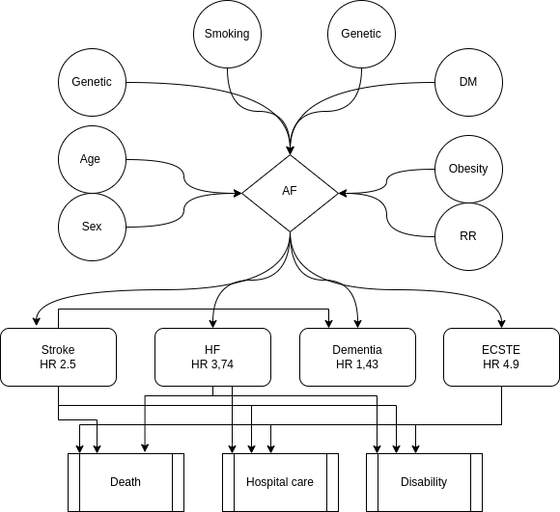

Slide 4
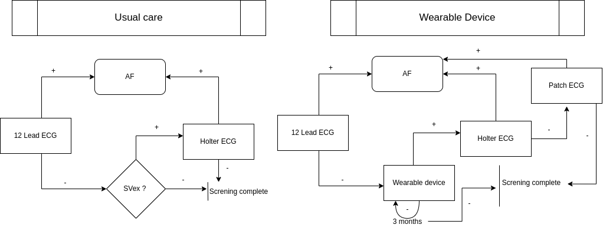

Slide 5
Interventions and comparators
What is the background problem you want to solve
Available interventions
Important health and/or cost consequences of these interventions

Slide 6
Aim/research question
Answerable research question (Use PICOT, include perspective, target group, and
intervention and comparator, time horizon)
Expected efficiency based on evidence (hypothesis)

Slide 7
Overall framing
Objective of economic evaluation (e.g. reimbursement, standardisation of care)
Relevant audience(s); to whom will the results be of importance?
Time horizon and perspective
Target group (in and exclusion criteria e.g. age, gender, disease severity, co-morbidities)
Type of economic evaluation (CEA, CUA, and optional CMA, CBA)
Definition of incremental cost-effectiveness ratio (ICER)
Country and centres included (look at the relevant guidelines for that country)
Analytical approach, i.e. TBEE/MBEE (and why) and specifics for the design
Data sources and collection

Slide 8
Costs
Identification of relevant cost categories (use a formal classification and societal perspective
Instrument used for measurement of cost categories
Valuation; sources for of cost prices (guidelines for costing)
Valuation; which method to use for paid work, unpaid work, informal care, etc.
Chosen cost price year and why
Discounting, look at guidelines

Slide 9
Outcome measurement
Primary and secondary outcomes
Selected outcomes for effectiveness and utilities, and why
Instruments used for outcomes, and why
Valuation method to derive utilities (instruments, population)

Slide 10
Synthesising costs and effects
Calculation of ICER/ICUR
Interpretation of ICER; what does it mean, comparable studies

Slide 11
Uncertainty
Investigating uncertainty & diversity: (which sensitivity / scenario / subgroup analysis)
CEA plane, CEAC curve
Chosen threshold for the WTP of CUA and why

Slide 12
Discussion of the expected outcomes
Expected most important outcome(s) of study, based on the literature
Relationship of results with existing evidence
Limitations of design economic evaluation (bias)
Generalisability/transferability of the results to other settings and/or patient groups
Other relevant considerations to decision-maker
Issues of implementation
Expected recommendations, and results based on this study

Slide 13
References
Staerk L, Sherer JA, Ko D, Benjamin EJ, Helm RH. Atrial Fibrillation: Epidemiology, Pathophysiology, and Clinical Outcomes. Circ Res. 2017 Apr 28;120(9):1501-1517. doi: 10.1161/CIRCRESAHA.117.309732. PMID: 28450367; PMCID: PMC5500874.
Lippi G, Sanchis-Gomar F, Cervellin G. Global epidemiology of atrial fibrillation: An increasing epidemic and public health challenge. Int J Stroke. 2021 Feb;16(2):217-221. doi: 10.1177/1747493019897870. Epub 2020 Jan 19. Erratum in: Int J Stroke. 2020 Jan 28;:1747493020905964. PMID: 31955707.
Sankaranarayanan R, Kirkwood G, Visweswariah R, Fox DJ. How does Chronic Atrial Fibrillation Influence Mortality in the Modern Treatment Era? Curr Cardiol Rev. 2015;11(3):190-8. doi: 10.2174/1573403x10666140902143020. PMID: 25182145; PMCID: PMC4558350.
Johnsen, S.P., Dalby, L.W., Täckström, T. et al. Cost of illness of atrial fibrillation: a nationwide study of societal impact. BMC Health Serv Res 17, 714 (2017). https://doi.org/10.1186/s12913-017-2652-y
Quality of Life in Patients with Atrial Fibrillation: A Systematic Review Thrall, Graham et al. The American Journal of Medicine, Volume 119, Issue 5, 448.e1 - 448.e19

