Slide 1
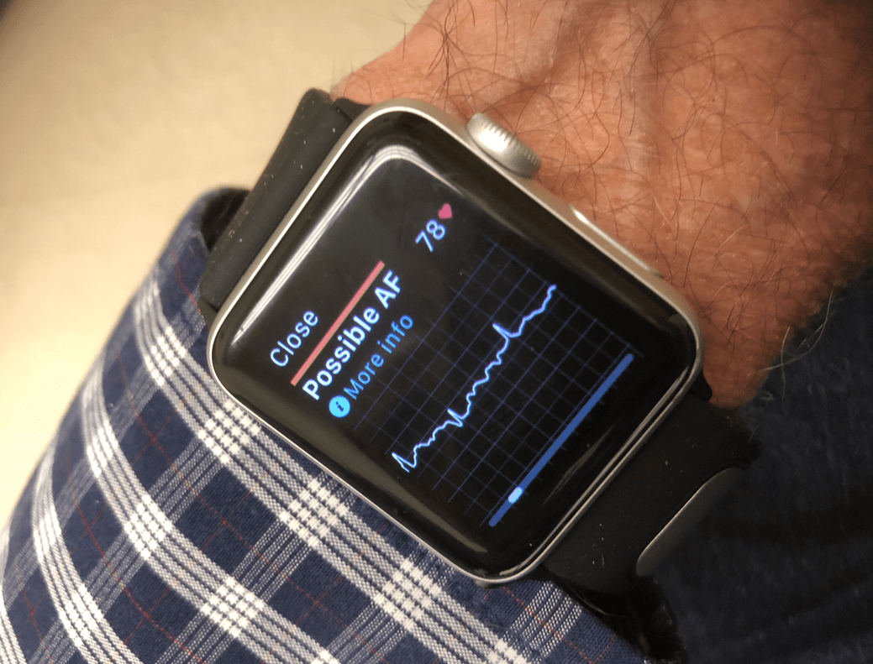




RESEARCH PROPOSAL DIGITAL WATCHS A-FIB SCRENING ECONOMIC EVALUATION
Irine Khubua
Olgha Kukhianidze
Kostadin Kostadinov
Vihar Kotecha
Bojana Letic
With the help and under the supervision of

Slide 2
Characteristics of the disease
Atrial fibrillation (AF) is a condition characterised by an abnormal heart rhythm
Atrial fibrillation is difficult to diagnose
Oral anticoagulation (OAC) can prevent AF-related strokes
Baseline prevalence 7.2% ¹
Incidence rate 31/100 per year ²
Excess in all-cause mortality rates attributable to AF is 50% for men, and 90% for women.³
Iceberg of morbidity
Average 3-year societal costs were estimated as €20,403–26,544 per patient. The costs were highest during the first year after diagnosis. Admission costs constituted the largest cost component ⁴
Pts. with AF reported a reduced QoL compared with healthy controls ⁵

Slide 3
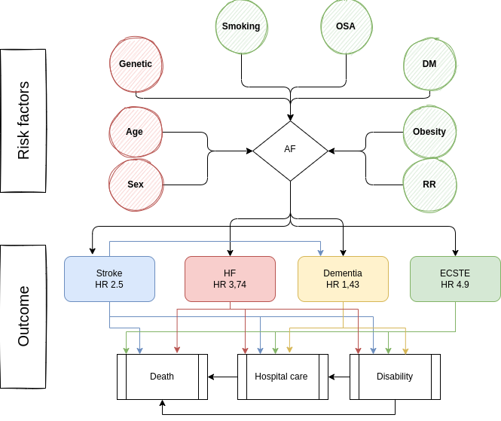

Slide 4
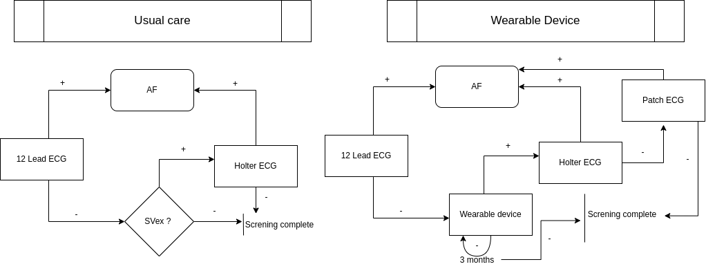
Interventions and comparators

Slide 5
Aim/research question
Q: Is risk-based atrial fibrillation (AF) screening using wearable devices cost-effective?
Population | Asymptomatic patients over the age of 50 with 2 or more risk factors
Intervention | Wrist wearable device (watch)
Comparison | Usual care
Outcome | Number of patients diagnosed Sensitivity/Specificity
Time | One year

Slide 6
Overall framing
Objective: Partial (or full) reimbursement of WWD for AF screening
Relevant audience(s): Decision makers (public funds)
Time horizon and perspective: 1-year evaluation and 10 cycles/ societal perspective
Target group: Hight risk individuals aged over 50 with know 2 or more RF
Type of economic evaluation CEA
Definition of incremental cost-effectiveness ratio (ICER) – Additional costs for one additional diagnosed patient
Country: Denmark
Analytical approach: Markov model with age dependent transition probability and pay-off
Data sources and collection: Register analyses (The National Patient Registry; The National Health Insurance Service Registry; Danish Heart Register)

Slide 7
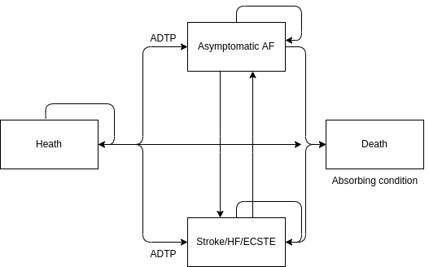
Model specification
Transition probabilities and pay-off (values attach to state) depend on age

Slide 8
Costs
Direct costs: (medical and non-medical). Cost for WWD (and amortisation plan)*; patient education**; Patch device*; Holter-ECG***; 12 Lead ECG***; Medical team time***; Patient transport costs**; Absence days***
Indirect costs: Social benefits saved due to timely treatment***; Permanent disability prevention (workplace and colleges)*, formal and non-formal caregivers (average wage per hour)**
Costs data: Literature review*; Questionnaire***; Registry and HR Data**

Slide 9
Outcome measurement
Primary outcome: Number of screen positive cases, mean ICER and diagnostic odds ratio of detecting new AF cases compared with usual care
Secondary outcomes: Real – world sensitivity and specificity, patients preferences
Selected outcomes for effectiveness: N and % difference of screen positive cases. ICD - 10 classification system
Additional benefits: E- device sector growth

Slide 10
Synthesising costs and effects
COSTS (wwd) – COSTS (usual care)
ICER = —————————————————————
N of pts. (AF wwd) – N of pts (usual care AF)

Slide 11
Uncertainty
Tornado plot and ICER plane. Willingness-to-pay threshold of €22 000
Probabilistic sensitivity analysis.
For number of new diagnosed patient – Poisson distribution with 20% Mean/SD ratio
For costs – Log normal distribution. SD estimated by marked SD of the highest cost items

Slide 12
Discussion of the expected outcomes
Expected most important outcome(s) of study: WWD probably can be used as cost effective risk based screening
Limitations of design economic evaluation (bias): The model is simplified.
Other relevant considerations to decision-maker: WWD may initially increase AF incidence which is associated with increased expenditures for treatment (AG)

Slide 13
References
Staerk L, Sherer JA, Ko D, Benjamin EJ, Helm RH. Atrial Fibrillation: Epidemiology, Pathophysiology, and Clinical Outcomes. Circ Res. 2017 Apr 28;120(9):1501-1517. doi: 10.1161/CIRCRESAHA.117.309732. PMID: 28450367; PMCID: PMC5500874.
Lippi G, Sanchis-Gomar F, Cervellin G. Global epidemiology of atrial fibrillation: An increasing epidemic and public health challenge. Int J Stroke. 2021 Feb;16(2):217-221. doi: 10.1177/1747493019897870. Epub 2020 Jan 19. Erratum in: Int J Stroke. 2020 Jan 28;:1747493020905964. PMID: 31955707.
Sankaranarayanan R, Kirkwood G, Visweswariah R, Fox DJ. How does Chronic Atrial Fibrillation Influence Mortality in the Modern Treatment Era? Curr Cardiol Rev. 2015;11(3):190-8. doi: 10.2174/1573403x10666140902143020. PMID: 25182145; PMCID: PMC4558350.
Johnsen, S.P., Dalby, L.W., Täckström, T. et al. Cost of illness of atrial fibrillation: a nationwide study of societal impact. BMC Health Serv Res 17, 714 (2017). https://doi.org/10.1186/s12913-017-2652-y
Quality of Life in Patients with Atrial Fibrillation: A Systematic Review Thrall, Graham et al. The American Journal of Medicine, Volume 119, Issue 5, 448.e1 - 448.e19
Chen W, Khurshid S, Singer DE, Atlas SJ, Ashburner JM, Ellinor PT, McManus DD, Lubitz SA, Chhatwal J. Cost-effectiveness of Screening for Atrial Fibrillation Using Wearable Devices. JAMA Health Forum. 2022 Aug 5;3(8):e222419. doi: 10.1001/jamahealthforum.2022.2419. PMID: 36003419; PMCID: PMC9356321.
Riva JJ, Malik KM, Burnie SJ, Endicott AR, Busse JW. What is your research question? An introduction to the PICOT format for clinicians. J Can Chiropr Assoc. 2012 Sep;56(3):167-71. PMID: 22997465; PMCID: PMC3430448.
Jacobs MS, Kaasenbrood F, Postma MJ, van Hulst M, Tieleman RG. Cost-effectiveness of screening for atrial fibrillation in primary care with a handheld, single-lead electrocardiogram device in the Netherlands. Europace. 2018 Jan 1;20(1):12-18. doi: 10.1093/europace/euw285. PMID: 27733465.
Sciera LK, Frost L, Dybro L, Poulsen PB. The cost-effectiveness of one-time opportunistic screening for atrial fibrillation in different age cohorts of inhabitants in Denmark aged 65 years and above: a Markov modelled analysis. Eur Heart J Qual Care Clin Outcomes. 2022 Mar 2;8(2):177-186. doi: 10.1093/ehjqcco/qcaa092. PMID: 33337469.

