Slide 1
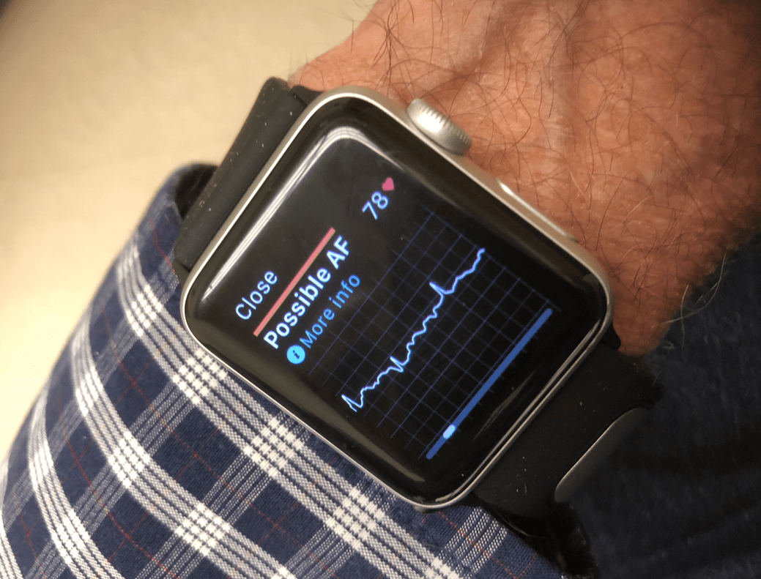




RESEARCH PROPOSAL DIGITAL WATCHS A-FIB SCRENING ECONOMIC EVALUATION
Irine Khubua
Olgha Kukhianidze
Kostadin Kostadinov
Vihar Kotecha
Bojana Letic
With the help and under the supervision of

Slide 2
Characteristics of the disease
Atrial fibrillation (AF) is a condition characterised by an abnormal heart rhythm
Atrial fibrillation is difficult to diagnose
Oral anticoagulation (OAC) can prevent AF-related strokes
Baseline prevalence 7.2% ¹
Incidence rate 31/100 per year ²
Excess in all-cause mortality rates attributable to AF is 50% for men, and 90% for women.³
Iceberg of morbidity
Average 3-year societal costs were estimated as €20,403–26,544 per patient. The costs were highest during the first year after diagnosis. Admission costs constituted the largest cost component ⁴
Pts. with AF reported a reduced QoL compared with healthy controls ⁵

Slide 3
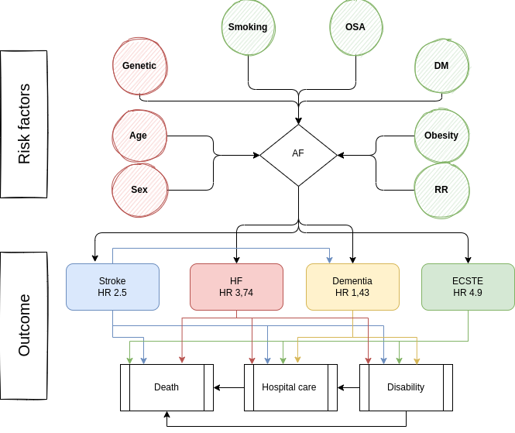

Slide 4
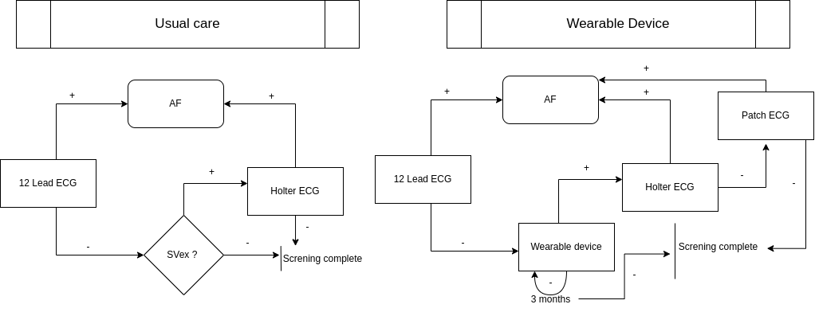
Interventions and comparators

Slide 5
Aim/research question
Q: Is risk-based atrial fibrillation (AF) screening using wearable devices cost-effective?
Population | Asymptomatic patients over the age of 50 with 2 or more risk factors
Intervention | Wrist wearable device (watch)
Comparison | Usual care
Outcome | Number of patients diagnosed Sensitivity/Specificity
Time | One year

Slide 6
Overall framing
Objective: Partial (or full) reimbursement of WWD for AF screening
Relevant audience(s): Decision makers (public funds)
Time horizon and perspective: 1-year evaluation and 10 cycles/ societal perspective
Target group: Hight risk individuals aged over 50 with know 2 or more RF
Type of economic evaluation CEA
Definition of incremental cost-effectiveness ratio (ICER) – Additional costs for one additional diagnosed patient
Country: Denmark
Analytical approach: Markov model with age dependent transition probability and pay-off
Data sources and collection: Register analyses (The National Patient Registry; The National Health Insurance Service Registry; Danish Heart Register)

Slide 7
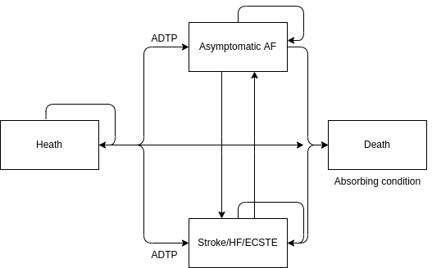
Model specification
Transition probabilities and pay-off (values attach to state) depend on age

Slide 8
Costs
Direct costs: (medical and non-medical). Cost for WWD (and amortisation plan)*; patient education**; Patch device*; Holter-ECG***; 12 Lead ECG***; Medical team time***; Patient transport costs**; Absence days***
Indirect costs: Social benefits saved due to timely treatment***; Permanent disability prevention (workplace and colleges)*, formal and non-formal caregivers (average wage per hour)**
Costs data: Literature review*; Questionnaire***; Registry and HR Data**

Slide 9
Outcome measurement
Primary outcome: Number of screen positive cases, mean ICER and diagnostic odds ratio of detecting new AF cases compared with usual care
Secondary outcomes: Real – world sensitivity and specificity, patients preferences
Selected outcomes for effectiveness: N and % difference of screen positive cases. ICD - 10 classification system
Additional benefits: E- device sector growth

Slide 10
Synthesising costs and effects
COSTS (wwd) – COSTS (usual care)
ICER = —————————————————————
N of pts. (AF wwd) – N of pts (usual care AF)

Slide 11
Uncertainty
Tornado plot and ICER plane. Willingness-to-pay threshold of €22 000
Probabilistic sensitivity analysis.
For number of new diagnosed patient – Poisson distribution with 20% Mean/SD ratio
For costs – Log normal distribution. SD estimated by marked SD of the highest cost items

Slide 12
Discussion of the expected outcomes
Expected most important outcome(s) of study: WWD probrably can be used as cost efective risk based screening
Limitations of design economic evaluation (bias):
Generalisability/transferability of the results to other settings and/or patient groups:
Other relevant considerations to decision-maker: WWD may initially increase AF incidence which is associated with increased expenditures for treatment
Issues of implementation

Slide 13
References
Staerk L, Sherer JA, Ko D, Benjamin EJ, Helm RH. Atrial Fibrillation: Epidemiology, Pathophysiology, and Clinical Outcomes. Circ Res. 2017 Apr 28;120(9):1501-1517. doi: 10.1161/CIRCRESAHA.117.309732. PMID: 28450367; PMCID: PMC5500874.
Lippi G, Sanchis-Gomar F, Cervellin G. Global epidemiology of atrial fibrillation: An increasing epidemic and public health challenge. Int J Stroke. 2021 Feb;16(2):217-221. doi: 10.1177/1747493019897870. Epub 2020 Jan 19. Erratum in: Int J Stroke. 2020 Jan 28;:1747493020905964. PMID: 31955707.
Sankaranarayanan R, Kirkwood G, Visweswariah R, Fox DJ. How does Chronic Atrial Fibrillation Influence Mortality in the Modern Treatment Era? Curr Cardiol Rev. 2015;11(3):190-8. doi: 10.2174/1573403x10666140902143020. PMID: 25182145; PMCID: PMC4558350.
Johnsen, S.P., Dalby, L.W., Täckström, T. et al. Cost of illness of atrial fibrillation: a nationwide study of societal impact. BMC Health Serv Res 17, 714 (2017). https://doi.org/10.1186/s12913-017-2652-y
Quality of Life in Patients with Atrial Fibrillation: A Systematic Review Thrall, Graham et al. The American Journal of Medicine, Volume 119, Issue 5, 448.e1 - 448.e19
Chen W, Khurshid S, Singer DE, Atlas SJ, Ashburner JM, Ellinor PT, McManus DD, Lubitz SA, Chhatwal J. Cost-effectiveness of Screening for Atrial Fibrillation Using Wearable Devices. JAMA Health Forum. 2022 Aug 5;3(8):e222419. doi: 10.1001/jamahealthforum.2022.2419. PMID: 36003419; PMCID: PMC9356321.
Riva JJ, Malik KM, Burnie SJ, Endicott AR, Busse JW. What is your research question? An introduction to the PICOT format for clinicians. J Can Chiropr Assoc. 2012 Sep;56(3):167-71. PMID: 22997465; PMCID: PMC3430448.
Jacobs MS, Kaasenbrood F, Postma MJ, van Hulst M, Tieleman RG. Cost-effectiveness of screening for atrial fibrillation in primary care with a handheld, single-lead electrocardiogram device in the Netherlands. Europace. 2018 Jan 1;20(1):12-18. doi: 10.1093/europace/euw285. PMID: 27733465.
Sciera LK, Frost L, Dybro L, Poulsen PB. The cost-effectiveness of one-time opportunistic screening for atrial fibrillation in different age cohorts of inhabitants in Denmark aged 65 years and above: a Markov modelled analysis. Eur Heart J Qual Care Clin Outcomes. 2022 Mar 2;8(2):177-186. doi: 10.1093/ehjqcco/qcaa092. PMID: 33337469.

