Slide 1
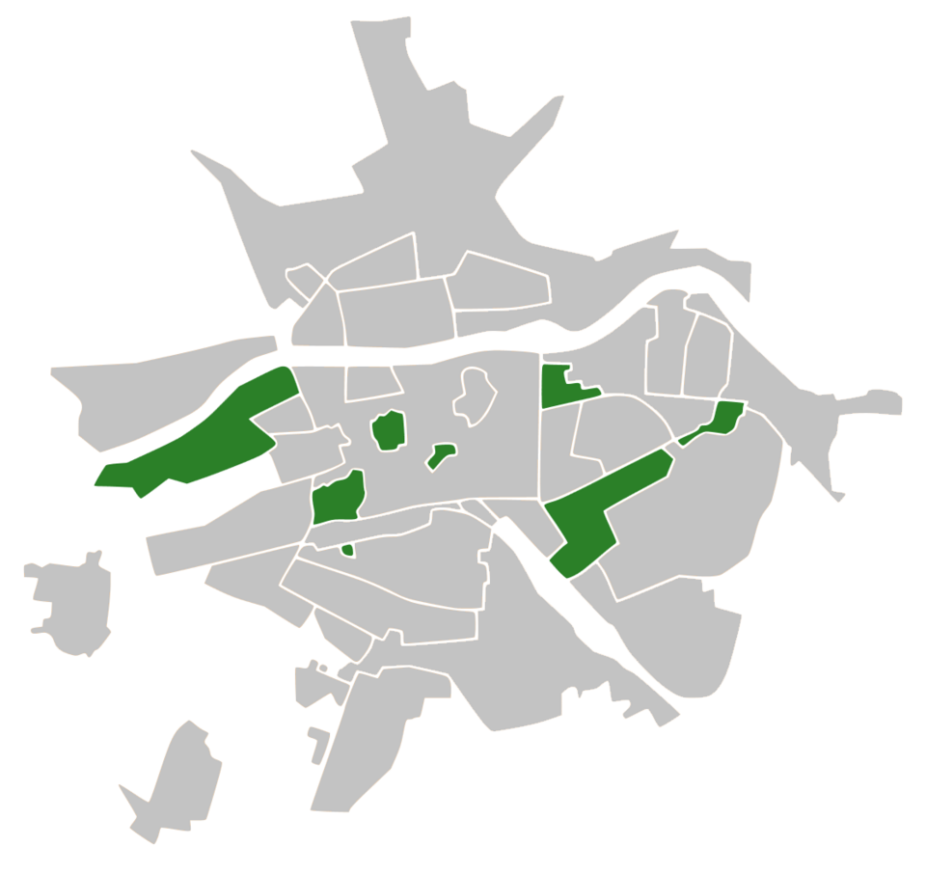




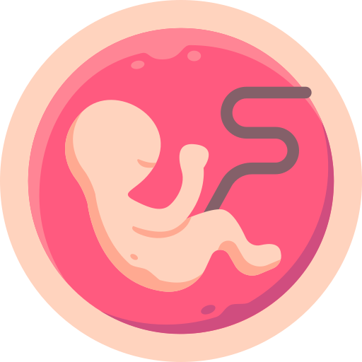


A RAPID REVIEW OF HEALTH OUTCOMES ASSOCIATED
WITH THE FOOD ENVIRONMENT IN CITIES
Kostadin Kostadinov ^{1,2,3}; Donka Dimitrova ^{1,2,4}; Marco Helbich ^{1,2,5}; Angel Burov ^{1,2,6}; Angel M. Dzhambov ^{1,2}
^{1.} Environmental Health Division, Research Institute at Medical University of Plovdiv, Medical University of Plovdiv, Plovdiv, Bulgaria;
^{2.} Health and Quality of Life in a Green and Sustainable Environment Research Group, Strategic Research and Innovation Program for the Development of MU - Plovdiv, Medical University of Plovdiv, Plovdiv, Bulgaria;
^{3.} Department of Social Medicine and Public Health, Faculty of Public Health, Medical University of Plovdiv, Plovdiv, Bulgaria;
^{4.} Department of Health management and health economics, Faculty of Public health, Medical University of Plovdiv, Plovdiv, Bulgaria;
^{5.} Department of Human Geography and Spatial Planning, Faculty of Geosciences, Utrecht University, the Netherlands;
^{6.} Department of Urban Planning, Faculty of Architecture, University of Architecture, Civil Engineering and Geodesy, Sofia, Bulgaria.
Introduction
Cardiovascular Health
The physical food environment in cities represents the geographical access to various food establishments and shops, availability of different foods, reflects the opportunities and conditions influence people's food choices and nutritional status
plays a critical role in shaping dietary behaviors and long-term health outcomes. It encompasses factors such as the availability, accessibility, affordability, and quality of food across neighborhoods. As cities grow and dietary patterns shift, understanding how local food environments influence population health is increasingly important. This knowledge can inform both public health strategies and urban policy aimed at reducing health inequalities and promoting healthier lifestyles.
Healthier food environments with greater availability of fresh foods were associated with a 10-15% lower risk of cardiovascular diseases, including hypertension and dyslipidemia.
Obesity
Exposure to ultra-processed foods and food deserts was tied to dietary patterns causing a 1.5-2 kg/m² BMI increase, with food desert residents showing 25% higher obesity rates.
Pregnancy-Related Outcomes
Aim
Food environment-related dietary patterns were associated with a 1.8-fold increased risk of gestational diabetes and hypertensive disorders during pregnancy
To synthesize recent peer-reviewed evidence on how characteristics of the urban food environment—such as food availability, accessibility, and quality—relate to health outcomes across different population groups.
Materials and Methods
Discussion
A structured literature search was conducted in PubMed for peer-reviewed studies published in English between January 2021 and January 2025. The search strategy was developed using DeepSeek, focusing on terms related to food environments and health outcomes. Screening and classification of studies were carried out using Rayyan.
This review highlights consistent associations between unhealthy food environments and poor health outcomes in urban settings. Dietary patterns influenced by exposure to ultra-processed foods and food deserts may also affect pregnancy outcomes, such as gestational diabetes and hypertension. However, the reviewed studies varied widely in their definitions and methods, limiting comparability and causal interpretation.
Scan the QR code to find out more for Materials and Methods
Results
A total of 1,417 records were identified and screened. After applying inclusion criteria, eligible studies were subjected to data charting and narrative synthesis.
Four main outcome areas emerged
Policy implications
Urban planning may benefit from considering food access strategies—such as zoning regulations, incentives for healthy retailers, and improved infrastructure — as potential tools to support healthier dietary behaviors, pending further evidence
Diabetes
Unhealthy food environments with high fast-food outlet density and limited fresh produce access were linked to a 20-30% higher incidence of type 2 diabetes, driven by poor dietary choices.
References
Договор №BG-RRP-2.004-007C01 "Програма за стратегически изследвания и иновации на МУ- Пловдив (ПСНИИР-МУП)",
Стълб 2: Създаване на мрежа от изследователски висши училища на Програмата за ускоряване на икономическото възстановяване и трансформация чрез наука и иновации
от компонент "Иновативна България" Националин план за възстановяване и устойчивост“, финансиран от европейския съюз - NextGenerationEU

