Slide 1
Tissue-specific transcriptome-wide networks reflect joint regulation of alternative splicing and gene expression
Ashis Saha⁺, Yungil Kim, David Knowles, Sara Mostafavi, The GTEx Consortium, Alexis Battle
*Dept. of Computer Science, Johns Hopkins University, USA. ashis@jhu.edu

Slide 2
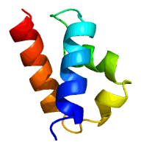
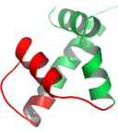
Alternative splicing
exon
exon
exon
pre-mRNA
A
intron
B
intron
C
A
B
C
A
C
isoform-1
isoform-2
protein-1
protein-2
phenotype-1
(Healthy)
phenotype-2
(Disease)
phenotype-2
(Diseased)

Slide 3
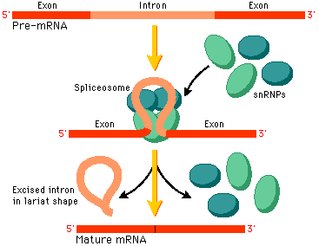
Regulation of alternative splicing
RBP
SF
RBP
SF

Slide 4
Transcriptome-wide Networks (TWN)
Project goals
Identify genes that may regulate alternative splicing
Find associations between total gene expression (TE) and relative isoform abundance or isoform ratio (IR)
Identify tissue-specific regulatory relationships
TE₁
IR₃¹
TE₂
TE₃
TE₄
IR₅¹
IR₂²
IR₃²
IR₆²
TE₅
TE₆
Blood
TE₁
IR₂¹
Heart
TE₁
IR₂¹

Slide 5
Regulation of alternative splicing
SF
SF
SF
SF
SF
isoform-1 abundant
isoform-2 less abundant
isoform-1 less abundant
isoform-2 abundant

Slide 6
Isoform ratio
Fraction of total transcript abundance arising from each isoform of the same gene.
TE represents steady-state total expression of a gene.
IR represents alternative splicing given total gene expression.
Gene-1
isoform-1
isoform-2
TE₁ = 5
IR₁¹ = 0.80
IR₁² = 0.20
TE₁ = 5
IR₁¹ = 0.20
IR₁² = 0.80

Slide 7
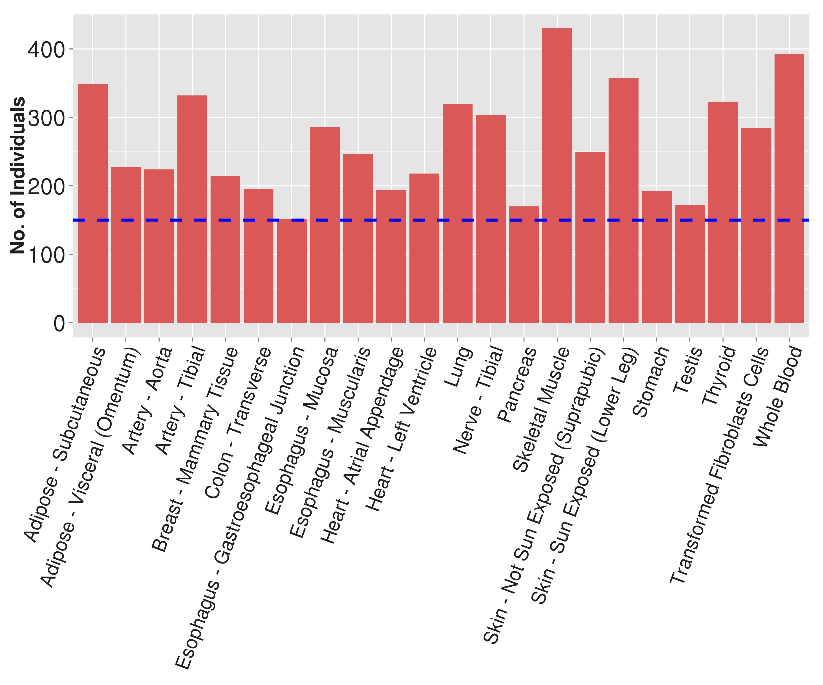
Data
GTEx (Genotype-Tissue Expression) Project
Multi-tissue RNA-seq and genotyping data
8555 samples, 552 individuals, 54 Tissues (V6)
For analysis, we selected
22 tissues (>= 150 indivs.)
2500 genes
2500 isoforms

Slide 8
Network construction: Graphical Lasso
TE_{i}
IR_{j}
Gaussian Markov Random Field
Estimate inverse covariance matrix by maximizing penalized log-likelihood: log det Θ – tr (SΘ) – ρǁΘǁ₁ S = sample covariance matrix Θ = inverse covariance matrix ρ = regularization parameter
Learns a sparse network.
Identifies direct relationships.
Sample-1
Sample-2
data
Sample-6
Covariance
TE_{i}
IR_{j}
TE_{i}
Sample
Covariance
IR_{j}
Graphical
Lasso
TE_{i}
IR_{j}
TE_{i}
 |  |  |  |  | `
Inverse
Covariance
IR_{j}

Slide 9
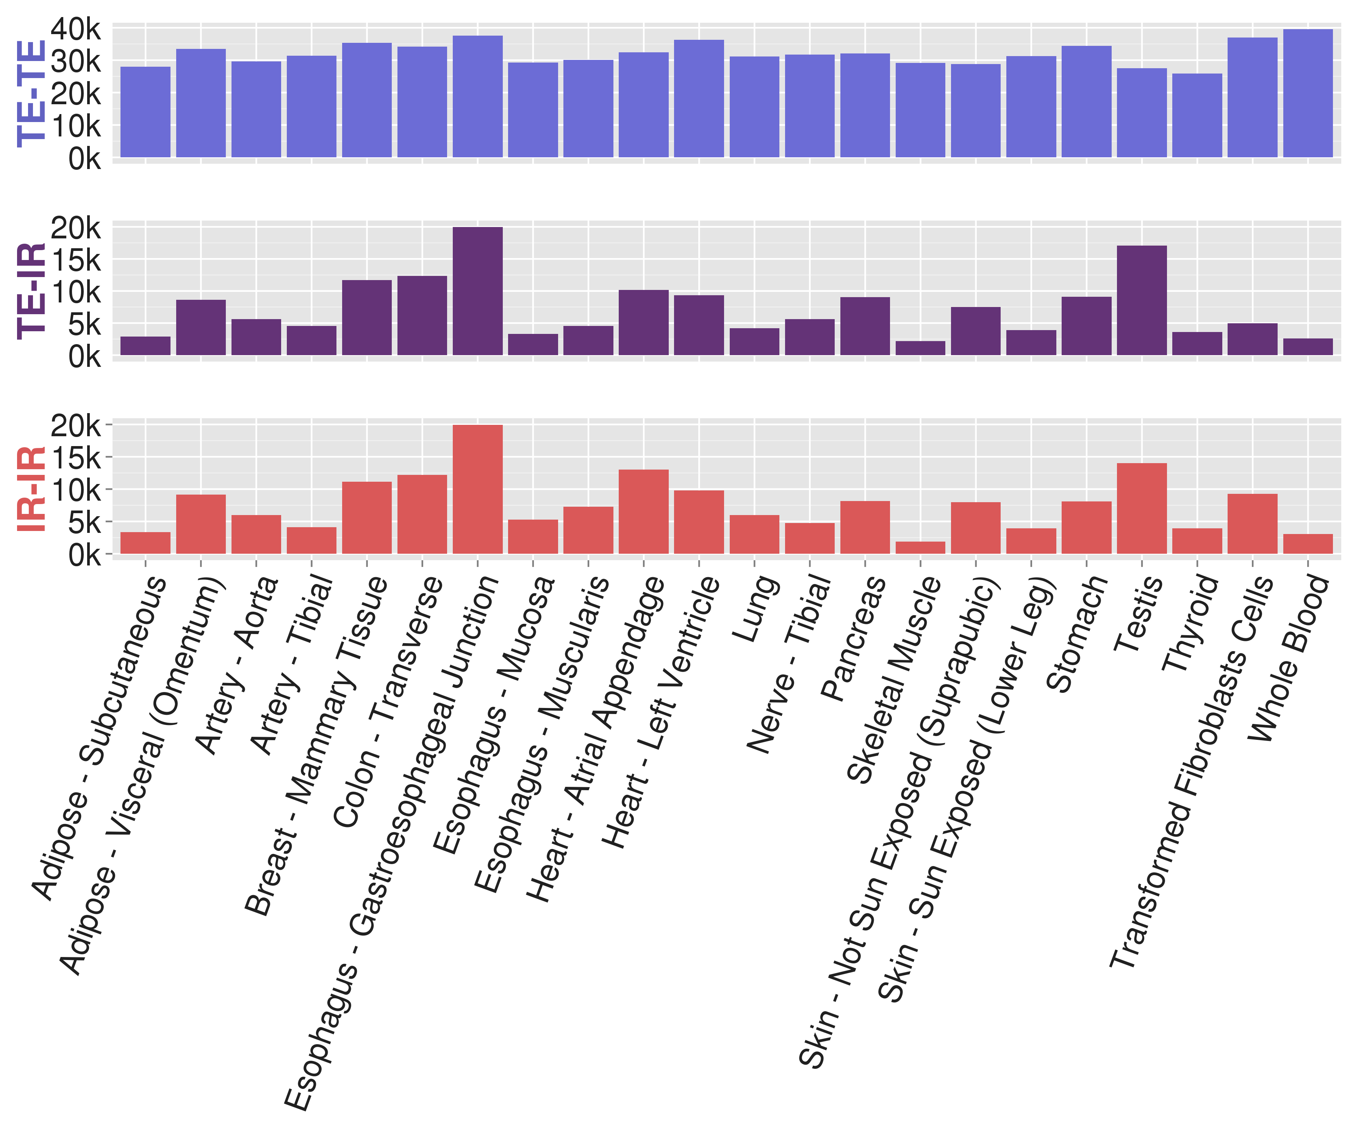
GTEx TWN edge statistics

Slide 10
Hubs as candidate regulators
TE₃
IR₃³
IR₄¹
TE₄
TE₂
IR₂¹
TE₁
TE₅
TE₁
IR₅²
TE₆
IR₆¹
Hub TE with TE neighbors (TE- TE) Transcription Regulator
Hub TE with IR neighbors (TE- IR)
Alternative Splicing Regulator
TE₃
IR₃³
IR₄¹
TE₄
TE₂
IR₂¹
IR₁¹
TE₅
IR₁¹
IR₅²
TE₆
IR₆¹
Hub IR with TE neighbors (IR-TE)
Isoform-specific Transcription Regulator
Hub IR with IR neighbors (IR-IR)
Isoform-specific Splicing Regulator

Slide 11
RNA-binding proteins as TWN hubs
Bind to RNAs to form ribonucleoprotein complexes.
Many known to regulate alternative splicing.
Ex: NOVA-1 regulates splicing of GLRA2, GABRA1*.
Expect TE-IR hubs to be regulator of alternative splicing.
Collected genes annotated with ‘Rna Binding’ from AMIGO.
IR₃³
IR₄¹
IR₂¹
TE₁
IR₅²
IR₆¹

Slide 12
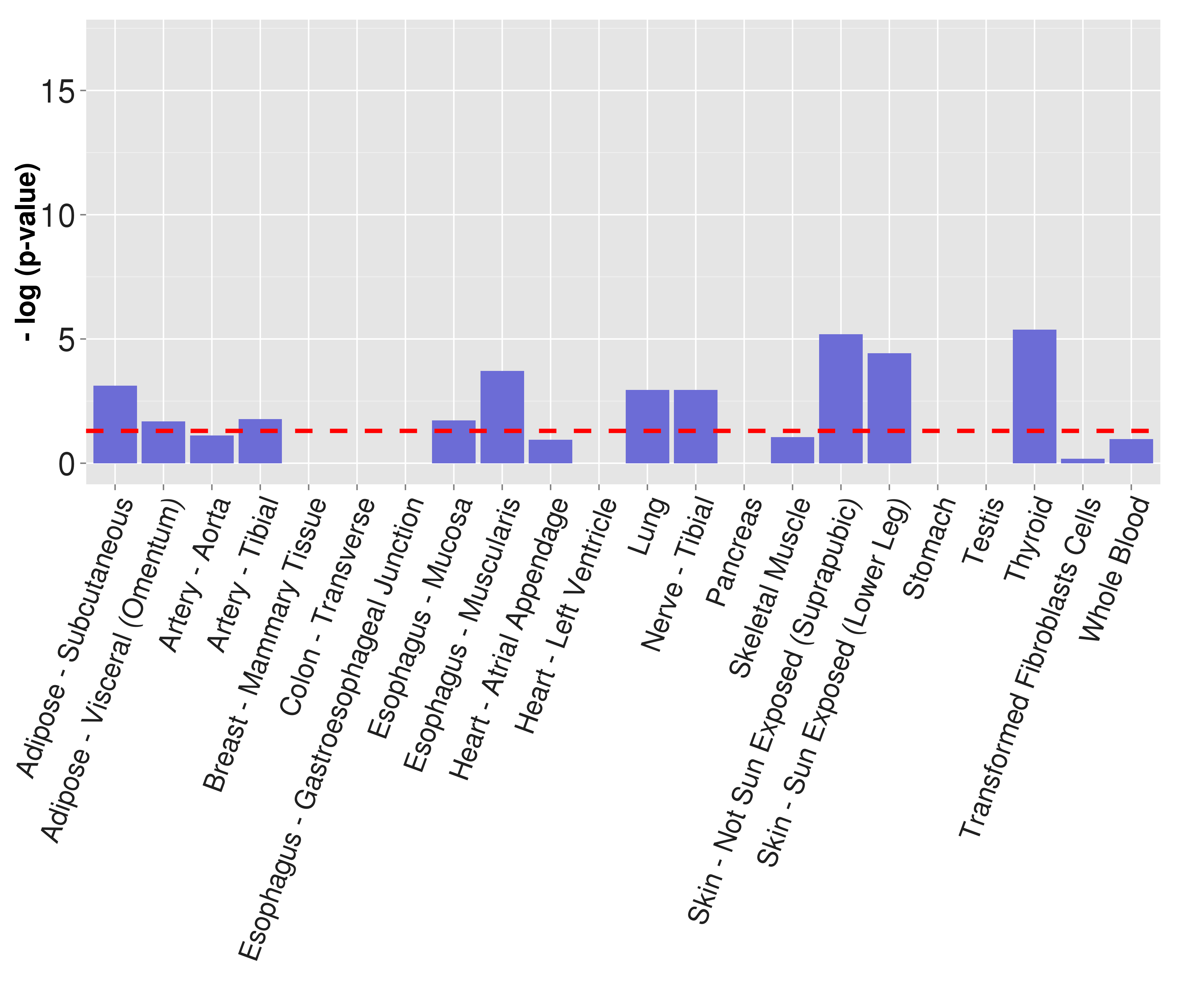
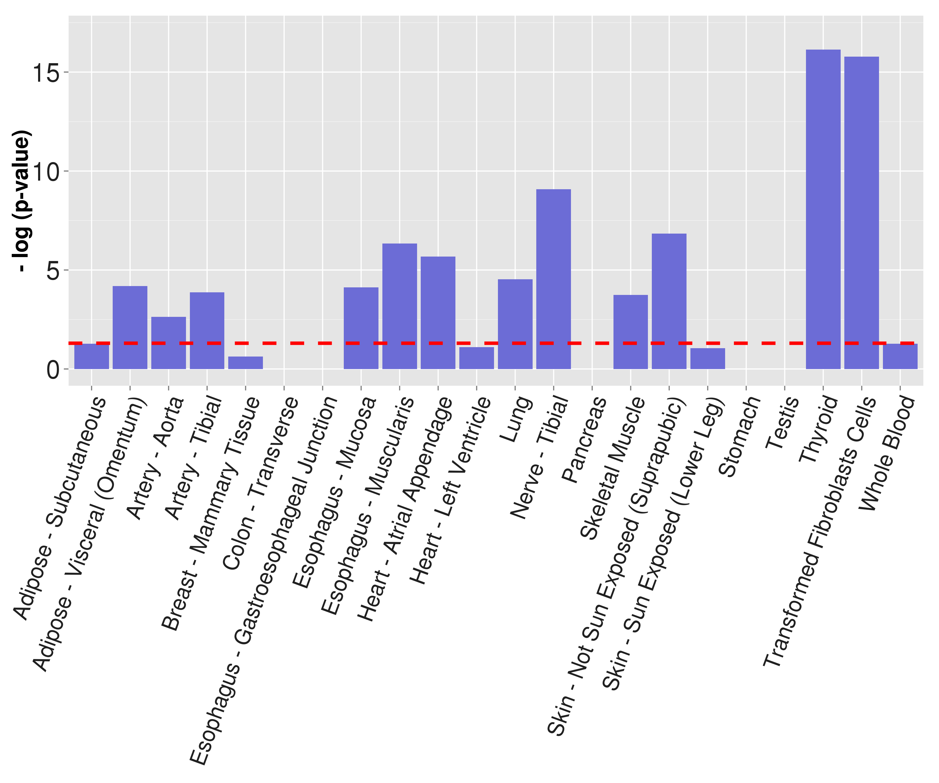
RBP enrichment across GTEx tissues*
Dataset: 2.5k TE, 2.5k IR**
Dataset: 10k TE, 10k IR***

Slide 13
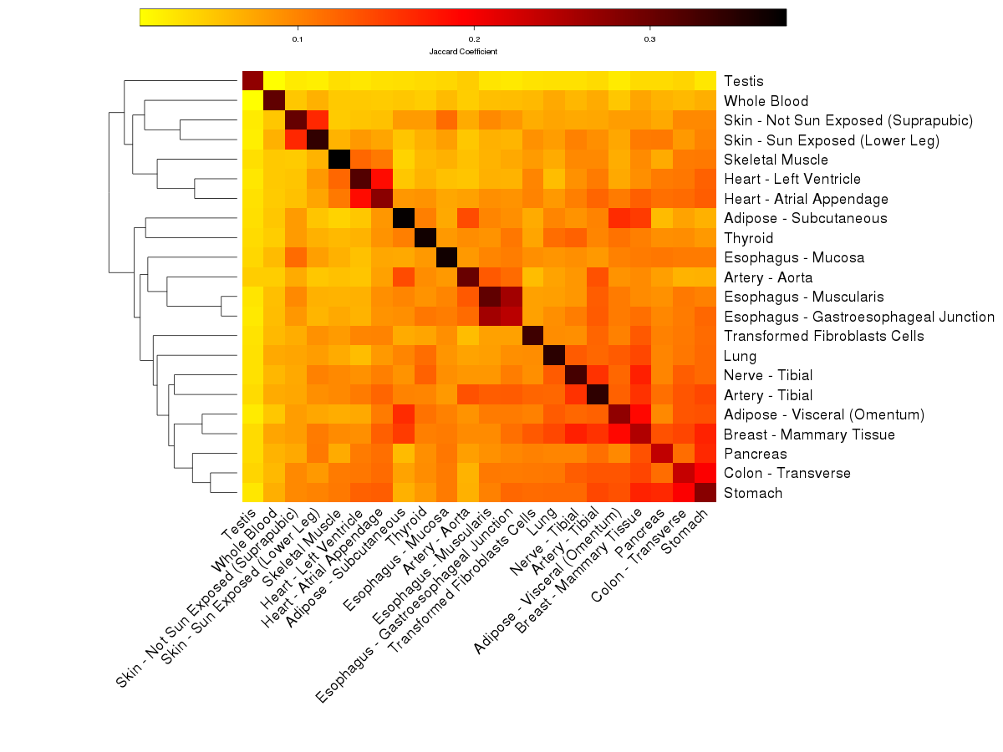
Tissue-specificity of TWN hubs
TE-IR hubs
across
GTEx tissues

Slide 14
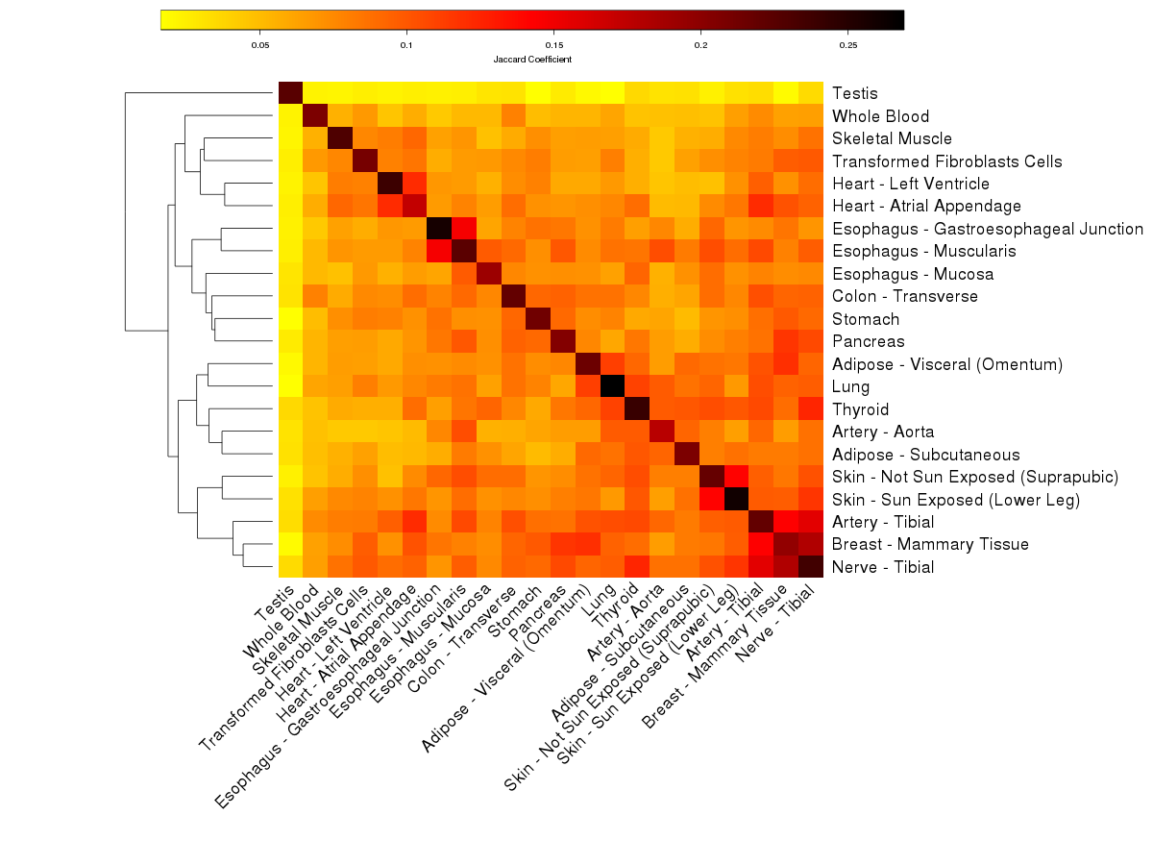
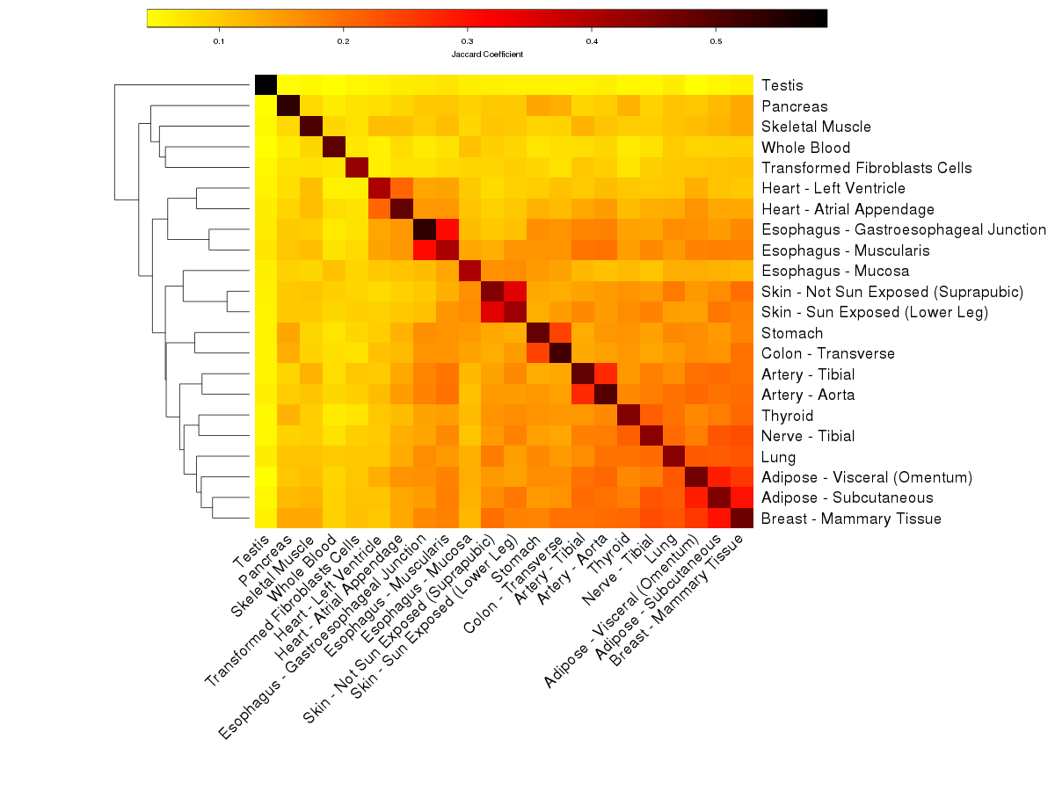
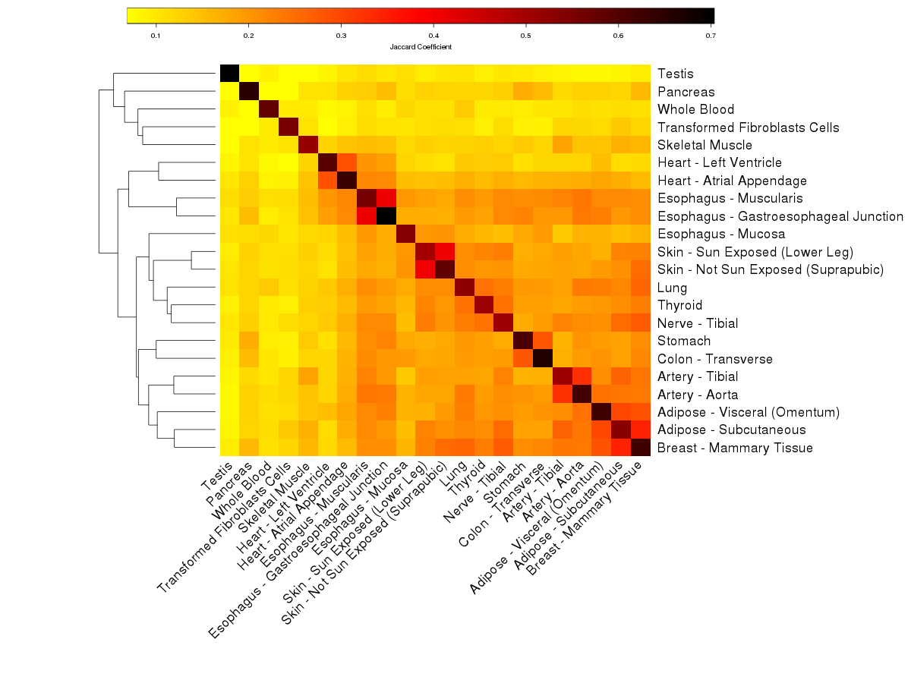
Tissue-specificity of TWN hubs
TE-TE Hubs
TE-IR Hubs
IR-TE Hubs
IR-IR Hubs

Slide 15
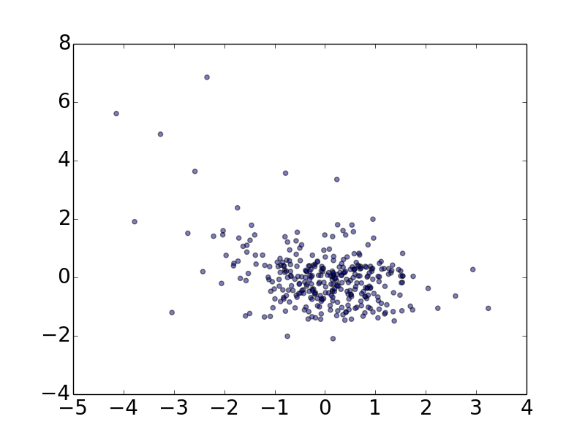
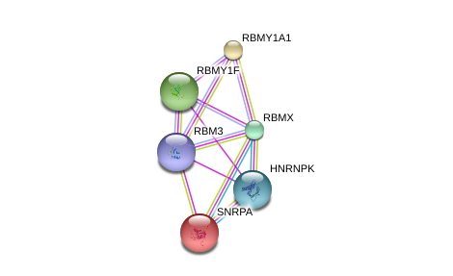
Example: regulator shared across tissues
20 out of 22 tissues have RBM3 in top 500 TE-IR hubs.
Known RNA-binding protein
Interacts with SNRPA, HNRNPK (components of spliceosome).*
Associated diseases:
Prostate cancer **
Colorectal cancer ***
Bladder cancer ****
Artery-Tibial
z-score (MFSD10 IR)
z-score (RBM3 expression)

Slide 16
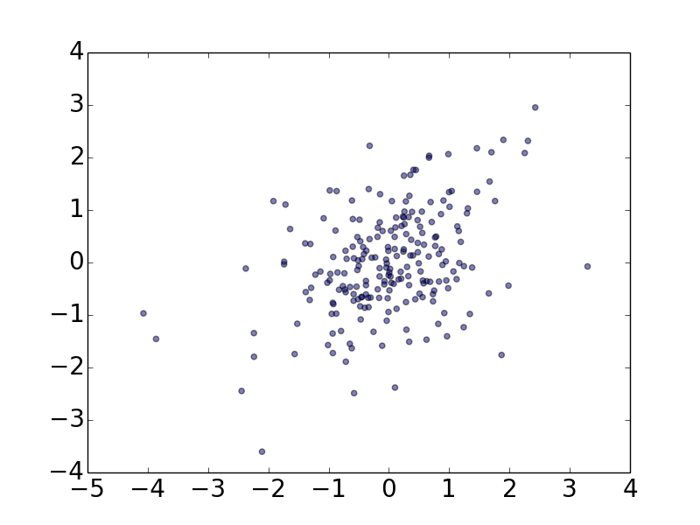
Example: tissue-specific splicing regulator
Only 2 heart tissues (Heart - Left Ventricle, Heart- Atrial Appendage) have GATA4 in top 500 TE-IR hubs.
Associated with heart disease*
Atrial septal defect 2
Ventricular septal defect 1
Involved in ‘Heart Development’ pathway. **
Heart – Left Ventricle
z-score (PFKFB2 IR)
z-score (GATA4 expression)

Slide 17
Summary
Sparse Gaussian Markov Random fields used to identify transcriptome-wide regulatory networks (TWNs)
TWNs show potential to find regulators of alternative splicing.
TWNs applied to GTEx data reveal tissue-specific regulatory relationships

Slide 18
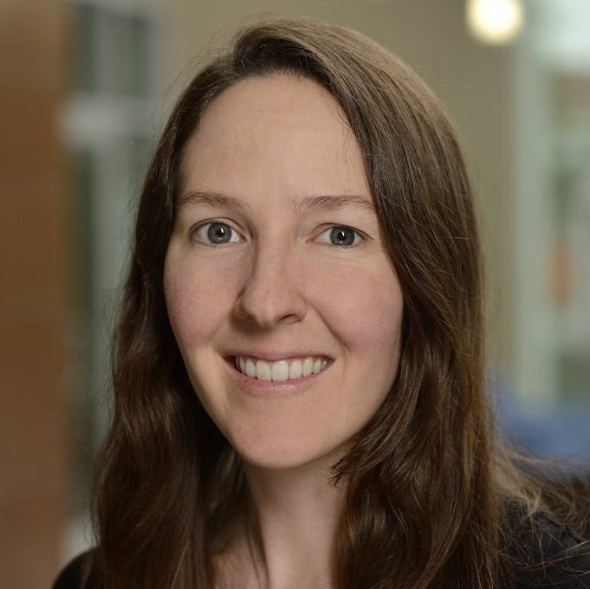
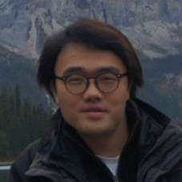
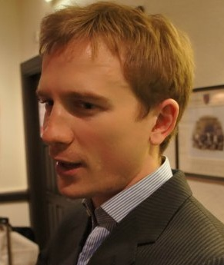
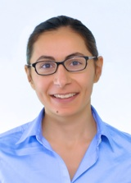
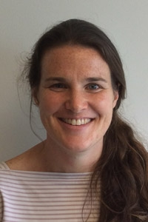
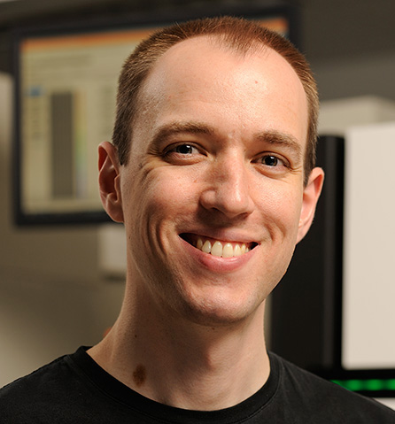
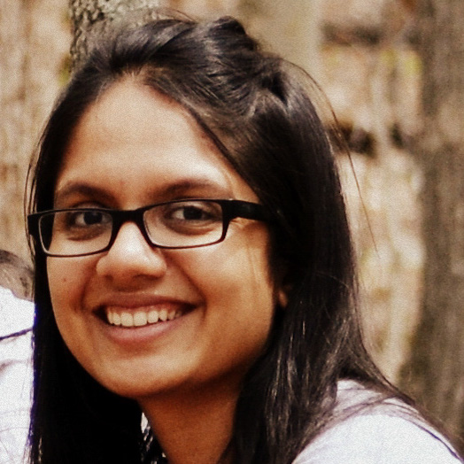




Acknowledgement
Alexis Battle
Yungil Kim
David Knowles
Sara Mostafavi
Barbara Engelhardt
The GTEx Consortium
NIH (R01 MH101814)
Ben Langmead
Princy Parsana
Battle Lab
Thank you!
JHU

