Slide 1
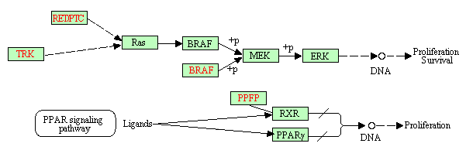
Gene Interaction-Level Cancer Classification using Gene Expression Profiles
Ashis Saha, Jaewoo Kang Korea University, Seoul, Republic of Korea.
Notes:
Hello, everybody, Good afternoon. My name is Ashis Saha. I am from Korea University in South Korea. Today I shall be presenting my research titled “Gene Interaction-Level Cancer Classification using Gene Expression Profiles.”

Slide 2
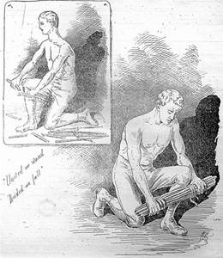
Union is strength.
Notes:
This study is highly influenced by 2 lessons I learned in childhood. This picture depicts the first lesson. It says that we can break one single stick easily, but we cannot break a bundle of sticks. That means, “Union is Strength”.

Slide 3

Too many cooks
spoil the broth.
Notes:
Next lesson is quite opposite to the first one which says “Too many cooks spoil the broth”. These two together mean that you have to choose the optimal number- not too few, not too many.

Slide 4
Gene Interaction-Level Cancer Classification using Gene Expression Profiles
Introduction
Problem
Key Idea
Results
Notes:
Let us get back to the title. Gene Interaction-Level Cancer Classification using Gene Expression Profiles. Here “Cancer Classification” is the main task. What do we mean by it?

Slide 5
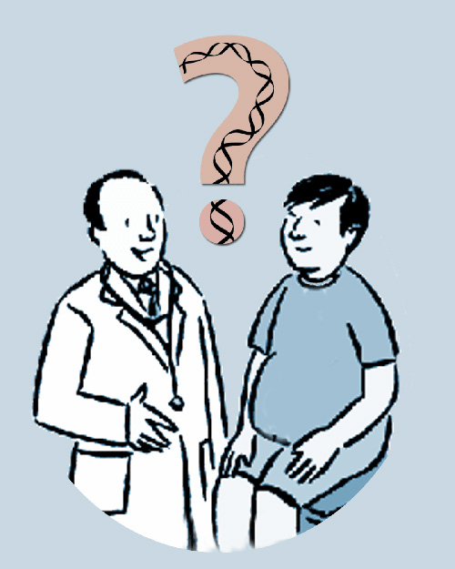
Cancer Classification
Do I have cancer?
Am I susceptible to cancer?
Introduction
Problem
Key Idea
Results
Notes:
A person goes to the doctor and asks, “doctor, do I have cancer?” or “am I susceptible to cancer?” Then the doctor asks for genetic tests and after analyzing the data he says, “yes, you have cancer” or “no, you are not susceptible to cancer.” What type of genetic data can he use? Here we use Gene Expression data from microarray profiling.

Slide 6
Gene Expression
BRCA2 : A tumor suppressor gene
Activity
Increased
Tumor
Suppressed
No Cancer!
Activity
decreased
Tumor Not
Suppressed
Cancer!
Introduction
Problem
Key Idea
Results
Notes:
Let us see how BRCA2 gene works. It is a tumor suppressor gene. So, if its activity is increased, tumor is better suppressed. That means cancer is cancer is suppressed. Alternately, if activity is decreased, tumor is not suppressed well and we see cancer. This activity can be represented by a number by micro-array profiling.

Slide 7
Gene Expression Profiles
?
P
N
N
…
P
Genes
Gene-1
Gene-2
Gene-3
…
Gene-N
P-1
213.1
98.3
31.4
…
-75
P-2
204.5
80.4
39.4
…
-99.5
P-3
214.5
82.3
36.9
…
-87
…
…
…
…
…
…
P-M
204.1
95.7
-43.5
…
-85.1
New
250.1
70.3
-50.4
…
-80
Introduction
Problem
Key Idea
Results
Notes:
Let’s say, in our microarray, there are N genes, Gene-1 to gene-N. Few persons did the microarray testing. And we know if those persons are cancer positive or cancer negative. We have to analyze this data, and when a new person comes, we have to predict if he is positive or not. This is our goal.

Slide 8
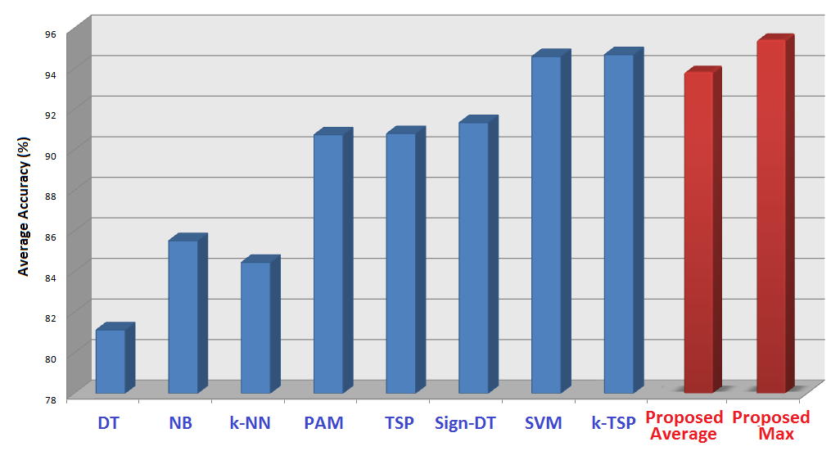

Contribution
Biological
Interpretability
How Genes Work
Find Treatment
Happy
Life
Introduction
Problem
Key Idea
Results
Notes:
Here we present an approach to which can predict cancer as accurately as the existing top-class classifier with the additional feature of biological interpretability. It means, from the results, the biologist can interpret how genes work to cause cancer. Then pharmacologists can develop effective drug to ensure happy life. Biological interpretability is very important, otherwise we can at best detect cancer, but we cannot develop drugs using it.

Slide 9
Learning Algorithms
Decision Tree
Naïve Bayesian
K - Nearest Neighbor
PAM
SVM
Consider
only 1 gene
at a time
Introduction
Problem
Key Idea
Results
Notes:
There are many learning algorithms to do this job – Decision tree, Naïve Bayesian, Nearest neighbor, PAM, SVM. All of them consider only 1 gene at a time.

Slide 10
1 single gene does NOT cause cancer.
A set of genes work together.
Introduction
Problem
Key Idea
Results
Notes:
But, 1 single gene does not cause cancer. Rather a set of genes work together to develop cancer.

Slide 11
Union is strength.
Introduction
Problem
Key Idea
Results
Notes:
Here comes our first lesson. If we can take more genes, we can expect better results.

Slide 12
Previous Efforts
2 genes
TSP (Top Scoring Pair) [Geman et al.]
k-TSP [Tan et al.]
Doublets [Chopra et al.]
1. O(n²)
2. NO Biological Relation
Introduction
Problem
Key Idea
Results
Notes:
Researchers have already tried to utilize this lesson. TSP, k-TSP, Doubltes – all these methods consider a pair of genes together. 2 gene combinations. And they got better results than taking 1 gene only. However they could not take more genes together, because by the time they took 2 genes, complexity became O(n²). Thousands of genes produced millions of gene-pairs. Moreover, they naively took all possible combinations, genes do not need to be biologically related to make a pair.

Slide 13
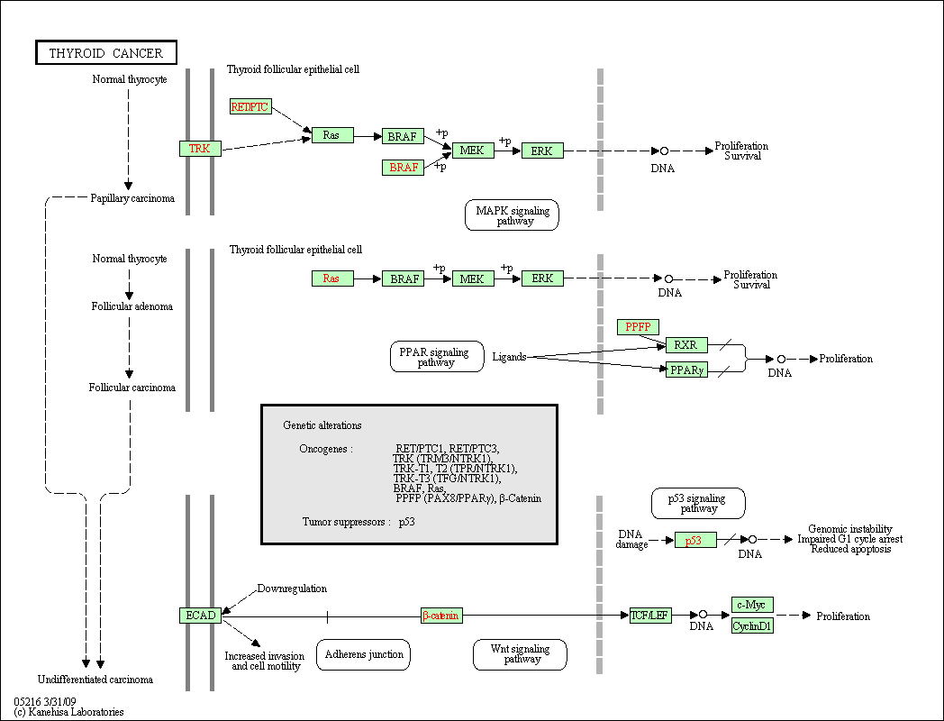
Pathways
Introduction
Problem
Key Idea
Results
Notes:
We approach to these problems by taking pathways. Pathways are already-known sequence of genes showing which gene affects which other genes. Biologists already know how they work together. For example in this thyroid cancer pathway, TRK gene indirectly activates RAS, RAS then activates BRAF, and two more activations causes survival from proliferation. We use this knowledgebase, we don’t take all combinations of genes naively. Rather, we take only those genes in a combination who are in the same pathway.

Slide 14
Too many cooks
spoil the broth.
Introduction
Problem
Key Idea
Results
Notes:
Now, let’s see if we can use the 2nd lesson - Too many cooks spoil the broth, if we can reduce the number of genes.

Slide 15
Disconnected
Gene Interaction Set
Introduction
Problem
Key Idea
Results
Notes:
If you look at it carefully, you’ll see that there are some disconnected components. That means that they are not working together even after being in the same pathway. So, we propose to take only those genes in a combination, who interact with each other. We call it Gene Interaction Set.

Slide 16
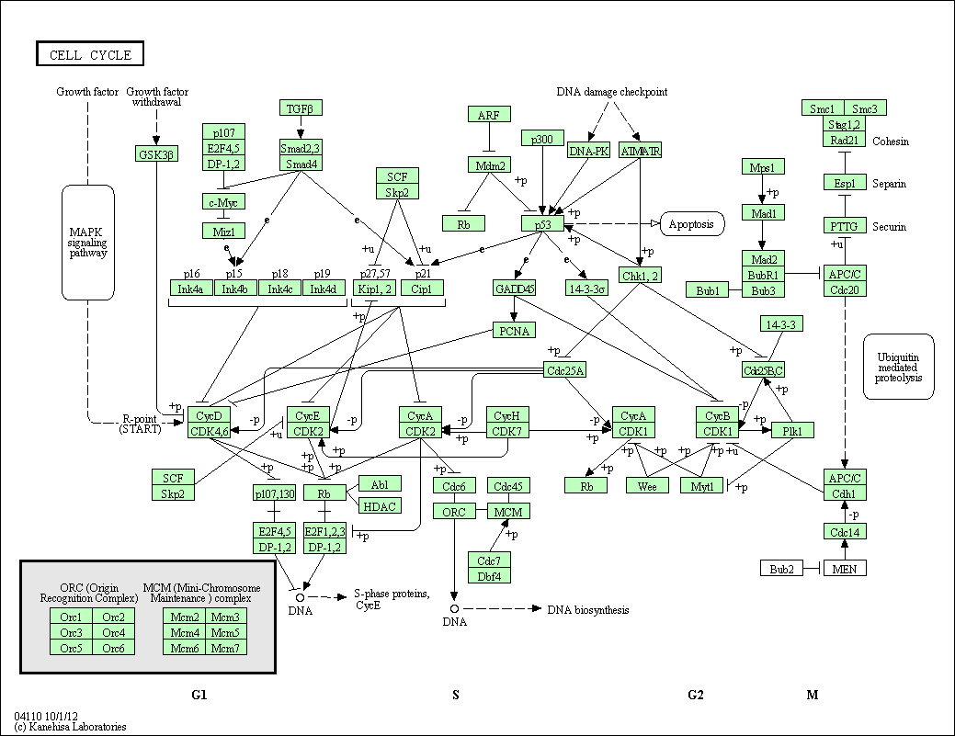
Too Many Genes
Indirect connection
Very low interaction
Strong Interaction
Strong Combined Effect
Introduction
Problem
Key Idea
Results
Notes:
Can we reduce the number even more? Look at this pathway. It is cell cycle pathway. Here there are lots of genes here and all the genes are in fact connected. But distant connections may denote low interaction. So, we can further divide this pathway using clustering approach to get highly interacting genes in a gene interaction set.

Slide 17
Algorithm Overview
1. Find out Gene Interaction Set (GIS)
2. Estimate importance for each GIS by entropy score
3. Sort and take top k GIS
4. Determine class by weighted voting
Introduction
Problem
Key Idea
Results
Notes:
Once we understand the gene interaction set, the algorithm becomes very simple. Here the first task is to find out all the gene interaction sets. Then we will estimate the importance of each gene interaction set using our proposed entropy score. We can sort them and take only top K sets who will vote to determine the final class of the new sample.

Slide 18
Algorithm Overview (cont’d)
GIS
0.49
0.49
GIS
0.83
0.83
Top K
GIS
0.14
0.14
GIS
0.21
0.21
Entropy Calculation
Sorting
GIS
0.38
0.38
GIS
0.08
0.08
GIS
0.60
0.60
GIS
0.05
0.05
GIS
0.30
0.30
Introduction
Problem
Key Idea
Results
Notes:
Let us visualize the steps. Firstly we found all the gene interaction sets. Then we calculated entropy of each set and sorted them. Only top k gene interaction sets here can vote.

Slide 19
Algorithm Overview (cont’d)
Vote for Positive
Vote for Negative
0.05
0.90
0.10
0.08
0.85
0.15
0.14
0.93
0.07
0.21
0.30
0.70
0.30
0.75
0.25
>
Positive
(+) 3.73
1.27
Introduction
Problem
Key Idea
Results
Notes:
Here each top gene interaction set will vote. Unlike normal voting, their vote will be weighted. For example, first gene set says that “I am 90% confident that the new sample will be cancer positive”. So, its vote for positive is 0.9 and vote for negative is 0.1. Thus if the sum of all the votes for positive becomes higher than the negative, then we predict that the new sample is positive.

Slide 20
Remaining
1. Find out Gene Interaction Set (GIS)
2. Estimate importance for each GIS by entropy score
3. Sort and take top k GIS
4. Determine class by weighted voting
Introduction
Problem
Key Idea
Results
Notes:
We have already seen how to find gene interaction sets. Sorting is trivial. The remaining part is importance estimation and voting.

Slide 21


Importance of a GIS
Genes | P-1 | P-2 | P-2 | … | P-M
Gene-1 | 213.1 | 204.5 | 204.5 | … | 224.1
Gene-2 | 98.3 | 80.4 | 80.4 | … | 85.6
Gene-3 | 31.4 | 39.4 | 39.4 | … | -39.6
… | … | … | … | … | …
Gene-N | -75 | -99.5 | -99.5 | … | -70.2
B
Gene-2
A
C
Gene-1
Introduction
Problem
Key Idea
Results
Notes:
Let us consider that one set has 2 genes- gene-1 and gene-2. We plot them in graph and cluster. If one cluster contains only positive data, then we can say that the data in this cluster are most likely positive. Same is true, if all data in a cluster are negative. But, if both positive and negative points are mixed in a cluster, then we cannot predict from it. So, we want such a metric with prioritize same kind of point in a cluster.

Slide 22
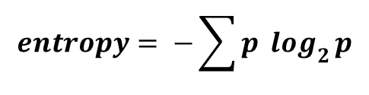
Entropy
0
$$entropy= −\sum{p \log_{2}{p}}$$
0
1
Less Entropy
Better Classification
Introduction
Problem
Key Idea
Results
Notes:
Entropy used in Information theory is such a metric where if all data are either positive or negative, entropy is 0. And if they are uniformly mixed, entropy is 1. So, less entropy signifies better classification.

Slide 23


Entropy
Count Positive & Negative (P_{i} & N_{i})
Normalize
Calculate proportion
4.
5.
P₂= 1
N₂= 15
/10 = 0.1
/20 = 0.75
p₂ = 0.1/(0.1+0.75)
e₂ = 0.522
B
Gene-2
P₃= 5
N₃= 1
/10 = 0.5
/20 = 0.05
A
C
p₃ = 0.5/(0.5+0.05)
P₁= 4
N₁= 4
/10 = 0.4
/20 = 0.2
e₃ = 0.434
p₁ = 0.4/(0.4+0.2)
e₁ = 0.918
Gene-1
Entropy = 0.618
Introduction
Problem
Key Idea
Results
Notes:
We can calculate the entropy following the formulas. But I would like to mention one important thing that, as in most dataset, number of positive and negative samples are not equal, we have to first normalize their count by dividing total number of positive and negative points respectively.

Slide 24
Voting Weight
w(pos) = P₃/(P₃+N₃)
w(neg) = N₃/(P₃+N₃)
B
Gene-2
P₃= 5
N₃= 1
/10 = 0.5
/20 = 0.05
A
C
Gene-1
Introduction
Problem
Key Idea
Results
Notes:
The voting comes from the cluster in which the sample resides. If the sample resides in the cluster C, then the voting weight will depend on the proportion of positive and negative samples in the cluster C.

Slide 25

Classification
Vote for Positive
Vote for Negative
0.05
0.90
0.10
0.08
0.85
0.15
0.14
0.93
0.07
0.21
0.30
0.70
0.30
0.75
0.25
(+) 3.73
>
1.27
$\sum{w\left(pos\right)}$ > $\sum{w\left(neg\right)}⇒pos$
Introduction
Problem
Key Idea
Results
Notes:
As I described earlier, if the total vote for positive is greater than the negative the prediction will be positive.

Slide 26
Results
Leave one out cross validation (LOOCV)
Average accuracy over 7 Cancer Datasets
Introduction
Problem
Key Idea
Results
Notes:
We measured accuracy of our method using leave-one-out policy on 7 datasets. We found that our method produces comparable accuracy to the top-class existing methods. I should note that as the result of our method is non-deterministic, that means, it can produce different results on different run, we run our method 10 times and take the average of 10 accuracies. If we consider the maximum accuracy achieved in 10 runs, we see that it can be better than any of the other methods.

Slide 27
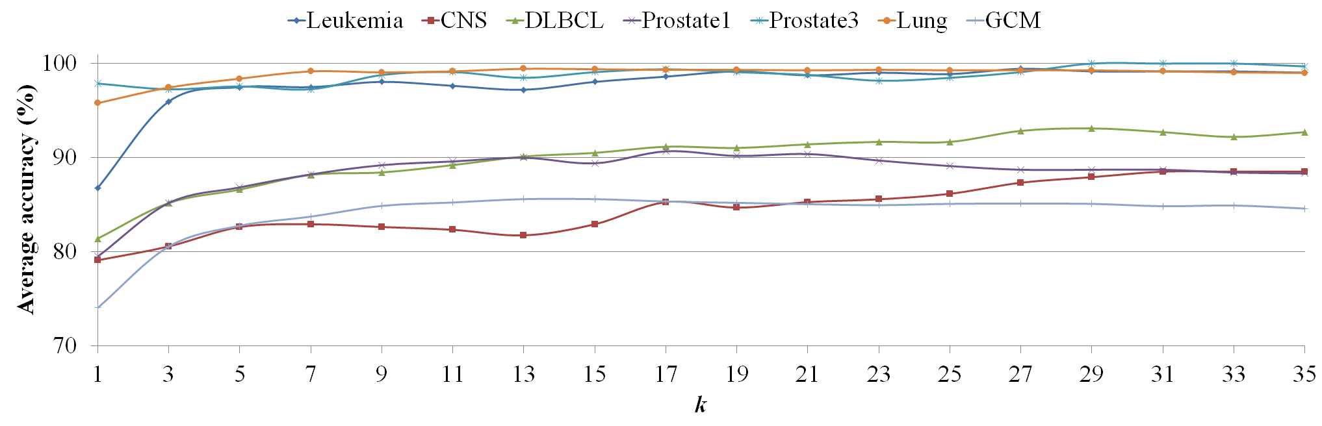
Accuracy vs. k
More k
Better Accuracy
Consistent Ranking
Introduction
Problem
Key Idea
Results
Notes:
Moreover, we see that accuracy increases as the take more gene interaction sets for classification. It implies the consistency of the ranking.

Slide 28
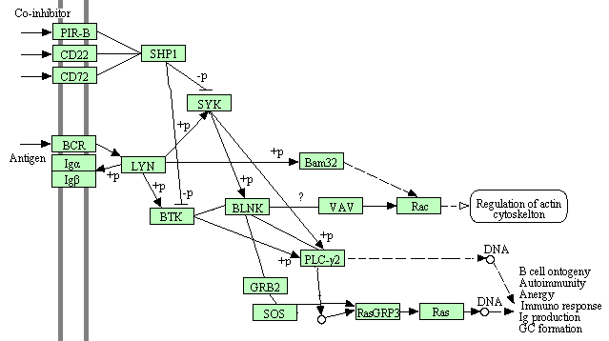
Leukemia B cell receptor signaling pathway
Introduction
Problem
Key Idea
Results
Notes:
This is one gene interaction set consistently ranked high in Leukemia dataset. You can see how easily biologist can figure out how this genes are working to cause that leukemia.

Slide 29
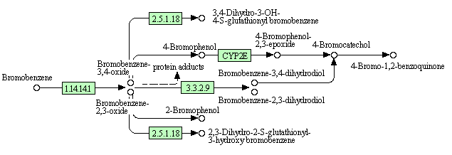
Prostate Cancer Metabolism of xenobiotics by cytochrome P450
Introduction
Problem
Key Idea
Results
Notes:
This is another example gene interaction set found from Prostate cancer dataset.

Slide 30
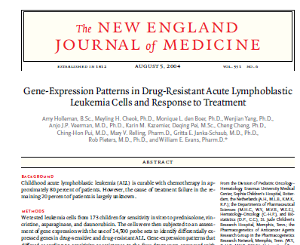



Literature Support
Introduction
Problem
Key Idea
Results
Notes:
All these results are supported are supported by the existing literatures.

Slide 31
Thank You …
Q&A

Slide 32
Extra Slides

Slide 33

GIS Generation
Find out connected components (CCs).
Take all CCs having more at least min no. of genes at most expected no. of genes
If CC has more than expected no. of genes
Divide CC into clusters
If cluster has at least min no. of genes, take it.

Slide 34
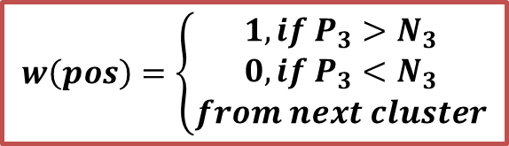

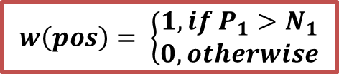
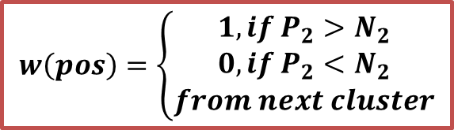
Binary Voting
$$w\left(pos\right)=\left\{\begin{aligned}1, if P_{2}>N_{2} \\ 0, if P_{2}<N_{2} \\ from next cluster\end{aligned}\right.$$
B
Gene-2
$$w\left(pos\right)=\left\{\begin{aligned}1, if P_{3}>N_{3} \\ 0, if P_{3}<N_{3} \\ from next cluster\end{aligned}\right.$$
$$w\left(pos\right)= \left\{\begin{aligned}1, if P_{1}>N_{1} \\ 0, otherwise\end{aligned}\right.$$
A
C
$$w\left(neg\right)=1−w(pos)$$
Gene-1

