Slide 1
Best place to open new Souvlaki Shop
Kostas Smonos

Slide 2
Determining the best spot is crucial for success
People tend to gather in places with the most venues, therefore a place with high people density is a safe bet
Accessibility is key for any kind of shop. That’s why our target areas are within 400 meter range from subway stations
Overloading an area with a lot of shops offering the same commodity is bad for business. That’s why in the end we cluster areas depending on the number of preexisting Souvlaki Shops.
Being a pioneer is good but risky, that’s why we choose areas that already have at least one Souvlaki Shop in range to ensure there is a market in the area.

Slide 3
Data Acquisition and cleaning
Subway station names scraped from https://en.wikipedia.org/wiki/List_of_Athens_Metro_stations
Subway station locations scraped from each respective link in the above table. They were afterwards converted from DMS to DD for use with Folium maps.
Surrounding venue data was acquired from Foursquare API
In total 2295 samples in my venue dataset, of 249 unique venue categories.

Slide 4
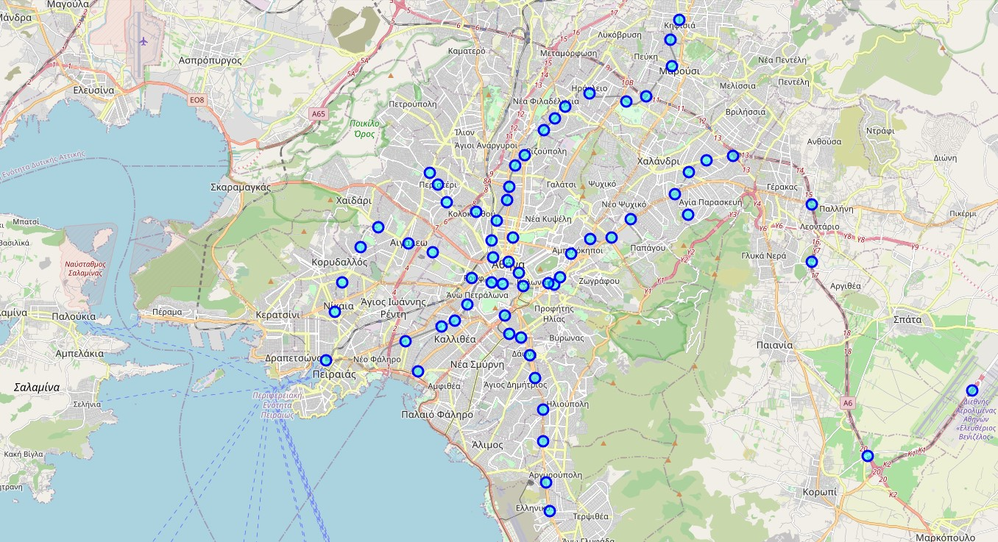
Map of all subway stations in Athens.
Created with Folium using scraped Wikipedia data.

Slide 5
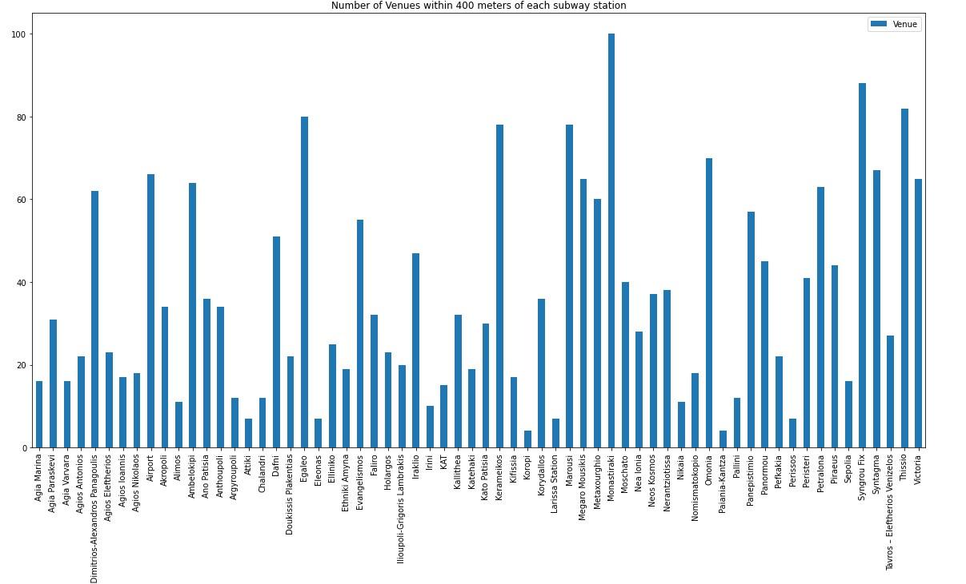
Venue count by area
We use this data to determine the most venue – dense locations around subway stations.

Slide 6
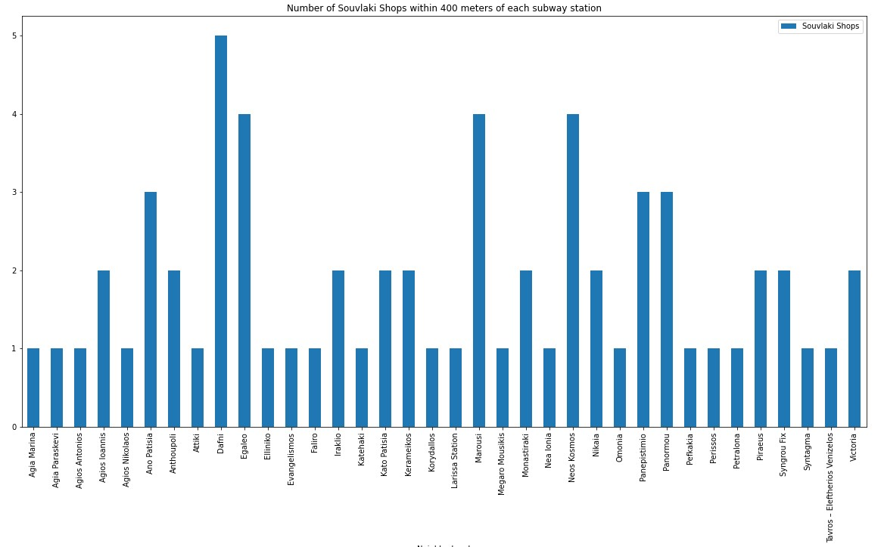
We want a dense area with a small amount of Souvlaki Shops already present

Slide 7
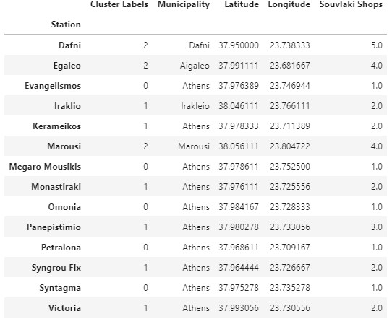
Clusters of venue-dense subway areas based on num of Souvlaki Shops present

Slide 8
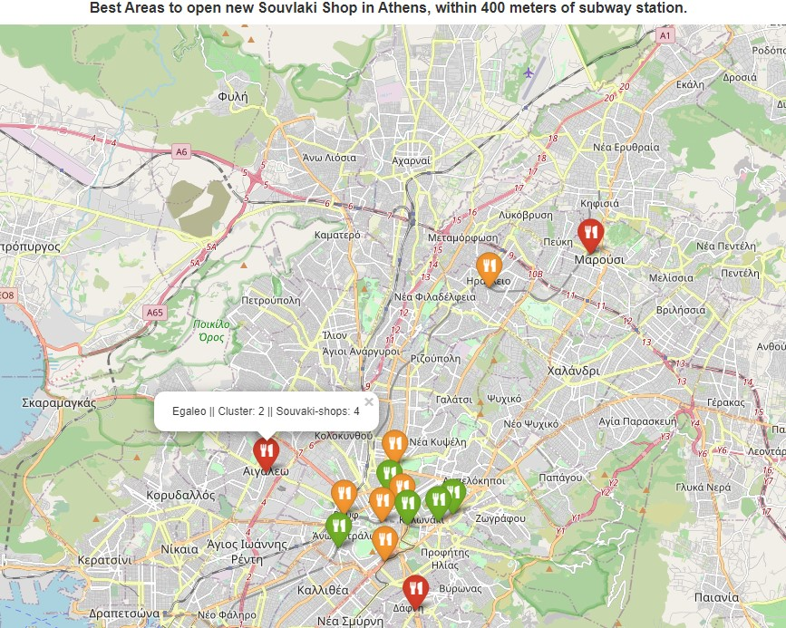
Best areas to open a new Souvlaki Shop (based on our criteria) map

Slide 9
Conclusion
It seems the best areas for a new Souvlaki Shop based on our criteria are very close to the center of Athens. This reenforces our confidence that our model is correct as those are also the most populated areas in Athens.
Specifically the best options would be within 400 meters of subway stations in:
Petralona
Omonoia
Megaro Mousikis
Evangelismos
Sintagma
Results were produced analyzing results from Foursquare which were a bit lacking in some areas so further analysis might be in order.

