Slide 1
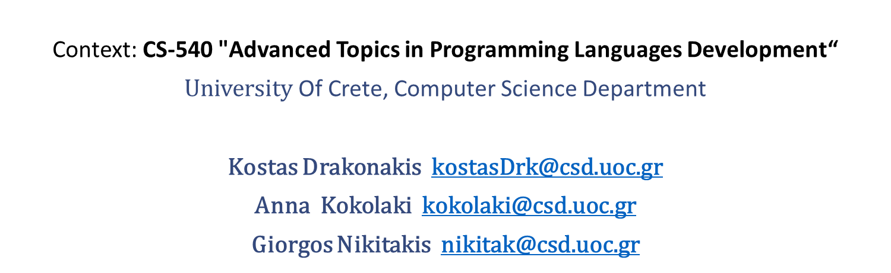
Metafox
Context: CS-540 "Advanced Topics in Programming Languages Development“
$\text{University}$ Of Crete, Computer Science Department
Kostas Drakonakis kostasDrk@csd.uoc.gr
Anna Kokolaki kokolaki@csd.uoc.gr
Giorgos Nikitakis nikitak@csd.uoc.gr

Slide 2
Metafox
Metafox is:
Interpreted
Untyped
Statement based
A meta language

Slide 3

Basic Flow
First pass
Lexical Analysis
Syntax Analysis
AST is produced
Second pass
ExecutionASTVisitor invoked
AST nodes are visited recursively (interpretation)
Further internal passes may occur
source
First-pass
(lexical and syntax analysis = parsing)
AST
Second-pass
(execution = semantic analysis and interpretation)

Slide 4
ASTNodes and Visitors
Three types of ASTVisitors:
ExecutionASTVisitor
ToStringASTVisitor
IteratorASTVisitor
AST classes include their own accept method, which allows for an ASTVisitor to visit them

Slide 5
Example ASTNodes
IdentifierExpression
FunctionDef
BinaryExpression
ObjectDefinition
Etc…

Slide 6
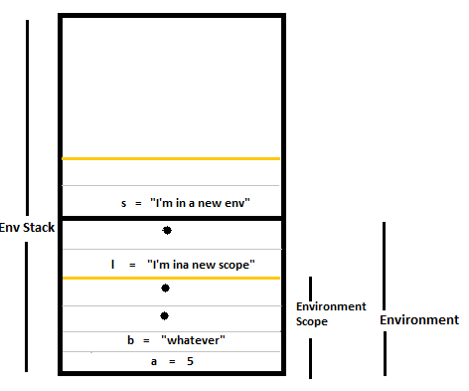
Environment Stack
Stack of environments, which internally store scope stacks
IdentifierExpressions hold links towards their stack entries and stack entries hold links to their IdentifierExpression references

Slide 7
Built-in library functions
General purpose library functions:
println
isNull, isInteger etc. (type checking)
len
keys
copy
push
Etc..
Meta-related library functions for AST manipulation
iterator
isIfStatement, isBinaryExpression etc.
getExpression
setExpression
setIdentifier, setIdentifierNew
And more!

Slide 8
Meta features
Metafox supports a set of meta operators, for additional AST manipulation
.<[expr|stmt|stmtlist]>. | MetaSyntax: Get Expression/Statement AST
.!expr | MetaExecute: Execute AST stored in expression
.~expr | MetaEscape: Assume expression carries an AST
.@”string” | MetaRun: Lift string to valid AST
.eval(expr) | MetaEval: Equivalent to .!.@”<validcode>”
.#expr | MetaToText: Transform AST to equivalent string

Slide 9
Demonstration
General fox script (Queens problem from CS-340)
Diagnostic checks and aspectual transformations
Object factory
Static function analysis (runtime warnings)
Exit paths
Simple dead code elimination
Assignment in condition
Static function style checker
Function size in statements
Expression tokenization and complexity

Slide 10

$$\text{Thank} \text{you} \text{for} \text{your} \text{attention}\text{.}$$
Questions!

