Slide 1
Stores (bakeries, cafeterias, etc.) in the center of Athens, Greece
Gkiouliavas Konstantinos
July 10, 2021

Slide 2
1.Introduction
City of interest : Athens , Greece
Belongs to the greater area of Attika with a population approximate to 4 million
Capital of Greece
Economic center of the country

Slide 3
Problem
Cafes , Bakery Stores , Restaurants in the city of Athens

Slide 4
Getting the Data
Data retrieved from the foursquare API
For more specific data like this project , we can use the coordinates of a location in order retrieve valuable and interesting data

Slide 5
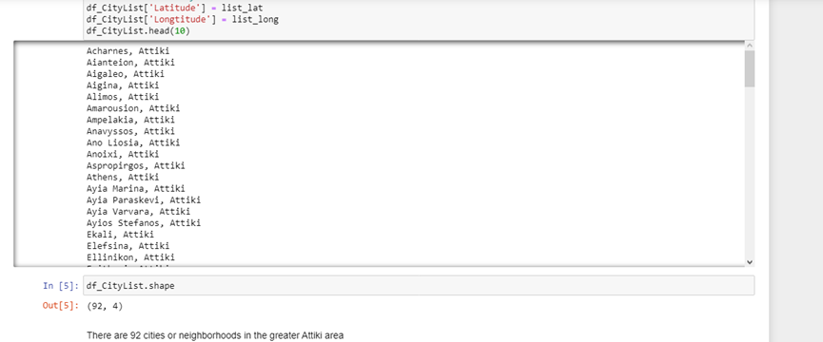
Analysis
Using data from weatherdatasource.com , we were able to find how many cities-neighborhoods existing at the greater Attika area

Slide 6
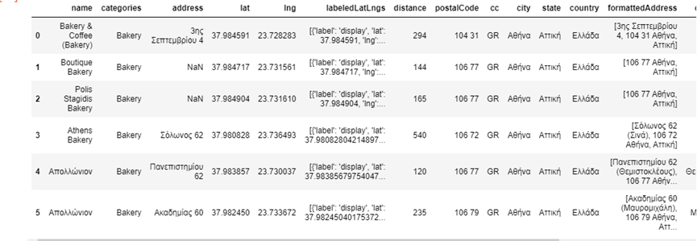
Analysis
At first we chose the “Mr Bean Coffee”
Center of Athens , at the Emmanouil Mpenaki street , number 20
Bakeries at a radius of 500m

Slide 7
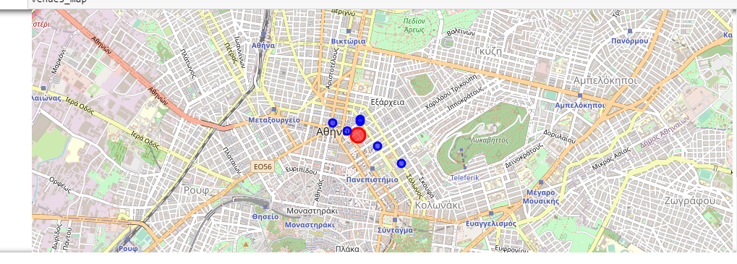
Map with the bakeries(blue dots) near Mr Bean Coffee" ( red dot)

Slide 8
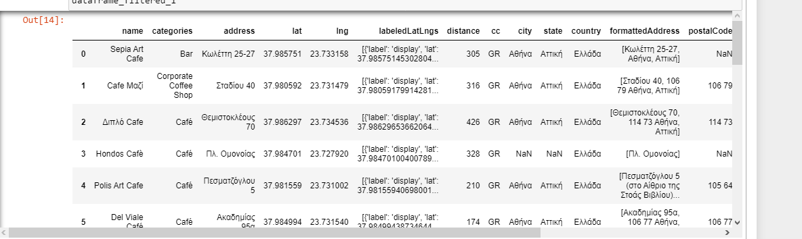
Cafes at a radius of 500 meters

Slide 9
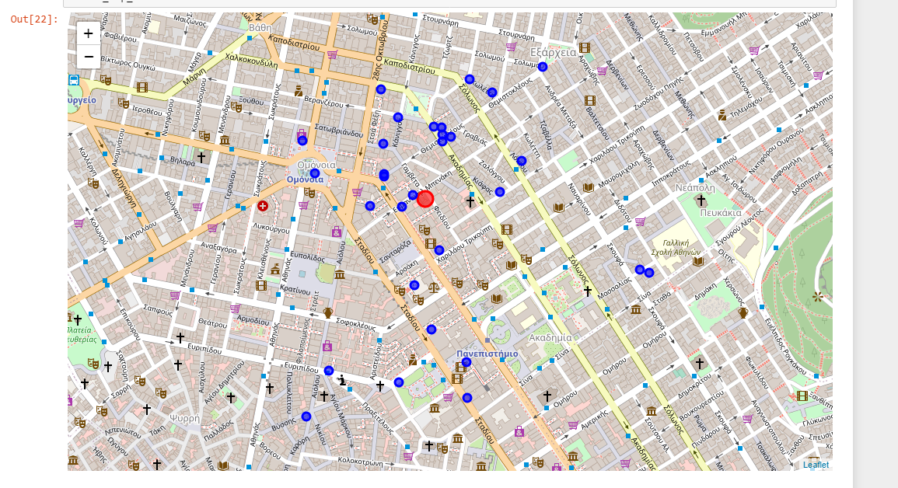
Map with the Cafes (blue dots) near Mr Bean Coffee" ( red dot)

Slide 10
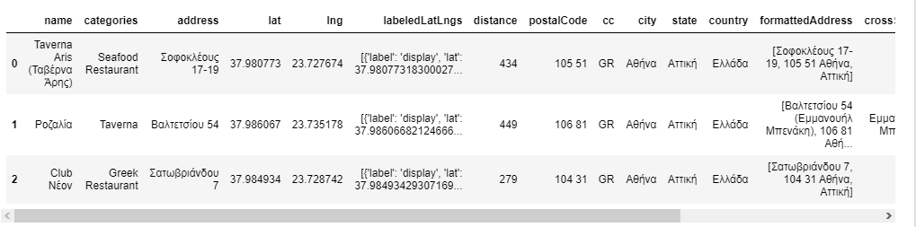
Greek restaurants near Mr Bean Coffee"

Slide 11
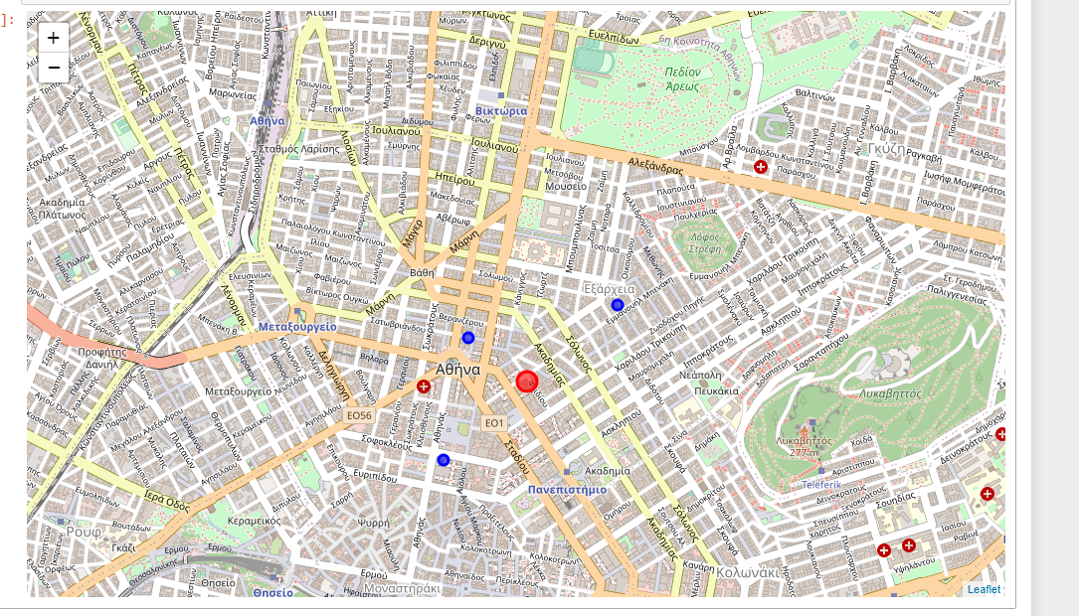
Map with the Greek restaurants (blue dots) near Mr Bean Coffee" ( red dot)

Slide 12
Conclusion
Based on the analysis above , the center of Athens is the best place for someone to invest on restaurants coffees etc. We reached this conclusion with the help of the maps showing a lot pf this type of stores in the center of the city , including the comments from the customers.

