Slide 1


Prioritizr: Systematic conservation planning in R
Jeffrey Hanson
jeffrey.hanson@uqconnect.edu.au
prioritizr.github.io/prioritizr

Slide 2


Acknowledgements

Slide 3
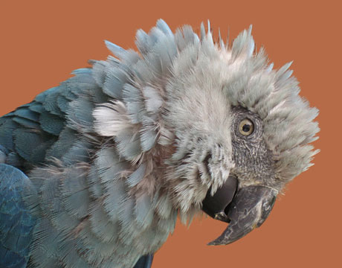
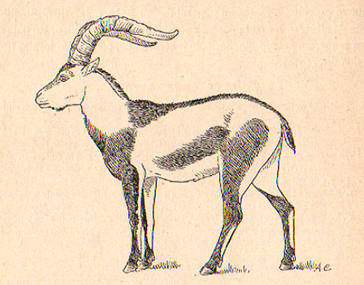

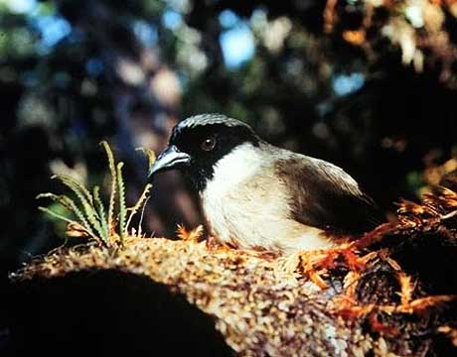
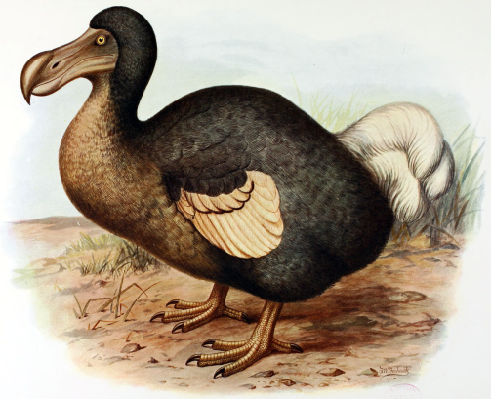
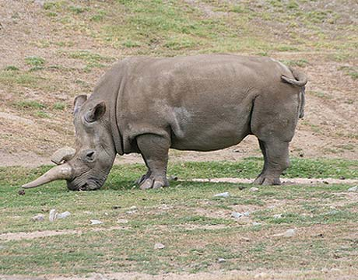
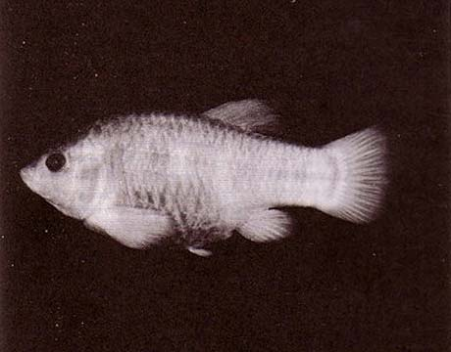
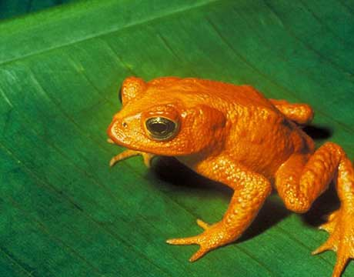
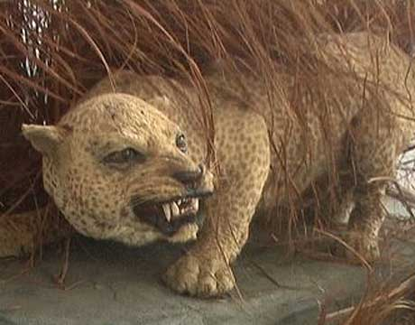
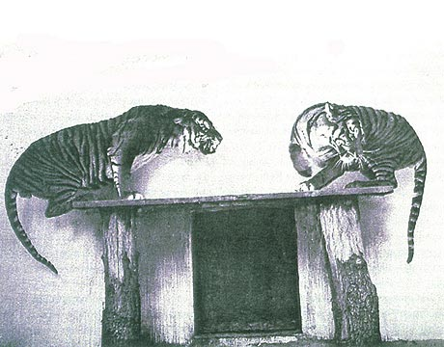
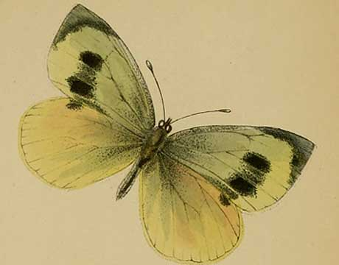
Global biodiversity crisis
Notes:
- high extinction rate
- conservation aims to maintain existing patterns of biodiversity and the processes that sustain them
- areas set aside to preserve biodiversity, and spearhead direct management actions

Slide 4
How should we manage some areas to
achieve conservation?

Slide 5
Data
Biodiversity data
Economic data
Social data

Slide 6
Data
Biodiversity data
Economic data
Social data

Slide 7
Data
Biodiversity data
Economic data
Social data

Slide 8
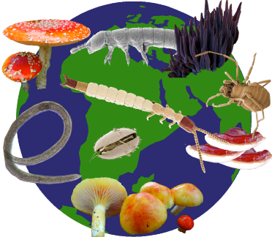


Objectives

Slide 9
Constraints
Biological constraints
Spatial constraints
Social constraints

Slide 10
Decisions
Yes or no?
Proportion?

Slide 11
Solve it

Slide 12
prioritizr

Slide 13
Find the solution to your problem

Slide 14
And find it fast!

Slide 15
Case-study

Slide 16
Case-study

Slide 17
Case-study

Slide 18
Case-study

Slide 19
Case-study

Slide 20
Limitations

Slide 21



jeffrey.hanson@uqconnect.edu.au
github.com/jeffreyhanson
jeffrey-hanson.com

