Slide 1
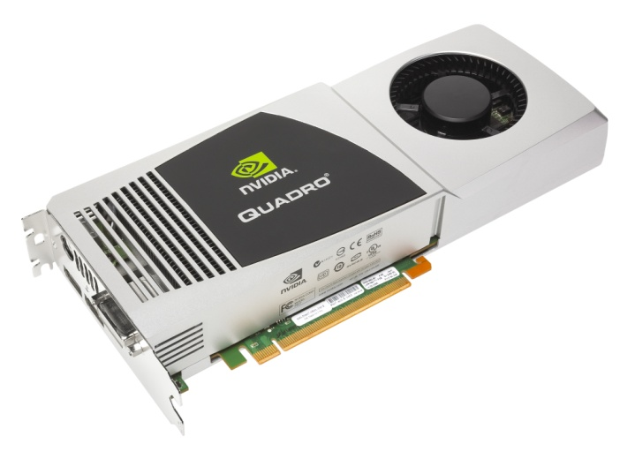
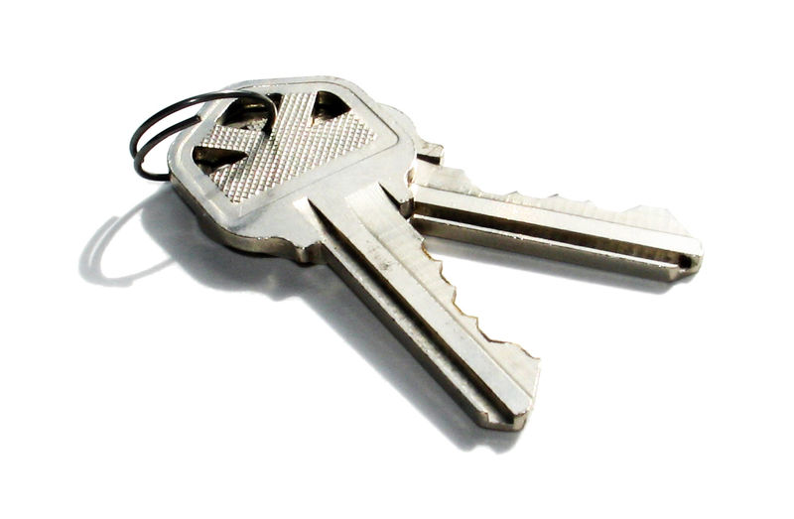

GPU-assisted password cracking
Kerckhoff’s Institute – Research A
Kostas Papagiannopoulos
Academic Supervisor: Lejla Batina

Slide 2



Breaking a password can take really long…
So, we must find a way to speed things up!

Slide 3
Split
Basic Idea
Encrypt 10 million passwords
Encrypt 1million passwords
GPU Cores
Encrypt 1 million passwords
GPU Cores
Host Memory
Host Memory
GPU Device Memory
Encrypt 1 million passwords
Encrypt 1 million passwords
Encrypt 1 million passwords
GPU Cores
GPU Cores
GPU Cores
Assign

Slide 4
SHA 1
Input text
Hash Function
Encrypted Output
Hash function
Relatively Secure
1st & 2nd Pre-imaging attacks
Collisions – Collision Resistance
Speed vs Security
Limitations in High Security

Slide 5
SHA 1 CRYPT
Input text
Hash Function
Encrypted Output
Hashing Scheme
Loop for security hardening
Collision Resistance
Speed vs Security
Limitations in High Speed
Deployed in Unix/Linux Password protection
Repeat 1000
times

Slide 6
CUDA Primer
Allocate Memory for your Data in the GPU
CudaMalloc(cuda_pointer , size of your Data);
Copy Data from Host GPU
cudaMemcpy(cuda_pointer, host_pointer, Data Size, cudaMemcpyHostToDevice);
Process Data with Threads inside the GPU
SHA1Crypt(password array, from, upto, salt, salt length); Do this thread for every password on array
Copy Data from GPU Host
cudaMemcpy(host_pointer, cuda_pointer, Data Size cudaMemcpyDeviceToHost);
A | L | L | O | C
A | T | E | !

Slide 7
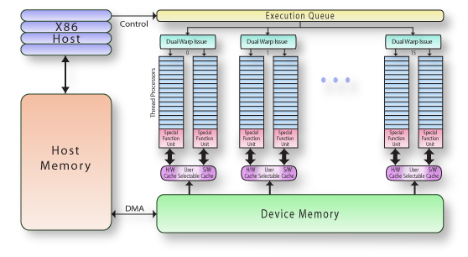
CUDA Architecture
High Parallelization
High Latency
Low Cache depth
Conclusion: Focus on calling the GPU kernel less times and with lots of data.

Slide 8
Calculations
Full Keyspace : A-Z, a-z, 0-9, all symbols
Limited Keyspace : A-Z, a-z, 0-9, ~ ! @ # $ % ^ & * - _ + = ?
Key length : 4 or 8 digits
Key length | Key Space | Combinations | Comments
4 digits | a-z, A-Z, 0-9, all keyboard symbols | 103^4 = 112*10^6 | Worst case keyspace, small key length
4 digits | a-z, A-Z, 0-9, limited symbols | 72^4 = 26*10^6 | Limited keyspace assumption, small key length
8 digits | a-z, A-Z, 0-9, all keyboard symbols | 103^8 = 12*10^15 | Worst case keyspace, large key length
8 digits | a-z, A-Z, 0-9, limited symbols | 72^8 = 7*10^14 | Limited keyspace assumption, large key length

Slide 9
Results – 4 digits
4 digits, limited keyspace, 26 million passwords
Growth
Underpowered

Slide 10
Results – 4 digits
4 digit throughput : Growth, Saturation
Saturation
Growth

Slide 11
Results – 8 digits
8 digits, limited keyspace, 7*10^14 passwords
Growth
Underpowered

Slide 12
Results – 8 digits
8 digit throughput : Growth, Saturation
Saturation
Growth

Slide 13
Results - Comparisons
SHA-1 CRYPT
MD5 CRYPT
Simple Implementation
More computations
1000 hardening loops (set)
10000 hashes per second
Optimized Implementation
Less computations
1000 hardening loops (default)
800000 hashes per second

Slide 14

Results – Cost Estimations
Can I break SHA-1 crypt with 4 digits?
Sure! You only need a decent laptop
Can I break SHA-1 crypt with 8 digits?
Buy 10^6 GPUs and let them run for 20 hours
7*10^14 passwords / 10000 passwords per sec / 70000 sec /10^6 GPUs
You only need 100 million euros! [but I suppose you will get a discount if you order that many GPUs]

Slide 15

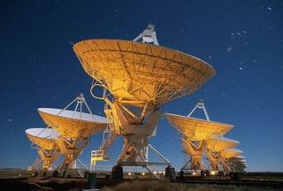
Future Sight
Thread & Block optimization (which is the optimal combination?)
Compiler optimization (e.g. perform loop unrolling)
Cache Optimization (use CUDA _shared_ memory)
OpenCL Implementation (ATI GPU support)
Consideration: Infected computers that
perform crypto for you!
Conspiracy theory: Remember SETI @ home (Search for ExtraTerrestial Inteligence)?

