Slide 1


GPU-Powered ECDSA Verification for VANET Applications
Kostas Papagiannopoulos (RU)
Arturo Cedillo Torres (TU/e)
Mathias Morbitzer (RU)
Jonathan Petit (UT)

Slide 2
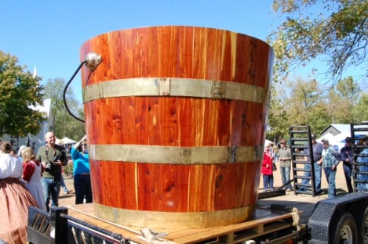
GPU-Powered ECDSA Verification for VANET Applications
Imagine the a job as a big tank filled with water!
You have to empty the tank…

Slide 3


GPU-Powered ECDSA Verification for VANET Applications
Would you like that 2 Supermen empty the tank?
They seem a good choice!
They are fast
They can use large buckets
But there are only 2 of them!

Slide 4
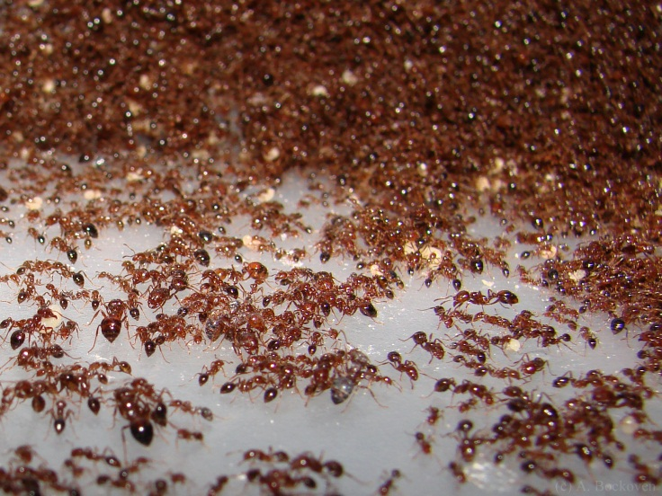

GPU-Powered ECDSA Verification for VANET Applications
Or would you prefer an army of ants equipped with buckets?
They seem a bad choice!
They are slow
They can use small buckets
But there are lots of them!

Slide 5
GPU-Powered ECDSA Verification for VANET Applications
"If you were plowing a field, which would you rather use: Two strong oxen or 1024 chickens?"
-Seymour Roger Cray, father of supercomputing
A CPU is the equivalent of Superman
A GPU is the equivalent of the ant army

Slide 6
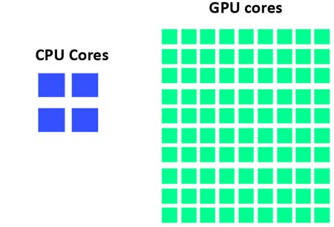
GPU-Powered ECDSA Verification for VANET Applications
GPUs are very effective at conducting many parallel processes concurrently because they have a large amount of cores
The story so far: We have a powerful device for parallel processing! How will we use it and what will we try to achieve?

Slide 7
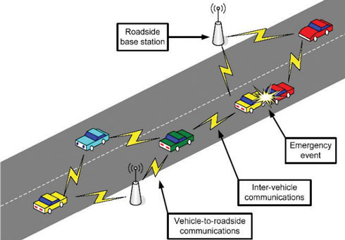
GPU-Powered ECDSA Verification for VANET Applications
Vehicular Ad Hoc networks offer a large range of applications, including safety-critical ones
Still, several security vulnerabilities exist, thus applications need to fulfill security requirements such as authentication/integrity
The VANET may be limited in bandwidth, using demanding ad hoc protocols and having a large traffic load.
The story so far: We need to achieve security efficiently, thus we will examine the GPU’s potential in a VANET context.
Is the emergency real or not?

Slide 8
GPU-Powered ECDSA Verification for VANET Applications
Every second, the vehicular node receives a large number of messages that need to be verified and the GPU helps to compute parallel verifications efficiently
Current IEEE standard proposes ECDSA for verification.
Research Goal: Use the GPU capabilities to implement efficient ECDSA signature verification. In a VANET setting we focus primarily on low latency and secondarily on high throughput.
Common cryptographic libraries are not ported to CUDA.
We implemented our own from scratch [Project Lola Scam Van]
Large integer arithmetic
Elliptic curve arithmetic
Optimized mathematical computations
Low latency
High throughput

Slide 9
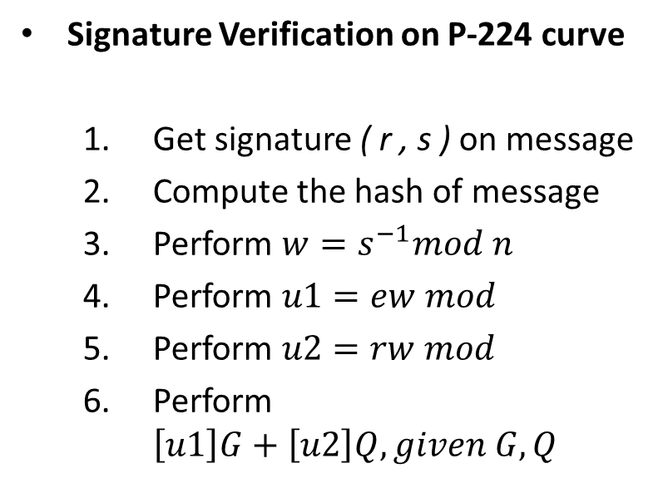
Analyzing the ECDSA Verification
1 hash calculation
1 modular inversion
1 modular multiplication
1 modular multiplication
2 scalar multiplications!
Signature Verification on P-224 curve
Get signature ( r , s ) on message
Compute the hash of message
Perform $w=s^{−1}mod n$
Perform $u1=ew mod$
Perform $u2=rw mod$
Perform $\left[u1\right]G+\left[u2\right]Q, given G,Q$
We have identified the scalar multiplication to be the most computationally intensive part of the verification

Slide 10
Analyzing the Scalar Multiplication
We used the simple `Double and Add’ algorithm
Scalar multiplication with an n-bit scalar costs:
n doublings in the elliptic curve
n/2 additions in the elliptic curve
For the P-224 curve it translates to 224 EC_DBL and 112 EC_ADD
With affine coordinates, a single scalar multiplication would need:
Almost 4000 modular multiplications of 224-bit numbers
1000 modular inversions of 224-bit numbers
Modular inversion in a large prime finite field is very time consuming and discouraged by crypto standards
We need more efficient, inversion-free coordinates

Slide 11
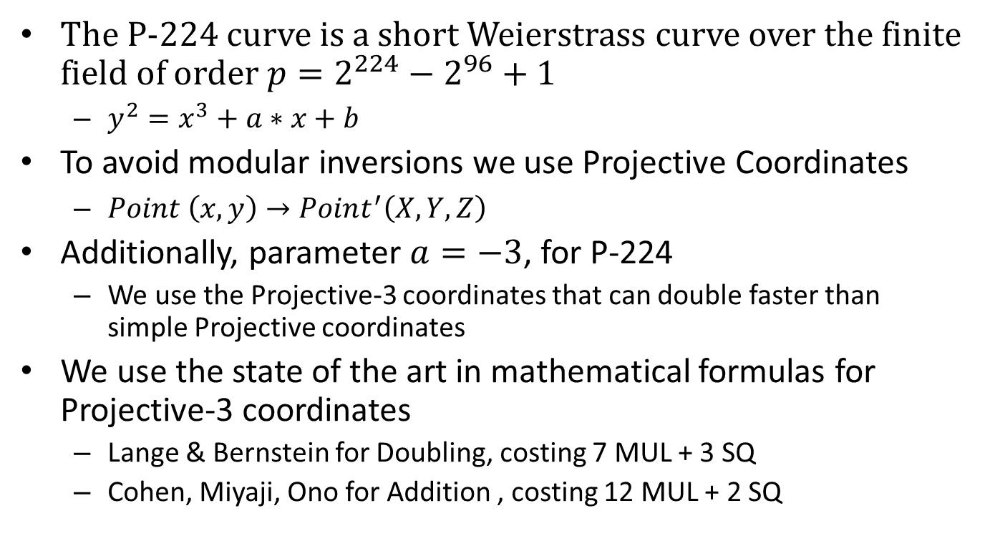
Elliptic Curve Coordinates
The P-224 curve is a short Weierstrass curve over the finite field of order $p=2^{224}−2^{96}+1$
$y^{2}=x^{3}+a∗x+b$
To avoid modular inversions we use Projective Coordinates
$Point \left(x,y\right)→Point^{′}\left(X,Y,Z\right)$
Additionally, parameter $a=−3$, for P-224
We use the Projective-3 coordinates that can double faster than simple Projective coordinates
We use the state of the art in mathematical formulas for Projective-3 coordinates
Lange & Bernstein for Doubling, costing 7 MUL + 3 SQ
Cohen, Miyaji, Ono for Addition , costing 12 MUL + 2 SQ

Slide 12
Optimizing Multiprecision Addition
We need to efficiently add 224 bit integers
C language does not offer direct access to add/sub carry flag
So we used GPU assembly!
add.cc.u32 a0, a0, b0;
addc.cc.u32 a1, a1, b1;
addc.cc.u32 a2, a2, b2;
addc.cc.u32 a3, a3, b3;
addc.cc.u32 a4, a4, b4;
addc.cc.u32 a5, a5, b5;
addc.cc.u32 a6, a6, b6;
Over
f
low
a0 a1 a2 a3 a4 a5 a6
+ + + + + + +
b0 b1 b2 b3 b4 b5 b6

Slide 13
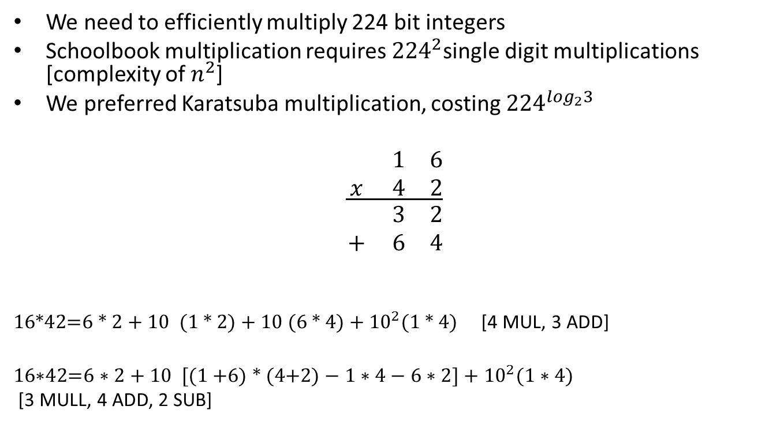
Optimizing Multiplication
We need to efficiently multiply 224 bit integers
Schoolbook multiplication requires ${224}^{2}$single digit multiplications [complexity of $n^{2}$]
We preferred Karatsuba multiplication, costing ${224}^{\log_{2}3}$
$$\frac{\begin{matrix} & 1 & 6 \\ x & 4 & 2\end{matrix}}{\begin{matrix} & 3 & 2 \\ + & 6 & 4\end{matrix}}$$
$\text{16*42}\text{=}\text{6 * 2 + 10 (1 * }\text{2}\text{) + 10 (6 * 4) + }{10}^{2}\text{(1 * 4)}$ [4 MUL, 3 ADD]
$\text{16∗42=6 ∗ 2 + 10 }\text{[}\text{(1 }\text{+6}\text{)}\text{ * }\text{(4}\text{+2}\text{)}−1∗4−6∗2]+{10}^{2}\text{(}\text{1 ∗ 4)}$
[3 MULL, 4 ADD, 2 SUB]

Slide 14
Optimizing multiplication
We applied the same procedure to the 224 bit integers
3 levels of Karatsuba expansion
GPU assembly at lowest level
224*224
128*128
128*128
128*128
64*64
64*64
64*64
32*32
32*32
32*32
mul.lo.u32 %low32bits, %a, %b;
mul.hi.u32 %high32bits, %a, %b;

Slide 15
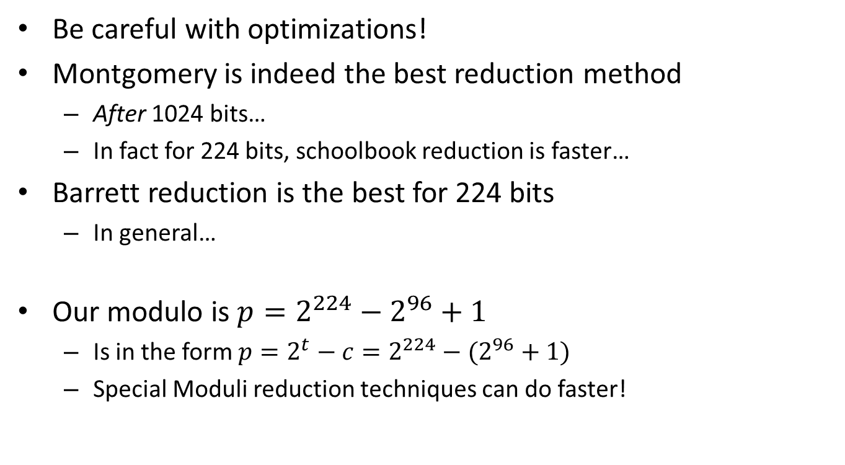
Optimizing Modular Reduction
Be careful with optimizations!
Montgomery is indeed the best reduction method
After 1024 bits…
In fact for 224 bits, schoolbook reduction is faster…
Barrett reduction is the best for 224 bits
In general…
Our modulo is $p=2^{224}−2^{96}+1$
Is in the form $p=2^{t}−c=2^{224}−(2^{96}+1)$
Special Moduli reduction techniques can do faster!

Slide 16
Optimizing Modular Reduction
Simple case: Reduction after addition
Addition of 224 bit integers results in 225 bit
Reduction can be simply done with subtractions
Special Moduli case: Reduction after multiplication
Multiplication of 224 bit integers results in 447 bit
We use special moduli reduction
Reduction is ‘reduced’ to shifts and subtractions
INPUT: a base b, positive integer x,
and a modulus n = 2^224 – (2^96-1).
OUTPUT: r = x mod n.
1. q0 = x / 2^224 [shift]
2. r0= x - q0 * 2^224 [shift, sub]
3. r=r0, i=0
4. While qi > 0 do the following:
4.1 qi+1= (qi * (2^96-1)) / 2^224
[shift, sub, shift]
4.2 ri=(qi * (2^96-1) – qi + 1) * 2^224
[shift, sub, shift]
4.3 i= i + 1, r= r + ri.
5. While r >= n do: r =r - n
6. Return(r)

Slide 17
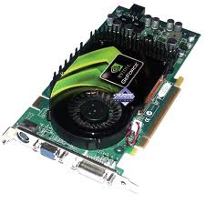
CUDA Deployment
We used NVIDIA CUDA
We assigned a scalar multiplication to each GPU thread
Parallelism at message level
Tested several CUDA kernel configurations

Slide 18
Benchmarks
We achieved a minimum latency of 69 ms per scalar multiplication
We achieved a throughput of 10039 scalar multiplications per second with individual latency around 100ms
On a GeForce 525m with 96 CUDA cores, priced less than 50 euros

Slide 19
Benchmarks
Apart from us, 3 other groups have implemented low latency scalar multiplication.
Group | GPU | Cores | Clock (MHz) | Latency (ms) | Throughput (op/s)
Szerwinski et al. | 8800 GTS | 96 | 1200 | 305 ms | 1413
Our Group | 525M GT | 96 | 1200 | 69 ms | 10039
Antao et al. | 8800 GTS | 96 | 1200 | 30 ms | 3138
J. Bos | 480 GTX | 480 | 1400 | 2.3 ms | 237415
Openssl | Intel i7 | 4 | 3400 | 0.09 | 46176

Slide 20
Benchmarks
Comparisons may be tricky due to different GPUs w.r.t. architecture and performance characteristics
Still, our GeForce 525m is relatively similar to 8800 GTS
Same amount of cores (96)
Same clock speed (1200MHz)
8800 GTS presents better benchmarks than 525m GT
G3D Mark: 862 vs G3D Mark: 554
525m uses a more recent architecture (Fermi)
If we consider them to be equal what is the factor that drops their latency even more? (30 ms vs 69 ms)

Slide 21
Benchmarks
Similar mathematical techniques and optimizations were used w.r.t. modular arithmetic and elliptic curve arithmetic.
Antao’s and Bos’s step ahead was to parallelize the elliptic curve arithmetic within a single scalar multiplication
1 scalar
multiplication
Thread 1
Thread 2
Thread 3
Thread 4
Thread 5
Thread 6
Thread 7
J. Bos’s approach to scalar multiplication

Slide 22
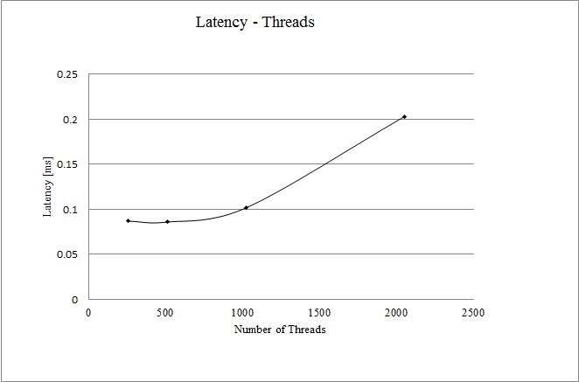
Benchmarks
There exists a tradeoff between latency and throughput
There is a limited amount of streaming multiprocessors to dispatch
The more you parallelize (in order to reduce latency) the more you get throughput penalty
Our latency > Antao’s latency
Our throughput > Antao’s troughput
Devices with a larger number of cores will manage greater throughput will less latency penalties
Latency vs throughput diagram

Slide 23
Architecture
The GPU is architecturally a high latency – high throughput device
It has a large number of cores and few caches
On the other hand, the CPU is architecturally a low latency – low throughput device
It has a small number of cores and a large cache hierarchy
Given a budget of C euros we could opt for a GPU or a CPU
Perhaps we should consider splitting the budget in both!

Slide 24
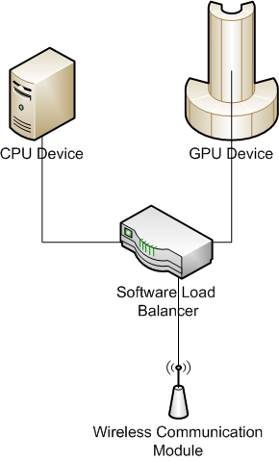
Architecture
A 2-tier architecture
When network load is low, we use the CPU for low latency
When network load increases, we offload to the GPU for high throughput
A two-tier architecture

Slide 25
The GPU against the world
The Verdict: Is the GPU a viable alternative to Cryptographic coprocessor or the FPGAs?
Pros
It is cheap to buy and requires a very small R&D budget (only for software implementation)
It can produce an amazing throughput
It can achieve low latency
Cons
High energy consumption (especially vs FPGAs)
Problems with latency
Not modifiable hardware (vs Crypto processor)
Huge vulnerability to side channels
Even when Montgomery ladder is used
But not an issue in signature verification, only in generation

