Slide 1





LUPE
Why we're here.
We're not here to pitch a tool & fix all your problems
We're here to understand your current state and see if we can help
We have experience in fixing the foundation that's blocking
If there's no fit, we'll say it.

Slide 2
WHO WE ARE
Lupe - Built from real problems.
Real data. Real integrations.
Kostas and Claudia spent five years at Popcore as BI Director and VP Technology, building the data platform that powered Popcore's growth. After the acquisition by Rollic (Zynga/Take-Two), we handled the full data integration into their centralized systems.
That experience led to Lupe. We started working with mobile app publishers, building SSOT data infrastructure, custom user-level attribution models, and forecasting. Our product was built on real problems and real data.
In AI times, AI-ready data is the core to build tooling on top. And we saw that everyone has the same problems: fragmented data stacks and disconnected insights.

Slide 3


YOUR SITUATION
What we understand so far.
Correct us.
User Acquisition & Data
Internal History & NCSoft
High UA spend (mainly non-sans like Applovin, Mistral, some Meta)
NCSoft integration coming: requirements unclear
No reliable user-level view across spend + revenue + payouts
Increasing pressure to have clean, structured data
No consistent definitions (ROAS, LTV, etc.)
Current data team failed to deliver impact
Reporting not decision-grade for daily budget allocation
Recently restructuring of current data team took place
Heavy manual work, analyst dependency
Where is this wrong or incomplete?

Slide 4
What matters here.
Protect
your return
on ad spend.
Where to scale.
Where to cut.
How fast you can decide.
Everything in this conversation ties back to better, faster spend decisions.

Slide 5
WHY THIS KEEPS HAPPENING
The data exists.
It just doesn't support decisions.
No consistent user-level view across spend, revenue and payouts
When trust is low, decisions slow down.
Different numbers depending on which source you ask
Every question becomes: which number do we trust?

Slide 6



WHAT GREAT LOOKS LIKE
What changes when this works.
Clear daily decisions
One consistent view
What to scale, what to pause. No ambiguity.
Applovin, Mistral, Meta, product revenue. All unified.
Real LTV, not proxies
Data can be leveraged by AI
Evaluate campaigns on actual long-term value. Compare channels fairly.
Once you have reliable data and a context layer you can maximise the impact with AI tooling.
Fast answers. No waiting on analysts. No conflicting numbers.

Slide 7




WHAT NEEDS TO EXIST
The non-negotiable foundation.
Single Source of Truth
Identity Resolution
User-level dataset unifying spend, revenue, payouts and attribution across all channels.
Stable mapping across MMP IDs, network IDs, and product data. One user, one record.
Consistent Definitions
Integration-Ready Structure
One agreed definition of ROAS, LTV, installs, retention. Used everywhere.
Supports both internal daily decisions, external platform integration (NCSoft) and AI ready data.
No product talk yet. This is the reality any solution must address.

Slide 8


WHAT LUPE DELIVERS
The marketing intelligence
layer on top of your data.
Lupe doesn't replace your data engineering. We add the intelligence layer that makes your data actionable for marketing decisions.
Your team owns
Lupe delivers
Data warehouse and infrastructure
Data audit and SSOT architecture
Ingestion pipelines for all sources
User-level attribution and ID logic
Dashboard and reporting migration
Semantic layer with your business logic
Internal process and team workflows
AI-powered reports, chat, and explain
Complementary to your existing data engineering work. Nothing gets replaced or disrupted.

Slide 9
THE NCSOFT FACTOR
This is about maintaining
control over your UA decisions.
1
Your performance data will be evaluated externally
NCSoft's centralised platform will consume your marketing data.
2
Decisions may rely on centralised systems
If your data is inconsistent, others define how performance is interpreted.
3
Clean data means you stay in control
Integration becomes a non-event when the foundation is solid.

Slide 10
CREDIBILITY
We've done this before.
Popcore → Zynga / Take-Two
What it delivered
Consistent performance view across systems
Kostas and Claudia built the UA data platform at Popcore as BI Director and VP Technology.
After the acquisition by Rollic (Zynga/Take-Two), we handled the full data integration into their centralized systems. Spend, revenue, forecasts, retention, engagement.
Because the data foundation was clean, the integration was straightforward.
Faster decision cycles for UA teams
Seamless integration into centralized platform
This improved how teams spent budget, not just how data was stored.

Slide 11
PHASED APPROACH
Five phases. Sign-off gates.
No surprises.
1
2
3
4
5
Data Audit
& Planning
Data
Foundation
Activation
AI-Ready
Data
Custom
Models
Automated audit.
SSOT blueprint.
Sign-off.
User-level attribution.
Product data.
User catalog.
Production.
Backfill.
Migration support.
Semantic layer.
Base pLTV.
Metric governance.
Custom pLTV.
Payout prediction.
CTV attribution.
Phase 1 is standalone. Low commitment. Clear deliverables. No build until sign-off.

Slide 12

START SMALL
Data audit only.
No commitment to full build.
What the audit delivers
You'll see immediately if this improves your decision-making.
Where decisions are currently unreliable
What needs to change in your data foundation
SSOT blueprint and architecture design
Clear project plan for full build (if you decide to proceed)

Slide 13
NEXT STEPS
Two options. Your call.
A
Start the data audit
B
Align internally first
Grant warehouse access and we begin the automated data audit within the week. You get a structured report, SSOT blueprint, and a clear project plan.
Take this back to the team, discuss internally, and we reconvene with a focused technical session. No pressure, no timeline.
LUPE
Either way, the next step is clear and low-risk.

Slide 14
LUPE
Protect your return
on ad spend.
A single view of all relevant data down to device level.
AI agents surface growth potential, where you're wasting budget,
and where to act.

Slide 15
WHAT LUPE BUILT
A context layer for
mobile marketing teams.
DATA SOURCES
Context Agent
FEATURES
Ad Networks
Daily Report
Semantic Layer
Vertical Context
MMPs
→
→
Weekly Summary
Business Context
User Context
Revenue Platforms
Explain Feature
SSOT
Analytics Tools
NL Querying
Single Source of Truth
Accessible through Slack Bot & Dashboard

Slide 16
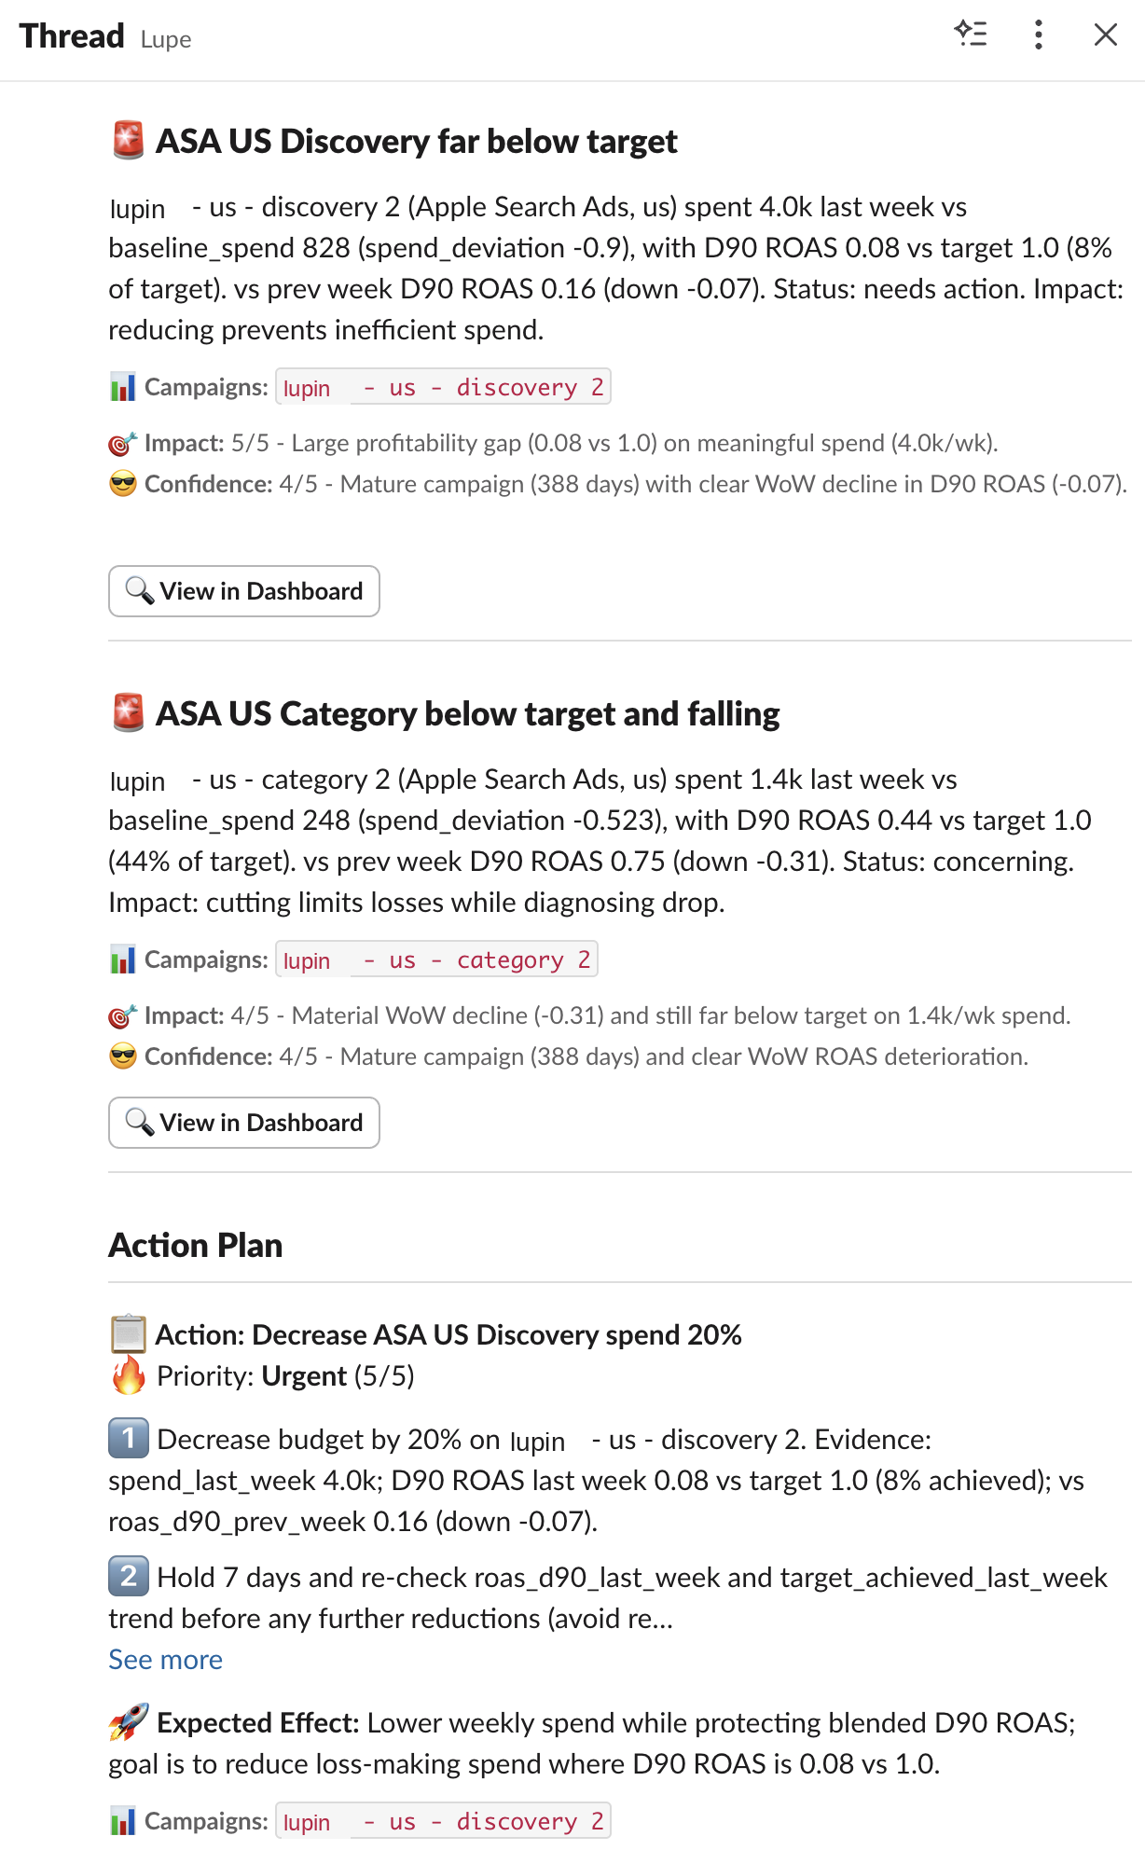

DAILY MARKETING REPORT
Wake up knowing where
you're losing money.
Every morning, Lupe's AI agents analyze your campaigns across every channel and flag where budget is being wasted. You get a prioritized breakdown: which campaigns to pause, which to scale, and where your next dollar works hardest.
Delivered to Slack every morning
Full dashboard with drill-down

Slide 17
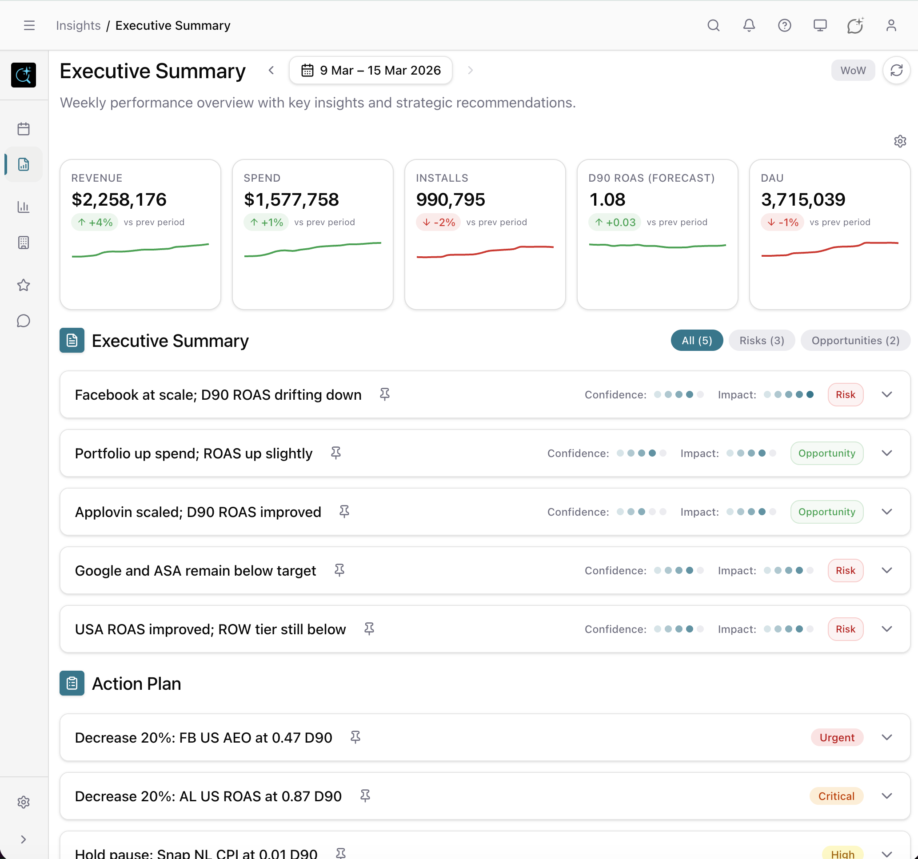
WEEKLY EXECUTIVE SUMMARY
Strategic performance
overview, every week.
Revenue, Spend, Installs, ROAS, DAU at a glance. AI-generated insights classify findings as risks or opportunities with confidence scoring. Each summary includes a prioritized action plan with urgency levels.
Delivered to Slack weekly
KPI dashboard with trend lines

Slide 18
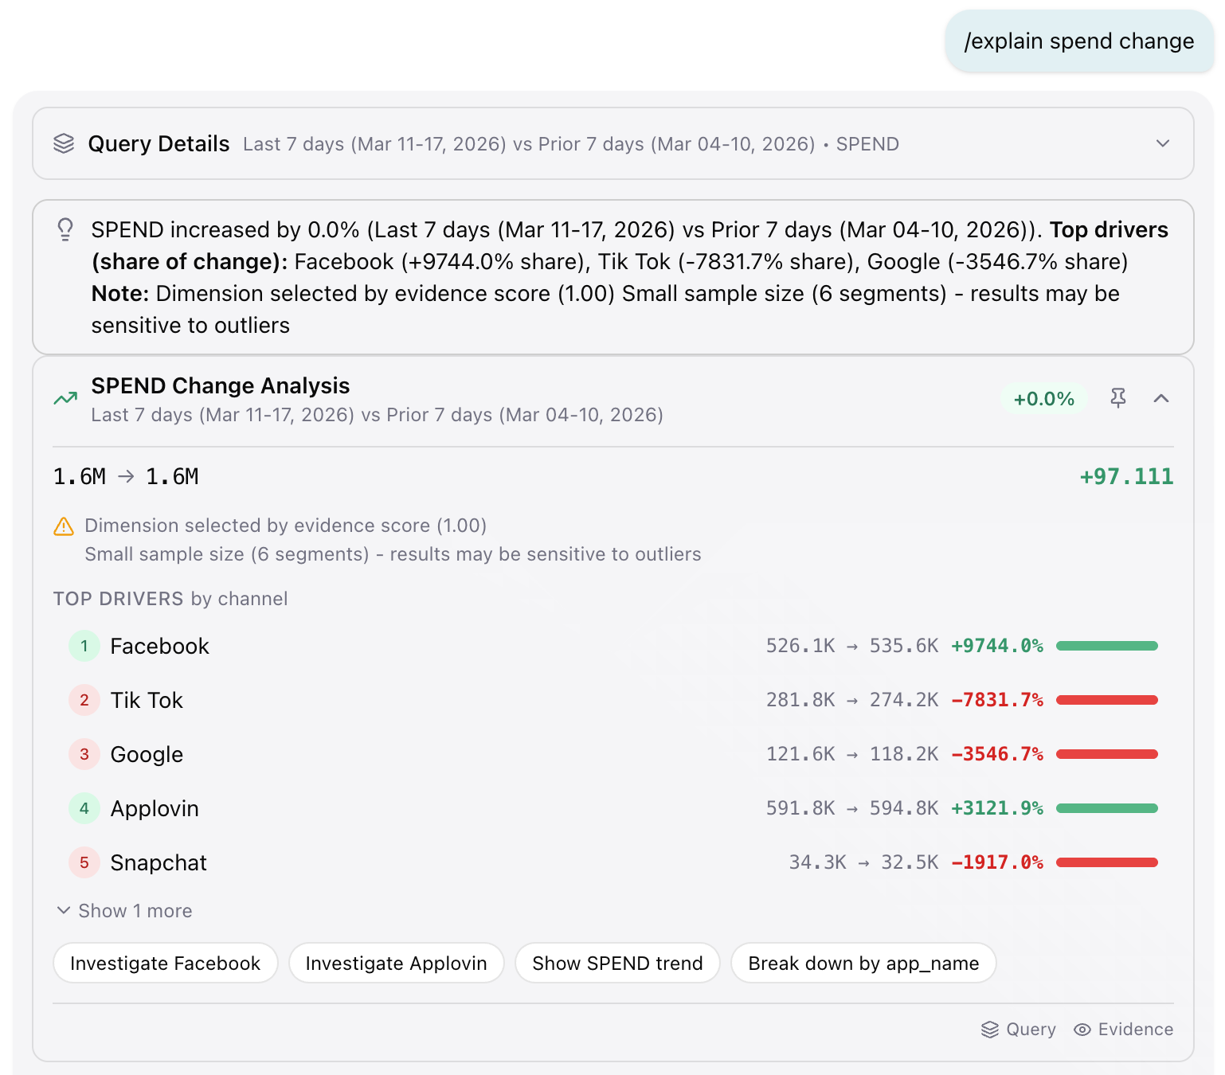

EXPLAIN FEATURE
Understand why your
metrics changed.
Ask "why did spend change?" and get a driver breakdown by channel. Evidence-scored analysis shows exactly which channels drove the shift, with magnitude and direction. Suggested next steps let you investigate further or take action immediately.
Driver analysis with evidence scoring
Available in Slack and Dashboard

Slide 19
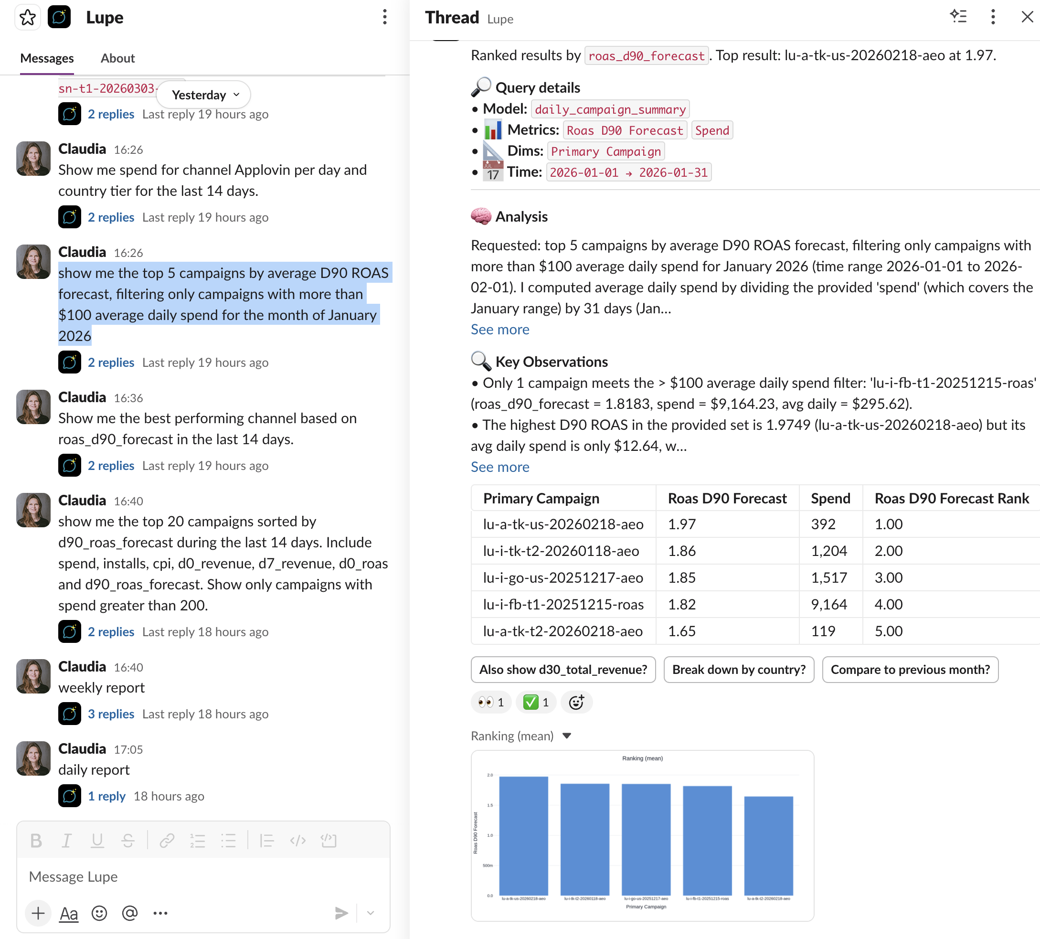

NATURAL LANGUAGE QUERYING
From question to answer
in seconds, not days.
Ask questions in plain English. "Show me the top 5 campaigns by average D90 ROAS forecast, filtering only campaigns with more than $100 average daily spend for the month of January 2026" Lupe queries your unified data, builds the table, runs the analysis, and explains key observations. No SQL. No analyst bottleneck. Follow-up suggestions keep the conversation going.
Chat interface with context-aware follow-ups
Available in Slack and Dashboard

Slide 20
JUSTPLAY ENGAGEMENT
Your path to unified
marketing intelligence.
A phased engagement built around JustPlay's
data landscape, team, and business goals.

Slide 21
PHASE 1
Data Audit &
SSOT Planning
Automated data audit: gaps, discrepancies, duplications across all granularities
Deliverables
App initialisation audit: ID consistency across all data sources
Assessment of data quality, event taxonomy, and tracking consistency
Instructions for your data engineers to fix missing or incomplete data streams
Mapping of existing attribution setup and gap identification
Project definition and timeline for Phase 2
SSOT architecture design: data model, table structure, refresh cadence
Canonical user catalog schema to be implemented in Phase 2
Joint review and sign-off session with technical and marketing stakeholders
Phase 2 does not start until deliverables are reviewed and signed off.

Slide 22
PHASE 2
Data Foundation: Marketing,
Product Data & User Catalog
User-Level Attribution
Product Data
User Catalog & QA
SAN networks: full iOS visibility
Normalisation at user level
Identity resolution: device, user, MMP IDs unified
Google: iOS attribution
Agreed event taxonomy from Phase 1
Automated validation: completeness, freshness, join integrity
Meta iOS: AEM-based attribution
Transformation logic documented
Full documentation of all tables and fields
Meta: Android full visibility
Revenue + spend at user level
Dependency: JustPlay's data team delivers ingestion pipelines for all agreed sources before Phase 2 starts.

Slide 23






PHASE 3
Activation: Production,
Backfill & Migration Support
Move the SSOT from build to production. Your team migrates existing dashboards and reports. We support the transition.
Incremental refresh
Historical backfill
All master tables running on production cadence
Full backfill for the agreed lookback period
Data quality monitoring
Migration support
Alerting on pipeline failures, gaps, and anomalies
Technical support while your team migrates dashboards
Handover + runbook
Two-week hypercare
Documentation for ongoing operations
Post-migration monitoring and issue resolution
JustPlay's team must have capacity allocated for dashboard migration in parallel.

Slide 24
PHASE 4
AI-Ready Data: Semantic
Layer & Base pLTV
Semantic Layer
Base pLTV Prediction
Encode JustPlay's business logic and metric definitions into a governed layer
Combined growth and log model approach
Canonical definitions: ROAS, LTV, retention, installs aligned across all consumers
Available at user level on agreed refresh cadence
Structured workshop to capture and sign off all metric definitions
Use for benchmarking against any in-house models
Every downstream feature works from the same numbers
Foundation for custom pLTV in Phase 5
Metric definitions must be signed off before build begins. Changes after sign-off require a change order.

Slide 25
PHASE 5
Custom pLTV &
CTV Attribution Models
Custom pLTV + Payout Prediction
CTV Attribution Model
Benchmark multiple model approaches against base pLTV from Phase 4
Probabilistic attribution using impression data and organic baseline
Payout prediction: translate LTV signals into spend and bid guidance
CTV contribution metrics integrated into campaign reporting
Prediction horizon and target metric signed off before build
Documented methodology, assumptions, and known limitations
CTV is not a priority today. This phase is available when the time is right.

Slide 26

ONGOING
Continuous support.
Not a handoff.
12-Month Platform Access
& SSOT Support
Model Maintenance
Retainer
Lupe console access
Monthly pLTV performance monitoring
AI assistant
Quarterly model retraining
Automated reporting
CTV recalibration
Alerting
Written monthly performance report
Ads Co-Pilot
Semantic layer maintenance
Quarterly business reviews

