Slide 1

Protect your return
on ad spend.
A single view of all relevant data down to device level.
AI agents surface growth potential, where you're wasting budget,
and where to act.

Slide 2
THE PROBLEM
Every day you can't see where budget
is leaking, you're paying for it.
Mobile growth teams run campaigns across a dozen channels but rarely have a unified view of what's actually working at device level. Attribution data lives in one place, spend data in another, revenue in a third. By the time someone pulls it all together, the waste has already happened.
30%+
6+
48hrs
of ad budgets spent
without clear attribution
platforms with no unified
device-level view
of budget burning before
anyone notices

Slide 3

THE SOLUTION
A context layer for
mobile marketing teams.
DATA SOURCES
FEATURES
SSOT
Ad Networks
Daily Report
Single Source of Truth
MMPs
Weekly Summary
Context Agent
Revenue Platforms
Explain Feature
Manages semantic layer,
ensures data quality
Analytics Tools
NL Querying
Accessible through Slack Bot & Dashboard

Slide 4
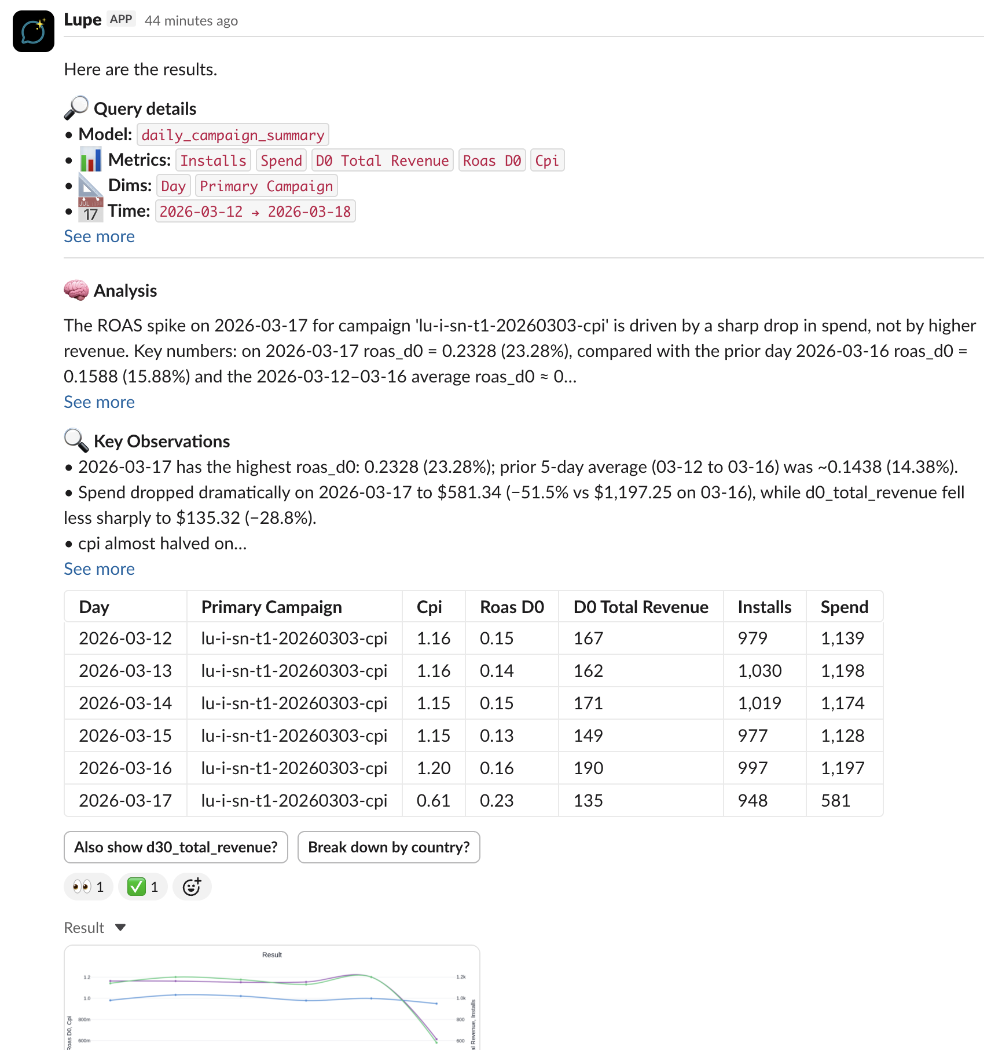


DAILY MARKETING REPORT
Wake up knowing where
you're losing money.
Every morning, Lupe's AI agents analyze your campaigns across every channel and flag where budget is being wasted. You get a prioritized breakdown: which campaigns to pause, which to scale, and where your next dollar works hardest.
Delivered to Slack every morning
Full dashboard with drill-down

Slide 5
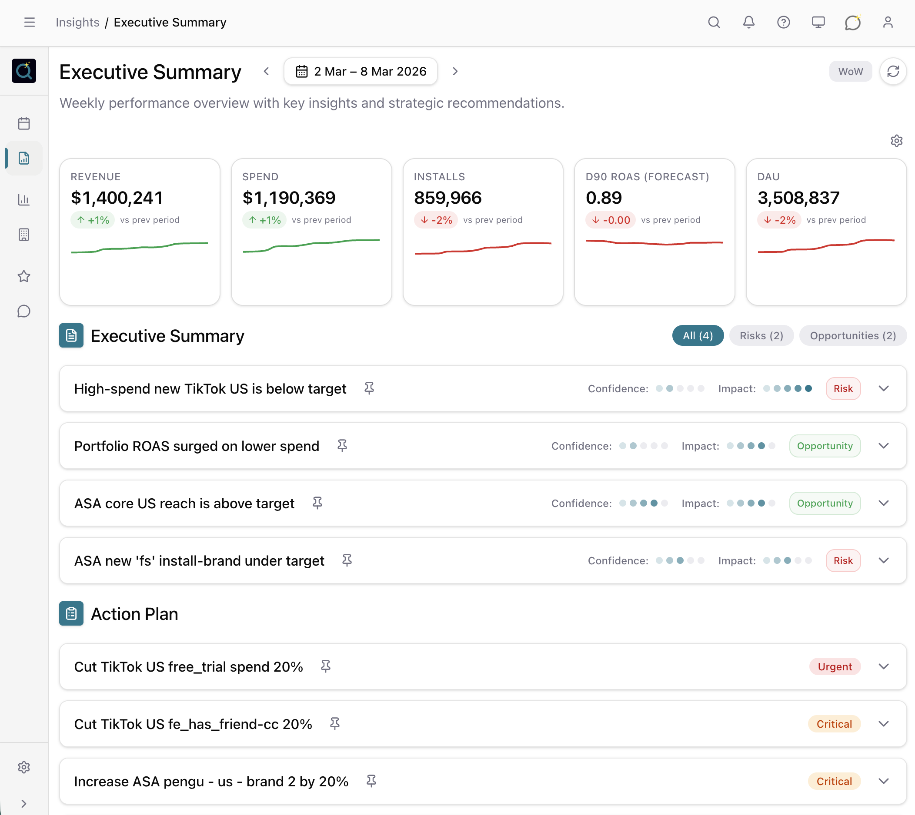
WEEKLY EXECUTIVE SUMMARY
Strategic performance
overview, every week.
Revenue, Spend, Installs, ROAS, DAU at a glance. AI-generated insights classify findings as risks or opportunities with confidence scoring. Each summary includes a prioritized action plan with urgency levels.
Delivered to Slack weekly
KPI dashboard with trend lines

Slide 6
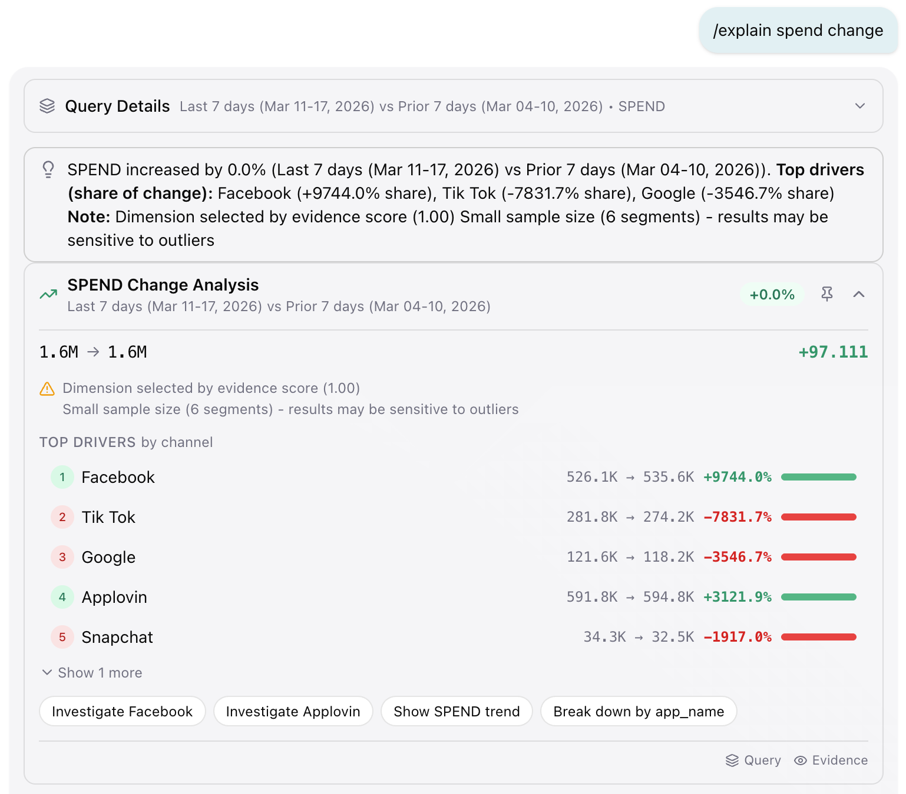

EXPLAIN FEATURE
Understand why your
metrics changed.
Ask "why did spend change?" and get a driver breakdown by channel. Evidence-scored analysis shows exactly which channels drove the shift, with magnitude and direction. Suggested next steps let you investigate further or take action immediately.
Driver analysis with evidence scoring
Available in Slack and Dashboard

Slide 7
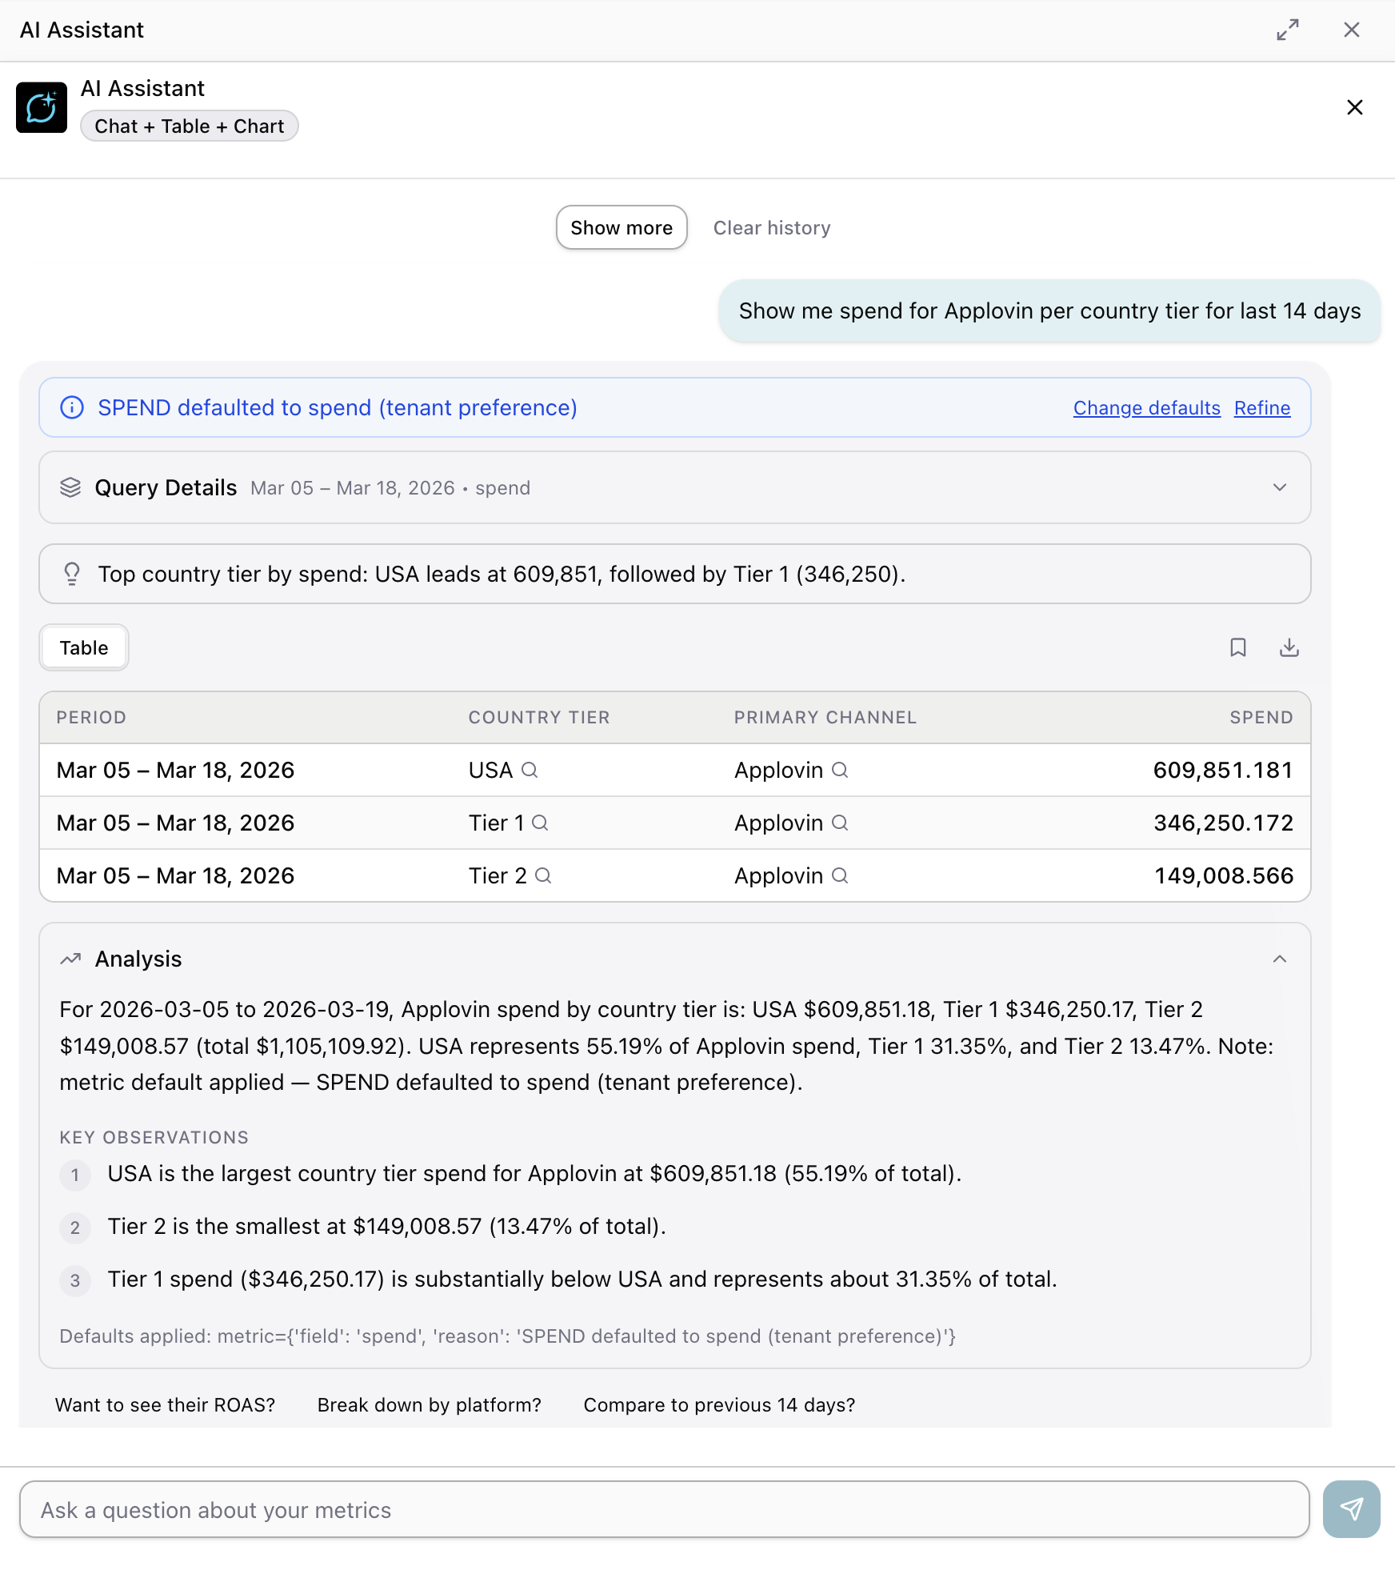

NATURAL LANGUAGE QUERYING
From question to answer
in seconds, not days.
Ask questions in plain English. "Show me spend for Applovin per country tier for last 14 days." Lupe queries your unified data, builds the table, runs the analysis, and explains key observations. No SQL. No analyst bottleneck. Follow-up suggestions keep the conversation going.
Chat interface with context-aware follow-ups
Available in Slack and Dashboard

Slide 8



WHAT MAKES IT WORK
Every feature is powered by one
unified data model.
The Single Source of Truth (SSOT) is the foundation. Our Context Agent builds, manages, and continuously validates this layer so every report, every query, and every insight draws from the same trusted data.
Single Source of Truth
Context Agent
Semantic Layer
Attribution, spend, and revenue unified at device level. One data model, one definition of every metric.
Manages the semantic layer. Runs data quality checks, validates business logic, and keeps the SSOT accurate.
Custom business logic configuration on top of the SSOT. Powers all AI features with domain-specific context.

Slide 9
ONBOARDING
From plug-in to full visibility.
Nothing breaks.
01
Connect Warehouse
02
Agentic Data Quality Audit
03
Configure ID Logic
Access to your warehouse + clean git repository & dbt Cloud account.
Automated audit of revenue, spend, and installs data integrity.
Data blending configuration and device-level attribution for real organics.
04
Generate Semantic Layer
05
Product Data (On Demand)
06
Go Live
Custom business logic configuration on top of your data model.
Optional integration of product analytics data into the unified model.
Raw data accessible in your warehouse. Parallel setup, minimal incremental costs.

Slide 10
WHERE WE ARE
Built from real problems.
Shipping a real product.
We built custom SSOT solutions for three mobile app companies. That hands-on work exposed the same patterns every time: fragmented data, duplicate definitions, slow reporting, and marketing teams flying blind on budget allocation. It led to our product: a context layer for mobile marketing teams.
3
1
1
Custom SSOT builds
for mobile app companies
Pilot customer
in onboarding phase
Pilot customer
in signature phase
Foundation of the product
Active implementation
Pipeline

Slide 11
Ready to protect your
return on ad spend?
See where you're wasting budget. Get full visibility in 90 days.
Book a Demo

