Slide 1

Protect your return
on ad spend.
A single view of attribution, spend, and revenue at device level.
AI agents find where you're wasting budget, explain why,
and tell you where to act next.

Slide 2
THE PROBLEM
Every day you can't see where budget
is leaking, you're paying for it.
Mobile growth teams run campaigns across a dozen channels but rarely have a unified view of what's actually working at device level. Attribution data lives in one place, spend data in another, revenue in a third. By the time someone pulls it all together, the waste has already happened.
30%+
6+
48hrs
of ad budgets spent
without clear attribution
platforms with no unified
device-level view
of budget burning before
anyone notices

Slide 3
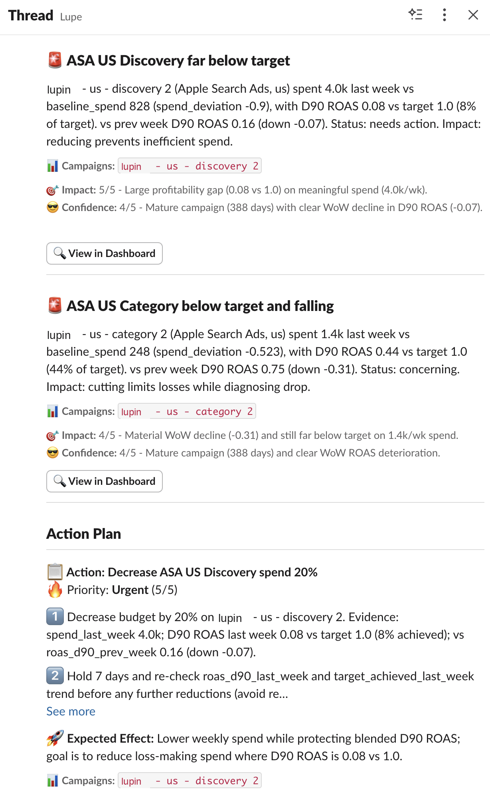


DAILY MARKETING REPORT
Wake up knowing where
you're losing money.
Every morning, Lupe's AI agents analyze your campaigns across every channel and flag where budget is being wasted. You get a prioritized breakdown: which campaigns to pause, which to scale, and where your next dollar works hardest.
Delivered to Slack every morning
Full dashboard with drill-down

Slide 4
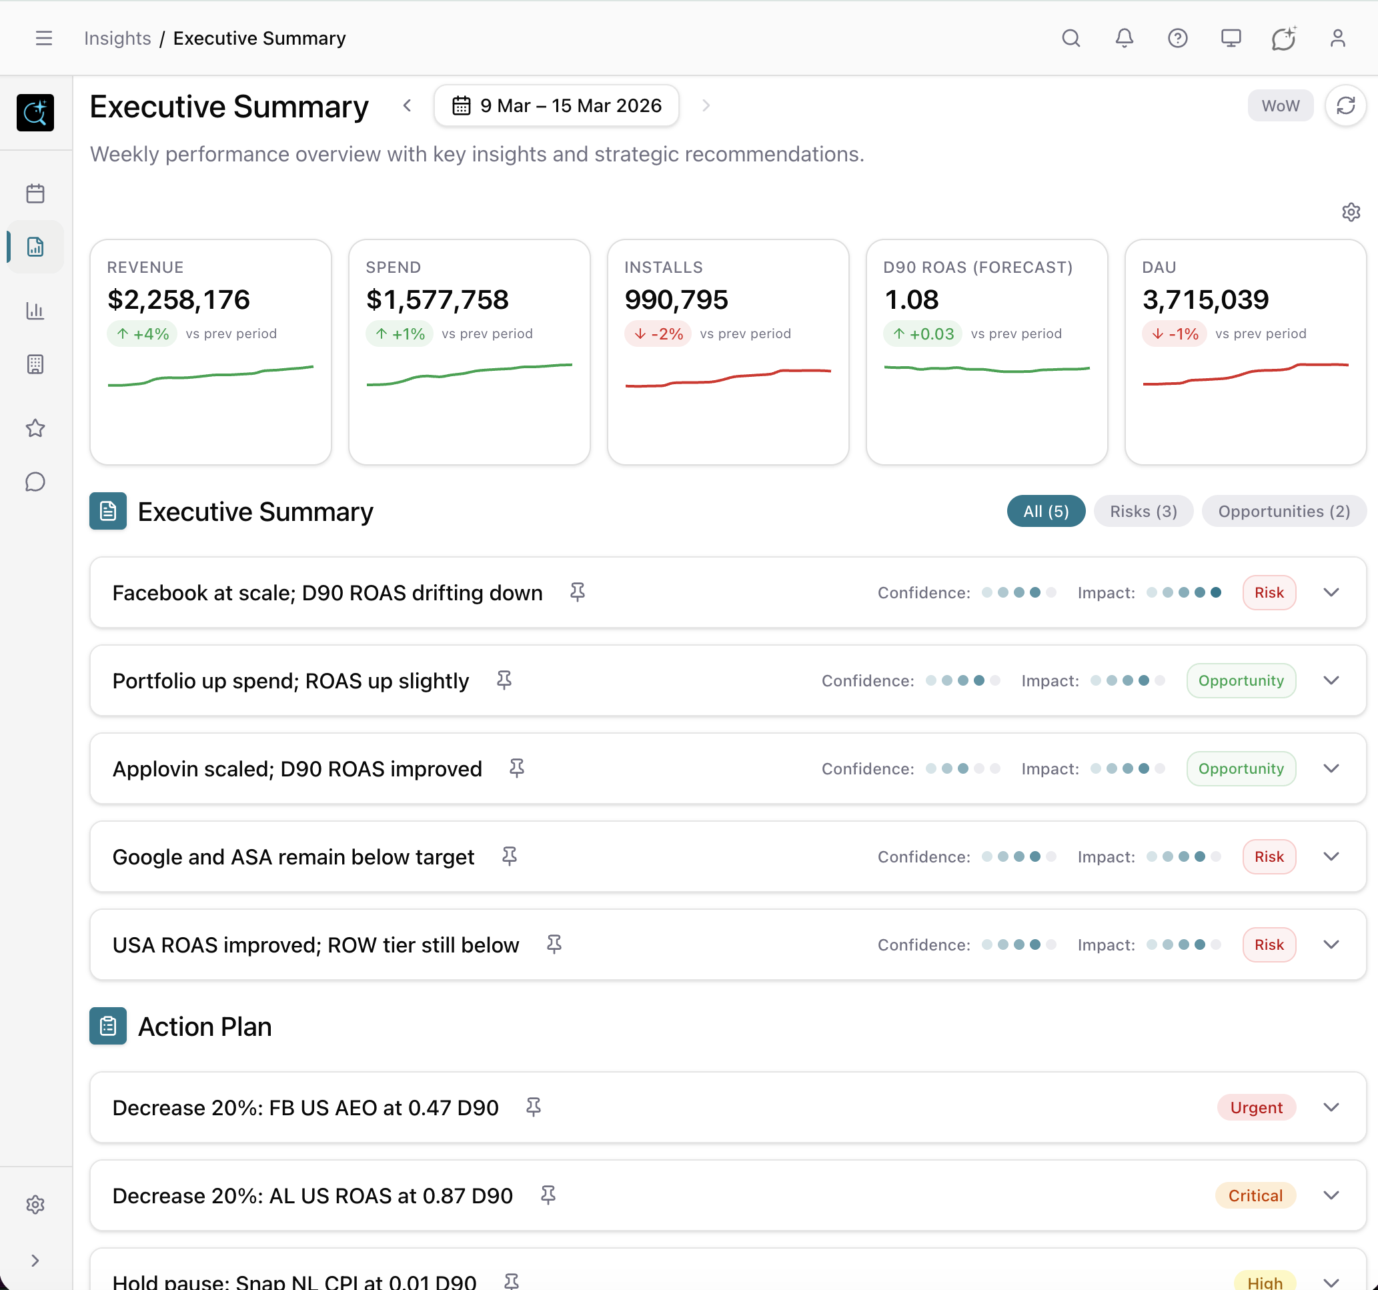
WEEKLY EXECUTIVE SUMMARY
Strategic performance
overview, every week.
Revenue, Spend, Installs, ROAS, DAU at a glance. AI-generated insights classify findings as risks or opportunities with confidence scoring. Each summary includes a prioritized action plan with urgency levels.
Delivered to Slack weekly
KPI dashboard with trend lines

Slide 5
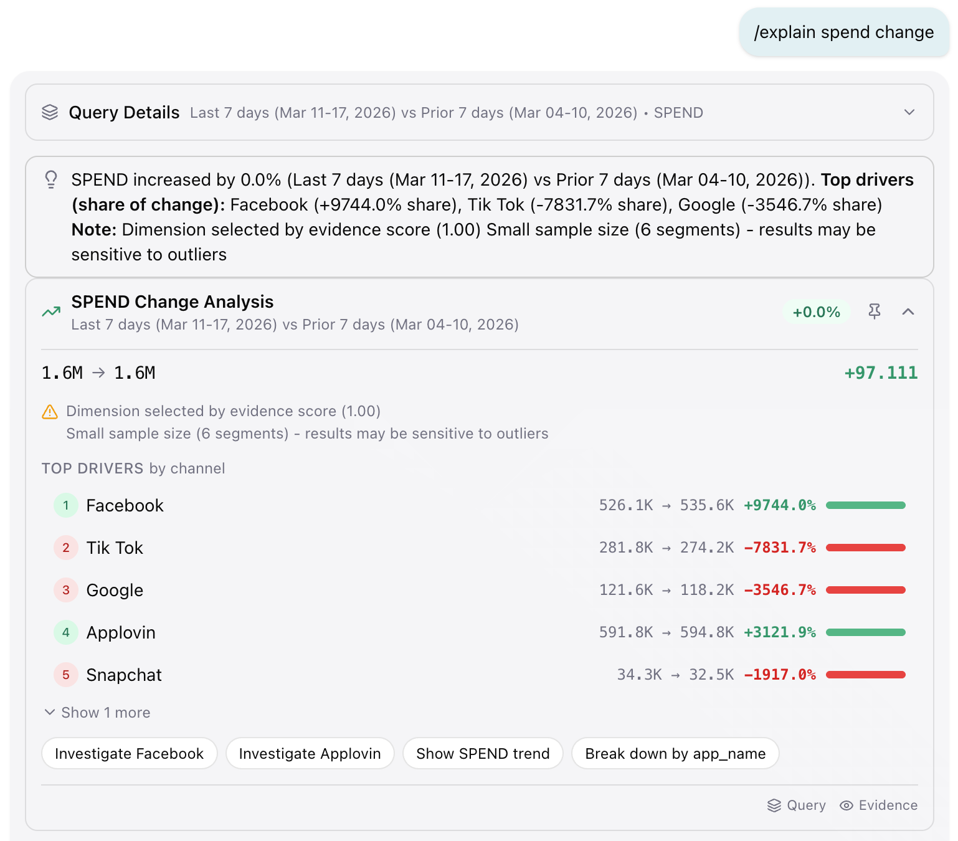

EXPLAIN FEATURE
Understand why your
metrics changed.
Ask "why did spend change?" and get a driver breakdown by channel. Evidence-scored analysis shows exactly which channels drove the shift, with magnitude and direction. Suggested next steps let you investigate further or take action immediately.
Driver analysis with evidence scoring
Available in Slack and Dashboard

Slide 6
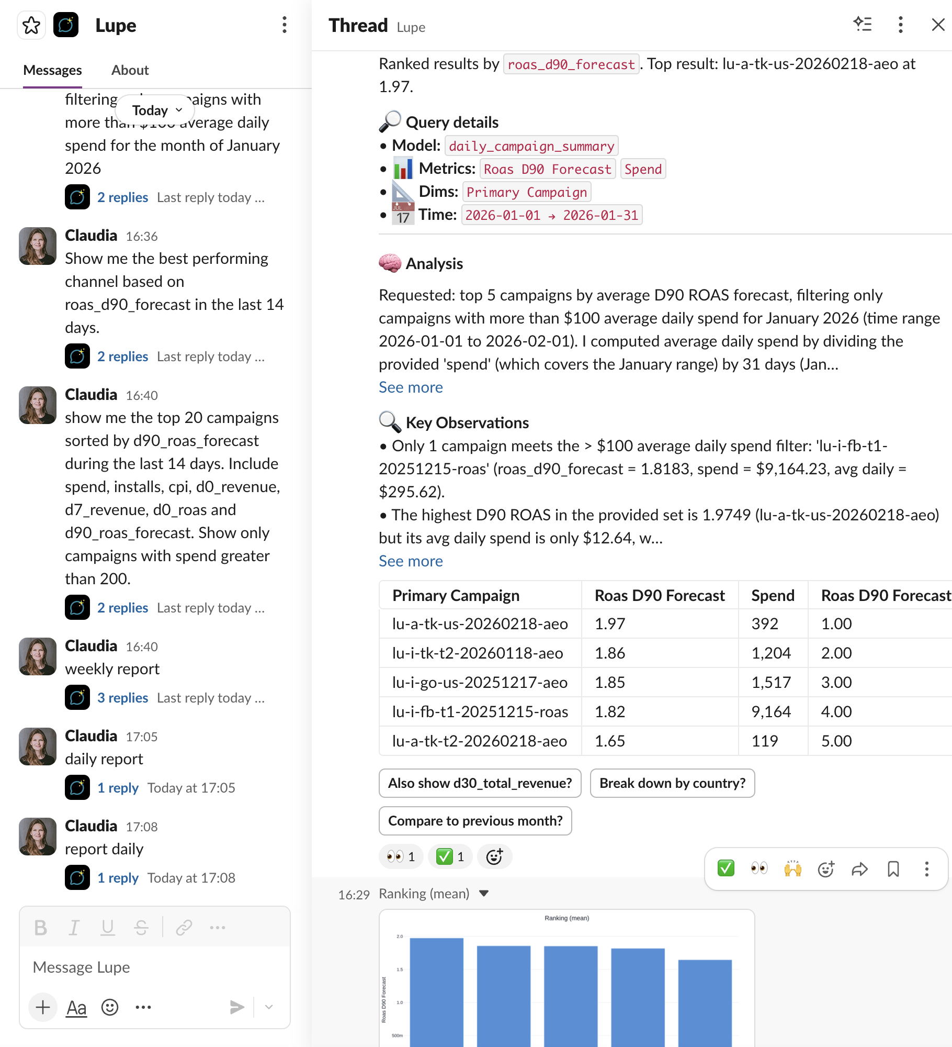

NATURAL LANGUAGE QUERYING
From question to root cause
in seconds, not days.
Ask questions in plain English. "Which campaigns should I pause this week?" "Show me ROAS by channel for the last 30 days." "Where am I overspending in LATAM?" Lupe queries your unified data, builds the chart, and explains what it means. No SQL. No analyst bottleneck. Follow-up suggestions keep the conversation going.
Chat interface with context-aware follow-ups
Available in Slack and Dashboard

Slide 7
ONBOARDING
From plug-in to full visibility.
Nothing breaks.
01
Connect Your Data
02
Data Quality Check
03
Attribution Setup
We plug into your existing warehouse and data infrastructure. Nothing to migrate.
Automated audit of revenue, spend, and installs data integrity.
Device-level attribution configured for accurate cross-channel measurement.
04
Build Your Metrics
05
Product Data (On Demand)
06
Go Live
Your business logic and metric definitions, configured once, consistent everywhere.
Optional integration of product analytics data into the unified model.
Daily digests, AI chat, and dashboards live. Your team starts getting answers.

Slide 8
WHAT CHANGES
What your team looks like
after 90 days with Lupe.
Lupe deploys alongside your existing stack. Your data stays in your warehouse. Your team keeps their tools. The only thing that changes is how fast they can act on what the data is telling them.
Week 1
Week 4
Day 90
Connected. First daily digest.
Unified cross-channel view.
Team asking questions daily.
First budget reallocation.
Full visibility on waste.
Marketing team self-serve.
Immediate value
Team adoption
Full ROI

Slide 9
Ready to protect your
return on ad spend?
See where you're wasting budget. Get full visibility in 90 days.
Book a Demo

Slide 10

THE SOLUTION
A context layer for
mobile marketing teams.
DATA SOURCES
FEATURES
SSOT
Ad Networks
Daily Report
Single Source of Truth
MMPs
Weekly Summary
Context Agent
Revenue Platforms
Explain Feature
Manages semantic layer,
ensures data quality
Analytics Tools
NL Querying
Accessible through Slack Bot & Dashboard

Slide 11



WHAT MAKES IT WORK
Every feature is powered by one
unified data model.
The Single Source of Truth (SSOT) is the foundation. Our Context Agent builds, manages, and continuously validates this layer so every report, every query, and every insight draws from the same trusted data.
Single Source of Truth
Context Agent
Semantic Layer
Manages the semantic layer. Runs data quality checks, validates business logic, and keeps the SSOT accurate.
Custom business logic configuration on top of the SSOT. Powers all AI features with domain-specific context.
Attribution, spend, and revenue unified at device level. One data model, one definition of every metric.

