Slide 1
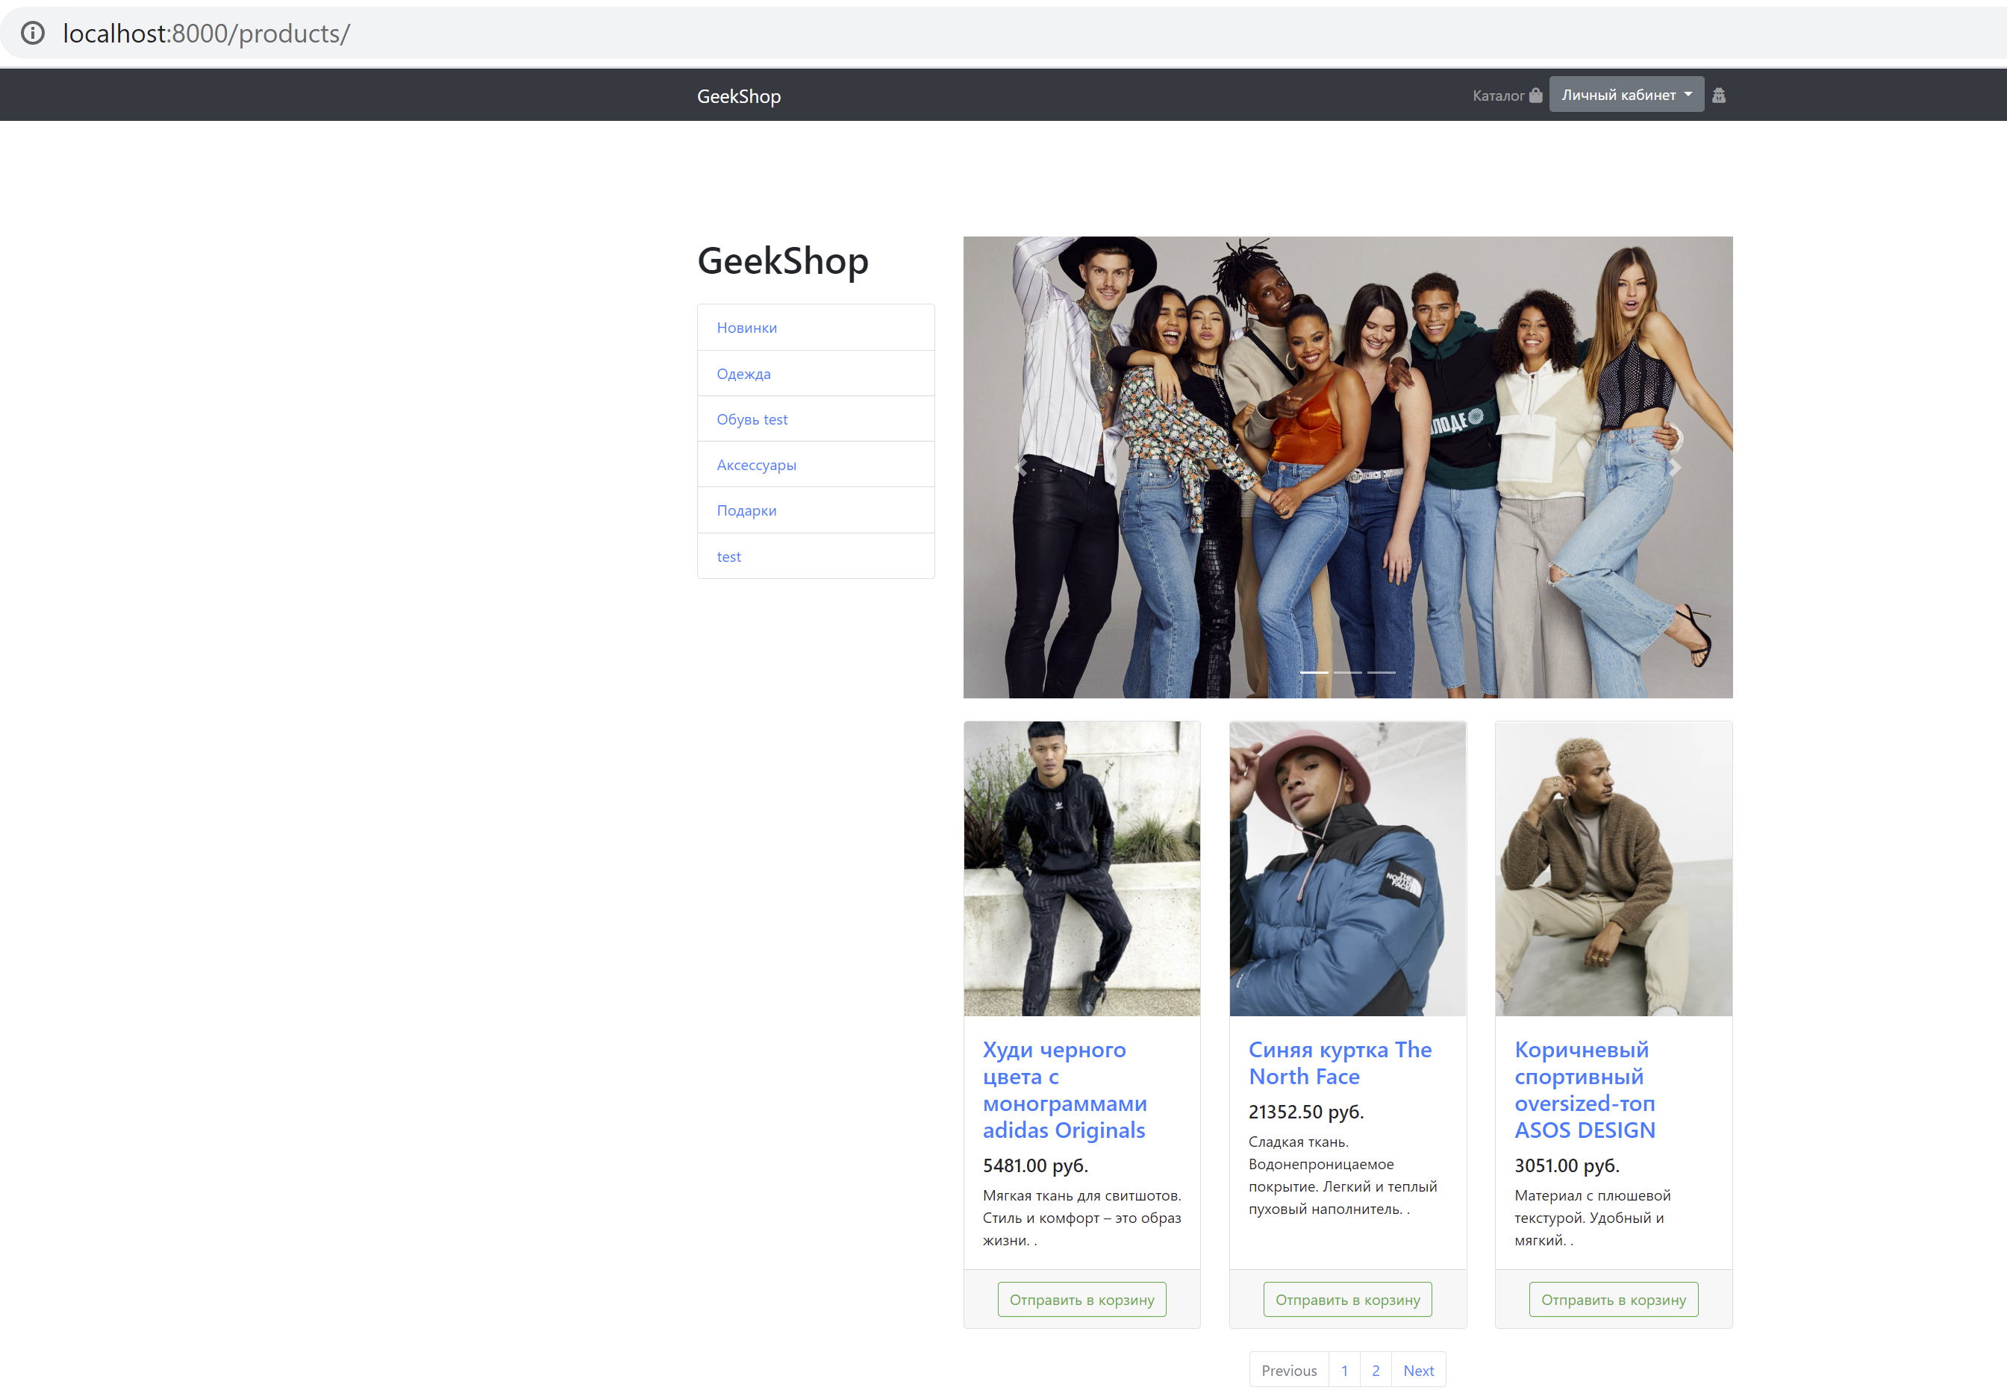
Catalog page with pagination and opportunity to choose category of products

Slide 2
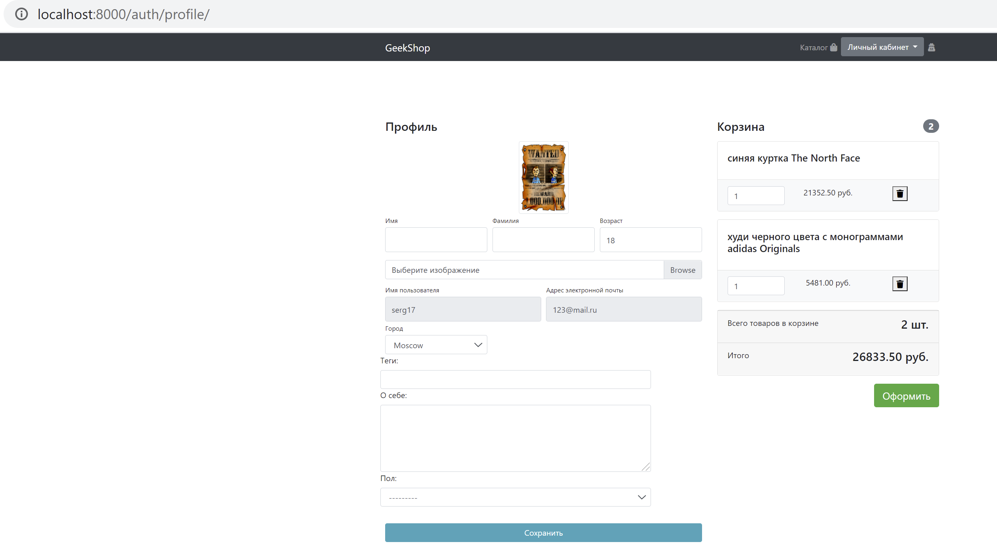
Profile page. Shows user’s basket and profile data. Allows to change user data using Django forms and to change basket filling using JavaScript

Slide 3
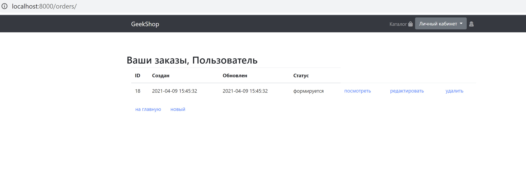
Order’s page. Allows to create, to change, to delete user’s orders. Uses Django Formsets

Slide 4
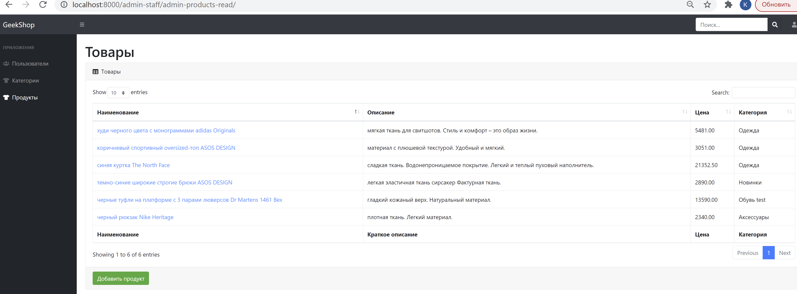
Custom admin panel. Allows to create, to change, to delete users, product categories and products, to add some discount for some category of products

Slide 5
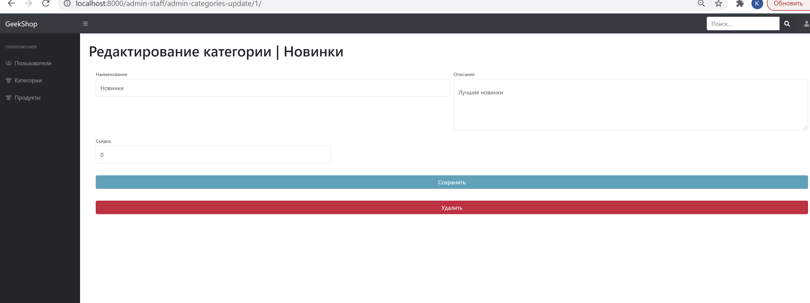

Slide 6
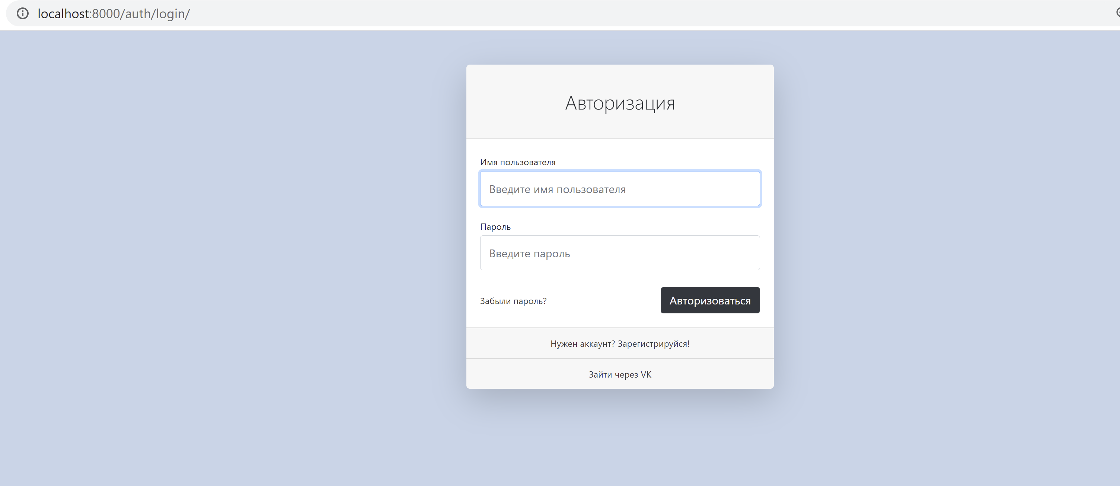
Login page. Allows to authorize using social network too

