Slide 1
VMware Cloud Foundation
Technical Overview
Notes:
Key Message:
Opening slide
Talk Track:
Welcome! My name is Kyle Gleed and I am part of the VMware Cloud Foundation Technical Marketing team at Broadcom. In this presentation, my colleagues and I will provide an overview of VMware Cloud Foundation.
Notes:
Resources:
To gain a greater understanding of VCF features, key concepts and how they are used please refer to the VCF Master Technical (Deep Div)e presentation.
VMware Cloud Foundation 9.0 Release Notes:
https://docs.vmware.com/en/VMware-Cloud-Foundation/index.html

Slide 2
01
Introducing VMware Cloud Foundation Use Cases
02
Infrastructure Modernization
Agenda
03
Application Modernization
04
Security Modernization
Notes:
Key Message:
Agenda
Talk Track:
We’ll begin by first looking at the business initiatives and associated use cases that are driving private cloud adoption with VMware cloud foundation.
We’ll then dive into the areas of infrastructure modernization, application modernization, and security modernization.
Notes:
Resources:
VMware Cloud Foundation 9.0 Release Notes:
https://docs.vmware.com/en/VMware-Cloud-Foundation/index.html

Slide 3

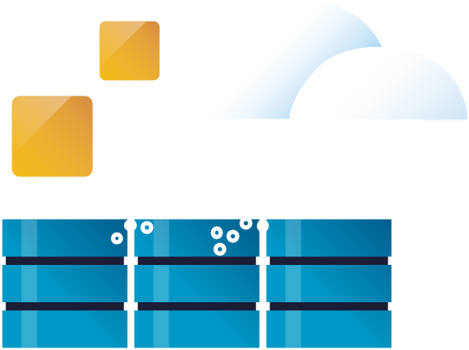
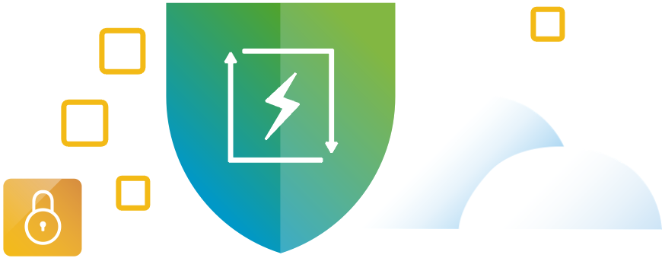






Business Initiatives and Use Cases
Infrastructure Modernization
Application
Modernization
Security
Modernization
Build and deploy private cloud infrastructure on-premises
Enable self-service infrastructure and cloud services for app teams
Strengthen compliance and harden infrastructure
Optimize infrastructure and operations
Build, run and manage Kubernetes and other modern apps
Bolster lateral security and intrusion prevention / detection
Extend data center to the edge, public and sovereign clouds
Build, run and manage Private AI apps
Accelerate recovery from ransomware and other disasters
Notes:
Key Message:
Before we jump into our overview of VMware Cloud Foundation 9.1, let’s review the key business initiatives that are driving private cloud adoption and their supporting use cases.
Talk Track:
Before we jump into our overview of VMware Cloud Foundation 9.1, let’s review the key business initiatives that are driving private cloud adoption and their supporting use cases.
First, under Infrastructure Modernization, we are seeing customers building private cloud platforms to not just update their outdated and aging infrastructure — but to also modernizing their core data centers with automated provisioning and full-stack lifecycle management. Under the infrastructure modernization initiative we are enabling the following use cases – (1) building and deploying private cloud infrastructure on-premises, (2) optimizing infrastructure and operations, and (3) extending the data center to the edge and to the cloud.
Next, under Application Modernization, we are seeing customers adopt new technologies in order to accelerate application development. In addition, they are incorporating DevOps principles like infrastructure as code and running Kubernetes clusters alongside VMs on shared infrastructure. And of course, Private AI is always top of mind. Under this business initiative we are enabling the following use cases – (1) Enabling self-service infrastructure, (2) build run and mange Kubernetes, and (3) build, run, and manage, Private AI applications.
Finally, under Security Modernization, customers are turning to the private cloud to become more secure and be better protected. Under the security modernization initiative VCF is delivering on the following use cases – (1) strengthening compliance and hardening infrastructure (2) bolstering lateral security and intrusion prevention and detection, and (3) accelerating recovery from ransomware and other disasters.
As we continue through this presentation keep these business initiatives in mind consider how each capability and feature that is discussed ties back to these key initiatives and how it is helping Cloud Foundation achieve the targeted use cases and provide the industries best private cloud platform.
Notes:
Resources:
VMware Cloud Foundation 9.0 Release Notes:
https://docs.vmware.com/en/VMware-Cloud-Foundation/index.html

Slide 4
Build and Deploy Private Cloud Infrastructure On-Premises
Architecture Overview
Notes:
Key Message:
VCF Architecture
Talk Track:
Lets start by looking at the high level architecture of VCF.
Notes:
References:

Slide 5
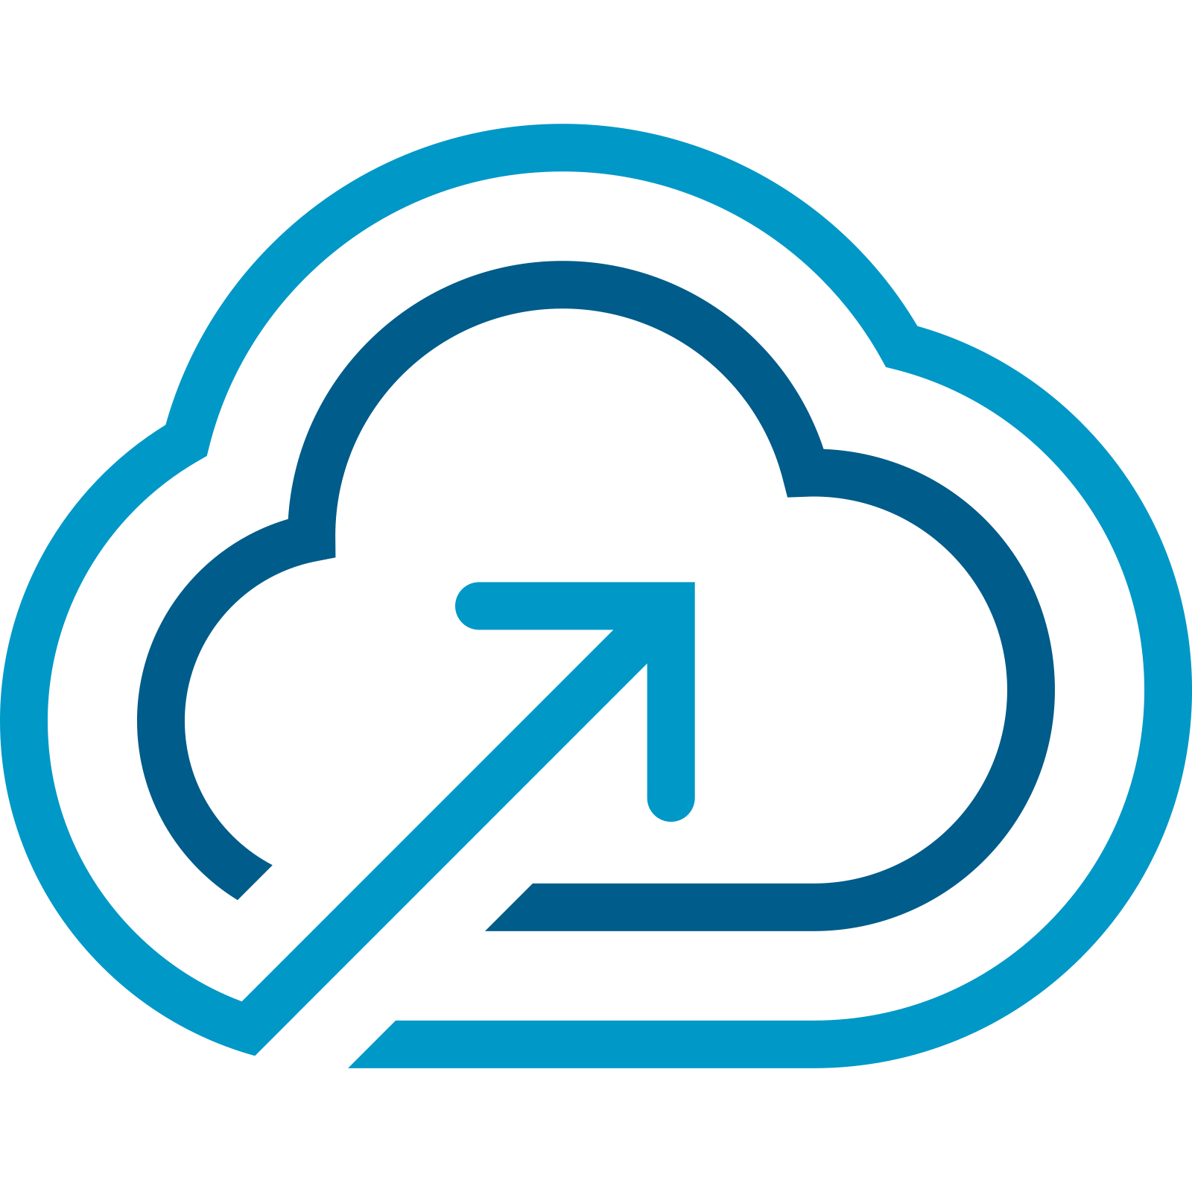
Private Cloud Constructs within VMware Cloud Foundation
VCF Fleet
VCF Instance
Region A
VCF Fleet
VCF Instance
VCF Automation
VCF Operations
Workload Domain
Workload Domain
vCenter
VCF Instance 1
VCF Instance 2
NSX
Workload Domain
Workload Domain
SDDC Manager
vCenter
vCenter
Workload Domain
Clusters
NSX
NSX
Clusters
vCenter
Core Infrastructure
SDDC Manager
SDDC Manager
NSX
Clusters
Clusters
SDDC Manager
Clusters
Clusters
Clusters
Core Infrastructure
Core Infrastructure
Core Infrastructure
Workload Domain
vCenter
NSX
Workload Domain
Workload Domain
Clusters
vCenter
vCenter
Core Infrastructure
NSX
NSX
Clusters
Clusters
Core Infrastructure
Core Infrastructure
Additional Workload Domains
Additional Workload Domains
Additional Workload Domains
Notes:
Key Message:
A VCF private cloud is implemented on a modular architecture that combines workload domains into VCF Instances, which are further combined into VCF Fleets. VCF Fleets are centrally managed from central instance of VCF Operations and Automation.
Talk Track:
Workload Domain
At the core of the VCF architecture is the workload domain. A Workload Domain is a logical unit of application-ready infrastructure that groups ESX hosts into one or more vSphere clusters each providing specific performance, availability, or security characteristics.
Think of a workload domain as a standardized, repeatable unit of private cloud capacity—bundling compute, storage, and networking into an isolated pool. Because workload domains are managed through automation, you can create, scale, or delete them on demand. In addition, each workload domain is managed and life-cycled independently.
VCF Instance
One or more workload domains are logically combined into a VCF Instance. A VCF Instance represents the collection of workload domains within a single location or site. VCF Instances shared a common software depot and collection of VCF management services.
VCF Fleet
VCF Instances are then grouped into VCF fleets. Each VCF Fleet is managed from a set of centralized services that are provided by a dedicated instance of VCF Operations and Automation.
Notes:
Resources:
Refer to the VMware Cloud Foundation Design Guide for further information on Workload Domains:
https://techdocs.broadcom.com/us/en/vmware-cis/vcf.html
Refer to Getting Started Guide for further information on Getting Started with VMware Cloud Foundation:
https://techdocs.broadcom.com/us/en/vmware-cis/vcf.html

Slide 6
Private Cloud Constructs within VMware Cloud Foundation
VCF Private Cloud
VCF Private Cloud
One or more VCF Fleets
VCF Fleet
VCF Operations instance
VCF Automation Instance
One or more VCF instance
VCF Instance
One or more Workload Domains
Region A
Region B
VCF Fleet
VCF Fleet
VCF Automation
VCF Automation
VCF Operations
VCF Operations
VCF Instance 1
VCF Instance 2
VCF Instance 1
Workload Domain
Workload Domain
Workload Domain
vCenter
vCenter
vCenter
NSX
NSX
NSX
SDDC Manager
SDDC Manager
SDDC Manager
Clusters
Clusters
Clusters
Clusters
Clusters
Clusters
Core Infrastructure
Core Infrastructure
Core Infrastructure
Workload Domain
Workload Domain
Workload Domain
vCenter
vCenter
vCenter
NSX
NSX
NSX
Clusters
Clusters
Clusters
Core Infrastructure
Core Infrastructure
Core Infrastructure
Additional Workload Domains
Additional Workload Domains
Additional Workload Domains
Notes:
Key Message:
VCF Fleets provide the centralized management framework to scale independent VCF Instances into a resilient, multi-region Private Cloud.
Talk Track:
Finaly, A VCF Private Cloud aggregates one or more Fleets into a unified operational environment.
The beauty of this architecture lies in its modularity, allowing a private cloud to scale from a single-site deployment to a massive, global operation. For a small organization, a VCF Private Cloud might consist of a single Fleet containing just one Instance with two or three Workload Domains—providing a simple, automated footprint. As an enterprise grows, it can gain flexibility by adding multiple Instances across different geographic regions to ensure low latency and disaster recovery, all while maintaining unified visibility through the Fleet’s centralized operations. For the largest global entities, the ability to aggregate multiple Fleets into a singular Private Cloud means they can maintain regional autonomy and compliance standards while still benefiting from a high-level, cohesive operational strategy that spans thousands of hosts across the globe.
Notes:
Resources:
Refer to the VMware Cloud Foundation Design Guide for further information on Workload Domains:
https://techdocs.broadcom.com/us/en/vmware-cis/vcf.html
Refer to Getting Started Guide for further information on Getting Started with VMware Cloud Foundation:
https://techdocs.broadcom.com/us/en/vmware-cis/vcf.html

Slide 7
Build and Deploy Private Cloud Infrastructure On-Premises
VCF Installer
Notes:
Key Message:
Talk Track:
Now that we’ve covered the high-level VCF architecture, it’s time to move from theory to practice. In this next section, I’ll dive into the technical implementation—specifically, how we use the VCF Installer to build and deploy a VCF Private Cloud.
Notes:
References:

Slide 8
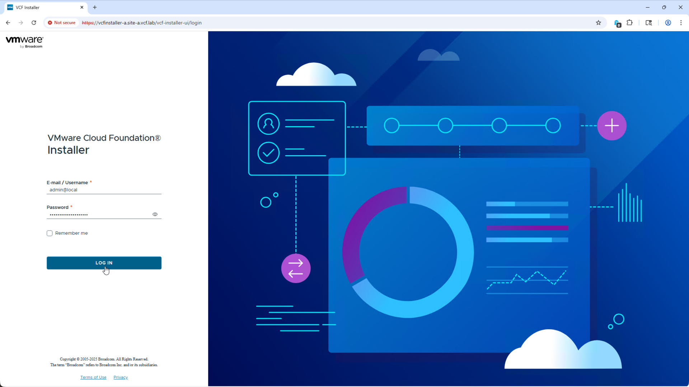
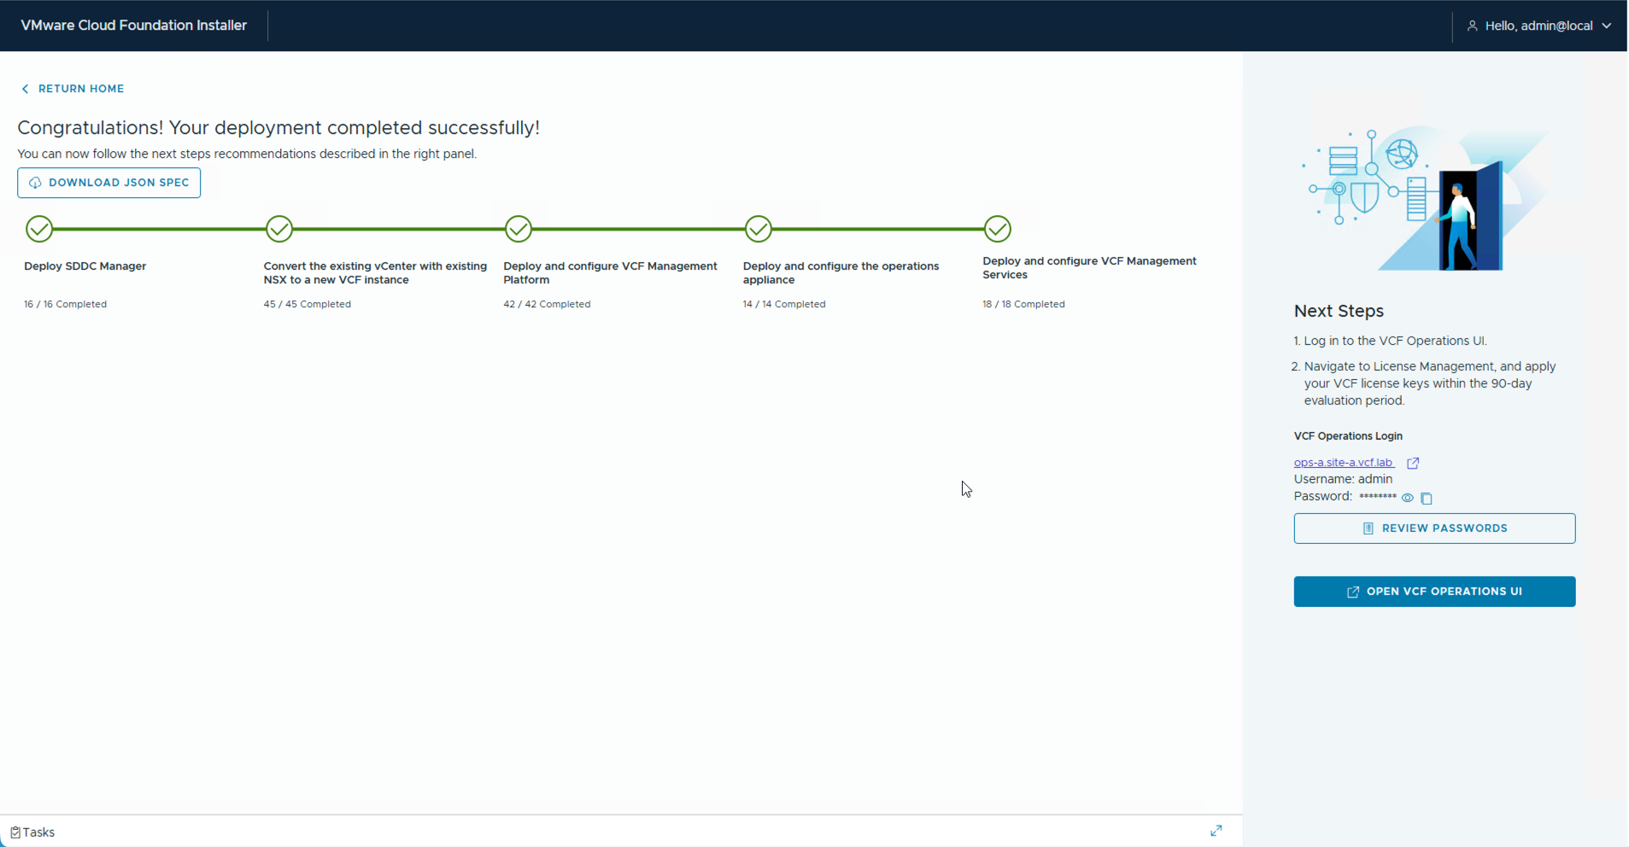
VCF Installer Overview
Light weight appliance used to deploy and scale VCF Fleets and Instances
Key Benefits
  Unified installer for all components.
  Distributed as a lightweight OVA.
  Support both online and offline software depots.
Technical Value
  Single installer for all components.
  Simple to deploy, easy to use.
  Supports both connected and disconnected environments.
Notes:
Key Message:
The VCF Installer is a lightweight, unified appliance that simplifies the "Day 0" experience by providing a streamlined path from initial download to staging the core installation binaries.
Talk Track:
To deploy Cloud Foundation you use the VCF Installer.
The VCF installer is easily downloaded as a single OVA file directly from the Broadcom software portal. The initial setup is remarkably lightweight; when you deploy the appliance, you only need to provide basic IP information to get it on the network.
Once deployed, you configure the software depot and download the binaries needed to deploy VCF.
Notes:
It’s worth noting that we support both online and offline depots. If your environment is air-gapped, you’ll use our VCF Download tool to fetch those binaries and move them to a local web server—but we’ll dive deeper into that workflow a bit later."
Resources:

Slide 9
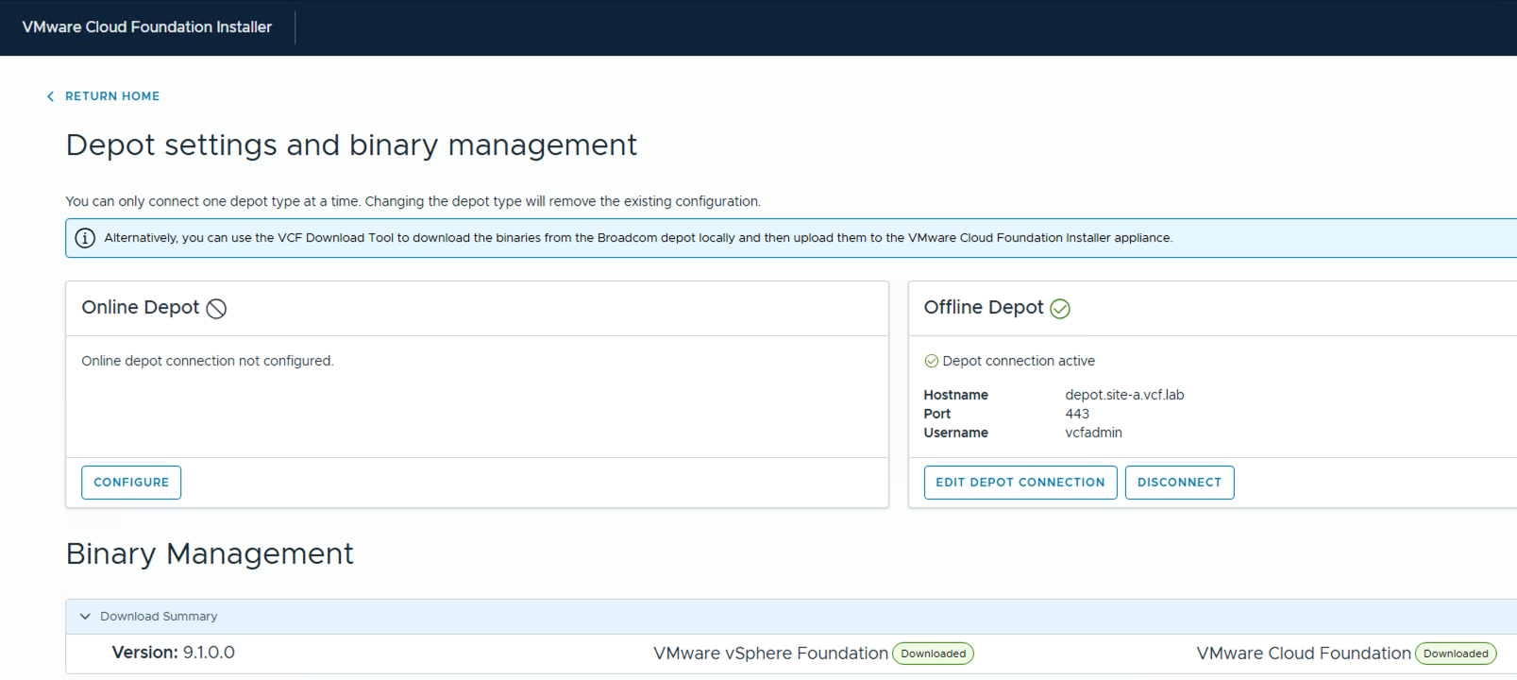
Choice of Online or Offline Software Depot
Easy, secure download of VCF Binaries
Key Benefits
  Easy download of all VCF binaries.
  Choice of online or offline software depot.
  Easy to setup and configure.
Technical Value
  Centralized location for all VCF Binaries
  Secure - uses Broadcom activation code for authentication.
  Supports both connected and disconnected environments.
Notes:
Key Message:
The VCF Installer is a lightweight, unified appliance that simplifies the "Day 0" experience by providing a streamlined path from initial download to staging the core installation binaries.
Talk Track:
Once deployed, you configure the software depot and download the VCF software binaries.
The software depot provides a single location for downloading all the required VCF binaries in addition, the binary downloads are secured with your Broadcom activation Code.
The VCF Installer supports using either an “online” software depot for when internet access is available, or an “offline” software depot for when the site is not connected to the internet. Thus providing support for both connected and disconnected sites.
The online depot is the easiest to use as you simply register the software depot over the internet after which you can immediately begin downloading the VCF binaries. If you use the offline depot, there are additional steps as you will first need to setup an external web server and use the VCF download tool to download the VCF Binaries and copy them to the web server.
In either case, once the depot has been configured and the binaries downloaded, you are ready to begin the VCF deployment...
Notes:
It’s worth noting that we support both online and offline depots. If your environment is air-gapped, you’ll use our VCF Download tool to fetch those binaries and move them to a local web server—but we’ll dive deeper into that workflow a bit later."
Resources:

Slide 10
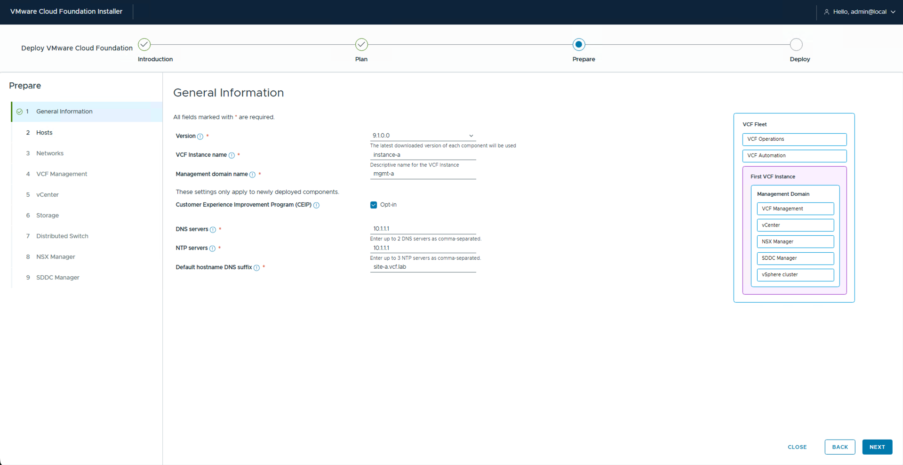
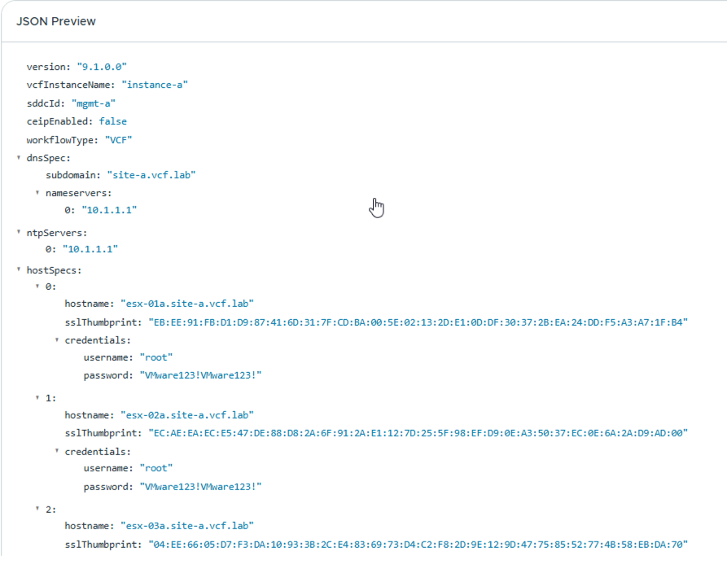
Intuitive Wizard-driven UI with Support for JSON
Fully guided deployments with extensive validation to ensure successful deployments
Key Benefits
Guided deployments with simple / Intuitive wizard driven UI.
Extensive validation to ensure success.
Support for using JSON / API.
Technical Value
Guided deployment captures & validates deployment parameters.
Monitor deployment progress Realtime.
Ability to capture inputs as JSON for future deployments.
Notes:
Key Message:
Whether using the intuitive UI wizard or automated JSON imports, VCF ensures deployment success through a rigorous validation engine that catches environmental issues before the installation begins.
Talk Track:
Deploying Cloud Foundation with the VCF installer is easy and efficient. In most cases, especially when doing a first-time deployment, you will use the wizard-driven UI. This intuitive UI guides you through the deployment prompting you each step of the way for the required input parameters. Once all the parameters have been provided, an extensive validation of the target environment is performed. Upon successful validation, the installer proceeds to automate the deployment of the VCF Fleet. During the deployment you can track the progress directly from the installer UI.
Along with using the intuitive wizard-driven UI, the VCF Installer also supports providing the site specific parameters using a using JSON file. This is helpful when needing to do a custom deployment or in situations where you will do repeated installations. In these advanced scenarios you simply save the input parameters in a JSON file that you then import into the VCF installer to be validated.
In fact, we find that many customers like to use the wizard to do their first deployment and then save that configuration as a JSON template that they can then use for future deployments.
In either case, the VCF installer makes deploying Cloud Foundation easy. You simply provided the required input parameters, let the installer perform its extensive validation of the environment, and when ready let to automate the deployment the VCF Fleet.
Notes:
Regardless of the method you choose, the installer includes a rigorous validation engine. Before a single service is actually deployed, it checks your environment against every prerequisite. If it finds a mismatch, you can save your progress, fix the infrastructure issue, and come back to re-validate without starting from scratch."
Resources:

Slide 11
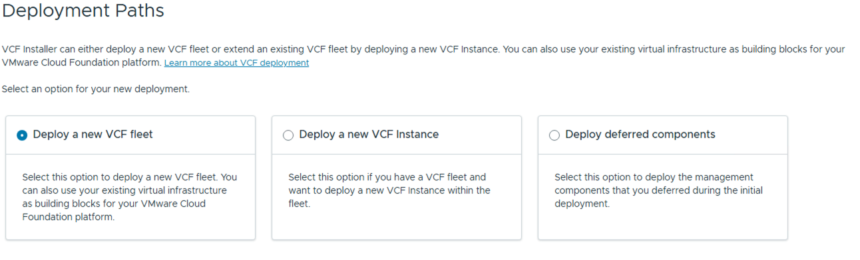
Deploy New Fleets and Expand Existing Fleets
Stand up a new fleet or add additional VCF Instances to an existing fleet
Key Benefits
Deploy a new VCF Fleet
Add a VCF Instance to an existing fleet
Install deferred components to complete a VCF Fleet
Technical Value
One tool used to deploy and expand your VCF Fleet.
Facilitates ability to get started and grow/complete your fleet over time.
Notes:
Key Message:
The VCF Installer is a long-term management tool that enables you to seamlessly expand your fleet or add deferred components as your infrastructure requirements evolve.
Talk Track:
The VCF Installer is not only used for doing new 'greenfield’ VCF deployments but also used to add VCF instances to existing fleets.
In addition, the installer supports advanced deployments. For example, you may want to defer some components at the time of the initial deployment and return to to deploy them later. Consider a custom deployment where you want VCF Operations and VCF Automation to run on virtual networks rather than traditional VLANs, To do this, you would select the ’deferred components’ path in order to quickly stand up the core fleet components and then after you have configured the virtual networks, re-run the installer later to add the deferred components.
This flexibility allows you to deploy and scale your private cloud at a pace that matches your specific networking or business requirements.”
Notes:
Resources:

Slide 12
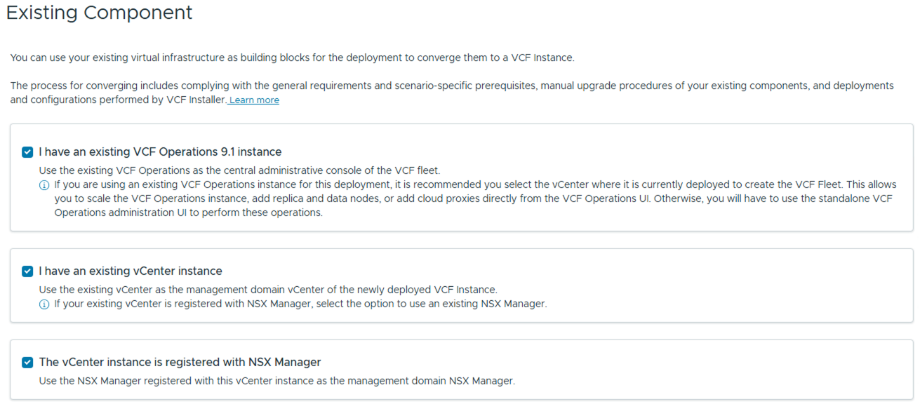
Deploy VCF Using Existing Components
Converge existing VCF Operations, vSphere, and NSX Infrastructure
Key Benefits
Support new & converge Deployments.
VCF Deployment is not tied to new hardware purchase.
Technical Value
Deploy on new hardware to benefit from latest features (e.g. vSAN ESA & vSphere Memory Tiering).
Create a new VCF Fleet / Instance from existing infrastructure w/out need to procure new infrastructure.
Notes:
Key Message:
VCF provides a low-friction entry point through convergence, allowing you to transform existing vSphere environments into fully managed VCF workload domains without a complete "rip-and-replace."
Talk Track:
Beyond greenfield deployments, we know many of you aren't starting from a blank slate...
This brings us to a key feature of the VCF Installer that is referred to as Convergence.
If you already have a vSphere environment running—meaning a vCenter and one or more clusters—you don't have to tear it down or fuss with migrating workloads in order to move to VCF. You can simply point the installer at that existing vSphere environment and 'converge' it into a VCF workload domain.
When doing a converge deployment, the installer first validates the existing components and then deploys any additional component needed to convert the environment into a VCF instance —such as NSX, VCF Management Services, and Operations.
This makes it very easy to get started with VCF as you can simply identify an existing vSphere environment and use it to build your first VCF instance.
Notes:
During this process, the validation engine is especially critical. It will assess your existing host capacity to ensure you have the capacity required for the new management components. It’s also smart enough to recognize if you already have some of these components deployed, opting to integrate with existing services rather than duplicating them."
Resources:

Slide 13
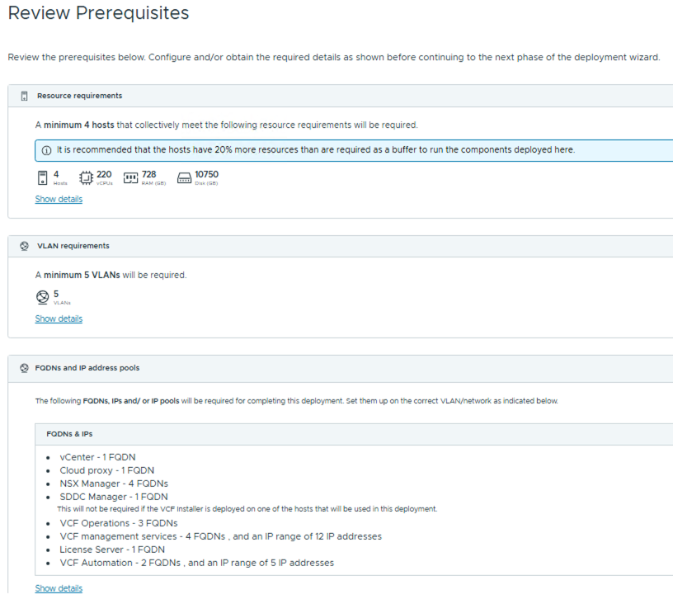
Integrated Planning & Preparation with VCF Installer
Customized guidance on amount of CPU, Memory and Storage needed for each deployment
Customized based on each deployment
Factors in:
  Sizing preferences
  Network Options
  Storage Type
Provides requirements for:
  Host Resources requirements
  VLANs
  FQDNs and IPs
Notes:
Key Message:
With support for offline air-gapped environments, a choice between Simple or High Availability modes, and new built-in resource guidance, the VCF Installer takes the guesswork out of complex enterprise planning.
Talk Track:
The VCF Installer also includes Built-in Planning Guidance.
Early in the VCF Installer wizard workflow, the installer will factor in your deployment choices—things like your choice of storage, choice of the high availability model vs. simple model, and size of deployment—and calculate how much CPU, RAM, and Storage you’ll need, along with the required VLANs, FQDNs and IPs. This helps take the guesswork out of trying to predict the resources you will need for your deployment ensuring you’re ready to go before you hit that final 'deploy' button."
That covers the core capabilities of the VCF Installer. Next, we will look at the lifecycle management capabilities of Cloud Foundation.
Notes:
Resources:

Slide 14
Build and Deploy Private Cloud Infrastructure On-Premises
Centralized Lifecycle Management
(Patch & Upgrade)
Notes:
Key Message:
After we use the VCF Installer to deploy our VCF Fleet, our focus immediately shifts from deployment to maintenance. In this next section, we’ll explore how when it comes to managing software updates, VCF Operations takes the reins—providing a centralized, automated approach to the ongoing patching and upgrading of your entire VCF fleet.
Talk Track:
After we use the VCF Installer to deploy our VCF Fleet, our focus immediately shifts from deployment to maintenance. In this next section, we’ll explore how when it comes to managing software updates, VCF Operations takes the reins—providing a centralized, automated approach to the ongoing patching and upgrading of your entire VCF fleet.
Notes:
References:

Slide 15
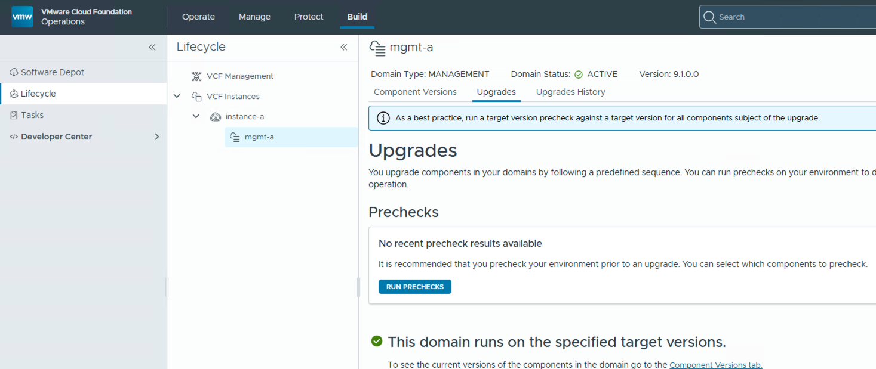
Centralized Lifecycle Management
VCF Operations consolidates patching and upgrade for all components
Key Benefits
VCF lifecycle management consolidated into a single UI.
Single location to patch/upgrade all components.
Technical Value
Manage software updates from one place.
Consistent experience across management and core components.
Notes:
Key Message:
VCF Operations provides a "single pane of glass" for the entire private cloud, eliminating the complexity of managing disparate software stacks and interfaces.
Talk Track:
In VCF, we have consolidated lifecycle management across the entire VCF fleet into a single, unified interface within VCF Operations. You no longer need to jump between different UIs or spend time researching interoperability and compatibility matrices. VCF consolidates everything into one place and guides you through the process of updating each component.
From VCF Operations you are able to view, plan, and upgrade both the VCF Fleet components and the individual workload domains that make up your VCF instances.
By centralizing the core components and the management components into VCF Operations, VCF ensures a consistent, repeatable experience for tracking and applying software updates across your entire private cloud."
Notes:
VCF Lifecycle Management is an orchestrator, not a replacement for native component tools. It coordinates updates by leveraging existing technologies like vSphere Lifecycle Manager (vLCM) and ESX Live Patch. Because VCF supports features like Reduced Downtime Upgrades for vCenter and ESX, you can be confident that the latest vSphere and NSX patching innovations are fully integrated into the VCF workflow.
Resources:

Slide 16
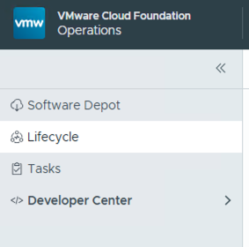
Centralized Lifecycle Management
VCF Operations consolidates patching and upgrade for all components
VCF 5.x & Aria Suite
Management Components
Key Benefits
VCF Ops 9
VCF lifecycle management consolidated into a single UI.
Single location to patch/upgrade all components.
VCF Operations
VCF Management Services
VCF Management
Fleet Management
VCF Operations
VCF Automation
VIDB, Logs, Ops for Networks (etc.)
Core Components (per domain)
SDDC Manager
Technical Value
vCenter Server
VMware ESX
Manage software updates from one place.
Consistent experience across management and core components.
VMware NSX
SDDC Manager
VCF Infrastructure Components
vSphere 9 NSX 9
Notes:
Key Message:
VCF Operations provides a "single pane of glass" for the entire private cloud, eliminating the complexity of managing disparate software stacks and interfaces.
Talk Track:
Within VCF Operations, lifecycle management is divided into two sections:
The management Components which include things like VCF Operations, VCF Automation, VCF Logs, and VCF Operations for Networks. These components are managed and updated as part of the VCF management services.
The VCF Instances which are the core SDDC components that make up the workload domains that run within each VCF instance. These include the SDDC Managers, vCenter Servers, NSX Managers, and ESX hosts.
By centralizing the core components and the management components into VCF Operations, VCF ensures a consistent, repeatable experience for tracking and applying software updates across your entire private cloud."
Notes:
VCF Lifecycle Management is an orchestrator, not a replacement for native component tools. It coordinates updates by leveraging existing technologies like vSphere Lifecycle Manager (vLCM) and ESX Live Patch. Because VCF supports features like Reduced Downtime Upgrades for vCenter and ESX, you can be confident that the latest vSphere and NSX patching innovations are fully integrated into the VCF workflow.
Resources:

Slide 17
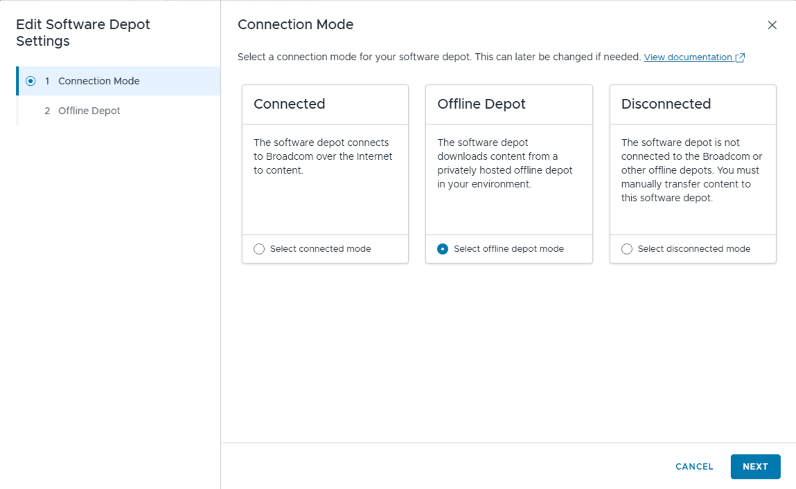
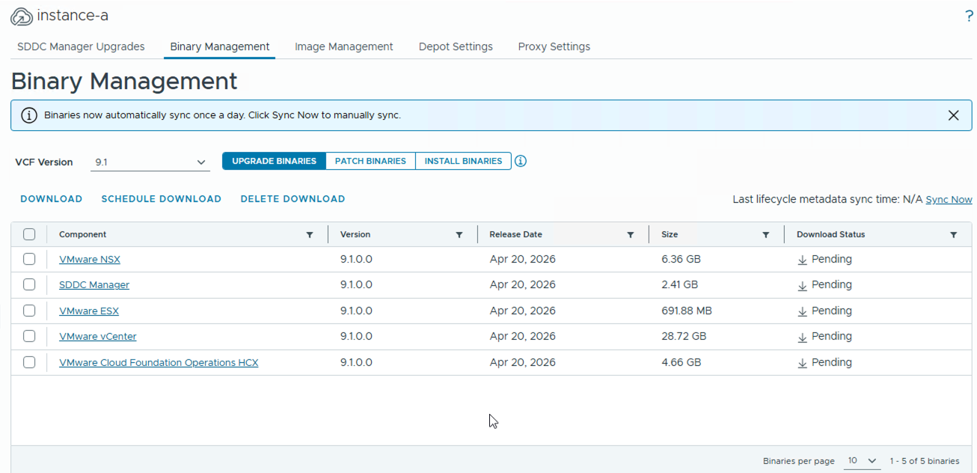
Simplified Binary Management with a Central Software Depot
Configure one software depot to track, download, and install upgrade & patch binaries
VCF 5.x & Aria Suite
VCF 9
Key Benefits
Centralized location to download and store binaries.
Configure per-fleet or per-instance
Three modes: connected, offline, disconnected
Technical Value
One place to track and download software updates
Readily identify/download new patches and binaries.
Support for connected and disconnected environments.
Notes:
Key Message:
The central software depot automates the retrieval and staging of binaries, giving administrators flexible, scheduled control over both online and offline update sources.
Talk Track:
Of course, the process for tracking and managing software updates for the private cloud starts with setting up a software depot and downloading binaries. Similar to the VCF Installer, VCF Operations provides you a choice in how to configure your software depot - you can choose between a Connected Depot, an Offline depot, or a Disconnected Depot. We’ll discuss these in more detail in a minute.
One thing worth noting here is that the default software depot configuration—including your access code—is automatically carried over from the VCF Installer during deployment. However, you can switch your software depot types at anytime, although , you only be connected to one type of depot at a time.
Once connected to a software depot, you have a centralized view into all available software binaries and updates – to include upgrades packages, component security patches, as well as new installation binaries.
Also, you can choose when to download the binaries. You can choose to download binaries manually or schedule them for off-peak hours to save bandwidth.
Notes:
Just keep in mind that you only connect to one depot type at a time; switching from an online to an offline source will replace your existing connection.
Resources:

Slide 18
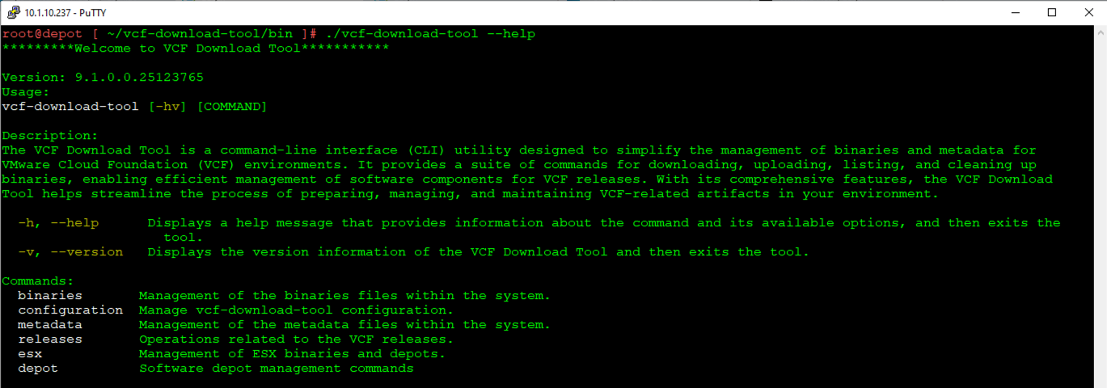
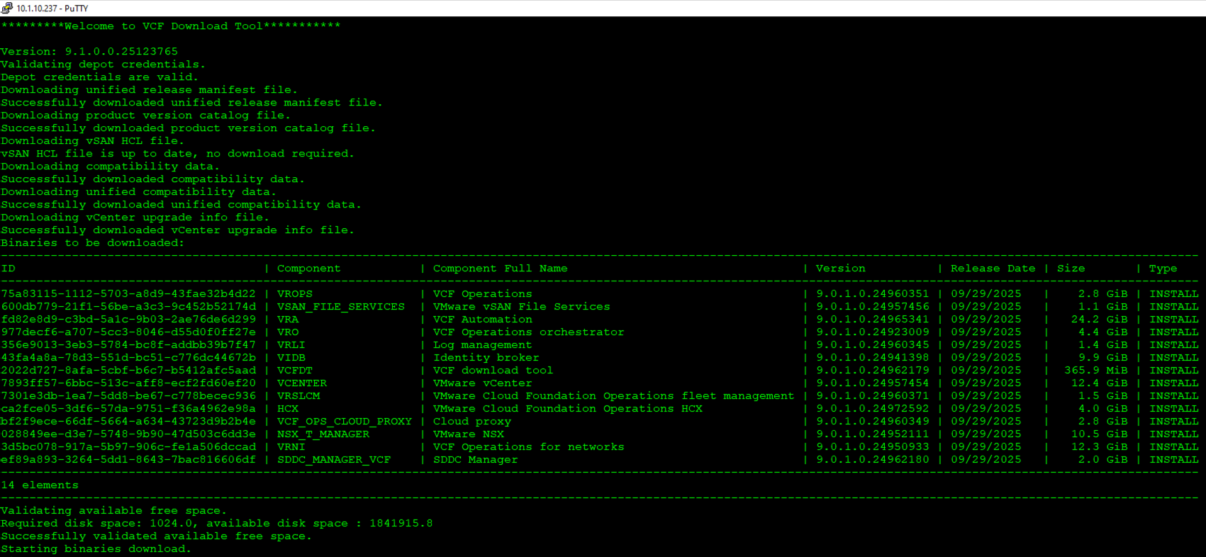
VCF Download Tool
CLI Tool used to download and stage binaries for disconnected sites
VCF
Key Benefits
Download and manage binaries in environments without Internet access.
Use primarily with “offline” and “disconnected” software depots.
Technical Value
Facilitates binary management for disconnected sites.
Stage binaries to a local web server (offline depot)
Stage binaries directly to VCF Operations (disconnected depot)
Notes:
Key Message:
Secure, air-gapped sites maintain full operational parity with connected environments by using the VCF Download Tool to orchestrate offline binary management.
Talk Track:
The connected depot is the quickest and easiest way to get the VCF binaries. However, this is not practical for disconnected sites. For these sites provide support for the disconnected and offline depots.
In order to configure a disconnected or offline depot you will need to use the VCF Download Tool.
The VCF Download Tool is a command-line utility that you will need to download separately and run on a machine that has internet access. After registering the tool and receiving an access code, you can use it to securely download the VCF software binaries and patches. Once downloaded, can then either upload them directly to VCF Operations—known as a Disconnected Depot—or upload them to a local web server and configure it to act as an Offline Depot.
While the disconnected and offline depots do require some extra setup, they ensure that even disconnected sites can benefit from the same automated lifecycle efficiencies as a connected site.
Notes:
Resources:

Slide 19
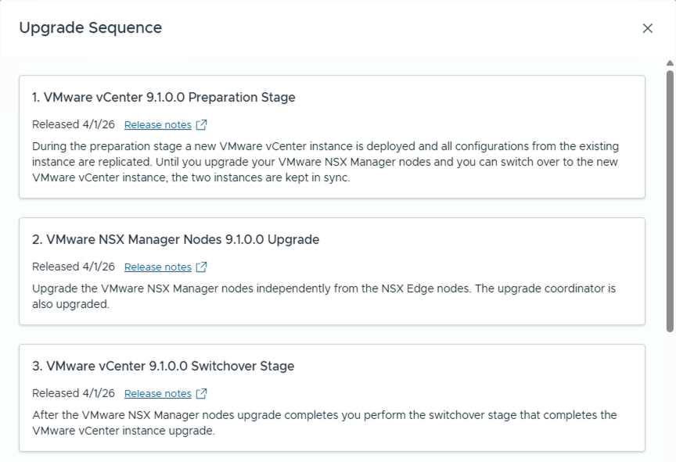
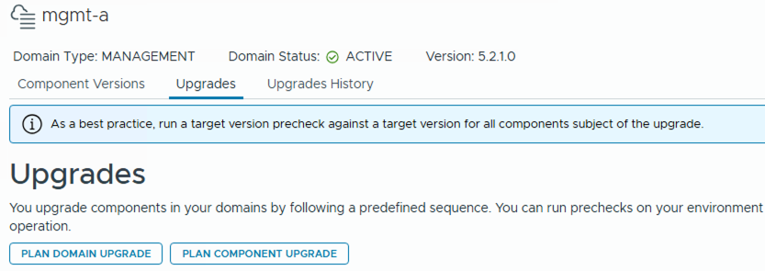
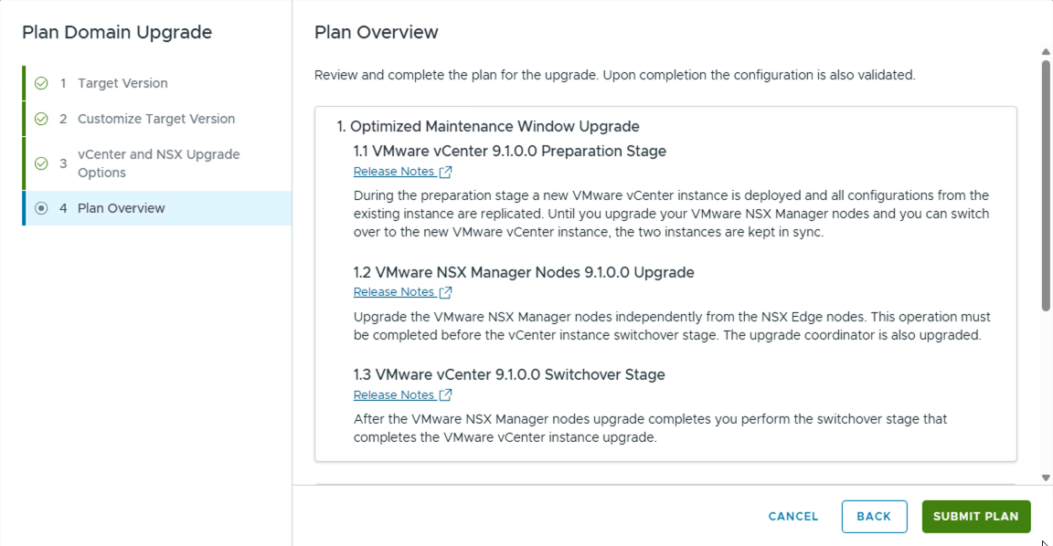
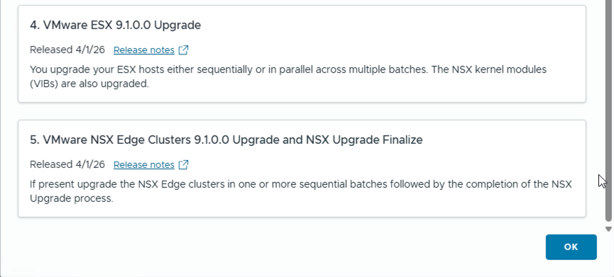
Upgrade & Patch Planning
Quickly identify the steps and sequence for applying updates
Create / Customize Upgrade Plan
Review Upgrade Sequence
Key Benefits
Create a plan for applying updates.
Plan identifies number of steps and sequence for applying updates.
Create a custom plan for each domain.
Technical Value
Understand steps prior to starting an update.
Compatibility and Interoperability verified by VCF LCM.
Fully guided patch and upgrade deployments.
Notes:
Key Message:
Intelligent upgrade planning removes the guesswork of component interoperability by automatically enforcing the correct installation sequence across the SDDC stack.
Talk Track:
Once the software depot has been setup and the binaries downloaded, you are ready to plan for your software updates. This is where the intelligence of VCF really shines. Instead of spending time researching how to upgrade each component and manually cross-referencing compatibility matrices, you simply tell VCF if you want to apply a patch or perform an upgrade.
VCF automatically evaluates your current version against your desired target version and generates a step-by-step Plan that you follow to apply the updates.
In this slide I’m showing an example of the plan that was created to upgrade a workload domain from VCF 5.2 to VCF 9.1. We can see that this plan involves 5-steps – we start by staging the vCenter upgrade, we then upgrade NSX and switch to the new vCenter, we then upgrade the ESX hosts and finish by upgrading the NSX Edge nodes.
VCF understands the interdependencies between vCenter, NSX, and ESX, ensuring that every component is updated in the exact order required.
Do note that patches and upgrades within a Cloud Foundation private cloud are applied to each workload domain independently. This eliminates the need to upgrade everything at once allowing you to seamlessly roll updates in over time.
Notes:
Resources:

Slide 20
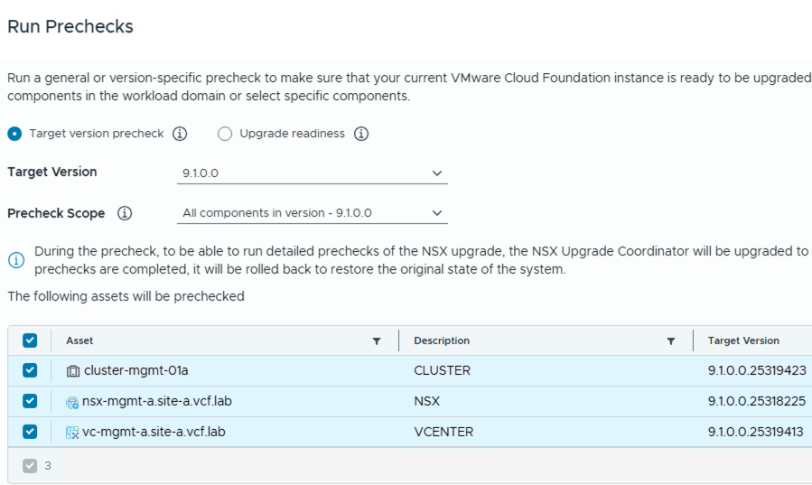
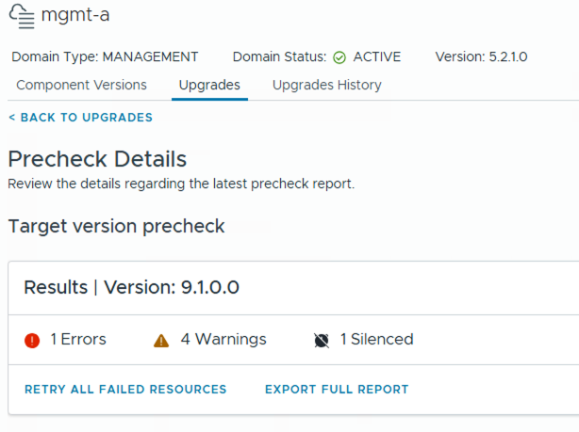
VCF Lifecycle Prechecks
Verify domain health and upgrade readiness
VCF 5.x & Aria Suite
VCF 9
Key Benefits
Comprehensive set of prechecks to verify domain health prior to upgrade.
General upgrade readiness as well as component-level checks.
Run a general or version-specific precheck…
Vew results in detailed report…
Technical Value
Improve upgrade confidence by ensuring domain health prior to upgrades.
Run at anytime to ensure ongoing health and continual upgrade readiness.
Notes:
Key Message:
Continuous and automated pre-checks shift lifecycle management from reactive troubleshooting to proactive validation, ensuring a high success rate for every update.
Talk Track:
Finally, I’d like to wrap up this section by calling out what is perhaps the most critical step to applying software updates in Cloud Foundation. This is running a Pre-check.
VCF provides pre-checks at both the Domain and Component levels. These checks help to validate the health of the domain prior to attempting an upgrade. The checks look for everything from general health issues to specific upgrade readiness blockers. We are constantly updating these checks with every release to account for the latest known issues and environmental variables.
While these are run before an upgrade, we recommend running them routinely as part of your standard operations. By proactively identifying and resolving health warnings—which you can export via CSV for deeper analysis—you ensure your environment is always 'upgrade-ready.' This instills confidence that when you do decide to move to the next version, the process will be smooth and successful.
This concludes this section on building and deploying a private cloud. I’ll now hand it off to the next presenter to continue with the cloud foundation overview.
Notes:
Resources:

Slide 21
Optimize Infrastructure and Operations
Storage
Notes:
Key Message:
Talk Track:
Now, let’s take a look at how storage is configured and utilized within VMware Cloud Foundation.
Notes:
Resources:

Slide 22
VMware Cloud Foundation Storage
Flexible Storage Options when deploying a new VCF instance
Principal storage options for the Management Domain of a new VCF instance
IP or FC Network
Switches
vSAN HCI (ESA/OSA)
NFS
FC
Principal storage options when creating a Workload Domain or Cluster (configured per-cluster)
vSAN HCI (ESA/OSA)
vSAN HCI Storage Clusters
vSAN
Remote Datastores
NFS
FC
Supplemental storage – Used to add capacity to any domain
vSAN HCI
Storage Clusters
vSAN Remote Datastores
NFS*
FC
iSCSI
NVMe
/FC
NVMe
/TCP
*LCM, patching, and upgrades of Supplemental Storage is not managed by VCF Operations
Notes:
Presenter note – this slide contains animation
Key Message:
VMware Cloud Foundation defines two (2) categories of storage - Principal storage and Supplemental storage.
Talk Track:
VMware Cloud Foundation provides flexible storage support for Workload Domains to satisfy a broad range of customer application requirements.
Cloud Foundation defines two (2) categories of storage.
Principal storage is the storage type selected when creating a new domain
During the initial deployment of a new Cloud Foundation instance, the management domain is configured using one of three storage types. vSAN HCI is recommended for use in the management domain.
<click>
When an additional workload domain or cluster is created, the customer is given several additional storage options to choose from. vSAN can be deployed as hyperconverged (vSAN HCI), disaggregated (using vSAN storage clusters) or as remote vSAN datastore.
Workload domains can also configured using NFS or VMFS on FC.
Having the flexibility to choose from a selection of different storage types allows customers to leverage their existing investments in storage hardware while also providing an easy on-ramp to move their workloads and applications to vSAN when they are ready.
<click>
Supplemental storage is the second storage type defined by Cloud Foundation.
While Principal Storage is used when configuring a workload domain or cluster, Supplemental Storage can be used to add storage capacity to any domain or cluster, including the management domain.
Supplemental storage options include:
vSAN Storage Clusters, vSAN remote datastores, NFS options NFSv3 and NFSv4.1 as well as VMFS on FC, VMFS on iSCSI, NVMe/FC, and now NVMe/TCP.
It is important to point out that adding and scaling any storage type other than vSAN is a manual process… just as it would be in a traditional environment using hardware-based storage solutions.
When vSAN is not used, the customer is responsible for maintaining server firmware/drivers and plug-ins in accordance with the VMware Compatibility Guide. If a customer is using VMFS on FC it is important that they also check HCL for FC array & HBA compatibility.
Notes:
Principal Storage:
Provisioning is automated in VCF Operations when creating Workload Domain(s).
Supplemental Storage:
Targets:
Data protection (File/Image backups).
Data at rest (templates, backups, archives).
Migration to a full SDDC.
Connect/mount:
Use vSphere web client to connect storage to workload domains.
vSAN Storage:
VCF provides support for clusters configured using vSAN Original Storage Architecture (vSAN OSA) and vSAN Express Storage Architecture (vSAN ESA).
vSAN can be configured as local or remote. vSAN local storage is a principal storage option which leverages local storage from the hosts configured as part of the cluster.
NVMeof/TCP:
VMware Cloud Foundation includes added supplemental storage support for NVMe-TCP. Cloud Administrators can utilize the benefits of using NVMeoF storage in a standard ethernet-based networking environment. The use of NVMe/TCP is more cost efficient and negates the need to deploy a fibre channel fabric.
NVMe Storage an be added by creating a new VMFS datastore which can be done quickly by following the steps in the VMware vSphere Product Documentation.
iSCSI:
VMware Cloud Foundation supports the use of iSCSI when for supplemental storage in any domain. Admins can register a VASA provider to configure iSCSI using APIs provided by the storage vendor. For a list of supported VASA providers please check the VMware Compatibility Guide. Once the VASA provider is configured, the user can then create a Network pool from the vSphere client to provide IP addresses for the VASA endpoints.
vSAN Storage Clusters (formerly vSAN Max):
vSAN 8 U3 also brings support of vSAN Storage Clusters (formerly known as vSAN Max) as principal storage in VMware Cloud Foundation 5.2. vSAN Storage Clusters leverages vSAN ESA architecture providing a disaggregated HCI solution that allows for the independent scaling of storage resources from compute resources. It enables businesses to adapt to changing needs quickly, ensuring storage capabilities align precisely with demand. This adaptability supports dynamic workloads and growth, significantly enhancing IT infrastructure’s flexibility and scalability
VCF Import:
If you use the VCF Operations to converge an existing vSphere environment to a VCF management domain, that management domain can use VMFS-FC and NFS v3 as principal storage, in addition to vSAN
Virtual Volumes (vVols)
vVols will be deprecated beginning with VVF/VCF 9.0 and will be fully disabled in in an upcoming release of VVF and VCF.
Limited time support for customers in 9.0 may be considered on a case-by-case basis under TQR/RPQ until vVol capabilities are fully disabled.
Resources:
For further information on Cloud Foundation storage please consult the Cloud Foundation Operations and Administration Guide.
https://docs.vmware.com/en/VMware-Cloud-Foundation/index.html
VMware Compatibility Guide:
https://www.vmware.com/resources/compatibility/search.php
VMware vSphere Product Documentation:
https://docs.vmware.com/en/VMware-vSphere/index.html

Slide 23
Cloud Foundation Storage Options
Storage Options and Capabilities
Provides a Full SDDC Solution
Storage Policy Based Management
Automated Deployment and Scale
Automated LCM, Patching, Upgrades
Stretched Clusters
Remote Clusters
Compute Only Clusters
vSAN HCI
vSAN Storage Clusters
VMFS on FC
NFS
Notes:
Key Message:
Summary of different storage options within VCF and their capabilities.
Talk Track:
What we can see here are the different storage options available within a VCF deployment…and their capabilities.
Using vSAN provides the customer with a full software defined solution. It is flexible, it’s quick to configure and easy to manage and change at a per workload-level with storage policy-based management.
vSAN can be configured for aggregated storage (using vSAN HCI) and disaggregated storage using vSAN Storage Clusters (formerly known as vSAN Max).
Storage Policy-based Management (SPBM) removes the need for manual hardware configuration and potential disruption when inevitable changes are needed later down the track. vSAN is also very easy to scale, allowing you to add compute and storage together when it is needed without the need to plan up-front for growth capacity. vSAN is also fully lifecycle managed, patched and upgraded which is completely automated when used with Cloud Foundation.
Cloud Foundation supports stretched clusters when using vSAN (both vSAN OSA and vSAN ESA).
Administrators can also configure multiple remote clusters using vSAN, NFS, VMFS on FC
It’s for these reasons why VMware recommends using vSAN with Cloud Foundation.
Notes:
- It is important to point out that adding and scaling any storage type other than vSAN is a manual process… just as it would be in a traditional environment which uses hardware-based storage solutions.
- When vSAN isn’t used, the customer is responsible for maintaining server Firmware/Drivers and plug-ins in accordance with the VMware Compatibility Guide.
If a customer is using VMFS on FC it is important that they also check HCL for FC array & HBA compatibility.
Resources:
VMware Compatibility Guide:
https://www.vmware.com/resources/compatibility/search.php
(ESX Host, vSAN, storage compatibility and more)

Slide 24
Evolving your Platform for the Demands of Today and Tomorrow
Remove hardware dependencies, decrease TCO, increase agility
Legacy Three-Tier
Hyperconverged
Proprietary storage hardware
Limited scalability
Siloed management
Inflexible
Commodity server hardware
Distributed scale-out storage
Common management
Highly flexible
Aggregated Resources
Compute
& storage
Compute
only
vSAN
Or…
Compute
only
Storage
array
Disaggregated Resources
Scale out
Scale out
Storage
only
vSAN
Notes:
Key Message/Talk track:
Traditional three-tier architectures have been powering data centers for many years, but have been hampered by fundamental limitations, including the use of proprietary hardware, and the need for special teams to manage specific aspects of the architecture. A fully integrated solution like vSAN can remove dependencies from hardware feature sets. By abstracting these features away from underlying hardware, you can address and apply the RIGHT settings in the RIGHT way for each workload running in a data center. Being able to apply these settings in a granular way, using software, is quickly turning into a requirement.
----------------------------------
Overview:
Legacy Three-Tier
Proprietary storage hardware
Limited scalability
Siloed management
Inflexible
Hyperconverged
Commodity server hardware
Distributed scale-out storage
Common management
Highly flexible

Slide 25
Next Generation Architecture built into vSAN
vSAN Express Storage Architecture™ (ESA) in vSAN
Next generation storage architecture for the workloads of today and tomorrow
Optional, alternative architecture to the vSAN original storage architecture
Available when running on qualified hardware in ESA approved vSAN ReadyNodes
Powers aggregated vSAN HCI clusters and disaggregated vSAN storage clusters
vSphere
vSphere
Compute
only
vSphere
vSAN ESA
Powered by
vSAN ESA
vSAN ESA
Compute
& storage
Storage
only
vSAN HCI cluster
vSAN
vSAN storage cluster
Express
Storage
Architecture™
vSAN HCI Clusters
Aggregated resources
vSAN Storage Clusters
Disaggregated resources
Notes:
Key Message/Talk track:
Back in 2022, VMware introduced the revolutionary Express Storage Architecture (ESA). This is our next generation storage architecture, written specifically for modern high-performance hardware that not only delivers unprecedented levels of performance and efficiency, but allows us to introduce new capabilities not previously possible. With vSAN ESA, you can easily choose by one of two deployment options. Aggregated vSAN HCI clusters, or disaggregated vSAN Storage Clusters. No matter what you choose, The vSAN Express Storage Architecture unlocks the capabilities of modern hardware to allow the workloads of today and tomorrow perform as the hardware allows.
----------------------------------
Overview:
Next generation storage architecture for the workloads of today and tomorrow
Optional, alternative architecture to the vSAN original storage architecture
Available when running on qualified hardware in ESA approved vSAN ReadyNodes
Powers aggregated vSAN HCI Clusters and disaggregated vSAN Storage Clusters
----------------------------------
Details:
N/A
Positioning
We want to make it very clear that while this new, optional architecture within vSAN introduces new patented technologies offering unprecedented new capabilities, vSAN was not “rewritten.” In fact, you’ll find many aspect of vSAN, such as the Distributed Object Manager (DOM), the Cluster Level Object Manager (CLOM) and the Cluster Management and Monitoring Directory Service (CMMDS) in place just like past editions, as it solves many of the great challenges of a distributed storage system. The new architecture simply helps address our ability to capitalize on the capabilities of this latest generation of high-performance hardware.
The vSAN ESA is not a “replacement” architecture, but an alternative architecture optimized for high performing, modern hardware. vSAN remains as a single product, but now includes the architectural capability to accommodate for these next generation hardware devices. It should not be positioned as a “rewrite” or a replacement in any way.
Do not reference the ESA and vSAN’s original storage architecture as “new” and “old” or any variation of that, as this can have a negative connotation toward previous editions of vSAN. While the vSAN ESA is the storage architecture where all future development efforts will be focused on, VMware is committing to ongoing support of the original storage architecture for many years to come. The official naming reference for the original storage architecture should be “Original Storage Architecture” abbreviated to OSA only when absolutely necessary.”
The internal name for our durable log-structured file system is “zDOM.” This is an engineering-centric name, and not intended as a public reference. One can refer to it as the “vSAN log-structured file system” or vSAN LFS when necessary.
Note that the references to “log-structured file system” do not refer in any way to a traditional file system such as NTFS, ext4, etc. It is a common industry reference to a method of how data and metadata are written to a circular log buffer and persisted to the storage subsystem.
Please note: Specific terms and details not readily available in the UI or KB articles, deemed as intellectual property, or sensitive have been obfuscated. Even the information here should be treated as sensitive, and should not necessarily be shared with external audiences. There is generally no need to use the terms CMMDS, CLOM, DOM, and LSOM with customers verbally, in correspondence, or in any published material. These are internal terms that are provided to help you better understand how vSAN works. Generalized terms such as “vSAN’s object manager…” will suffice in most cases.
The vSAN ESA is not a “replacement” architecture, but an alternative architecture optimized for high performing, modern hardware. vSAN remains as a single product, but now includes the architectural capability to accommodate for these next generation hardware devices. It should NOT be positioned as a “rewrite” or a replacement in any way.
Do not reference the ESA and vSAN’s classic architecture as “new” and “old” or any variation of that, as this can have a negative connotation toward previous editions of vSAN. While the vSAN ESA is the storage architecture where all future development efforts will be focused on, VMware is committing to ongoing support of the classic architecture for many years to come.
The internal name for our durable log-structured file system is “zDOM.” This is an engineering-centric name, and not intended as a public reference. One can refer to it as the “vSAN log-structured file system” or “vSAN LFS” when necessary.
Note that the references to “log-structured file system” do not refer in any way to a traditional file system such as NTFS, ext4, etc. It is a common industry reference to a method of how data and metadata are written to a circular log buffer and persisted to the storage subsystem.
Please note: Specific terms and details not readily available in the UI or KB articles, deemed as intellectual property, or sensitive have been obfuscated. Even the information here should be treated as sensitive, and should not necessarily be shared with external audiences. There is generally no need to use the terms CMMDS, CLOM, DOM, and LSOM with customers verbally, in correspondence, or in any published material. These are internal terms that are provided to help you better understand how vSAN works. Generalized terms such as “vSAN’s object manager…” will suffice in most cases.
----------------------------------
Additional Information:
Blog: https://blogs.vmware.com/cloud-foundation/2022/08/30/an-introduction-to-the-vsan-express-storage-architecture/

Slide 26
The vSAN Difference
Scale UP and OUT for maximum agility
Run more VMs per host
Add capacity the way you want
Scale UP by adding drives
Scale OUT by adding hosts
Agile, cost-effective cluster designs
vSphere
vSAN
vSphere
vSAN
vSphere
vSAN
Scale Up
vSAN Datastore
Scale Out
Notes:
Key Message/Talk track:
The tremendous efficiency of vSAN means that it can run more VMs per host than other HCI systems not integrated into the hypervisor. And not only that, but do with much more consistent levels of performance and tighter integration. This ability to scale up and out – often not possible in the same way when using storage arrays - means that users can strategically design their vSAN powered cluster to accommodate growth that best reflects the needs of their organization.
----------------------------------
Overview:
Add capacity the way you want
Scale UP by adding drives
Scale OUT by adding hosts
Agile, cost-effective cluster designs
----------------------------------
Details:
The difference in VM per host density is NOT a trivial amount. Actual real world environments have suggested competing solutions can only get ½ to 1/3rd the number of VMs per host, and lacking the consistency in performance that an in-kernel solution like vSAN has.
Designing vSAN hosts for future “scale up” expansion is an extremely powerful message that resonates with customers (e.g. Add capacity without any new hosts or licensing). See “Options in Scalability” that provides details and illustrations on how scale up expansion works. VirtualBlocks blog post at: https://blogs.vmware.com/virtualblocks/2016/09/15/options-scalability-virtual-san/
Some current scaling limits PER cluster are current set to:
Max cluster size: 64 hosts
Max stretched cluster size: 15 hosts + 15 hosts + 1 witness host
Max components: 9,000 per ESX host
Max witness components: 45,000 per ESX host
Max VMDK size: 62TB
6,400 VMs per cluster (limitation of vSphere HA)
A full listing of vSAN Limits and design considerations can be found here: https://storagehub.vmware.com/t/vmware-vsan/vmware-r-vsan-tm-design-and-sizing-guide/ as well as common FAQs found at: https://storagehub.vmware.com/t/vmware-vsan/vsan-frequently-asked-questions-faq/architecture/
----------------------------------
Additional Information:
TBD

Slide 27
Additional Data Services to Meet your Business Requirements
Easily tailor unique data services on a per cluster basis
vSAN iSCSI
target service
vSAN File
Services
S3 compatible
object storage*
Extend vSAN beyond native VM storage
Enable/disable based on organizational needs
  SMB and NFS file services
  iSCSI block access for legacy workloads
  S3 compatible object storage*
Provide FIPS validated data-at-rest and data-in-transit encryption
Physical
Virtual
App
Windows clients
Linux
clients
Container
PVs
Cloud native applications
iSCSI Network
vSphere
vSAN
DiT
Data-at-Rest
Encryption
Data-in-Transit
Encryption
vSAN Datastore
*Native S3 announced as a “technical preview” available in vSAN for VCF 9.1
Notes:
Key Message/Talk track:
vSAN offers a number of data services to help you address your organization’s unique needs. While vSAN can run hundreds of VMs per host in a vSAN cluster, additional data services are available to extend the functionality of vSAN. Take for example the vSAN iSCSI target service, where you can create an iSCSI target on vSAN so that a legacy physical server running an application can mount that iSCSI volume. Or perhaps your organization needs file services. vSAN File Services offers the ability to create SMB and NFS shares to work with both traditional and cloud native workloads. vSAN also offers native S3 compatible object storage. This has been announced as a “technical preview” available in a patch release of VCF 9.1. And finally, vSAN offers the ability to ensure the highest levels of security through data-at-rest encryption and data-in-transit encryption offerings. All of this adds up to a highly flexible, robust, and secure storage solution.
----------------------------------
Overview:
Extend vSAN beyond native VM storage
Enable/disable based on organizational needs
SMB and NFS file services
iSCSI block access for legacy workloads
S3 compatible object storage*
Provide FIPS validated data-at-rest and data-in-transit encryption
----------------------------------
Details:
Some features subject to licensing requirements and depend on the architecture used. (OSA versus ESA)
----------------------------------
Additional Information:
vSAN iSCSI Target Usage Guide: https://www.vmware.com/docs/vmw-vsan-iscsi-target-usage-guide
vSAN File Services: https://www.vmware.com/docs/vmw-vsan-file-services
vSAN Encryption Services: https://www.vmware.com/docs/vmw-vsan-encryption-services

Slide 28
Simple, Insightful Cluster Health Status and Troubleshooting
vSAN Health intelligent cluster health scoring, diagnostics and remediation
vCenter
Provides cluster health score for at-a-glance condition of cluster
Prioritizes identified issues to help address most important condition first
Weighs issues using common Administrator responsibilities
  Data availability
  Performance
  Capacity utilization
  Efficiency & Compliance
Take action on the most important issue, first
Summary
Monitor
Configure
Permissions
vSAN Health
Cluster health score
Health score trend
Weighted
score & history
92
92
52
Attention
Healthy
Health Findings
UNHEALTHY (2)
HEALTHY (49)
INFO (2)
SILENCED (1)
Prioritized issues with remedies
vSAN object health
Impact -40
Availability
Performance
Impact area:
Availability
Capacity
Compliance
Calculates Impact
Relationships
Category
Priority
Analyzes Conditions
vSAN
Notes:
Key Message/Talk track:
Administrators responsible for the health and well-being of an environment have a lot to think about. vSAN includes an innovative cluster health status and troubleshooting dashboard. It helps answer the basic questions of, “Is my cluster and the workloads it serves in a health state?” and if not, how sever is the condition? …and should the issue be resolved? It provides that information that traditional health alerts alone cannot. For each vSAN cluster, vSAN Health will provide a quick at-a-glance score of the condition of a cluster so an administrator can easily determine if all is good, and if not, how impactful any identified issues are. The new mechanism used a sophisticated method of weighing triggered health checks, and aligns them with common pillars of responsibility. It will then provide the most important, impactful triggered health findings in an order of priority so that an administrator can resolve issues quickly and easily.
----------------------------------
Overview:
Provides cluster health score for at-a-glance condition of cluster
Prioritizes identified issues to help address most important condition first
Weighs issues using common Administrator responsibilities
Data availability
Performance
Capacity utilization
Efficiency & Compliance
Take action on the most important issue, first
----------------------------------
Details:
The Skyline Health checks for vSAN allows administrators to verify the status of well over a hundred discrete health checks. While this can be useful, it lacks in its usefulness to administrators in the following ways:
Does not convey health condition in a way that is in alignment with common administrative pillars of responsibility (e.g. Availability of data and services, Performance SLAs, etc.)
Does not convey health severity. What type of impact the triggered health check(s) may have on a cluster
Does not provide a correlation of triggered health checks and their relationship to one another. (until vSAN 7 U3)
It presents triggered health checks in arbitrary form, visually presenting a more benign triggered health check with a more important triggered health check equally – which can be misleading in terms of what to address first.
More health checks added to a list exacerbates the problem of which triggered health check to address first.
Methods and order of remediation were unclear for many users.
vSAN 8 U1 introduces an all-new simplified way understand the health or status of a cluster, and remediate issues in a prioritized way.
Quickly identify the status of a cluster (e.g. “Do I need to address an issue now, or is it just a small matter that can wait?”)
Provides a summed, weighted value of triggered health checks to indicate severity, and priority.
Understand how any triggered health checks are impacting core administrator responsibilities
Gives a priority of remediation for triggered health checks.
Simplified steps for remediation in UI (manual or automated depending on the circumstances)
Provides a historical view of this cluster health score.
The new cluster health score and troubleshooting framework in vSAN uses a sophisticated algorithm to determine the score of a cluster so that triggered checks are accounted for with the appropriate level of severity. It does so through the following ways:
Category Factor. All health checks fall into one of 4 general categories. They are “Availability,” “Performance,” “Capacity Utilization” and “Efficiency and Compliance.” These categories are weighted to align with typical administrator pillars of responsibility. (Example. Efficiency and compliance isn’t important if none of the data is available in the first place). Some categories like “Availability” have an additional level of distinction between data availability, and infrastructure availability to be more accurate in its scoring.
Priority factor. This helps give a weight to a triggered heath check within a category, aggregating the weight of the triggered health checks.
The cluster score ranges from 0-100, with 100 being a perfectly healthy cluster based on the condition of the health checks.
Triggered alerts that are silenced will still be deducted from the total score.
The cluster score dial has line breaks that denote three general states of the cluster. This mimics, but in a much more accurate way, a common task administrators perform in quickly opening up vCenter server and randomly checking health checks, but in an arbitrary way.
81-100. On Target/Healthy - No attention required
61-80. Degraded health - Attention suggested.
0-60. Unhealthy - Attention required
Given the defined categories, one will find that if there are any triggered issues regarding “availability” (where data is unavailable, and not just degraded in prescribed resilience) it will always reduce the total cluster health score enough to where the scoring will be in the “Unhealthy – Attention required” range.
This capability is designed to prevent false positives from operational tasks, or the designed behavior of vSAN in how the types of conditions of alerts are weighted. The vSAN health checks for vSAN can distinguish between data unavailability versus data still available but degraded in its level of prescribed resilience. For example, a triggered health check of “vSAN Object Health” will impact a health score much more so if it is unavailable, than if it is available, but degraded due to a “reduced level of resilience” condition that could have been invoked by a planned EMM event using the “ensure accessibility” option. It methodology is also applicable to device and host failures.
The “Capacity Utilization” and the “Efficiency and Compliance” categories attempt to convey to the administrator if they are utilizing their purchased resources optimally. Anything that subtracts from the aggregate sum of resources could be deemed a reduction in efficiency because the cost of providing the services was increased relative to the loss of resources.
Rendering a cluster health score sets the stage for the other aspect of this feature: The prioritized order of remediation of outstanding issues, with improved guidance for the triggered issues.
The UX deemphasizes the simple enumeration of green health checks for the reasons described in bullet point #1, and prioritizes triggered health checks in priority of 1.) Level of impact on the cluster, and 2.) the hierarchal relationship that the triggered health checks have to each other.
“Health Findings” will be presented in a list below the cluster health score and score timeline. It will be sorted by a “recommend” (e.g. “root cause”) order of remediation.
The triggered health findings will always be sorted by “root cause” by default. It can also be sorted by:
Occurred on
Status
Score
Category
Impact area
The remediation will always surface the root cause of the issue. For example, in the event of a data availability issue, there may be an “object health” warning that is most certainly important, but this in many ways is a symptom-based health check. There may also be a “network partition” alert associated with this issue, where it is a symptom of the related issue. vSAN health will recognize this, and present the “root cause” alert “e.g. “vSAN vmknic is not configured” as the first order of resolving the issue.
The dashboard deemphasizes an enumerated list of health checks that have passed, as the details of passed health checks have limited relevance. They are however visible by selecting the “Healthy” tab in the “Health Findings” of the Cluster dashboard.
The guidance in many of the triggered health checks have improved. While we aim to have semi-automated “fix issue” workflows in place, enhancements in the guidance should help customers resolve issues more quickly.
This new capability builds off of the vSAN Health Check correlation capability introduced in vSAN 7 U3. This health check correlation capability introduced the ability for various health checks to understand the relationship of one health check to another for improved levels of troubleshooting. These relationship mapping of the health checks grows more sophisticated with each release, and plays a critical role in helping the administrator address the root cause of a triggered issue.
At this time, the majority of the checks in the vSAN health check engine are focused availability. As a result, the cluster scoring, identification of issues, and direct paths for remediation are the strongest with availability concerns. As our health check engine continues to add more checks for performance, capacity utilization, and efficiency, it will become more effective and important to the understanding of the conditions of cluster health in those areas, and offer more sophisticated methods for remediation.
A cross-BG effort has transitioned the “health Check” terminology across vCenter Server to “Health Findings.” They mean the same thing, but for all future UI references, you will see the term “health findings” used.
Note that for all time based-metrics, the formatting of dates across a time-line can be adjusted to suit a country of origin. Clicking on the “My Preferences” will provide a time format and language selection that can either be set for the browser default, or to a specific language.
Positioning
The Cluster health scoring mechanism mimics an approach often practiced by seasoned administrators, where issues are identified, weighted, and steps for remediation are prioritized. However, vSAN Health is able to achieve these practices in a similar way for all customers, regardless of skillset.
----------------------------------
Additional Information:
TBD

Slide 29
Run Multiple Workloads and Topologies Simultaneously
Provides flexibility in powering many types of workloads across different environments
Edge
Edge
Power multiple application types using vSAN
  Business Critical Apps (BCA)
  Cloud Native Apps (CNA)
  IT Core Infrastructure svcs.
  Virtual desktops (VDI)
  Edge (2-Node Clusters)
Easily adapt configuration to evolving needs
Use multiple topologies across environment
Manage through single interface
vCenter Server
vSAN
vSAN
Edge / Branch Offices
Business Critical Apps (BCA)
VDI
CNA
IT
Stretched Cluster
vSAN
vSAN
vSAN
Co-Lo
Primary Data center
Notes:
Key Message/Talk track:
vSAN supports all different types of workloads and topologies. Run business critical applications along-side other applications or carve out clusters focused on specific application requirements. Whether they be VDI workloads, business critical workloads, cloud native applications, or common IT service workloads, not only can you easily meet the needs of the application, but the flexibility of the architecture allows you to deliver those services in many different ways. House them in a central data center, or perhaps a stretched cluster that spans two physical sites. Maybe an organization has several branch offices, or perhaps they want the flexibility to expand resources by using the cloud. vSAN can meet all of these demands, and more, all by using a single management plane: vCenter Server.
----------------------------------
Overview:
Power multiple application types using vSAN
Business Critical Apps (BCA)
Cloud Native Apps (CNA)
IT Core Infrastructure svcs.
Virtual desktops (VDI)
Edge (2-Node Clusters)
Easily adapt configuration to evolving needs
Use multiple topologies across environment
Manage through single interface
----------------------------------
Details:
Flexibility in topologies could include, but are not limited to:
Standard clusters carved up to meet specific business needs
Standard clusters using explicit fault domains
Standard clusters using HCI-Mesh
Hybrid-cloud configurations using a blend of hardware on premises and in the cloud
Stretched clusters
2-Node clusters
Clusters connected to DRaaS
The emphasis of this slide is focused on traditional application. Cloud native apps can be intermingled in this, but it is not shown for clarity.
----------------------------------
Additional Information:
Use case: vSAN in Industrial Environments: https://blogs.vmware.com/cloud-foundation/2021/03/26/vsan-in-industrial-environments/
Use case: vSAN in Healthcare: https://blogs.vmware.com/cloud-foundation/2021/06/16/vsan-in-healthcare/
Use case: vSAN Powering Biotech: https://blogs.vmware.com/cloud-foundation/2021/04/07/vsan-powering-biotech/
Use case: Multitenancy in vSAN: https://blogs.vmware.com/cloud-foundation/2022/09/23/multitenancy-in-vsan/

Slide 30
One Solution – Multiple Deployment Options
Aggregated resources using vSAN HCI or disaggregated resources using vSAN storage clusters
Unified lifecycle management of storage and compute resources
Symmetrical scaling of storage and compute resources
Treats storage as a resource of the cluster
Compute
& storage
vSAN HCI
vSAN HCI
Compute
only
Independent lifecycle management of storage and compute resources
Asymmetrical scaling of storage and compute resources
Extreme capacity can serve many clusters
Decoupled vSphere clusters can be sized to optimize application licensing
Scale out
Scale out
Storage
only
vSAN storage cluster
vSAN Storage Cluster
Powered by vSAN ESA
Centralized Management
Storage integrated into hypervisor
Notes:
Key Message/Talk track:
vSAN can be deployed in different ways. The two primary deployment options are aggregated “vSAN HCI” clusters and disaggregated “vSAN storage clusters.” vSAN HCI clusters are what most people think of when they hear “hyperconverged” where storage resources are provided on the same hosts that provide memory and compute resources. But vSAN can be deploy in a disaggregated way, where a cluster can be deployed for the single purpose of providing centralized shared storage for vSphere clusters. Which deployment option is right for you? The circumstances or requirements you have in your environment may favor one deployment option over the other, but in most cases, it does not mean that a specific deployment option should be excluded from consideration. Whatever is chosen, vSAN HCI clusters can happily coexist with vSAN storage clusters, as they are all managed in the very same way, using the very same software.
----------------------------------
Overview:
vSAN HCI
Unified lifecycle management of storage and compute resources
Symmetrical scaling of storage and compute resources
Treats storage as a resource of the cluster
vSAN Storage Clusters
Independent lifecycle management of storage and compute resources
Asymmetrical scaling of storage and compute resources
Extreme capacity can serve many clusters
Decoupled vSphere clusters can be sized to optimize application licensing
----------------------------------
Details:
See the document referenced below
----------------------------------
Additional Information:
Asset detailing this decision-making process: https://blogs.vmware.com/cloud-foundation/2024/01/22/vsan-hci-or-storage-clusters-which-deployment-option-is-right-for-you/

Slide 31
A New Way to Process and Store Data Efficiently
vSAN Express Storage Architecture
Fast & efficient data path
Native scalable
snapshots
Simplified
Administration
vSphere
vSAN ESA
Efficient and resilient data structure
Single tier
Single tier
Single tier
vSAN ESA Datastore
Performance
Efficiency
New Capabilities
More data on less hardware
Fewer hosts to process data
More capacity on less hardware
Fewer hosts to process data
vSAN Protection and Recovery
vSAN storage clusters, etc.
Notes:
Key Message/Talk track:
It is the Express Storage Architecture that makes vSAN so unique in its abilities to deliver performance, efficiency, and new capabilities like never before. The best way to think of vSAN ESA is that it provides a better way for vSAN to process and store data efficiently. A new fast and efficient data path paired with an efficient and resilient data structure give our users the ability store and access data fast and efficiently. vSAN ESA also provides its own snapshot engine that is meets high levels of performance and scalability, not only maintaining full compatibility for our partners providing backup solutions, but new capabilities courtesy of vSAN Protection and Recovery. And finally, the vSAN Express Storage Architecture makes administering an environment easier in a myriad of ways.
----------------------------------
Overview:
Highly adaptable to the hardware of today and tomorrow
Stores data efficiently while meeting performance requirements
Higher levels of resilience without compromise
Native, scalable snapshots
Simplifies administration and serviceability
----------------------------------
Details:
Technical details provided in the subsequent slides.
Positioning
The vSAN ESA is not a “replacement” architecture, but an alternative architecture optimized for high performing, modern hardware. vSAN remains as a single product, but now includes the architectural capability to accommodate for these next generation hardware devices. It should NOT be positioned as a “rewrite” or a replacement in any way.
Do not reference the ESA and vSAN’s original storage architecture as “new” and “old” or any variation of that, as this can have a negative connotation toward previous editions of vSAN. While the vSAN ESA is the storage architecture where all future development efforts will be focused on, VMware is committing to ongoing support of the original storage architecture for many years to come. The official naming reference for the original storage architecture should be “Original Storage Architecture” abbreviated to OSA only when absolutely necessary.”
----------------------------------
Additional Information:
Blog: https://blogs.vmware.com/cloud-foundation/2022/08/30/an-introduction-to-the-vsan-express-storage-architecture/

Slide 32
Do More with What You Already Have to Reduce TCO
Key benefits over vSAN OSA and traditional storage
Greater Performance
Higher Storage Efficiency
Better Resilience & Security
Consistent, scale-out performance beating traditional storage
Consistent low latency
Adaptive write path for maximum throughput
Supports latest CPU/server platform with fast and high capacity NVMe devices
RAID-5/6 at the performance of RAID-1
Global deduplication without compromise on performance or security
Lower overheads with single-tier architecture
Lower CPU/Memory usage per I/O processed
New data compression capabilities
Reduced failure domains improve availability upon device failure
Native, scalable snapshots with minimal performance impact
Improved encryption in-transit and at-rest
Durable data during planned and unplanned events
Automated resilience using Auto-RAID
Better performance than traditional storage!
Lower TCO than traditional storage
Protection without compromise
Notes:
Key Message/Talk track:
The Express Storage Architecture allows customers to provide a platform that serves and stores data faster and more efficiently than ever before. But of course, it is not just about performance and efficiency. It is about having a platform that demonstrates the agility needed to support a variety of use cases, while making sure that it is easy, and intuitive to deploy, operate, and optimize.
----------------------------------
Overview:
Better Performance & Scalability
Consistent, scale-out performance beating traditional storage
Consistent low latency
Adaptive write path for maximum throughput
Supports latest CPU/server platform with fast and high capacity NVMe devices
Supreme Resource & Space Efficiency
RAID-5/6 at the performance of RAID-1
Global deduplication without compromise on performance or security
Lower overheads with single-tier architecture
Lower CPU/Memory usage per I/O processed
New data compression capabilities
Better Resilience
Reduced failure domains improve availability upon device failure
Native, scalable snapshots with minimal performance impact
Improved encryption in-transit and at-rest
Durable data during planned and unplanned events
Automated resilience using Auto-RAID
----------------------------------
Details:
The performance claims are generalized in this presentation. Additional material will be provided that will demonstrate referenceable and quantifiable improvements when compared to vSAN using the original storage architecture. As with any performance and efficiency claims, it is subject to several environmental conditions, such as hardware, workload characteristics, data services used, etc.
Positioning
The Express Storage Architecture has numerous architectural details that provide several positive benefits to the customer, but many of them (especially performance and efficiency improvements) are implementation details that will be transparent to the administrator. They are, however, important to the concept of doing more with less to drive down costs.
----------------------------------
Additional Information:
TBD

Slide 33
vSAN - The premier storage for VMware Cloud Foundation
You’ve trusted the hypervisor to manage your workloads. Why not let it manage your storage?
vSAN is a part of the hypervisor and licensing. Why not use it?
vSAN HCI
vSAN storage clusters
VMware Cloud Foundation
Manage and protect your workloads at the VM level for unprecedented levels of control, visibility, and protection
Notes:
Key Message/Talk track:
Simply put, vSAN is the premier storage platform for VMware Cloud Foundation. Ask yourself the questions: “You’ve trusted the hypervisor to manage your workloads. Why not let it manage your storage?” “vSAN is a part of the hypervisor and licensing. Why not use it? vSAN allows you to manage and protect your workloads at the VM level for unprecedented levels of control, visibility, and protection.

Slide 34
Optimize Infrastructure and Operations
Networking - NSX
Notes:
Key Message:
Networking is a core component of Cloud Foundation's software defined capabilities.
Talk Track: (50)
The public cloud (as we know it) is built upon and heavily leverages software defined networking. VMware NSX is an inherent part of Cloud Foundation and allows IT teams to deliver similar cloud-like capabilities into the data center.
Software Defined Networking and Security with NSX removes the need to individually configure networking and security components manually. Switched and routed networks can be provisioned and managed with ease to support the changing needs of your applications. It removes the complexities associated with provisioning and managing traditional networking infrastructure allowing you to build and scale it in software using automation.
SDDC Manager takes NSX even further adding automation capabilities. Administrators can build, scale and lifecycle manage networking and security as part of the full platform stack.
Notes:
Cloud Foundation delivers a complete SDDC platform where all elements of infrastructure (compute, storage, networking, security and lifecycle management) are virtualized and abstracted from the underlying hardware. Having these capabilities allows IT Teams to deliver an unprecedented level of flexibility within the data center allowing them to best service the needs of their applications and services without disruption and in less time.
References:

Slide 35

Network Virtualization is Required to Deliver a Modern Private Cloud
Network
Virtualization
Modern Apps
Networking
Network Visibility
and Troubleshooting
Workload
Mobility
Lateral
Security*
Integrated
SDN
Simplified K8s Networking
Powerful
Monitoring
Large-scale
Mobility
E-W Traffic
Protection
Self-service networks
with Virtual Private Cloud
Comprehensive network
policy model
Pre-deployment assessment
Any-to-any vSphere version
Stateful L7
Distributed FW
Virtual distributed switching & routing
K8s platform agnostic
Application discovery
Zero-downtime migration
ATP with IDS/IPS, Network Sandbox, NTA/NDR
Consistent networking policies across sites
Integration with NSX offers a single pane of glass
Network topology and metrics visualization
Various migration modes
Security analytics and rule recommendations
*Add-on advanced services not included with VCF
Notes:
Presenter Note: This slide contains animation.
Key Message:
VCF virtual networking makes private cloud networking simpler, more flexible, and more secure. It helps teams connect virtual machines and containers, see network traffic more clearly, move workloads more easily, and protect apps and data with built-in security.
Talk Track:
Traditional networks can be slow to change and hard to scale.
VCF virtual networking with NSX solves this by abstracting networking in software instead of relying only on hardware.
Setting up and managing networking, security, and services is faster and easier thanks to virtual networking.
<click 1>
VCF virtual networking also works well with containers and Kubernetes.
It gives virtual machines and containers the same networking and security policies, which makes hybrid environments easier to manage.
<click 2>
VCF virtual networking gives admins a clear view of network traffic and security rules.
This helps them find problems faster, improve performance, and reduce downtime.
<click 3>
Virtual networking makes it easier to move workloads between data centers and the cloud.
Because policies stay consistent, apps can move with less rework and less risk.
<click 4>
With vDefend add-on services, VCF virtual networking adds stronger security.
It helps stop threats, reduce blind spots, and better protect applications and data across the environment.

Slide 36
Virtual Networking in VMware Cloud Foundation
Networking has changed…
Virtual Networking is Built for the Application
Applications in Focus
Building a repeatable infrastructure for applications
Abstracts the hardware layer and virtualizes network resources
Application Layer
Hosted on VMS
Centrally Controlled
and Deployed
SDN Layer
Operations
Policy-based enforcement based on application behavior
Enforcement at application level and not at multiple points in the infrastructure
Switching
Routing
Stateful Firewalling
LB
NAT
VPN
Physical Infrastructure
as Transport
Infrastructure Layer
Notes:
Presenter Note: This slide contains animation.
Talk Track:
Networking has changed. It is no longer about configuring hardware. It is now focused on the needs of the application.
VCF provides virtual networking and security services that help you see your apps, traffic, and security policies more clearly.
<click 1>
The main idea is to move complexity out of the physical network. Because policies are software-based, they are easier to apply, manage, and keep aligned with each application’s needs.
<click 2>
This also makes the physical network simpler. Its main job is limited to providing a reliable, highly available foundation, while the virtual network handles most of the intelligence.
Notes:
* Security features are consumed as an add-on NSX license (VMware vDefend).
Other advantages of software-defined networking as expressed as part of VMware Cloud Foundation:
1.) Abstraction through encapsulation – traffic can now simply transit (bypass) over the hardware layer by making use of encapsulation technologies.
2.) Integrated networking across application frameworks (this means that routing and switching policies can be applied at application-level and across the entire SDDC)
3.) Integrated security throughout the data center by introducing the concept of micro-segmentation (application-focused firewalling)
4.) Single pane of glass for troubleshooting
Resources:
For further information on Cloud Foundation networking please refer to the VCF Design Guide

Slide 37
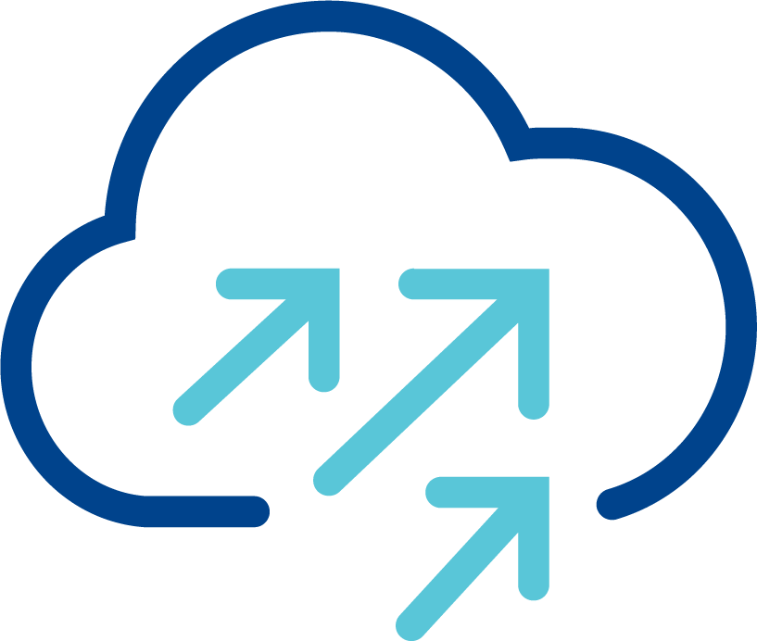
VCF with Physical Networking
IP Fabric with service appliances
Vendor #1 configuration/API
Switching
Vendor #2 configuration/API
Routing/NAT
VLAN z
VLAN y
VLAN x
VCF with vSphere Networking
Vendor #3 configuration/API
Load Balancing
ESX
ESX
ESX
Vendor #4 configuration/API
Firewall, IDS/IPS, ATP
DvPG x
DvPG y
DvPG z
DvPG x
DvPG y
DvPG z
Vendor #5 configuration/API
Monitoring and Analytics
Monitoring and Analytics
Vmware Cloud Foundation
Notes:
Presenter Note: This slide contains animation.
Key Message:
Using vSphere networking with VCF requires tight coordination with physical infrastructure, creating delays and making full automation complex and often unfeasible.
Talk Track:
Let’s compare physical-based networking and virtual networking in VCF.
When running VCF with traditional vSphere networking, coordination with the physical network is necessary.
For example, deploying a new application involves attaching its VMs or containers to dvportgroups
<click 1>
Those dvportgroups must then be mapped to corresponding VLANs in the physical fabric.
Even with advanced technologies like EVPN, coordination between application and network teams cannot be avoided.
<click 2>
Beyond Layer 2, deployments require changes to routing, load balancing, security, and more.
This typically involves multiple teams.
In many organizations, these interactions rely on ticketing systems, introducing delays that can span weeks.
And the number of independent configuration touchpoints makes end-to-end automation extremely difficult, if not impossible.
Notes:
Resources:

Slide 38
VCF with NSX Virtual Networking
Independent of the physical infrastructure
IP Fabric with service appliances
Tunnels over physical infrastructure
VCF with NSX Virtual Networking
ESX
ESX
ESX
Subnet Z
Subnet Y
Subnet X (virtual network)
Vmware Cloud Foundation
Notes:
Presenter Note: This slide contains animation.
Key Message:
NSX enables seamless, scalable virtual networking over existing IP infrastructure, with no physical network changes required.
Talk Track:
VCF includes NSX virtual networking.
With virtual networking, workloads can be connected to virtual networks that we call subnets. Those subnets are completely independent of the physical infrastructure.
<click 1>
For example, here we create subnet X using NSX. The VMs attached to this network immediately get Layer 2 connectivity—no additional configuration is needed anywhere else.
How is this achieved?
<click 2>
NSX automatically establishes tunnels between the hosts. No user intervention is required.
<click 3>
When traffic for a subnet needs to be carried between hosts, NSX encapsulates it and sends it over the physical infrastructure.
The physical network only sees standard IP traffic between hosts.
It’s unaware of the underlying virtual network, which only exists within NSX.
<click 4>
This allows NSX to instantiate any number of virtual networks over the same set of tunnels, without requiring any configuration on the physical network side.
Notes:
Resources:

Slide 39
VCF with NSX Networking
The whole networking stack is virtualized
IP Fabric with service appliances
GENERIC IP FABRIC
Switching
Routing/NAT
VCF with NSX Virtual Networking
Load Balancing
ESX
ESX
ESX
Firewall, IDS/IPS, ATP
Subnet Z
Subnet Y
NSX REST API
Automation
Subnet X
Monitoring and Analytics
Vmware Cloud Foundation
Notes:
Presenter Note: This slide contains animation.
Key Message:
NSX delivers a full virtual networking stack with centralized, API-driven control—enabling cloud-like automation and simplicity on a standard IP fabric.
Talk Track:
Of course, NSX offers much more than just virtual Layer 2 networking.
In fact, NSX builds a complete virtual networking stack on top of those virtual networks.
<click 1>
With NSX, all you need is a simple IP fabric. There’s no need to manage a variety of appliances in the physical network.
Application deployment now only involves configuring virtual components.
<click 2>
And because all those components are managed by NSX, you can deploy your application through a single configuration point.
With NSX’s intent-based model, multiple networking features can even be configured in a single REST API call.
This API driven architecture makes automation straightforward.
These benefits are well established in the public cloud—and with VCF, which integrates compute, storage, and virtual networking—you now get that same experience in your private cloud.
Notes:
Resources:

Slide 40

Some Additional Uses Cases for VCF with NSX
VM Mobility
L2 DC Extension
Rack 1
Rack 2
Rack 3
DC1
DC2
Disaster Recovery
Multi-Site
DC1
DC2
London
Paris
DC1
Notes:
Presenter Note: This slide contains animation.
Key Message:
NSX enables flexible, location-independent networking that supports workload mobility, simplified disaster recovery, and scalable multi-site deployments—all over standard IP infrastructure.
Talk Track:
NSX virtual networking unlocks several additional use cases.
In traditional data centers using physical appliances, workloads are often tied to specific locations—creating silos and limiting flexibility.
<click 1>
With virtualized networking, workloads become mobile. VMs can move freely across the data center, enabling optimal compute utilization and better redundancy.
<click 2>
Because NSX virtual networks operate over basic IP connectivity, they can be extended across racks—or even between data centers—without requiring complex overlays deployed in the physical infrastructure.
<click 3>
This flexibility is the foundation for simplified disaster recovery.
<click 4>
When a site fails, its networking environment can be instantly re-created at the backup site, where workloads can be redeployed.
<click 5>
More advanced multi-site deployments are also possible. NSX allows dynamic extension and instantiation of networking infrastructure, all managed from a central control point.
Notes:
Resources:

Slide 41
NSX Components
Physical Network Infrastructure
VM Management Network
NSX Overlay network
/Edge Overlay Network
ESX
ESX
ESX
Edge Node VM
Edge Node VM
Virtual Network Appliance (VNA)
Virtual Network Appliance (VNA)
vCenter
NSX manager
TEP
TEP
TEP
TEP
TEP
TEP
TEP
TEP
TEP
TEP
Edge Cluster
VNA Cluster
Vmware Cloud Foundation
Configured by VCF Operations
Optional Appliances for Centralized Services
Deployed by VCF Operations
Notes:
Presenter Note: This slide contains animation.
Key Message:
NSX is automatically deployed in VCF, with NSX Manager, host TEPs, and optional edge nodes/virtual network appliances providing a fully integrated virtual networking stack over a shared IP fabric.
Talk Track:
NSX is integrated into VCF and automatically deployed through VCF operations.
At the core of NSX is the NSX Manager, which handles both the control and management planes.
In smaller environments, it can run as a single VM protected by vSphere HA.
More commonly, it runs as a cluster of three VMs for scale and redundancy.
NSX Manager is tightly coupled with vCenter, which acts as the compute manager.
Both components connect to a shared “VM Management Network” within VCF.
<click 1>
Each ESX host is automatically configured by VCF with Tunnel Endpoints, or TEPs.
Those TEPs are vmkernel interfaces that are used to establish tunnels between hosts and enable virtual networks over the physical infrastructure.
<click 2>
VCF also includes the appropriate guided workflows for easily deploying optional appliances that run centralized virtual network services like DHCP, load balancers, stateful NAT etc.
Two kinds of appliances are available in NSX.
<click 3>
The edge nodes are transport nodes with their TEPs connected to either the “NSX Overlay Network” or the “Edge Overlay Network.”
<click 4>
VCF 9.1 introduces a new virtual network appliance, or VNA, that is simpler to deploy as it does not even require dedicated TEP connectivity.
Notes:
Resources:

Slide 42
Major NSX features
Distributed or centralized on edge nodes
ESX
ESX
ESX
Edge node VM1
Edge node VM2
Virtual Network Appliance (VNA)
Virtual Network Appliance (VNA)
Edge Cluster
VNA Cluster
Features distributed across ESX hosts
Features requiring edge nodes or VNAs
Distributed routing and switching
Distributed routing to physical infrastructure
1:1 NAT
Distributed DHCP
QoS
BGP, EVPN
NAT
DHCP
Load balancing
Edge only: Gateway QoS, VPN
Distributed firewall, IDS/IPS, ATP*
Gateway firewall*
*requires vDefend add-on
Notes:
Key Message:
NSX’s virtual networking stack includes centralized services on edge nodes and can be extended with advanced security features.
Talk Track:
Here’s a selection of key features offered by the NSX virtual networking stack.
Stateful services typically run centralized on an appliance and require edge nodes or virtual network appliances.
And while NSX includes core networking capabilities out of the box, advanced security features are available as add-ons.
Notes:
Resources:

Slide 43

Simple Networking with Virtual Private Clouds (VPCs)
Clear role definition allows self-service network for the end user
PHYSICAL NETWORK
Resources pre-provisioning
VCF with VPCs
Required
Networking
Expertise
Enterprise Admin:
  Owns the physical infrastructure
Project Admin:
  A tenant
  No direct access to physical network
VPC Admin:
  End user
  Simple, self-service networking
Configure external connectivity
Create projects, allocate resources
(ex. IP pools)
Enterprise Admin
advanced
Project
Create VPCs
Distribute network resources
Project Admin
basic
VPC
VPC
Required
Networking
Expertise
Create subnets (1click)
Attach VMs
VPC Admin
minimal
subnet
subnet
Self-service resources consumption
Notes:
Presenter Note: This slide contains animation.
Key Message:
Virtual Private Cloud configuration is split into multiple roles, matching the different responsibilities required in a multi-tenant environment.
One of the main benefit of this model is that it shields VPC admin (a VI admin for example) from complex networking configurations that are pre-configured by the upper tiers (enterprise admin/project admin.)
Talk Track:
A Virtual Private Cloud, or VPC, is a logically isolated, tenant-specific virtual network that provides dedicated routing, switching, and security services.
In VCF, the model defines clear roles to support multi-tenancy and enables self-service capabilities for end users.
The first role is the Enterprise Admin, who owns the VCF infrastructure and manages the connection to the physical network.
<click 1>
The Enterprise Admin is responsible for coordinating with the physical network to ensure proper connectivity.
They also create "projects," which represent the first level of tenancy. The enterprise admin can assign resources, quotas and limits to those projects.
<click 2>
Next, the Project Admin steps in to manage the resources delegated by the Enterprise Admin, but without direct access to the physical infrastructure.
<click 3>
The Project Admin is responsible for creating and managing VPCs, which represent the second level of tenancy.
<click 4>
Finally, we have the VPC Admin, who acts as the end user in this model.
The VPC Admin can independently create virtual networks—called subnets—
and easily attach workloads to these networks.
<click 5>
A key benefit of this model is that the VPC Admin can fully leverage networking services without requiring in-depth networking expertise.
This is possible because the Enterprise and Project Admins pre-configure the underlying network and resource allocations, enabling true self-service with minimal need for additional support.
Notes:
Resources:

Slide 44
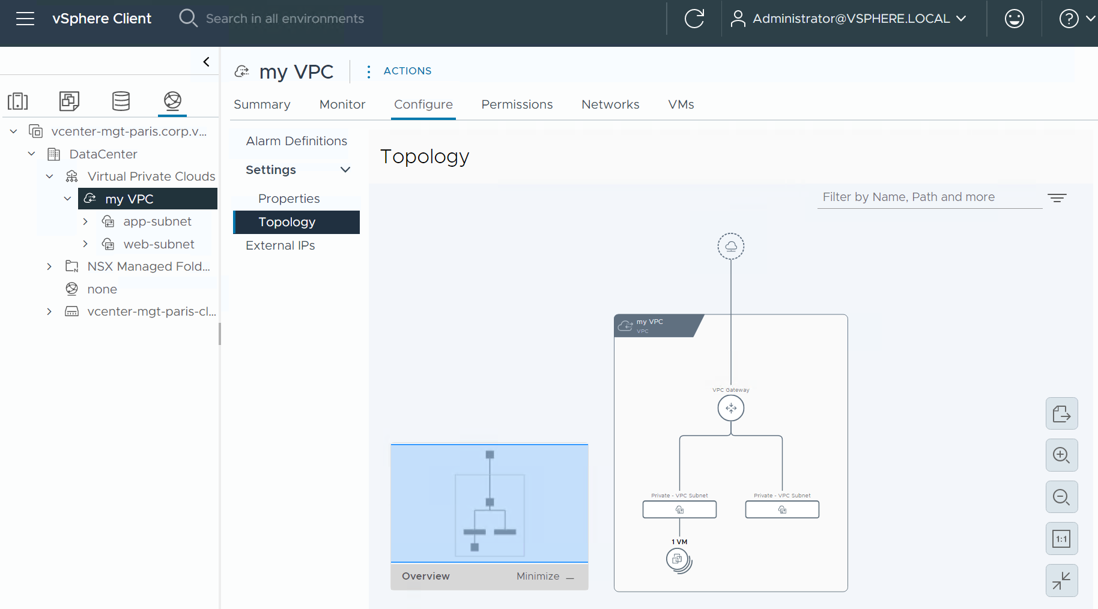
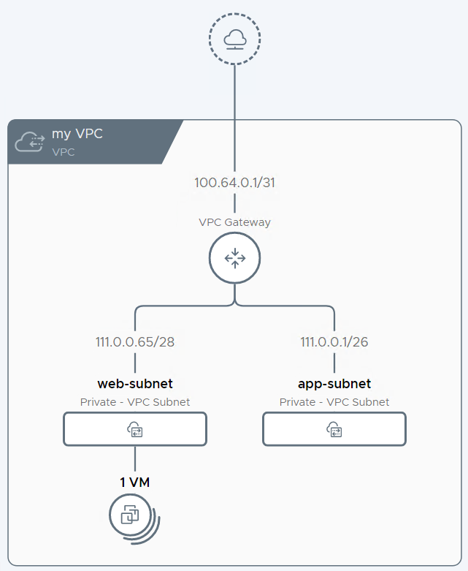
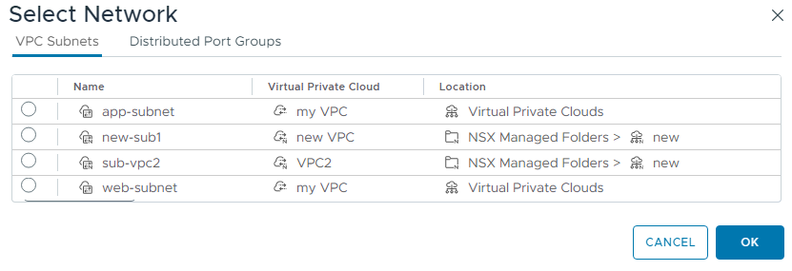
Consume VPCs in vCenter and VCF Automation
Consistent implementation of Virtual Private Clouds (VPCs) across the platform
VPCs can be configured directly from vCenter and VCF Automation
VPCs and subnets are first-class objects
Attaching a VM to a subnet is straightforward
Notes:
Presenter Note: This slide contains animation.
Key Message:
With VCF 9.0, VPCs are fully integrated across the platform, exposed as first-class objects in vCenter where the default project is fully configurable by the vCenter Admin, who can easily connect VMs to subnets or DVPGs directly from the UI.
Talk Track:
The VPC concept is fully integrated and consumable across the different components of VCF.
VCF automation leverages VPC objects, and VPCs are now exposed as first-class objects directly within vCenter.
In fact, a default project is pre-created in vCenter and is fully configurable by the vCenter Admin.
Other, non-default projects appear in vCenter as read-only and cannot be modified from there.
<click 1>
vCenter also displays subnets directly its the UI, allowing you to easily connect a VM to a subnet, the same way you would attach a VM to a DVPG.
Notes:
Resources:

Slide 45
Virtual Network Infrastructure Supporting Each VPC Tier
Logical view
PHYSICAL NETWORK
The enterprise admin creates external connections
  They represent connectivity to the physical network
  Can be a centralized (tied to a Tier0 GW) or distributed (VLAN/VXLAN)
The transit gateways (TGW)
  Owned by the project admin
  centralized (CTGW) or distributed (DTGW) based on the external connection selected by the project admin for N/S connectivity
  Mix and match centralized/distributed possible in each project
  Centralized TGW can attach to multiple centralized external connections
The Virtual Private Cloud gateway (VPC GW)
  Local to a VPC
  The transit gateway interconnects the VPC gateways within a project
Tier0
Gateways
VLAN/VXLAN
External Connection
External Connection
External Connection
s
Centralized
Centralized
Distributed
External Connection
External Connection
External Connection
project
CTGW
Transit Gateways
DTGW
VPC
VPC
VPC
VPC
Gateway
VPC
Gateway
VPC
Gateway
subnet
subnet
subnet
Notes:
Presenter Note: This slide contains animation.
Key Message:
The multi-tier gateway model enables Enterprise, Project, and VPC Admins to make independent connectivity decisions, with Project Admins using transit gateways to connect projects to external networks, and VPC Admins leveraging VPC gateways to connect subnets within each VPC.
Talk Track:
We’ve seen that the VPC model defines three distinct roles, three different tiers, each with clear responsibilities.
Let’s delve into the virtual networking components providing connectivity at each tier.
The Enterprise Admin manages interactions with the physical network and provides connectivity options to Project Admins by defining "external connections."
These external connections are profiles that describe how access to the physical network is delivered.
<click 1>
An external connection can represent either a connection centralized through a virtual router called a Tier-0 gateway, or direct access to the physical infrastructure via VLAN or VXLAN .
<click 2>
The Project Admin, who has no direct access to the physical infrastructure, manages a virtual router called the transit gateway.
By attaching the transit gateway to an external connection exposed by the Enterprise Admin, the Project Admin defines how the project connects to the external network.
The choice of external connection also determines whether the transit gateway will function in a distributed or centralized mode.
<click 3>
Finally, within each VPC, a VPC gateway is deployed.
The VPC gateway connects internal subnets and provides external connectivity by routing through the transit gateway.
Notes:
Resources:

Slide 46
Centralized External Connection
Logical to physical component mapping
PHYSICAL NETWORK
Centralized transit gateway runs on NSX Edges
Follows the traditional NSX deployment model and provides the richest feature set
All traffic in/out VCF go through one of those NSX edges
VPC gateways include a distributed component on each ESX host
Traffic between VCF workloads can bypass the edges
Tier0
Gateway
External Connection
Centralized
Transit
Gateway
VPC Gateway
NSX Edge
NSX Edge
ESX
ESX
ESX
ESX
ESX
ESX
ESX
ESX
Vmware Cloud Foundation
Notes:
Presenter Note: This slide contains animation.
Key Message:
When attaching to a centralized external connection, the transit gateway is running on an edge node and is attached to a Tier0 gateway.
This is the most traditional connectivity model and offers all NSX services.
Talk Track:
When the transit gateway uses a centralized external connection, it runs on edge nodes.
Through the centralized external connection, the transit gateway attaches to a Tier-0 gateway, which provides access to the physical network.
<click>
As a result, all traffic entering or leaving the VCF virtual network, what we call North/South traffic, must go through the edge nodes.
The edge nodes also run all centralized services, so they must be sized correctly for both traffic load and service requirements.
<click>
The VPC gateway is distributed across the hosts and the edge nodes.
Traffic between workloads inside VCF does not necessarily need to go through the edge nodes.
Notes:
Resources:

Slide 47
Distributed External Connection
Logical to physical component mapping
PHYSICAL NETWORK
Common VLAN
Distributed transit gateway instantiated on every ESX host
Simpler deployment model, no NSX Edge required
ESX hosts must connect to a common physical VLAN
Direct VCF ingress and egress through ESX uplinks to the common VLAN
VNAs are available for traffic requiring centralized services
Traffic between VCF workloads doesn’t use the common VLAN
External Connection
Distributed
Transit
Gateway
VPC Gateway
VNA
VNA
ESX
ESX
ESX
ESX
Vmware Cloud Foundation
Notes:
Key Message:
VCF 9.0 simplifies VPC deployment by removing the need for NSX Edge appliances, allowing ESX hosts to route external traffic directly via a distributed external connection.
This reduces complexity
Talk Track:
With the distributed external connection, the NSX Edge becomes optional.
In this model, the transit gateway connects directly to the physical network.
The key requirement, which is a new constraint, is that all ESX hosts must be connected to the same physical VLAN.
<click>
A major benefit is that north/south traffic is distributed across the hosts.
This improves performance and lowers latency.
The design is also simpler.
There is no need to deploy NSX Edges or configure routing protocols on them.
<click>
When centralized services are required, they can run on virtual network appliances.
The VNAs are easy to deploy because they do not require TEP connectivity or routing protocol setup.
<click>
Also, only the traffic that needs stateful services is directed to the VNA.
All other traffic can go directly to the physical network through the transit gateway uplink connected to the VLAN.
<click>
Finally, as in the previous model, traffic between VCF workloads stays tunneled between hosts. It does not need to leave the VCF environment through the VLAN uplinks.
Notes:
Resources:

Slide 48
Distributed VXLAN External Connection
Direct connectivity to EVPN/VXLAN fabric
PHYSICAL NETWORK
BGP EVPN
With an EVPN/VXLAN external connection, the transit gateway is still instantiated on every ESX host
Direct VCF ingress and egress through ESX uplinks using VXLAN
No NSX Edge required
No need for a common VLAN in the physical network
A route controller VM peers using BGP with EVPN Gateways in the physical infrastructure
EVPN GWs
VXLAN
VXLAN
VXLAN
VXLAN
External Connection
Distributed
Transit
Gateway
Route Controller
VM
VPC Gateway
ESX
ESX
ESX
ESX
Vmware Cloud Foundation
Notes:
Key Message:
VCF 9.1 adds a VXLAN external connectivity option for EVPN/VXLAN fabrics. No edge, no need for connecting ESX hosts directly to a VLAN.
Be careful that VNA support has no been delivered yet.
Talk Track:
VCF 9.1 adds a new VXLAN external connectivity option for environments using an EVPN/VXLAN fabric.
With this model, transit gateways communicate directly to the EVPN gateways in the physical network using VXLAN.
Like the other distributed model, it does not require NSX Edges. But it also removes the need to place all ESX hosts on the same VLAN.
<click>
A route controller is needed to handle control-plane coordination with the EVPN gateways.
The key point is that, unlike a Tier-0 gateway, the route controller is not in the traffic path. It only supports the control plane, so it does not need to scale based on data traffic.
Notes:
VNAs are not yet available for the VXLAN external connection. They should be available in a maintenance release (9.1.1 potentially) but until then, there’s no centralized services possible with this model.
Resources:

Slide 49
Modernize Infrastructure
Migrating to VCF with HCX
Notes:
Key Message:
Talk Track:
Next, we look at workload migration and some of the enhancements we’ve made to HCX.
Notes:
Resources:

Slide 50



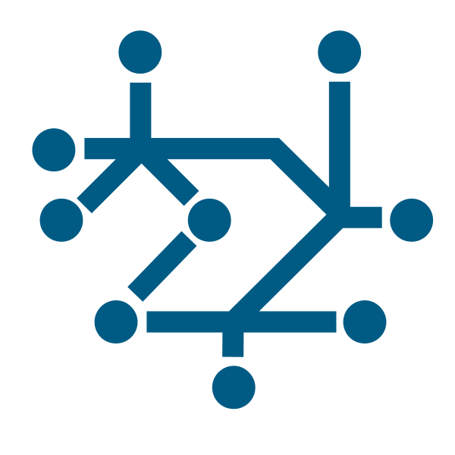


HCX Capabilities in VCF
HCX Networking
Hybrid Interconnect
Configurable Transport Encryption
Traffic Engineering
Mobility Optimized Networking
HCX Network
Extension w/ HA
HCX Migration
Migration Planning
Replication Assisted vMotion
OS Assisted Migration
HCX Assisted vMotion
Bulk Migration
Cloud to Cloud
Reverse Migration
Notes:
Presenter note: This slide contains animation
Key Message:
HCX provides both Networking and Migration Types for an end-to-end migration.
Talk Track:
VMware HCX is the solution that’s build ground up for Workload migration and mobility.
We achieve this by providing 2 pillars: HCX Networking and HCX Migration Types.
First HCX automatically builds a secure, fast, and robust networking pipeline between the sites.
HCX also allows customer to add other optional capabilities like L2 Extension, Encryption, Traffic Engineering, Mobility Optimization Networking (MON), etc.
On top of that HCX gives customer option on using different Migrations Types that suited the customer use case. We will go over these migration types in details in following slides
Notes:
Resources:

Slide 51
VCF Mobility Use Case – Workload Migration to VCF
vCenter to vCenter Migration
Certified compatibility between legacy & latest software
Reduction of VC-VC & NSX-NSX cross-site dependencies with Traditional IX Mobility Transport
Leverages existing compute/networks/storage as is
Scheduled replication allows high concurrency data prep with minimum VC overhead
RAV allows large scale data prep with scheduled live switchovers
Mapped Network extension allows the workloads to remain connected
MON for reduced latency patterns and conditional traffic steering
V\
c
vSphere
VCF
Legacy Data Center
Private Cloud
V\
Sample Customer Scenario:
Ageing HW/SW incompatible source software stack & modern target infra stack
No infra changes to reduce impact to stable source environment
No investment of time or effort in aging infrastructure
No disruption to existing applications
Scale for aggressive evac deadlines. Execution based planned milestones
Built-in workload networks at destination
Unified/prescriptive/planned approach for variable workload mobility scenarios
Notes:
Key Message:
HCX workload migration to VCF in a greenfield environment.
Talk Track:
On this slide we have provided multiple scenarios and HCX values for migration into a greenfield environment but let's talk about a common scenario in details.
For example, we see a lot of customers moving to VCF private cloud during their hardware refresh cycles. During the hardware upgrade customer deploys the VCF on the brand-new hardware and can use HCX to migrate the workload from legacy side (all the way from vSphere 6.x) to the new VCF without any disruptions to the services. This migration can be done as Lift-&-Shift approach where the entire Data Center migrate at once or, as a Wave migrations where certain application(s) or workloads from certain racks migrate first and others follow suit at different time, in that approach HCX can also provide L2 Extension so workloads can continue to communicate between sites, and nothing breaks.
With both approaches HCX also provides capabilities to retain IP address and MAC address on the VM and can live migrate large amount of VMs simultaneously without the need of rebooting it.
Notes:
Resources:

Slide 52
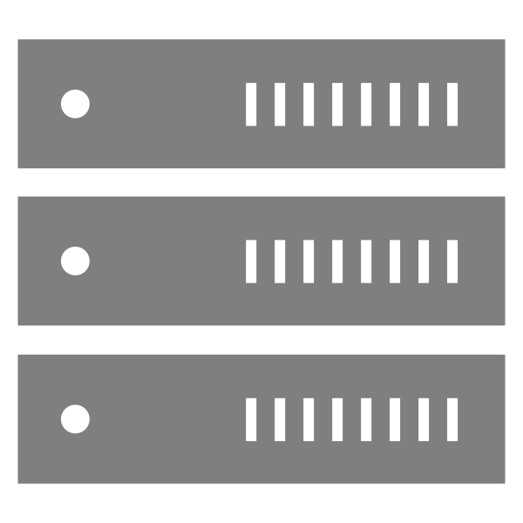







VCF Mobility Use Case – Workload Migration to VCF
Same vCenter (Cluster to Cluster Migration)
One platform for workload mobility
Bulk migration for cross-vendor & VM Transformation with inbuilt scheduling
Network extension allows workloads to remain connected & eases VCF adoption over time
Scheduled replication allows high concurrency data prep with minimal VC overhead
RAV allows extra large data prep with scheduled live switchovers
Migration over the traditional HCX transports or directly between clusters in one place
vCenter Server
Cluster B
Sample Customer Scenarios:
Hardware Refresh / Large Scale Rebalancing
Cluster-to-cluster migration to VCF remote clusters
Cross-vendor migration (AMD <-> Intel)
Network Conversion (vLAN to VPC)
Storage Migrations (VSAN OSA to ESA)
Migration with environmental constraints
Notes:
Key Message:
HCX workload migration to VCF in a brownfield environment (within same vCenter – between clusters)
Talk Track:
On this slide we have provided multiple scenarios and HCX values for migration into a greenfield environment but let's talk about a common scenario in details.
Some customers simply don’t have enough hardware resources to lift-&-shift the entire DC or migrate to a different vCenter. In such case HCX can also help migrate large number of VMs within the same vCenter but between different clusters. For migration within the same vCenter cluster vMotion from vSphere is recommended as HCX won’t work in that case.
Couple of common use-cases are cluster rebalancing and cross vendor migration (AMD to/from Intel) for CPU hardware change customer can use HCX Bulk Migration type which requires the VM reboot. But customer can do a large-scale migration (up to 1000 VM) and they still have option to retain IP and MAC address and option to migrate from VLAN to NSX or VLAN to VLAN based network.
Notes:
Resources:

Slide 53
Best-In-Class: HCX Migration Options
Migration using HCX
VM State
DataTransfer
VM Migration
Bulk Migration
On
HBR
Warm
Replication Assisted vMotion
On
HBR + vMotion
(IX-based)
Live
HCX Assisted vMotion
On/Off
vMotion when On
NFC when Off
Live
HCX vMotion
On
MA vMotion
(IX-based)
Live
Cold Migration
Off
NFC
Cold
OS Assisted Replication
On
Sentinel Agent
Warm
Notes:
Presenter note: This slide contains animation
Key Message:
HCX has many options for VM migration.
Talk Track:
HCX has several migration types. Each of these migration options helps to address specific customer application migration use-cases.
Let's dive into the technical details on each of these as they pertain to HCX when used with VMware Cloud Foundation.
Bulk Migration
HCX Bulk Migration uses the host-based replication protocol to copy the disks of the VM to the target site. The VM can remain powered on during this disk replication period. Once the disk replication is complete, a delta sync occurs on the disk(s). After the delta sync is complete, HCX proceeds with the switchover process. During the switchover phase, the source VM is powered off, and the replica is powered on in the target site. The switch over process can run immediately or wait until a scheduled downtime window. The downtime period of a bulk migration is concise.
The workflow for this process is: power-off source, then, power-on target. Bulk migration, as the name implies and can occur on multiple VMs at once.
Bulk Migrations do not require Layer 2 extension but are recommended for a faster switchover. Personalization scripts can be run during the switchover phase allowing you to change the IP address or make other VM modifications.
Additional HCX automated options include; updating the VM tools driver(s), and VM Hardware level. These settings are all selectable from the HCX UI. They are then executed immediately to the target side replica VM during the switchover process.
<click>
Replication Assisted vMotion (RAV).
RAV combines the power of vSphere Replication and vMotion. This advance migration service allows you to live migrate multiple VMs all at once. Select all the VMs you would like to migrate, and HCX begins the process of replicating the VM state to the target site. When it is time to migrate, HCX then switches from replication to vMotion and moves the active state of the VM.
<click>
HCX Assisted vMotion – launched in VCF 5.2.
Using HCX Assisted vMotion leverages the VMware vMotion protocol to move a live VM to the target site. During the migration, HCX copies the active state of the virtual machine, including virtual disks, CPU cycles, RAM, IP address, and MAC address. HCX Orchestrate the vMotion of multiple VMs with almost line-rate speed. Listed in the HCX documentation are several prerequisites for HCX vMotion.
Some essential perquisites include.
- The VM virtual hardware is version 9 or above.
- The Layer 2 network subnet of the VM you are migrating is extended from source to target.
- HCX vMotion requires 150 Mbps or higher throughput capability.
HCX provides a simple user interface for extending a Layer 2 network. Once you have extended the network, you can proceed to live-migrate one VM at a time. You also have the option to select upgrading the VM tools or VM hardware during HCX vMotion.
Note: Selecting these options does not automatically update either of these components during the vMotion process. Instead, it creates a pending operation in the VM. These updates are then completed after the next reboot of the VM, as these changes require the VM to be powered off.
<click>
vMotion
You can also do a regular vMotion of 1 VM at a time with HCX. This is same vMotion that you are familiar from vCenter and can also be executed for HCX UI.
<click>
Cold Migration
HCX has a third method for VM migration, this option is not listed in the UI for migration and is dependent on the power status of the VM you have chosen to migrate. If the VM is powered off, a cold migration process occurs by default. Cold migration uses the NFC protocol to migrate the virtual machine. During a cold migration, the virtual machine IP address and MAC address remain preserved. Cold migrations must satisfy the same requirements as vMotion.
<click>
OS Assisted Migration (OSAM)
OSAM enables you to migrate application VMs that are running in other hypervisors such as KVM and Hyper-V into a vSphere-based hypervisor environment (VCF).
OSAM is an agent-based migration service that copies the state of a VM and recreates it in a vSphere Environment. The migration process is a warm migration, once the VM is copied to the target site. HCX powers-off the source, and powers-on the target VM.
Notes:
From VCF 5.1, VCF includes entitlement to both HCX Advanced and HCX Enterprise licenses.
With VCF 5.2 the total number of VMs migration limit has been increased to 1000VMs. For further information on the number of HCX migrations supported please refer to the VMware ConfigMax site
Resources:
For further information on HCX migration approaches please refer the VMware HCX documentation:
https://docs.vmware.com/en/VMware-HCX/index.html
VMware ConfigMax site:
https://configmax.esp.vmware.com/guest?vmwareproduct=VMware%20HCX&release=VMware%20HCX%204.9&categories=41-0

Slide 54
Migrate Workloads Non-disruptively to VCF
Multiple HCX Migration Types and Network Extension support
VPC Subnet support
NSX Segment & NSX-VLAN supported
NSX Global Segment supported
VLAN supported
Migrate from KVM & Hyper-V
Support migration from any vCenter version to VCF
Supervisor Cluster Onboarding supported
V\
HCX Network Extension (L2)
HCX Service Mesh (IPsec tunnels)
VM1
VM2
VM3
VM4
VM5
vLAN
VPC Subnet
NSX vLAN
NSX Network
vLAN
VCF Cluster
HCX Manager
vCenter
VCF-Site B
vCenter Site A
Notes:
Key Message: HCX support multiple scenarios to easy the workload migration to VCF
Talk Track:
Embarking on a migration to VMware Cloud Foundation (VCF) often means consolidating workloads from a multitude of different environments, network topologies, and even hypervisor platforms. This complexity can seem daunting, but HCX is engineered precisely to address this challenge, offering unparalleled flexibility and broad compatibility to streamline your VCF adoption journey.
HCX acts as a universal adapter, simplifying migrations regardless of your starting point. Its strength lies in supporting an extensive range of source and destination configurations:
Network Diversity: HCX seamlessly handles various networking constructs. Whether your workloads currently run on:
Traditional VLANs (like those backed by vSphere Distributed Port Groups)
Modern NSX Segments or NSX-VLAN Segments
Advanced multi-site NSX Global Segments
Or need to land in VPC Subnets within VCF, HCX provides the migration paths and crucial L2 Network Extension capabilities to ensure smooth transitions and maintain connectivity.
Platform Heterogeneity: Migration isn't limited to VMware environments. HCX includes dedicated workflows to migrate workloads directly from non-vSphere platforms, specifically supporting KVM and Hyper-V sources, bringing them into your VCF environment.
Legacy vSphere Support: Age is not a barrier. HCX is designed to connect to and migrate workloads from any source vCenter version, enabling you to modernize even your oldest vSphere estates directly onto the VCF platform.
Modern Application Platforms: Looking ahead, HCX also facilitates Supervisor Cluster Onboarding, assisting in bringing your Kubernetes workloads into your VCF-managed environment.
This extensive compatibility is powered by HCX's robust migration mechanisms – including Bulk Migration, Replication-Assisted vMotion (RAV), OS Assisted Migration, and– ensuring you can choose the right method for each workload with minimal disruption.
In summary, HCX removes the friction typically associated with migrating from diverse and heterogeneous environments. By offering extensive support across numerous network types, multiple hypervisors, all vSphere versions, and even modern application platforms, HCX stands out as the key enabler to simplify, de-risk, and accelerate your specific workload migration path to VMware Cloud Foundation.
Here are some examples of the scenario HCX support…
<click> <click> <click> <click>
Notes:
Resources:

Slide 55
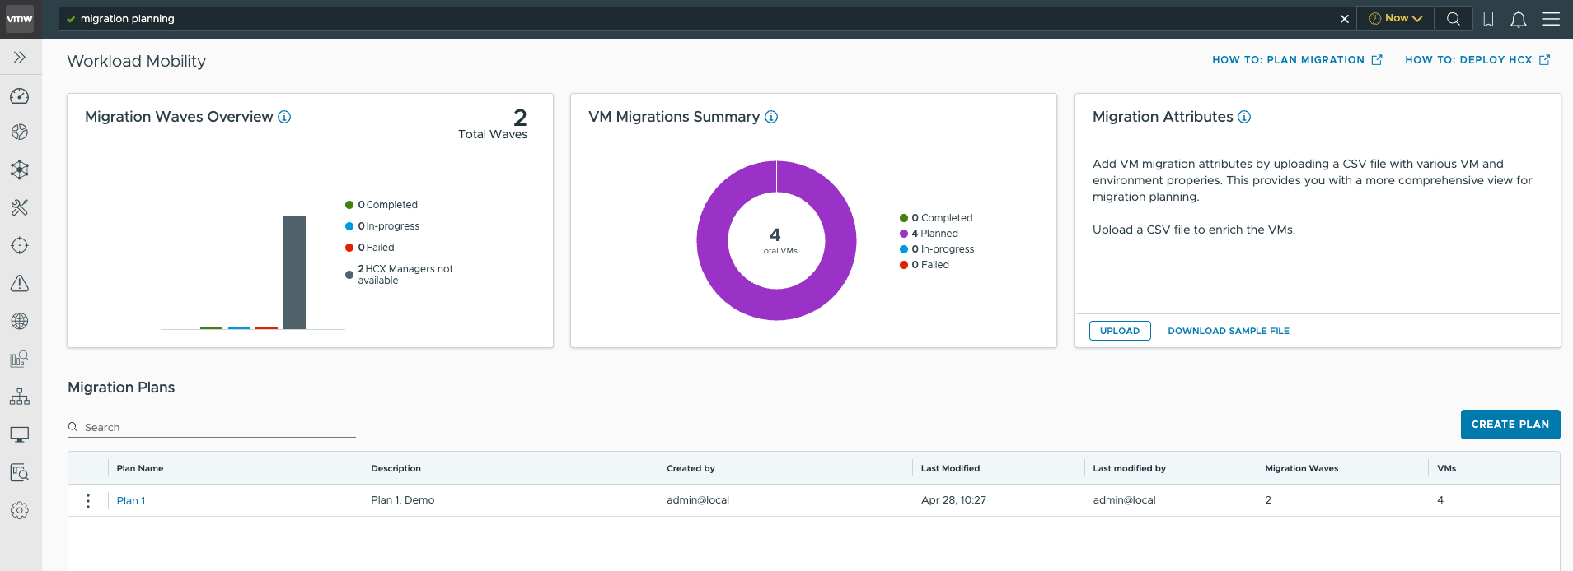
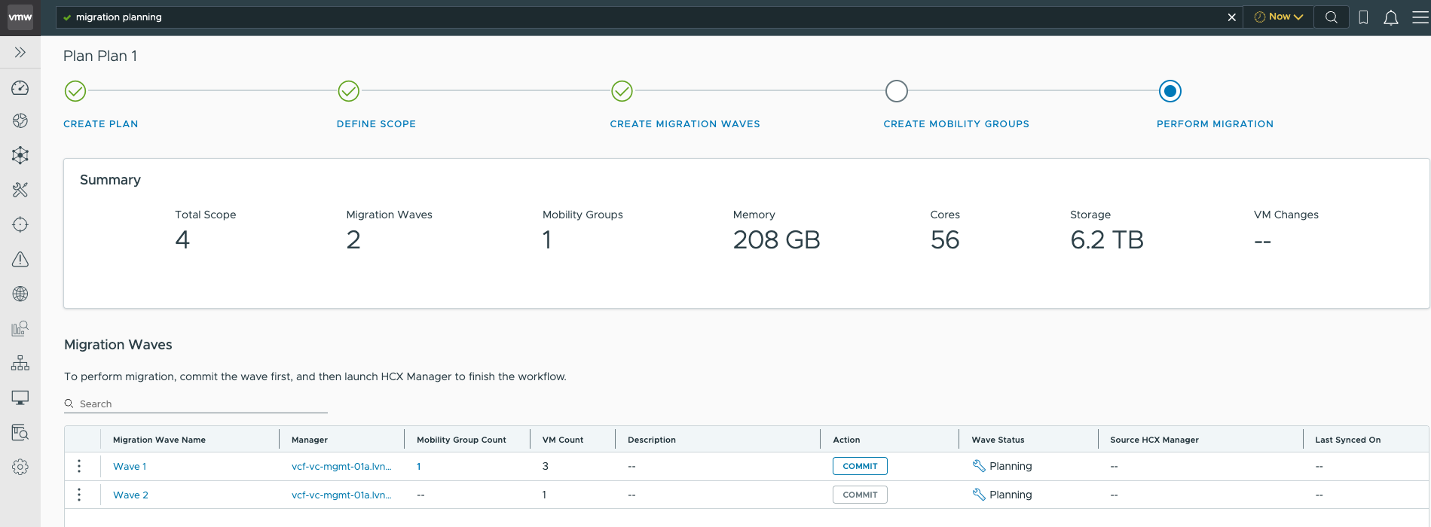
End-to end Process - Plan, Schedule and Migrate Workloads at Scale
VCF Operations – Workload Migration Planning
  Efficient migrations save time and cost
  Automated migration and execution workflows
  Granular planning to analyze network flows, create move groups and create mobility groups
  Robust Large Scale Migration Execution:
  Scenarios (On-prem; vSphere only)
  Into/between/within VCF
  From/to VPC
  M&A, DC consolidation
  On-demand and planned workload mobility
Notes:
Key Message:
The latest update in VCF Operations for networks (version 9.0) introduces enhanced Migration Planning capabilities, allowing for a more streamlined and informed approach to migrating workloads to VCF.
Talk Track:
Let’s start by taking a look at some of the key features of the Migration Planning in this release. One of the most powerful aspects of this feature is how it allows users to define the scope of migration, either using specific applications or members of those applications. This flexibility makes it much easier to identify and manage the applications that are critical for migration while also uncovering the necessary application and network dependencies.
Another important aspect to highlight is the creation of migration waves. This concept breaks down the overall migration process into more manageable steps, enabling you to focus on smaller, defined groups of resources at a time. With migration waves, you can better plan and execute your strategy in a phased approach, minimizing risk and complexity.
Next, we have an overview of resource consumption. This feature provides insight into the usage of memory, cores, and storage, helping you to effectively plan for any resource limitations that could affect your migration. Having this data at hand ensures you’re not only making informed decisions but also optimizing resource allocation as you move through the migration.
Lastly, I want to emphasize the Commit feature. This is a key tool for creating mobility groups, which can then be committed to HCX. This capability facilitates smooth, seamless migrations by allowing users to prepare these groups in advance, ensuring they are ready for HCX at the right time.
Key Benefits:
Efficient Migration Planning: Users can easily define the migration scope based on applications and understand dependencies, ensuring no critical elements are overlooked.
Informed Decision-Making: The discovery of application and network dependencies reduces the risk of errors during migration, enhancing reliability.
Resource Awareness: The detailed overview of resource consumption ensures that users are fully aware of the infrastructure requirements before starting the migration process.
Flexibility with Migration Waves: Breaking down the migration into waves allows for phased implementation, reducing potential downtime and disruptions.
Customer Outcomes:
Customers will experience smoother, more efficient migration to VCF with a clear understanding of resource needs and dependencies.
By using migration waves, they can minimize operational risk and downtime during migrations.
The ability to commit mobility groups for HCX ensures a seamless handoff, making the process more flexible and adaptable to different infrastructure environments.
Notes:
Resources:

Slide 56
Optimize Infrastructure and Operations
Operations - Manage

Slide 57

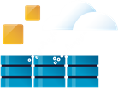



VCF Operations: Efficient Infrastructure & Operations at Scale
Build
Manage
Accelerate Scalability
Install core infrastructure components
Scale workloads and upgrade systems
Manage the entire environment lifecycle
Unified Management
Manage your infrastructure fleet with single sign-on, licensing, certificates, and passwords
Optimize operational costs through automated workflows
Maximize resource capacity and utilization efficiency
Operate
Protect
Simplified Day 2 Operations
Observe infrastructure health and metrics in real-time
Optimize performance for modern VKS and existing workloads
Simplify troubleshooting processes to reduce mean time to resolution (MTTR).
Enhanced Security Posture
Secure and respond to threats
Investigate with audit forensics
Compliance and improve posture (requires ACC)
Notes:
SLIDE CONTAINS ANIMATION
Key Message:
VMware Cloud Foundation Operations centers on four aspects to run private cloud infrastructure: Build, Manage, Operate, and Protect. These four operational aspects transform infrastructure management into a resilient, automated private cloud platform that adapts to enterprise demands.
Talk Track:
VCF Operations centers on four aspects to run private cloud infrastructure: Build, Manage, Operate, and Protect. These four operational aspects transform infrastructure management into a resilient, automated private cloud platform that adapts to enterprise demands.
<CLICK>
We have already discussed how to BUILD your VCF cloud, now let’s discuss how to make MANAGING that cloud on a day-to-day basis as simple as possible. VCF Operations expands cloud management across your VCF fleet through diverse environments while maintaining centralized control over single sign-on, licensing, certificates, and passwords. VCF Operations then helps reduce operational costs with cost visibility and chargeback capabilities, allowing IT teams to focus on maximizing resource capacity of the infrastructure.

Slide 58
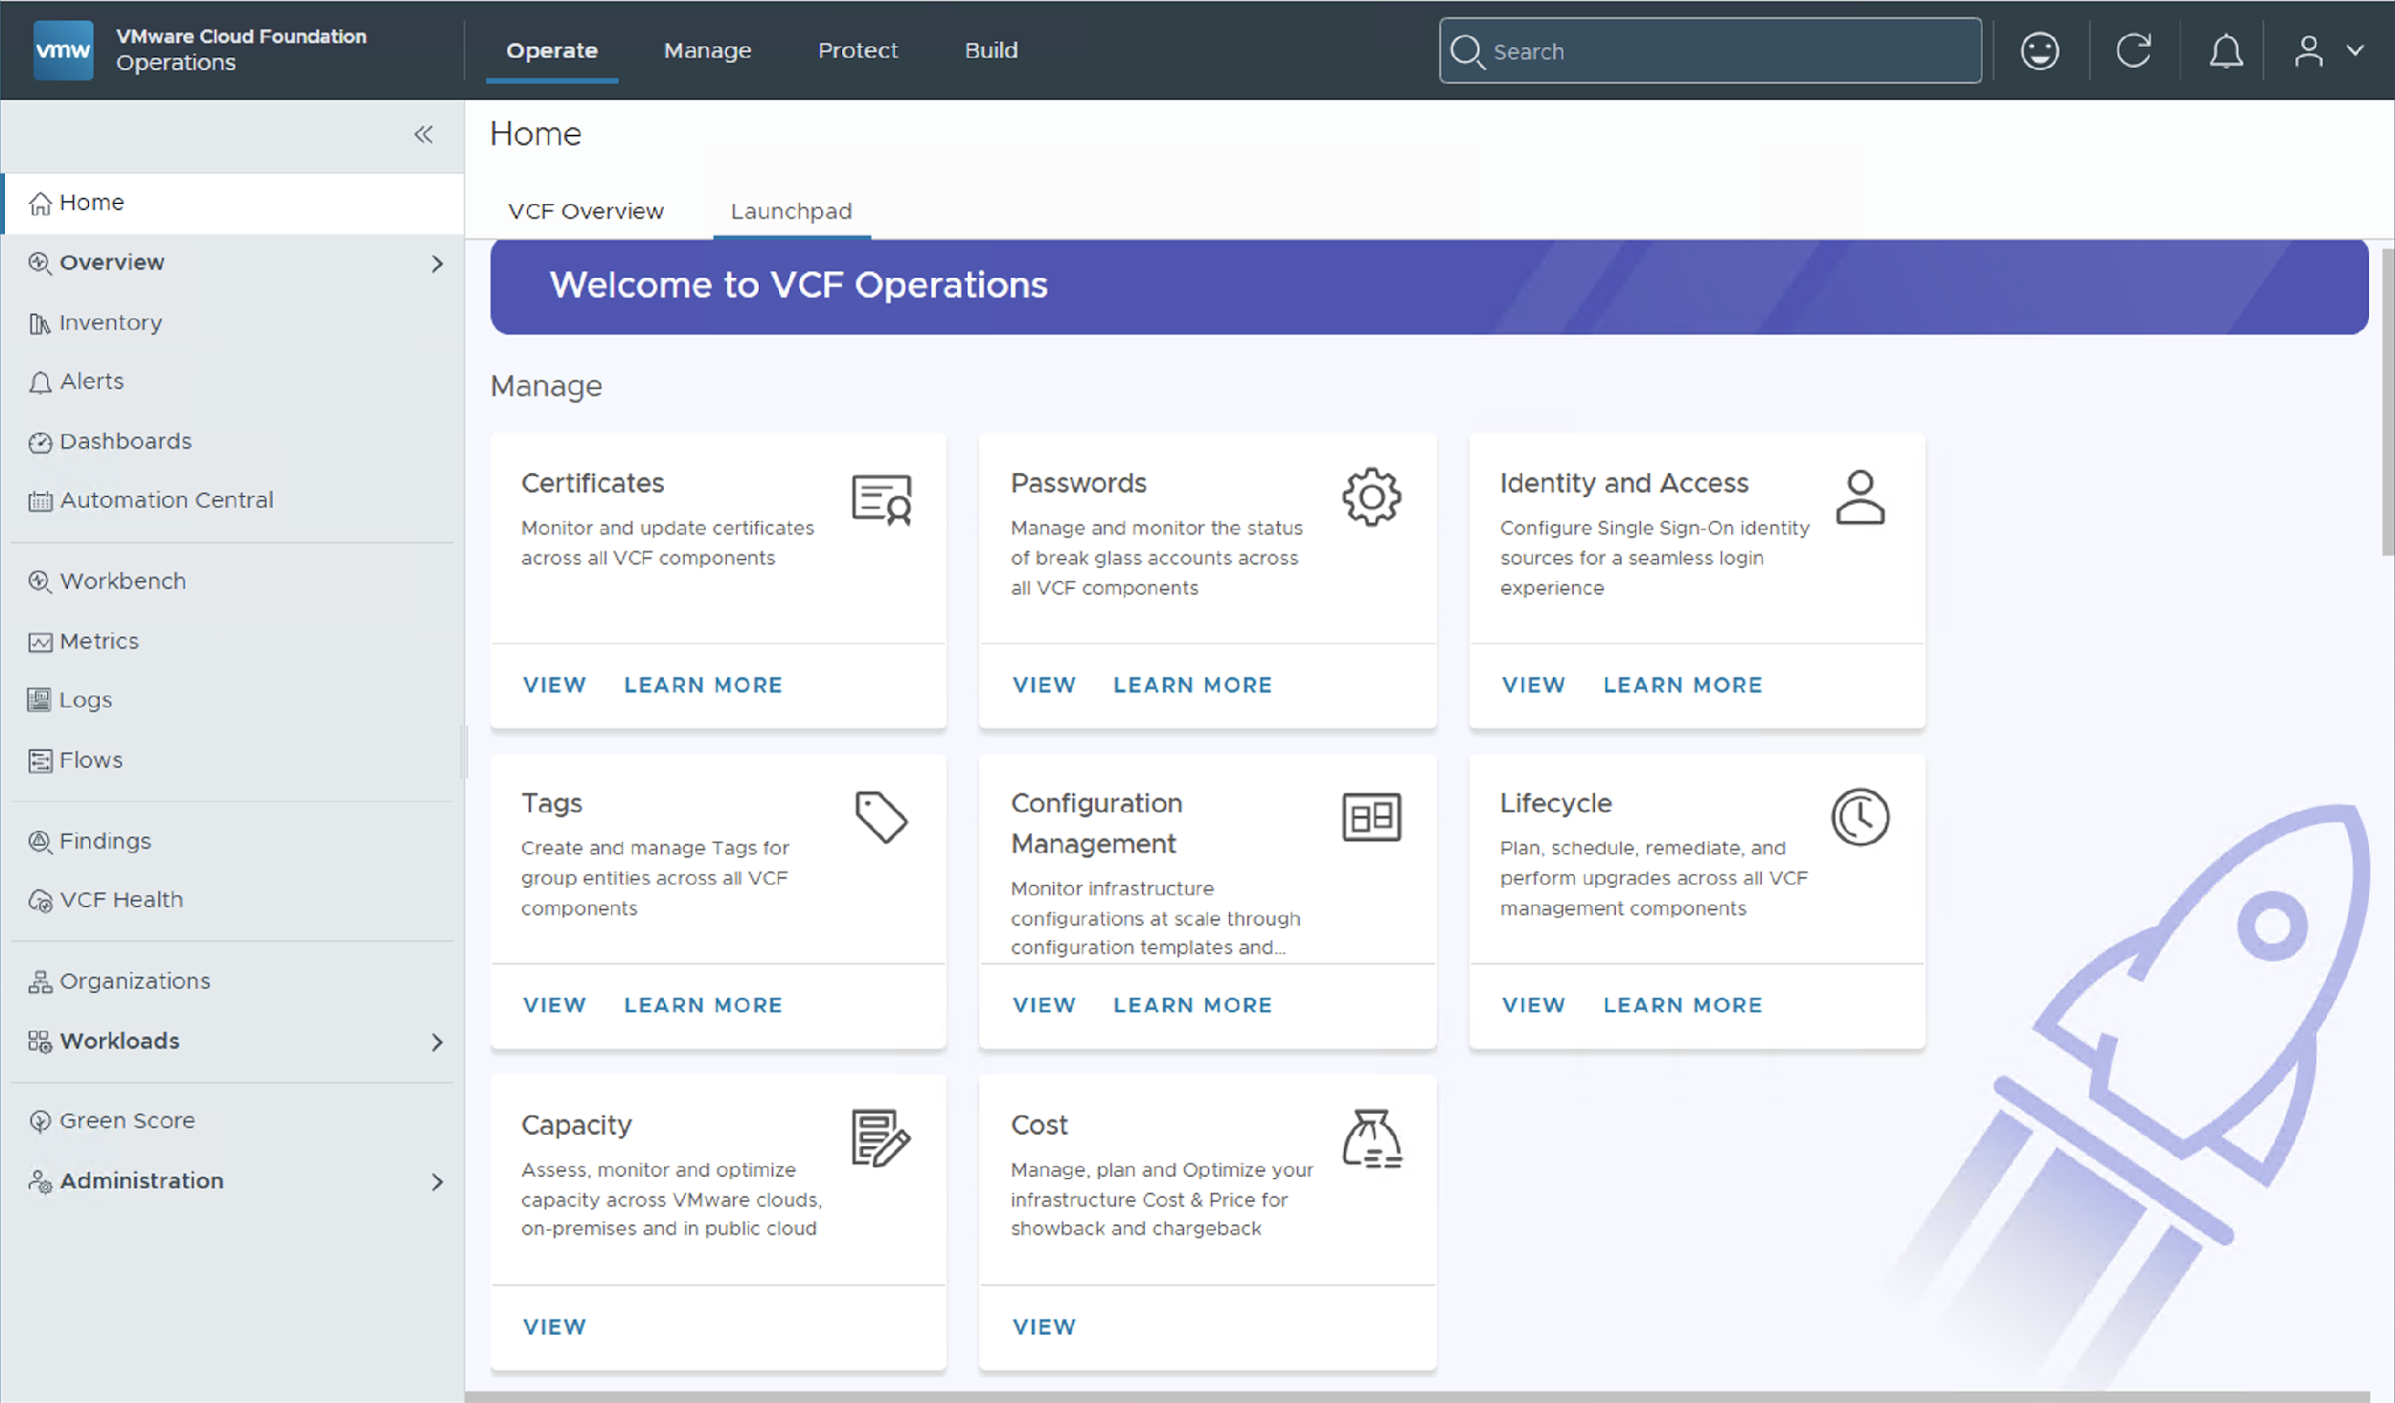
Fleet Management – Consolidating Related Activities
Quickly access common fleet management tasks in VCF Operations
Fleet Management groups common post-deployment operations with automated workflows to streamline and simplify the management of large environments.
It consolidates access to essential administrative tasks for VCF infrastructure and management components
Now, related activities such as managing certificates and passwords and setting up single sign-on are managed centrally from VCF Operations
Notes:
Key Message:
VCF 9.1 introduces new navigation making it easier for Administrators to perform common tasks. The VCF Operations console consolidates fleet management activities under the Manage tab.
Talk Track:
VCF Operations is the primary administrative console for administrators to manage the underlying VCF infrastructure and management components.
New navigation includes a new section called “Fleet Management” which conveniently groups fleet related activities for quick access.
In this section, administrators will find important configuration interfaces for essential tasks such as:
Setting up VCF Single Sign-On and identity and Access Management for seamless management of VCF components such as NSX Manager and VCF Automation
Viewing and updating security certificates for management appliances and ESX hosts within a fleet.
Configuration management and tags
Password and password policy management
Notes:
This is just an intro slide to the concept of Fleet Management.
Resources:
Refer to the VMware Cloud Foundation Operations Guide for further information
https://techdocs.broadcom.com/us/en/vmware-cis/vcf.html

Slide 59
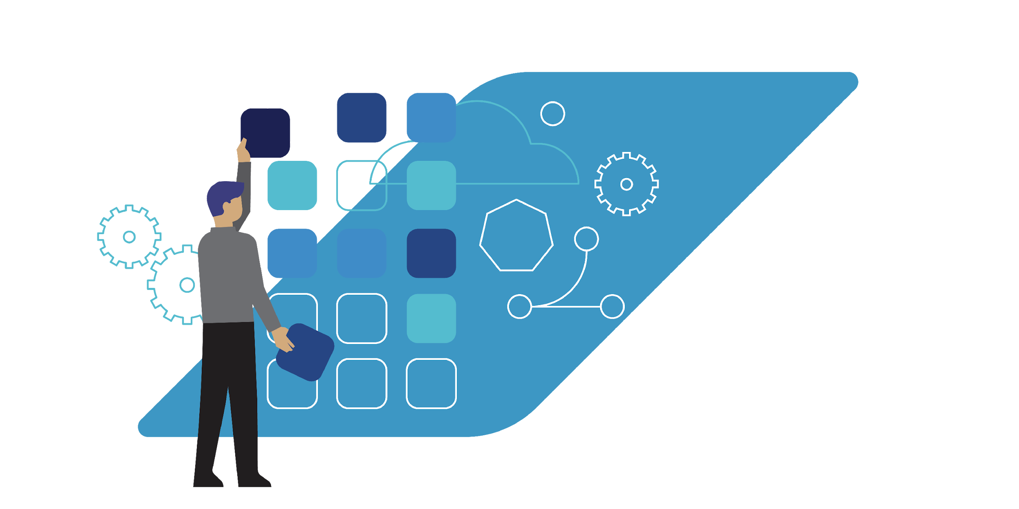


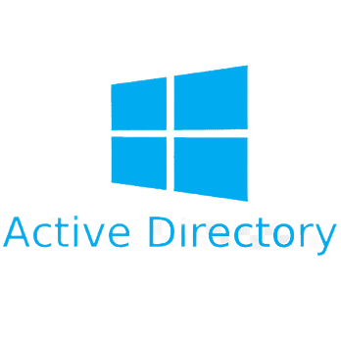

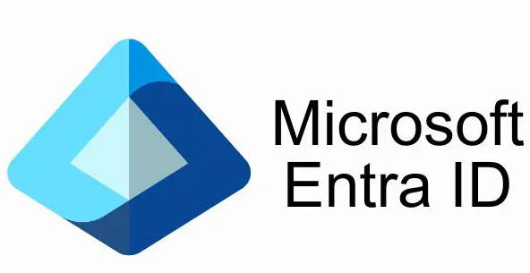
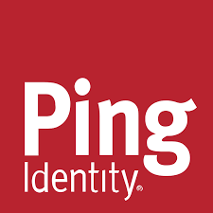



Consistent, Secure and Compliant Management of VCF Components
Streamlined workflows to set up Identity and Access Management
One set of roles for all VCF components
Secure connectivity to Identity Providers
VCF Instance Components
Identity Providers
vCenter
NSX
OIDC
SAML
VCF Management Components
Identity Broker
AD/LDAP
Operations
Automation
Operations for Logs
Operations for Networks
Workload Mobility (HCX)
Orchestration
User/Group Provisioning
JIT
SCIM
VCF SSO
AD/LDAP
VCF Identity and Access Management
VCF Roles (in-built)
SDDC Viewer
SDDC Administrator
VCF Viewer
VCF Administrator
Custom Roles (optional)
User
User
User
API Client
Oauth API token access
VCF Role
VCF Role
VCF Role
Notes:
Key Message:
VCF Operations includes enhanced workflows to configure Identity and Access Management (IAM) for VCF components end-to-end. The workflow streamlines SSO and IDP configuration which now includes VCF-level role assignment.
Talk Track:
VCF Operations includes enhanced workflows which further streamline the configuration of Single Sign-on and Identity and Access Management for VCF components within or across VCF instances. SSO and IAM can be configured end-to-end for VCF instance components (vCenter and NSX) and VCF management components (VCF Operations, VCF Automation, Operations for Logs, Operations for Networks, HCX and Orchestrator).
The “Configure VCF SSO” workflow is intuitive and quick to run and offers the Admin many different configuration options.
The Identity Broker is configured to connect VCF components to a externally managed Identity Provider or Directory Service.
- Modern Identity providers include Symantec Identity Security for VCF (IDSP), OKTA, Microsoft ADFS, Microsoft Entra ID, Ping or any (generic) SAML 2.0 provider.
- Directory-based services can be configured using either Active Directory/LDAP or Open LDAP.
The workflow then assigns access to SSO users/groups to each VCF management component. Users and groups are then assigned VCF-specific roles or custom roles and granted management access. By assigning user and group access, Admins can ensure VCF components are secure and compliant.
Notes:
Custom VCF Roles and Custom vCenter roles are separate features and are not to be confused.
VCF roles and Custom roles can be defined globally and enforced locally.
Resources:
Please refer to the VCF 9.1 Fleet Management Documentation for additional information
https://techdocs.broadcom.com/us/en/vmware-cis/vcf/vcf-9-0-and-later/9-1/fleet-management.html
--------
AF notes to delete:
From DZ
Need to configure SSO first before the API client can be configured.
After this you then go in and configure the API client. The API client is what other 3rd party systems use to programmatically interact with VCF
Give the API client a name, select the scope of VIDB (all or partial vCenter), give it a VCF role or a custom VCF role and select an expiry for the API client.
Think of the API client as a service account generally used by non-humans.
For example you have a third party system that has API access to VCF. VCF generates a token for these 3rd party systems (service accounts) to use which have an expiry date. Keeps things much more secure.
The API token is requested by the 3rd party (not human). Humans would typically use SSO based access.

Slide 60
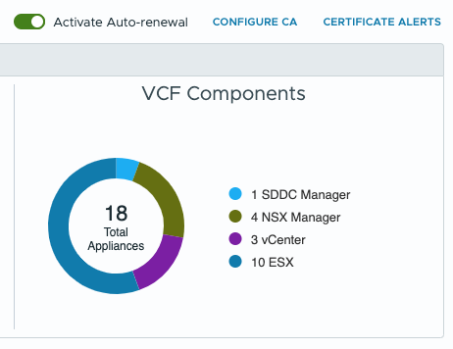
Centralized Certificate Management
Non-disruptive certificate updates for VCF infrastructure and management components
One interface to bulk manage certificates for VCF Infrastructure & Management components
Configure a Microsoft, Open SSL or external CA across a VCF Fleet
Activate Automatic renewal
Inbuilt alerting out of the box
Expanded support for standalone vCenter 8.0 U3 and VCF 5.2 BOM
APIs for 3rd party integration
Track expiry of intermediate CA certificates for vCenter and ESX
VCF Fleet Management
VCF Operations
Certificate Management
Certificate Authority for a VCF Fleet
VCF Operator
Expanded Component and BOM Support
VCF 9.x
VCF 5.2.x
vSphere 8.0 U3
Perform Bulk Certificate Operations
VCF Instance
VCF Instance
vCenter
NSX Manager
. . .
vCenter
NSX Manager
Core Infrastructure
Core Infrastructure
Notes:
Key Message:
VMware Cloud Foundation 9 Delivers A Powerful New Approach to Certificate Management
Talk Track:
VCF 9.x introduces a completely revamped certificate management experience, bringing both the infrastructure and management components under one umbrella. Administrators now have greater flexibility in their certificate management approach, with the ability to leverage existing Microsoft Active Directory Certificate Services CAs, utilize the open-source OpenSSL for certificate generation, or even generate certificate requests for use with external CAs.
One of the key enhancements in VCF 9 is the automatic certificate renewal functionality when using integrated CAs. This streamlines the process, ensuring certificates are automatically renewed and replaced for compatible components, eliminating the need for manual intervention. The new certificate management infrastructure also integrates with VCF Operations alerts, providing timely notifications about expiring certificates and upcoming renewals, enabling proactive management and minimizing potential disruptions.
VCF Operations 9.1 includes the ability to manage certificates for VCF 5.2.x components (such as vCenter, NSX, and ESX hosts) which is useful in mixed-mode deployments. The VCF Operations console also provides support for managing certificates for standalone vCenter and ESX hosts for 8.0 U3. Certificates for VCF Operations workload mobility (formerly HCX) and AVI load balancers can also be managed when they are deployed or upgraded for VCF version 9.1.
Operators can now perform bulk certificate operations. Certificate signing requests, certificate renewals and certificate import operations can all be performed in bulk, reducing time and further streamlining certificate management operations. The VCF Operations API can be used for third-party integration and automation of certificate management for all VCF components.
Overall, VCF 9's certificate management capabilities represent a significant step forward in managing and securing your cloud infrastructure. This new approach delivers enhanced flexibility, increased automation, and improved compliance, ultimately making your cloud environment more secure and efficient.
Notes:
Prior versions of VCF provided certificate management at a per VCF instance-level. Certificate management can be performed at a fleet-level from VCF 9.1.
Certificate management for HCX and the Avi LB requires the installation of management packs. The management pack for each component provides both password and certificate management integration.
A Certificate Authority (CA) is configured at a VCF fleet-level from VCF 9.1 and is no longer configured at a per VCF instance-level.
VCF 9.0 supported Microsoft CA and Open SSL for VCF instance components (vCenter, NSX and ESX). VCF 9.0 management components could be configured only using Microsoft CAs. VCF 9.1 includes expanded support for Microsoft CAs and Open SSL for VCF instance and VCF management components.
From VCF 9.1 Administrators can view running password management tasks from within VCF Operations.
From VCF 9.1 Administrators can activate certificate autorenewal for VCF 5.2.x components.
Certificates for all VCF components in a VCF fleet are auto-renewed upon enabling certificate Auto-renewal.
Resources:
Please refer to the VCF 9.1 Fleet Management Documentation for additional information
https://techdocs.broadcom.com/us/en/vmware-cis/vcf/vcf-9-0-and-later/9-1/fleet-management.html

Slide 61
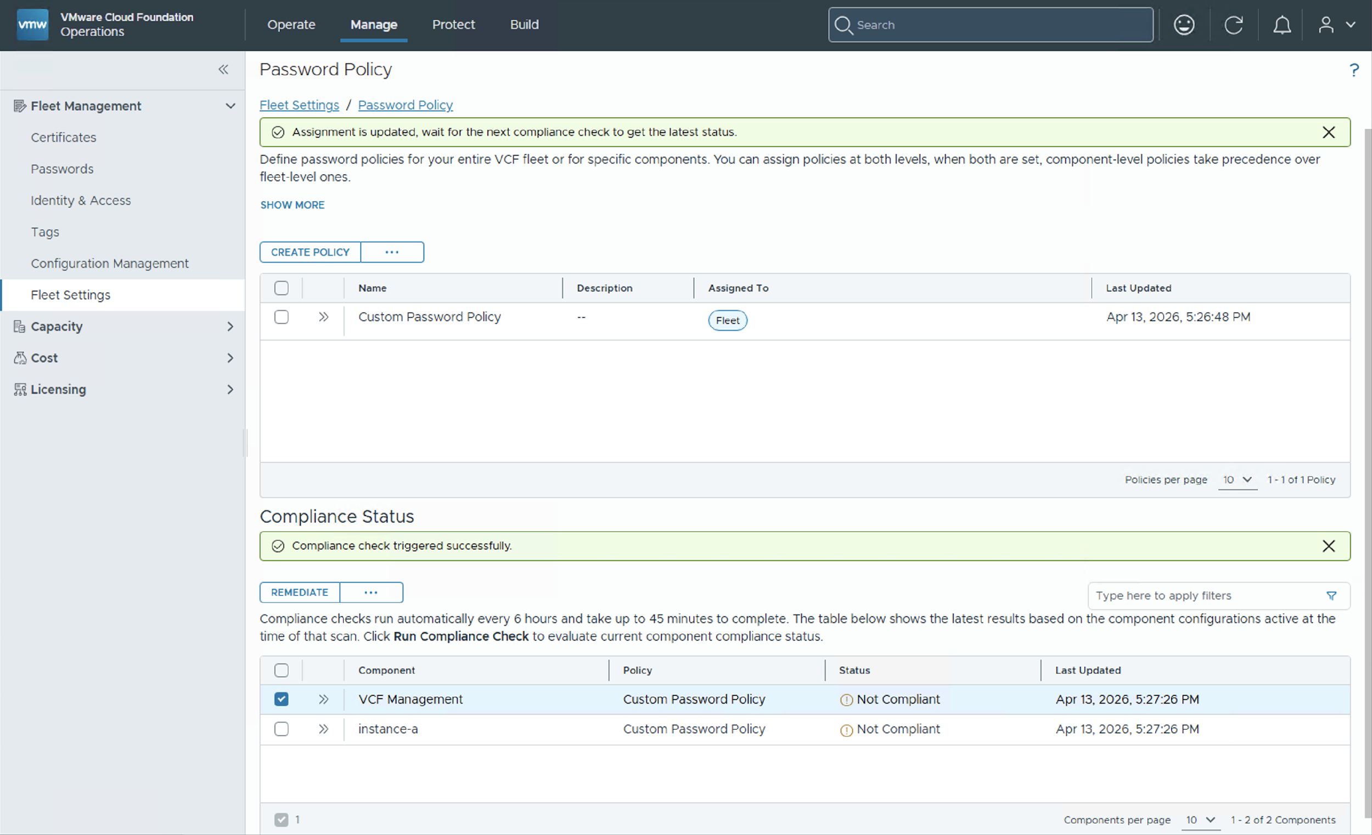
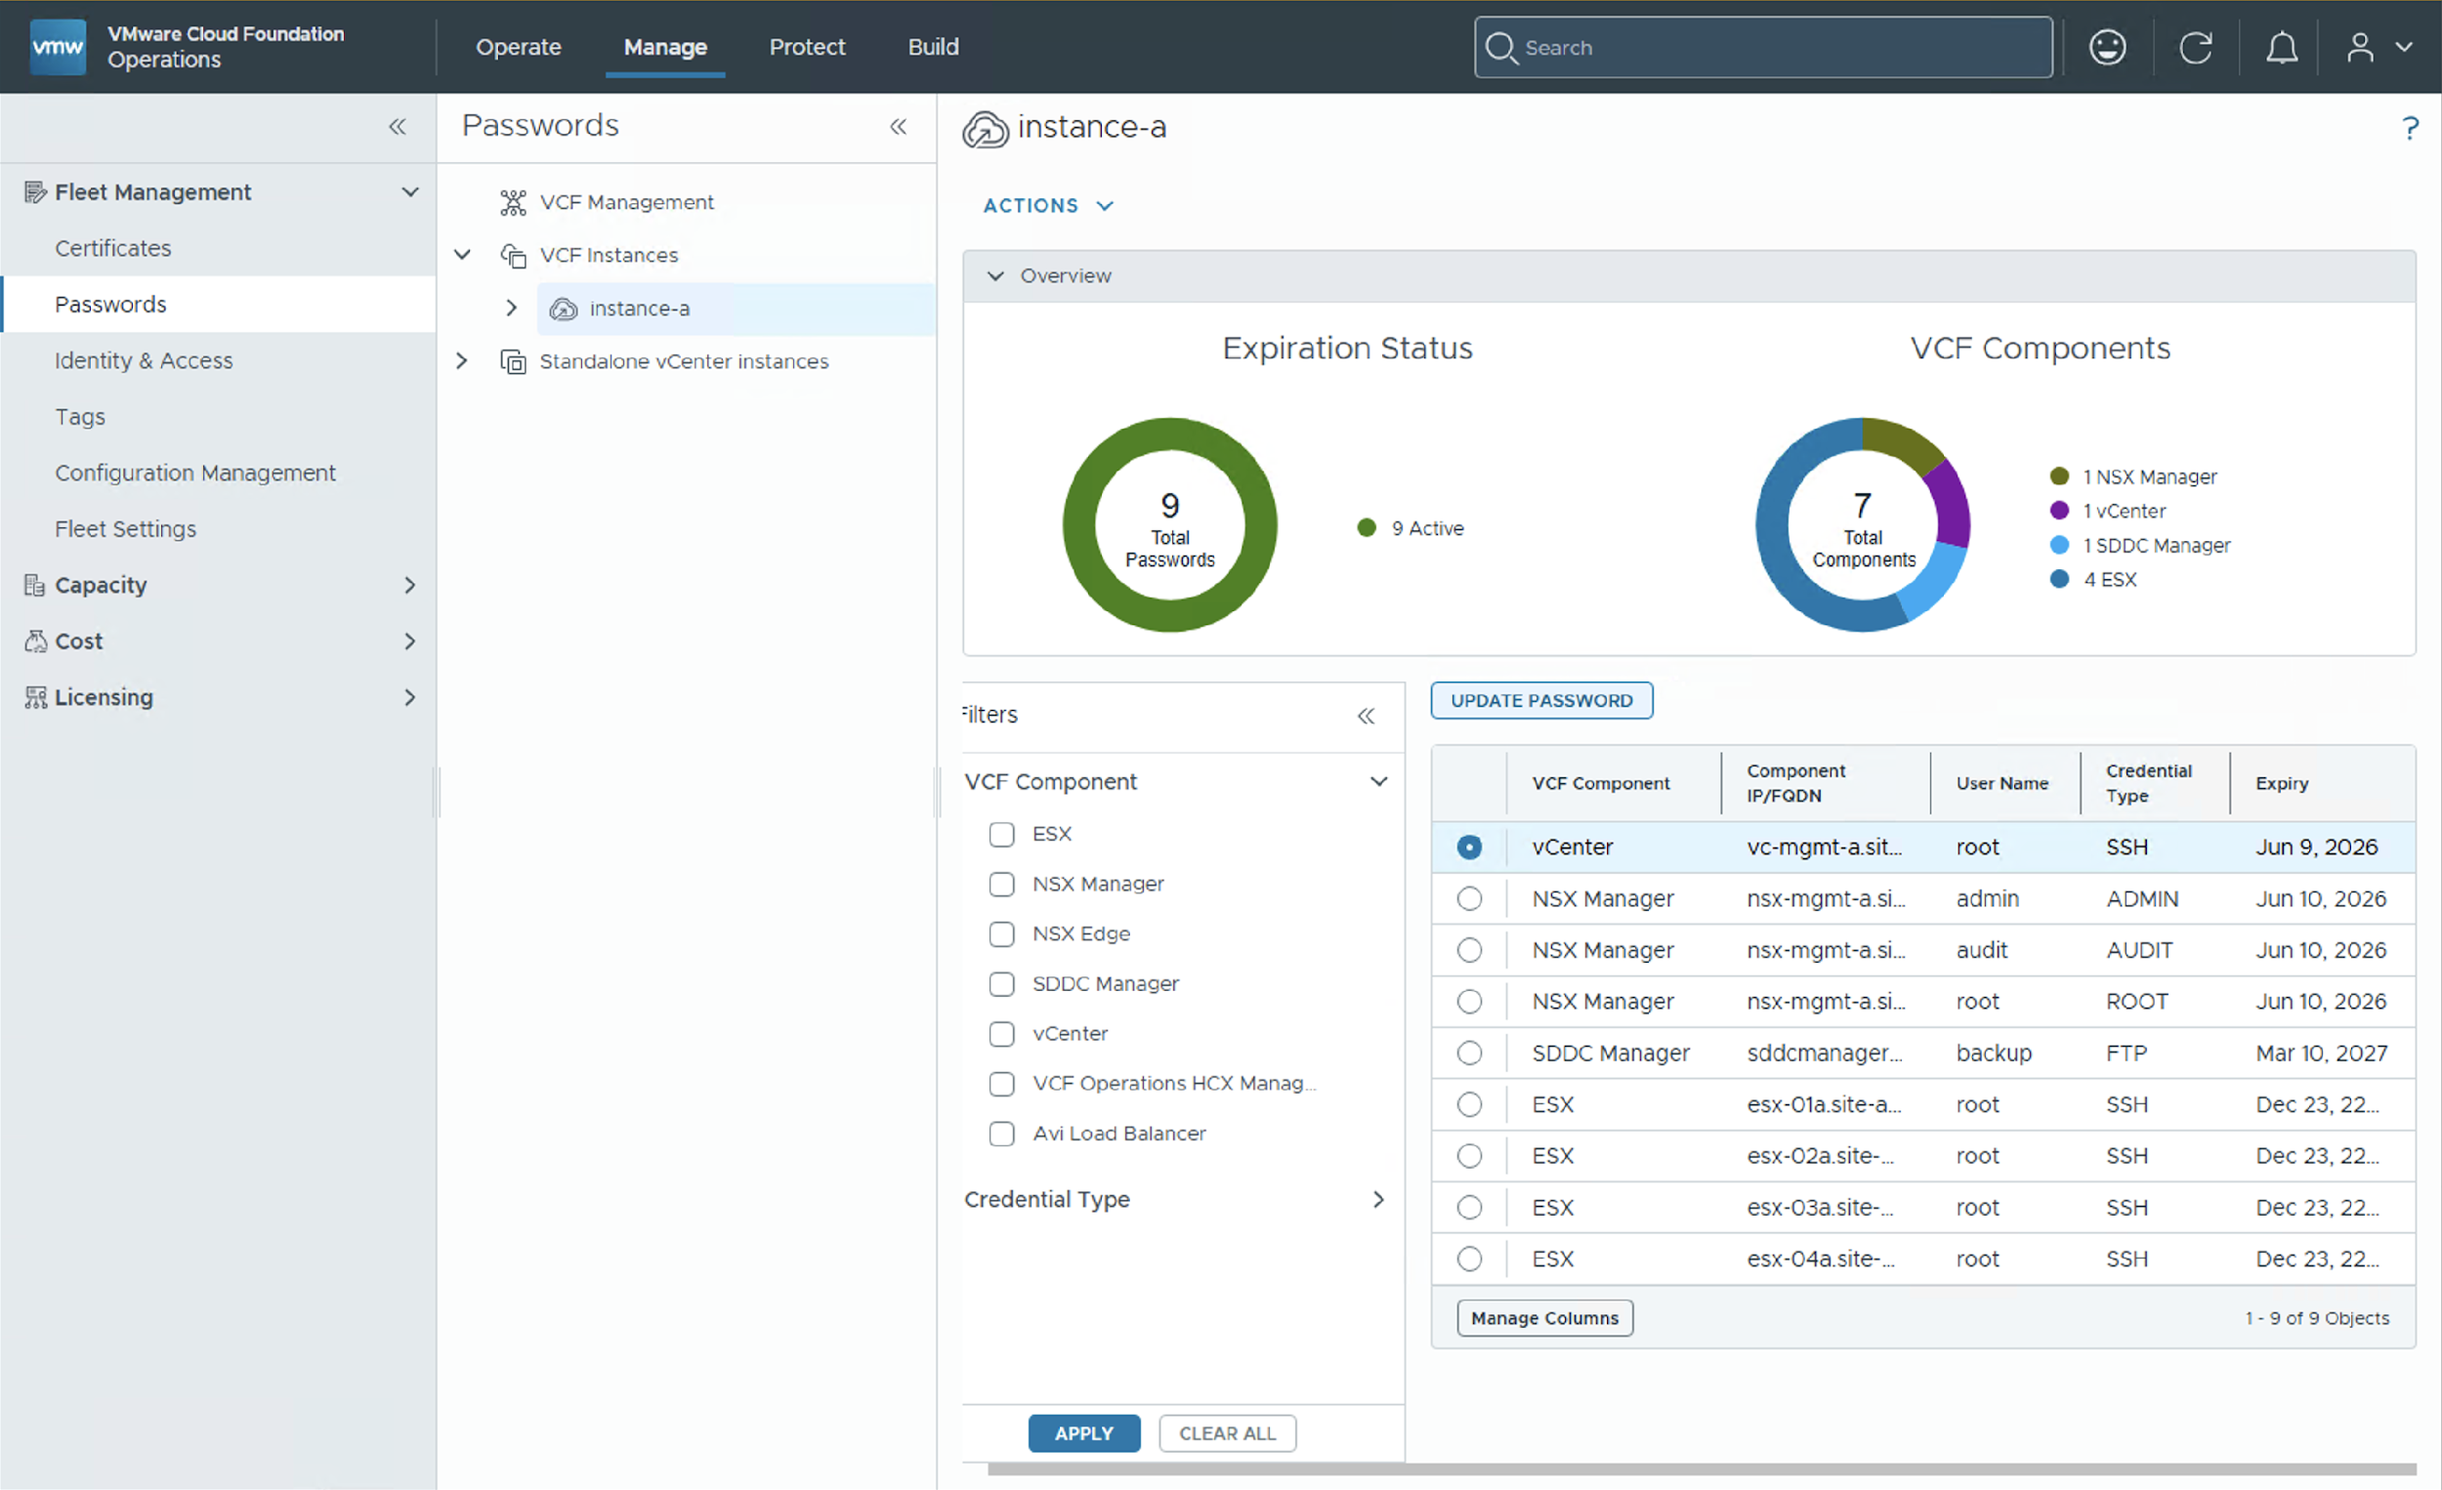


Centralized Password Management
Simplified password management across infrastructure and management components
VCF Operations alerts to warn of upcoming password expiration
Expanded support for standalone vCenter 8.0 U3 and VCF 5.2 BOM
Set unified password policies at a VCF Fleet or component level
Run a Password Compliance Check and perform a Remediation
APIs for Password Vault integration
Break glass accounts no longer stored in VCF Operations
Notes:
Key Message:
Streamlined Password Management for Enhanced Security and Efficiency
Talk Track:
VMware Cloud Foundation 9.x introduces a centralized and unified password management experience, which helps to simplify the process of securing your VCF environment.
The new VCF Operations interface brings centralized control: You can manage and update passwords for both infrastructure and management components from a single location.
<click 1>
VCF Operations 9.1 further extends on these capabilities to include VCF 5.2.x components within your VCF 9.1 environment, such as vCenter, NSX, and ESX hosts. Standalone vCenter and ESX hosts from version vSphere 8.0 U3 and later are also supported. In addition, you can manage passwords for VCF Operations workload mobility (formerly known as HCX) and AVI load balancers which are deployed or upgraded to VCF 9.1.
<click 2>
Perhaps the biggest enhancement for password management in VCF 9.1 is the ability for Admins to create and assign uniform password policies across VCF components¹. Password policies define password length, complexity requirements, account lockout settings, expiry and change intervals, and re-use settings. Once created these policies can then be assigned at a VCF Fleet-level or to VCF components².
<click 3>
A password compliance check can be run at any time to notify the operator of password policy compliance or non-compliance.
<click 4>
This allows the operator to view the current and desired definitions and perform a one click remediate function.
VCF operations 9.1 has also been engineered to integrate with third party tools from the API such as enterprise password vaults. We’ve also enhanced our password security and no longer stors break-glass account passwords, eliminating the need for password remediation.
Integration with VCF Operations also brings another benefit: Administrators can view running password management tasks and will receive timely alerts when passwords are approaching expiration, minimizing security risks and downtime.
Notes:
Resources:
Refer to the VMware Cloud Foundation Operations Guide for further information
https://techdocs.broadcom.com/us/en/vmware-cis/vcf.html

Slide 62
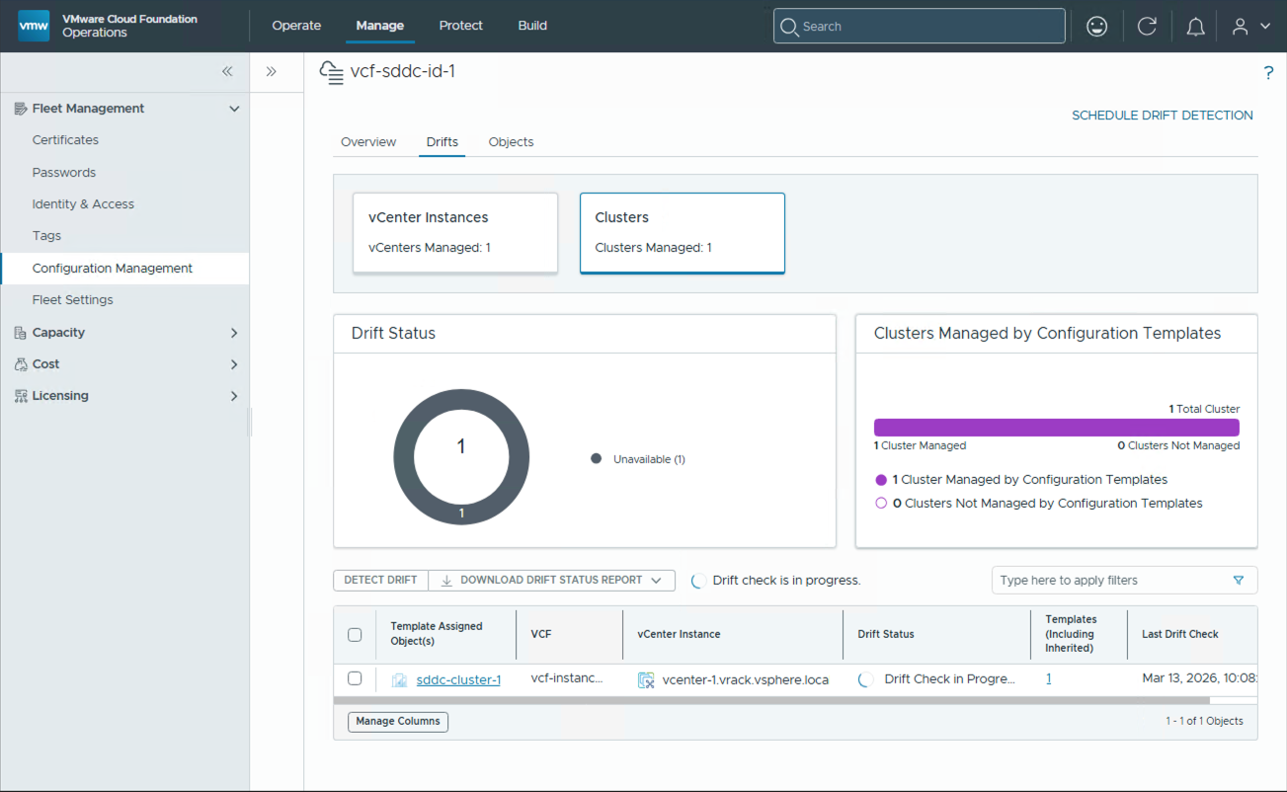
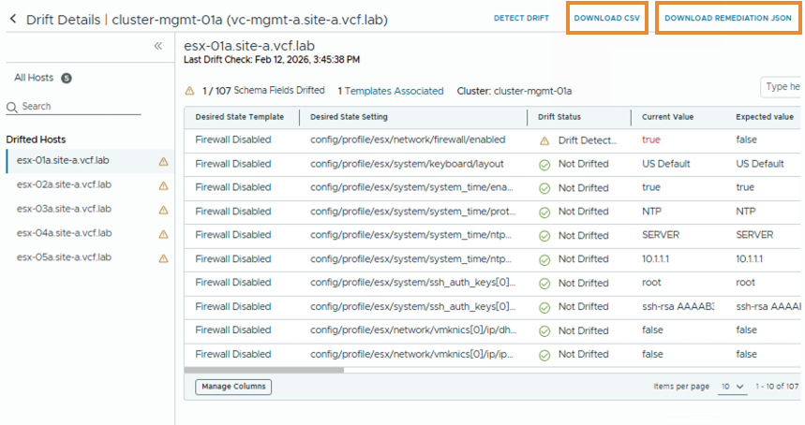
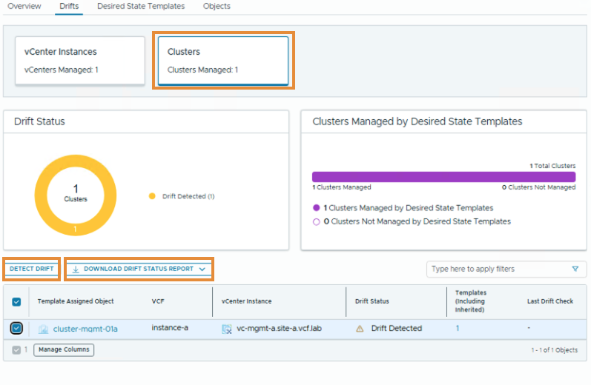
Enhanced Fleet-level Configuration Management
Analyze configuration changes using desired state templates
Quickly view detailed configuration changes at a VCF instance, vCenter, cluster* and host level
Create desired state vCenter and desired state cluster templates
Git integration for vCenter templates and cluster templates
Schedule or run drift detection on-demand for vCenters or clusters
Download a Remediation JSON file
Download a drift status report in PDF or XLS format
* Desired State Cluster Templates are new to VCF 9.1
Notes:
Presenter Note: This slide contains animation.
Key Message:
VCF Operations has been further enhanced for VCF 9.1 additional capabilities for fleet-level configuration management with the addition of cluster-level templates to define the desired state of a cluster.
Talk Track:
When it comes to Configuration Management, Admins face the challenge of enforcing global and regional standards as they struggle to manage configuration drifts across hosts, clusters, VCs, and SDDCs. The process is manual, tedious, prone to error, hard-to-track, and often requires them to use multiple technologies and interfaces.
Unified Configuration Management within VCF alleviates these challenges by preventing misconfiguration from going unnoticed, reducing the risk of security breaches, and keeping their environment running smoothly with the following enhancements and capabilities:
Desired state templates (formerly known as configuration templates) can now be configured at a vCenter or a cluster-level, which is new in this release. This allows Administrators the option to configure policies at a more granular cluster-level where required…and eliminate the need for configuring and monitoring changes manually down to a host level.
The process to configure a cluster-level template differs from a vCenter template and leverages its configuration from vSphere Configuration profiles (VCP). If a vSphere configuration profile has not been created, the VCF Operations workflow will guide the user through the configuration process and redirect them to the vSphere client.
Drifts or changes from the monitored configuration can be viewed at an VCF instance, vCenter or cluster level through VCF Operations.
In alignment with vCenter desired state templates, cluster templates can also be integrated with GitHub or GitLab repositories.
Drift detection for vCenters or clusters can be scheduled to run at a particular date and time or it can be run on-demand.
<click 1>
VCF Operations provides users with the option to download a JSON Remediation File or CSV to assist in identifying host configuration changes at a cluster level.
Administrators can also download a drift status report in PDF or XLS to view vCenter and cluster level configuration changes.
Notes:
Configuring a Cluster Template first requires setting up a vSphere Configuration Profile (VCP). A VCP is used to apply cluster-level ESX host settings and not vCenter-level settings. A VCP cluster is a cluster which has a vSphere Configuration Profile enabled.
When creating a cluster template, VCF Operations provides a link to configure a VCP if it is not present.
If an environment is configured with both vCenter and cluster templates the policies set at the cluster-level take precedence.
Only one desired state template can be associated to each policy (VCP clusters only). Policies to which a template has already been assigned will not be available to select.
Resources:
Please refer to the VCF 9.1 Fleet Management Documentation for additional information
https://techdocs.broadcom.com/us/en/vmware-cis/vcf/vcf-9-0-and-later/9-1/fleet-management.html

Slide 63
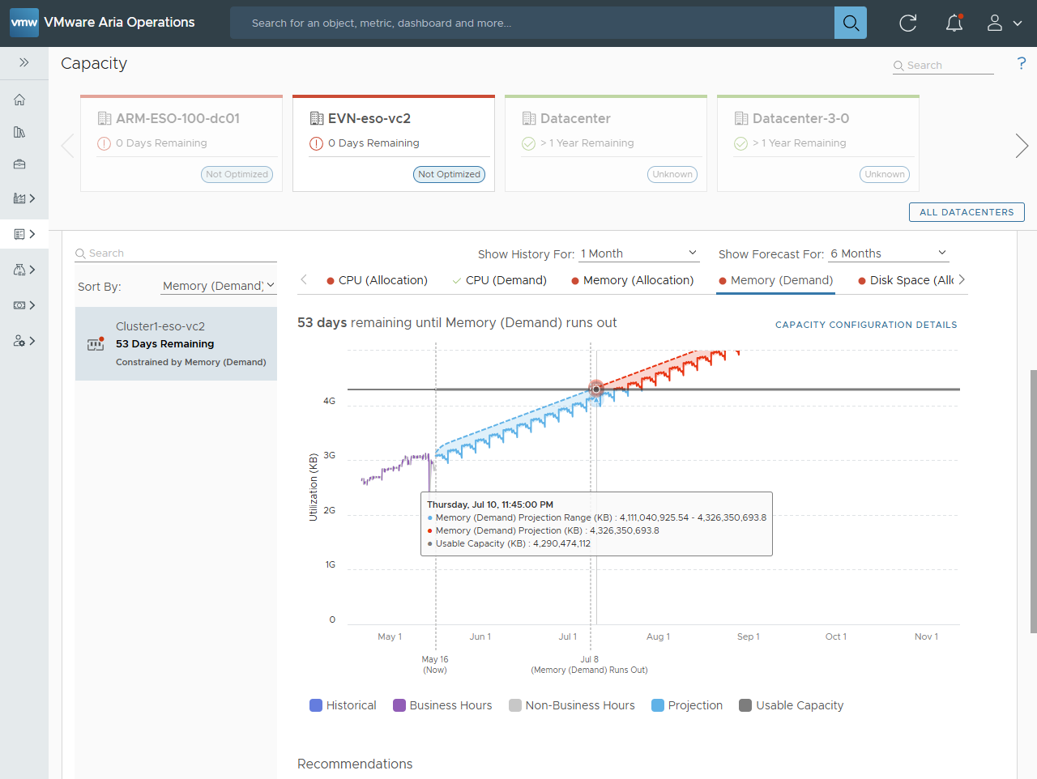
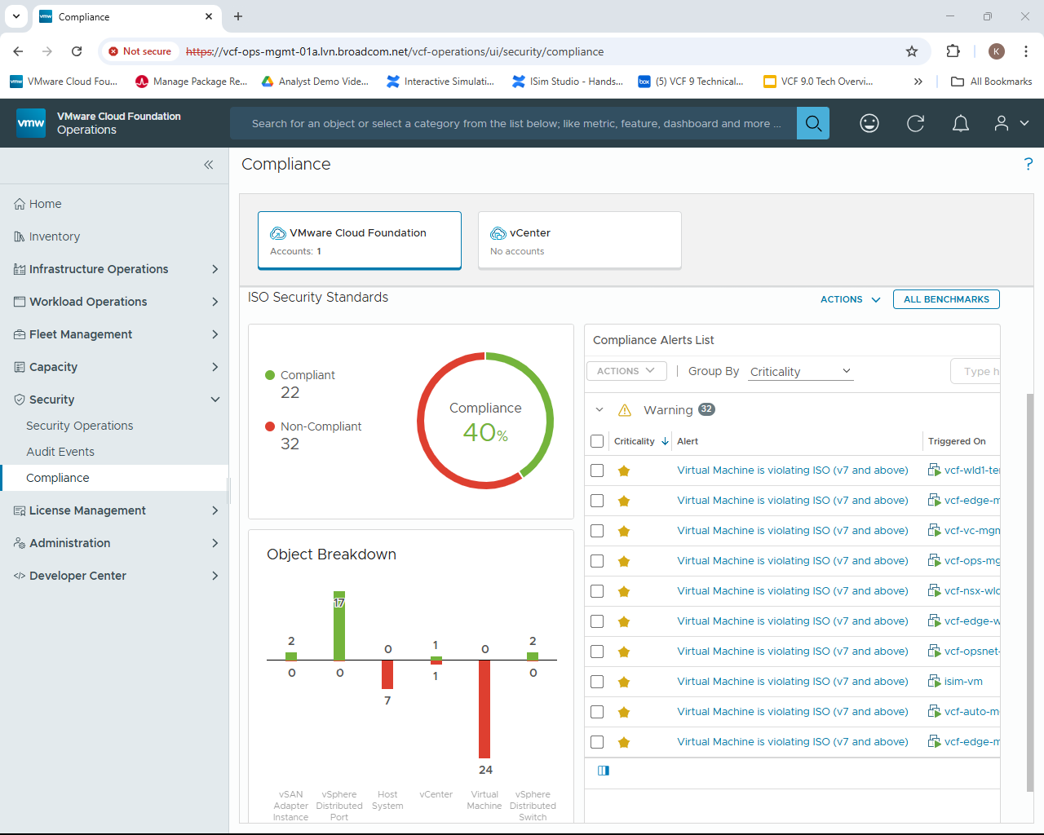
Maximize Your Infrastructure Utilization
VCF Operations – Capacity Management
Optimize resource utilization
Prevent unnecessary spending
Improve Performance
Scalability and Flexibility
Assess current state and current capacity
Set capacity thresholds and risk levels
View most constrained resources, predict shortfalls and plan future capacity
Reclaim and right-size resources and see the impact on savings
Notes:
Key Message:
VCF Capacity Management tools help ensure that your organization's infrastructure has sufficient resources (such as computing power, storage, and memory capacity) to meet current and future demands.
Talk Track:
Capacity management in IT involves ensuring that an organization's infrastructure has sufficient resources (such as computing power, storage, and memory capacity) to meet current and future demands. And to effectively perform Capacity Management, you need a combination of accurate data analysis, strategic planning, and automation tools to help you monitor and adjust capacity in real-time.
And this is where VCF shines. With it, you can:
- Set capacity thresholds and risk levels
- Assess the current state of your environment’s current capacity and predict shortfalls in the future.
- See most constrained resources
- Identify resources that can be reclaimed and rightsized
- Forecast the performance (and financial) impact of adding and removing workloads or infrastructure (e.g., new servers) to and from you’re your environment with What-If Scenario/Workload Planning Tools.
These capabilities provide the following benefits:
- Ensures that hardware, software, and infrastructure are used efficiently, reduce waste and avoid over-provisioning
- Prevent unnecessary spending on IT resources by aligning capacity with actual demand and identifying opportunities for consolidation or decommissioning.
- Help maintain system performance and availability by proactively addressing capacity constraints before they impact users.
- Forecast future capacity needs, making it easier to scale services up or down as demand changes.
Notes:
Resources:

Slide 64
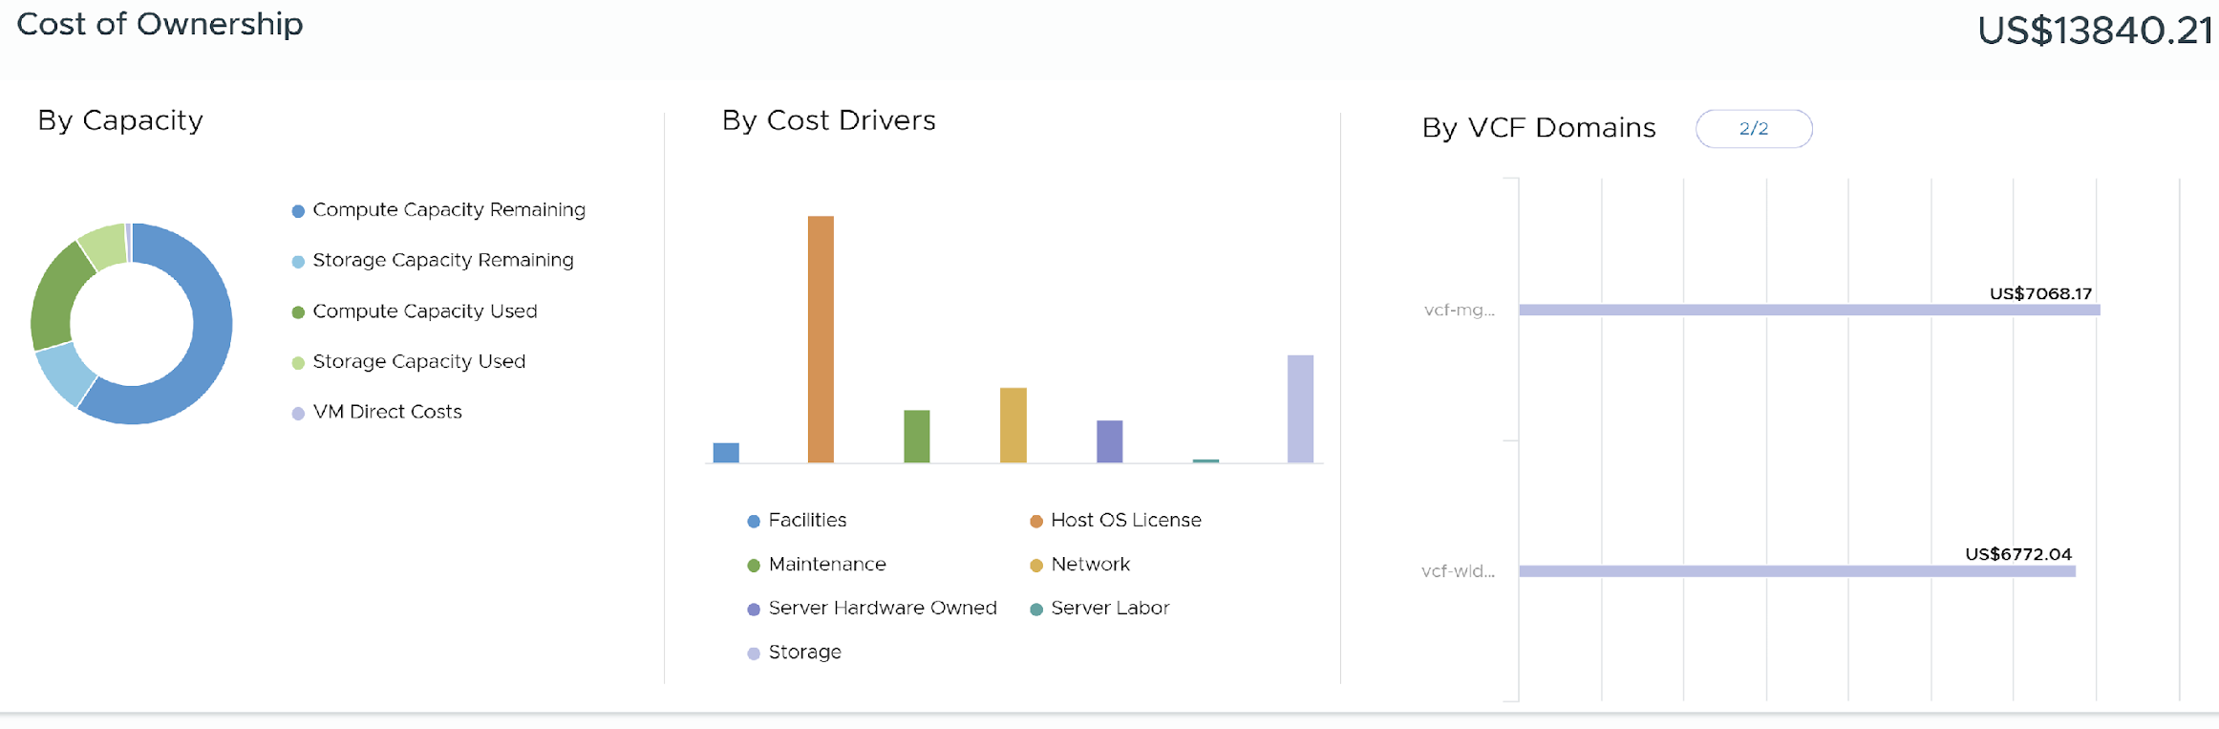
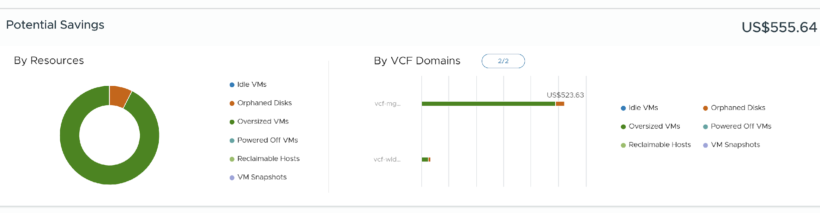
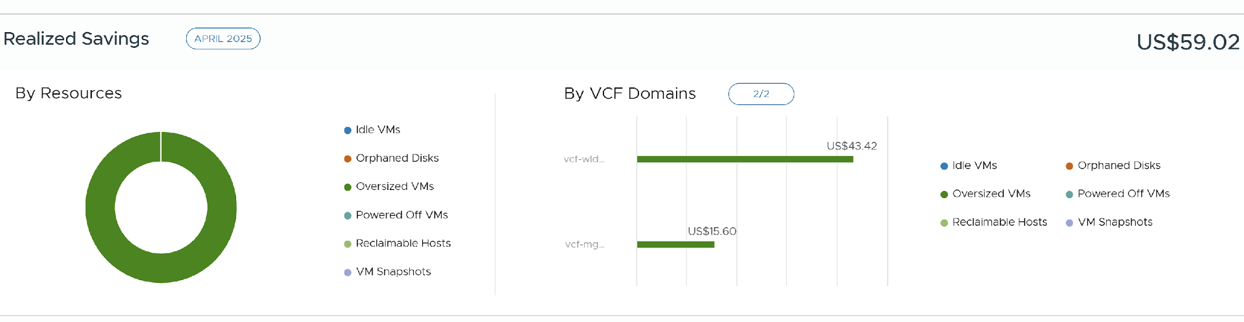
Reduce Costs and Run a More Efficient Cloud
VCF Operations – FinOps
Track, forecast, and optimize resources
Drive cost transparency and accountability
Run IT like a business. Make informed financial decisions before committing
View TCO, potential savings opportunities, and realized savings
Customize OOTB Cost/Pricing Dashboards
View operational costs with Showback
Chargeback - Generate tenant bills
Perform What-If Cost Analysis
Notes:
Key Message:
The FinOps capabilities within VCF integrates financial management with operational processes. With it, Organizations can track, forecast, and optimize their spending on IT resources and services efficiently and effectively.
Talk Track:
The FinOps capabilities within VCF integrates financial management with operational processes. With it, Organizations can track, forecast, and optimize their spending on IT resources and services efficiently and effectively with a variety of tools including:
VCF’s Cost Overview page (shown here) allows you to see the total cost of ownership, potential savings, and realized savings for your environment in a single location.
Highly customizable OOTB costing and pricing dashboards with interactive widgets that allow you to drill down into more financial detail for reporting purposes.
Showback and Chargeback Tools that allow you to see what your spending vs what you’re charging your tenants.
And planning tools that allow you to perform What-If Analysis to see the financial impact of scaling your infrastructure (such as additional VMs or Clusters), before making a final decision.
Notes:
Resources:

Slide 65
Optimize Infrastructure and Operations
Operations - Operate
Notes:
Key Message:
Talk Track:
Notes:
Resources:

Slide 66
VCF Operations: Efficient Infrastructure & Operations at Scale
Build
Manage
Accelerate Scalability
Install core infrastructure components
Scale workloads and upgrade systems
Manage the entire environment lifecycle
Unified Management
Manage your infrastructure fleet with single sign-on, licensing, certificates, and passwords
Optimize operational costs through automated workflows
Maximize resource capacity and utilization efficiency
Operate
Protect
Simplified Day 2 Operations
Observe infrastructure health and metrics in real-time
Optimize performance for modern VKS and existing workloads
Simplify troubleshooting processes to reduce mean time to resolution (MTTR).
Enhanced Security Posture
Secure and respond to threats
Investigate with audit forensics
Compliance and improve posture (requires ACC)
Notes:
SLIDE CONTAINS ANIMATION
Key Message:
VMware Cloud Foundation Operations centers on four aspects to run private cloud infrastructure: Build, Manage, Operate, and Protect. These four operational aspects transform infrastructure management into a resilient, automated private cloud platform that adapts to enterprise demands.
Talk Track:
Now let's turn our attention to Operating the private cloud where VCF Operations provides:
Real-time infrastructure monitoring delivering comprehensive visibility into system health and performance metrics
Optimizations for both modern containerized workloads running on VMware vSphere Kubernetes Service (VKS) and existing virtual machine workloads
And streamlined troubleshooting processes that reduce mean time to resolution (MTTR), shifting operations from reactive incident response to proactive performance optimization

Slide 67
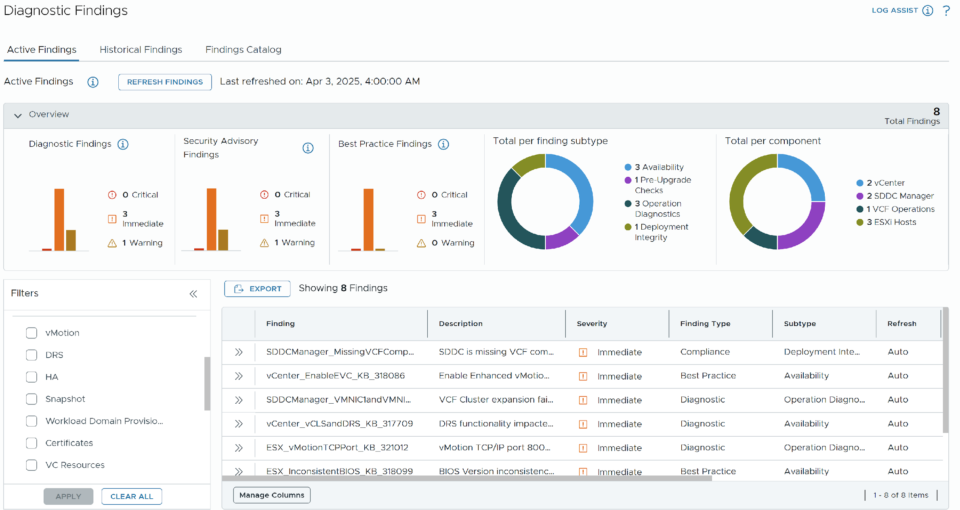
Ensure VCF is Running at Optimal Health
VCF Operations – Health and Diagnostics
Faster issue detection & resolution
Diagnostics capabilities to improve VCF health
Faster engagement with support via log assist
Single console to diagnose known issues impacting VCF software
View security risks (CVE & VMSA)
Understand impacted components with curated remediation steps
Diagnose vMotion, snapshots, vSphere HA, and vSAN Health
Notes:
Key Message:
VCF’s Diagnostic Findings and VCF Health provides a single-pane-of-glass to correlate issues across your infrastructure.
Talk Track:
VCF’s Diagnostic Findings and VCF Health provides a single-pane-of-glass to correlate issues across your infrastructure.
With these tools, you can monitor the operational state of critical components, such as VCF Instances, ESX hosts, vCenters, vSAN Clusters, and NSX Instances, to ensure everything is functioning correctly, ranging from issues related to vMotion, Snapshots, vSphere High Availability, vSAN Health, NTP, and DNS… the list goes on and on.
And if an issue, such as a Security Advisory Finding that requires immediate attention is identified, you can see impacted objects and get recommendations on how to remediate the issue yourself.
And, in addition to self-service remediation, you can even send Log Bundles to our support team, via VCF’s Log Assist tool, to speed discovery and drive faster resolution for issues that you can’t resolve on your own.
All in All, VCF Diagnostics and Health helps you to:
- Increase visibility & speeds discovery
- Drive faster resolution
- Improve environment stability and resiliency.
Notes
Resources:

Slide 68
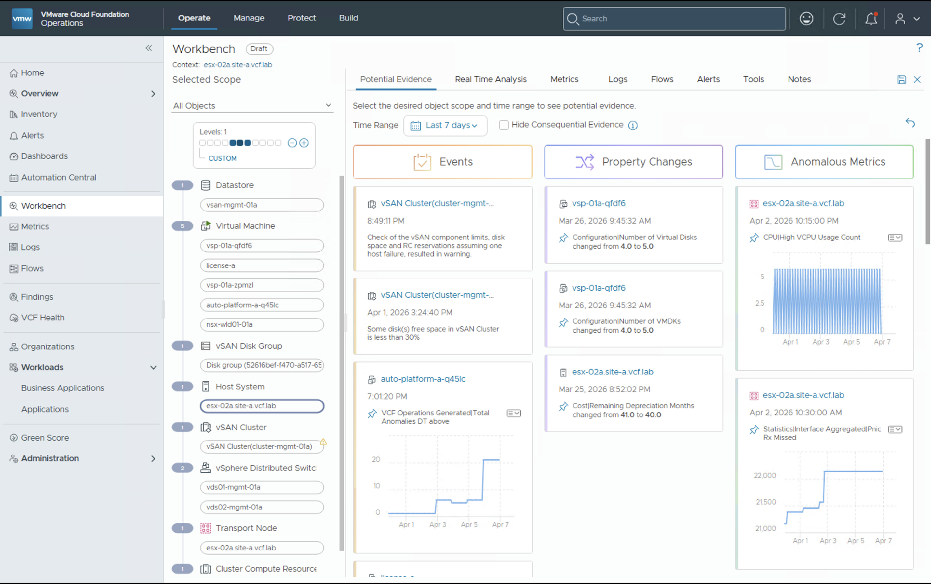
Know When There is a Problem and Solve it Quickly
VCF Operations – Performance Management & Troubleshooting
Lower Mean Time to Resolution
Meet your SLA/SLOs
Provide visibility to both IT & LOB stakeholders
Reduce costly downtime
Observe and fix problems using metrics, logs and network flows
Built in TopN views and 20-seconds real-time metrics collection
Highlights events, property changes and anomalous metrics
Capture notes on issue investigation
Intuitive AI driven troubleshooting
Notes:
Key Message:
Continuous Performance monitoring is all about ensuring your VCF objects have access to the resources they need to run properly across their lifecycle.​
Achieve faster time to resolution of issues to realize better performance at lower costs with AI-driven troubleshooting and remediation.
Talk Track:
The ability to troubleshoot and remediate issues lies at the heart of infrastructure and application performance management of your VCF environment.​
When an alert is triggered on an object, you can use VCF Operations’ Troubleshooting Workbench and its AI-based analytics to perform advanced troubleshooting tasks. ​
VCF Operations narrows down the potential sources of an issue by correlating similar metrics or objects to check for trends or patterns.​ It looks for potential evidence of a problem such as events for metrics that have breached usual behavior parameters, major configuration changes, or metrics that have shown a drastic change within a selected scope and time.​
It then ties into VCF Operations for Logs, VMware’s log management solution, for “last mile” root cause analysis to determine the specific source.​ At that point, VCF Operations provides guided recommendations on how to fix the issue.​ It also provides you the option to have the system automatically apply the recommended fix should a similar issue reoccur in the future.​
VCF Operations also provides more granular metrics collection and visualization to enable deeper visibility into application workload performance and facilitate troubleshooting. The real time metrics are collected every 20 second with an optional ability to configure as low as 2-second metrics collection for ESX hosts. To access the real time metrics, navigate to the Real Time tab under troubleshooting workbench.
In addition to real time metrics collection, the troubleshooting workbench also includes a “TopN” tab allowing admins to readily identify the “top” VM, Host, Cluster, Datacenter, NSX, and vSAN objects.
The troubleshooting workbench also provides a notes section where you can capture and store notes amongst other teammates. These notes are readily available to anyone who logs on to the VCF Operations troubleshooting workbench helping to document troubleshooting findings and to facilitate collaboration.
With VCF Operations issues can be resolved faster, reducing the MTTR, ensuring your SLAs with the business are met.​
Plus, since transparency and communication are critical to IT’s relationship with the business, VCF Operations can notify important stakeholders via alert notifications and reports of any issues that pop up.​
Notes:
Resources:

Slide 69

Network Monitoring and Troubleshooting
VCF Operations – Network Operations
Dedicated VCF Networking health monitoring and diagnostics
Accelerated Private Cloud adoption by simplifying the path to VPCs
Guided step-by-step analysis to transition legacy networks to VPC
Real-time networking metrics for NSX Edge/VNA’s
Deep visibility into VKS workload and microservices communication
Network Path visualization through flow insights
Traffic summary and analyze flows
Application insights
Notes:
Key Message:
VCF Operations provides complete network view with real-time health monitoring, traffic analysis, and application insights.
Talk Track:
VCF Operations provides a dedicated Network monitoring and diagnostics visibility across your VCF environment. We are transforming network management from reactive troubleshooting to proactive observability. Our NSX Health Diagnostics framework provides an automated health view of network across your entire fleet—monitoring everything from NSX Manager cluster stability to individual Edge data path performance and ESX host connectivity.
To support customers modernization journey, VCF Operations includes Guided VPC Analysis, which evaluates customers current VDS configurations and provides a data-driven roadmap to adopt VPCs significantly improving workload mobility and reducing TCO. This is all backed by Real-time Metrics, giving you second-by-second visibility into API request rates and resource utilization to catch issues before they impact your users.
VCF Operations also provides a complete overview of your network inventory, helping users monitor the health of your components in real time. You also gain quick access to a traffic summary and flow analysis, making it easier to detect and troubleshoot issues.
Additionally, application insights allow you to understand how network health impacts workloads.
The dashboard centralizes all this information, providing a one-stop view that makes troubleshooting faster and network management more effective.
Finally, we’ve extended this visibility into the modern application layer with VKS Workload Monitoring, allowing customers to visualize container flows and microservices communication directly alongside your traditional infrastructure. Together, these capabilities ensure your private cloud network remains resilient, scalable, and ready for the next generation of workloads.
Key Benefits:
Comprehensive visibility: Get a full view of the entire VCF network from a single dashboard.
Proactive troubleshooting: Quickly identify and resolve traffic and health issues with real-time flow insights.
Operational efficiency: Reduce the time needed to monitor, analyze, and maintain network health.
Notes:
Resources:

Slide 70

Achieve Higher MTTR to identify vSAN Health issues
VCF Operations – Storage Operations
Storage visibility and insights in a across VCF Infrastructure
Storage Ops Dashboard includes:
  Alerts
  Inventory
  Configuration
  Performance & Cost
Proactive Performance insights through automated diagnostic checks
Predict potential performance issues in vSAN clusters
Identify root cause for performance deviations
Notes:
Key Message:
VMware Cloud Foundation Operations streamlines storage management by consolidating key insights into a unified view, enabling proactive optimization, efficient resource allocation, and minimized downtime.
Talk Track:
VMware Cloud Foundation Operations centralizes storage management, providing a unified view of your entire storage environment. With a centralized storage inventory, you gain complete visibility, simplify capacity planning, and ensure efficient resource allocation. This eliminates the need to navigate multiple tools, streamlining operations and saving time.
Understanding storage usage is crucial, and VCF Operations excels at utilization trend analysis. By tracking consumption patterns, you can proactively optimize resource allocation, prevent bottlenecks, ensure consistent performance, and avoid potential disruptions. Additionally, vSAN Cluster Health monitoring offers real-time insights, enabling you to quickly address issues and maintain optimal storage availability, minimizing downtime and maximizing uptime.
Storage Distribution insights reveal how storage is allocated across clusters and workloads. This detailed view empowers you to manage resources efficiently and troubleshoot issues, ensuring optimal performance and resource utilization. Finally, Alert Trends allows you to analyze storage-related alert trends, facilitating proactive issue resolution and minimizing potential downtime. By consolidating these storage insights, VCF Operations simplifies management, optimizes performance, and ensures the continuous availability of your critical data.
VCF Operations also provides a new vSAN Diagnostic check option, which enables users to run live diagnostics on vSAN clusters. Admins can now run diagnostics checks on clusters facing performance issues and Ops provides insights and recommendations to improve storage performance
VCF Operations integrates the vCenter vSAN health workflows, including detailed alert views and guided remediation steps, directly into the Storage Operations screen and includes the Proactive Performance Insights feature which automatically runs diagnostics for vSAN clusters every hour using performance metrics collected from the last 60 minutes.
If no issue is detected during a diagnostics run, no action is taken.
If an issue is found, a Performance Insight of type “Proactive Insight” is created.
These insights are automatically deleted once subsequent diagnostics detect no further issues.
These Insights provide the users with clear identification of the problematic vSAN cluster(s) , plausible root causes for the performance deviation and Step-by-step guidance on how to remediate the identified issues.
Notes:
Resources:

Slide 71

Faster and Simplified Troubleshooting with Logs
VCF Operations - Unified Logging Operations
Faster issue detection and resolution
Improve efficiency and save time by simplified logging workflow
Consistent log collection reduces human error
Simplified log collection from VCF components
Flexible log forwarding protocols
Granular control to start/stop log collection
Compare logs and perform analysis
Log widgets and alerts in VCF Operations
Unified Cloud Proxy for metrics and logs
Notes:
Key Message:
Log Operations simplifies the collection, forwarding, and analysis of logs across all VCF components, accelerating troubleshooting while improving consistency and control.
Talk Track:
Log collection is unified across all VCF components, making it easier to detect and resolve issues quickly.
Admins can use a simplified workflow to configure log collection using common protocols like TCP, UDP, or SSL.
You also gain granular control to start or stop log collection per component.
Logs can be compared side by side, enabling streamlined analysis of issues across different time periods or services.
Plus, log widgets and alerts are built into the VCF Operations framework, offering a consistent and centralized experience.
All of this is powered by a unified cloud proxy that supports both metrics and logs, reducing complexity and improving reliability.
Key Benefits:
Faster issue detection and resolution with centralized log access.
Improved efficiency through a simplified and automated logging workflow.
Reduced human error via consistent log collection and configuration.
Comprehensive control and flexibility with protocol and component-specific log settings.
Notes:
Resources:

Slide 72

Monitoring Traditional Applications
VCF Operations – Workload Operations
Agent-based application monitoring via Telegraf agents
OS and process-level visibility
Management Pack Builder
  No Code Tool
  Create new custom Management packs
  Bring new data in Ops using Prometheus or HTTP API
Application Auto-discovery
Understand application boundaries and communications
Monitor Business critical application availability and performance
Know where a problem lies: infrastructure or application
Notes:
Key Message:
Continuous Performance monitoring is all about ensuring your VCF objects have access to the resources they need to run properly across their lifecycle.​
Ensure critical applications are running properly by monitoring their performance, availability and end-user experience.​
Talk Track:
The purpose of infrastructure is to serve the needs of your applications (native or containerized) which in turn serve the needs of your business.​
Hence, understanding and ensuring the health and performance of your applications running on VCF – not just the infrastructure on which they run – is critical.​
VCF Operations monitors popular and mission-critical application services like Java application, PostgreSQL, Nginx, etc.​
The first step for understanding infrastructure is to use application discovery which uses machine learning and traffic flows to map out which VMs are part of an application. This helps with defining what the application boundaries are so that users know how much traffic bandwidth is used as well as where applications are communicating with other applications.​
Telegraf provides in depth agent-based application monitoring with OOTB 200+ apps supported with the open source telegraf agent​.
VCF Operations helps eliminate customer-impacting issues by leveraging flexible tracing and analytics using logs and metrics.​ Our ability to correlate between issues makes it much easier to identify where a problem lies – in the infrastructure or the application layer -- thus creating a more collaborative and proactive problem-solving environment among teams.​
VCF Operations also provides Management Pack Builder which is a no-code tool for creating custom management packs. Users can bring new data into VCF Operations from an HTTP API or Prometheus end points.
With VMware application monitoring, you can deliver significantly faster mean time to resolution (MTTR), helping you meet and exceed your SLAs.​
Notes:
Resources:

Slide 73

Monitoring Modern Applications
Out of the Box for Modern Applications and Containers
Automated monitoring for VKS Supervisor and guest clusters
VKS Logs management
Antrea CNI Network Flows
Drill down into Kubernetes objects
Detailed metrics for further troubleshooting
Discovers Kubernetes entities nodes, namespaces and workloads
OOTB Health Dashboards, metrics and alerts for Kubernetes objects
Notes:
Key Message: VKS Observability improvements with Out of the box metrics for VKS supervisor and guest clusters
Talk Track:
VKS is the native Kubernetes service in VCF for customers to run containerized workloads in a conformant Kubernetes cluster. VCF Operations automates monitoring for VKS supervisor clusters (control pane) and guest clusters.. The process of installing Prometheus and Telegraf agents on VKS clusters is hands-free and requires no “extra steps”. This is done using the Add-ons Management Framework available since the VKS 3.6.0 release helping admins spend less time setting up monitoring.
The Kubernetes monitoring covers aspects like utilization, availability, and performance.
So, every time a Supervisor is created in vCenter, it will start reporting into VCF Ops, so you don’t have to do any installation or download anything from the marketplace to set this up.
So, you will see the whole Kubernetes constructs of the supervisor, the overall topology showing the Kubernetes constructs like the Namespaces, deployments, the nodes, pods and containers. and then you see the vCenter constructs because you are creating the supervisor on the VC which is a collection of vSphere clusters and it will have namespaces on top of that and then the workloads in them so all those topology mapping will be built for you.
Also, different performance KPI metrics for the supervisor like the CPU ,memory, disk, the nodes, pods and the container level metrics.
We are pushing some OOTB content for the supervisor and VKS clusters. Additionally, new control pane metrics have been included in these dashboards as control pane forms a very important component for supervisor and VKS clusters. Some of the issues we notice where the control pane components are misbehaving and because of it the applications run into degraded state within k8s so we want to provide some insights for these critical components, they at least know, we point them in this direction that this is where things would be going wrong and continue to DEBUG further. So, these dashboards provides pointers in that direction for troubleshooting issues.
Finally, we’ve extended this visibility into the modern application layer by support Antrea CNI Network flows, allowing customers to visualize container flows and microservices communication directly alongside your traditional infrastructure. Together, these capabilities ensure your private cloud network remains resilient, scalable, and ready for the next generation of workloads.
Notes:
Resources:

Slide 74
Optimize Infrastructure and Operations
API SDK and PowerCLI
Notes:
Key Message:
VCF Architecture
Talk Track:
Lets start by looking at the high level architecture of VCF.
Notes:
References:

Slide 75
Driving Automation Excellence through an API-First Strategy
The automation tool is only as capable as the API beneath it.
We ensure that our foundation offers best-in-class developer experience

Slide 76

VCF 9.1
OpenAPI Specifications
Expanding the coverage of OpenAPI Specifications
Expanded VCF SDK Coverage
New API bindings for NSX, VCF Operations and Fleet Management
OAuth 2.0 Authntication
Introducing OAuth 2.0 Authentication
VCF PowerCLI
New cmdlets and SDK bindings
$ _
Notes:
Building on the momentum from VCF 9.0, we are delivering an automation experience with unprecedented consistency. By placing API-first design at the heart of the VCF stack, we ensure that our developer experience is backed by a robust, programmatic API contract.
With the release of VCF 9.1, we are excited to introduce new OpenAPI specifications, expanded SDK coverage, consistent authentication via OAuth 2.0, and broader capabilities for VCF PowerCLI.
OpenAPI Specifications
When we talk about OpenAPI, think of it as the foundational blueprint for the entire Software-Defined Data Center. It is more than just documentation; it is a human-readable API contract that serves two business-critical roles:
First, it provides a Universal Definition: Every endpoint, parameter, and response across the VCF stack is explicitly defined. This eliminates the guesswork that usually plagues infrastructure automation. Your teams know exactly what to send and exactly what to expect in return.
Second, it enables Seamless Translation: Because these specs are machine-readable, they act as a "gold master" that feeds our automation tools. We can automatically translate these endpoints into Software Development Kits (SDKs) and CLI commands, which virtually eliminates manual coding errors and ensures our tooling is always consistent with VCF APIs.
In short: The spec drives the tool, not the other way around.
Starting with VCF 9.0, we offered OpenAPI specifications for SDDC Manager and vSphere APIs. With VCF 9.1, we are expanding this coverage by offering new API specifications for VCF NSX, VCF Operations, VCF Operations for Networks, and Log Management.
Expanding VCF SDK Coverage
In VCF 9.0, we introduced our first unified SDK for VCF, enabling developers to work with a single, consumable library. Developers no longer need to download and install separate libraries to interact with various VCF components.
While 9.0 provided unified SDK coverage for vSphere, vSAN, VCF Installer, and SDDC Manager, VCF 9.1 extends this coverage to VCF NSX, VCF Operations, VCF Operations for Networks, and Log Management.
OAuth 2.0 Authentication
OAuth-based authentication is becoming the standard, consistent method for authenticating across VCF stacks. While components such as VCF Operations and VCF Automation already offer OAuth-based authentication, starting with VCF 9.1, we are introducing OAuth-based authentication to vSphere as well.
VCF PowerCLI
We are also introducing new cmdlets and significant enhancements to VCF PowerCLI, ensuring that PowerShell users benefit from the same deep API integration as our SDK developers.

Slide 77
Download the VCF OpenAPI Specifications
Developer Portal
GitHub Repository
brcm.tech/vcf-91-api-spec-dev
brcm.tech/vcf-91-api-spec-gh
Notes:
VCF OpenAPI Specifications are available at Broadcom Developer Portal and also on Github Repository. Visit the following links to download the VCF OpenAPI Specifications

Slide 78
Resources
Broadcom Developer Portal for VCF
brcm.tech/vcf-dev-portal
Python SDK (PyPi - Online)
brcm.tech/vcf-91-python-sdk-pypi
OpenAPI Spec (Dev Portal)
brcm.tech/vcf-91-api-spec-dev
Python SDK (Dev Portal - Offline)
brcm.tech/vcf-91-python-sdk-dev
OpenAPI Spec (GitHub)
brcm.tech/vcf-91-api-spec-gh
Java SDK (Maven - Online)
brcm.tech/vcf-91-java-sdk-maven
VCF 9.1 API Change Log
brcm.tech/vcf-91-api-change-log
Java SDK (Dev Portal - Offline)
brcm.tech/vcf-91-java-sdk-dev
API SDK & PowerCLI Release Notes
brcm.tech/vcf-91-api-release-notes
Python SDK Samples
brcm.tech/vcf-91-python-sdk-samples
PowerCLI Change Log
brcm.tech/vcf-91-powercli-change-log
Java SDK Samples
brcm.tech/vcf-91-java-sdk-samples
PowerCLI (PowerShell Gallery)
brcm.tech/vcf-91-powercli-psgallery

Slide 79
Extend Data Center to the Edge
Notes:
Key Message:
Talk Track:
Notes:
Resources:

Slide 80
VMware Cloud Foundation Edge: Overview
Operate Thousands
of Edge Sites as One
AI-Ready and
Cloud-Native Edge
Secure and
Resilient Edge
Right Sized Edge Deployments
Single Node: Compact footprint with vSphere + vSphere Kubernetes Service(VKS)
Two Node: High Availability with vSAN + Witness
Multi Cluster (3+ Node): Scalable Configurations
Unified Application Runtime
Accelerate workloads deployments
Built-in Container-as-a-Service (CaaS)
Run AI anywhere (CPU and GPU)
Fleet Compliance
Configuration Management - Desired State
Compliance certifications (FIPS 140-3, STIG)
Fine-grained access control for sensitive credentials
Fleet Scale & Automation
Zero Touch Provisioning
Day Zero Activation Script
Expanded Fleet Size and Upgrade Scale
Continuous Delivery
Centralize Image Distribution (Content Library)
GitOps Desired State (Argo CD)
Real Time Fleet Observability
Intrinsic Edge Security
Non-Disruptive Live Patching
Enhanced Confidential Computing
Hardware Root of Trust (Secure Boot, TPM)
Notes:
Key Message:
VCF Edge Overview - Standardize operations. Accelerate AI. Secure perimeter
Talk Track:
VCF Edge Overview - Standardize operations. Accelerate AI. Secure perimeter
Here's the feature map for VCF Edge, organized by our three pillars.
Operate Thousands of Edge Sites as One: Right-sized deployments from one to three-plus nodes, fleet-scale automation with zero-touch provisioning, day-0 activation scripts, and expanded fleet capacity. As you can see in the first pillar, we support Single-Node deployments. This is huge because it allows you to bring VCF to locations where space and power were previously a barrier. Centralized Fleet Management: Deploy and scale across thousands of sites with zero touch automation.
AI-Ready and Cloud-Native Edge: Unified application runtime with accelerated workload deployment, simplified Container-as-a-Service, GPU support for AI workloads, and continuous delivery through GitOps and Content Library. Modern App Acceleration: Bringing GPU-powered AI and GitOps automation to the farthest edge
Secure and Resilient Edge: Autonomous fleet compliance with desired-state configuration management, FIPS 140-3 and STIG certification support, namespace-scoped secret management, hardened security with non-disruptive live patching, enhanced confidential computing, and hardware root of trust.

Slide 81





Right-Size Every Edge Location (1, 2, or 3+ Nodes)
Flexible Edge Topologies (1/ 2/ 3+ Node):
1 Node: Minimal footprint vSphere + VKS
2 Node: HA with vSAN + witness appliance or external storage
3+ Nodes (Multi Cluster): Scalable, autonomous operations
VM
P
VM
P
VM
P
Unified Platform for
Edge Workloads
Unified Platform for
Edge Workloads
Unified Platform for
Edge Workloads
Benefits
Supervisor
Supervisor
Supervisor
ESX
ESX
ESX
Built for Real Edge Conditions:
Operate in air gapped and disconnected environments. Resilient to WAN outages and limited connectivity.
Operational Consistency: :
Align infrastructure to site and workload needs, from single-node to full cluster, without changing platforms.
Hardware Agnostic:
Certified high performance ruggedized servers for the edge
1 Node
2 Node
vSAN+
Witness
3+ Node
Support Air-Gapped or Disconnected Designs Across all Topologies
All VCF Edge patterns require a minimum 10 Mbps bandwidth and can tolerate max. 100 ms latency.
VKS (vSphere Kubernetes Service)
P
vSphere Pods
Notes:
Key Message:
VCF Edge gives you three flexible deployment options, matched to real-world site requirements.
Talk Track:
VCF Edge gives you three flexible deployment options, matched to real-world site requirements.
A single-node deployment delivers a minimal footprint with vSphere and vSphere Kubernetes Service, ideal for the most space constrained locations.
A two-node deployment adds high availability using vSAN with a witness appliance or external storage, the sweet spot for retail and branch office scenarios where uptime matters.
A three plus node multi-cluster configurations delivers scalable, autonomous operations for data intensive sites running real-time analytics or AI.
All three topologies support air-gapped and disconnected designs. You're not locked into specific hardware. We certify high performance ruggedized servers across vendors. And the key point: regardless of topology, the operating model is identical. You manage a single node the same way you manage a full cluster. One platform, consistent operations

Slide 82





Zero Touch Provisioning of Edge Site
Central Data Center
Management Domain
Customer Provided
VCF Fleet
VCF Operations
vCenter
Workload Domain
vCenter
Kubernetes Config
App Manifest
Content Library
1
Configure ZTP in vCenter
1
4
2
Onboard Host, deploy ESX with ZTP
3
Use Automation Script: Configure Cluster (vDS, vSAN, DRS, HA, etc.),
Supervisor + FLB,
Enable Argo CD
3
VM Service
VKS Cluster
4
Supervisor
Configure Argo CD/ Deploy Application
VMware ESX
2
Physical Host
VCF Edge Site
Notes:
Key Message:
Deploying infrastructure to hundreds or thousands of edge sites has traditionally required skilled technicians at every location. VCF Edge changes that with Zero Touch Provisioning (ZTP).
Talk Track:
Deploying infrastructure to hundreds or thousands of edge sites has traditionally required skilled technicians at every location. VCF Edge changes that with Zero Touch Provisioning (ZTP).
Here is the workflow:
First, you configure ZTP in vCenter at your central data center. You define deploy rules, image profiles, and cluster assignments.
Second, you ship physical hosts to the edge site. When they power on and connect to the network, they automatically reach back to vCenter, download the ESX image, and register themselves.
Third, an automation script configures the cluster - vDS, vSAN, DRS, HA, Supervisor deployment, Supervisor services like Argo CD and the foundation load balancer.
Fourth, you configure ArgoCD and deploy applications through GitOps by defining your application YAML in a git repository.
The result: edge sites go from bare metal to production-ready without a single on-site configuration step. This is how you scale edge deployments from dozens to thousands.

Slide 83


Edge Site Activation with ZTP
DAY 0
DAY 0 — Infrastructure Provisioning & Registration
1
2
📦
3
🔗
4
✅
Pre-Configuration
Physical Deployment
Registration
Activation
vCenter & ZTP Setup
New Edge Hosts
New Edge Hosts
Edge Cluster
Configure vCenter
Configure Auto-Deploy (ZTP) & Deploy Rule*
Configure vSphere Desired State Configuration*
→
Ship to Edge Site
Connect Network
Power ON
Edge host(s) boots:
  Receives IP from DHCP
  Or Statically configured
→
Establishes connection with vCenter
Downloads & installs ESX image
ZTP Deploy-Rule assigns host to Destination cluster
→
Launch PowerShell script: Configures vSphere Cluster using the new hosts
Configure storage tagging and policy*
Deploy Supervisor Services (Argo CD)*
Enable vSphere Configuration Profile (VCP)
● Registered
● Active
* Manual or future automation script
DAY 1 — Pull-Based Workload Management via Git
DAY 1
5
Git Association Established — Edge Cluster linked to Git Repository
git
Git Repository (Customer Provided)
GitOps Controller
🚀
Auto-Deployment
Source of Truth
Pull-Based Sync
Manifest Driven App
→
→
App manifests & workload definitions stored in Git
Admins push changes via PRs / commits
Version-controlled infra as code
Git Association links cluster to repository
Pull-based sync watches for manifest changes
Detects drift and auto-corrects
Workloads auto-deployed per App manifest
No manual intervention at edge site
Full audit trail via Git commit history
● Synchronized
Notes:
Key Message:
activation timeline
Talk Track:
Let me walk through the activation timeline in more detail, because this is where the operational savings really compound.
Day Zero is infrastructure provisioning: You pre-configure vCenter with Auto-Deploy rules and desired-state configuration profiles. Hosts ship to the edge site. When powered on, each host receives an IP address via DHCP or static assignment, establishes a connection back to vCenter, downloads and installs the ESX image, and is automatically assigned to the destination cluster by the ZTP deploy rule.
From there, a PowerShell script configures the vSphere cluster, sets up storage policies, deploys Supervisor and Supervisor services including Argo CD, and enables vSphere Configuration Profiles (VCP) for ongoing drift management.
Day One shifts to pull-based workload management via Git. The edge cluster links to a Git repository - your single source of truth. Application manifests and workload definitions are stored in Git. Admins push changes through pull requests. The Argo CD controller watches for changes to the git repository, detects drift, and auto-corrects. Workloads deploy automatically per manifest, no manual intervention at the edge site, full audit trail through Git commit history.
This two-phase model - automated infrastructure on Day Zero, GitOps-driven workloads on Day One is what makes VCF Edge operationally sustainable at thousands of sites.

Slide 84


Industrial vSwitch - EDP Dedicated Low Latency Support
Support for OT use-cases
Advanced capability added within NSX and exposed via vSphere vDS to enable low latency application networking
Ensures EDP switch latency of less than 500 microseconds in a very prescriptive environment
Support for Parallel Redundancy Protocol (PRP) and Process Field Network (PROFINET) protocols
PROFINET – widely used in industrial automation and manufacturing use-cases for supporting real-time applications such as controlling robotic arms
Provides virtual networking foundation for the most demanding industrial ethernet deployments
vPLC A
vPLC B
vPLC C
Profinet
EDP Dedicated Low Latency Switch (PRP)
ESX Host
Profinet over PRP
PRP LAN A
PRP LAN B
Production Network Fabric
VLAN A
IE switch
IE switch
VLAN B
Profinet
Notes:
Key Message:
The Industrial Virtual Switch (IvS) is an NSX virtual switch configuration designed to support real-time PROFINET communication over industrial Ethernet networks
Talk Track:
The Industrial Virtual Switch (IvS) is an NSX virtual switch configuration designed to support real-time PROFINET communication over industrial Ethernet networks, ensuring low latency and bounded jitter. This is especially useful in the Operational Technology (OT) world use-cases where low latency and real-time deterministic responses are required such as controlling robotic arms on a manufacturing floor.
IvS enables the forwarding of PROFINET traffic between virtual Programmable Logic Controllers (vPLCs) running on ESXi hosts and I/O devices located outside the vSphere cluster. IvS also supports the Parallel Redundancy Protocol (PRP), providing seamless network redundancy and high availability for traffic across two distinct LANs. Additionally, IvS is natively optimized and tuned for PROFINET performance.
The following considerations apply to IvS configuration and use:
A maximum of two Industrial vSwitches are supported per Transport Node Profile and per vSphere host, and they can only be configured on VLAN transport zones.
PRP can only be configured and enabled on one IvS per host.
Deterministic latency for packets forwarded in Industrial vSwitch is not guaranteed to be bounded during vMotion, software upgrade, or configuration changes.
For virtual machines connected to the IvS to leverage the supported features, only vmxnet3 interfaces using the latest driver version 1.9 or later are supported. Latency Sensitivity High is also required for the VM settings.

Slide 85
Maintain privacy, control, and reduce risk
Build on top of VMware Cloud Foundation infrastructure for cost effectiveness
Edge AI with
VMware
Fine-tune / augment your choice of LLM at Data Center and deploy for inferencing at the edge
An architectural approach that balances the business gains from AI with the privacy and compliance needs of the organization.
Run AI inference applications at the edge for specialized use-cases
Broadcom Proprietary and Confidential. Copyright © 2026 Broadcom.
All Rights Reserved. The term “Broadcom” refers to Broadcom Inc. and/or its subsidiaries.
Notes:
Key Message:
Edge AI is transforming how and where intelligence is applied — by bringing compute and inference closer to where data is generated.
Talk Track:
Edge AI is transforming how and where intelligence is applied — by bringing compute and inference closer to where data is generated.
Instead of sending data back to the cloud or data center, AI models now run locally — at the edge — enabling real-time decisions, lower latency, and reduced bandwidth usage. Think of use cases like smart cameras detecting anomalies, predictive maintenance on factory equipment, or autonomous systems in retail and utilities — all happening instantly, on-site.
VMware’s edge infrastructure supports this shift by providing a secure, scalable, and consistent platform to deploy and manage AI workloads — from the core to remote edge locations.
Customers have the option to deploy VMware Private AI Foundation with Nvidia at the Data Center to fine tune models on their specific data and build AI applications that can be deployed at edge locations powered by CPUs/GPUs. This also enables DevOps-style workflows and GitOps automation, so teams can train in the cloud and deploy at the edge, seamlessly.
Edge AI isn’t just about speed — it’s about enabling smarter, safer, and more autonomous operations — exactly where they’re needed most.

Slide 86


Current Edge Hardware Support
Certified Edge Hardware
Manufacturing / Utilities
Defense
Retail & Branch
Edge AI
Cubic M3-SE-VSVR5-P
(Naval / Ships)
Dell XR4000 / XR12
(Industrial / Utilities)
Cisco UCS
XE9305/220/240
(Retail Stores)
Lenovo SE 450
(AI Inference)
Pacstar 451/452
(Tactical / Army)
HPE DL380
(Manufacturing)
Supermicro WIO
(AI Workloads)
Lenovo SE 350
(Retail / Branch)
Klas VoyagerVM 4.0
(Field Operations)
ODM self-certification expected to expand this further
Note: Industry categories are illustrative; these certified platforms are highly versatile and can be deployed across various edge environments.
Notes:
Key Message:
VCF Edge is certified on a broad range of ruggedized and purpose-built edge platforms from major vendors.
Talk Track:
Let me highlight some examples from our rich hardware ecosystem. VCF Edge is certified on a broad range of ruggedized and purpose-built edge platforms from major vendors.
For manufacturing and utilities, we certify platforms like the Dell XR4000 and XR12 series and the HPE ProLiant DL380, built for harsh industrial environments.
For defense and tactical operations, we support the Cubic M3 for naval deployments, the Pacstar 451 and 452 for army tactical systems, and the Klas VoyagerVM 4.0 for field operations.
For retail and branch scenarios, the Cisco UCS XE9305, XE220, and XE240 along with the Lenovo SE 350 provide compact, reliable form factors.
And for edge AI workloads, the Lenovo SE 450 and Supermicro WIO platforms deliver GPU-capable compute in edge-optimized designs.
Importantly, ODM self-certification is expected to expand this list further.
These platforms are highly versatile. The categories shown are illustrative. Any certified platform can be deployed across different edge environments based on your requirements.

Slide 87
Notes:
Key Message:
real-world manufacturing deployment
Talk Track:
Let’s see a real-world manufacturing deployment to make the VCF Edge capabilities concrete.
This architecture diagram represents a typical manufacturing edge site with four production lines running mission-critical industrial control systems. On the left, you see the central data center providing centralized management through VCF Fleet, vCenter, VCF Operations, and license services. All management traffic flows over WAN/MPLS connections through the TOR network fabric.
The edge site itself is divided into two domains. First, the ESX workload domain on the left handles real-time industrial workloads using Industrial vSwitch configured in NSX, that's the specialized networking stack for deterministic, low-latency OT traffic. You see the real-time cluster with three nodes running vPLC instances on four separate VLANs: VLAN 100, 200, 300, and 400, each representing a production line. These VLANs are fully isolated for safety and operational reasons.
The non-real-time cluster on the right runs engineering VMs, MES and SCADA systems for production management, and the Historian for data collection. At the bottom, you see the management VDS and a VDS specifically for Industrial vSwitch, running on a separate RT cluster strictly for the production floor.
On the far right, the production floor shows four lines with RedBox gateways providing protocol translation, PROFINET endpoints for industrial networking, and HMI terminals for operator interaction. Each line is network-segmented to prevent cross-contamination and ensure deterministic performance.
This is a converged infrastructure platform. Traditional manufacturing IT ran on separate systems: SCADA on one server, MES on another, vPLCs on dedicated hardware. VCF Edge consolidates all of this onto a single platform while maintaining the hard real-time guarantees required for industrial automation. And because it's VCF, the entire site is managed centrally from the data center, no on-site IT staff required.

Slide 88
Notes:
Key Message:
retail deployment
Talk Track:
Now let's look at a retail deployment. This architecture shows a typical store location running on VCF Edge in a compact two-to-three ESX host configuration.
Again, the central data center on the left provides centralized management: vSAN Witness Node for two-node HA, Management Domain with VCF Operations and vCenter, NTP and DNS services, plus content library for image distribution. The witness connects over WAN/MPLS with witness and management traffic.
The retail edge site is built on a VCF Edge cluster with shared vSAN datastore across all ESX hosts. The network fabric uses a TOR switch with L2/L3 capabilities and VLAN segmentation to separate services by function.
In the middle, you see the ESX hypervisor layer and the vSphere Supervisor, which is the Kubernetes control plane running directly on ESX. This is where the container-as-a-service capability and VKS capability mentioned earlier comes into play.
The VKS clusters section shows multiple workload clusters: payment processing, pricing engine, transaction engine, and computer vision for customer experience. These pull container images from Harbor, the integrated container registry, and use ArgoCD as the GitOps operator for automated deployments. No manual app deployment at the store.
Below that, you see the retail application VMs running traditional VM-based workloads: patient profile for healthcare retail, inventory and stock management, and prescription management for pharmacy applications. These are monolithic apps that haven't been containerized yet, running alongside the modern containerized workloads on the same platform.
On the far right, the users and clients section shows what the store staff and customers interact with: self-checkout kiosks, CV and safety cameras for loss prevention and customer analytics, CX analytics for experience optimization, and pharmacy prescription management terminals.
This is operational consistency in action. Every store location runs the same VCF Edge platform. When corporate IT needs to deploy a new pricing algorithm, they push it to Git. ArgoCD detects the change and rolls it out automatically to every store in the fleet. No on-site IT, no store-by-store deployment windows.

Slide 89
Notes:
Key Message:
government and defense deployment
Talk Track:
This final reference architecture represents the most demanding edge environment: a fully disconnected, degraded, intermittent, or limited connectivity deployment for government and defense applications. This is Situation Awareness using ATAK, the Android Tactical Assault Kit used by military and first responder teams in the field.
The central data center on the left provides the management domain, but notice the connectivity model. This edge site uses a vSAN Witness Node in a two-node cluster configuration, but the witness connects over SATCOM/WAN - satellite communication, with ground station and RF uplinks providing the only connection back to central management. The link status indicator at the bottom shows three states: connected, degraded DIL, and denied or air-gap. This site must operate autonomously when connectivity is lost.
The edge site architecture mirrors the retail example but with mission-specific workloads. The DIL WAN connection uses satellite and RF uplink. The TOR network fabric uses L2/L3 with VLAN-segmented services. Two-Three ESX hosts provide the physical compute layer with vSAN datastore for shared storage.
The vSphere Supervisor runs the Kubernetes control plane with one or more VKS clusters: AI model serving for computer vision and ISR workloads, sensor fusion for integrating data from multiple sources, and ingress controller for managing external access. These workloads must continue running even when the site loses satellite connectivity.
The mission application VMs at the bottom show the tactical software stack: OpenTAK Server as the ATAK backend, Mumble for voice and PTT communication, and MediaMTX for video streaming from drones and ground sensors. These are the collaboration tools that battlefield commanders and first responders rely on.
On the far right, the users and clients section shows the field devices: enemy recognition systems using computer vision, geospatial and situational awareness displays showing the common operating picture, real-time telemetry from sensors and systems, and ATAK client devices used by personnel in the field.
The critical point here is reserved capacity licensing. This site may go weeks or months without a license check-in. In traditional licensing models, it would eventually go out of compliance and stop functioning. With VCF Edge reserved capacity, the site remains fully licensed and operational regardless of connectivity. The mission doesn't stop because of a licensing timeout.
This is VCF Edge at the extreme: supporting life-or-death decision-making in contested, disconnected environments where traditional cloud or even traditional on-premises infrastructure simply can't operate.

Slide 90
Enable Self-Service Infrastructure
Notes:
Key Message:
Talk Track:
Notes:
Resources:

Slide 91
The VCF Automation Solution Overview
Enable self-service consumption to build, run, and manage AI, K8s, and VM-based workloads
VMware Cloud Foundation
VCF Automation
Consumer
MODERN CLOUD INTERFACE
[SELF-SERVICE CATALOG | SELF-SERVICE IAAS] [WORKLOAD PERFORMANCE & COST VISIBILITY]
Developers, DevOps Engineers,
Data Scientists, Low Tech Users
PRIVATE CLOUD
SERVICES
PRIVATE AI
SERVICES
BLUEPRINTS & INFRASTRUCTURE
AS CODE
KUBERNETES
MULTI-CLUSTER MANAGEMENT
LOB Admin, Platform Engineers
GOVERNANCE & POLICIES
TENANT & CONTENT
MANAGEMENT
NETWORK & SECURITY AUTOMATION
ORCHESTRATION & EXTENSIBILITY
Organization (Tenant) Admin
Enterprise IT / Provider Admin
vSphere
vSAN
NSX
Provider
Data Center | Edge | Service Provider | Public Cloud
Note: Availability of certain features differ between Org for VM Apps and Org for All Apps experience
Notes:
Key Message:
In short, VCF 9.x enables IT to deliver a self-service private cloud for application teams to build, run, and manage all types of applications on a single platform.
Talk Track:
In short, VCF 9.x enables IT to deliver a self-service private cloud for application teams to build, run, and manage all types of applications on a single platform.
This groundbreaking release brings a host of new cloud infrastructure automation capabilities that can help inexperienced VI Admins evolve into an Enterprise IT Admin (Cloud Admin), a Provider (of IT Services).
You can deliver a unified cloud consumption experience to your Consumers, the application teams, including developers and DevOps engineers, through the solution’s Modern Cloud Interface and enable them with Infrastructure as Code, Private AI Automation, and Orchestration & Extensibility.
Application teams are no longer forced to worry about the intricacies of the underlying infrastructure and can focus on application development.
It accomplishes this in a secure private cloud environment, complete with governance & policies, tenant management, content management, and workload lifecycle management to help you scale cloud governance.

Slide 92




Comprehensive set of Cloud Services for your Cloud Native Applications
Kubernetes, Networking, Data Services and more!
Runtimes
Additional Cloud Services
Harbor Image Registry
Kubernetes Service (VKS)
VM Service
Container Service
External DNS
ArgoCD
Infrastructure Services
Secret Service
Cert-Manager
Data Services
Load Balancer Service
Storage Service Volume, Object
Network Service
DR Service
AI Services
Notes:
Key Message:
VCF Automation provides a set of private cloud services for VCFcustomers for their applications across the Organization.
Talk Track:
Modern Runtime Enablement empowers Consumers. Consumers within their vSphere Namespace have the flexibility to select and deploy workloads using three modern runtimes:
VKS – Deploy conformant Kubernetes clusters to run cloud-native applications. Virtual Machines (VMs) – Launch VMs with support for cloud-init, enabling post-install customization. vSphere Pods – Deploy containers using a lightweight, secure, and high-performance container runtime. This offers complete isolation with no shared kernel, effectively eliminating the concept of a noisy neighbor.
Integrated Infrastructure Services provide a modern architecture. Alongside these runtimes, three core infrastructure service categories provide deep integration and support:
Load Balancing - Built-in L4 load balancing across all runtime types. Networking support for the Virtual Private Cloud (VPC) network model, allowing consumers to leverage subnets: Private Subnets - not routable outside the VPC | Private internal Subnet - routable only within the Organization boundary defined via Tenant Transit Gateway | Public Subnet - Public-facing networks within the enterprise footprint, using flexible subnetting.
Storage Integration with vSAN and 3rd Party Storage vendors. Support for Persistent Volume Claims (PVCs), including, ReadWriteOnce (RWO) | ReadWriteMany (RWX) access modes | Access to multiple storage classes based on performance and availability requirements.
Other VCF Services
Consumers also have the ability to leverage many services available through a single declarative API (Supervisor API) which can be access to additional capabilities during or after workload deployment:
1.Multi-cluster Kubernetes management
2.Private container registries for hosting OCI-compliant images
3.Service mesh integration for simplifying service-to-service communication and observability
4.Backup and restore using integrated Velero-based services
5.GitOps workflows using consumer-deployed Argo CD, fully compatible with Supervisor-based deployments
6.Secrets Management – Secure storage and lifecycle management of sensitive data.
7.Policy Service – Define and enforce organizational policies for compliance, security, and operational governance.
8.Self-managed databases or object stores, or Managed services provided within the platform ecosystem.
9.AI-powered services, delivering an out-of-the-box (OOTB) experience to jumpstart their GenAI journey with real, tangible use cases.
A Consistent, Extensible API Experience
The Supervisor API provides a single, declarative interface for all services. This enables seamless onboarding of new services without breaking existing consumer integrations. A consistent experience for both internal development teams and third-party ISVs or customers, who can extend the platform’s capabilities in the same standardized way.

Slide 93
A view into the VCF Private Cloud Experience for each Persona
Self-Service for services and catalog items
Day 2 operations on workloads and services
Workload operations visibility
End User,
Developer,
Platform Engineer
Enable new consumption experience with Projects, vSphere Namespaces and VPCs
Enforce policies – Quota, Leases, Approvals, IaaS policies
Manage Content
LOB Admin
or
Org Admin
Organize infrastructure resources among tenants and LOBs
Setup networking
Multi-tenant Administration and Creation
Manage services ecosystem for tenants
Enterprise IT Admin
or
Service Provider Admin
Notes:
Key Message:
A view into VCF Private Cloud Experience for each Persona.
Talk Track:
Let’s walk through key personas for adoption and consumption of VCF from a VCF Automation context.
There are two types of users, the “Provider” (of IT services) and the “Consumer” (the consumers of the private cloud). (Note, personas are on a continuum, and the role is relative to who is receiving services vs providing services.)
The providers are concerned with organizing infrastructure resources among tenants and LOBs, setting up networking, managing tenant utilization and chargeback, and managing the services ecosystem for Tenants.
The Org Admin enables the new consumption experience with projects, vSphere namespaces, and VPCs. They create and enforce policies for quotas, leases, approvals, IaaS policies, and can also manage Content.
End users can consume Self-service IaaS services and the Catalog, perform day 2 operations on workloads and IaaS services, and gain visibility into Workload Operations.
Notes:
Resources:

Slide 94
VCF Automation Governance & Consumption Models
VCF Automation isn’t just a simple VM provisioning tool
Enterprise/Service Provider
Gov & Consumption Model
Traditional/Modern Workload
Gov & Consumption Model
Self-Service IaaS/Catalog
Gov & Consumption Model
Enterprise
Service Provider
Traditional + Modern
Cloud Native Workloads
Self-Service IaaS experience
(public cloud-like)
Traditional Workloads
VM
VM
VM
VM
VM
VM
K8s
AI
VM Service
Create K8s Cluster(s) on-demand
Project
A
Project
B
Project
C
Tenant
A
Tenant
B
Tenant
C
VKS Service
Namespace(s)
Network Service
Volume Service
Project(s)
Project(s)
Cloud Services
VCF
VCF
Org(s)*
Org(s)
Hardware
Hardware
Self-Service IaaS with K8s CLI / UI / API
Cloud Zone(s)
Region(s)
No infrastructure isolation
Infrastructure is divided
by identity access management
Infrastructure isolation
Isolated resource pool created in cluster (eg: GPU)
Can set allocations
No sharing of vCenter across Orgs
Costing (chargeback)
Dev/test/prod environments
vSphere Cluster(s)
Supervisor Cluster(s)
Self-Service Catalog experience
Org for VM Apps
Org for All Apps
(default experience)
Curated Catalog(s) based on IaC blueprints
Notes:
Presenter Note: This slide contains animation
Key Message:
VCF Automation isn’t just a simple VM provisioning tool. It provides Governance and Consumption models for enterprise and service providers, traditional and modern workloads along with Self-service IaaS and Catalogs.
Talk Track:
By now, you probably understand that VCF Automation powers the private cloud self-service experience and isn’t just a simple VM provisioning tool. In VCF Automation, there are three new concepts that you need to be aware of.​
​
VCF Automation introduces three types of governance & consumption models.​
​
The Enterprise/Service Provider Governance & Consumption model is about whether a customer requires multi-tenancy or not.
Multi-tenancy is a cloud computing architecture where a single instance of software and/or infrastructure serves multiple “customers,” known as tenants (organizations), while keeping their data, processes, and infrastructure (compute, storage, network) isolated from one another. In other words, each organization has a dedicated environment. ​
Many Enterprise customers may not require such a type of multi-tenancy, and a single-tenant model is sufficient (sharing infrastructure resources, but segregating data/process via RBAC, etc.). Historically, “Aria Automation” supported this type of Enterprise customer. ​
Enterprises that operate like Service Providers (e.g., Broadcom) may require multi-tenancy that has infrastructure isolation requirements. Historically, “vCD” supported this type of Enterprise customer. VCF Automation can support both kinds of Enterprise customers.​
Most Enterprise customers may not care about multi-tenancy, so determine how much time you want to spend discussing this model, depending on your customer.​
<click>
2. The Traditional/Modern Workload Governance & Consumption model is about whether you need to support all types of apps (AI, K8s, VM-based) or only VM-based apps.​
It is very important to be aware that the default experience for VCF Automation supports all types of apps, delivered via the “Org for All Apps” experience. This is the new model that VMware would like all customers to adopt and consume. It is the strategic direction of the VCF product. The Supervisor technology in the underlying vSphere, enables this experience.​
However, some customers, including existing “Aria Automation” customers, may not be ready for this experience. In that case, as a “back pocket” solution, we also offer an “Org for VM Apps” experience that provides an Aria Automation 8.x experience for VM-only workloads. We highly encourage customers to adopt the new default experience; however, we understand that it may take time for some customers to adopt this newer model.​
Organization for All Apps is an organization used to run a wide variety of applications, including VMs, Kubernetes, data services, etc. This organization type can be used to create multiple tenants with secure infrastructure isolation, quotas, and chargeback.​
Organization for VM Apps is an organization used to support VM-based applications, powered by vSphere clusters. VMware Aria Automation customers can use this organization to continue to leverage the Aria Automation capabilities to provision VM-based applications via catalogs, apply policies, etc. ​
NOTE: We are NOT forcing existing customers to migrate from the old experience to the new experience. Customers are encouraged to explore the new experience and adopt/transition at their own pace.​
3. Self-Service IaaS/Self-Service Catalog is about providing a flexible consumption/control model with a choice of consumption methods.​
Organizations (based on their internal policies and operational styles) can choose how much control they want to enforce. Organizations can balance the right amount of self-service consumption and apply controls at varying levels in various environments and stages of an application's lifecycle (conception, development, deployment, management, maintenance, and retirement).​
The Self-Service Catalog is a Provider-oriented approach, which is ideal for production environments, where the Provider (e.g., a Platform Engineer) offers a curated catalog with pre-approved standardized application blueprints. This is the approach that “Aria Automation” has always supported.​
​
Notes:
Resources:

Slide 95
Modern Service Provider Experience
VCF Automation Tenant Management
Self-service consumption for developers and app owners
Secure multi-tenancy
Centralized governance for the IT infrastructure team
Unified platform for VMs and containers
Flexible resource allocation
Cloud-like networking
VPC
VPC
VPC
End User, Developer, Platform Engineer
vSphere Namespace
vSphere Namespace
vSphere Namespace
vSphere Namespace
LOB Admin
or
Org Admin
Project
Project
Project
Organization
Organization
Region
Region
Enterprise IT Admin
or
Service Provider Admin
Supervisor
Supervisor
Supervisor
vSphere Zone
vSphere Zone
vSphere Zone
vSphere Zone
vSphere Zone
Cluster
Cluster
Cluster
Cluster
Cluster
vCenter
vCenter
Notes:
Presenter Note: This slide contains animation
Key Message:
VMware Cloud Foundation enables secure multi-tenancy by allowing isolated teams to share infrastructure through constructs such as vSphere Zones, Supervisors, Regions, Projects, and VPCs. Developers gain self-service access to VMs and containers, while IT controls security, policies, and resource governance.
Talk Track:
A modern private cloud provides multi-tenancy. Multi-tenancy is an architecture in which a software platform and infrastructure serve multiple isolated tenants, such as different teams, departments, or customers. Each tenant utilizes the underlying hardware and software resources but operates in a logically isolated environment with separate resources, data, configurations, and access controls. Let’s look at how VMware Cloud Foundation achieves this.
vSphere Zones correspond to vSphere clusters and delineate CPU and memory resources for workload placement. They do not include storage and networking. Zones are isolated to ensure that failures in one Zone do not affect others. Zones operate with the Supervisor to direct Kubernetes and VM scheduling, facilitating resilient workload distribution across fault domains.
<click 1>
The vSphere Supervisor integrates a Kubernetes control plane into vSphere, enabling clusters to run both VMs and containerized applications. Developers use Kubernetes tools, while IT manages resources through the vSphere interface. There is no need for a separate container platform. This unifies virtual machines and cloud-native applications on a single infrastructure.
<click 2>
At the VCF Automation level, regions are a logical grouping of compute, storage, VM Classes, and network resources, typically aligned with a geographic location. They facilitate resource allocation for tenants with different service levels. Each region comprises one or more Supervisors and supports performance, capacity, and feature-based segmentation.
<click 3>
Organizations are top-level constructs that isolate tenants and group users, policies, services, and resources within defined boundaries. They provide centralized access control, governance, and usage-based billing. Providers assign regional quotas to organizations, specifying the capacity and number of vSphere zones available to each.
<click 4>
With the underlying infrastructure, services, and controls in place, the organization admin creates projects. A Project is a logical construct that groups namespaces and their related VPCs (Virtual Private Clouds), users, and policies under a single administrative boundary. This simplifies management by allowing each project to have dedicated IP spaces, access controls, and security policies that do not interfere with other projects.
<click 5>
A VPC (Virtual Private Cloud) is an isolated virtual network environment that delivers cloud-like networking capabilities within your on-premises data center. It includes components configured by the organization admin, such as subnets, routers, and NAT, to enable easy self-service access to networking resources for tenants. Each VPC provides isolation, making it ideal for multi-tenancy, development environments, application owner segmentation, etc.
Within a VPC, one or more vSphere Namespaces provide the resources from a vSphere Supervisor cluster where Kubernetes workloads can operate. It serves as a container for applications, integrating the concept of Kubernetes namespaces with vSphere-specific features such as resource limits, access control, storage policies, and container network settings.
<click 6>
End users, such as developers and app owners, can access these resources in a self-service manner while organization admins and provider admins ensure security and governance. End Users can deploy virtual machines and modern applications without configuring or understanding the underlying infrastructure. This approach helps control costs and facilitates faster development cycles, enhancing speed to market.
Notes:
Resources:

Slide 96
Built-in Guidance for Creating Your Modern Private Cloud
VCF Automation Tenant Management
…
Create regions and tenant organizations
Define IP Blocks to centralize IP management
Create external connections for DTGW or CTGW configurations
Share or assign entire Region capacity to the Organization(s)
Notes:
Key Message:
VMware Cloud Foundation provides built-in guidance for establishing a modern private cloud through a structured approach to scalable, secure multi-tenancy. By incorporating regions, organizations, external connections, IP blocks, and regional network settings, VCF enhances the delivery of isolated resources, external connectivity, and high-availability infrastructure.
Talk Track:
The first step involves creating a region. A region consists of one or more supervisors and provides organizations with a collection of compute, memory, storage, and networking resources. It can extend across multiple vCenter instances, provided the supervisors communicate with the same NSX instance, i.e., within the same network boundaries. A region typically aligns with a geographic entity such as “US-East.”
Next, we add an organization. An organization is a top-level entity that groups and manages resources, users, policies, IaaS services, and catalog entities while maintaining a secure boundary from other organizations. It provides centralized billing, access control, and a resource-sharing structure, facilitating collaboration and governance across teams, departments, business units, or entire companies.
IP blocks provide a structured method for providers to allocate IP addresses to various organizations, facilitating connectivity to external networks. Quotas may be utilized to manage usage. For internal communication, organizations can independently manage their own IP address blocks.
External Connections allow organizations to connect to external networks. A external connection utilizes NSX Tier 0 Gateways or T0 Virtual Routing and Forwarding (VRF) tables and links them with IP addresses from IP spaces that can be advertised through those gateways. Or an external connection can be configured to utilize a Distributed Gateway and is based on a VLAN; VNA clusters are used for DTGW connections vs edge clusters being used for centralized connections. .
Regional Network Settings determine the networking resources available to an organization in a specific region. These settings enable administrators to assign external connections, share subnets,, edge and/or VNA clusters, and IP blocks to organizations, facilitating external connectivity, routing, and IP address management. This configuration ensures that each organization can access the necessary infrastructure for north-south traffic, high availability, and tenant isolation.
Notes:
A VRF table in NSX offers logical separation of Layer 3 routing tables, allowing different tenants or services to operate with isolated routing policies without the need for separate physical routers or Tier 0 gateways. In other words, it enables tenant isolation, permitting the use of overlapping IP addresses across tenants. It helps avoid the need to deploy multiple T0 Gateways.
Resources:

Slide 97
Streamline Organizational Resource Management and Operations
Build a secure and efficient Private Cloud
Manage Organization region quotas, networking, settings and more from the Provider Portal
Increased visibility and control:
Enables application teams to choose multiple vSphere zones for deploying applications.
Organizations have separate resources and can use VPCs to isolate teams in those organizations.
Manage resources, set quotas, control permissions, offer managed services like encryption and secrets.
Notes:
Key Message:
VCF Automation enables single or multi-tenant private clouds, allowing IT Admins to allocate resources to organizations, each managing users and resources specific to their group. The first step in building a private cloud is to break down a shared infrastructure into individual segments and allocate these segments to different organizations. This approach ensures that each organization feels isolated from the others while allowing for secure and efficient use of resources tailored to their specific needs.
Talk Track:
With VCF Automation, you can select multiple vSphere zones to deploy applications. This flexibility will enable teams to optimize resource utilization, enhance application performance, and ensure redundancy across different zones, ultimately improving the reliability and scalability of their deployments.
By ensuring organization isolation at the networking level and aligning with NSX tenancy constructs, we provide comprehensive network isolation throughout the stack while guaranteeing immediate internal and external connectivity upon the creation of the organization.
Improved compliance and security measures ensure consistent policy enforcement across LoBs, minimizing human error while adhering to organizational and regulatory standards. IT administrators can also provide organizations with a comprehensive Private Cloud experience supported by an extensible managed services ecosystem from VMware.
Enhanced cost visibility and control are achieved by providing deeper insights into the consumption of cloud infrastructure through chargeback and showback methods. This approach allows for more informed decision-making and proactive resource management. These controls effectively manage consumption, prevent over-provisioning, and help eliminate unnecessary costs.
A Supervisor can be deployed on three vSphere Zones to provide clusters with high availability and fault tolerance, which are essential for building highly reliable applications.
First, ensure that each organization is isolated from one another in terms of networking and computing resources. Next, establish network isolation for different application teams within each organization by using Virtual Private Clouds (VPCs). Finally, implement a transit gateway to facilitate communication between VPCs and to enable connectivity with external networks outside the organization.
Enterprise IT admins manage resources and set quota policies for each org. They control identity, permissions, and operations, and they organize content management across different LOBs. Additionally, IT admins can provide various managed services such as encryption, backup, and data management using services created by VMware and third-party software vendors (e.g., Veeam for backup services).
Additionally, if desired, custom branding can be created for each org console within VCF Automation, allowing for a distinct branding experience for each org.
Notes:
For a short and sweet summary of Tenant Management, explained in an alternative way (spans across different themes):
Organization Management: Create, manage, and maintain organizational units to structure organizations effectively.
Resource Management and Allocation to Organizations: Allocate and manage cloud resources such as compute, storage, and network quotas across organizations.
Cost and Chargeback: Track resource consumption and generate cost insights, enabling chargeback or showback for individual orgs.
Access Control and Identity Management: Manage user roles, permissions, and authentication to ensure secure and tailored access for each org.
Content Management: Share content such as blueprints, images, and workflows from the provider to multiple organizations for seamless consumption.
Resources:

Slide 98
Manage and Configure Organizations
Organization Portal Provides Organization Admins with Visibility into the Organization
Organization Admins get visibility into resources deployed, utilization and cost of Projects and Namespaces
MTD Cost broken down by CPU, Memory and Storage, VCF Operations Chargeback and Pricing Policy configurations allow for this data to show up in VCF Automation
Quickly view Namespaces and the services that are available to the users
Notes:
Key Message:
Organization Portal provides Organization Admins quick glimpse into the Org as well as the ability to manage the Organization itself
Talk Track:
As an administrator of a VCF Automation organization, you manage user access, network configurations, including VPCs and subnets, and policies for your organization. You also create namespaces and manage provider-assigned quotas for the resources associated with the namespaces in your organization. The automatic creation of projects and vSphere namespaces by default accelerates the process of provisioning workloads almost immediately.
Additionally, having a default Virtual Private Cloud (VPC) setup establishes a network isolation domain within the organization, laying the groundwork for future scalability when multiple network isolation domains are needed.
The Overview tab shows you important infrastructure and consumption metrics in your organization. It also provides quick links to your VCF services.
The Build & Deploy tab is your content hub and development home. Administrators can create blueprints and content libraries, publish workflows to the catalog, and create extensibility events. Project users can deploy cloud services from catalog items or can access the IaaS Services console.
The Manage & Govern tab is where administrators manage the slices of infrastructure that the provider allocated to the organization. That includes projects, namespaces, namespace classes, policies, and networking.
The Orchestrate tab is where you access the VCF Operations orchestrator integration that your provider administrator configured for the organization.
The Administer tab is where you manage expenses, identity providers, users and user roles, integrations, certificates and passwords, email notifications, and so on.
Notes:

Slide 99
Modern Infrastructure and Multi-tenancy Enables More Use Cases
Example: Infrastructure-as-a-Service (IaaS)
Self-service access for users to deploy applications and services
Catalog with up-front price estimate for VMs and VKS clusters
Policy Driven via approvals, lease times, etc.
Notes:
Key Message:
Modern infrastructure and multi-tenancy facilitate a wider range of use cases. For example, IaaS allows for self-service infrastructure provisioning within a secure, multi-tenant environment, merging speed and consistency with centralized governance and policy control.
Talk Track:
With modern infrastructure and a multi-tenant environment established, more use cases are enabled, such as Infrastructure as a Service and catalog items in VCF Automation, which offers self-service virtual infrastructure provisioning.
It provides a library of standardized IaaS resource policy-driven templates that outline compute, storage, and networking resources, ensuring that each organization can deploy infrastructure within its designated boundaries.
With integrated role-based access control, users can provision resources on demand while IT retains centralized governance, compliance, and oversight.
This streamlines operations, accelerates delivery, and empowers teams to work independently without compromising security or standardization.
Notes:
Resources:

Slide 100
Provide Out-of-the-Box VCF Services
Self-service cloud experience enabled by Cloud Services
Simplify the deployment and management of IT resources.
Increase user productivity by reducing dependence on IT Admins.
User-friendly interface to save time and simplify operations.
Comprehensive OOTB IaaS services.
Public cloud-like experience.
Streamline provisioning of VCF services with VCFA’s interface.
Notes:
Key Message:
With VCFA 9, we provide out-of-the-box Cloud Services to simplify the deployment of IT resources while increasing user productivity by reducing the dependence on IT Admins with a time-saving user-friendly interface to simplify operations.
Talk Track:
With our comprehensive suite of out-of-the-box services (Core “VM, Kubernetes, Network, Volume” Extended “Data Services, Object Store Services” etc.), we simplify the deployment and management of IT resources.
This allows organizations to quickly scale their infrastructure needs, reduce operational complexities, and focus more on innovation and development rather than on maintaining disparate systems.
OOTB Cloud Services (Supervisor and associated services) are exposed across VCF environments and aggregated into a common endpoint that can be accessed through a choice of interfaces: UI, CLI, or the declarative Kubernetes IaaS API for self-service consumption.
Users can leverage a variety of Cloud Services such as VM Service that allows you to declaratively define and provision VMs, VKS Service for deploying Kubernetes Clusters, Network Service to deploy Load balancers, Volume Service to deploy Persistent Volumes, Cloud Services that help you extend the capabilities of the Platform like, Harbor for OCI Image registry, or Cert Manager for certificate management and the list can go on.
The Self-Service IaaS is an end-user-oriented approach. End users and app teams can freely consume the OOTB Cloud Services just like a public cloud for maximum productivity and efficiency.
End users and app teams can deploy and manage VMs alongside Kubernetes clusters and other vSphere-based resources using a unified management experience.
Notes:
Customer Benefits:
Offer a comprehensive suite of out-of-the-box services (VM, Kubernetes, Network, Volume, Data Services, Harbor, etc.), which simplifies the deployment and management of IT resources. This allows organizations to quickly scale their infrastructure needs, reduce operational complexities, and focus more on innovation and development rather than on maintaining disparate systems.
Increase end-user satisfaction & productivity – they can get the infrastructure they need when they need it, the way they want it, and w/out having to rely on or wait for other teams.
Leveraging a unified management interface means having a streamlined and user-friendly platform to oversee all Infrastructure as a Service (IaaS) offerings. This can enhance efficiency by reducing the complexity of managing multiple services separately. Customers can expect to easily deploy, monitor, and scale their infrastructure resources from one central location, which saves time and simplifies operations. Additionally, this unified approach can lead to better resource allocation and cost management, ultimately contributing to a more effective use of their IT investments.
Key Attributes:
OOTB Cloud Services (Supervisor and associated services) are exposed across VCF environments and aggregated into a common endpoint that can be accessed through a choice of interfaces: UI, CLI, or the declarative Kubernetes IaaS API for self-service consumption. Users can leverage a variety of Cloud Services such as VM Service that allows you to declaratively define and provision VMs, VKS Service for deploying Kubernetes Clusters, Network Service to deploy LBs, Volume Service to deploy Persistent Volumes, Cloud Services that help you extend the capabilities of the IaaS Platform (e.g., Harbor for OCI Image registry, or Cert Manager for certificate management) and the list can go on.
Self-Service IaaS is an end user-oriented approach, which is ideal for dev/test environments, where end users and app teams can freely consume the OOTB Cloud Services just like a public cloud for maximum productivity and efficiency.
End users and app teams deploy and manage VMs alongside Kubernetes clusters and other vSphere-based resources using a unified management experience.
Resources:

Slide 101
Declare Infrastructure in a Blueprint
Provide custom blueprint development for tailored services
Implement controls to enhance security and efficiency for reduced downtime.
Accelerate app development and reduce time-to-market.
Declarative Blueprint Features:
Provide curated catalog items based on IaC templates
Facilitate the creation of customized services and publish them to the catalog, as needed.
Version control and source control
Drag & Drop Canvas
Notes:
Key Message:
With VCFA 9 customers can create custom blueprints tailored to IaaS Services, while enforcing infrastructure governance and enabling self-service consumption.
Talk Track:
One benefit of allowing Enterprise IT Admins to have more control in their environments is enhanced security. With increased control, admins can implement stricter access controls, monitor system activities more closely, and enforce compliance with organizational policies, reducing the risk of unauthorized access or data breaches.
One benefit of providing application teams with more flexibility to consume self-service IaaS resources is the acceleration of development and testing cycles. By allowing teams to quickly provision and configure the necessary infrastructure on-demand, they can focus more on writing and testing code rather than waiting for resources, leading to faster time-to-market for new features and enhancements.
The catalog experience allows users to provision traditional, modern, and generative AI applications. Each catalog item is supported by templates that have been developed and published for the project teams. It is designed for users to utilize the templates provided in the catalog easily.
Create on-demand resources like VMs, Kubernetes, volumes, networks, and storage. This is ideal for users who wish to utilize the design canvas to create resources from scratch and publish them in the catalog.
Notes:
Customer Benefits:
One benefit of allowing Enterprise IT Admins to have more control in production environments is enhanced security. With increased control, admins can implement stricter access controls, monitor system activities more closely, and enforce compliance with organizational policies, thereby reducing the risk of unauthorized access or data breaches; ideal for in-production environments.
One benefit of providing application teams with more flexibility to consume self-service IaaS resources is the acceleration of development and testing cycles. By allowing teams to quickly provision and configure the necessary infrastructure on-demand, they can focus more on writing and testing code rather than waiting for resources, leading to faster time-to-market for new features and enhancements.
Key Attributes:
The catalog experience allows users to provision traditional, modern, and generative AI applications. Each catalog item is supported by templates that have been developed and published for the project teams. It is designed for low-tech users to easily utilize the templates provided in the catalog.
Create on-demand resources like VMs, Kubernetes, volumes, networks, and storage. This is ideal for high-tech users who wish to utilize the design canvas to create resources from scratch and publish them in the catalog.
Resources:

Slide 102
Enforce Best Practices for Resource and Security Configurations
Implement resource policies with Policy as Code.
Create a secure, compliant, and efficient cloud infrastructure while empowering teams with the tools they need to manage policies.
An effective policy management process enables customers to focus on innovation and core business activities.
Flexible framework for implementing IaaS and Kubernetes policies.
OOTB templates for day 0 Kubernetes and VM policies
Notes:
Presenter Note: This slide contains animation.
Key Message:
With VCFA 9 you can implement resource policies with policies-as-code to enforce bast practices for your resources and apply security configurations.
Talk Track:
With VCF Automation 9 you can implement a YAML-based approach to policy as code to enforce best practices for your resources and apply security configurations.
The pre-defined OOTB templates are designed to streamline the implementation of policies as code for both initial setup (day 0) and ongoing management (day 2) of Kubernetes and VM environments. These templates serve as a solid foundation, allowing users to easily customize and fine-tune their policies through a user-friendly interface or directly via the Kubernetes command-line interface (CLI), ensuring a tailored approach to meet specific operational needs.
Notes:
Customer Benefits:
Using a YAML-based Policy-as-Code framework with Kyverno for IaaS and Kubernetes offers multiple benefits, including flexibility in adapting policies, automation for consistent enforcement, and improved compliance with security and regulatory standards. It fosters collaboration within the open-source community, enables easy tracking of policy changes through version control, and provides clarity for auditing. Additionally, leveraging an open-source solution helps reduce licensing costs, ultimately enhancing security, compliance, and efficiency in cloud infrastructure.
Customers benefit from pre-defined Out-of-the-Box (OOTB) templates through quick deployment, easy customization, and best practice integration. These templates ensure consistency, reduce complexity, enhance agility, and improve governance, enabling organizations to focus on innovation.
Key Attributes:
Introducing new governance policies that leverage a YAML-based approach to policy as code. To support this initiative, we are using Kyverno, an open-source technology that operates on the backend, enabling us to seamlessly integrate and enforce these policies in a robust and efficient manner.
Resources:

Slide 103
Balancing Access and Efficiency for Optimal Resource Management
Governance for users and resources with Limits and Reservations.
Enhance efficiency and streamline processes of infrastructure resources.
Achieve control over resources, cost, scaling, and overall operational performance.
Organization Admins can create projects and vSphere Namespaces, assign users, and view usage/costs.
A vSphere Namespace is a resource pool that facilitates IaaS provisioning by providing a framework through the vSphere Namespace class.
Notes:
Key Message:
Each org can have specific infrastructure quotas for their region. Orgs enjoy complete network and computing isolation, which means they are entirely separate from one another. This setup makes Org Admins feel like they have their own private cloud, even though the Enterprise IT Admin manages shared VCF vCenter resources in the background. The Org Admin can log into their own portal to create PROJECTS and assign it to different LOBs. In each project, Org Admins can create IaaS NAMESPACES, which define application boundaries, limits on infrastructure use, and reservations so end-users and application teams can easily access modern IaaS services. Each vSphere Namespace can be under an isolated networking domain (VPC).
Talk Track:
With governance for users and resources, IT Admins can enable effective resource management through capabilities like reservations and limits, ensuring that critical applications receive the necessary resources while avoiding over-provisioning, which leads to cost savings.
Organization Admins can create and manage multiple projects while assigning specific users to each project (LOBs).
After the creation of a project, vSphere Namespaces can be created.
Org Admins can create and configure namespaces, with namespace classes, to set quotas, reservations, content libraries, and Virtual Private Clouds (VPC).
The vSphere Namespace is an advanced resource pool that provides features such as utilization, reservations, limits, and the ability to provision various IaaS Services.
The Namespace class is a template that can be tailored based on the specific needs of the namespace, whether they are small, medium, or large. It enforces limits on resource consumption to prevent individual users from monopolizing resources, especially in multi-tenant environments.
Org Admins can also gain insights into utilization at the organizational, project, vSphere Namespace, and infrastructure level (VM and VKS clusters).
Also, Org admins can view costs at the organizational level, region quota, and namespace levels.
Notes:
Customer Benefits:
Establishing a well-defined distribution of infrastructure resources, including quotas and policies, for each application team is essential. This approach not only fosters accountability and clarity among teams but also ensures that resources are utilized effectively, promoting collaboration and reducing potential conflicts over resource allocation. By doing so, Org Admins can enhance overall productivity and allow each app team to focus on their specific goals with the necessary support.
Enable effective resource management through capabilities like reservations and limits, ensuring that critical applications receive the necessary resources while avoiding over-provisioning, which leads to cost savings. The flexibility to customize namespace classes allows for efficient scaling to meet changing business demands.
Key Attributes:
Org Admins can create and manage multiple projects while assigning specific users to each project (LOBs). Org Admins can also gain insights into utilization and costs at the organizational, project, and vSphere Namespace levels. During the creation of a project, vSphere Namespaces can be dynamically created and attached. Org Admins can customize namespaces by setting quotas, reservations, content policies, and Virtual Private Clouds (VPC).
The vSphere Namespace is an advanced resource pool that provides features such as utilization, reservations, limits, and the ability to provision various IaaS Services. The Namespace class is a template that can be tailored based on the specific needs of the namespace, whether they are small, medium, or large. It enforces limits on resource consumption to prevent individual users from monopolizing resources, especially in multi-tenant environments. The built-in reservations ensure guaranteed resource availability for critical applications, while quotas help control resource usage and spending, aligning with organizational policies.
Resources:

Slide 104
Simplify the Content Management Experience
Centralize content management via Content Hub
Streamline the overall content management process.
Boost productivity and collaboration with a unified content portal.
Discover vCenter content libraries automatically and allocate new or existing libraries to one or more organizations.
Publish content to the self-service catalog with one click.
Create orchestrator workflows in VCF Automation that can be easily published to the catalog.
Create Project Level or Organization Level Content Libraries
Canonical Libraries provide access to native & secure Ubuntu images
Notes:
Key Message:
With centralized content management via the content hub, customers can streamline the overall content management process while improving productivity and collaboration with a unified content management portal.
Talk Track:
Centralized content management enables IT Admins to easily discover, create, and allocate content libraries directly within VCF Automation, reducing complexity, minimizing errors, and streamlining the overall management process. This leads to increased efficiency and better resource allocation for customers.
By consolidating the IT Admin published content and the Organization Admin created/imported content in one place, VCF Automation simplifies sharing resources across various projects. This enhances collaboration among team members and ensures that everyone has quick access to the necessary tools and assets, which ultimately improves project execution and boosts overall productivity.
The ability for Org Admins to publish content to the self-service catalog streamlines access to resources by allowing quick publication with a single click. This enables end-users and app teams to independently consume resources without waiting for approvals. This empowerment fosters innovation and boosts productivity while allowing Org Admins to efficiently manage and update content, ensuring end users/app teams can access the latest information.
Improved user experience by integrating the Orchestrator UI into the VCF Automation UI under the Orchestrate tab, making it easier to navigate and reducing the need for a separate interface. This streamlines workflow creation and management in a consistent environment.
The Content Hub Management was designed specifically for Org Admins and Line of Business (LOB) teams to efficiently manage a wide array of resources. This includes content libraries, virtual machine (VM) images, blueprints, and orchestrator workflows. Users can seamlessly organize and maintain these resources in one location, simplifying the process of sharing them across multiple projects.
Project Content Libraries are a new form of content library available within the organization scope, which allow for creating libraries restricted to only specific projects within the organization and to the users of those projects.
A Project Content Library is created from the content hub, the same as previous content libraries. The project option will be the default, and the user will be prompted to select either specific project(s) for the library, or to share with all projects in the organization. This can also be changed after the library is created.
These libraries act like other content libraries in 9.0, however you can now set read or read/write permissions per project in 9.1.
Notes:
Customer Benefits:
Centralized content management enables IT Admins to easily discover, create, and allocate content libraries directly within VCFA, reducing complexity, minimizing errors, and streamlining the overall management process. This leads to increased efficiency and better resource allocation for customers.
By consolidating the IT Admin published content and the Org Admin created/imported content in one place, VCFA simplifies the process of sharing the resources across various projects. This enhances collaboration among team members and ensures that everyone has quick access to the necessary tools and assets, which ultimately improves project execution and boosts overall productivity.
The ability for Org Admins to publish content to the self-service catalog streamlines access to resources by allowing quick publication with a single click. This enables end-users and app teams to independently consume resources without waiting for approvals. This empowerment fosters innovation and boosts productivity while allowing Org Admins to efficiently manage and update content, ensuring end users/app teams have access to the latest information.
Improved user experience by integrating the Orchestrator UI into the VCFA UI under the Orchestrate tab, making it easier to navigate and reducing the need for a separate interface. This streamlines workflow creation and management in a consistent environment.
Key Attributes:
All existing customers utilize the vCenter content library for VM image management. Before the introduction of VCF 9.0, managing the content library across multiple vCenters and data centers involved a “publish and subscribe” model. In this model, one vCenter acted as the publisher, hosting the content library, while the other vCenters served as subscribers. This setup, known as "pub and sub," could become quite complicated, especially with many vCenters across multiple data centers, leading to significant challenges in synchronizing content libraries. With VCF 9.0, we are consolidating content library management within VCFA. In VCFA, we connect to all vCenters to discover all content libraries. This process allows the IT Admin to allocate a content library to one or all organizations. VCFA automatically synchronizes these libraries with the vCenters in the background, streamlining the process. In VCF 9.0, you can also create a new content library directly within VCFA, add one or more VM images to this library, and allocate it to one or more organizations, as needed. All of these tasks can be accomplished within VCFA without relying on the previous "pub and sub" model, simplifying management and eliminating associated complexities. Another important feature to note is that users can leverage the same content library across multiple vCenters via Regions; it’s a cool feature that a lot of customers identified as missing from the vCenter content library that VCFA currently provides.
The Content Hub Management was designed specifically for Org Admins and Line of Business (LOB) teams to efficiently manage a wide array of resources. This includes content libraries, virtual machine (VM) images, blueprints, and orchestrator workflows. Users can seamlessly organize and maintain these resources in one location, simplifying the process of sharing them across multiple projects.
Org Admins can publish content to the self-service catalog with a single, easy click. This streamlined process allows them to make resources readily available to end-users and app teams, empowering them to access and utilize the content efficiently.
Org Admins and Lines of Business (LOBs) no longer need a separate product to access workflow orchestration. This capability is now available as a feature within VCFA called "orchestrate." Users can build orchestrator workflows directly from VCFA. These workflows can be published into a catalog or triggered based on various events generated within VCFA, utilizing what we refer to as the "event broker system." With the extensibility feature, users can view a list of all system events generated and subscribe to them. For different events, they can trigger distinct workflows. For instance, if an event is generated after a VM is successfully created, they can subscribe to it and initiate an orchestrator workflow that registers the VM in a CMDB within their environment.
Resources:

Slide 105

Support Network Governance and Enable Self-service Networking
Manage IP Addresses and Isolation via VPCs.
Enhance Security through network isolation.
Leverage VPCs networks for each application team to ensure isolation.
Link each VPC to one or more vSphere Namespaces for resource control.
Oversee IP addresses provided by IT Admins or external Providers to prevent conflicts.
Develop and manage IP addresses for internal use.
Notes:
Key Message:
Complete network governance for Org Admin with the power to enable self-service networking for consumers.
Talk Track:
By creating network isolation domains (VPC) for different application teams, organizations can significantly improve their security posture. Each team’s resources are separated, which minimizes the risk of data breaches and unauthorized access.
Managing IP addresses locally and coordinating them effectively with IT Admins or Providers allows for better resource allocation and reduces conflicts. This ensures that applications run smoothly without network disruptions.
Set up dedicated network isolation domains (VPCs) tailored for different application teams within the organization. This ensures that each team operates within its secure environment, minimizing the risk of cross-team interference and enhancing network security.
Allocate the created virtual private clouds (VPCs) to one or more vSphere Namespaces. This integration allows for better resource management, ensuring that each namespace can leverage the benefits of its assigned VPC for enhanced isolation and control over network resources.
Oversee the distribution and management of IP addresses provided by IT Administrators. This includes tracking allocated addresses, ensuring proper subnetting, and maintaining an organized IP address inventory to prevent conflicts and streamline network operations.
Develop and oversee a range of IP addresses that are specifically designated for use within the organization. This involves planning IP address allocations, managing the lifecycle of these addresses, and ensuring compliance with organizational policies and standards for internal network management.
Notes:
Customer Benefits:
By creating network isolation domains (VPC) for different application teams, organizations can significantly improve their security posture. Each team’s resources are separated, which minimizes the risk of data breaches and unauthorized access. Customers care about this because protecting sensitive information and maintaining compliance with regulations are critical for their business integrity and trustworthiness.
Managing IP addresses locally and coordinating them effectively with IT Admins or Providers allows for better resource allocation and reduces conflicts. This ensures that applications run smoothly without network disruptions. Customers value this benefit as it leads to improved operational efficiency and reduced downtime, ultimately enhancing their productivity and cost-effectiveness in managing their IT infrastructure.
Key Attributes:
Set up dedicated network isolation domains (VPCs) tailored for different application teams within the organization. This ensures that each team operates within its secure environment, minimizing the risk of cross-team interference and enhancing network security.
Allocate the created virtual private clouds (VPCs) to one or more vSphere Namespaces. This integration allows for better resource management, ensuring that each namespace can leverage the benefits of its assigned VPC for enhanced isolation and control over network resources.
Oversee the distribution and management of IP addresses provided by IT Administrators or external Providers. This includes tracking allocated addresses, ensuring proper subnetting, and maintaining an organized IP address inventory to prevent conflicts and streamline network operations.
Develop and oversee a range of IP addresses that are specifically designated for use within the organization. This involves planning IP address allocations, managing the lifecycle of these addresses, and ensuring compliance with organizational policies and standards for internal network management.
Resources:

Slide 106
ADVANCED SERVICE
SUPPORTED DATABASES
VMware
Data Services Manager
PostgreSQL/pgvector
Provision | Backup | Clone | Patch | Scale | Cluster
Simplified database management at scale
Operational
Excellence
Database Lifecycle
Management at Scale
Policy-based
Governance
Key Benefits
Notes:
VMware Data Services Manager is a Database-as-a-Service solution for VMware Cloud Foundation. It simplifies and automates database lifecycle management for the three most popular database engines deployed in VCF environments: PostgreSQL, MySQL, and Microsoft SQL Server.
DSM is delivered as a VCF Advanced Service and gives customers centralized provisioning, backup, cloning, patching, scaling, and clustering for their database environments. It’s DBaaS for the private cloud and eliminates slow, ticket-based workflows that drive shadow IT.
DSM provides administrators with policy-based controls for centralized governance while application teams gain agility and self-service through the DSM web UI, a robust Kubernetes API, or with VCF Automation.

Slide 107
VMware Cloud Foundation with Data Services Manager
Ops
Auto
DSM
DSM Managed
vSphere Namespace
Infrastructure
Policy
VC
NSX
VC
Cluster | Resource Pool
Supervisor
Management Domain
Workload Domain
Notes:
DSM integrates into standard VMware Cloud Foundation architecture with clear separation between management and workload domains.
The Management Domain hosts core VCF components: vCenter Servers, NSX Managers, and VCF Automation. The DSM appliance deploys here as an OVA. [CLICK]
Once deployed, DSM connects to the vCenter Server managing your Workload Domain. This is where applications and DSM-provisioned databases run. [CLICK]
The vSphere administrator designates specific compute resources within the Workload Domain for DSM use. [CLICK]
Resources can be allocated through a DSM Managed policy—targeting a Cluster or Resource Pool—or through a vSphere Namespace with Supervisor enabled. [CLICK]
This architecture maintains clean separation between management and consumption, delivering a scalable model.

Slide 108
Build, Run and Manage Kubernetes
Notes:
Key Message:
Talk Track:
Now let’s look at building, running, and managing Kubernetes in VCF 9.1
Notes:
Resources:

Slide 109
vSphere Kubernetes Service (VKS)
Deploy Fully Conformant Kubernetes Clusters
Hardware Integration
Seamless access to virtual resources (GPUs, storage, etc.)
Long Term Support
24 months of support for each VKr minor version
Kubernetes Applications
Kubernetes Applications
Enhanced Security
Run modern workloads in VMs to ensure hardware-level isolation superior to bare-metal deployments
Kubernetes Applications
Multi-version Support
Support multiple Kubernetes versions for testing and planned upgrades
Control Plane
Control Plane
Control Plane
N
N
N
N
N
N
N
N
N
N
Kubernetes Cluster
Kubernetes Cluster
Kubernetes Cluster
vSphere
Streamlined Deployment
Easily deploy scalable, fault-isolated Kubernetes clusters
Faster Access to innovation
VKS has delivered the last five Kubernetes versions within an average of 57 days of the upstream release
Notes:
Key Message:
vSphere Kubernetes Service (VKS) provides a fully conformant, enterprise-ready Kubernetes experience that combines the speed of upstream innovation with the security and stability of vSphere.
Talk Track:
When we talk about deploying Kubernetes with VKS, we are talking about delivering a fully conformant, "upstream-aligned" experience without compromising on enterprise requirements. VKS is designed to give you the best of both worlds: faster access to innovation, with new versions delivered on average within 57 days of upstream release, and the long-term stability of 24 months of support per version. By running these workloads in VMs, we provide hardware-level isolation that is inherently more secure than bare-metal, while still offering seamless integration with specialized hardware like GPUs. This allows you to deploy scalable, fault-isolated clusters that are ready for production from day one.
Notes:
Conformity: Emphasize the "Certified Kubernetes" logo to reassure the audience that this is standard Kubernetes, not a proprietary fork.
The "57-day" Stat: Use this to highlight the agility of the VKS release cycle compared to traditional enterprise software.
Security: Contrast the VM-based isolation of VKS against bare-metal risks to appeal to security-conscious stakeholders.
Lifecycle: Mention the 24-month support window as a key differentiator for maintaining stable production environments.
Resources:

Slide 110
v
Fast Deploy for VKS clusters accelerating provisioning and upgrades
Improved Scalability up to 500 VKS clusters in a single control plane
VCF 9.1 delivers significant platform-level enhancements to VKS 3.6
Multi-network support for VKS clusters
Bring Your Own CNI
Notes:
Key Message:
VCF 9.1 delivers significant platform-level enhancements to VKS 3.6, enabling customers to scale more efficiently, customize their networking, and accelerate cluster deployments.
Talk Track:
With the release of VCF 9.1, we are seeing the direct benefits of deep platform integration for VKS 3.6. We’ve focused heavily on performance and flexibility to meet enterprise demands. First, we’ve introduced "Fast Deploy," which drastically reduces the time it takes to provision and upgrade clusters. On the scale front, we now support up to 500 VKS clusters within a single control plane, providing the headroom needed for massive multi-tenant environments. We are also providing much more architectural freedom with multi-network support and a "Bring Your Own CNI" model, ensuring that your Kubernetes clusters fit into your existing networking standards rather than forcing you to change them.
Notes:
Synergy: Explain that while VKS releases are asynchronous, being on the latest VCF 9.1 "unlocks" these specific underlying platform performance gains.
Scale: The jump to 500 clusters is a major proof point for large enterprise customers.
Flexibility: Emphasize "Bring Your Own CNI" for customers with specific security or networking requirements (e.g., Antrea, Calico, etc.).
Efficiency: "Fast Deploy" targets "Day 0" and "Day 2" operational pain points by cutting down wait times.
Resources:

Slide 111



Flexibility and Scalability On Demand
Right-size your clusters with agility and efficiency
Small Clusters
Large Clusters
On-Demand Deployment
Fast to deploy and tear down
Perfect for dev/test or isolated environments
Custom VM classes for right sizing
Ideal for large-scale or shared workloads
Centralized management and visibility
High availability and capacity planning
Deploy as needed, destroy when done
Optimize resource usage dynamically
Scale with ease
VKS empowers teams to deploy clusters that match their needs
Deliver Bigger Wins
Notes:
Key Message:
VKS gives customers the flexibility to deploy clusters that fit their exact needs — from small, agile environments to large, scalable production systems — all managed consistently through the same platform.
Talk Track:
With VKS, customers can right-size their Kubernetes environments.
For smaller workloads or test environments, small clusters can be deployed quickly, used for experimentation or development, and easily decommissioned when no longer needed.
For larger, business-critical workloads, large clusters provide centralized control, high availability, and scalability — ideal for teams that need shared infrastructure and operational consistency.
Because deployment is automated, both models can be created on demand and scaled up or down as business needs evolve.
It’s all about giving customers the freedom to choose — agility for small projects and stability for enterprise-grade operations.

Slide 112




















Comprehensive Set of Packages with VKS
Standard Packages
(out of the box)
Contour
Harbor
Prometheus
Windows gMSA
Open Extensible for CNCF Compliant Open Source and
3rd Party Packages
CertManager
Telegraf
Istio
External DNS
Cluster Autoscaler
Velero
FluentBit
VKS Cluster
Consumer
Core Packages
(pre-installed, pre-enabled)
vSphere K8s Release (VKr)
Pinniped
Antrea
kapp-controller
Guest-cluster-auth-service
Gateway-api
secret-gen controller
vSphere-csi
Calico
vSphere-cpi
metrics-server
Notes:
Key Message:
vSphere Kubernetes Service (VKS) simplifies day-two operations by providing a curated, production-ready stack of core and standard packages, while maintaining the flexibility to integrate any CNCF-compliant tool.
Talk Track: A Kubernetes cluster by itself is just the beginning; the real value comes from the services that make it production-ready. VKS delivers a comprehensive ecosystem divided into three layers. First, we have Core Packages—like Antrea, Calico, and vSphere-CSI—which are pre-installed and pre-enabled to ensure the cluster is functional from the moment it’s spun up. On top of that, we offer Standard Packages provided "out of the box," including industry favorites like Prometheus for monitoring, Harbor for registry, and Istio for service mesh. Finally, we remain an open platform. Because VKS is fully conformant, you are free to extend your environment with any CNCF-compliant open-source or third-party packages that your specific workloads require.
Notes:
Differentiation: Distinguish between "Core" (infrastructure essentials) and "Standard" (optional but easily enabled via the service).
Ecosystem: Highlight that these aren't just random tools; they are a curated, tested, and supported stack designed to reduce "tool sprawl" and configuration headaches.
Openness: Reiterate the "Open Extensible" box on the right to reassure developers they aren't locked into only what VMware provides.
User Personas: Mention that this "Consumer" view simplifies the experience for developers who just want to get to work without building the platform from scratch.
Resources:

Slide 113

Kubernetes Multi-Cluster Management
Deploy and manage add-ons at the push of a button
Lifecycle management of VKS standard packages
Self-service access to add-on packages for simple cluster deployment
Point and click deployment to VKS clusters without CLI
Dynamic inventory of core and user-managed add-ons
Notes:
Key Message:
VKS Cluster Management simplifies the complexity of scaling Kubernetes environments by providing a centralized, point-and-click interface for the lifecycle management of standard packages and add-ons.
Talk Track:
Managing a fleet of Kubernetes clusters becomes a lot easier when you move away from manual CLI configurations. Through VKS Cluster Management, we provide a unified interface where you can deploy and manage add-ons at the push of a button. This self-service capability gives you a dynamic inventory of both core and user-managed add-ons, allowing you to maintain consistency across your entire environment. By removing the need for complex command-line operations for these day-two tasks, we enable your team to scale operations faster while ensuring every cluster remains correctly configured and up to date.
Notes:
Simplicity: Emphasize the "without CLI" aspect to appeal to VI Admins and teams looking for operational efficiency.
Self-Service: Highlight how this empowers developers or sub-teams to manage their own add-on needs within the guardrails set by the platform team.
UI Focus: Call out the specific sections of the UI shown, such as the "Available Add-ons" catalog and the easy "Install Add-on" buttons.
Scale: Position this as the solution for moving from managing "one cluster" to "many clusters" without increasing administrative overhead.
Resources:

Slide 114




VKS is a service enabled by Supervisor
A Declarative API for unified resource management
Deploy and manage Virtual Machines, Kubernetes clusters, and other resources using a single API
vSphere Supervisor provides an extensible ecosystem with private cloud services
Add new functionality when needed while providing a consistent consumption experience
Provide abstraction for underlying infrastructure
Certificate Management
Secret Store
Operators
Operators
vSphere Kubernetes Service (VKS)
TKG
Service
Network Service
Storage and Data Services
VM Service
Image Registry
Supervisor Control Plane
Supervisor
Notes:
Key Message:
vSphere Supervisor acts as a unified control plane that leverages a declarative API to manage VMs, Kubernetes clusters, and essential cloud services through a single, consistent interface.
Talk Track:
To understand how VKS functions, we have to look at the Supervisor. Think of the Supervisor as the engine that provides a declarative API for unified resource management across your entire SDDC. It allows you to deploy and manage not just Kubernetes clusters via VKS, but also virtual machines through the VM Service, as well as networking, storage, and image registries—all using that same single API. This extensible ecosystem means you can add new functionality as needed while maintaining a consistent consumption experience for your developers. Essentially, the Supervisor provides the necessary abstraction from the underlying hardware, turning your vSphere infrastructure into a true private cloud service.
Notes:
Centralization: Emphasize that the Supervisor is the "brain" that bridges traditional VI operations with modern cloud-native service delivery.
Declarative API: Highlight this as the key for automation; it allows users to define the "what" (e.g., "I need a cluster with these specs") and lets the Supervisor handle the "how."
Unified Management: Call out that this isn't just for K8s; it’s a shared platform for VMs and data services, which simplifies the stack for IT operations.
Abstraction: Explain that this layer hides the complexity of the underlying ESXi, vSAN, and NSX components from the end consumer.
Resources:

Slide 115


Introducing Container Service
Highlights
Deploy isolated and secure containers
Isolated and secure containers
Removing the overhead of Kubernetes for container deployments
UI-driven provisioning and lifecycle control of Container Instance within vSphere Namespaces
Pod
Pod
Pod
Pod
Features
vSphere Namespace
Based on vSphere Pods
Extremely fast deployment
Ability to create StatefulSets by attaching a Persistent Volume
Multi-container support
vSphere
Notes:
Key Message:
The new Container Service enables the deployment of isolated, secure container instances directly within vSphere Namespaces, removing the management overhead of a full Kubernetes cluster.
Talk Track:
We are very excited to introduce the Container Service, which allows you to focus purely on your applications without needing to manage the complexities of Kubernetes. By leveraging vSphere Pods, this service creates isolated and secure container instances that run directly on the ESXi node as a first-class workload.
These containers are incredibly small and fast to deploy, making them the perfect fit for edge deployments where resources and time are at a premium. You’ll have full visibility into them within your vSphere inventory, and you can manage their entire lifecycle through a simple, UI-driven experience. Additionally, the service is robust enough to handle production needs, supporting multi-container pods—like those using init containers—and the ability to attach persistent volumes to create StatefulSets.
Notes:
Simplicity: Provides a "Kubernetes-less" experience for container consumers, reducing the learning curve and operational tax.
Security & Performance: Based on vSphere Pod technology, offering hardware-level isolation and near-instant deployment speeds.
Visibility: Containers appear directly in the vSphere inventory as native workloads.
Advanced Capabilities: Supports Persistent Volumes for stateful workloads and multi-container configurations.
Resources:

Slide 116
VM Service
Highlights
Deploy declaratively defined Virtual Machines
Declarative definition of Virtual Machines
Desired State lifecycle management
Direct access and self-service by Consumers
Full VM configuration through cloud config
VM
VM
VM
VM
Features
vSphere Namespace
Deploy from OVF or ISO
Hardware definition through VMClass
Cloud-init and Sysprep support
Easy integration with existing image packaging and configuration management tools
GitOps support
vSphere
Notes:
Key Message:
The VM Service allows organizations to manage virtual machines with the same declarative, cloud-native workflow as Kubernetes, bridging the gap between traditional and modern infrastructure management.
Talk Track:
While much of the focus is on Kubernetes, we recognize that many applications still rely on traditional virtual machines. The VM Service brings the best of the cloud-native world to these workloads by allowing them to be defined declaratively within a vSphere Namespace. This means developers can use "Desired State" lifecycle management and self-service access to provision VMs using YAML, just as they would a container. By leveraging cloud-init or Sysprep for configuration and VMClass for hardware definitions, teams can integrate VM management directly into their GitOps pipelines. This provides a unified consumption model where VMs and Kubernetes clusters are managed side-by-side using a single API.
Notes:
Declarative Management: Emphasize that this isn't just "deploying a VM"—it's managing the VM's lifecycle through a Kubernetes-style API.
Flexibility: Highlight the support for both OVF and ISO, as well as common guest customization tools like cloud-init and Sysprep.
Consumer Focus: Point out that this enables "self-service," reducing the ticket-based burden on infrastructure teams.
Integration: Mention GitOps support to appeal to DevOps teams looking to automate their entire stack, not just the containerized portions.
Resources:

Slide 117



Enable GitOps with ArgoCD Service
Introducing ArgoCD service
Continuous Delivery with ArgoCD
Single API target for all resources – VKS clusters, VMs, LBs, PVCs,..
Reuse automatically created desired state manifest
Manage ArgoCD Instance and Apps with UI or argocd CLI
Kubernetes Applications
Kubernetes Applications
VM
Control Plane
VM
Control Plane
VM
P
P
P
P
P
P
Node
Node
Node
P
P
P
P
P
P
N
N
N
Kubernetes Cluster
ArgoCD Instance
vSphere Pods
Kubernetes Cluster
vSphere
Namespace
vSphere
Namespace
vSphere
Namespace
Service vSphere
Namespace
ArgoCD
Supervisor Control Plane
Supervisor
Notes:
Key Message:
ArgoCD Service brings GitOps to VCF, giving you a single API to manage all your resources with automated, desired-state delivery.
Talk Track:
We are introducing the ArgoCD Service in VMware Cloud Foundation.
Enable GitOps in your environment to make application and infrastructure delivery fully automated and consistent.
Use a single API target to manage all resources—whether it’s Kubernetes clusters, VMs, load balancers, or persistent volumes.
This means you can point ArgoCD to a single target and it will take care of keeping your environment in the desired state defined in Git.
You can manage everything through the ArgoCD UI or the CLI, and the service ensures that your resources are always up to date with what’s in your Git repository.
This is a major step toward streamlined operations and modern GitOps workflows for both developers and infrastructure teams.
Notes:
Simple to adopt for teams new to GitOps.
Provides consistency and single-source-of-truth management.
Resources:

Slide 118



Simplify VKS Secret Injection
Automatic Creation of Secret Store Agent Injector to Consume Secrets
before, consumers had to manually create this resource
Uniform automated injection mechanism
Strengthens security, auditability, & consistency across all workloads
Automatically creates the Secret Store Agent Injector for VKS Pods
Consistent & streamlined secret-injection workflow across all Supervisor workloads
Secret Store agent Injector
Secret Injection
Kubernetes Applications
Agent-inject annotation to Kubernetes Pod spec:
Kubernetes Applications
VM
Control Plane
VM
Control Plane
VM
P
P
P
Node
Node
Node
P
P
P
N
N
N
Kubernetes Cluster
vSphere Pods
Kubernetes Cluster
vSphere
Namespace
vSphere
Namespace
Service vSphere
Namespace
Secret Store
vSphere
Notes:
Key Message:
vSphere Kubernetes Service (VKS) simplifies security operations by automating secret injection, providing a uniform and consistent experience across both VMs and Pods.
Talk Track:
Security is paramount, but it shouldn't come at the cost of operational complexity. Previously, injecting secrets into VKS Kubernetes Pods was a manual, multi-step process that differed from how we handled VMs and other workloads. While it worked in version 9.0, it required significant manual configuration to get the Secret Store Agent Injector up and running.
In VCF 9.1, we are streamlining this entirely. We’ve introduced the automatic creation of the Secret Store Agent Injector. This means that the secret-injection workflow is now uniform across all Supervisor workloads. By simply using annotations in the Pod spec, the system handles the heavy lifting. This doesn't just save time; it strengthens your security posture by ensuring auditability and consistency across every application, whether it's running in a VM or a container.
Notes:
Automation: Eliminates the need for consumers to manually create the Secret Store Agent Injector resource.
Uniformity: Aligns the VKS secret consumption experience with the existing VM service workflow.
Security Benefits: Increases consistency and auditability while reducing the risk of manual configuration errors.
Mechanism: Leverages agent-inject annotations within the Kubernetes Pod specification to trigger the automated process.
Resources:

Slide 119









Unified Management and Operations Across VMs and Containers
Unified Lifecycle Management
Desired state definition, deployment and deletion
Unified Automation and Config Management
Same tools targeting both VMs and Kubernetes
Integrate with Build Tools
Build, customize, and publish VM images and templates
Packer Plugin
HCL
Packer Template
Supervisor
Unified GitOps
Continuous delivery targeting both VMs and Kubernetes
Supervisor
Notes:
Key Message:
VMware Cloud Foundation delivers a unified private cloud platform for managing VMs and containers with a single set of tools and processes.
Talk Track:
The vSphere Supervisor is a core capability of VMware Cloud Foundation (VCF), enabling modern app and VM operations on a single platform.
This unified approach brings powerful capabilities to your private cloud, including:
Unified Lifecycle Management – Simplified deployment, updates, and retirement of workloads through desired state definitions.
Unified Automation and Configuration Management – Operate both VMs and Kubernetes clusters using the same automation and management tools.
Integration with Build Tools – Build, customize, and publish VM templates seamlessly using tools like Packer.
Unified GitOps – Use ArgoCD and Git-based workflows for consistent and automated cluster and application delivery.
By leveraging VCF as the private cloud platform, customers gain a modern, cloud-like operational experience for both VMs and containers, streamlining operations and accelerating innovation.
Notes:
Emphasize that this capability bridges traditional and modern workloads without requiring separate platforms.
Resources:

Slide 120
Build, Run and Manage Private AI Apps
Notes:
Key Message:
VCF is the right platform to build, run, and manage Private AI Apps
Talk Track:
This section provides a detailed look at VCF Private AI Services, which is designed for building, running, and managing Private AI Apps securely within a customer’s own infrastructure. In this section, we'll show you exactly how this platform addresses the major challenges customers face when adopting Generative AI.

Slide 121


Maintain privacy, control,
and reduce risk
Build on top of VMware Cloud Foundation infrastructure for cost effectiveness
VCF Private AI Services
Fine-tune / augment your choice of LLM and deploy for inferencing
An architectural approach that balances the business gains from AI with the privacy and compliance needs of the organization.
Deliver accelerated LLM services
to transform AI powered apps
VMware Private AI Foundation is a licensed Add-on to VMware Cloud Foundation
Broadcom Proprietary and Confidential. Copyright © 2026 Broadcom.
121
All Rights Reserved. The term “Broadcom” refers to Broadcom Inc. and/or its subsidiaries.
Notes:
Key Message:
VCF Private AI Services allows customers to adopt GenAI on-premises addressing many of the typical concerns of performance, flexibility, data privacy and security.
Talk Track:
A question often asked is “Why Private AI on-premises instead of AI hosted in the cloud?” The answer lies in common concerns customers usually have with AI - security, privacy, and cost concerns are top of mind for you when looking to implement GenAI in your enterprises. It is absolutely paramount that your private data and intellectual property are protected and controlled, whether they are being used in fine-tuning LLMs or in Retrieval Augmented Generation (RAG).
VCF Private AI Services is tailored to unlock GenAI and unleash productivity for today’s enterprises. We provide a turnkey, cost-effective alternative to public cloud or bare metal AI platforms. By building on top of your existing VMware Cloud Foundation infrastructure, you can run AI workloads alongside traditional ones and scale your existing infrastructure. In addition, the LLMs that you choose, be it NVIDIA proprietary, open source, or 3rd party LLMs, can be fine tuned in-house by you before deploying for inferencing. You can then deploy RAG and run inference workloads within your own data centers to best align it to your data governance and regulatory compliance requirements. The result: you maintain privacy, control, and reduce risk while delivering accelerated LLM services.

Slide 122









VMware Private AI Foundation with NVIDIA
Unlock AI & Unleash Productivity With Lower TCO
NVIDIA Foundation Models
NVIDIA Optimized Models
Third party & Community Models
NVIDIA
NIMTM Microservices
NVIDIA
NeMoTM Retriever
NVIDIA
Blueprints
NVIDIA
NIM Operator
AI Enterprise
Model Context Protocol
Governance
Agent Builder
Service
Model
Runtime
Model
Gallery
VCF Private AI
Services
AI Metrics
Dashboard
Vector
Databases
AI Blueprints
Quick Start
vGPU Profile
Visibility
Multitenancy
Distributed
Resource Scheduler
Workload
Security
GPU
Monitoring
Choice of LLMs
Bare-Metal Performance
Faster Time-To-Value
Notes:
Key Message:
VMware Private AI Foundation with NVIDIA solves privacy, control, and compliance challenges enabling enterprises to deploy Private AI with confidence and unleashing productivity with lower TCO.
Talk Track:
To deliver on that promise, one of our solutions - VMware Private AI Foundation with NVIDIA is built on three tightly integrated elements that allow you to Unlock GenAI & Unleash Productivity With Lower TCO.
First, at the foundation, is the VMware Cloud Foundation Layer. This is the industry’s leading private cloud platform, providing the scale, security, resilience, and performance you need for all your AI and non-AI workloads.
Second, we have the VCF Private AI Services. This layer includes tools like the Model Context Protocol Governance for providing a secure and standardized method to integrate AI assistants with internal content repositories and external tools, Model Gallery for secure model governance, the Model Runtime for scalable model endpoints, AI Blueprints Quick Start to automate infrastructure provisioning for data scientists, and Agent Builder Service for composing the Model Endpoint and the indexed Knowledge Base/Vector Database to build and serve a new RAG Agent.
Finally, the top layer is NVIDIA AI Enterprise. This provides powerful capabilities, including NVIDIA NIM Microservices for speeding up Gen AI deployment and high-performance inference, NVIDIA NeMo Retriever for world-class information retrieval to enhance RAG applications with the lowest latency, highest throughput, and maximum data privacy, NVIDIA Blueprints for customizable reference AI workflows pre-trained for specific use cases, and NVIDIA NIM Operator for simplified deployment of Gen AI pipelines by automating the scaling, management, and inference of RAG and AI models using NIM microservices. These three layers are seamlessly integrated, delivering a unified, exceptional experience.
Extended Talk Track:
VCF Layer: VMware Cloud Foundation is the industry’s private cloud platform that delivers public cloud scale and agility, private cloud security, resilience and performance, and low overall total cost of ownership for your AI workloads. automates IT operations, simplifies workload deployment and management, and supports a wide range of workloads, including VMs, containers, and AI technologies. With VCF, organizations can easily scale their AI initiatives and leverage a streamlined and automated IT environment.
VCF Private AI services – VCF Private AI services are a set of special capabilities for AI deployments in VCF.
Model Context Protocol (MCP) Governance - MCP provide enterprises with a secure and standardized method to integrate AI assistants with internal content repositories and external tools like Oracle, Microsoft SQL Server, ServiceNow, GitHub, Slack, PostgreSQL, and more—without building and maintaining custom connectors. We will also enable end-to-end authentication and RBAC, adding enterprise-grade governance and controls.
Model Gallery - Currently, enterprises lack the proper governance measures for downloading and deploying LLMs from ISVs like Hugging Face or other third-party sources. This can pose significant risks to enterprises, as LLMs with malware or viruses could be introduced into the environment, knowingly or unknowingly. This capability, Model Gallery, enables MLOps teams and data scientists to curate and provide secure LLMs with integrated access control (RBAC). This can ensure governance and security for the environment, as well as the privacy of enterprise data and IP.
Model Runtime – This capability helps enterprises easily create and manage model endpoints for model deployment and scalability. With this capability model usage can be simplified and easily scaled.
AI Blueprints Quick Start: Infrastructure provisioning of AI projects involves complex steps, including the selection and deployment of the right VM classes, K8s clusters, vGPUs, and AI/ML software, such as the containers in the NGC catalog. LOB admins carry out these specialized tasks. In many enterprises, Data Scientists and DevOps spend a lot of time putting together the infrastructure they need for AI/ML model development and production. The resulting infrastructure may not be compliant and scalable across teams and projects. With this capability, LOB Admins can quickly design, curate, and offer optimized AI infrastructure catalog objects through VCF Automation.
Agent Builder Service- AI agents are increasingly being integrated into generative AI applications, enhancing their capabilities and enabling a wide range of creative and functional tasks. To make these use cases real, LLMs need to be customized with enterprises’ private data, a complex task that requires special expertise. This new capability will greatly streamline the process for application developers, MLOps engineers, and data scientists, of building and deploying AI Agents by utilizing the LLMs from the Model Gallery and data from the Data Indexing & Retrieval service.
NVIDIA capabilities (in the green layer) Description
NVIDIA NIM microservices: NVIDIA NIM is a set of easy-to-use microservices designed to speed up the deployment of Gen AI across enterprises. This versatile microservice supports NVIDIA AI Foundation Models — a broad spectrum of models, from leading community models to NVIDIA-built models to bespoke custom AI models optimized for the NVIDIA accelerated stack. Built on the foundations of NVIDIA Triton Inference Server, NVIDIA TensorRT, TensorRT-LLM, and PyTorch, NVIDIA NIM is engineered to facilitate seamless AI inferencing at scale, helping developers deploy AI in production with agility and assurance.
NVIDIA Nemo Retriever: NVIDIA NeMo Retriever, part of the NVIDIA NeMo platform, is a collection of NVIDIA CUDA-X Gen AI microservices enabling organizations to seamlessly connect custom models to diverse business data and deliver highly accurate responses. NeMo Retriever provides world-class information retrieval with the lowest latency, highest throughput, and maximum data privacy, enabling organizations to make better use of their data and generate business insights in real time. NeMo Retriever enhances GenAI applications with enhanced RAG capabilities, which can be connected to business data wherever it resides.
NVIDIA Blueprints: NVIDIA Blueprints are reference AI workflows, pre-trained for specific use cases, that can be customized by enterprise developers and the NVIDIA partner ecosystem.
NVIDIA NIM Operator: NVIDIA NIM Operator makes it easy to deploy generative AI pipelines into production. With an NVIDIA AI Enterprise subscription, the NIM operator automates the deployment, scaling, and management of RAG pipelines and AI inference using NVIDIA NIM microservices and delivers reduced inference latency and increased auto-scaling performance with intelligent model caching. Enterprise-grade support, security, and stability ensure smooth transition from pilot to production

Slide 123





Orchestrated Private AI Deployment Steps
VMware Private AI Foundation with NVIDIA
Prerequisites
Deploy Private AI Infrastructure
Configure vSphere Supervisor
Provision in VCF Automation
Install Private AI Services & DSM
Completed Deployment
VI Admin
Links to Documentation
Orchestrated Workflows
Orchestrated Workflows
Orchestrated Workflows
Orchestrated Workflows
Prepare ESX Hosts
Cloud Connected / Cloud Disconnected
Configure vCenter Linking to VCF Management Domain
Provider configures Region, Org and Content Libraries
Install Cloud Services for Harbor & register Model Gallery
Tenant Admin(s)
Install NVIDIA host vGPU driver
Create a Network Pool
Setup network connectivity & deploy NSX Edge cluster
Provider sets up consumption for Tenant Admins
Install Cloud Services for Private AI Services
Storage Considerations
Commission ESX Hosts with GPUs
Create VM Classes for NVIDIA vGPUs
Deploy Data Services Manager (DSM)
Consumers
Data Scientists, DevOps, MLOps
Deploy VCF Automation*
Deploy a new WLD for Private AI Foundation
Import Data Services Manager.ova (DSM)
Configure PAIF Licensing
Namespace
Namespace
This illustration showcases the workflow for configuring PAIF-N when cloud connected
Notes:
Presenter Note: This slide contains animation
Key Message:
An overview of the in-built workflows for deploying VMware Private AI Foundation with NVIDIA.
Talk Track:
The deployment process of VMware Private AI Foundation with NVIDIA is streamlined through built-in, Orchestrated Private AI Deployment Steps. We initiate this guided workflow within the vSphere client that acts as a single console and simplifies configuring a full Private AI platform end-to-end.
It begins with the Prerequisites. The prerequisites include preparing ESX Hosts with a vLCM image, installing the NVIDIA vGPU host driver, configuring storage, and acquiring the necessary VMware and NVIDIA licenses. Additional optional steps involve deploying VCF Automation and VMware Data Services Manager (or DSM).
<Click 1>
Then, an orchestrated workflow is used to deploy Private AI infrastructure, guiding the admin through creating a network pool, setting up the Workload Domain, commissioning GPU-enabled hosts, and configuring the licenses.
<Click 2>
We then configure the vSphere Supervisor, setup the workload domain networking with the NSX edge cluster, and configure vCenter Linking to the VCF management domain. Setting up the NSX edge cluster allows you to consume networking services such as DHCP, NAT and VPN. This step also includes creating the necessary VM Classes with NVIDIA GPU resources for Kubernetes cluster nodes and virtual machines.
<Click 3>
Next, we create a region with the Supervisor and associated regional networking in the VCF Automation Provider Management portal. We also set up the organization, configure deep learning VM images with content libraries, and associate the content libraries with the organization. At this point, the VCF administrator can hand over the setup for Private AI Foundation consumption to a tenant administrator.
<Click 4>
Finally, we move on to the Install Private AI Services & DSM step. This step includes installing the Cloud Services for Harbor and registering it as our secure Model Gallery, and the Private AI Services which gives Data Scientists the ability to manage models and build RAG applications. Then we deploy DSM to the management domain and connect it into the AI workload domain.
<Click 5>
With these orchestrated steps complete, your infrastructure is ready for consumers to deploy workloads. Once Tenant Admins provide access to deep learning VMs (or DLVMs) and other catalog items via a quickstart in VCF automation, data scientists and developers can deploy DLVMs or VKS clusters on-demand using the self-service catalog.

Slide 124


VCF Private AI Services
Deliver self-service AI workloads with VCF Automation
Overview
VCF Admins can deliver self-service AI-ready workloads to Data Scientists/DevOps teams with VCF Automation
Service Broker Catalog includes several templates to simplify and accelerate deployment of AI workloads
Data Scientists can deploy AI workloads quickly using a choice of LLM and appropriately sized GPU resources
Private AI-Lab
Private AI-Lab
Private AI-Lab
Private AI-Lab
Private AI-Lab
Private AI-Lab
Private AI-Lab
Private AI-Lab
Notes:
Presenter Note: This slide contains animation
Key Message:
VCF Private AI Services allow VCF infrastructure admins to deliver self-service AI-ready workloads to Data Scientists and DevOps teams securely and privately.
Talk Track:
the infrastructure deployed, the self-service capability of VCF Private AI Services can be utilized by data scientists to spin up deep learning VMs and VKS clusters using the AI blueprints, delivered via VCF Automation.
The tenant administrators grant access to data scientists and Dev-Ops or ML-Ops teams to the platform. Then the data scientists and Dev-Ops or ML-Ops teams can deploy AI workloads using the self-service catalog. The self-service catalog provides a range of quickstart templates, like the AI Workstation: Deep Learning VM, or specialized AI Kubernetes RAG Cluster.
<Click>
A Data Scientist simply selects the catalog item, defines the necessary GPU resources using pre-configured VMClasses, and chooses the desired software bundle. This automation eliminates the manual effort of constructing specialized VMs, accelerating time-to-value and ensuring their confidential data remains secure and private.

Slide 125

Expanded Collaboration with AMD on AI
Advance Private AI
Notes:
Key Message:
Broadcom and AMD are extending their strategic collaboration to deliver a high-performance, cost-competitive platform for VCF Private AI Services, prioritizing choice and control for all your AI workloads.
Talk Track:
We’ve discussed our solution with NVIDIA up to this point. Next up, we would like to emphasize our strategic partnership with AMD to further advance our Private AI solution.
Broadcom and AMD are extending strong collaboration to provide VCF customers with a high-performance, cost-competitive platform for all their AI workloads. This solution allows you to fine-tune LLMs, deploy RAG workflows, and run inference workloads entirely within your data center, effectively addressing crucial concerns around privacy, choice, cost, performance, and compliance.
The core of our expanded collaboration with AMD is a robust architecture for enterprise AI, built on four key components:
VMware Cloud Foundation (or VCF), our private cloud platform provides public cloud scale and agility with private cloud security and low overall TCO for your AI and non-AI workloads. Cloud admins can customize workload domains to optimize GPU resource utilization.
VCF Private AI Services, included with your VCF subscription, ensures privacy and security, simplifies infrastructure management, and streamline model deployment. It includes capabilities like the Model Gallery for secure model governance, the Model Runtime for scalable model endpoints, AI Blueprints Quick Start to automate infrastructure provisioning for data scientists, and Agent Builder Service for composing the Model Endpoint and the indexed Knowledge Base to build and serve a new RAG Agent.
Enterprise AI Software, which is an open source software stack, including Rockem Software, programming models, tools, and runtimes, all tailored for AI solutions developed on AMD Instinct GPUs.
AMD Instinct GPUs like the MI350 series, built on 4th Gen AMD CDNA architecture, delivers exceptional efficiency and performance for training massive AI models and high-speed inference. It supports high-performance models (for example, Llama3.1 405B) and specialized containers for frameworks like PyTorch and vLLM. It also offers massive HBM3E memory, allowing customers to run larger AI models with fewer GPUs.

Slide 126



VCF Private AI Services
Model Gallery | Model Endpoints | Data Indexing & Retrieval | Agent Builder
vSphere Supervisor Namespace
Harbor for Model Gallery
Storage for all validated and secure models shared with appropriate teams.
Model Runtime
Service consumes available model in Harbor to support Model Endpoint creation
Agent Builder Service
Used to build, iterate and serve AI agents (builds RAG pipelines)
Pull model from online source: Hugging Face, NVIDIA NGC…
Deep Learning VM (DMZ)
Validate your model
Agent API Endpoint
Customer Application
Data Indexing and Retrieval Service
Connects to different data sources. Loads relevant data into vector databases
Data Sources
Vector DB (DSM)
VI Admin
MLOps
Developer
Data Scientist
Notes:
Key Message:
VCF Private AI Services is catered to simplify the deployment of A application, especially RAG applications. This is a summary of the activities of the data science team along with people who support them (such as DevOps teams, MLOps teams, or system administrators) and the application developers who use the model in their app. The flow from left to right shows how these different user types use the services.
Talk Track:
VCF Private AI Services streamlines the deployment and management of AI or Gen AI workloads for enterprise customers, particularly implementing the very popular RAG design pattern for AI-based applications. This diagram illustrates the full RAG application flow, showing how the VCF Private AI Services can streamline deployments for enterprise customers.
A Data Scientist downloads a new model from a public source like Hugging Face and validates it in a Deep Learning VM. Once approved, the model is 'pushed' into the Harbor Model Gallery.
Next, the MLOps team uses the Model Runtime service to create a Model Endpoint for that model, which is a reference point for using the model.
Separately, the Data Indexing and Retrieval Service takes your private enterprise data, and processes it into a Knowledge Base. It converts this data into 'embeddings', and loads them into a vector database which prepares it for fast querying.
Finally, the Developer uses the Agent Builder Service to compose the Model Endpoint, and the Knowledge Base, to build and serve a fully functional RAG Agent. This agent then exposes an API endpoint to your front-end application.
Extended Talk Track:
Shown in the diagram is an example of how a model is tested and consumed during its lifetime – along with the private data that is stored in a vector database.
On the top left side, models are pulled from online sources such as Hugging Face, NVIDIA NGC or others. Those sites contain large numbers of models that have been uploaded by organizations who allow them to be used for business purposes with open licensing. It is very natural for an enterprise’s data science teams to want to use the latest models from those sites. An example of this is the Llama family of models, contributed by Meta/Facebook or the Mistral models from an organization with that same name.
Data Scientists download, test, validate and check these open-use models for use with VMware Private AI Foundation with NVIDIA in a deep learning VM running in a DMZ environment. This deep learning VM is deployed by a user by using the Catalog item called “AI Workstation” in VMware Private AI Foundation with NVIDIA (the existing product that shipped in VCF 5.2.1).
Once the data science team has fully tested and approved the new model, and they are happy with its accuracy, performance and safety, then the Harbor Registry is used as a Model Store for storing internally validated and secure models. By storing (pushing) the model into the Model Store, data scientists are asserting that the model is safe and can be used by MLOps teams and application developers who use the model as part of their app design. The model store is therefore a central repository of models in the activity of “Model Governance”.
Next, the Model Runtime service is used to create a Model Endpoint (i.e. a reference point) that will be used for inference work using that model.
You can think of a Model Endpoint as a connection point for calling the model to do some work (such as creating new text). The Model Endpoint will be used later on in the process by the Agent Builder.
As part of the creation of a Model Endpoint using the Model Runtime service, an entry for that particular model from the Model Store is used to identify it. Then the Model Runtime service performs a set of actions on an underlying VKS cluster (that is hidden from the user) to deploy the model (i.e. start it up) using an inference server such as vLLM or Infinity. These inference servers are open source server processes that bring the model to life in a pod that runs within a VKS node.
Additionally, an API Gateway (a front-end part in the Model Runtime) can be configured which provides a stable and secure API interface for accessing model endpoints.
MLOps teams/App Developers can now consume the available models running in a namespace under the control of the model runtime service. Applications/agents use the model endpoints along with data from a Vector database that has been pre-loaded, as a separate step.
The Data Indexing and Retrieval Service is used to take your private data sources, collect them into a Knowledge Base (key concept) and convert that data into a new form called “embeddings”. That new embeddings form of the private data is then loaded into a vector database under the control of the Knowledge Base. Data sources can be local files, Confluence pages, Sharepoint directories, Google drives or S3-compatible sources. An example of a data source can be one or more PDF documents that give an internal description of a new product that is not yet released to the public.
The Agent Builder Service is then used by Developers to build RAG pipelines for applications. The Agent Builder service is used to build, test, and serve AI agents such as a RAG Agent, that brings together one or more model endpoints and a knowledge base/vector database. This pipeline of components/services is used by an end-user application through calling the new Agent.
The newly-created Agent presents an API endpoint to a front-end customer application, such as an interactive chatbot application for our customer representatives to use within the enterprise.
User Interfaces to PAIS:
A user would create their initial model endpoints within the Model Runtime service that is seen within the VCF Automation screen..
The “Data Indexing & Retrieval” service and “Aqent Builder” service have separate UIs of their own, that are accessed from the Private AI Services main screen in the VCF Automation tool.

Slide 127
Model Runtime supports Model Endpoints
Deployed as VKS Node Pools
Purpose: Run, serve, and scale models.
Users pull the model from Model Gallery into a Runtime
Model Endpoints serve both Completions and Embeddings models
Model Runtime supports popular inferencing servers (e.g. vLLM)
Models stored in Harbor
Nodepool 1
Nodepool 2
Model Endpoint 1
Model Endpoint 2
VKS Cluster Nodes With GPU
Notes:
Key Message:
Model Runtime runs, serves, and scales models by creating dedicated Model Endpoints for both completions and embeddings models.
Talk Track:
Let's drill down on a key service: Model Runtime. Its primary purpose is to run, serve, and scale models. The Model Runtime service consumes validated models pulled from our Harbor Model Gallery, which functions as a secure, central repository for models that have been internally tested and approved.
The service takes these models and deploys them behind a Model Endpoint. This endpoint abstracts away complexity for the developers, providing a stable access point for calling the model. It supports inference using popular servers like vLLM, Llama.cpp, and Infinity, and the endpoints serve both Completions and Embeddings models.
For optimal performance, scalability, and isolation, the Model Runtime deploys the model as Kubernetes pods. Critically, each model endpoint is deployed in a VKS cluster on its own separate node pool. This distinct deployment ensures predictable scaling and efficient resource utilization for the specific model being served.

Slide 128

Data Indexing & Retrieval
Building comprehensive knowledge bases
Unlock the full value of your internal documents
Data Indexing and Retrieval Service can use content from various data sources such as Sharepoint, Confluence, Google Workspace, S3-compatible Object Stores, etc. for building knowledge bases
The data in the data sources is fetched, crawled, and indexed to generate the metadata and text chunks
The metadata is stored in the SQL database while text chunks and their corresponding embeddings (after being processed by the embeddings model) are stored in Vector database
New
Notes:
Key Message:
Data Indexing and Retrieval unlocks the full value of internal documents by creating indexed Knowledge Bases from diverse sources in a vector database.
Talk Track:
Moving to data, the Data Indexing and Retrieval service is how we Unlock the full value of your internal documents.
This diagram shows the full process of data indexing and placement into a vector database. The retrieval of that data is facilitated by the indexing process.
A list of the supported data sources is given on the left hand side – these are - Sharepoint directories, Confluence pages, Google Workspace, and S3-compatible object stores. Each of these can be referenced as a “data source”. Any files within the named directories are then considered to be data stores for use in embeddings created and indexing.
The next step is the creation of a Knowledge Base. A Knowledge Base is a collection of data sources that is capable of being indexed. What is meant by indexing in this context is the application of a chosen Embeddings model to that data, to chunk it into pieces, create embeddings from it and then apply the result to a vector database with indexing metadata.
This is to enable a subsequent query to be executed against this data. The vector database supported is the PostgreSQL database with the pgVector extension added to it.

Slide 129


VCF Private AI Services
Deployment Guidance for Retrieval Augmented Generation
Overview
VCF Admins can utilize VMware Data Services Manager to deploy a vector database using PostgreSQL and pgvector
pgvector is VMware’s vector database used to capture semantic relationships and similarities between data sets used with RAG
LLM
+
+
DSM 2.0
PostgreSQL
pgvector
Included in VCF
Relational Database
Extension
Notes:
Key Message:
VCF includes components for data scientists to quickly provision vector databases for training LLMs using VMware Data Services Manager. These databases can be used to store and query text documents and other data sources for Retrieval Augmented Generation (or RAG).
Talk Track:
One of the key components of our RAG architecture is the vector database. The vector database augments the model by providing content from previously loaded business documents that are relevant to the user’s current question that had been asked of the model. This capability in VCF is powered by DSM.
DSM allows VCF Admins to quickly provision a PostgreSQL relational database with the pgvector extension. The critical component here is the pgvector extension. This extension transforms the relational database into a highly efficient vector database, capable of storing and querying those semantic relationships.
A vector database supports fast querying and real-time updates for document content. Thus, by using Retrieval Augmented Generation, the vector database augments the LLMs with real-time, up-to-date content from your private business documents, ensuring your chatbots provide relevant and highly accurate answers. This is why RAG is the easiest and most popular path for enterprises to start their GenAI journey.

Slide 130

Agent Builder Service
Deploy AI Agents based on pre-trained LLMs
Enhance the agents with internal data via RAG
Retrieval Augmented Generation (RAG) combines a large language model with a retrieval system to fetch real-time, relevant information, enhancing the accuracy and context of generated responses.
Notes:
Key Message:
Retrieval Augmented Generation (RAG) agents are deployed via the Agent Builder Service, which orchestrates Model Endpoints and Knowledge Bases to connect LLMs with internal data for accurate, context-rich responses.
Talk Track:
This brings us to the final piece of the RAG pipeline: the Agent Builder Service. This service abstracts the complexity of constructing RAG pipelines and empowers developers to orchestrate the pieces we just discussed—the Model Endpoint and the Knowledge Base—to Deploy AI Agents.
The Agent Builder allows developers to build, test, iterate, and serve AI Agents. Within the service, you can configure the agent by selecting a running model endpoint, choosing a knowledge base, and specifying instructions, which act as a system prompt to guide the AI. Developers can rapidly test, iterate, and deploy these agents.
The resulting Agent utilizes RAG. RAG combines a large language model with a retrieval system to fetch real-time, relevant information. By connecting the LLM to your internal data, this process dramatically enhances the accuracy and context of every generated response.

Slide 131



GPU and Model Observability
Monitor GPU resources and model utilization
Detailed analysis of GPU resources and Model Utilization:
Operators can drill into:
GPU Utilization
Memory Usage
GPU Temperature
and more
Real-time stats at high granularity (per-GPU, per-process) for all connected GPUs (including passthrough)
MLOps Engineers can understand which models are heavily being used to inform scaling and cost decisions
Notes:
Key Message:
VCF's high-granularity GPU and Model Observability delivers real-time metrics to infrastructure operators and MLOps engineers, ensuring resource optimization and informed scaling decisions.
Talk Track:
As you scale your AI environment, monitoring and observability becomes crucial. VCF provides administrators the ability to drill into detailed, real-time stats at a high granularity. Infrastructure operators can monitor real-time stats of the GPU and MLOps engineers can gain critical insights into the model consumption.
You can monitor GPU Utilization, Memory Usage, GPU Temperature, and many more metrics critical for GPU monitoring in the GPU Overview dashboard. These are available per-GPU and per-process, even for passthrough connections. This allows operators to reduce mean time to repair in case of issues and take informed decisions for resource optimization.
For the MLOps Engineers, we offer the AI Metrics Observability Dashboard. This provides granular insights into model performance, exposing metrics like Time to First Token and Token Throughput, which are essential for identifying bottlenecks and ensuring optimal application performance. This deep visibility allows MLOps Engineers to understand which models are being heavily used, which directly informs scaling decisions and helps optimize TCO.

Slide 132

Agility
Reconfigure or re-allocate hardware in minutes
Avoid bare-metal silos, share GPU resources Choice of LLMs, tools, data sets and parameters
Scale
Right-size compute to match demand
Provision new resources quickly
Rapid configuration of new HW
VMware Cloud Foundation
A proven platform for AI production
Enhanced Lifecycle Management
Streamline Maintenance, Upgrades, Patches Increase Reliability and Uptime
Self-service and RAG Automation
Privacy & Security
Secure Boot, Host Lockdown, VM Encryption
and more…
Notes:
Key Message:
VCF Private AI Services leverages these core strengths of VCF to deliver a unified, secure, and highly performant platform to accelerate your GenAI journey.
Talk Track:
In closing, we return to the basics: VMware Cloud Foundation is a proven platform for AI in production. It delivers the necessary characteristics for a successful, modern AI strategy.
First, Agility. VCF eliminates bare-metal silos and allows infrastructure admins to reconfigure and re-allocate shared GPU resources in minutes.
Second, Scale. We provide the capability to right-size compute to match demand, provision new resources quickly, and use VCF Operations to ensure optimized utilization for a low TCO.
Third, Enhanced Lifecycle Management. VCF streamlines maintenance, patching, and upgrades, increasing reliability and saving your team's valuable time. Deploying a RAG agent through the self-service capabilities of VCF Private AI Services provides a seamless on-ramp to GenAI adoption.
Finally, and most critically, Privacy and Security. With features like Secure Boot and VM Encryption built into the stack, VCF ensures you maintain full control over your infrastructure, protecting all sensitive information and intellectual property.
VCF Private AI Services leverages these core strengths of VCF to deliver a unified, secure, and highly performant platform to accelerate your GenAI journey.

Slide 133
Strengthen Compliance and Harden Infrastructure

Slide 134



Defense in Depth with VMware Cloud Foundation
AI-Powered Live
Behavioral Analysis
On-Premises
Isolated Clean Room
Continuous replication with rollback points
Automated testing in isolated networks​
Choice of detection vendor​
Faster recovery, verified clean
Cyber-Resilient Recovery
Lateral
Security
IDS/
IPS
NTA/
NDR
Web App Security
Visibility into every workload and flow
Signature- and behavior-based detection
Automated response and policy tuning
Reduce blast radius and dwell time
Strong Lateral Security
Compliance enforcement and drift detection
Patching while workloads stay running
High performance, secure storage
Resilient from hardware to workload
Hardened Infrastructure
COMPUTE
STORAGE
NETWORKING
MANAGEMENT
Platform Hardening
Advanced Security*
Cyber Recovery*
* Capabilities mentioned here may require additional licensing​
​
Notes:
VMware Cloud Foundation, at its core, is about resilience. And that resilience can be seen as layers, providing what is known as defense-in-depth. Hardening inside the base platform itself is the start, with layers of protections inside ESX and vCenter, proven isolation between workloads, mandatory access control, and EDR, among other things. We can use zero-downtime patching techniques to keep both workloads and infrastructure operational while it is updated, helping respond to the rapidly changing security threats brought by AI. And we can continuously monitor for changes, alerting and logging so that threats are seen quickly.
We go out a notch and we have vDefend, which is the premier way to secure virtual workloads. There is nothing that comes close to the protections, visibility, and just the ability to detect and contain problems. Great threat intelligence, and very flexible, so that it’s easy to be very secure but then also adapt when new workloads or change occurs.
On top of that we have cyber recovery, tools that help if something bad does happen. And while it’s designed for helping with breaches, it can also be used for more tactical things, too, like a failed application upgrade or even just a monthly guest OS patch gone sideways.
[PLANKERS:48ee41db-8483-4e91-9f04-5a44338b25ed:2026043003]

Slide 135







Unified Identity: One Broker for All VCF Components
VMware Cloud Foundation SSO
VCF Identity Broker (VIDB)
Embedded (in vCenter), standalone, and clustered appliance deployment models
Automatic configuration for vCenter, NSX, Operations,
and Automation
One IdP configuration for VCF management components, but Automation has multitenancy
Supports any SAML, OIDC, and AD/LDAPS-based IdP
SAML/OIDC
LDAPS
\
Notes:
We have put a lot of work into making VCF able to federate with modern identity providers, to gain the rich protections they offer. Flexible deployment models, automatic configuration, and the ability to talk to any provider you want is very helpful.
The VCF Identity Broker, or VIDB, is the centerpiece of it all, and replaces the old VIDM as the single broker that all components talk to. It is also now the authoritative source for identity configuration, so if there’s ever a disagreement inside VCF about authentication configurations the VIDB wins. This also means that if the VIDB is reverted to an older configuration, from a backup or snapshot, that older configuration will be the running one. That’s intentional, so that you get a working system back if there’s a problem.
There are also new mechanisms to help validate IDP configurations without accidentally causing lockouts, and an API-driven method to force-delete the SSO configurations if everything is going wrong.
[PLANKERS:363bb6a9-faa1-417e-9b4a-9d6cbb21544c:2026043002]

Slide 136

One-Stop Dashboard for Baseline Security Operations
VCF Operations Security Dashboards
Overview provides insight into user and infrastructure security
Configurable baselines for assessments
Be notified quickly when things change
Continuous monitoring replaces trust with data
Notes:
VCF Operations helps immensely with the ongoing monitoring. For example, security dashboards. You find out right away when something changes.
[PLANKERS:bef17f76-f128-4246-982b-c73d327b5005:2026043002]

Slide 137

Know Where Your Security Stands
ACC
Continuous Compliance Enforcement & Security Posture Management
See exactly where your environment stands against common baselines
Be alerted when settings change
Search audit logs to see what changed and who changed it
Unified with vCenter Desired State
Notes:
Another feature in the Advanced Cyber Compliance toolkit is Continuous Compliance Enforcement, or security posture management. You don’t have to make assumptions about how your environment is configured, you have up-to-the-minute data about it. Zero trust, right? And if something changes you get an alert, and can use the audit trail to drill down into what changed, and who changed it. Was it malicious, or a misguided admin? Either way, you saw it early.

Slide 138
Trusted Execution Environments Create Strong Boundaries
ACC
Confidential Computing in VCF Advanced Cyber Compliance
Guest OS
Guest OS
Guest OS
VM Runtime
VM Runtime
VM Runtime
Sandbox
Sandbox
Sandbox
ESX
Trusted Execution Environment A
Trusted Execution Environment B
CPU and Memory
AMD SEV-SNP or Intel TDX
Notes:
Confidential computing technologies such as Intel TDX and AMD SEV-SNP use hardware encryption to make VM memory unreadable even to the hypervisor, so that a successful escape from the VM layer does not automatically yield access to the guest's data.
You’ve heard a lot about this sort of thing in the public cloud space, and it’s really important there, because there’s no trust. Beyond a compliance whitepaper from two years ago you really don’t know the remediation state of the hosts in the cloud, nor do you know your neighbors are, and whether they’re evil or not.
On-premises, though, is often a little different, in that you can see and monitor and know truths about the whole stack, all the way down to the CPU microcode, and on a continuous basis. But why can’t we have the interesting security things, too? And so we have added them.
This illustration is about AMD, who actually embedded an ARM Cortex A5 inside their EPYC CPUs as a security processor. Intel TDX does it as a logical function in their chipsets. Either way, when a VM wants to participate, that VM requests support, and a trust boundary is created around the memory for that VM. Data held in memory is encrypted, and only decrypted when the CPU goes to use it. The practical effect is that the contents of a VM's memory are inaccessible to anyone outside that VM, including a person with full administrative access to the host server. An administrator with SSH access to an ESX host, or an attacker who has obtained those credentials, cannot read the memory of a confidential VM because the encryption and decryption happen inside the processor itself and the keys never leave it.
These technologies can be turned on granularly, VM by VM, so it’s easy to grow into it. It’s also a space that’s very much under development in the industry, which we’ll talk about in a second.
[PLANKERS:8d199de2-ef2a-4b0f-95d1-784dbfef5293:2026043002]

Slide 139

Confidential Computing Helps Reduce The Need For Trust
ACC
Zero Trust Means Less Trust, Not More
AMD SEV-ES & SEV-SNP and Intel SGX & TDX support
Not compatible with Memory Tiering
ESX Quick Boot
Rich roadmap going forward, deep security made easier
Notes:
VMware Cloud Foundation has supported earlier generations of this technology for several years; VCF 9.1 continues to mature support for the current-generation implementations, Intel TDX and AMD SEV-SNP, moving them toward general availability. One practical improvement in 9.1 is the re-enablement of Quick Boot on hosts that have confidential computing active: previously, hosts using Intel TDX or AMD SEV-SNP could not take advantage of Quick Boot, the feature that allows ESX to restart without a full hardware initialization cycle and thereby reduces maintenance windows. The 9.1 release resolves the technical conflicts that required that restriction.
On the roadmap are additional capabilities including support for Windows guest operating systems, confidential GPU workloads, and live patching of confidential VMs.
[PLANKERS:f058e14c-f26c-4939-9aa8-195ca50e9aa9:2026043002]

Slide 140
End-to-End Resilience in VMware Cloud Foundation
Dependency
Mapping
Continuous
Monitoring
Automated
Patching
Data-at-Rest
Encryption
Process
Sandbox
Network Detection
& Response
Workload
Mobility
High
Availability
Redeploy
Applications
Delta-Based
Failback
Identify
Protect
Detect
Respond
Recover
Trusted
Execution
Application
Load Balancing
Identity
Federation
vMotion &
DRS
Continuous
Health Checks
Distributed
Firewall
Behavioral
Analysis
Snapshots &
Data Protection
Isolated
Environment
Audit & Change
Tracking
Host
Attestation
Data-in-Transit
Encryption
TPM &
Secure Boot
Network
Monitoring
Log
Monitoring
Code
Signing
Workload
Clustering
Stretched
Cluster
Isolated
Recovery
Notes:
Many organizations call this idea “resilience” and we can illustrate that with the NIST Cybersecurity Framework. There are features and capabilities in the products for every stage of cybersecurity. Every type of problem you might encounter has a solution in the VCF stack itself, from vMotion, to snapshots, to replication, workload high availability, and so on.
Notes:
Again, not a complete list of features and functionality.
References:
https://brcm.tech/vcf-security, https://sales-resources.broadcom.com/group/vcf/security-compliance
[PLANKERS:b024c6ec-2353-4120-b735-b563ad2d36b0:2026043002]

Slide 141
Security Hardening & Compliance Resources
https://brcm.tech/vcf-security
https://github.com/vmware/vcf-security-and-compliance-guidelines/
Notes:
And please visit our GitHub repository for resources and links on system hardening, ransomware defense, and more.
[PLANKERS:28e49869-6e0c-499e-a309-850913d6f1e5:2026043002]

Slide 142
Accelerate Recovery from Ransomware and Other Disasters

Slide 143
Delivering the Modern Private Cloud
VCF Advanced Services
Private
AI
DR and
Ransomware
Recovery
Advanced
Security
Load
Balancing
Application
Services
Data
Services
Network
Observability
Business
Operations
Secure
Access
VMware Cloud Foundation 9.0
Modern Cloud Interface
Tenant
Management,
Content
Service Catalog, Orchestration,
Apps
AI / ML
Traditional VMs
K8s
CONSUMER
Automation and Operations
Capacity,
Configuration,
Tenancy
SRE Ops, Fleet
and Security
Management,
CLOUD ADMIN
Compute
(VMware vSphere)
Storage
(VMware vSAN)
Networking
(VMware NSX)
On Prem
Public Cloud
Sovereign Cloud
Edge
Telco
The information in this presentation is for informational purposes only and may not be incorporated
into any contract. There is no commitment or obligation to deliver any items presented herein.
Notes:
Key Message:
Introduce VMware Advanced Services (Add-on Licenses)
Talk Track:
VCF as a private cloud platform can also be deployed with a portfolio of advanced capabilities that help customers support an extended set of use use cases to further drive innovation and improve operational resilience.
These advanced services are available as add-on licenses and include capabilities such as Private AI which I touched on earlier where customers can securely deploy and scale AI workloads within their private cloud. Other advanced services are also available, in fact there are several.
We have DR and Ransomware Recovery, delivering built-in protection and rapid recovery from cyber threats.
There are is also Advanced Security which strengthens lateral security and zero-trust architectures,
And then there is Load Balancing and Application Services which ensure better performance and availability for modern applications.
We also see customers leveraging Data Services to optimize storage for AI, databases, and container workloads
And we have Network Observability to gain deeper visibility into traffic patterns and performance across the environment.
Finally, capabilities like Business Operations automation and Secure Access help customers drive efficiency, enforce governance, and improve user access control across the private cloud.
Consumers can access these services through their preferred language, whether it's APIs, CLIs, or infrastructure-as-code, providing a flexible and scalable platform that meets a variety of needs.
Notes:
VCF Advanced Services require an add-on license.
Resources:

Slide 144
A Robust Catalog of
Advanced Services
Private AI
Secure Access
VMware Private AI Foundation
with NVIDIA
Identity Access Management
Privileged Access Management
DR and Ransomware Recovery
Business Operations
Automic Automation
by Broadcom
ValueOps
by Broadcom
Advanced Cyber Compliance
Protection and Recovery
Advanced Security
Network Observability
VMware vDefend
Firewall
VMware vDefend
Firewall w/ATP
Network Observability
by Broadcom
Load Balancing
Data Services
VMware Avi
Load Balancer
VMware Data Services Manager
VMware Tanzu
Data Suite
Application Services
VMware Data
Services
VMware Tanzu
Rabbit MQ
/
VMware Tanzu
Platform
VMware Tanzu
Spring Essentials
VMware Tanzu
App Catalog
Notes:
Key Message:
VMware Cloud Foundation offers a comprehensive suite of Advanced Services designed to extend the core capabilities of the platform and address diverse business needs.
Each service is engineered to integrate seamlessly with VCF, providing organizations with the flexibility to tailor their private cloud environments to specific requirements.
By leveraging these Advanced Services, customers can enhance security, accelerate innovation, and achieve greater operational efficiency within their private cloud infrastructure.
Talk Track:
VMware Cloud Foundation is much more than just infrastructure — it’s also a platform for advanced capabilities that help customers support new use cases, drive innovation, and improve operational resilience.
These advanced services include areas like Private AI, where customers can securely deploy and scale AI workloads within their private cloud, and DR and Ransomware Recovery, delivering built-in protection and rapid recovery from cyber threats.
Advanced Security strengthens lateral security and zero-trust architectures, while Load Balancing and Application Services ensure better performance and availability for modern applications.
We also see customers leveraging Data Services to optimize storage for AI, databases, and container workloads, and Network Observability to gain deeper visibility into traffic patterns and performance across the environment.
Finally, capabilities like Business Operations automation and Secure Access help customers drive efficiency, enforce governance, and improve user access control across the private cloud.
In the next few slides, we’ll walk through each of these categories at a high level so you can see how VCF Advanced Services open up even more value for customers beyond just the core deployment.
Notes:
VCF Advanced Services require an add-on license.
Resources:

Slide 145
VCF Protection & Recovery
What’s New in 9.1 – Highlight!
The name has changed!
VMware Live Recovery is now VCF Protection and Recovery
This solution now provides:
  Local operational recovery with vSAN snapshots,
  Remote disaster recovery with orchestrated failover / failback,
  Isolated cyber recovery with on-prem clean room capabilities, and
  Support for multi-tenant deployed VM self-service disaster recovery
Notes:
Key Message:
Sell the value - this is not branding change
Talk Track:
Sell the value - this is not branding change
This naming change is to tightly integrate with VCF and hence it is VCF Protection and Recovery
You will start seeing these changes in UIs across the product sets – VCF Ops, VC, SRM UI, CSP VLR Global Console and in product docs, support portal, downloads, etc.
The transaction for this will still be called one of the following: a) ACC b) Standalone SRM/VCF-SRM and c) VLR Cloud

Slide 146
VCF Protection & Recovery
What’s New in 9.1 – Summary
General
  Elevation of solution functionality into the various UIs – specific Protection and Recovery views
  Protection Groups policy enhancements – membership & scheduling
  Improved VCF Ops integration with management packs for key components (VR, vSAN DP, Cyber Recovery)
  Better vSAN (ESA) and VCF clean room workload domain hardware options
Operational Recovery
  Deeper UI integration with vSAN (ESA) local snapshots and Protection Groups
Disaster Recovery
  Support for “any” to vSAN replication and target snapshots – plus target seeding enhancements
  Support for VPCs in site-to-site network mappings
Cyber Recovery
  Construction of on-prem clean room instrumented with cyber recovery workflow enhancements
  Support for CrowdStrike BYOL EDR solution (Carbon Black default is “included”)
  vDefend enabled push-button network isolation control
Notes:
Key Message:
Summary review of the key enhancements
Talk Track:
Improved visibility of the features for protection and recovery functionality has been elevated into more specific upper-level views and access points within the VCF Ops and vCenter Server interfaces. This makes it easier to find, configure and operate the protection and recovery services built onto VCF through the ACC offering.
NOTE: The existing VLSR (SRM) UI is still present and used for both DR and CR operational tasks as well as legacy SRM (VR/ABR) scenarios.
The Protection Group policy constructs used by vSAN data protection scenarios as well as DR/CR configurations leveraging vSAN (ESA) at the target site (as a minimum) have been enhanced to include the following new capabilities:
Broader VM inventory selection criteria including specific names, dynamic naming patterns, and vCenter tags
More extensive retention policies to enable better long-term retention of snapshots for any of the recovery scenarios and supporting a more traditional GFS (Grandfather, Father, Son) style retention result
vSAN (ESA) support for QLC drives for cyber recovery use case cost effectiveness
VCF Ready Nodes specifically for cyber recovery clean room scenarios and easier configuration choices
For Operational Recovery,
vSAN data protection (local snapshots) have been moved from the vSAN focus view to a more general and dedicated functional area in the Protection and Recovery UI
For Disaster Recovery,
Support for non-vSAN source datastores replicating to vSAN (ESA) ESA target datastores is provided along with the ability to define retention polices on the VSAN (ESA) datastores copies
NOTE: vSAN OSA to vSAN ESA replication is not supported at this time and is planned for 9.1.1 release
NOTE: basic vSphere Replication (VR) still exists and can be used for heterogenous environments – but VR replication does not support the current cyber recovery configuration requirements
Support for replication seeding to optimize initial configuration setup and data synchronization time requirements.
Site to site network mappings now fully support VPC constructs at either the source and/or the target locations.
NOTE: VPC network configuration is a requirement for the on-prem clean room configuration
NOTE: VPCs are not required for protected site configurations
Modern workloads (with container storage assets) and some VCF infrastructure services are protected with Velero backup capabilities
NOTE: details of Velero integration withing Protection and Recovery services is still TBD
For Cyber Recovery
Support for the construction of an on-prem clean room capability which includes:
Guided validation-oriented recovery workflow integration
NOTE: in the 9.1 release this integration is through an external connectivity to the CSP services previously used for VLCR/VCDR – CSP access is required
Push-button network isolation
NOTE: for 9.1 release the network isolation is still provided with the vDefend DFW solution (licenses separately)
NOTE: VCF VPCs will provide a VCF-based isolation capability in v9.1.1+
Support for fan-in architectures to help optimize the utilization of clean room investments across protection of multiple source sites
vCenter QuickStart storage clusters for cyber recovery
Cyber Recovery Ready Nodes

Slide 147
Operational Recovery
Local Site – Protection and Recovery Capabilities
Local vSAN snapshots provide recovery point inventory for local VM restore or clone operations
Snapshots are enabled through Protection and Recovery Combined Appliance service
Local snapshot protection included in VCF core licensing and vSAN ESA deployments
Protection Groups with replication are integrated into the Disaster Recovery orchestration UI
Notes:
Key Message:
Protection and Recovery provides support for the Operational Recovery use case through the local vSAN ESA snapshot restore or clone capabilities.
Talk Track:
Protection and Recovery provides support for the Operational Recovery use case through the local vSAN ESA snapshot restore or clone capabilities.
Snapshots can be regularly scheduled through the Protection Group policy structure or manually taken (ad-hoc) as desired for more day-to-day protection.
Like the current methods that vCenter/vSphere snapshots are often used to provide a quick restore – or safety net – when performing local VM operations that might need to be reversed.
Local snapshots provide a more efficient and faster means to temporarily protect VMs to overcome operational issues that might arise.
This view shows how simple VMs can be protected locally with Protection Groups and provide recovery options from local snapshots.

Slide 148
Disaster Recovery
Remote Site Failover – Protection and Recovery Capabilities
Remote vSAN snapshots provide recovery point inventory for disaster recovery failover scenarios
Replication is enabled through Protection and Recovery Combined Appliance service
VM based replication through enhanced vSphere Replication is included in VCF core licensing
Familiar Disaster Recovery orchestration UI
Notes:
Key Message:
The Disaster Recovery use case is one of the key resiliency pillars provided by VCF Protection and Recovery in the 9.1 release.
Talk Track:
The Disaster Recovery use case is one of the key resiliency pillars provided by VCF Protection and Recovery in the 9.1 release.
The addition of new vSAN snapshot mechanisms are tied into the recovery framework along with existing legacy vSphere Replication and 3rd party storage Array Based Replications (ABR)
Note: Protection Groups still have two places (and types) that can be defined.

Slide 149
Cyber Recovery
Isolated On-Prem Clean Room – Protection and Recovery Capabilities
Remote vSAN snapshots provide deeper recovery point inventory for cyber recovery
Clean room provides controlled environment for proper validation
Guided workflow integrated into Disaster Recovery orchestration UI
Network isolation control with vDefend firewalls
EDR integrated into the workflow UI – CrowdStrike or Carbon Black
Notes:
Key Message:
The newest addition to the Protection and Recovery solution for 9.1 is the support for constructing and on-prem clean room environment to conduct cyber recovery tasks.
Talk Track:
The newest addition to the Protection and Recovery solution for 9.1 is the support for constructing and on-prem clean room environment to conduct cyber recovery tasks.
This capability is built using the vSAN ESA storage for the clean room.
Network isolation control is enabled through vDefend Firewalls – which requires separate product licensing.
Carbon Black EDR solution is built-in to the clean room capabilities. Note: it is only available as a service when actively using the clean room functionality.
CrowdStrike has been enabled as an alternate EDR solution but will require the customer to bring their own license (BYOL) for CrowdStrike services.

