Slide 1
Upgrading to VMware Cloud Foundation 9.1

Slide 2
Upgrade Overview…

Slide 3
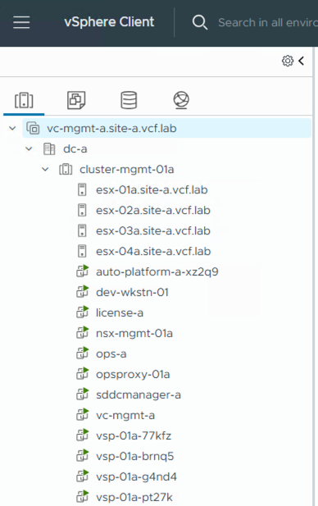
VCF 9.1 Upgrade at-a-Glance
1. Upgrade consist of two parts:
(1) completing your VCF Fleet (converge)
(2) upgrading existing components
2. Upgrade path varies depending on starting state and components deployed.
i.e., VCF Ops, NSX
3. Upgrade accomplished using mix of:
Manual upgrades
VCF Installer (vSphere/VVF)
VCF Operations (VCF)
Notes:
Key Message:
The upgrade path to VCF 9.0 starts with VCF Operations. Check for and resolve any alerts/alarms in your environment before attempting the upgrade. Note that VUM and ELM are deprecated in VCF 9.0 and as such you will need to transition away from these solutions when you upgrade.
Talk Track:
VCF Operations is a required component of VCF 9.0. As part of the VCF 9.0 upgrade you will need to either upgrade an existing Aria Operations instance to VCF Operations 9.0 or deploy a new VCF Operations 9.0 instance.
Before you attempt to upgrade, be sure to check for any open alerts/alarms in vSphere, vSAN, NSX, VCF Operations, and the SDDC manager. It’s recommended you address any issues prior to attempting the upgrade.
Also, it’s good to check for password and certificate expirations to ensure all are valid and nothing will expire during the upgrade window.
If using VUM or ELM you will need to transition away from those solutions as part of the VCF 9.0 upgrade.
Notes:
Resources:
VMware Cloud Foundation 9.0 Release Notes:
https://docs.vmware.com/en/VMware-Cloud-Foundation/index.html

Slide 4

Private Cloud Constructs within VMware Cloud Foundation
Workload Domain
VCF Instance
VCF Fleet
Region A
Workload Domain
VCF Instance
VCF Fleet
vCenter
Workload Domain
VCF Automation
NSX
vCenter
VCF Operations
NSX
VCF Instance 1
VCF Instance 2
Clusters
SDDC Manager
Workload Domain
Workload Domain
Core Infrastructure
Clusters
Clusters
vCenter
vCenter
Core Infrastructure
NSX
NSX
SDDC Manager
SDDC Manager
Clusters
Clusters
Clusters
Clusters
Workload Domain
Core Infrastructure
Core Infrastructure
vCenter
NSX
Clusters
Workload Domain
Workload Domain
Core Infrastructure
vCenter
vCenter
NSX
NSX
Clusters
Clusters
Additional Workload Domains
Core Infrastructure
Core Infrastructure
Additional Workload Domains
Additional Workload Domains
Notes:
Key Message:
A VCF private cloud is implemented on a modular architecture that combines workload domains into VCF Instances, which are further combined into VCF Fleets. VCF Fleets are centrally managed from central instance of VCF Operations and Automation.
Talk Track:
Workload Domain
At the core of the VCF architecture is the workload domain. A Workload Domain is a logical unit of application-ready infrastructure that groups ESX hosts into one or more vSphere clusters each providing specific performance, availability, or security characteristics.
Think of a workload domain as a standardized, repeatable unit of private cloud capacity—bundling compute, storage, and networking into an isolated pool. Because workload domains are managed through automation, you can create, scale, or delete them on demand. In addition, each workload domain is managed and life-cycled independently.
VCF Instance
One or more workload domains are logically combined into a VCF Instance. A VCF Instance represents the collection of workload domains within a single location or site. VCF Instances shared a common software depot and collection of VCF management services.
VCF Fleet
VCF Instances are then grouped into VCF fleets. Each VCF Fleet is managed from a set of centralized services that are provided by a dedicated instance of VCF Operations and Automation.
Notes:
Resources: Refer to the VMware Cloud Foundation Design Guide for further information on Workload Domains: https://techdocs.broadcom.com/us/en/vmware-cis/vcf.html
Refer to Getting Started Guide for further information on Getting Started with VMware Cloud Foundation: https://techdocs.broadcom.com/us/en/vmware-cis/vcf.html

Slide 5
VCF Fleet Components Overview*
Required Components By Deployment Type…
Component | vSphere 8.x | VCF 5.2 | VCF 9.0 | VCF 9.1
vCenter | Required | Required | Required | Required
NSX Manager | Optional | Required | Required | Required
SDDC Manager | n/a | Required | Required | Required
Fleet Manager | Optional | Optional | Required | n/a
Ops | Optional | Optional | Required | Required
Ops Proxy | Optional | Optional | Required | Required
Ops for Networks | Optional | Optional | Optional | Optional
Logs | Optional | Optional | Optional | Optional
Automation | Optional | Optional | Required | Required
Management Services | n/a | n/a | n/a | Required
License Server | n/a | n/a | n/a | Required
*Not inclusive of all components, for example does not cover NSX Edge, VNA, HCX, or AVI
Notes:
Upgrading involves updating the versions but also adding additional components to complete the Fleet. This slide shows an example of the components required by each deployment type starting with standalone vSphere to VCF 5.2 to VCF 9.0 and VCF 9.1. The intent of this slide is to highlight the evolution of VCF to include the additional components added with VCF 9.x to complete the VCF Fleet.

Slide 6
VCF 9.1 Upgrade High Level Overview
Converging vSphere 8.x to VCF 9.1
Current State
Verify Prerequisites
Deploy VCF Installer
Converge VCF Fleet
VCF Fleet
vCenter
VCF 9.1 binaries
VCF Automation
Clusters
vCenter 8.0u3
VCF Operations
A
Core Infrastructure
ESX 8.0u3
VCF Installer
VCF Instance 1
NSX 4.2.0.1
Workload Domain
Capacity for new components
vCenter
vCenter
vCenter
B
vCenter
B
NSX
B
Clusters
B
Clusters
Clusters
SDDC Manager
Clusters
Core Infrastructure
Core Infrastructure
Core Infrastructure
Clusters
Core Infrastructure
vCenter
C
Clusters
Workload Domain
Workload Domain
Core Infrastructure
vCenter
vCenter
Domain Import from VCF Ops
(verify prerequisites first)
NSX
NSX
Clusters
Clusters
Core Infrastructure
Core Infrastructure
A
C
Notes:
Key Message:
A VCF private cloud is implemented on a modular architecture that combines workload domains into VCF Instances, which are further combined into VCF Fleets. VCF Fleets are centrally managed from central instance of VCF Operations and Automation.
Talk Track:
Workload Domain
At the core of the VCF architecture is the workload domain. A Workload Domain is a logical unit of application-ready infrastructure that groups ESX hosts into one or more vSphere clusters each providing specific performance, availability, or security characteristics.
Think of a workload domain as a standardized, repeatable unit of private cloud capacity—bundling compute, storage, and networking into an isolated pool. Because workload domains are managed through automation, you can create, scale, or delete them on demand. In addition, each workload domain is managed and life-cycled independently.
VCF Instance
One or more workload domains are logically combined into a VCF Instance. A VCF Instance represents the collection of workload domains within a single location or site. VCF Instances shared a common software depot and collection of VCF management services.
VCF Fleet
VCF Instances are then grouped into VCF fleets. Each VCF Fleet is managed from a set of centralized services that are provided by a dedicated instance of VCF Operations and Automation.
Notes:
Resources: Refer to the VMware Cloud Foundation Design Guide for further information on Workload Domains: https://techdocs.broadcom.com/us/en/vmware-cis/vcf.html
Refer to Getting Started Guide for further information on Getting Started with VMware Cloud Foundation: https://techdocs.broadcom.com/us/en/vmware-cis/vcf.html

Slide 7
Deprecated Features…

Slide 8
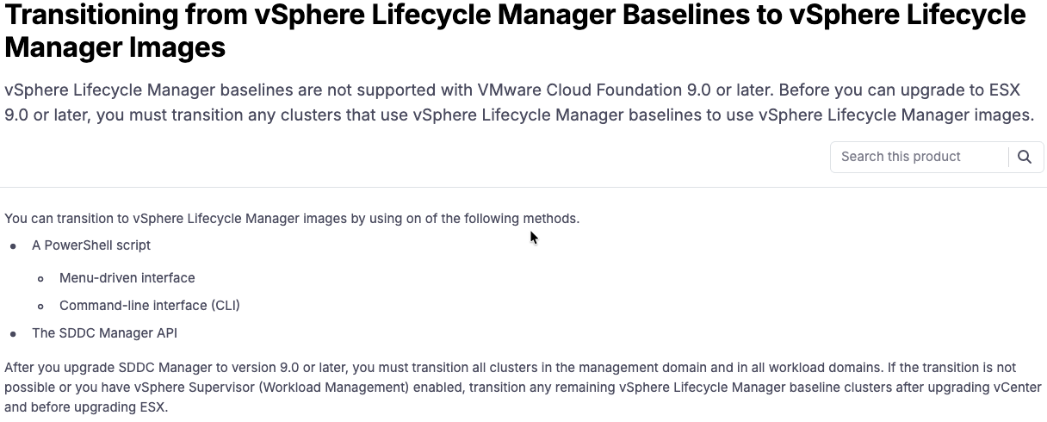
Deprecated Feature
vSphere Lifecycle Manager Baselines (aka VUM)
vSphere Lifecycle Manager Baselines is not supported with VCF 9.0 or later.
Replaced by vSphere Lifecycle Manager Images
Transition to vSphere Lifecycle Manager (vLCM) Prior to converging to VCF 9.1.

Slide 9
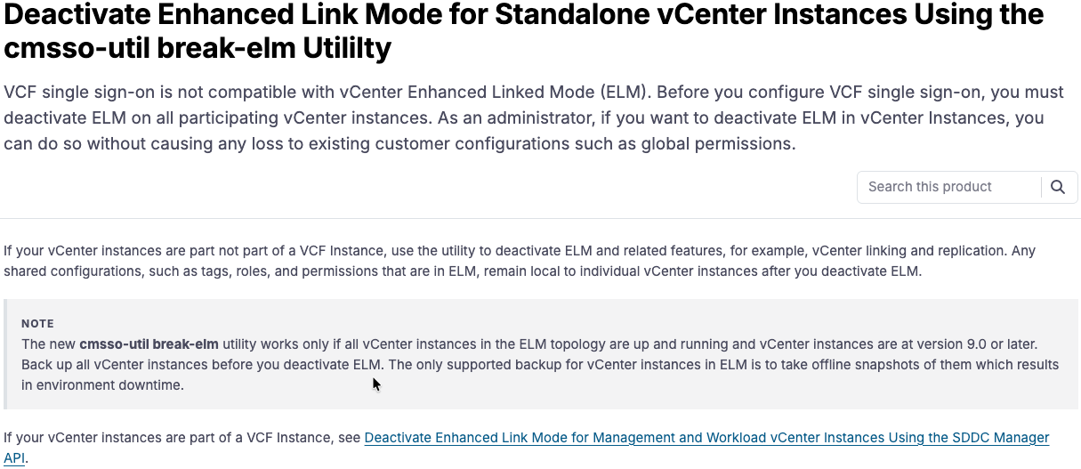
Deprecated Feature
vCenter Enhanced Linked Mode (ELM)
vCenter Enhanced Linked Mode (ELM):
Deactivate ELM for all vCenter instances
Steps to deactivate vary based on vCenter version.
In VCF 9.x ELM is replaced by:
Replaced by VF Single sign-on (SSO)
vCenter Linking

Slide 10
vSphere 8.x to VCF 9.1 Upgrade Overview…

Slide 11
Upgrade Path Differs Depending if NSX and Aria Ops is Used
NSX
Aria Operations
If your vCenter is NOT registered with NSX:
You must manually upgrade vCenter to 9.1
You can optionally uupgrade ESX to 9.1 as well, or use VCF Ops after convergence.
If your vCenter IS registered with NSX:
Update to vCenter 8.0u3a (or later)
Upgrade to ESX 8.0u3 (or later)
Update to NSX 4.2 (or later)
If Aria Operations IS used, manually upgrade to VCF Operations 9.1 using PAK file.
If Aria Operations is NOT used, it will be deployed by the VCF Installer.
Notes:
Aria Suite Lifecycle is not upgraded to 9.1.
Functionality moved to VCF management services
Continue to use the Aria Suite Lifecycle to manage components not upgraded to 9.1 (i.e. VIDM, Aria Logs)

Slide 12
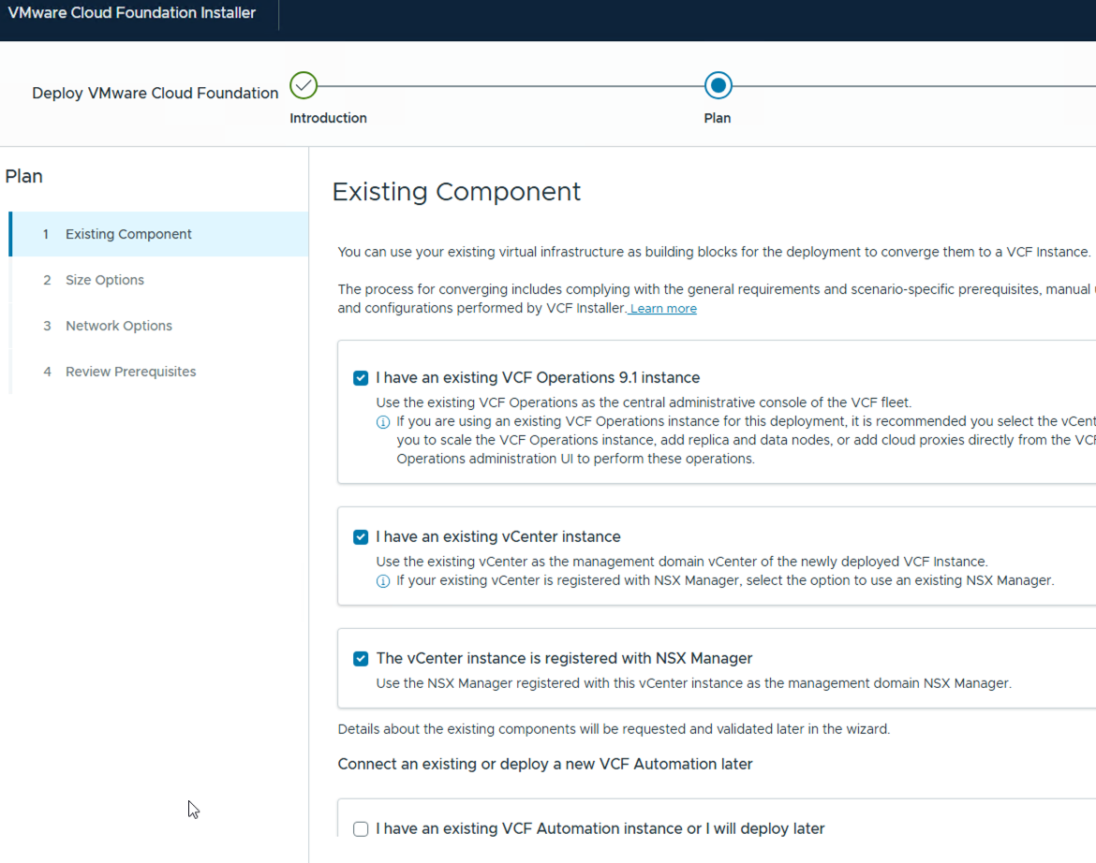
vSphere 8.x → VCF 9.1 Upgrade Considerations
Use the VCF Installer to ”converge” an existing vSphere environment to VCF 9.1 Instance.
The converged vSphere environment becomes the VCF management domain in a new VCF Instance.
Missing components automatically deployed to complete the VCF Instance/Fleet.
VCF Operations
NSX
VCF Automation
New components introduced with VCF 9.1.
VCF Management Services
VCF License Server

Slide 13
vSphere 8.x Upgrade Path
1
2
3
4
5
6
w/out Aria Ops
Upgrade vCenter to 9.1
Deploy VCF Installer & Dload Binaries
Converge vSphere & Deploy VCF
Config depot & dload binaries
Upgrade ESX
License VCF 9.1
w/out NSX
1
2
3
4
5
6
7
w/ Aria Ops 8.18
Upgrade Ops to 9.1
Upgrade vCenter to 9.1
Deploy VCF Installer & Dload Binaries
Converge vSphere + OPS
Config depot & dload binaries
Upgrade ESX
License VCF 9.1
vSphere
8.0 Update 3
1
2
3
4
5
w/out Aria Ops
Deploy VCF Installer & Dload Binaries
Converge vSphere + NSX & Deploy VCF
Config depot & dload binaries
Upgrade NSX, vCenter & ESX
License VCF 9.1
w/ NSX 4.2
1
2
3
4
5
6
w/ Aria Ops 8.18
Upgrade Ops to 9.1
Deploy VCF Installer & Dload Binaries
Converge vSphere+NSX+OPS & Deploy VCF
Config depot & dload binaries
Upgrade NSX, vCenter & ESX
License VCF 9.1

Slide 14
VCF 5.2 to VCF 9.1 Upgrade Overview…

Slide 15
VCF 5.2 → VCF 9.1 Upgrade Considerations
Sequential or skip-level upgrade from VCF 5.2.x.
Upgrade path varies depending if Aria Operations is deployed.
If deployed, start by upgrading to VCF Ops 9.1 & deploying Ops Proxy.
If not deployed, start by deploying VCF Ops 9.1 & deploying Ops Proxy.
Perform the upgrade from VCF Operations 9.1.
Upgrade VCF Management Domain first.
Other workload domains upgraded at any time after the management domain upgrade.
Notes:
SDDC Manager UI is being deprecated, replaced by VCF Operations UI.
Concept of ”VCF aware” Aria LCM goes away in VCF 9.x (Aria LCM deprecated).

Slide 16
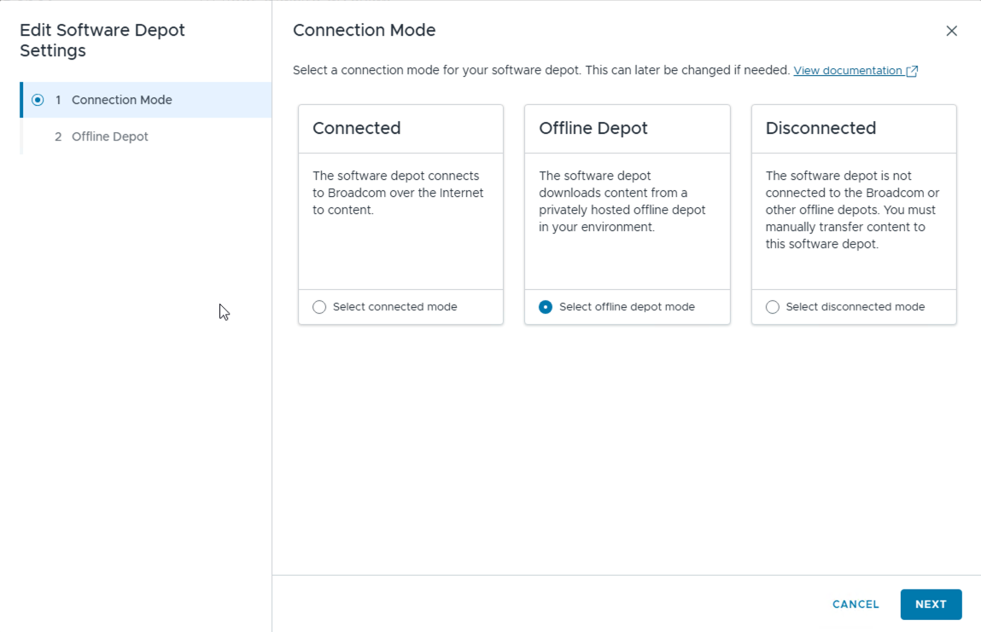
Notable Changes between VCF 5.2 and VCF 9.1
What’s New in VCF 9.1
VCF 9.1 introduces a single software depot
Verify/reconfigure following upgrade.
VCF 9.1 Introduces two new components:
VCF Management Services
Deployed from VCF Operations
VCF License Server
Connected mode: license server automatically registered.
Disconnected mode: will need to manually register.
Note, you won’t be able to upgrade ESX until after you complete the new license registration.

Slide 17
5.2.x Upgrade Path
VMware Cloud Foundation
1
2
3
4
5
6
Deploy/Upgrade Ops 9.1
Deploy/Upgrade Ops Proxy
Upgrade SDDC Manager
Config Software Depot
Deploy Mgmt Services
Deploy other VMS components
Start
7
8
9
10
11
12
Deploy/import/ Upgrade Auto / Ops for Net /
Upgrade Domain Core Components
(NSX, vCenter, ¹ESX)
Upgrade VDS Version
Upgrade vSAN Disk Version
Apply Config Drift Updates
License VCF 9.1
End
¹Create 9.1 ESX Image and Import to VCF Ops

Slide 18
VCF 9.0 to VCF 9.1 Upgrade Overview…

Slide 19
VCF 9.0 → VCF 9.1 Upgrade Considerations
Upgrade path is largely the same as VCF 5.2 to VCF 9.1
Upgrade is driven from VCF Operations
Primary Considerations:
VCF 9.1 deprecates Fleet Management and Introduces VCF Management Services
VCF 9.1 introduces the License Server
If licensed in connected mode, licenses auto configured.
If disconnected mode, manually configure.

Slide 20
VCF 9.0.x → VCF 9.1 Upgrade Path
VMware Cloud Foundation
1
Upgrade Ops to 9.1
(also upgrades Ops Proxy)
2
3
4
5
Upgrade SDDC Manager to 9.1
Deploy VCF Management Services
(deploys license server)
Verify Software Depot
Verify License
Upgrade VCF Management Components
(Auto, Ops for Networks, Logs, VIDB)
Start
6
Upgrade Domain Core Components
(NSX, vCenter, ¹ESX)
7
8
9
10
Upgrade VDS Version
Upgrade vSAN Disk Version
Apply Config Drift Updates
License for VCF 9.1
End
¹Create 9.1 ESX Image and Import to VCF Ops

Slide 21
VCF 9.1 Upgrade Paths
Overview
Starting Point…
What’s Involved…
Upgrade Method…
vSphere 8.x
(w/out NSX)
Manually upgrade vSphere to 9.1
Deploy VCF Installer & download binaries
Converge to VCF – deploys VCF Management Services, VCF Ops, NSX, VCF Auto
Relicense
Manual upgrade
VCF Installer
vSphere 8.x
(w NSX)
Update to vSphere 8.0u3 and NSX 4.2.x.
Deploy VCF Installer & download binaries
Converge to VCF – deploys VCF Management Services, VCF Ops, VCF Auto
Use VCF Ops LCM to upgrade vSphere
Relicense
VCF Installer
VVF 9.0.x
Manually upgrade vSphere to 9.1
Deploy VCF Installer & download binaries
Converge to VCF – deploys VCF Management Services, VCF Ops, VCF Auto
Verify license
VCF Installer
VCF 5.2.x
Manual Install/upgrade of VCF Ops & Ops Proxy
Use VCF Ops to upgrade SDDC Manager
Manually deploy VCF Management Services
Use Ops LCM to upgrade NSX, vCenter, ESX
Relicense
Manual Upgrade
VCF Ops LCM
VCF 9.0.x
Manually upgrade VCF Ops & Ops Proxy
Use VCF Ops to upgrade SDDC Manager
Manually deploy VCF Management Services
Use Ops LCM to upgrade NSX, vCenter, ESX
Verify Licensing
Manual upgrade
VCF Ops LCM

Slide 22
Additional Upgrade Considerations…

Slide 23
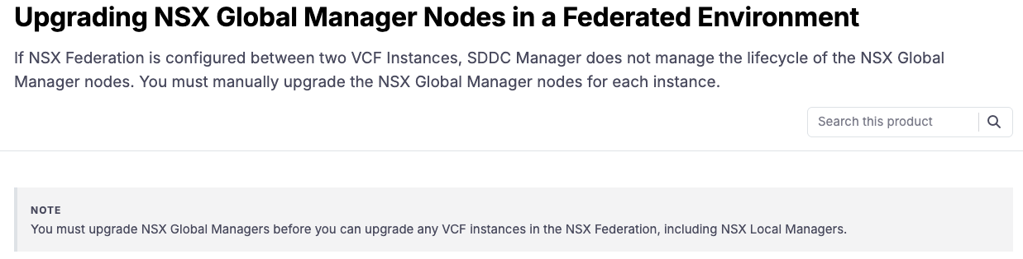
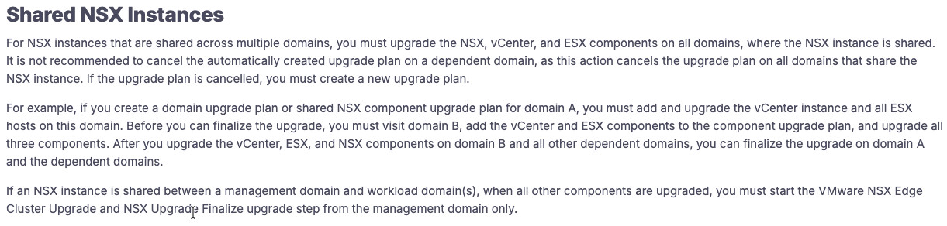
VCF 9.1 Upgrade Considerations
NSX
NSX 4.2.x → NSX 9.1 Upgrades
Standalone NSX upgrade not supported. Import NSX 4.2.x to VCF, then upgrade.
Finalize NSX upgrade after all ESX hosts in the domain have been upgraded to 9.1.
NSX Federation
NSX Global Managers must be manually upgraded.
Shared NSX
Finalize NSX upgrade on management domain after all ESX hosts across all domains have been upgraded to 9.1.

Slide 24
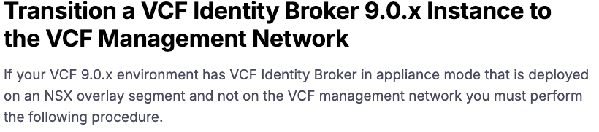
VCF 9.1 Upgrade Considerations
VIDB
VCF 9.0 Introduced the VCF Identity Broker (VIDB)
Embedded Mode: runs with vCenter.
Appliance Mode: runs as cluster of 3 VMs.
In VCF 9.1 the VIDB “appliance mode” is now part of the VCF management services
If VIDB is deployed in “appliance mode” and running on an NSX overlay segment, move it to the management network prior to upgrade.
Note: does not apply to embedded VIDB

Slide 25
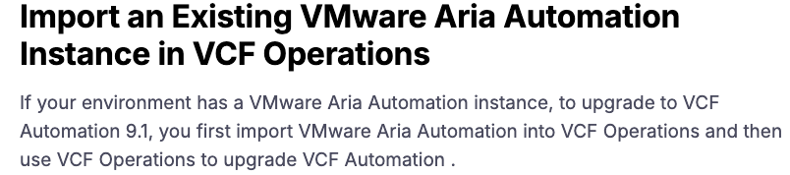
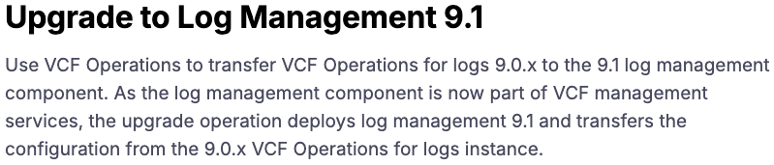
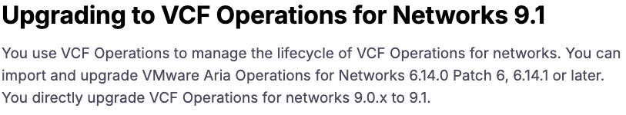
VCF 9.1 Upgrade Considerations
VCF Management Components
VCF Automation
VCF Logs
VCF Ops for Networks
Import existing Aria Automation 8.x to VCF Operations and upgrade
Migration upgrade – deploys second instance, migrates data, removes original.
No direct upgrade path for VMware Aria Logs.
Deploy VCF 9.1 Log Management & migrate the configuration.
To upgrade from VCF 9.0 log management, Logs must be running on the VCF Management Network.
Import 6.14.0 Patch6, 6.14.1 or later and upgrade.
Limited to one instance.

