Slide 1



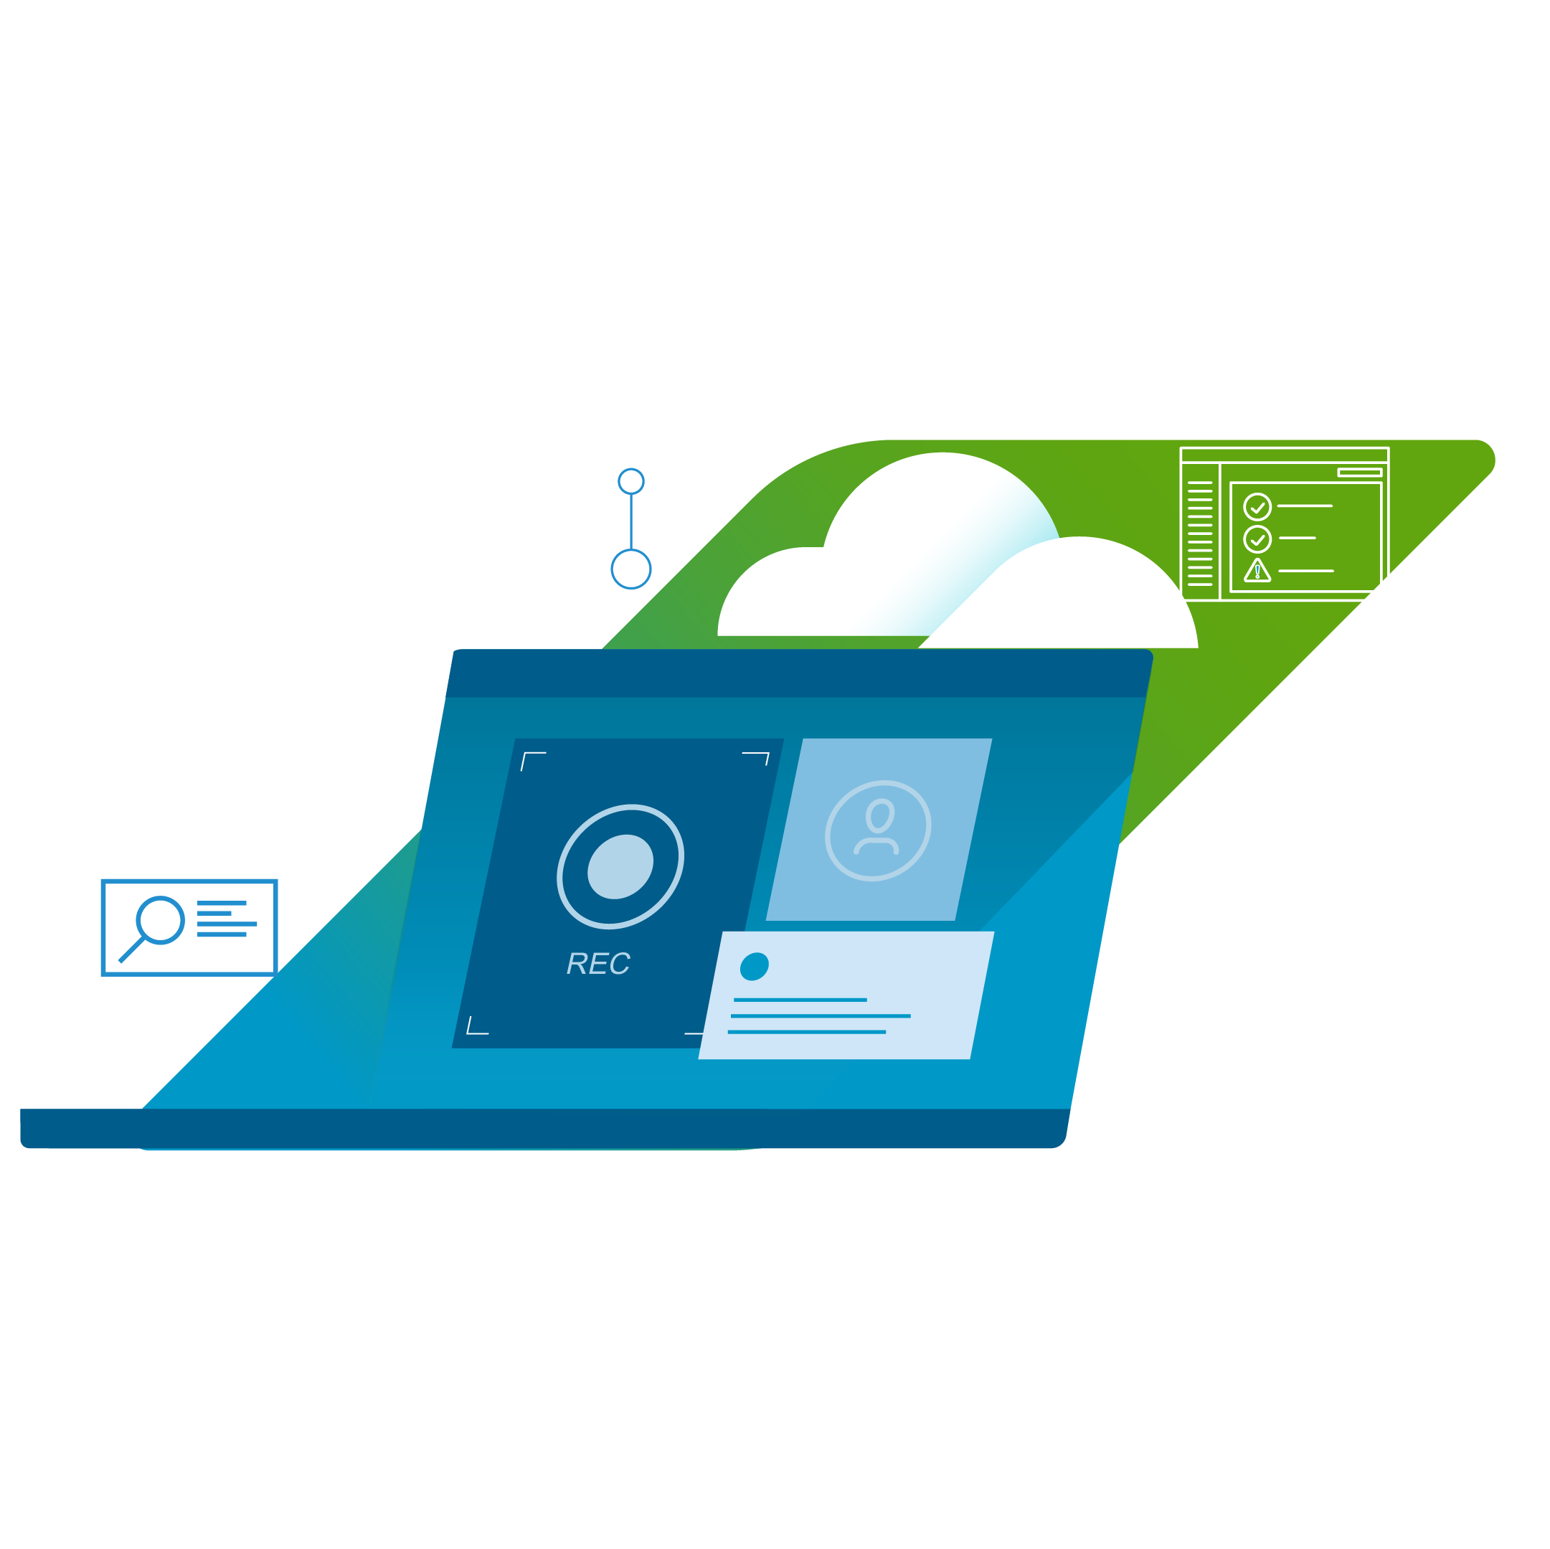
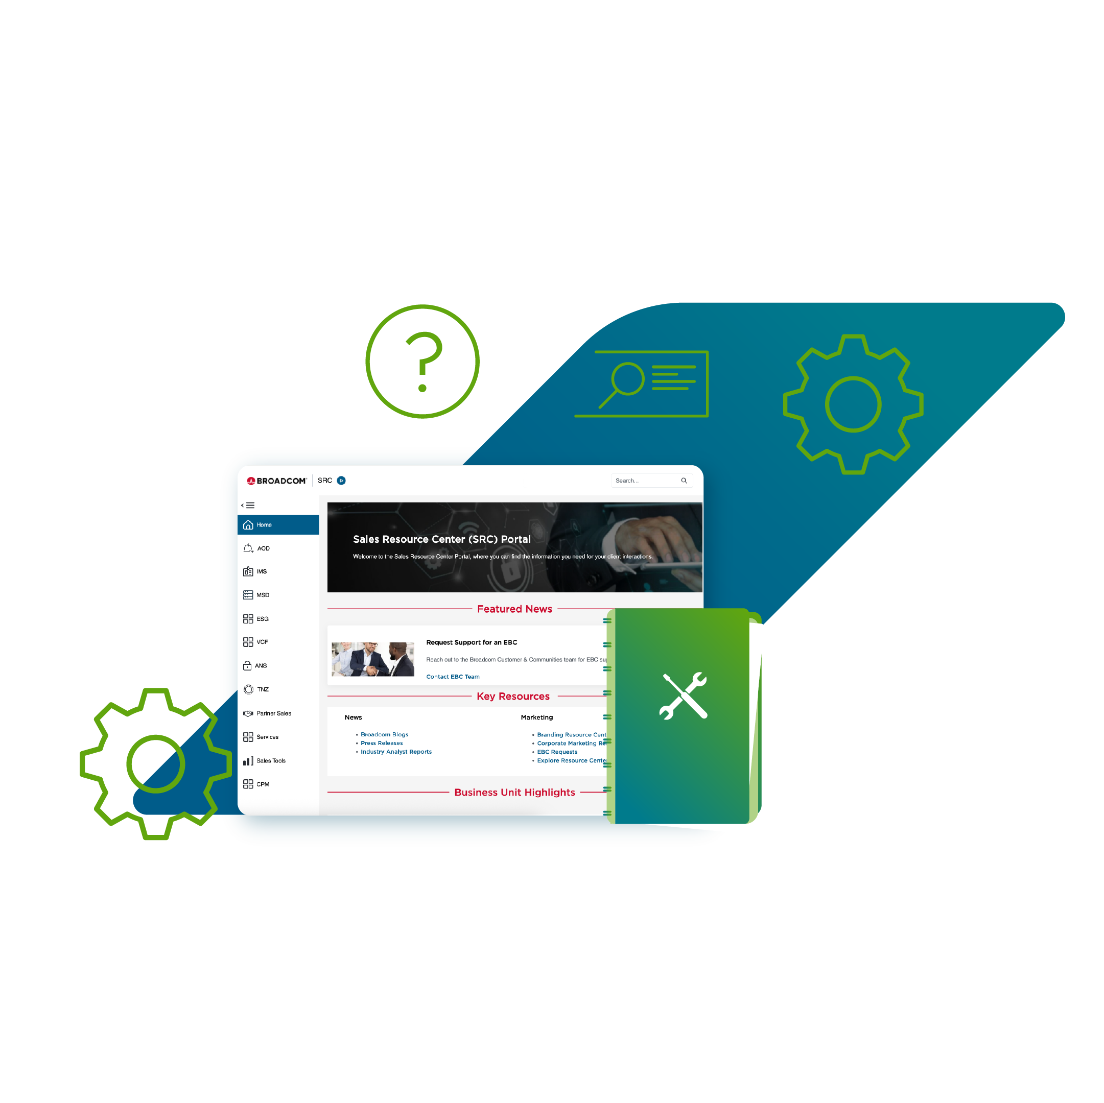

Housekeeping
Chat
Keep comments for Chat
Q&A
Add questions to the Q&A
Recording
Session is being recorded
Materials
See Week of Enablement SRC page for all uploads
Please, give us your feedback at the end of the session

Slide 2
Upgrade Pathways to VCF 9.1
VCF
9.1
VCF Division Solution Architecture
WOE FY26Q2 - March 2026
Notes:
Click to add notes

Slide 3

VCF
9.1
Agenda
VCF Upgrade Design Considerations
What’s New in Upgrade for 9.1
Upgrade 9.1 Considerations
VCF Upgrade Most Common Scenarios
vSphere 8.x with or without Ops to vSphere 8.x + VCF 9.1
vSphere 8.x with or without Ops to vSphere 9.x + Ops 9.1
vSphere 8.x to VCF 9.1
VCF 5.2/9.0.x to VCF 9.1
Takeaway

Slide 4
What’s New in Upgrade for 9.1

Slide 5
What’s New in Upgrades for VCF 9.1
Topic | 9.0.x | 9.1.x
NSX Convert and Import | ✔ | ✔
NSX Federation Support | ✔ | ✔
Can Upgrade Operations, Automation, Operations for Networks | ✔ | ✔
NSX Bare Metal Edges nodes are supported Import and Convert | ✘ | ✔
New VCF Management Services will be deployed during upgrade | ✘ | ✔
VCF Operations Fleet Management is a Service | ✘ | ✔
VCF Operations for Logs is a Service | ✘ | ✔
VIDB deployed Day 0 | ✘ | ✔

Slide 6
VCF 9.1Upgrade Considerations
Component
Not Supported in 9.1
Enhanced Linked Mode (ELM)
Customers with vSphere only will need to upgrade all vCenters in ELM Ring to 9.0 then break ELM.
Customers with vSphere and NSX will need to break Converge or Import vCenter away from ELM Ring.
VXRail
VXRail is supported to be upgraded in 9.1 release for existing VCF Customers
VXRail is not supported to be upgraded for vSphere Customers

Slide 7
VCF Upgrade Most Common Scenarios

Slide 8
vSphere 8.x with or without Ops to vSphere 8.x + VCF Operations 9.1

Slide 9
Minimum Supported Version for vSphere with or without Operations
Current State
Future State
vCenter 8.0u3a
vCenter 8.0u3a Aria Operations 9.1
vCenter 8.0u3a Aria Operations 8.18x
Upgrade Path:
Maintain vCenter 8.0u3a while upgrading Aria Operations from 8.18.x to 9.1

Slide 10
9.1 New Feature
Component
New Support
VCF Operations
Once VCF Operations is licensed with BSC, customers will have the ability to
replace passwords and certificates for none VCF instances vCenters and hosts. This is done as a standalone vCenter in VCF Operations

Slide 11
vSphere 8.x with or without Ops to VCF Operations 9.1
New Components
IP Requirements
DNS Requirements
License Server
1 IP
1 DNS

Slide 12
vSphere 8.x with or without Ops to vSphere 8.x + VCF Operations 9.1
Install Aria Operations
License VCF Operations 9.1
vSphere 8.0u3a – no change
Install VCF Operations 9.1
License VCF Operations 9.1
vSphere 8.0u3a
START
1
2
3
END
Upgrade Aria Operations
License VCF Operations 9.1
vSphere 8.0u3a – no change
Upgrade Aria Operations
8.18.x to VCF Operations 9.1
License VCF Operations 9.1
vSphere 8.0u3a
1
2
3
START
END

Slide 13
vSphere 8.x with or without Ops to vSphere 9.1+ VCF Operations 9.1

Slide 14
Minimum Supported Version for vSphere with or without Operations
Current State
Future State
vCenter 8.0u3a
vCenter 9.1 Aria Operations 9.1
vCenter 8.0u3a Aria Operations 8.18x
Upgrade Path:
Upgrade Aria Operations 8.18.x to VCF Operations 9.1
Upgrade vCenter 8.0u3a to vCenter 9.1

Slide 15
9.1 New Feature
Component
New Support
VCF Operations
Once VCF Operations is licensed with BSC, customers will have the ability to replace passwords and certificates for none VCF instances vCenters and hosts. This is done as a standalone vCenter in VCF Operations

Slide 16
vSphere 8.x with or without Ops to vSphere 9.1 + VCF Operations 9.1
New Components
IP Requirements
DNS Requirements
License Server
1 IP
1 DNS

Slide 17
vSphere 8.x with or without Ops to vSphere 9.1+ VCF Operations 9.1

Slide 18
vSphere 8.x with or without Ops to VCF 9.1

Slide 19
Minimum Supported Version for vSphere and Operations to VCF 9.1
Current State
Future State
vCenter 8.0u3a
SDDC Manager
vCenter 9.1
NSX 9.1
VCF Management Services
VCF Operations 9.1
VCF License Server
VCF Operations Cloud Proxy
VCF Automation 9.1
vCenter 8.0u3a
Aria Operations 8.18x
vCenter 8.0u3a Aria Operations 8.18x
Aria Suite Lifecycle Manager
Upgrade Path:
Upgrading vCenter 8.0u3a to vCenter 9.1
Upgrading Aria Operations from 8.18.x to 9.1

Slide 20
Upgrade path 1: vSphere with Operations
New Components
IP Requirements
DNS Requirements
VCF Management Services
1 IP
1 DNS
VCF Fleet Services
1 IP
1 DNS
VCF Instance Services
1 IP
1 DNS
License Server
1 IP
1 DNS
VCF Identity Broker
1 IP
1 DNS
VCF Management Services IP Pool
Simple Deployment: Minimum 6
High Availability: Minimum 8
_____
SDDC Manager
1 IP
1 DNS
NSX Manager
Simple Deployment: 2 IPs
High Availability: 4 IPs
Simple Deployment: VIP and Node A
High Availability: VIP, Node A, Node B and Node C
VCF Ops Cloud Proxy
1 IP
1 DNS
VCF Automation
Simple Deployment: 3 IPs
High Availability: 6 IPs
Simple Deployment: VIP, VCF Instance Service
High Availability: VIP, VCF, Instance Service

Slide 21
Path 1: vSphere with Ops to VCF 9.1
01
Design and Plan 9.0
(Sizing, IPs, DNS)
Configure Depot and Download Binaries in the Installer
06
02
Prepare all
Prerequisites
Converge vSphere + Ops to
VCF Instance
07
Upgrade Existing vSphere + Ops Deployment to VCF
03
Upgrade Ops
desired for Management
Configure VCF Operations
Licensing
08
04
Upgrade vCenter ESX
for Management
Optional: Import Workload Domain vCenter
09
05
Deploy VCF Installer

Slide 22
Path 1: vSphere with Ops to VCF 9.1

Slide 23
vSphere + NSX to VCF 9.1

Slide 24
Minimum Supported Version for vSphere + NSX to VCF 9.1
Current State
Future State
vCenter 8.0u3a
NSX 4.2.x
SDDC Manager
vCenter 9.1
NSX 9.1
VCF Management Services
VCF Operations 9.1
VCF License Server
VCF Operations Cloud Proxy
VCF Automation 9.1
vCenter 8.0u3a NSX 4.2.x
NSX Federation 4.2.x
vCenter 8.0u3a Aria Operations 8.18x
NSX Federation 4.2.x
NSX Bare Metal Edges
Upgrade Path:
Converge vCenter 8.0u3a t.x to NSX 4.2.x to VCF 9.1

Slide 25
Upgrade Path 1: vSphere with Operations
New Components
IP Requirements
DNS Requirements
VCF Management Services
1 IP
1 DNS
VCF Fleet Services
1 IP
1 DNS
VCF Instance Services
1 IP
1 DNS
License Server
1 IP
1 DNS
VCF Identity Broker
1 IP
1 DNS
VCF Management Services IP Pool
Simple Deployment: Minimum 6
High Availability: Minimum 8
_____
SDDC Manager
1 IP
1 DNS
NSX Manager
Simple Deployment: 1 IPs
High Availability: 3 IPs
Simple Deployment: Primary
High Availability: Primary, Replica, Data
VCF Ops Cloud Proxy
1 IP
1 DNS
VCF Automation
Simple Deployment: 3 IPs
High Availability: 6 IPs
Simple Deployment: VIP, VCF Instance Service
High Availability: VIP, VCF, Instance Service

Slide 26
Path 2: vSphere with NSX to VCF 9.1
01
Design and Plan 9.0
(Sizing, IPs, DNS)
Download NSX, vCenter,
ESX Binaries
06
02
Prepare all Prerequisites
Upgrade Existing vSphere with NSX Deployment to VCF
Upgrade NSX, vCenter, ESX
07
03
Deploy VCF Installer
Configure VCF Operations
Licensing
08
04
Configure Depot and Download
Binaries in the Installer
Optional: Import Workload Domain vCenter
09
05
Converge vSphere with NSX
To VCF Instance

Slide 27
Upgrade Prerequisites and Steps for VCF 5.x to VCF 9.1

Slide 28
Minimum Supported Version for upgrading to VCF 9.1
Upgrade
Management Domain 5.2
Workload Domain 5.2

Slide 29
Upgrade Path 3: VCF 5.2 to VCF 9.1
New Components
IP Requirements
DNS Requirements
VCF Management Services
1 IP
1 DNS
VCF Fleet Services
1 IP
1 DNS
VCF Instance Services
1 IP
1 DNS
License Server
1 IP
1 DNS
VCF Identity Broker
1 IP
1 DNS
VCF Management Services IP Pool
Simple Deployment: Minimum 6
High Availability: Minimum 8
_____
VCF Ops Cloud Proxy
1 IP
1 DNS
VCF Automation
Simple Deployment: 3 IPs
High Availability: 6 IPs
Simple Deployment: VIP, VCF Instance Service
High Availability: VIP, VCF, Instance Service

Slide 30
Upgrade Path 3: VCF 5.2 to VCF 9.1
01
Design and Plan 9.0
(Sizing, IPs, DNS)
Upgrade Management
Domain NSX
06
02
Prepare all Prerequisites
Upgrade / Deploy / Configure VCF Automation
07
03
Upgrade Existing VCF 5.2 to VCF 9.1
Upgrade VCF Operations 9.1
Deploy / Configure VCF SSO / Logs
08
Download SDDC
Binary / Upgrade
SDDC Manager / Deploy VCF Services
04
Upgrade Workload Domains
09
05
Download Upgrade
Binaries for NSX,
vCenter, ESX

Slide 31
VCF 5.2/9.0x to VCF 9.1

Slide 32
Minimum Supported Version for vSphere + NSX to VCF 9.1
Current State
Future State
VCF 5.2 without Aria
SDDC Manager
vCenter 9.1
NSX 9.1
VCF Management Services
VCF Operations 9.1
VCF License Server
VCF Operations Cloud Proxy
VCF Automation 9.1
VCF 5.2 with Aria
VCF 9.0.x
Upgrade Path:
Upgrade VCF 5.2 without Aria o VCF 9.1
Upgrade VCF 5.2 with Aria o VCF 9.1
Upgrade VCF 9.0.x to VCF 9.1

Slide 33
Minimum Supported Version for upgrading to VCF 9.1
Upgrade
Management Domain 9.0.x
Workload Domain 9.0.x

Slide 34
Upgrade Path 4: VCF 9.0.x to VCF 9.1
New Components
IP Requirements
DNS Requirements
VCF Management Services
1 IP
1 DNS
VCF Fleet Services
1 IP
1 DNS
VCF Instance Services
1 IP
1 DNS
License Server
1 IP
1 DNS
VCF Identity Broker
1 IP
1 DNS
VCF Management Services IP Pool
Simple Deployment: Minimum 6
High Availability: Minimum 8
_____
VCF Ops Cloud Proxy
1 IP
1 DNS
VCF Automation
Simple Deployment: 3 IPs
High Availability: 6 IPs
Simple Deployment: VIP, VCF Instance Service
High Availability: VIP, VCF, Instance Service

Slide 35
Upgrade Path 4: VCF 9.0.x to VCF 9.1
01
Design and Plan 9.0
(Sizing, IPs, DNS)
Upgrade Management
Domain NSX
06
02
Prepare all Prerequisites
Upgrade / Deploy / Configure VCF Automation
07
03
Upgrade VCF Operations 9.1 / Move Fleet to Service
Upgrade Existing VCF 9.0.x to VCF 9.1
Deploy / Configure VCF SSO / Logs
08
Download SDDC
Binary / Upgrade
SDDC Manager / Deploy VCF Services
04
Upgrade Workload Domains
09
05
Download Upgrade
Binaries for NSX,
vCenter, ESX

Slide 36
Takeaway

Slide 37




Week of Enablement Odyssey Tournament is Here!
Put your VKS knowledge to the test in 3 competitive Odyssey games featuring real hands-on lab challenges, live scoring, and a global leaderboard.
New Game will go live every day!
Climb the leaderboard or get left behind!
Games end Friday, March 20 at 8pm ET
Leaderboard
Play Here
Notes:
"🔥 Week of Enablement Odyssey Tournament is coming!
Put your VKS knowledge to the test in 3 competitive Odyssey games featuring real hands-on lab challenges, live scoring, and a global leaderboard.
Starts: Mar 16th at 8pm ET | Ends: Mar 20 at 8pm ET
New Game will go Live every day!
Climb the leaderboard or get left behind!"

Slide 39

VCF
9.1
Agenda
Agenda Items
xcxz

Slide 54
VCF
9.1

Slide 55
VCF
9.1

Slide 56
VCF
9.1

Slide 57

Next Steps & Call To Action
Field Guide
Marketing Calendar
SRC
‸
ENABLE
ENGAGE
EXECUTE
Expand expertise through RBF & new accred/certs
Leverage BU programs & resources for adoption at scale
100% utilization of service and learning entitlements

