Slide 1
VSMC Design
All slide options are visible under slide master
109 Release March 4, 2025
Notes:
Click to add notes

Slide 2
Naming Rule

Slide 3

FQDN Naming Rule For Sample
#Hardware Vender Short name HPE=HP
DELL=DL LENOVO=LE
Hardware
vf12p133le.vsmc.com (MES)
v f12 p1 c03 3 le .vsmc.com
department
FAB
Plane
Rack No.
Rack units No
Hardware Vender
VSMC Domain Name
Rack 2
Rack c03
department | v
FAB | f12
Plane | p1
Rack No. | No 1=c01
Rack units No | 10U=10
Hardware Vender | Lenovo=le
Rack 1
40U
vf12p1140le
30U
vf12p1230le
20U
vf12p1c0320le
10U
vf12p1410le

Slide 4
FQDN Naming Rule For Sample
VCF Component
VCF Management Component
vf12p1tcsvc01.vsmc.com.vsmc.net
v f12 p1 tcs vc 01 .vsmc.com
department
FAB
Plane
application
rules name
Serial number
VSMC Domain Name
vf12p1tcs_cluster
department | v
FAB | f12
Plane | p1
application | Prod line roles
rules name | Component name
Serial number | Append numbers to the component names.
Log Insight vf12p1tcslogvip.vsmc.com
NSX Managers vf12p1tcsnsxvip.vsmc.com
Aira automation vf12p1tcsvravip.vsmc.com
Aira Operation Manager vf12p1tcsops01.vsmc.com
NSX-T Managers
NSX Managers
Vf12p1tcsnsx01.vsmc.com
vCenter
vf12p1tcsvc01.vsmc.com

Slide 5
IP Addressing Design Principles

Slide 6
VCF High Level Design
Logical Design

Slide 7
Isolating Different Types Standard Mode (MES)
Architecture
vCenter On the shared datastore of the first Workload Domain (e.g., TCS Cluster)
NSX Manager (3 VMs) Also on the first Workload Domain (recommended cluster with at least 4 hosts)
The same placement principles apply to other components as well.
VCF MGMT Domain
Workload Domain 1. Multi-Cluster
Workload Domain
Aira Operation
vCenter Server
Cluster 1
Cluster 2
APP
OS
APP
OS
APP
OS
APP
OS
APP
APP
APP
APP
OS
OS
OS
OS
NSX Managers
EAP/TCS Cluster
EAP/TCS
Cluster
NSX-T Managers
Log insight
NSX
Edge
NSX-T Managers
NSX
ESG
NSX
ESG
Aira LCM
Aira Automation
ESXi
ESXi
ESXi
ESXi
IN House Cluster
AI Cluster
FDC Cluster
Workload Domain 2. – vLCM
Workload Domain 3. – vLCM
Cluster 1
Cluster 1
Cluster 2
Workload Cluster
VDI
VDI
VDI
VDI
APP
APP
DB
DB
OS
OS
OS
OS
APP
APP
DB
DB
OS
OS
OS
OS
ESXi
ESXi
ESXi
ESXi
ESXi
ESXi
Notes:
Workload Domains are useful for:
Isolating OS / Application types
Isolating VMware licensed features

Slide 8
Isolating Different Types Standard Mode (OA)
Architecture
Design Consideration
vCenter On the shared datastore of the first Workload Domain (e.g., TCS Cluster)
NSX Manager (3 VMs) Also on the first Workload Domain (recommended cluster with at least 4 hosts)
The same placement principles apply to other components as well.
VCF MGMT Domain
Workload Domain 1. Multi-Cluster
Workload Domain
Aira Operation
vCenter Server
Cluster 1
Cluster 2
APP
OS
APP
OS
APP
OS
APP
OS
APP
APP
APP
APP
OS
OS
OS
OS
NSX Managers
RD Cluster
Lnx
Cluster
NSX-T Managers
Log insight
NSX
Edge
NSX-T Managers
NSX
ESG
NSX
ESG
Aira LCM
Aira Automation
ESXi
ESXi
ESXi
ESXi
Net Cluster
OA VM Cluster
My VM Cluster
cluster
Cluster 1
APP
APP
DB
DB
VDI
VDI
VDI
VDI
APP
APP
DB
DB
OS
OS
OS
OS
OS
OS
OS
OS
ESXi
ESXi
ESXi
ESXi
ESXi
ESXi
Notes:
Workload Domains are useful for:
Isolating OS / Application types
Isolating VMware licensed features

Slide 9
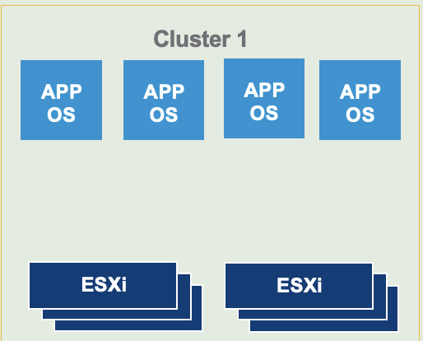
Isolating Different Types Standard Mode (DMZ)
Architecture Design
vCenter On the shared datastore of the first Workload Domain (e.g., TCS Cluster)
NSX Manager (3 VMs) Also on the first Workload Domain (recommended cluster with at least 4 hosts)
The same placement principles apply to other components as well.
VCF DMZ Domain
Aira Operation
OA vCenter Server
NSX Managers
NSX-T Managers
Log insight
NSX-T Managers
NSX
ESG
Aira LCM
Aira Automation
Notes:
Workload Domains are useful for:
Isolating OS / Application types
Isolating VMware licensed features

Slide 10
VCF Management Component Architecture Design
Logical Design

Slide 11
NSX-T 4.2 Recommended Resources- Manager
VM | vCPU | Memory (G) | Storage (G) | Quantity
NSX Manager (Medium or Large) | 12 | 48 | 300 | 3
NSX Manager VM Size
Extra Small: Only for Cloud Service Manager
Small: For PoC (Proof of Concept) only
Medium: Supports up to 64 hosts
Large: For environments with more than 64 hosts
NSX Manager must always be deployed as three nodes, following a 2+1 redundancy model.
An anti-affinity rule should be configured to ensure that the three NSX Manager VMs are not placed on the same host.
Resource reservations should be made specifically for NSX Manager.
Whether or not a dedicated Management Cluster is used, NSX Manager should be deployed on a vSphere Cluster with at least four hosts.

Slide 12
Simple VCF Operations for Networks Model v1.0
VCF Operations
VCF Operations
VCF Operations
(Fleet Management)
VCF Operations
Collector node
VCF Operations for Networks
VCF Operations for Networks
Platform Node
VCF Operations for Networks
Collector Node
VCF Instance
Management Domain
Workload Domain
vCenter
vCenter
NSX Manager
NSX Manager
SDDC Manager
Notes:
Version: 1.0
Original Author: Gary Blake
Change Log:
v1.0 – 09 June 2025 by Gary Blake
Initial creation

Slide 13
Architecture Design of VCF Components
VCF HA DR High Level Design

Slide 14
VCF Multiple Sites in a Single Region
All VCF components are shared.
Region A – DC 1 (2 host)
Region A – DC 2 (1 host)
Self-Service with VCF Automation
VCF Operations
VCF MGMT Stretched Cluster (MES Subnet)
vCenter
VCF Operations
vSphere HA
Sftp Server
Mgmt NSX Manager Cluster
VCF Automation Cluster
VCF ALL Cluster
Site Affinity
Site Affinity
VM
VM Cluster
VM
Storage
Networking
Physical Network
Physical Network
Notes:
Version: 1.1
Original Author: Michael Kolos
Change Log:
v1.1 - 06 June 2025 by Gary Blake
Added the Design Blueprint diagram to this master deck
Adjusted the font to Metropolis, the source PPT was using Arial but could be based on someone opening the document in Google Slides
Saved the image again using SVG format to obtain a better quality image within DocWorks and also captured just the diagram removing excessive whitespace in HTML output
v1.0 - 30 May 2025 by Michael Kolos
Initial creation of VCF Fleet with Multiple Sites in a Single Region Design Blueprint diagram using standards and guidelines

Slide 15
VCF HA and DR Design

Slide 16
item | cluster
Datastore | FC
vSphere HA | 
Admission Control | 
Host failures cluster tolerates | 1
Host Monitor | Enable
Host failure Response | Restart VM
Response for Host isolation | Power off and restart vm
Datastore with PDL | Power off and restart vm
Datastore with APD | Power off and restart VMs - Aggressive restart policy
vSphere DRS Enable | Yes
DRS Automation level | Manual
VMware EVC | Enabled
MGMT(FC)
Cluster Configuration Design
DesignOverview
Set the number of host failures allowed in vSphere HA to 1.
To ensure compatibility with future additions of ESXi hosts using newer CPU generations, enable VMware EVC (Enhanced vMotion Compatibility) in advance.
“If this cluster is expected to include ESXi hosts with older CPU generations in the future, the EVC compatibility level should be adjusted accordingly to match the older CPU model.”

Slide 17
item | cluster
Datastore | FC
vSphere HA | 
Admission Control | 
Host failures cluster tolerates | 1
Host Monitor | Enable
Host failure Response | Restart VM
Response for Host isolation | Power off and restart vm
Datastore with PDL | Power off and restart vm
Datastore with APD | Power off and restart VMs - Aggressive restart policy
vSphere DRS Enable | Yes
DRS Automation level | Manual
VMware EVC | Enabled
TCS(VSAN)
Cluster Configuration Design
DesignOverview
When using vSAN (FTT=2, RAID-1) in a production environment with eight hosts,
the vSAN storage policy is applied with vSphere HA configured to tolerate two host failures.
If new ESXi servers with a newer CPU generation are added to this vSphere cluster in the future,
VMware EVC must be enabled in advance.
“If this cluster is expected to include ESXi hosts with older CPU generations in the future, the EVC compatibility level should be adjusted accordingly to match the older CPU model.”

Slide 18
item | cluster
Datastore | FC
vSphere HA | 
Admission Control | 
Host failures cluster tolerates | 1
Host Monitor | Enable
Host failure Response | Restart VM
Response for Host isolation | Power off and restart vm
Datastore with PDL | Power off and restart vm
Datastore with APD | Power off and restart VMs - Aggressive restart policy
vSphere DRS Enable | Yes
DRS Automation level | Manual
VMware EVC | Enabled
In house (FC)
Cluster Configuration Design
DesignOverview
Set the number of host failures allowed in vSphere HA to 1.
To ensure compatibility with future additions of ESXi hosts using newer CPU generations, enable VMware EVC (Enhanced vMotion Compatibility) in advance.
“If this cluster is expected to include ESXi hosts with older CPU generations in the future, the EVC compatibility level should be adjusted accordingly to match the older CPU model.”

Slide 19
item | cluster
Datastore | FC
vSphere HA | 
Admission Control | 
Host failures cluster tolerates | 1
Host Monitor | Enable
Host failure Response | Restart VM
Response for Host isolation | Power off and restart vm
Datastore with PDL | Power off and restart vm
Datastore with APD | Power off and restart VMs - Aggressive restart policy
vSphere DRS Enable | Yes
DRS Automation level | Manual
VMware EVC | Enabled
OA Zone(FC)
Cluster Configuration Design
DesignOverview
Set the number of host failures allowed in vSphere HA to 1.
To ensure compatibility with future additions of ESXi hosts using newer CPU generations, enable VMware EVC (Enhanced vMotion Compatibility) in advance.
“If this cluster is expected to include ESXi hosts with older CPU generations in the future, the EVC compatibility level should be adjusted accordingly to match the older CPU model.”

Slide 20
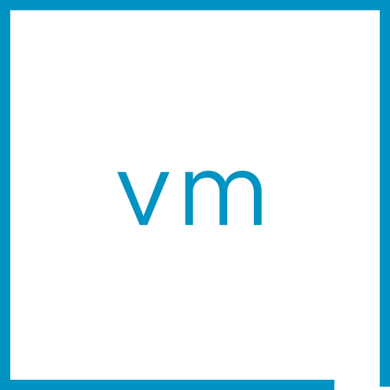


MES TCS Cluster VSAN Design
vCenter
Availability
Advanced
Tags
vSAN custom fault domains
Failures to tolerate
2 failure – RAID-1
VCF MGMT VM Cluster
FTT=2
RAID-1 (mirror)
Assumptions | Constraints
Confirmed with the network vendor that there are no bandwidth issues with the direct connection | All traffic will go across the two data centers.
vSAN cluster will be deployed one data centers. | Recovery from a Double Failure Site recovery requires using commands
The Witness VM and the same site won’t fail at the same time. | If the primary site and the witness fail at the same time, you’ll need to contact GSS to recover the site. Or Use Command line
site failure and a host failure within the same site will not happen at the same time | With a replica factor of 1, only one site or one host can fail — not both at the same time.
Witness vm
W
Object
Object
Rack/DC 1
Rack/DC 2
Notes:
Key Message/Talk track:
“Fault Domains” are a boundary of failure. vSAN extends this concept of fault domains so that environments can protect against failures such as a rack failure. It give an administrator the ability to 1.) determine what the logical boundary of failure should be (e.g. server rack), and 2.) define a logical container that represents that boundary in the cluster. The most common way fault domains are employed are by creating fault domains that represent a rack in a data center. The vSAN data would be distributed across multiple fault domains so that in the event of a total rack failure, no systems would be compromised.
----------------------------------
Overview:
Create explicit fault domains in cluster configuration to increase availability
Ensures object replicas do NOT live in the same fault domain as first copy
Most common use is for rack-level resilience
Automatically manages data placement to adhere to:
Assigned storage policy
Fault domain configuration
----------------------------------
Details:
In order to protect against a rack failure the minimum required number of failure domains is 3, This is similar to protecting against a host failure using FTT=1 where the minimum number of hosts is 3.
Running explicit fault domains does require some thought in design and operational considerations. Please see the link before deciding upon the use of fault domains.
When using explicit fault domains, a design decision that should be considered would be whether or not fault domains across a single cluster is a better choice than breaking the large cluster into smaller clusters. There are logistical issues that carving a large group of hosts into smaller clusters clan achieve that fault domains cannot.
Explicit fault domains can be associated with whatever the customer would like to define as the boundary of failure. When defining a boundary of failure for the use of fault domains, the most common examples are:
Server racks/cabinets
Server rooms/closets (must meet bandwidth/latency requirements)
Buildings (must meet bandwidth/latency requirements)
----------------------------------
Additional Information:
https://blogs.vmware.com/virtualblocks/2019/12/20/design-operation-considerations-using-vsan-fault-domains/

Slide 21
VMware Cloud Foundation Low-Level Design

Slide 22
Network Low Level

Slide 23

Network Logic Architecture
VCF Level
VM mgmt network
VM mgmt. network
Core Switch #1
Core Switch #2
Core Switch #1
Core Switch #2
VM MGMT 10.190.0.0/22
VM MGMT 172.16.0.0/22
TOR 10Gbps Switch 1
TOR 10Gbps Switch 2
TOR 10Gbps Switch 1
TOR 10Gbps Switch 2
TOR 10Gbps For VCF 1
TOR 10Gbps For VCF 2
TOR 10Gbps For VCF 1
TOR 10Gbps For VCF 2
FDC
NET
EAP/TCS
OA
vMotion/VSAN/TEPx3
vMotion/VSAN/TEPx3
vMotion/TEPx2
vMotion/TEPx2
RD
Lnx
IN House
AI
vMotion/TEPx2
vMotion/TEPx2
vMotion/VSAN/TEPx3
vMotion/VSAN/TEPx3
No routing is required for VMware functional subnets.
myvm
No routing is required for VMware functional subnets.
vMotion/TEPx2

Slide 24
Architecture Design For MES

Slide 25
MES
EAP/TCS Cluster
EAP/TCS
Cluster
TCS Cluster 1 DC1
TCS Cluster 2 DC2
Critial
Critial
Critial
Critial
DC1 ESXI
DC 2 ESXI
DC1 ESXI
DC 2 ESXI
ESXi
ESXi
ESXi
ESXi
ESXi
ESXi
ESXi
ESXi
TCS Cluster 3 DC1
TCS Cluster 4 DC4
Normal
Normal
Normal
Normal
DC 1 ESXI
DC2 ESXI
DC1 ESXI
DC 2 ESXI
ESXi
ESXi
ESXi
ESXi
ESXi
ESXi
ESXi
ESXi
#DRS Setup: Manual
Notes:
840 VM

Slide 26
Logical Network Architecture for Hosts
Service switch
Functional switch
ToR Switch
ToR Switch
ToR Switch
ToR Switch
ToR Switch
ToR Switch
vmnic0
vmnic4
vmnic2
vmnic10
vmnic11
vmnic12
VCF ESXi Host
vf12p1tcsvds01
vf12p1tcsvsan01
vf12p1tcstsm01
Service VLAN
Management VLAN
VSAN VMKernel
Backup VLAN
vMotion VLAN
vTEP VLAN
Notes:
Presenter note – this slide contains animation
Key Message:
Bringing it all together. Summarize how Networking is used and configured in Cloud Foundation.
Talk Track:
Let’s bring all the concepts we have discussed together to help provide a clearer view of VCF networking concepts.
Cloud Foundation requires a minimum of four (4) ESXi Hosts each with a minimum of two (2) pNICs – 10G minimum, 25G or greater recommended.
<click>
As part of a (default) Cloud Foundation Bring-up, one or more VDS are deployed to optimize network traffic flow with a selection of different network profiles.
The architecture and best practice configurations deployed, are fully documented in the VVS (VMware Validated Solutions) collateral.
We can see the core vSphere networks [VM Management, (Host) Management, vMotion, and vSAN] configured as VDS port groups. IP address assignment for vMotion and IP storage is automated using Network Pools.
<click>
We can also see the NSX Overlay Transport network, (Host TEP network) which is configured with an IP Pool or with DHCP. The Overlay Transport Network is used to a carry GENEVE encapsulated traffic (NSX Overlay traffic) between hosts, facilitating the ability to configure network segments dynamically and providing the basis of software defined networking.
<click>
Management components, such as the Management vCenter Server, the NSX Management cluster, and SDDC Manager are configured to the VM Management network during deployment.
The ESXi Host management IP addresses are statically assigned to the Management network.
SDDC Manager contains several in-built automated workflows which can be run post-deployment to help simplify the configuration and consumption of software defined networking.
We will discuss Cloud Foundation advanced networking and security concepts later in the Software Defined Networking and Initial Deployment sections of this presentation.
Notes:
Software Defined Networking: SDN is the concept of decoupling network functions from physical devices in a way that is analogous to decoupling virtual servers from physical servers.
Overlay Network: An Overlay Network is a network layered on top of another network. NSX provides the ability to programmatically create software defined networks (and provide network/security features and functions) on top of an existing “underlay” physical network.
For further detail on configuring NSX software defined networking and security please go to the Software Defined Networking and Security section of this deck.
Each workload domain is deployed with four (4) networks. Workload domains are not configured with a VM Management network.
---------
Pro TIP - VMware recommends ESXi Hosts configured with a min of 2 x 25G pNICs.
--------
References:
For further information on Cloud Foundation networking please refer to the VCF 5.1 Design Guide
https://docs.vmware.com/en/VMware-Cloud-Foundation/index.html
NSX QuickStart Guide – NSX Components Definitions:
https://docs.vmware.com/en/VMware-NSX/4.1/nsx_41_quick_start.pdf
VMware Validated Solutions
https://core.vmware.com/vmware-validated-solutions

Slide 27
Physical connectivity diagram
Service switch
Functional switch
ToR Switch
ToR Switch
ToR Switch
ToR Switch
Mellanox Technologies
MT27710 Family [ConnectX-4 Lx]
Mellanox Technologies
10Gb[ConnectX-4 Lx]
vmnic6
vmnic7
vmnic0
vmnic1
PCI-E (1)
PCI-E (4)
PCI-E (7)
PCI-E (2)
PCI-E (5)
PCI-E (8)
PCI-E (3)
PCI-E (6)
PSU
PSU
IPMI

Slide 28
Architecture Placement Design For OA

Slide 29
(OA VM)
VM Placement Design
AD1
DC1-vm
AD2
DC2-vm
Use DRS to evenly distribute OA VMs across the two racks. (Separate Virtual Machine)
ADDC1
AADC2
ADFS1
ADFS2
ECJOB01
ECJOB04
VMs that are not shown in the diagram will be automatically assigned.
ECJOB02
ECJOB05
ECJOB03
ECJOB06
Roles | Host Number | CPU Core | Memory | Storage | VSAN FTT1 | VCPU For Service | vMemory For Service | Storage | CPU Overcommit Ratio
OA | 12 | 384 | 6TB |  | N/A | 208 | 848GB | 18800GB | 0.541666667
DC1 ESXI
DC 2 ESXI
ESXi
ESXi
ESXi
ESXi
#DRS Setup: Manual
Notes:
840 VM

Slide 30
(RD VM)
VM Placement Design
DC1-vm
DC2-vm
Use DRS to evenly distribute RD VMs across the two racks. (Separate Virtual Machine)
IPSCAN
ADM08
IPSCAN
ADM09
JVD01
JVD02
DRC01
DRC02
S3sun7
S3sun7t
Roles | Host Number | CPU Core | Memory | Storage | VSAN FTT1 | VCPU For Service | vMemory For Service | Storage | CPU Overcommit Ratio
Lnx | 10 | 320 | 5TB |  | N/A | 176 | 928GB | 11500GB | 0.55
My VM | 8 | 256 | 4TB |  | N/A | 104 | 416GB | 7800GB | 0.40625
Net VM | 6 | 192 | 2TB |  | N/A | 432 | 992GB | 14900GB | 2.25
RD VM | 6 | 192 | 2TB |  | N/A | 80 | 896GB | 5000GB | 0.416666667
VCF MGMT / OA VM | 12 | 384 | 6TB |  | N/A | 208 | 848GB | 18800GB | 0.541666667
DC1 ESXI
DC 2 ESXI
ESXi
ESXi
ESXi
ESXi
#DRS Setup: Manual
Notes:
840 VM

Slide 31
(NET VM)
VM Placement Design
DC1-vm
DC2-vm
Use DRS to evenly distribute Net VMs across the two racks. (Separate Virtual Machine)
DHCP1
DNS1
DHCP2
DNS2
Proxy3
Proxy1
Proxy4
Proxy2
VMs that are not shown in the diagram will be automatically assigned.
TS01
TS02
TS04
TS06
TS03
TS05
DC1 ESXI
DC 2 ESXI
Roles | Host Number | CPU Core | Memory | Storage | VSAN FTT1 | VCPU For Service | vMemory For Service | Storage | CPU Overcommit Ratio
Net VM | 6 | 192 | 2TB |  | N/A | 432 | 992GB | 14900GB | 2.25
ESXi
ESXi
ESXi
ESXi
#DRS Setup: Manual
Notes:
840 VM

Slide 32
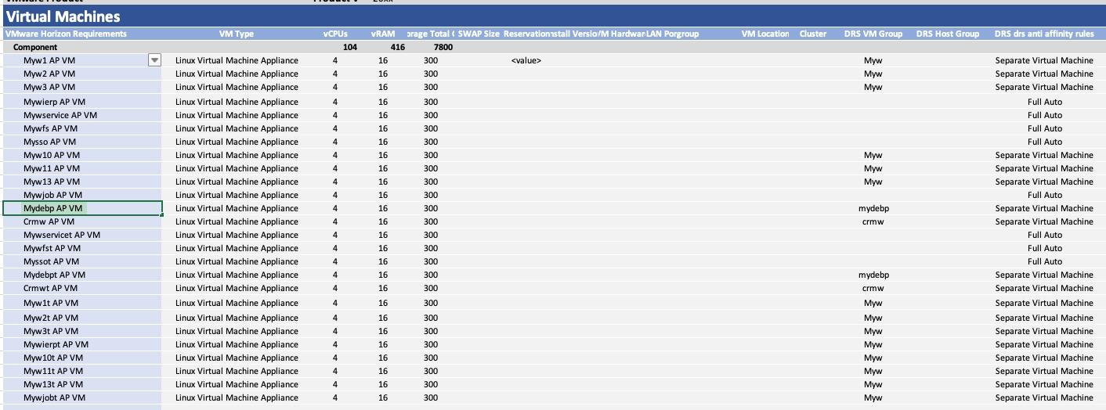
(My VM)
Use DRS to evenly distribute Net VMs across the two racks. (Separate Virtual Machine)
VM Placement Design
VMs that are not shown in the diagram will be automatically assigned.
DC1-vm
DC2-vm
myw
myw
crmw
crmw
myw
myw
crmwt
crmwt
DC1 ESXI
DC 2 ESXI
ESXi
ESXi
ESXi
ESXi
Roles | Host Number | CPU Core | Mem | Storage | VSAN FTT1 | VCPU For Service | vMemory For Service | Storage | CPU Overcommit Ratio
My VM | 8 | 256 | 4TB |  | N/A | 104 | 416GB | 7800GB | 0.40625
#DRS Setup: Manual
Notes:
840 VM

Slide 33
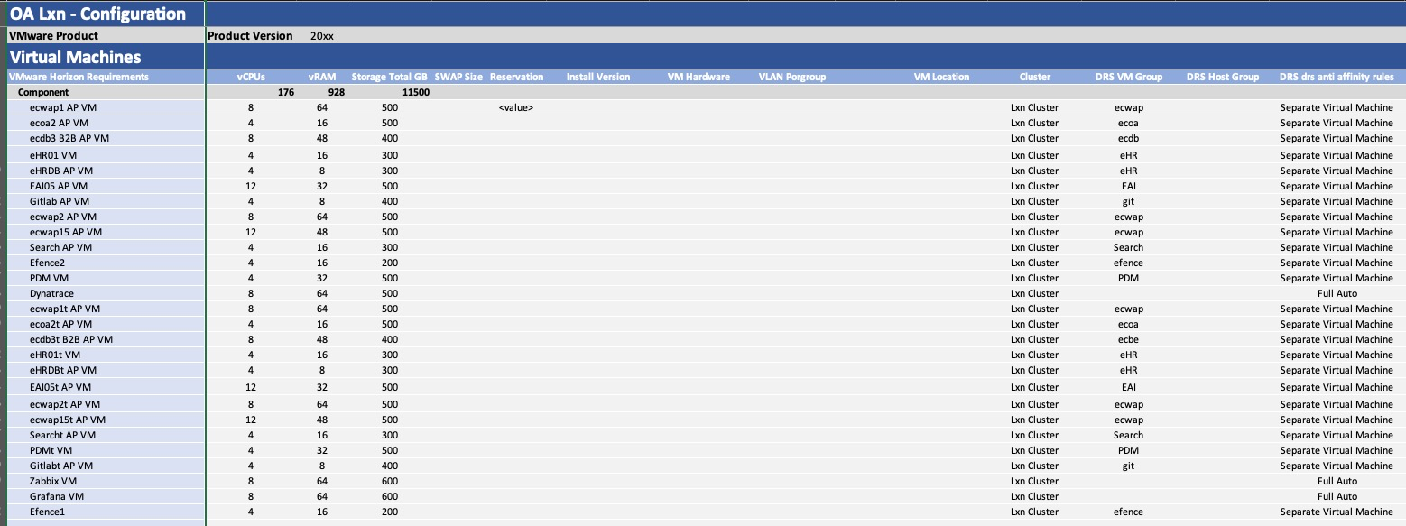
(Lnx VM)
VM Placement Design
DC1-vm
DC2-vm
eHR
ecwap
ecwap
EAI
EAI
ecwap
eHR
ecwap
DC1 ESXI
DC 2 ESXI
Use DRS to evenly distribute Net VMs across the two racks. (Separate Virtual Machine)
ESXi
ESXi
ESXi
ESXi
VMs that are not shown in the diagram will be automatically assigned.
#DRS Setup: Manual
Roles | Host Number | CPU Core | Memory | Storage | VSAN FTT1 | VCPU For Service | vMemory For Service | Storage | CPU Overcommit Ratio
Lnx | 10 | 320 | 5TB |  | N/A | 176 | 928GB | 11500GB | 0.55
Notes:
840 VM

Slide 34
VCF Fleet with Multiple Datacenter in a Single Region
DC1
DC2
Self-Service with VCF Automation
VCF Operations
Management Domain Cluster
Site Affinity
Failover Capacity
oavm
vCenter
VCF Operations Cluster
vSphere HA
NSX Manager Cluster
sftp
VCF Automation Cluster
Storage Site A1
Synchronous Replication
Storage Site A2
Virtual Networking
Physical Network
Layer 2 &
Layer 3
Physical Network
Notes:
Version: 1.1
Original Author: Michael Kolos
Change Log:
v1.1 - 06 June 2025 by Gary Blake
Added the Design Blueprint diagram to this master deck
Adjusted the font to Metropolis, the source PPT was using Arial but could be based on someone opening the document in Google Slides
Saved the image again using SVG format to obtain a better quality image within DocWorks and also captured just the diagram removing excessive whitespace in HTML output
v1.0 - 30 May 2025 by Michael Kolos
Initial creation of VCF Fleet with Multiple Sites in a Single Region Design Blueprint diagram using standards and guidelines

Slide 35
vSAN host node network interface numbering
vmnic編號確認
Mellanox Technologies
MT27710 Family [ConnectX-4 Lx]
vmnic4
vmnic5
Mellanox Technologies
MT27710 Family [ConnectX-4 Lx]
vmnic0
vmnic1
Mellanox Technologies
MT27710 Family [ConnectX-4 Lx]
vmnic10
vmnic11
PCI-E (1)
PCI-E (4)
PCI-E (7)
PCI-E (2)
PCI-E (5)
PCI-E (8)
PCI-E (3)
PCI-E (6)
PSU
PSU
COM
D-Sub
Intel(R) Ethernet Controller
MT27710 Family [ConnectX-4 Lx]
vmnic9
vmnic8
vmnic7
vmnic6
IPMI

Slide 36
Physical connectivity diagram
Service switch
Functional switch
ToR Switch
ToR Switch
ToR Switch
ToR Switch
Mellanox Technologies
MT27710 Family [ConnectX-4 Lx]
Mellanox Technologies
10Gb[ConnectX-4 Lx]
vmnic6
vmnic7
vmnic0
vmnic1
PCI-E (1)
PCI-E (4)
PCI-E (7)
PCI-E (5)
PCI-E (8)
PCI-E (3)
PCI-E (6)
PSU
PSU
IPMI

Slide 37
Architecture Design For MES

Slide 38
MES
EAP/TCS Cluster
EAP/TCS
Cluster
TCS Cluster 1 DC1
TCS Cluster 2 DC2
Critial
Critial
Critial
Critial
DC1 ESXI
DC 1 ESXI
DC2 ESXI
DC 2 ESXI
ESXi
ESXi
ESXi
ESXi
ESXi
ESXi
ESXi
ESXi
TCS Cluster 3 DC1
TCS Cluster 4 DC2
Normal
Normal
Normal
Normal
DC 1 ESXI
DC1 ESXI
DC2 ESXI
DC 2 ESXI
ESXi
ESXi
ESXi
ESXi
ESXi
ESXi
ESXi
ESXi
#DRS Setup: Manual
Notes:
840 VM

Slide 39
MES
TCS Cluster 5 DC1
TCS Cluster 2 DC2
Critial
Critial
Critial
Critial
DC1 ESXI
DC 1 ESXI
DC2 ESXI
DC 2 ESXI
ESXi
ESXi
ESXi
ESXi
ESXi
ESXi
ESXi
ESXi
TCS Cluster 3 DC1
TCS Cluster 4 DC4
ENG
ENG
ENG Normal
eng Normal
DC 1 ESXI
DC1 ESXI
DC2 ESXI
DC 2 ESXI
ESXi
ESXi
ESXi
ESXi
ESXi
ESXi
ESXi
ESXi
#DRS Setup: Manual
Notes:
840 VM

Slide 40
MES
TCS Cluster 5 DC1
TCS Cluster 6 DC2
Future
Critial
Critial
Critial
Critial
DC1 ESXI
DC 1 ESXI
DC2 ESXI
DC 2 ESXI
ESXi
ESXi
ESXi
ESXi
ESXi
ESXi
ESXi
ESXi
TCS Cluster 7 DC1
TCS Cluster 8 DC4
Future
Future
ENG
ENG
ENG Normal
eng Normal
DC 1 ESXI
DC1 ESXI
DC2 ESXI
DC 2 ESXI
ESXi
ESXi
ESXi
ESXi
ESXi
ESXi
ESXi
ESXi
#DRS Setup: Manual
Notes:
840 VM

Slide 41
MES-Rack Design
Rack 4
Rack 1
Rack 2
Rack 3
MES Cluster2
40U
30U
DC1
20U
MES Cluster1
10U
vf12p110le
vf12p1210le
vf12p1310le
vf12p1410le
Rack 1
Rack 4
Rack 2
Rack 3
MES Cluster 4
40U
30U
DC2
20U
MES Cluster 3
10U
vf12p1110le
vf12p1210le
vf12p1310le
vf12p1410le

Slide 42
Logical Network Architecture for Hosts
Service switch
Functional switch
ToR Switch
ToR Switch
ToR Switch
ToR Switch
ToR Switch
ToR Switch
vmnic0
vmnic4
vmnic2
vmnic10
vmnic11
vmnic12
VCF ESXi Host
vf12p1tcsvds01
vf12p1tcsvsan01
vf12p1tcstsm01
Service VLAN
Management VLAN
VSAN VMKernel
Backup VLAN
vMotion VLAN
vTEP VLAN
Notes:
Presenter note – this slide contains animation
Key Message:
Bringing it all together. Summarize how Networking is used and configured in Cloud Foundation.
Talk Track:
Let’s bring all the concepts we have discussed together to help provide a clearer view of VCF networking concepts.
Cloud Foundation requires a minimum of four (4) ESXi Hosts each with a minimum of two (2) pNICs – 10G minimum, 25G or greater recommended.
<click>
As part of a (default) Cloud Foundation Bring-up, one or more VDS are deployed to optimize network traffic flow with a selection of different network profiles.
The architecture and best practice configurations deployed, are fully documented in the VVS (VMware Validated Solutions) collateral.
We can see the core vSphere networks [VM Management, (Host) Management, vMotion, and vSAN] configured as VDS port groups. IP address assignment for vMotion and IP storage is automated using Network Pools.
<click>
We can also see the NSX Overlay Transport network, (Host TEP network) which is configured with an IP Pool or with DHCP. The Overlay Transport Network is used to a carry GENEVE encapsulated traffic (NSX Overlay traffic) between hosts, facilitating the ability to configure network segments dynamically and providing the basis of software defined networking.
<click>
Management components, such as the Management vCenter Server, the NSX Management cluster, and SDDC Manager are configured to the VM Management network during deployment.
The ESXi Host management IP addresses are statically assigned to the Management network.
SDDC Manager contains several in-built automated workflows which can be run post-deployment to help simplify the configuration and consumption of software defined networking.
We will discuss Cloud Foundation advanced networking and security concepts later in the Software Defined Networking and Initial Deployment sections of this presentation.
Notes:
Software Defined Networking: SDN is the concept of decoupling network functions from physical devices in a way that is analogous to decoupling virtual servers from physical servers.
Overlay Network: An Overlay Network is a network layered on top of another network. NSX provides the ability to programmatically create software defined networks (and provide network/security features and functions) on top of an existing “underlay” physical network.
For further detail on configuring NSX software defined networking and security please go to the Software Defined Networking and Security section of this deck.
Each workload domain is deployed with four (4) networks. Workload domains are not configured with a VM Management network.
---------
Pro TIP - VMware recommends ESXi Hosts configured with a min of 2 x 25G pNICs.
--------
References:
For further information on Cloud Foundation networking please refer to the VCF 5.1 Design Guide
https://docs.vmware.com/en/VMware-Cloud-Foundation/index.html
NSX QuickStart Guide – NSX Components Definitions:
https://docs.vmware.com/en/VMware-NSX/4.1/nsx_41_quick_start.pdf
VMware Validated Solutions
https://core.vmware.com/vmware-validated-solutions

Slide 43
Physical connectivity diagram
Service switch
Functional switch
ToR Switch
ToR Switch
ToR Switch
ToR Switch
Mellanox Technologies
MT27710 Family [ConnectX-4 Lx]
Mellanox Technologies
10Gb[ConnectX-4 Lx]
vmnic6
vmnic7
vmnic0
vmnic1
PCI-E (1)
PCI-E (4)
PCI-E (7)
PCI-E (5)
PCI-E (8)
PCI-E (3)
PCI-E (6)
PSU
PSU
IPMI

Slide 44
Physical connectivity diagram
Backup switch
ToR Switch
ToR Switch
Mellanox Technologies
10Gb[ConnectX-4 Lx]
vmnic10
vmnic11
vmnic12
vmnic13
Mellanox Technologies
MT27710 Family [ConnectX-4 Lx]
PCI-E (1)
PCI-E (4)
PCI-E (7)
PCI-E (5)
PCI-E (8)
PCI-E (3)
PCI-E (6)
PSU
PSU
IPMI

Slide 45
MES
EAP/TCS Cluster
EAP/TCS
Cluster
TCS Cluster 1 DC1
TCS Cluster 2 DC2
Critial
Critial
Critial
Critial
DC1 ESXI
DC 1 ESXI
DC2 ESXI
DC 2 ESXI
ESXi
ESXi
ESXi
ESXi
ESXi
ESXi
ESXi
ESXi
TCS Cluster 3 DC1
TCS Cluster 4 DC2
Normal
Normal
Normal
Normal
DC 1 ESXI
DC1 ESXI
DC2 ESXI
DC 2 ESXI
ESXi
ESXi
ESXi
ESXi
ESXi
ESXi
ESXi
ESXi
#DRS Setup: Manual
Notes:
840 VM

Slide 46
MES
TCS Cluster 5 DC1
TCS Cluster 2 DC2
Critial
Critial
Critial
Critial
DC1 ESXI
DC 1 ESXI
DC2 ESXI
DC 2 ESXI
ESXi
ESXi
ESXi
ESXi
ESXi
ESXi
ESXi
ESXi
TCS Cluster 3 DC1
TCS Cluster 4 DC4
ENG
ENG
ENG Normal
eng Normal
DC 1 ESXI
DC1 ESXI
DC2 ESXI
DC 2 ESXI
ESXi
ESXi
ESXi
ESXi
ESXi
ESXi
ESXi
ESXi
#DRS Setup: Manual
Notes:
840 VM

Slide 47
MES
TCS Cluster 5 DC1
TCS Cluster 6 DC2
Future
Critial
Critial
Critial
Critial
DC1 ESXI
DC 1 ESXI
DC2 ESXI
DC 2 ESXI
ESXi
ESXi
ESXi
ESXi
ESXi
ESXi
ESXi
ESXi
TCS Cluster 7 DC1
TCS Cluster 8 DC4
Future
Future
ENG
ENG
ENG Normal
eng Normal
DC 1 ESXI
DC1 ESXI
DC2 ESXI
DC 2 ESXI
ESXi
ESXi
ESXi
ESXi
ESXi
ESXi
ESXi
ESXi
#DRS Setup: Manual
Notes:
840 VM

Slide 48
Physical connectivity diagram
Backup switch
ToR Switch
ToR Switch
Mellanox Technologies
10Gb[ConnectX-4 Lx]
vmnic10
vmnic11
vmnic12
vmnic13
Mellanox Technologies
MT27710 Family [ConnectX-4 Lx]
PCI-E (1)
PCI-E (4)
PCI-E (7)
PCI-E (5)
PCI-E (8)
PCI-E (3)
PCI-E (6)
PSU
PSU
IPMI

Slide 49
Architecture Design For In House

Slide 50
IN House AP
Rack 1
Rack 2
Rack 3
Rack 6
Rack 5
Rack 4
DC1
In House Cluster1
vf12p110le
vf12p1210le
vf12p1310le
vf12p1410le
vf12p1510le
vf12p1610le

Slide 51
Physical connectivity diagram
Service switch
Functional switch
ToR Switch
ToR Switch
ToR Switch
ToR Switch
Mellanox Technologies
MT27710 Family [ConnectX-4 Lx]
Mellanox Technologies
10Gb[ConnectX-4 Lx]
vmnic6
vmnic7
vmnic0
vmnic1
PCI-E (1)
PCI-E (4)
PCI-E (7)
PCI-E (5)
PCI-E (8)
PCI-E (3)
PCI-E (6)
PSU
PSU
IPMI

Slide 52
Logical Network Architecture for Hosts
Service switch
Functional switch
ToR Switch
ToR Switch
ToR Switch
ToR Switch
vmnic0
vmnic6
vmnic1
vmnic7
VCF ESXi Host
vf12p1tcsvds01
vf12p1tcsvsan01
Service VLAN
Management VLAN
VSAN VMKernel
vMotion VLAN
vTEP VLAN
Notes:
Presenter note – this slide contains animation
Key Message:
Bringing it all together. Summarize how Networking is used and configured in Cloud Foundation.
Talk Track:
Let’s bring all the concepts we have discussed together to help provide a clearer view of VCF networking concepts.
Cloud Foundation requires a minimum of four (4) ESXi Hosts each with a minimum of two (2) pNICs – 10G minimum, 25G or greater recommended.
<click>
As part of a (default) Cloud Foundation Bring-up, one or more VDS are deployed to optimize network traffic flow with a selection of different network profiles.
The architecture and best practice configurations deployed, are fully documented in the VVS (VMware Validated Solutions) collateral.
We can see the core vSphere networks [VM Management, (Host) Management, vMotion, and vSAN] configured as VDS port groups. IP address assignment for vMotion and IP storage is automated using Network Pools.
<click>
We can also see the NSX Overlay Transport network, (Host TEP network) which is configured with an IP Pool or with DHCP. The Overlay Transport Network is used to a carry GENEVE encapsulated traffic (NSX Overlay traffic) between hosts, facilitating the ability to configure network segments dynamically and providing the basis of software defined networking.
<click>
Management components, such as the Management vCenter Server, the NSX Management cluster, and SDDC Manager are configured to the VM Management network during deployment.
The ESXi Host management IP addresses are statically assigned to the Management network.
SDDC Manager contains several in-built automated workflows which can be run post-deployment to help simplify the configuration and consumption of software defined networking.
We will discuss Cloud Foundation advanced networking and security concepts later in the Software Defined Networking and Initial Deployment sections of this presentation.
Notes:
Software Defined Networking: SDN is the concept of decoupling network functions from physical devices in a way that is analogous to decoupling virtual servers from physical servers.
Overlay Network: An Overlay Network is a network layered on top of another network. NSX provides the ability to programmatically create software defined networks (and provide network/security features and functions) on top of an existing “underlay” physical network.
For further detail on configuring NSX software defined networking and security please go to the Software Defined Networking and Security section of this deck.
Each workload domain is deployed with four (4) networks. Workload domains are not configured with a VM Management network.
---------
Pro TIP - VMware recommends ESXi Hosts configured with a min of 2 x 25G pNICs.
--------
References:
For further information on Cloud Foundation networking please refer to the VCF 5.1 Design Guide
https://docs.vmware.com/en/VMware-Cloud-Foundation/index.html
NSX QuickStart Guide – NSX Components Definitions:
https://docs.vmware.com/en/VMware-NSX/4.1/nsx_41_quick_start.pdf
VMware Validated Solutions
https://core.vmware.com/vmware-validated-solutions

Slide 53
Physical connectivity diagram
Backup switch
ToR Switch
ToR Switch
Mellanox Technologies
10Gb[ConnectX-4 Lx]
vmnic10
vmnic11
vmnic12
vmnic13
Mellanox Technologies
MT27710 Family [ConnectX-4 Lx]
PCI-E (1)
PCI-E (4)
PCI-E (7)
PCI-E (5)
PCI-E (8)
PCI-E (3)
PCI-E (6)
PSU
PSU
IPMI

Slide 54
Architecture Placement Design For OA

Slide 55
Logical Network Architecture for Hosts
Service switch
TSM switch
ToR Switch
ToR Switch
ToR Switch
ToR Switch
vmnic0
vmnic6
vmnic1
vmnic7
VCF ESXi Host
vf12p1oavds01
vf12p1oatsm01
Service VLAN
Management VLAN
TSM VMKernel
vMotion VLAN
vTEP VLAN
Notes:
Presenter note – this slide contains animation
Key Message:
Bringing it all together. Summarize how Networking is used and configured in Cloud Foundation.
Talk Track:
Let’s bring all the concepts we have discussed together to help provide a clearer view of VCF networking concepts.
Cloud Foundation requires a minimum of four (4) ESXi Hosts each with a minimum of two (2) pNICs – 10G minimum, 25G or greater recommended.
<click>
As part of a (default) Cloud Foundation Bring-up, one or more VDS are deployed to optimize network traffic flow with a selection of different network profiles.
The architecture and best practice configurations deployed, are fully documented in the VVS (VMware Validated Solutions) collateral.
We can see the core vSphere networks [VM Management, (Host) Management, vMotion, and vSAN] configured as VDS port groups. IP address assignment for vMotion and IP storage is automated using Network Pools.
<click>
We can also see the NSX Overlay Transport network, (Host TEP network) which is configured with an IP Pool or with DHCP. The Overlay Transport Network is used to a carry GENEVE encapsulated traffic (NSX Overlay traffic) between hosts, facilitating the ability to configure network segments dynamically and providing the basis of software defined networking.
<click>
Management components, such as the Management vCenter Server, the NSX Management cluster, and SDDC Manager are configured to the VM Management network during deployment.
The ESXi Host management IP addresses are statically assigned to the Management network.
SDDC Manager contains several in-built automated workflows which can be run post-deployment to help simplify the configuration and consumption of software defined networking.
We will discuss Cloud Foundation advanced networking and security concepts later in the Software Defined Networking and Initial Deployment sections of this presentation.
Notes:
Software Defined Networking: SDN is the concept of decoupling network functions from physical devices in a way that is analogous to decoupling virtual servers from physical servers.
Overlay Network: An Overlay Network is a network layered on top of another network. NSX provides the ability to programmatically create software defined networks (and provide network/security features and functions) on top of an existing “underlay” physical network.
For further detail on configuring NSX software defined networking and security please go to the Software Defined Networking and Security section of this deck.
Each workload domain is deployed with four (4) networks. Workload domains are not configured with a VM Management network.
---------
Pro TIP - VMware recommends ESXi Hosts configured with a min of 2 x 25G pNICs.
--------
References:
For further information on Cloud Foundation networking please refer to the VCF 5.1 Design Guide
https://docs.vmware.com/en/VMware-Cloud-Foundation/index.html
NSX QuickStart Guide – NSX Components Definitions:
https://docs.vmware.com/en/VMware-NSX/4.1/nsx_41_quick_start.pdf
VMware Validated Solutions
https://core.vmware.com/vmware-validated-solutions

Slide 56
Physical connectivity diagram
Network
Service switch
Functional switch
ToR Switch
ToR Switch
ToR Switch
ToR Switch
Mellanox Technologies
MT27710 Family [ConnectX-4 Lx]
Mellanox Technologies
10Gb[ConnectX-4 Lx]
vmnic6
vmnic7
vmnic0
vmnic1
PCI-E (1)
PCI-E (4)
PCI-E (7)
PCI-E (2)
PCI-E (5)
PCI-E (8)
PCI-E (3)
PCI-E (6)
PSU
PSU
IPMI

Slide 57
Physical connectivity diagram
SAN
Service switch
SAN Switch
SAN Switch
FC HBA
port 1
Port 2
FC HBA2
Port3
Port 4
PCI-E (1)
PCI-E (4)
PCI-E (7)
PCI-E (2)
PCI-E (5)
PCI-E (8)
PCI-E (3)
PCI-E (6)
PSU
PSU
IPMI

Slide 58
(OA VM)
VM Placement Design
AD1
DC1-vm
AD2
DC2-vm
Use DRS to evenly distribute OA VMs across the two racks. (Separate Virtual Machine)
ADDC1
AADC2
ADFS1
ADFS2
ECJOB01
ECJOB04
VMs that are not shown in the diagram will be automatically assigned.
ECJOB02
ECJOB05
ECJOB03
ECJOB06
Roles | Host Number | CPU Core | Memory | Storage | VSAN FTT1 | VCPU For Service | vMemory For Service | Storage | CPU Overcommit Ratio
OA | 12 | 384 | 6TB |  | N/A | 208 | 848GB | 18800GB | 0.541666667
DC1 ESXI
DC 2 ESXI
ESXi
ESXi
ESXi
ESXi
#DRS Setup: Manual
Notes:
840 VM

Slide 59
(RD VM)
VM Placement Design
DC1-vm
DC2-vm
Use DRS to evenly distribute RD VMs across the two racks. (Separate Virtual Machine)
IPSCAN
ADM08
IPSCAN
ADM09
JVD01
JVD02
DRC01
DRC02
S3sun7
S3sun7t
Roles | Host Number | CPU Core | Memory | Storage | VSAN FTT1 | VCPU For Service | vMemory For Service | Storage | CPU Overcommit Ratio
Lnx | 10 | 320 | 5TB |  | N/A | 176 | 928GB | 11500GB | 0.55
My VM | 8 | 256 | 4TB |  | N/A | 104 | 416GB | 7800GB | 0.40625
Net VM | 6 | 192 | 2TB |  | N/A | 432 | 992GB | 14900GB | 2.25
RD VM | 6 | 192 | 2TB |  | N/A | 80 | 896GB | 5000GB | 0.416666667
VCF MGMT / OA VM | 12 | 384 | 6TB |  | N/A | 208 | 848GB | 18800GB | 0.541666667
DC1 ESXI
DC 2 ESXI
ESXi
ESXi
ESXi
ESXi
#DRS Setup: Manual
Notes:
840 VM

Slide 60
(NET VM)
VM Placement Design
DC1-vm
DC2-vm
Use DRS to evenly distribute Net VMs across the two racks. (Separate Virtual Machine)
DHCP1
DNS1
DHCP2
DNS2
Proxy3
Proxy1
Proxy4
Proxy2
VMs that are not shown in the diagram will be automatically assigned.
TS01
TS02
TS04
TS06
TS03
TS05
DC1 ESXI
DC 2 ESXI
Roles | Host Number | CPU Core | Memory | Storage | VSAN FTT1 | VCPU For Service | vMemory For Service | Storage | CPU Overcommit Ratio
Net VM | 6 | 192 | 2TB |  | N/A | 432 | 992GB | 14900GB | 2.25
ESXi
ESXi
ESXi
ESXi
#DRS Setup: Manual
Notes:
840 VM

Slide 61
(My VM)
Use DRS to evenly distribute Net VMs across the two racks. (Separate Virtual Machine)
VM Placement Design
VMs that are not shown in the diagram will be automatically assigned.
DC1-vm
DC2-vm
myw
myw
crmw
crmw
myw
myw
crmwt
crmwt
DC1 ESXI
DC 2 ESXI
ESXi
ESXi
ESXi
ESXi
Roles | Host Number | CPU Core | Mem | Storage | VSAN FTT1 | VCPU For Service | vMemory For Service | Storage | CPU Overcommit Ratio
My VM | 8 | 256 | 4TB |  | N/A | 104 | 416GB | 7800GB | 0.40625
#DRS Setup: Manual
Notes:
840 VM

Slide 62
(Lnx VM)
VM Placement Design
DC1-vm
DC2-vm
eHR
ecwap
ecwap
EAI
EAI
ecwap
eHR
ecwap
DC1 ESXI
DC 2 ESXI
Use DRS to evenly distribute Net VMs across the two racks. (Separate Virtual Machine)
ESXi
ESXi
ESXi
ESXi
VMs that are not shown in the diagram will be automatically assigned.
#DRS Setup: Manual
Roles | Host Number | CPU Core | Memory | Storage | VSAN FTT1 | VCPU For Service | vMemory For Service | Storage | CPU Overcommit Ratio
Lnx | 10 | 320 | 5TB |  | N/A | 176 | 928GB | 11500GB | 0.55
Notes:
840 VM

Slide 63
Architecture Design For MGMT

Slide 64
MGMT Domain
MGMT Cluster 1 DC1
EAP/TCS Cluster
EAP/TCS
Cluster
RD VM
MGMT 1 VC
Workload Domain 2. – vLCM
MGMT 1 Aira Suite
Workload Domain 2. – vLCM
Cluster 1
TCS Cluster
DC1 ESXI
DC 2 ESXI
Cluster 1
VDI
VDI
VDI
ESXi
ESXi
ESXi
ESXi
I
Workload Domain 2. – vLCM
Lnx Cluster
OA
Workload Domain 2. – vLCM
Workload Domain 2. – vLCM
AI Cluster
Workload Domain 2. – vLCM
Cluster 1
IN House
Cluster 1
Cluster 1
Cluster 1
VDI
VDI
VDI
VDI
VDI
VDI
VDI
VDI
VDI
VDI
VDI
VDI
FDC Cluster
RD
Workload Domain 2. – vLCM
My VM
Workload Domain 2. – vLCM
Workload Domain 2. – vLCM
Cluster 1
Cluster 1
Cluster 1
VDI
VDI
VDI
VDI
VDI
VDI
VDI
VDI
VDI
Notes:
840 VM

Slide 65
Isolating Different Types Standard Mode (MES)
MGMT Cluster 1 DC1
Workload Domain 1. Multi-Cluster
MGMT Cluster 1 DC1
Cluster 1
Cluster 2
EAP/TCS Cluster
EAP/TCS
Cluster
APP
OS
APP
OS
APP
OS
APP
OS
APP
APP
APP
APP
EAP/TCS Cluster
OS
OS
OS
OS
MGMT 1 VC
MGMT 1 Aira Suite
NSX
Edge
NSX
ESG
DC1 ESXI
DC 2 ESXI
ESXi
ESXi
ESXi
ESXi
ESXi
ESXi
ESXi
ESXi
AI Cluster x 3
FDC Cluster
Workload Domain 2. – vLCM
Workload Domain 3. – vLCM
Cluster 1
Cluster 1
Cluster 2
IN House
APP
APP
DB
DB
Workload Cluster
VDI
VDI
VDI
VDI
OS
OS
OS
OS
APP
APP
DB
DB
OS
OS
OS
OS
ESXi
ESXi
ESXi
ESXi
ESXi
ESXi
Notes:
Workload Domains are useful for:
Isolating OS / Application types
Isolating VMware licensed features

Slide 66
Isolating Different Types Standard Mode (OA)
MGMT Cluster 1 DC1
MGMT VC
MGMT 1 Aira Suite
My VM Cluster
DC1 ESXI
DC 1 ESXI
Cluster 1
Cluster 2
APP
OS
APP
OS
APP
OS
APP
OS
APP
APP
APP
APP
RD Cluster
OS
OS
OS
OS
NSX
Edge
NSX
ESG
ESXi
ESXi
ESXi
ESXi
ESXi
ESXi
ESXi
ESXi
Net Cluster
OA VM Cluster
Lnx Cluster
Cluster
Cluster 1
APP
APP
DB
DB
VDI
VDI
VDI
APP
APP
DB
DB
OS
OS
OS
OS
OS
OS
OS
OS
ESXi
ESXi
ESXi
ESXi
ESXi
ESXi
Lnx
Cluster X10
Notes:
Workload Domains are useful for:
Isolating OS / Application types
Isolating VMware licensed features

Slide 67
MGMT Domain
EAP/TCS Cluster
EAP/TCS
Cluster
Future architecture recommendation
MGMT Cluster 1 DC1
MGMT Cluster 2 DC2
Future
MGMT 2 VC
MGMT 1 VC
MGMT 1 Aira Suite
DC1 ESXI
DC 2 ESXI
DC1 ESXI
DC 2 ESXI
ESXi
ESXi
ESXi
ESXi
ESXi
ESXi
ESXi
ESXi
#DRS Setup: Manual
Notes:
840 VM

Slide 68
虛擬主機與元件管理員存取的網段
Service switch
Functional switch
ToR Switch
ToR Switch
ToR Switch
ToR Switch
vmnic0
vmnic6
vmnic2
vmnic10
VCF ESXi Host
vf12ptcsvds01
vf12ptcsvsan01
Service VLAN
Management VLAN
VSAN VMKernel
Notes:
Presenter note – this slide contains animation
Key Message:
Bringing it all together. Summarize how Networking is used and configured in Cloud Foundation.
Talk Track:
Let’s bring all the concepts we have discussed together to help provide a clearer view of VCF networking concepts.
Cloud Foundation requires a minimum of four (4) ESXi Hosts each with a minimum of two (2) pNICs – 10G minimum, 25G or greater recommended.
<click>
As part of a (default) Cloud Foundation Bring-up, one or more VDS are deployed to optimize network traffic flow with a selection of different network profiles.
The architecture and best practice configurations deployed, are fully documented in the VVS (VMware Validated Solutions) collateral.
We can see the core vSphere networks [VM Management, (Host) Management, vMotion, and vSAN] configured as VDS port groups. IP address assignment for vMotion and IP storage is automated using Network Pools.
<click>
We can also see the NSX Overlay Transport network, (Host TEP network) which is configured with an IP Pool or with DHCP. The Overlay Transport Network is used to a carry GENEVE encapsulated traffic (NSX Overlay traffic) between hosts, facilitating the ability to configure network segments dynamically and providing the basis of software defined networking.
<click>
Management components, such as the Management vCenter Server, the NSX Management cluster, and SDDC Manager are configured to the VM Management network during deployment.
The ESXi Host management IP addresses are statically assigned to the Management network.
SDDC Manager contains several in-built automated workflows which can be run post-deployment to help simplify the configuration and consumption of software defined networking.
We will discuss Cloud Foundation advanced networking and security concepts later in the Software Defined Networking and Initial Deployment sections of this presentation.
Notes:
Software Defined Networking: SDN is the concept of decoupling network functions from physical devices in a way that is analogous to decoupling virtual servers from physical servers.
Overlay Network: An Overlay Network is a network layered on top of another network. NSX provides the ability to programmatically create software defined networks (and provide network/security features and functions) on top of an existing “underlay” physical network.
For further detail on configuring NSX software defined networking and security please go to the Software Defined Networking and Security section of this deck.
Each workload domain is deployed with four (4) networks. Workload domains are not configured with a VM Management network.
---------
Pro TIP - VMware recommends ESXi Hosts configured with a min of 2 x 25G pNICs.
--------
References:
For further information on Cloud Foundation networking please refer to the VCF 5.1 Design Guide
https://docs.vmware.com/en/VMware-Cloud-Foundation/index.html
NSX QuickStart Guide – NSX Components Definitions:
https://docs.vmware.com/en/VMware-NSX/4.1/nsx_41_quick_start.pdf
VMware Validated Solutions
https://core.vmware.com/vmware-validated-solutions

Slide 69
vSAN host node network interface numbering
vmnic編號確認
Service switch
Functional switch
ToR Switch
ToR Switch
ToR Switch
ToR Switch
Mellanox Technologies
MT27710 Family [ConnectX-4 Lx]
Mellanox Technologies
10Gb[ConnectX-4 Lx]
vmnic6
vmnic7
vmnic0
vmnic1
PCI-E (1)
PCI-E (4)
PCI-E (7)
PCI-E (2)
PCI-E (5)
PCI-E (8)
PCI-E (3)
PCI-E (6)
PSU
PSU
IPMI

Slide 70
Physical connectivity diagram
Service switch
Functional switch
ToR Switch
ToR Switch
ToR Switch
ToR Switch
Mellanox Technologies
MT27710 Family [ConnectX-4 Lx]
Mellanox Technologies
10Gb[ConnectX-4 Lx]
vmnic6
vmnic7
vmnic0
vmnic1
PCI-E (1)
PCI-E (4)
PCI-E (7)
PCI-E (5)
PCI-E (8)
PCI-E (3)
PCI-E (6)
PSU
PSU
IPMI

Slide 71
Physical connectivity diagram
Backup switch
ToR Switch
ToR Switch
Mellanox Technologies
10Gb[ConnectX-4 Lx]
vmnic10
vmnic11
vmnic12
vmnic13
Mellanox Technologies
MT27710 Family [ConnectX-4 Lx]
PCI-E (1)
PCI-E (4)
PCI-E (7)
PCI-E (5)
PCI-E (8)
PCI-E (3)
PCI-E (6)
PSU
PSU
IPMI

Slide 72
Architecture Design For In House

Slide 73
Logical Network Architecture for Hosts
Service switch
Functional switch
ToR Switch
ToR Switch
ToR Switch
ToR Switch
vmnic0
vmnic6
vmnic1
vmnic7
VCF ESXi Host
vf12p1tcsvds01
vf12p1tcsvsan01
Service VLAN
Management VLAN
VSAN VMKernel
vMotion VLAN
vTEP VLAN
Notes:
Presenter note – this slide contains animation
Key Message:
Bringing it all together. Summarize how Networking is used and configured in Cloud Foundation.
Talk Track:
Let’s bring all the concepts we have discussed together to help provide a clearer view of VCF networking concepts.
Cloud Foundation requires a minimum of four (4) ESXi Hosts each with a minimum of two (2) pNICs – 10G minimum, 25G or greater recommended.
<click>
As part of a (default) Cloud Foundation Bring-up, one or more VDS are deployed to optimize network traffic flow with a selection of different network profiles.
The architecture and best practice configurations deployed, are fully documented in the VVS (VMware Validated Solutions) collateral.
We can see the core vSphere networks [VM Management, (Host) Management, vMotion, and vSAN] configured as VDS port groups. IP address assignment for vMotion and IP storage is automated using Network Pools.
<click>
We can also see the NSX Overlay Transport network, (Host TEP network) which is configured with an IP Pool or with DHCP. The Overlay Transport Network is used to a carry GENEVE encapsulated traffic (NSX Overlay traffic) between hosts, facilitating the ability to configure network segments dynamically and providing the basis of software defined networking.
<click>
Management components, such as the Management vCenter Server, the NSX Management cluster, and SDDC Manager are configured to the VM Management network during deployment.
The ESXi Host management IP addresses are statically assigned to the Management network.
SDDC Manager contains several in-built automated workflows which can be run post-deployment to help simplify the configuration and consumption of software defined networking.
We will discuss Cloud Foundation advanced networking and security concepts later in the Software Defined Networking and Initial Deployment sections of this presentation.
Notes:
Software Defined Networking: SDN is the concept of decoupling network functions from physical devices in a way that is analogous to decoupling virtual servers from physical servers.
Overlay Network: An Overlay Network is a network layered on top of another network. NSX provides the ability to programmatically create software defined networks (and provide network/security features and functions) on top of an existing “underlay” physical network.
For further detail on configuring NSX software defined networking and security please go to the Software Defined Networking and Security section of this deck.
Each workload domain is deployed with four (4) networks. Workload domains are not configured with a VM Management network.
---------
Pro TIP - VMware recommends ESXi Hosts configured with a min of 2 x 25G pNICs.
--------
References:
For further information on Cloud Foundation networking please refer to the VCF 5.1 Design Guide
https://docs.vmware.com/en/VMware-Cloud-Foundation/index.html
NSX QuickStart Guide – NSX Components Definitions:
https://docs.vmware.com/en/VMware-NSX/4.1/nsx_41_quick_start.pdf
VMware Validated Solutions
https://core.vmware.com/vmware-validated-solutions

Slide 74
Physical connectivity diagram
vmnic編號確認
Service switch
Functional switch
ToR Switch
ToR Switch
ToR Switch
ToR Switch
Mellanox Technologies
MT27710 Family [ConnectX-4 Lx]
Mellanox Technologies
10Gb[ConnectX-4 Lx]
vmnic6
vmnic7
vmnic0
vmnic1
PCI-E (1)
PCI-E (4)
PCI-E (7)
PCI-E (2)
PCI-E (5)
PCI-E (8)
PCI-E (3)
PCI-E (6)
PSU
PSU
IPMI

Slide 75
Architecture Design For OA Zone

Slide 76
Logical Network Architecture for Hosts
Service switch
Functional switch
ToR Switch
ToR Switch
ToR Switch
ToR Switch
vmnic0
vmnic6
vmnic1
vmnic7
VCF ESXi Host
vf12p1tcsvds01
vf12p1tcsvsan01
Service VLAN
Management VLAN
VSAN VMKernel
vMotion VLAN
vTEP VLAN
Notes:
Presenter note – this slide contains animation
Key Message:
Bringing it all together. Summarize how Networking is used and configured in Cloud Foundation.
Talk Track:
Let’s bring all the concepts we have discussed together to help provide a clearer view of VCF networking concepts.
Cloud Foundation requires a minimum of four (4) ESXi Hosts each with a minimum of two (2) pNICs – 10G minimum, 25G or greater recommended.
<click>
As part of a (default) Cloud Foundation Bring-up, one or more VDS are deployed to optimize network traffic flow with a selection of different network profiles.
The architecture and best practice configurations deployed, are fully documented in the VVS (VMware Validated Solutions) collateral.
We can see the core vSphere networks [VM Management, (Host) Management, vMotion, and vSAN] configured as VDS port groups. IP address assignment for vMotion and IP storage is automated using Network Pools.
<click>
We can also see the NSX Overlay Transport network, (Host TEP network) which is configured with an IP Pool or with DHCP. The Overlay Transport Network is used to a carry GENEVE encapsulated traffic (NSX Overlay traffic) between hosts, facilitating the ability to configure network segments dynamically and providing the basis of software defined networking.
<click>
Management components, such as the Management vCenter Server, the NSX Management cluster, and SDDC Manager are configured to the VM Management network during deployment.
The ESXi Host management IP addresses are statically assigned to the Management network.
SDDC Manager contains several in-built automated workflows which can be run post-deployment to help simplify the configuration and consumption of software defined networking.
We will discuss Cloud Foundation advanced networking and security concepts later in the Software Defined Networking and Initial Deployment sections of this presentation.
Notes:
Software Defined Networking: SDN is the concept of decoupling network functions from physical devices in a way that is analogous to decoupling virtual servers from physical servers.
Overlay Network: An Overlay Network is a network layered on top of another network. NSX provides the ability to programmatically create software defined networks (and provide network/security features and functions) on top of an existing “underlay” physical network.
For further detail on configuring NSX software defined networking and security please go to the Software Defined Networking and Security section of this deck.
Each workload domain is deployed with four (4) networks. Workload domains are not configured with a VM Management network.
---------
Pro TIP - VMware recommends ESXi Hosts configured with a min of 2 x 25G pNICs.
--------
References:
For further information on Cloud Foundation networking please refer to the VCF 5.1 Design Guide
https://docs.vmware.com/en/VMware-Cloud-Foundation/index.html
NSX QuickStart Guide – NSX Components Definitions:
https://docs.vmware.com/en/VMware-NSX/4.1/nsx_41_quick_start.pdf
VMware Validated Solutions
https://core.vmware.com/vmware-validated-solutions

Slide 77
Physical connectivity diagram
vmnic編號確認
Service switch
Functional switch
ToR Switch
ToR Switch
ToR Switch
ToR Switch
Mellanox Technologies
MT27710 Family [ConnectX-4 Lx]
Mellanox Technologies
10Gb[ConnectX-4 Lx]
vmnic6
vmnic7
vmnic0
vmnic1
PCI-E (1)
PCI-E (4)
PCI-E (7)
PCI-E (2)
PCI-E (5)
PCI-E (8)
PCI-E (3)
PCI-E (6)
PSU
PSU
IPMI

Slide 78
(OA VM)
VM Placement Design
AD1
DC1-vm
AD2
DC2-vm
Use DRS to evenly distribute OA VMs across the two racks. (Separate Virtual Machine)
ADDC1
AADC2
ADFS1
ADFS2
ECJOB01
ECJOB04
VMs that are not shown in the diagram will be automatically assigned.
ECJOB02
ECJOB05
ECJOB03
ECJOB06
Roles | Host Number | CPU Core | Memory | Storage | VSAN FTT1 | VCPU For Service | vMemory For Service | Storage | CPU Overcommit Ratio
OA | 12 | 384 | 6TB |  | N/A | 208 | 848GB | 18800GB | 0.541666667
DC1 ESXI
DC 2 ESXI
ESXi
ESXi
ESXi
ESXi
#DRS Setup: Manual
Notes:
840 VM

Slide 79
(RD VM)
VM Placement Design
DC1-vm
DC2-vm
Use DRS to evenly distribute RD VMs across the two racks. (Separate Virtual Machine)
IPSCAN
ADM08
IPSCAN
ADM09
JVD01
JVD02
DRC01
DRC02
S3sun7
S3sun7t
Roles | Host Number | CPU Core | Memory | Storage | VSAN FTT1 | VCPU For Service | vMemory For Service | Storage | CPU Overcommit Ratio
Lnx | 10 | 320 | 5TB |  | N/A | 176 | 928GB | 11500GB | 0.55
My VM | 8 | 256 | 4TB |  | N/A | 104 | 416GB | 7800GB | 0.40625
Net VM | 6 | 192 | 2TB |  | N/A | 432 | 992GB | 14900GB | 2.25
RD VM | 6 | 192 | 2TB |  | N/A | 80 | 896GB | 5000GB | 0.416666667
VCF MGMT / OA VM | 12 | 384 | 6TB |  | N/A | 208 | 848GB | 18800GB | 0.541666667
DC1 ESXI
DC 2 ESXI
ESXi
ESXi
ESXi
ESXi
#DRS Setup: Manual
Notes:
840 VM

Slide 80
(NET VM)
VM Placement Design
DC1-vm
DC2-vm
Use DRS to evenly distribute Net VMs across the two racks. (Separate Virtual Machine)
DHCP1
DNS1
DHCP2
DNS2
Proxy3
Proxy1
Proxy4
Proxy2
VMs that are not shown in the diagram will be automatically assigned.
TS01
TS02
TS04
TS06
TS03
TS05
DC1 ESXI
DC 2 ESXI
Roles | Host Number | CPU Core | Memory | Storage | VSAN FTT1 | VCPU For Service | vMemory For Service | Storage | CPU Overcommit Ratio
Net VM | 6 | 192 | 2TB |  | N/A | 432 | 992GB | 14900GB | 2.25
ESXi
ESXi
ESXi
ESXi
#DRS Setup: Manual
Notes:
840 VM

Slide 81
(My VM)
Use DRS to evenly distribute Net VMs across the two racks. (Separate Virtual Machine)
VM Placement Design
VMs that are not shown in the diagram will be automatically assigned.
DC1-vm
DC2-vm
myw
myw
crmw
crmw
myw
myw
crmwt
crmwt
DC1 ESXI
DC 2 ESXI
ESXi
ESXi
ESXi
ESXi
Roles | Host Number | CPU Core | Mem | Storage | VSAN FTT1 | VCPU For Service | vMemory For Service | Storage | CPU Overcommit Ratio
My VM | 8 | 256 | 4TB |  | N/A | 104 | 416GB | 7800GB | 0.40625
#DRS Setup: Manual
Notes:
840 VM

Slide 82
(Lnx VM)
VM Placement Design
DC1-vm
DC2-vm
eHR
ecwap
ecwap
EAI
EAI
ecwap
eHR
ecwap
DC1 ESXI
DC 2 ESXI
Use DRS to evenly distribute Net VMs across the two racks. (Separate Virtual Machine)
ESXi
ESXi
ESXi
ESXi
VMs that are not shown in the diagram will be automatically assigned.
#DRS Setup: Manual
Roles | Host Number | CPU Core | Memory | Storage | VSAN FTT1 | VCPU For Service | vMemory For Service | Storage | CPU Overcommit Ratio
Lnx | 10 | 320 | 5TB |  | N/A | 176 | 928GB | 11500GB | 0.55
Notes:
840 VM

Slide 83
Aira Operation
Performance Monitor and Alert

Slide 84


Utilization vs. Contention
Utilization
Contention
Definition: How active a resource is.
Definition: The time a VM spends waiting for a resource.
High utilization isn't necessarily bad; it means you are getting value out of your hardware investment. A busy CPU is a working CPU.
This is the true performance killer. It means the VM wants to work but the hypervisor cannot schedule it. This equals lag.
Status: Informational
Status: Critical

Slide 85






Capacity & Risk Alerts
Disk Space
Snapshots
Availability
Datastore Full
Snapshot Age > 3 Days
Host Connection Lost
If a datastore fills up, all VMs on it will "Stun" (Freeze). Keep >10% free.
Old snapshots consume space and degrade storage performance during consolidation.
Indicates a potential PSOD (Purple Screen) or network isolation event.

Slide 86
Diagnostic Cheat Sheet
Symptom | Metric | Criteria | First Action
VM Lag / Stutter | CPU Ready % | > 5 - 10% | Right-size vCPU (Reduce count)
Application Slow | Memory Swap | > 0 KBps | Set Memory Reservation
DB Query Slow | Disk Latency | > 10-20ms | Check for active Backups
Network Drops | Dropped Packets | > 0.1% | Check Uplink Saturation

Slide 87
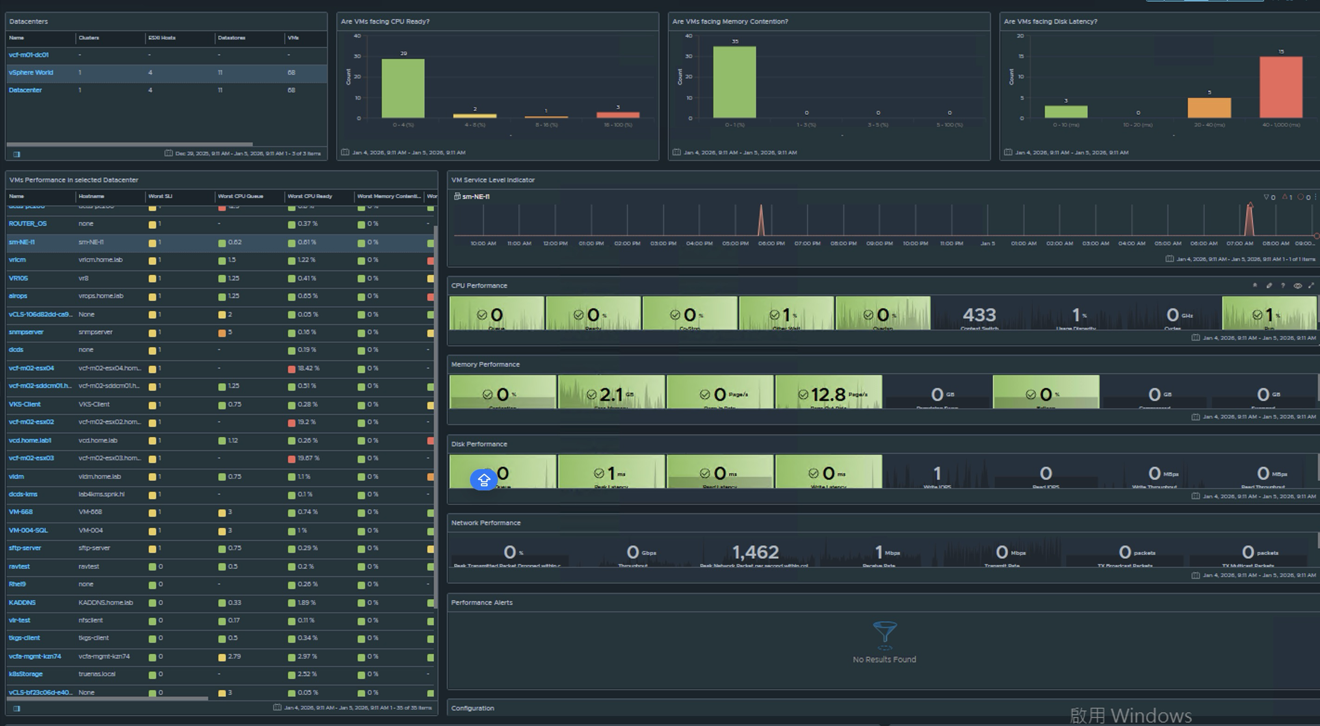
VM Performance
Datacenter
CPU Ready
CPU Contention
Disk Latency
VM Status / List
CPU
Memory
Disk
Network
Alert

Slide 88
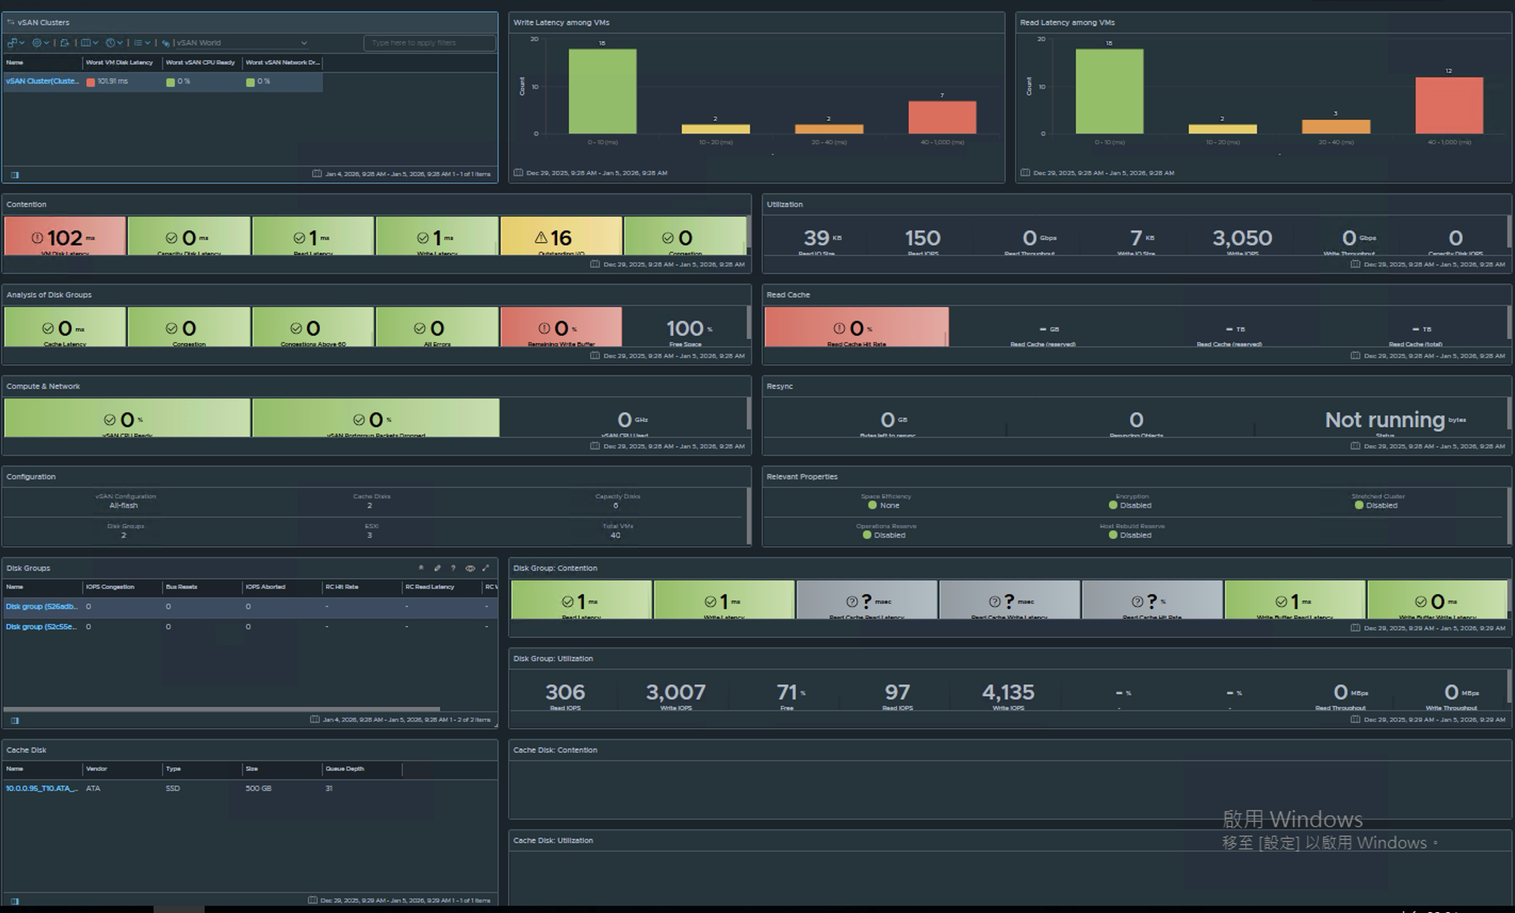
vSAN Performance
R/W Latency
vSAN Cluster
vSAN Contention
Unitization
Disk Group Alert
Read Cache
Net Lost package
vSAN Reync
Configuration
Properties
Disk Group List
Disk Group Contention
Disk Group List
Cache Disk List
Cache Disk contention
Cache Disk Unitization

Slide 89
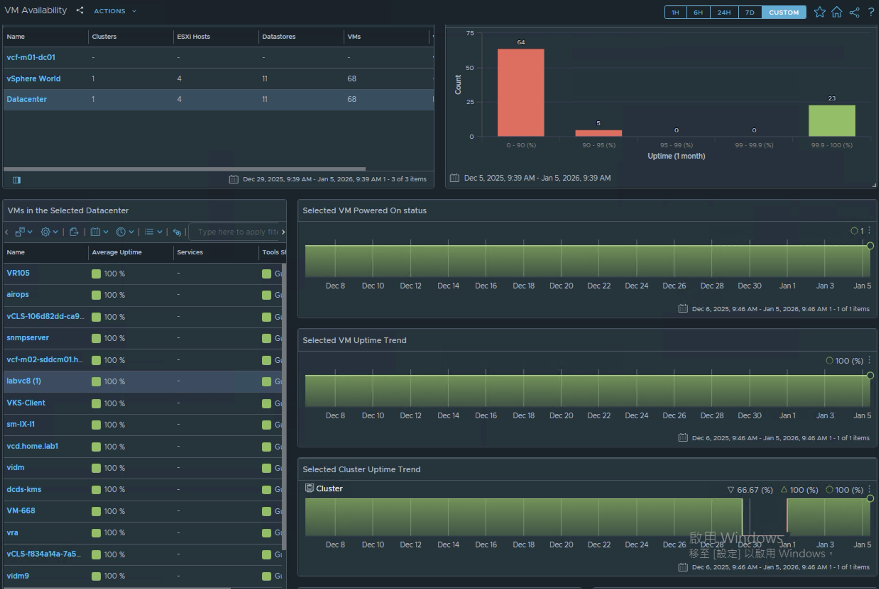
VM Availability
Data Center List
Unitization
VM Status
VM List

Slide 90
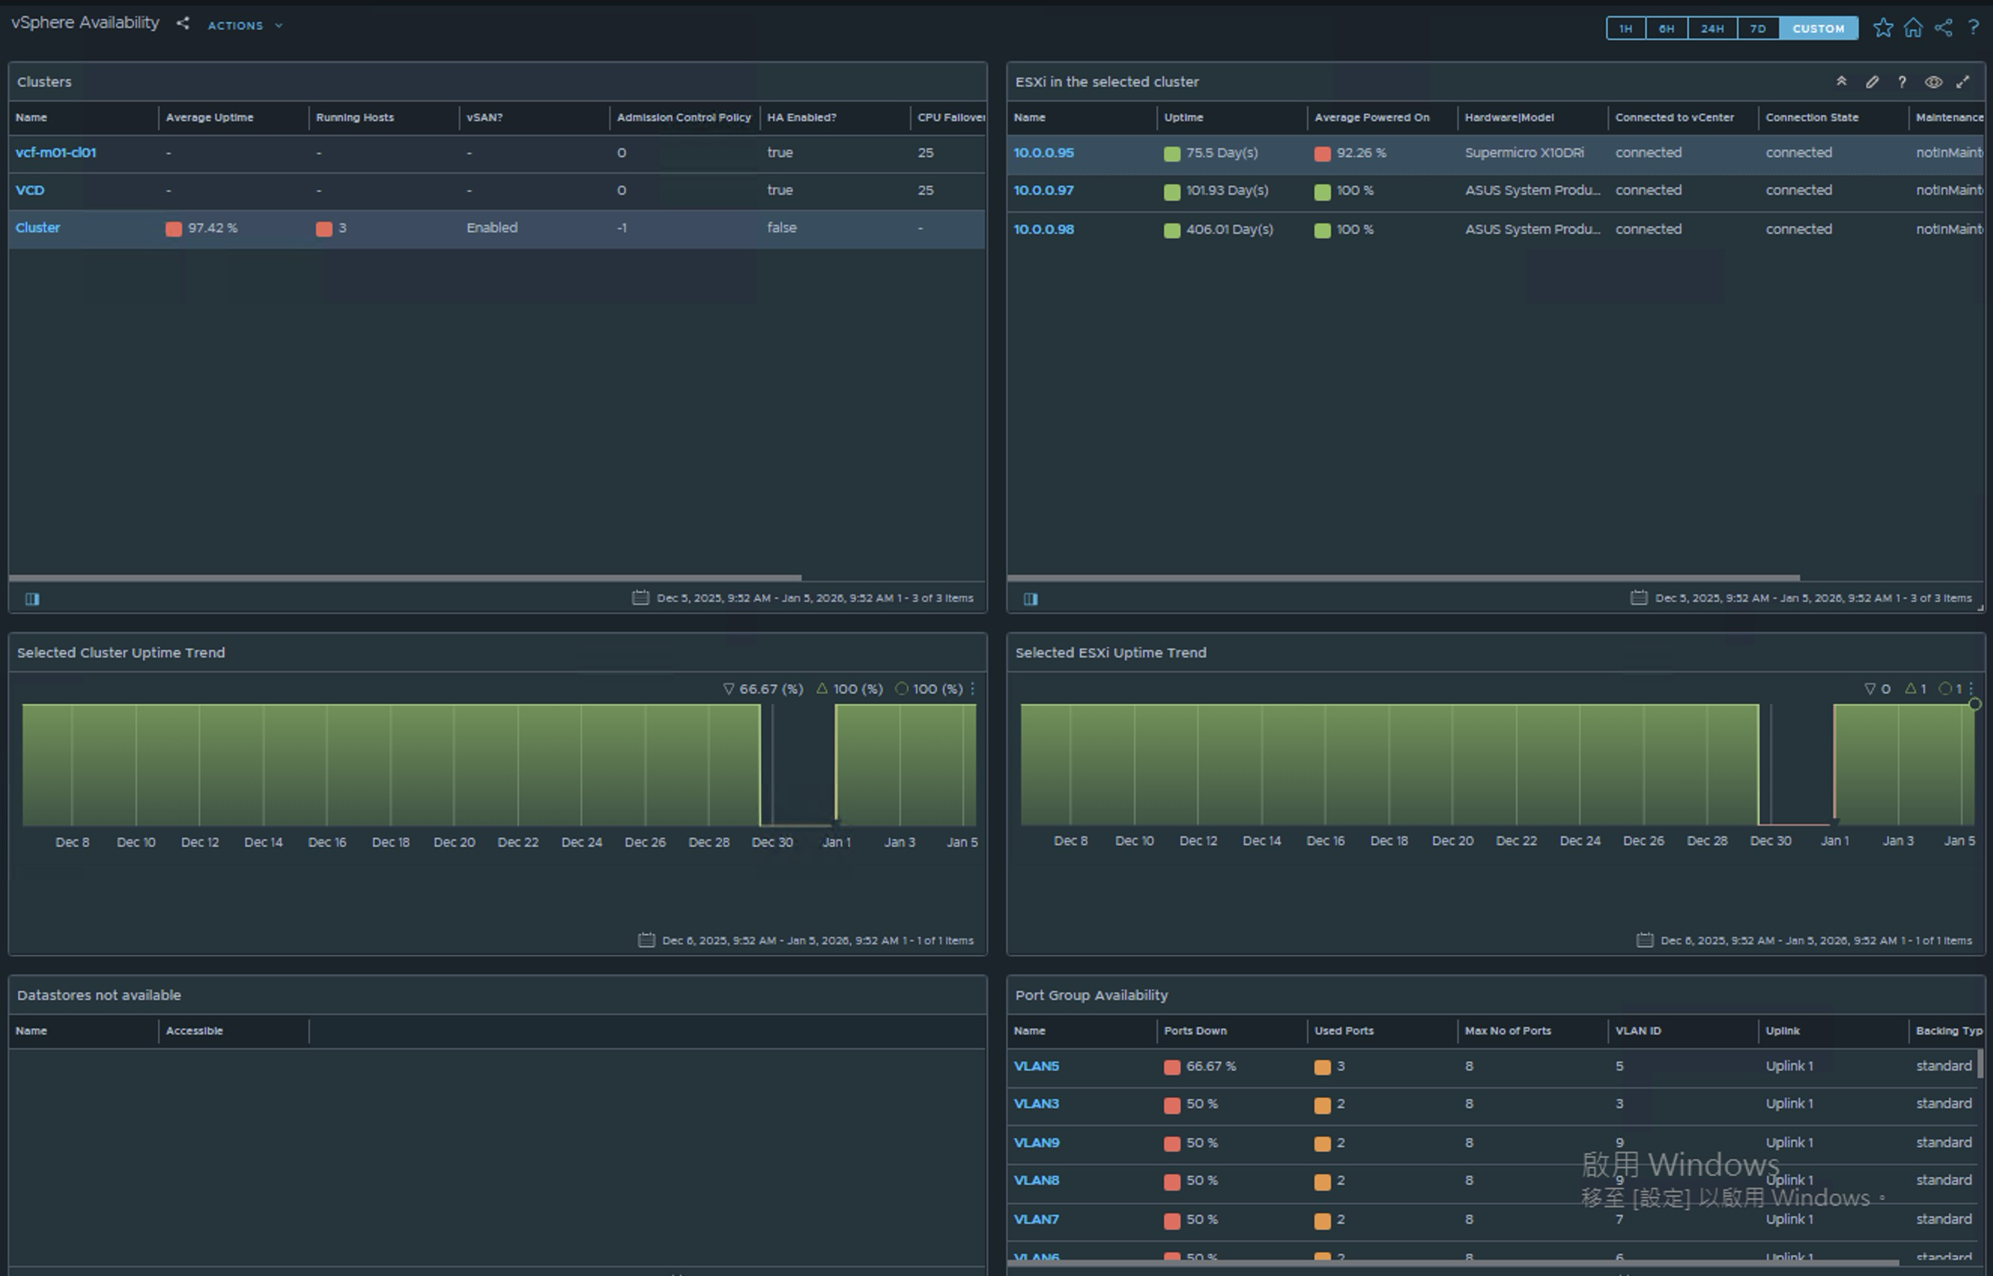
vSpher Availability
Datacenter list
Host Status
Cluster Up Time
VM List
Lost Datastore list
Net Port Status

Slide 91
vCenter Alert List
Performance Monitor and Alert

Slide 92









vCenter
Storage
Network & HA
Certificate expiration and Solution User health to prevent control plane outages.
Datastore usage, APD/PDL events, and path redundancy for core VM I/O.
Host connectivity, Distributed Switch sync, and HA restart failures.
vSAN Health
Hardware
Skyline Health, capacity, object status, and cluster partition checks.
Physical disk congestion, capacity consumption, and HCL compliance.

Slide 93

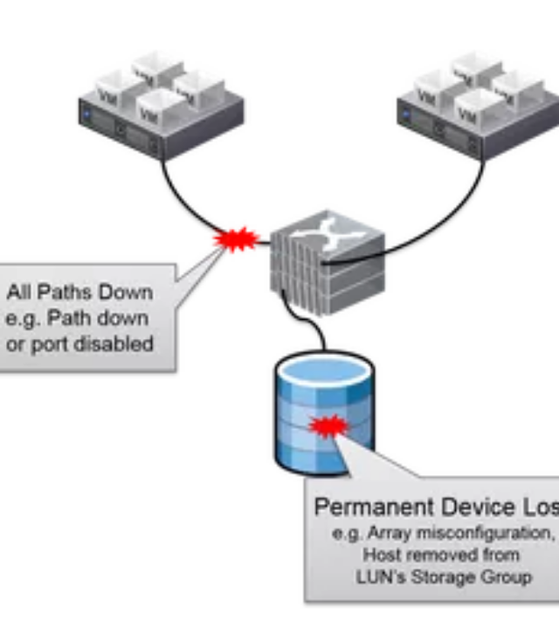
Storage Criticals (P1)
All Paths Down (APD)
Transient but critical. I/O halts, VMs may hang. Requires immediate triage of fabric/array.
Permanent Device Loss (PDL)
Device is gone. Requires immediate remediation or failover. Setup custom alarms for .
Datastore Usage
Set absolute guardrails (e.g., Warning < 200GB, Critical < 50GB) to prevent file system lockups.

Slide 94

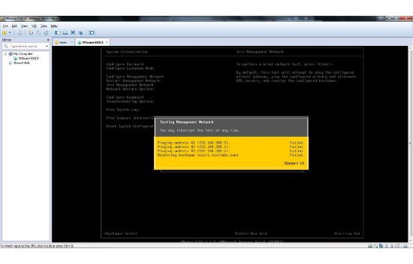
Host & Availability (P1)
Host Not Responding:
Direct impact to capacity headroom and HA behavior. Ensure alerting routes to 24x7 coverage.
HA Restart Failures:
Indicates a protected VM cannot restart. Direct RTO breach. Investigate resource isolation or storage locks immediately.
Connection State:
Trigger actions on state change. Filter for maintenance mode events to reduce noise.

Slide 95




Network Resilience
Host Network Lost (P1)
DSwitch Config (P2)
Trigger: Mgmt/vMotion/Storage connectivity loss.
Trigger: VLAN/MTU mismatch on Distributed Switch.
Impact: Loss of management cascades into HA/DRS failures (Split-brain risk). Prioritize Mgmt network routing.
Impact: Intermittent outages or blackholing traffic. Route to Network Ops for governance.

Slide 96

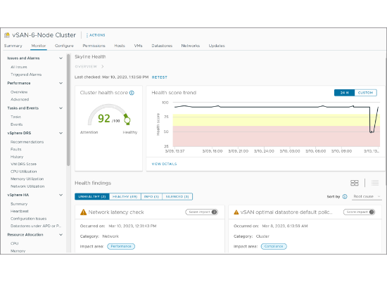
vSAN Capacity Management
Capacity vs. Datastore Alarms
Do not rely solely on generic Datastore Usage alarms for vSAN.
Warning Threshold (~80%):
Time to add nodes/disks or reclaim space.
Critical Threshold (~90%):
Immediate P1. Risk of component suspension and write failures.
Space:
Always maintain 25-30% slack for rebuilds and snapshots.

Slide 97






vSAN Cluster Health (P1)
Object Health
Time Sync
Network Partition
Inaccessible / Absent
Time Skew > 60s
Cluster Partition
Direct data availability risk. Start triage immediately (Disk, Network, Resync).
Causes control-plane and storage coordination failures. Verify NTP on ESXi/VC.
High-impact fault. Check vmk connectivity, Unicast/Multicast config.

Slide 98
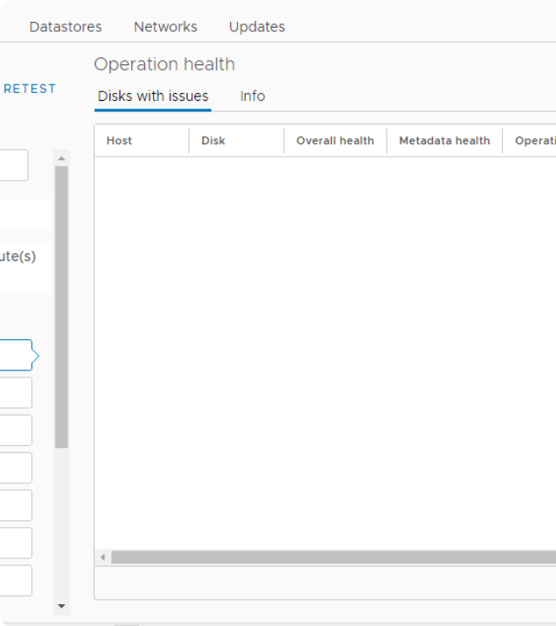
Physical Disk Health
The foundation of vSAN reliability.
Congestion (P1/P2):
Indicates device latency, queue depth issues, or controller saturation. Can cause cascading performance drops.
Disk Endurance (P2):
New in vSAN 8 U3. Monitor SSD wear-out. Treat "Exceeded" as Critical P1.
Encryption (P1):
KMS Connection check. Critical for encrypted vSAN I/O.

Slide 99




Operational Hygiene & Governance
Snapshot Consolidation (P2)
HCL & Compatibility (P3)
Trigger: Consolidation needed.
Trigger: Controller Driver / DB Auto Update.
Unmanaged snapshots impact performance and backup chains. Policy: Warning > 72h, Critical > 7 days.
Reduces risk of unsupported driver/firmware combos. Daily check item, not immediate incident.

