Slide 1
Interval Constraint Propagation Results
Group:
Vincent Drury
Konstantin Perun
David Wlazlo

Slide 2
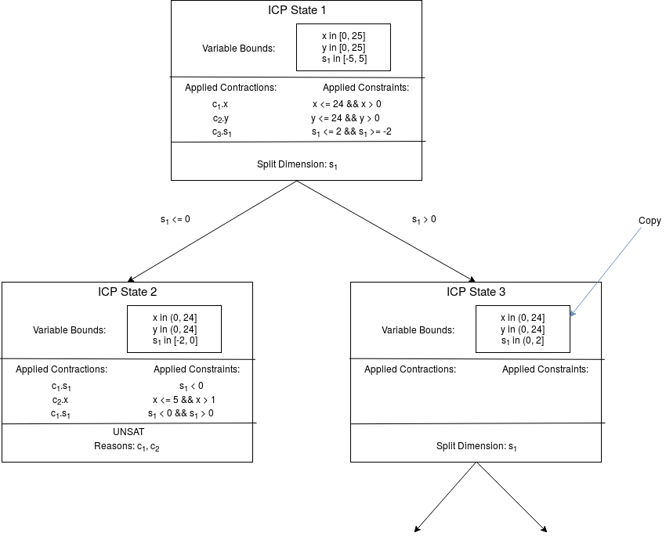
ICP Search Tree
Variable Bounds Copies, Independent Nodes → Easy Multi-Threading

Slide 3
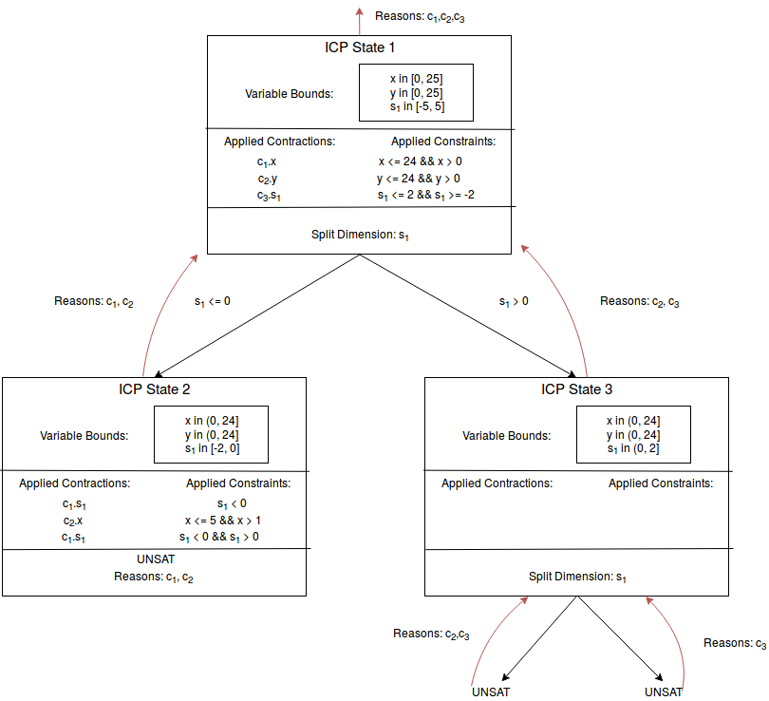
UNSAT Cores
Transitive Closure, Bottom-Up

Slide 4
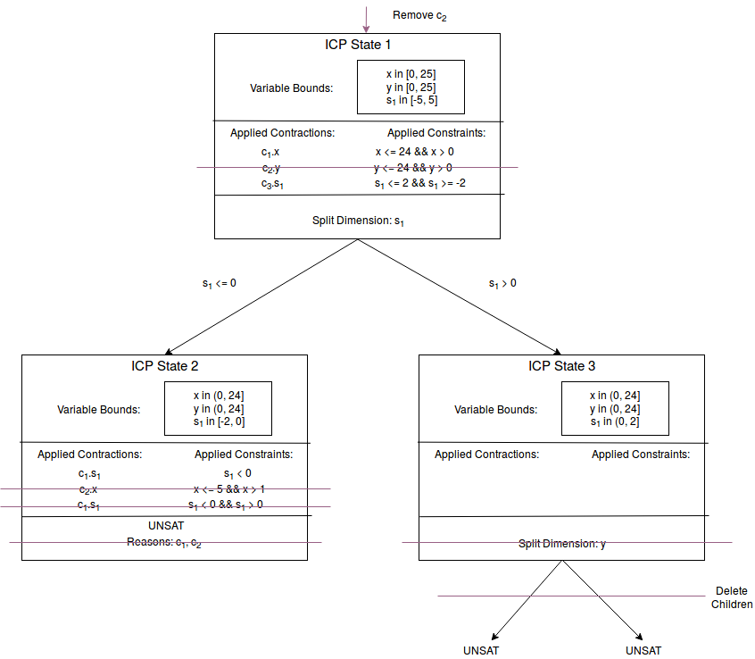
Removing Constraints
Transitive Closure, Top-Down

Slide 5
Governing Algorithm
Two priority queues: ICP States & Contraction Candidates
Take „best“ ICP State, contract it until:
SAT: Return Model
UNSAT: Continue with next State
Split Occurred: Add child states to queue
Other Termination Conditions: Ask Backend
If queue empty: Return UNSAT

Slide 6
Heuristics
State 1
…
State 2
Contractions are fast
Splits: Smaller Space vs. more trees
⇒ Contract before Splitting
SAT vs UNSAT
Found SAT ⇒ problem solved, disregard all sub-trees
Found UNSAT ⇒ problem not solved, regard all sub-trees
…
State 3
…
State 4
SAT | UNSAT

Slide 7
Choosing next Sub-Tree
Given several interval maps
Each has guessed solution
Choose the one with most fulfilled constraints
Then the one with the smallest diameters

Slide 8
Choosing Contraction Candidates
Weights/ History
Penalize Splits
Regard limited set of candidates:
1. look at first n candidates in priority queue
2. calculate and update weights
3. choose best
4. Threshold not passed?
Continue searching
Split later

Slide 9
Choosing Splitting Variable
Guess solution
Only split if variable occurs in UNSAT constraint
Choose variable with greatest diameter
Most gain from splitting

Slide 10
Problem of Parametrization
How to select parameter (alpha, threshold,…)?
Available approaches: Machine Learning vs. “Empirical Testing”
Machine Learning
Too complex, analysis of each problem instance required
Correlation/Causality between parameters
Deep Knowledge of the domain required

Slide 11
Empirical Testing
Test for each parameter and each possible assignment
Too many tests, for 8 parameters, 10 possible values -> 10^8 tests (per instance)
for 10.000 problems -> 10.000*10^8 tests
Abstraction Nr. 1: Create classes of problems
For each class: test all possible assignments, e.g., 10 classes
10*10^8, still too many
Abstraction Nr. 2: Test iteratively
Select one parameter, test several assignments, select best
Assign selected as new, precede with remaining attributes
10*10*8 tests required ( vs. 10^9)

Slide 12
Infrastructure
Adapted Parametrization:
Parametrization at run-time (and not compile-time)
New Class: Dynamic Settings (adapt settings from file)
Simple Python infrastructure for generation, processing and visualization of parameters
Problem left: Classification
Too many classes -> Testing not possible
Too few classes -> Testing too schematic

Slide 13
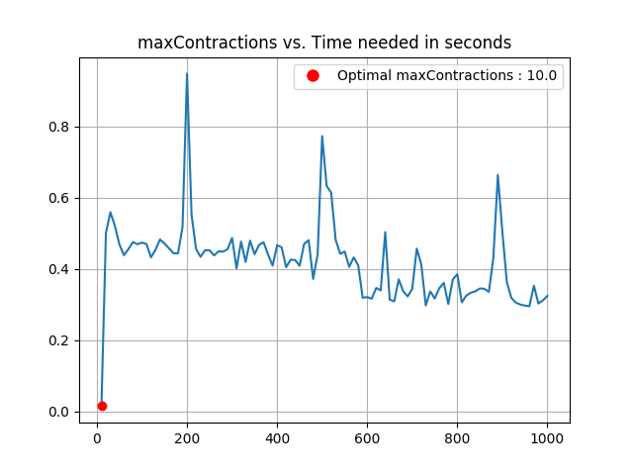
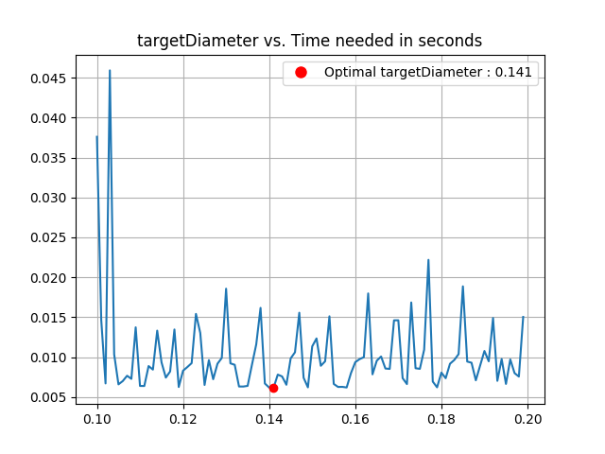
Results (Small Problem)
Tested : meti-tarski/sin/cos… classified by required computation time
Possible classifications: problem size, degree of polynomials, etc.

