Slide 1

Notes:
KAIROS
Kinetics of Aortic bioprosthesis Integrity, Risk-adapted echO Surveillance
καιρός, the right moment.
Dyania Health Hackathon 2026 · AVR Durability Challenge
Panagiotis Sotiropoulos, physician · Kostis Dovelos, PhD, engineering · Minas Papageorgiou, engineering
17 September 2026
1 / 10

Slide 2
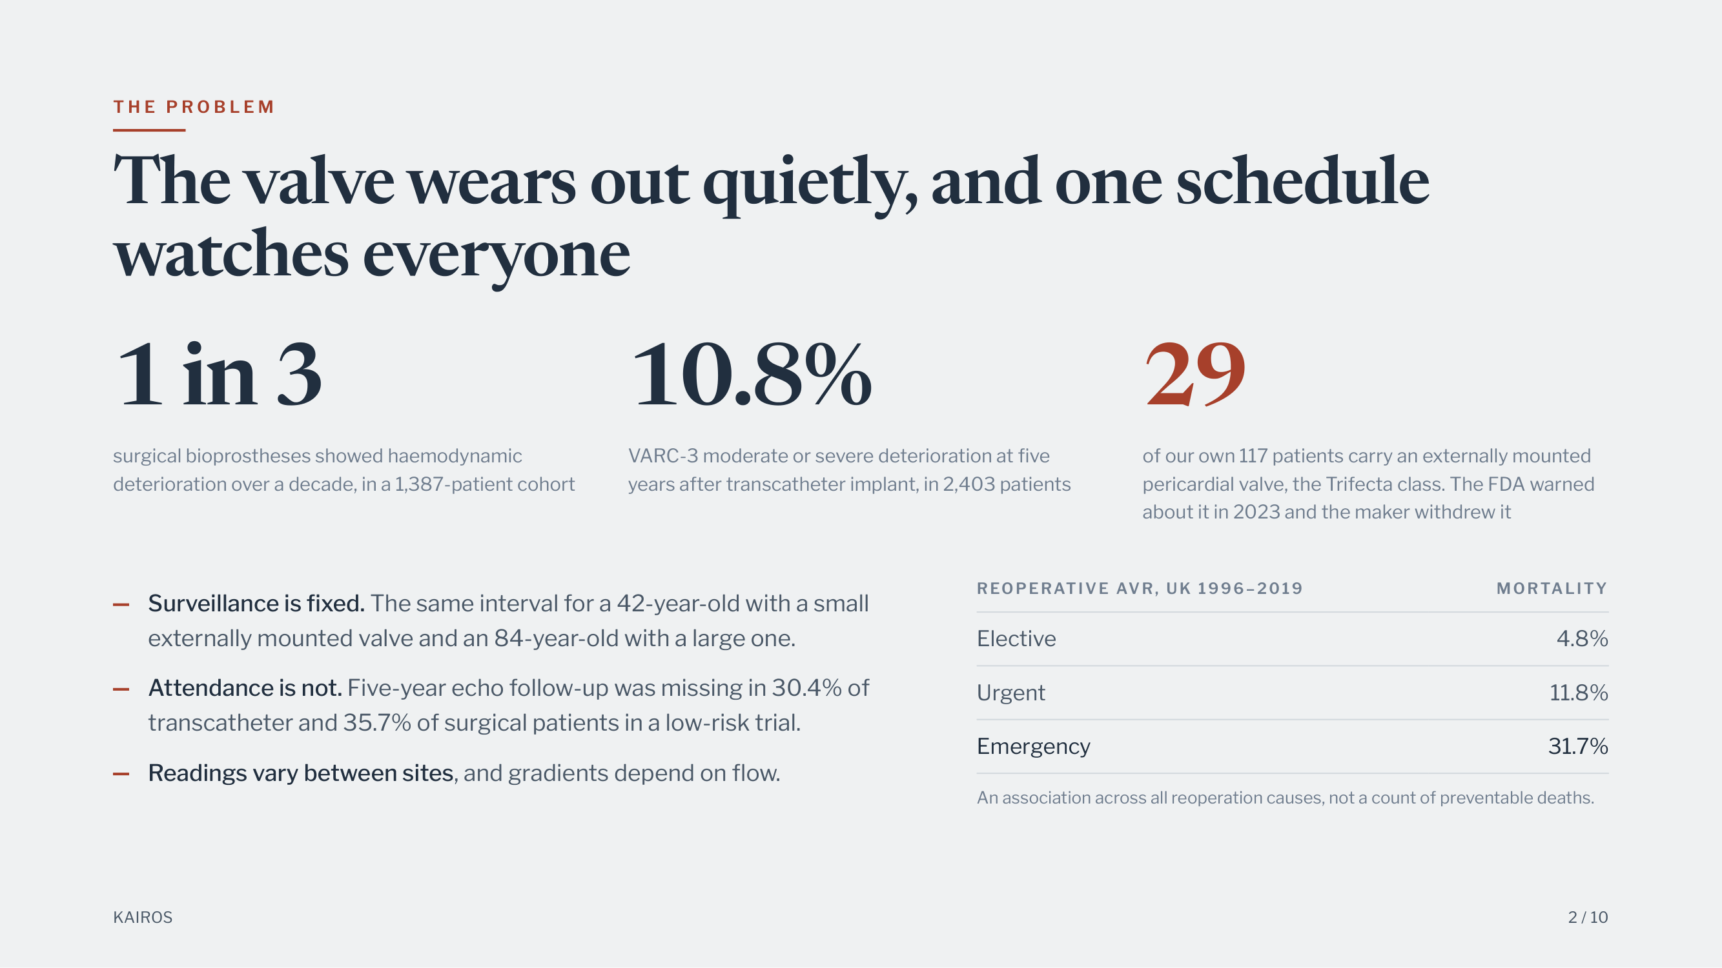
Notes:
T H E P R O B L E M
The valve wears out quietly, and one schedule
watches everyone
1 in 3
surgical bioprostheses showed haemodynamic
deterioration over a decade, in a 1,387-patient cohort
10.8%
VARC-3 moderate or severe deterioration at five
years after transcatheter implant, in 2,403 patients
29
of our own 117 patients carry an externally mounted
pericardial valve, the Trifecta class. The FDA warned
about it in 2023 and the maker withdrew it
REOPERATIVE AVR, UK 1996–2019
MORTALITY
Elective
4.8%
Urgent
11.8%
Emergency
31.7%
An association across all reoperation causes, not a count of preventable deaths.
Surveillance is fixed. The same interval for a 42-year-old with a small
externally mounted valve and an 84-year-old with a large one.
Attendance is not. Five-year echo follow-up was missing in 30.4% of
transcatheter and 35.7% of surgical patients in a low-risk trial.
Readings vary between sites, and gradients depend on flow.
KAIROS
2 / 10

Slide 3
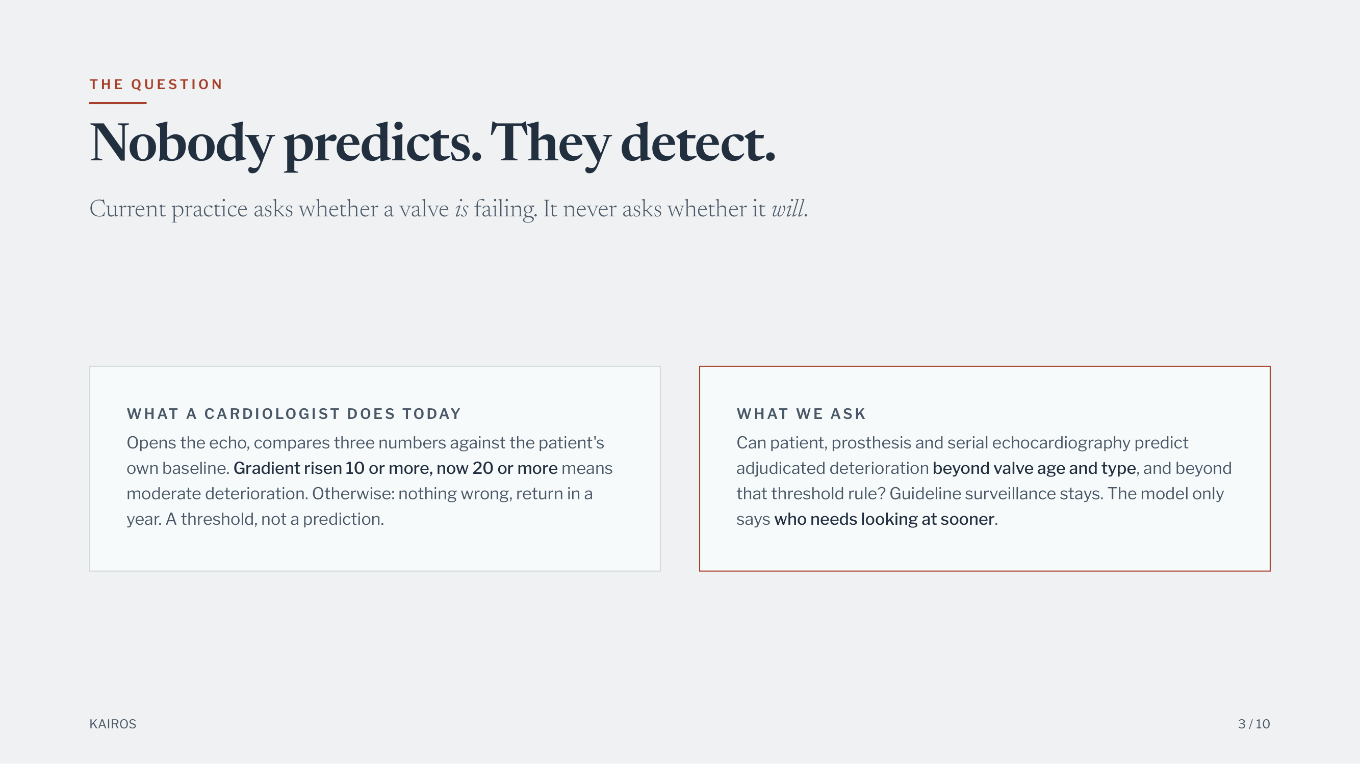
Notes:
T H E Q U E S T I O N
Nobody predicts. They detect.
Current practice asks whether a valve is failing. It never asks whether it will.
W H AT A CA R D I O LO G I ST D O E S TO DAY
Opens the echo, compares three numbers against the patient's
own baseline. Gradient risen 10 or more, now 20 or more means
moderate deterioration. Otherwise: nothing wrong, return in a
year. A threshold, not a prediction.
W H AT W E AS K
Can patient, prosthesis and serial echocardiography predict
adjudicated deterioration beyond valve age and type, and beyond
that threshold rule? Guideline surveillance stays. The model only
says who needs looking at sooner.
KAIROS
3 / 10

Slide 4
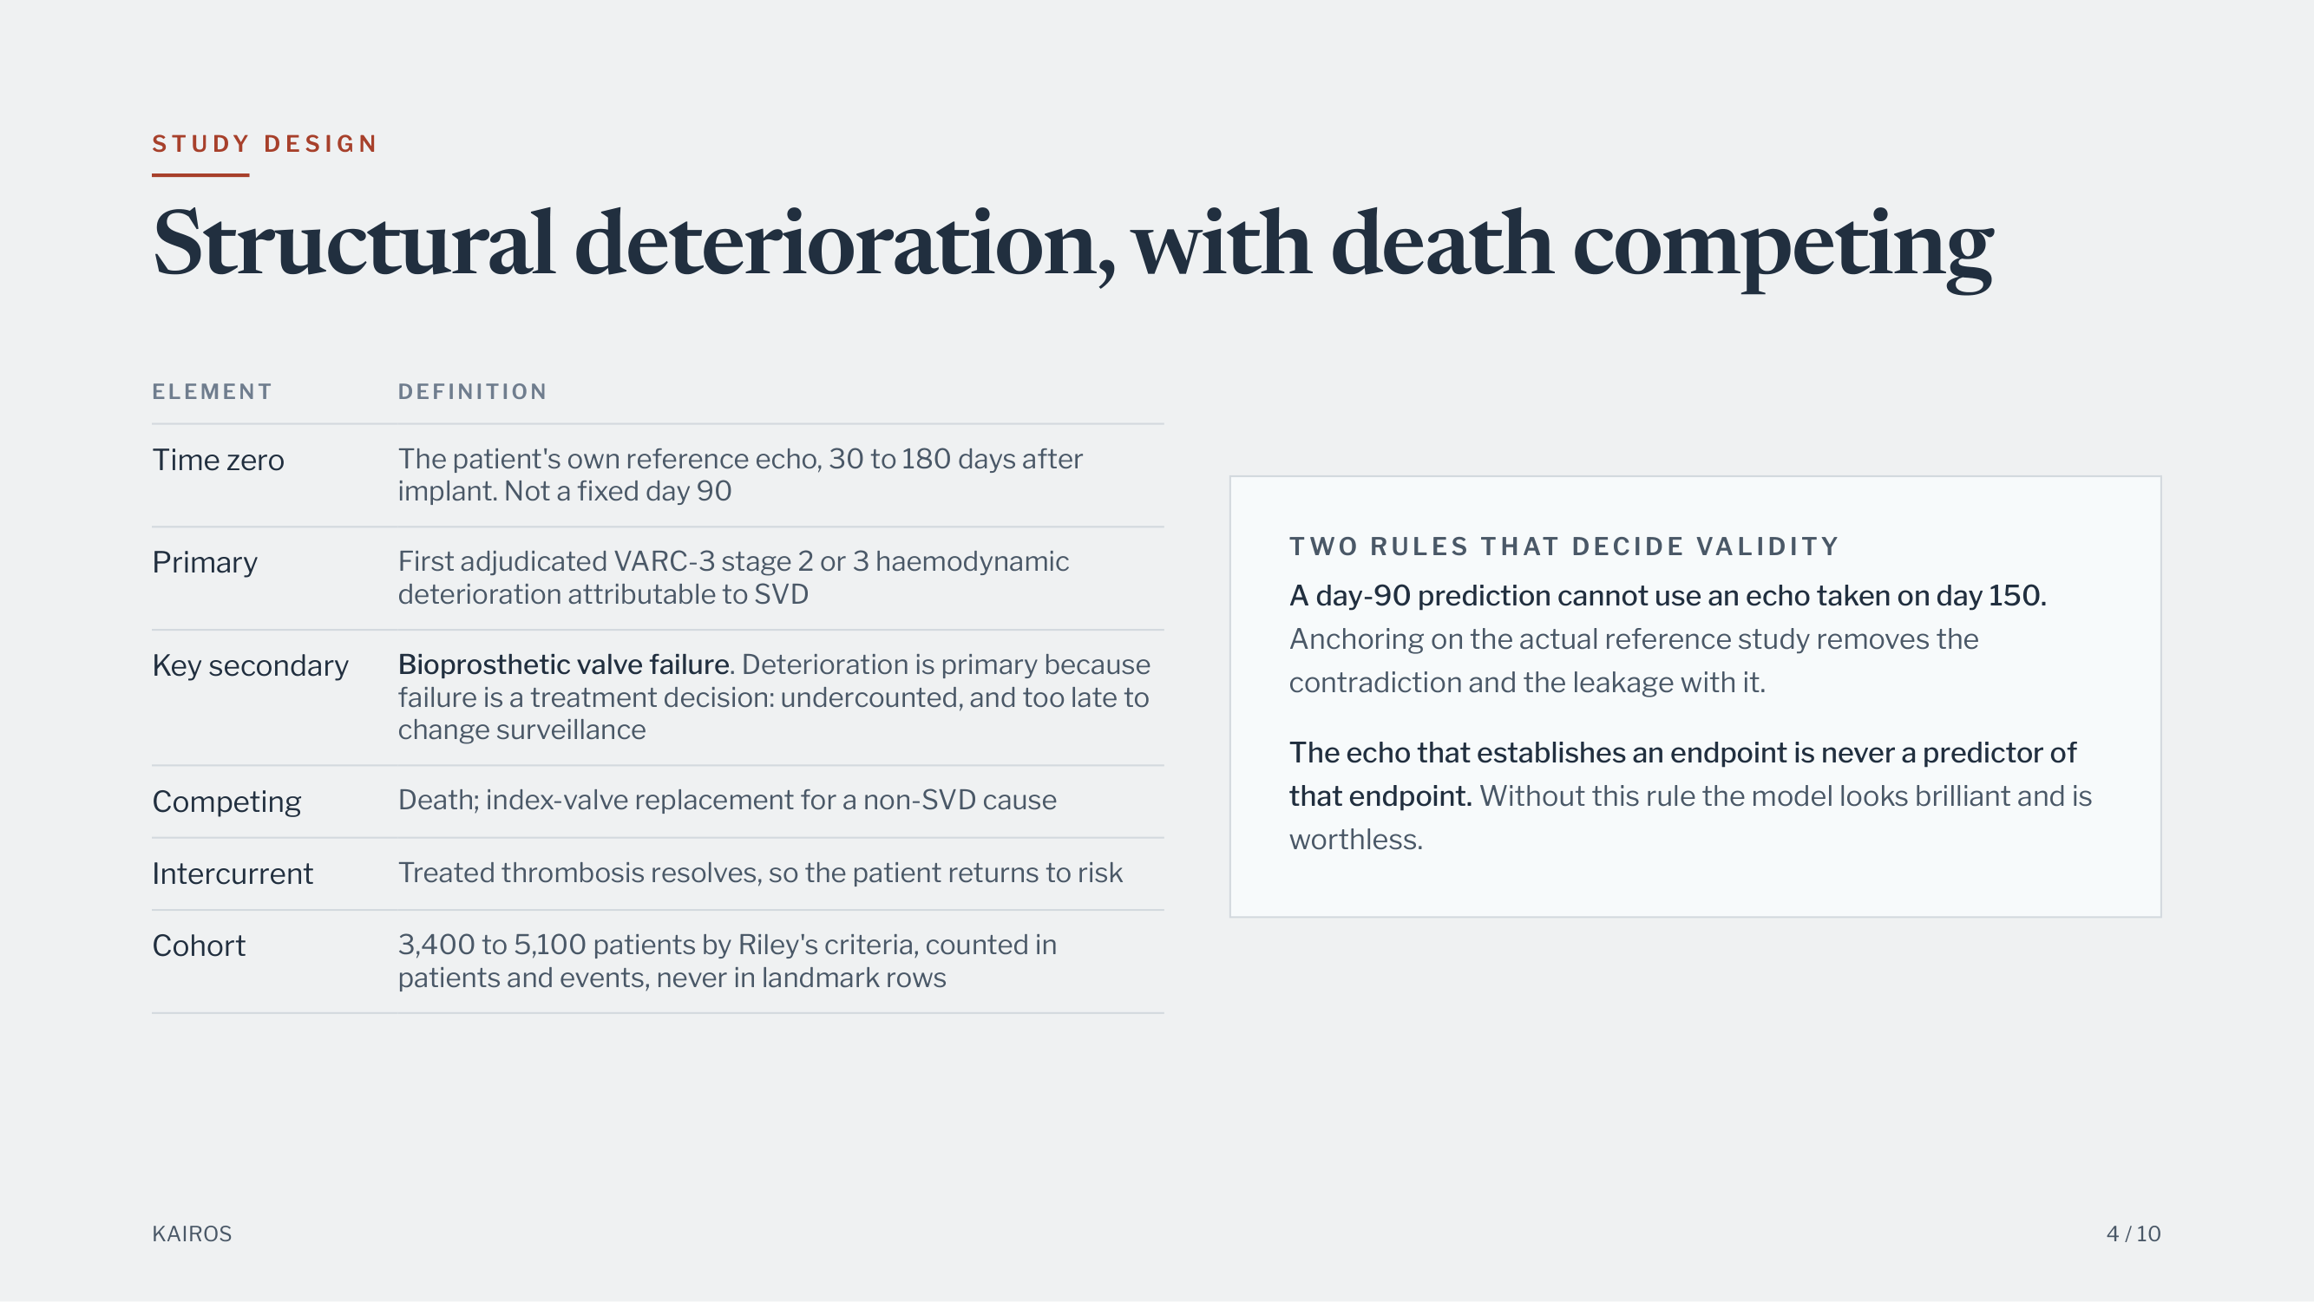
Notes:
S T U DY D E S I G N
Structural deterioration, with death competing
ELEMENT
DEFINITION
Time zero
The patient's own reference echo, 30 to 180 days after
implant. Not a fixed day 90
Primary
First adjudicated VARC-3 stage 2 or 3 haemodynamic
deterioration attributable to SVD
Key secondary
Bioprosthetic valve failure. Deterioration is primary because
failure is a treatment decision: undercounted, and too late to
change surveillance
Competing
Death; index-valve replacement for a non-SVD cause
Intercurrent
Treated thrombosis resolves, so the patient returns to risk
Cohort
3,400 to 5,100 patients by Riley's criteria, counted in
patients and events, never in landmark rows
T WO R U L E S T H AT D EC I D E VA L I D I TY
A day-90 prediction cannot use an echo taken on day 150.
Anchoring on the actual reference study removes the
contradiction and the leakage with it.
The echo that establishes an endpoint is never a predictor of
that endpoint. Without this rule the model looks brilliant and is
worthless.
KAIROS
4 / 10

Slide 5
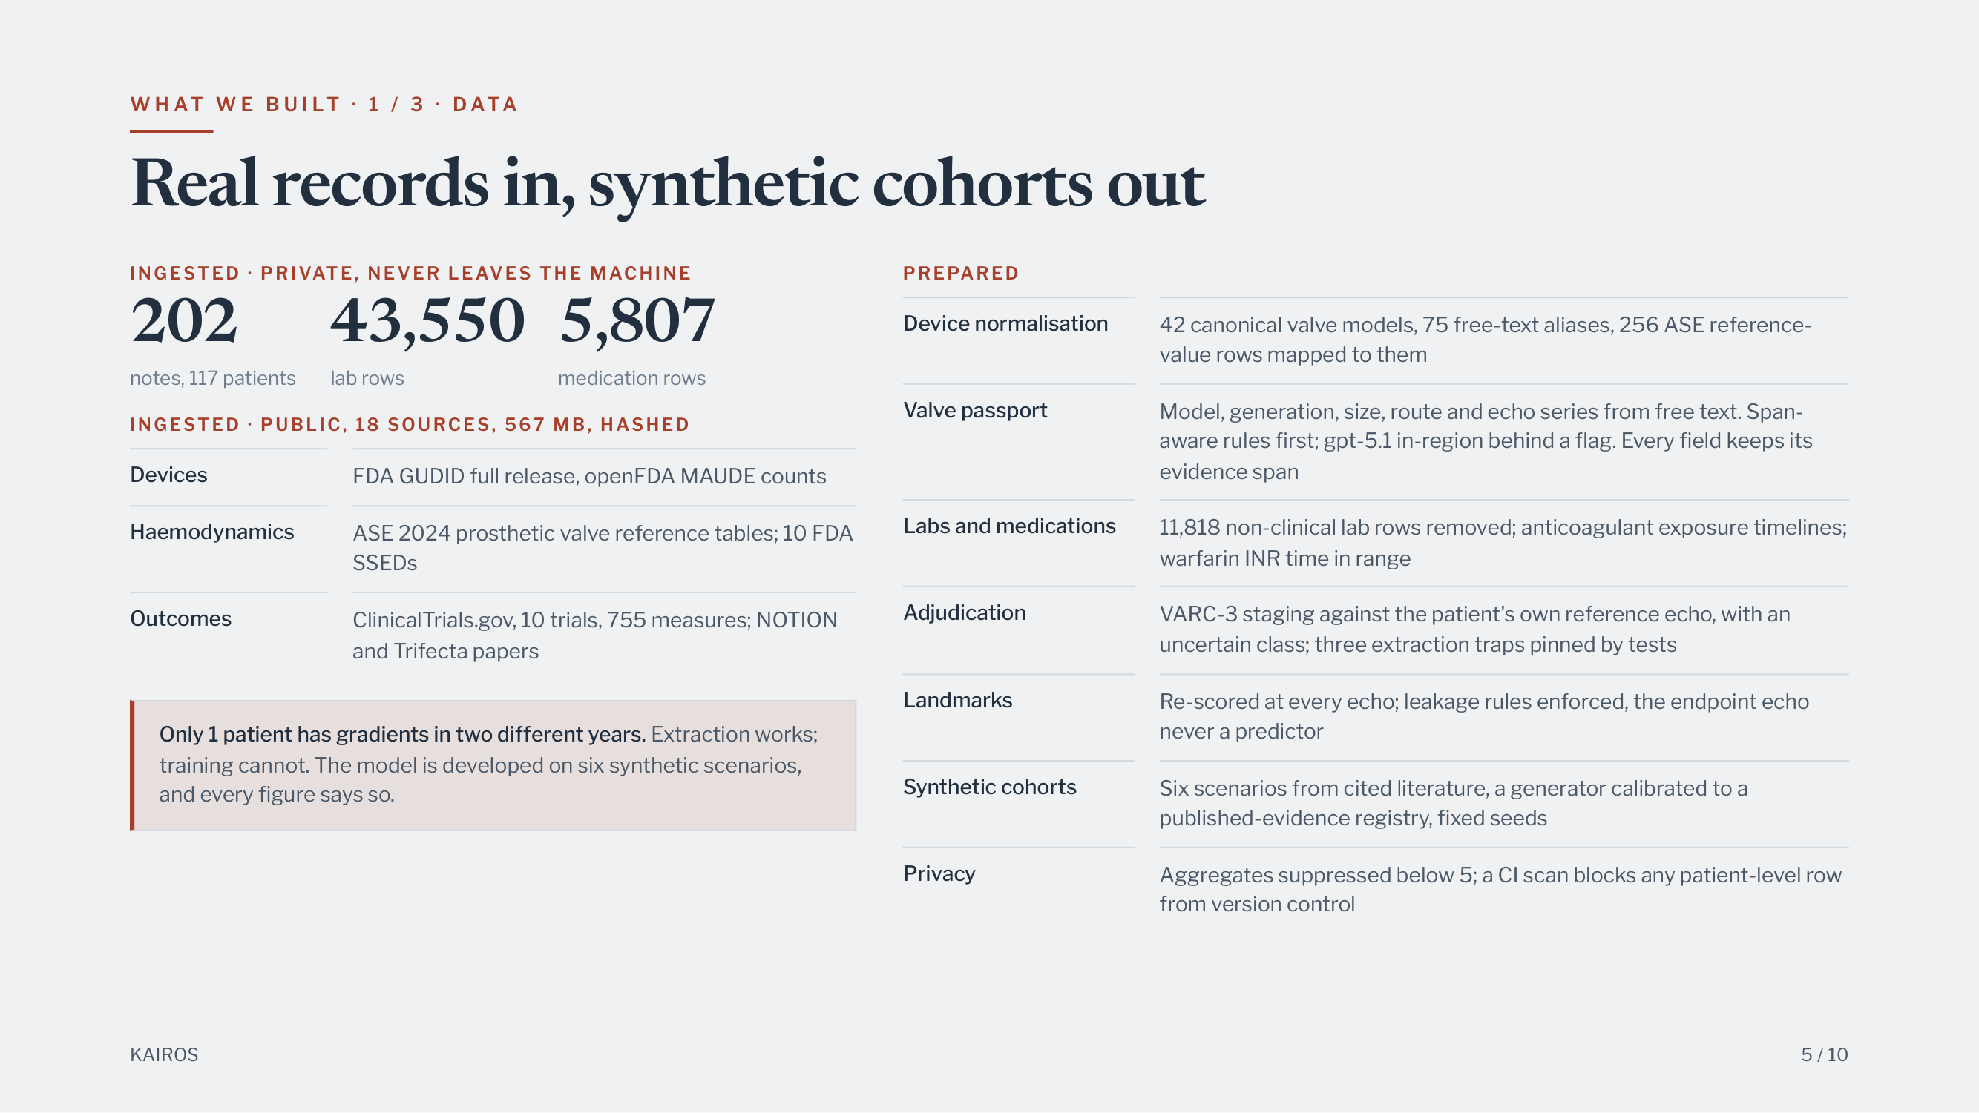
Notes:
W H AT W E B U I LT · 1 / 3 · D ATA
Real records in, synthetic cohorts out
INGESTED · PRIVATE, NEVER LEAVES THE MACHINE
202
notes, 117 patients 43,550
lab rows
5,807
medication rows
INGESTED · PUBLIC, 18 SOURCES, 567 MB, HASHED
Devices
FDA GUDID full release, openFDA MAUDE counts
Haemodynamics
ASE 2024 prosthetic valve reference tables; 10 FDA
SSEDs
Outcomes
ClinicalTrials.gov, 10 trials, 755 measures; NOTION
and Trifecta papers
Only 1 patient has gradients in two different years. Extraction works;
training cannot. The model is developed on six synthetic scenarios,
and every figure says so.
PREPARED
Device normalisation
42 canonical valve models, 75 free-text aliases, 256 ASE reference-
value rows mapped to them
Valve passport
Model, generation, size, route and echo series from free text. Span-
aware rules first; gpt-5.1 in-region behind a flag. Every field keeps its
evidence span
Labs and medications
11,818 non-clinical lab rows removed; anticoagulant exposure timelines;
warfarin INR time in range
Adjudication
VARC-3 staging against the patient's own reference echo, with an
uncertain class; three extraction traps pinned by tests
Landmarks
Re-scored at every echo; leakage rules enforced, the endpoint echo
never a predictor
Synthetic cohorts
Six scenarios from cited literature, a generator calibrated to a
published-evidence registry, fixed seeds
Privacy
Aggregates suppressed below 5; a CI scan blocks any patient-level row
from version control
KAIROS
5 / 10

Slide 6
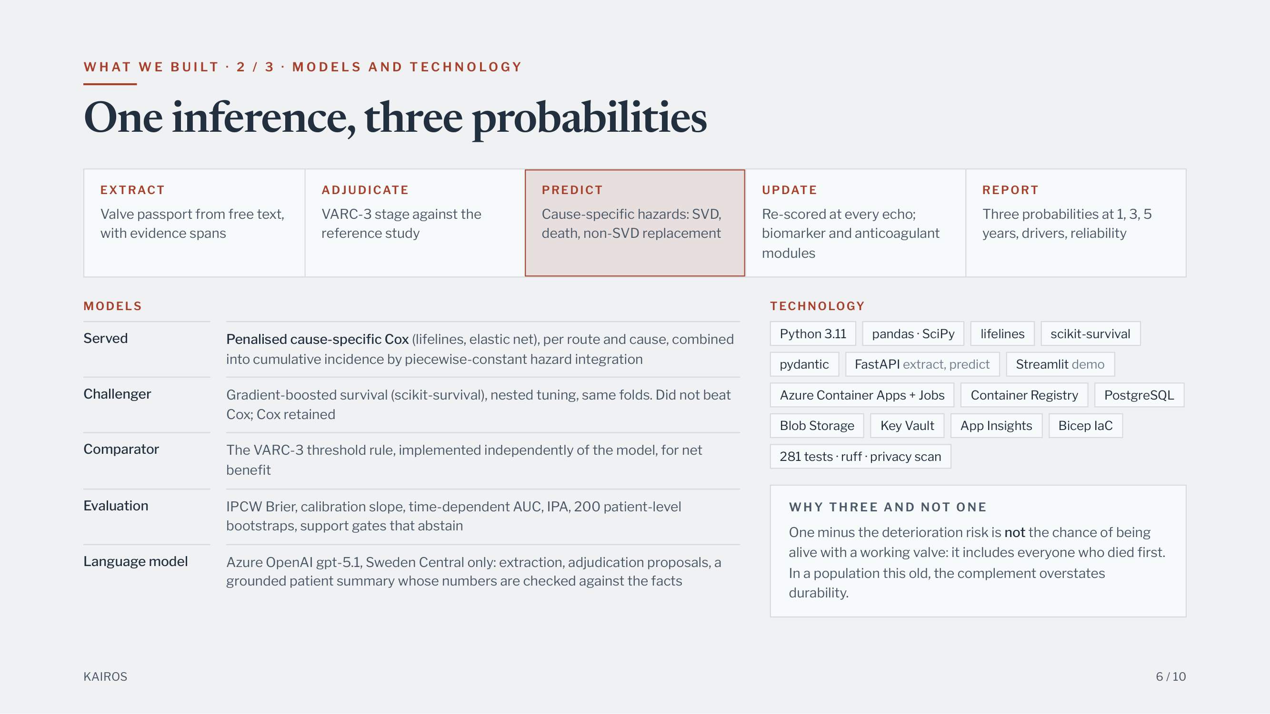
Notes:
W H AT W E B U I LT · 2 / 3 · M O D E L S A N D T E C H N O L O G Y
One inference, three probabilities
EXTRACT
Valve passport from free text,
with evidence spans
ADJUDICATE
VARC-3 stage against the
reference study
PREDICT
Cause-specific hazards: SVD,
death, non-SVD replacement
UPDATE
Re-scored at every echo;
biomarker and anticoagulant
modules
REPORT
Three probabilities at 1, 3, 5
years, drivers, reliability
MODELS
Served
Penalised cause-specific Cox (lifelines, elastic net), per route and cause, combined
into cumulative incidence by piecewise-constant hazard integration
Challenger
Gradient-boosted survival (scikit-survival), nested tuning, same folds. Did not beat
Cox; Cox retained
Comparator
The VARC-3 threshold rule, implemented independently of the model, for net
benefit
Evaluation
IPCW Brier, calibration slope, time-dependent AUC, IPA, 200 patient-level
bootstraps, support gates that abstain
Language model
Azure OpenAI gpt-5.1, Sweden Central only: extraction, adjudication proposals, a
grounded patient summary whose numbers are checked against the facts
TECHNOLOGY
Python 3.11
pandas · SciPy
lifelines
scikit-survival
pydantic
FastAPI extract, predict
Streamlit demo
Azure Container Apps + Jobs
Container Registry
PostgreSQL
Blob Storage
Key Vault
App Insights
Bicep IaC
281 tests · ruff · privacy scan
W H Y T H R E E A N D N OT O N E
One minus the deterioration risk is not the chance of being
alive with a working valve: it includes everyone who died first.
In a population this old, the complement overstates
durability.
KAIROS
6 / 10

Slide 7
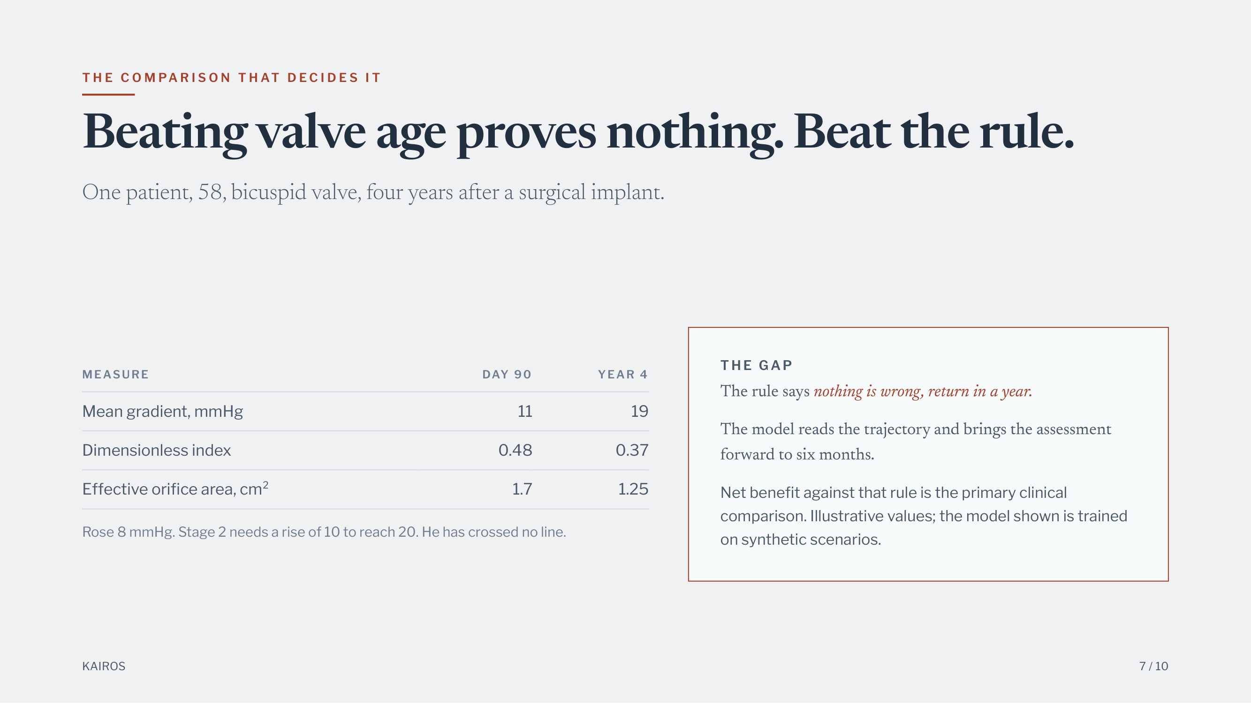
Notes:
T H E C O M PA R I S O N T H AT D E C I D E S I T
Beating valve age proves nothing. Beat the rule.
One patient, 58, bicuspid valve, four years after a surgical implant.
MEASURE
DAY 90
YEAR 4
Mean gradient, mmHg
11
19
Dimensionless index
0.48
0.37
Effective orifice area, cm²
1.7
1.25
Rose 8 mmHg. Stage 2 needs a rise of 10 to reach 20. He has crossed no line.
T H E G A P
The rule says nothing is wrong, return in a year.
The model reads the trajectory and brings the assessment
forward to six months.
Net benefit against that rule is the primary clinical
comparison. Illustrative values; the model shown is trained
on synthetic scenarios.
KAIROS
7 / 10

Slide 8
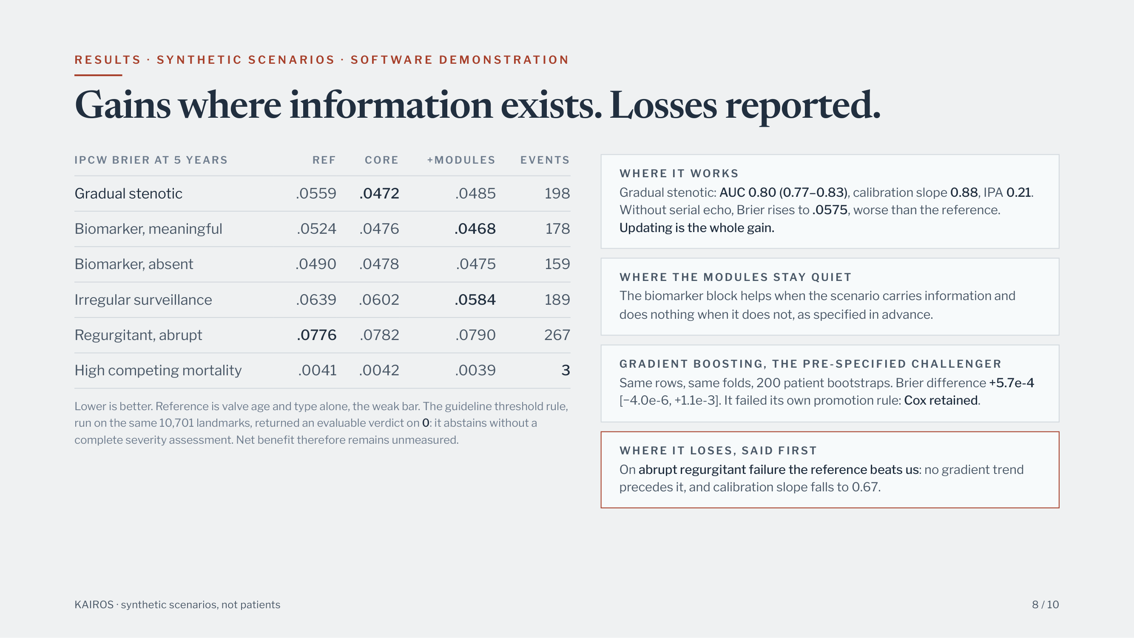
Notes:
R E S U LT S · S Y N T H E T I C S C E N A R I O S · S O F T WA R E D E M O N S T R AT I O N
Gains where information exists. Losses reported.
IPCW BRIER AT 5 YEARS
REF
CORE
+MODULES
EVENTS
Gradual stenotic
.0559
.0472
.0485
198
Biomarker, meaningful
.0524
.0476
.0468
178
Biomarker, absent
.0490
.0478
.0475
159
Irregular surveillance
.0639
.0602
.0584
189
Regurgitant, abrupt
.0776
.0782
.0790
267
High competing mortality
.0041
.0042
.0039
3
Lower is better. Reference is valve age and type alone, the weak bar. The guideline threshold rule,
run on the same 10,701 landmarks, returned an evaluable verdict on 0: it abstains without a
complete severity assessment. Net benefit therefore remains unmeasured.
W H E R E I T WO R KS
Gradual stenotic: AUC 0.80 (0.77–0.83), calibration slope 0.88, IPA 0.21.
Without serial echo, Brier rises to .0575, worse than the reference.
Updating is the whole gain.
W H E R E T H E M O D U L E S STAY Q U I E T
The biomarker block helps when the scenario carries information and
does nothing when it does not, as specified in advance.
G RA D I E N T B O OST I N G , T H E P R E - S P EC I F I E D C H A L L E N G E R
Same rows, same folds, 200 patient bootstraps. Brier difference +5.7e-4
[−4.0e-6, +1.1e-3]. It failed its own promotion rule: Cox retained.
W H E R E I T LOS E S , SA I D F I R ST
On abrupt regurgitant failure the reference beats us: no gradient trend
precedes it, and calibration slope falls to 0.67.
KAIROS · synthetic scenarios, not patients
8 / 10

Slide 9
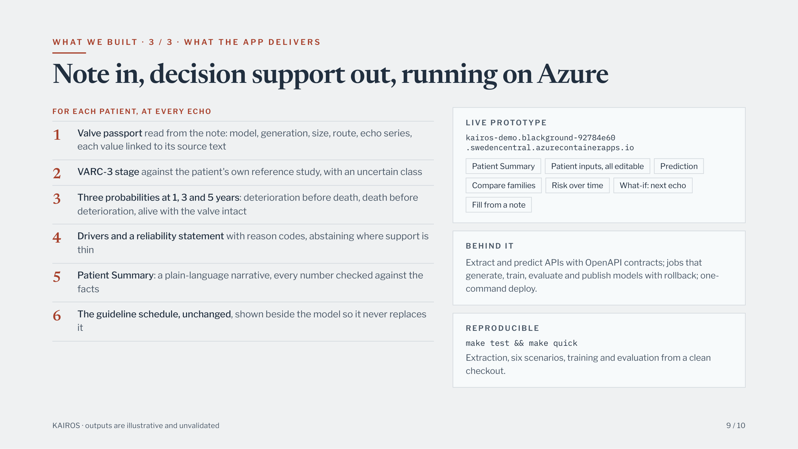
Notes:
W H AT W E B U I LT · 3 / 3 · W H AT T H E A P P D E L I V E R S
Note in, decision support out, running on Azure
FOR EACH PATIENT, AT EVERY ECHO
L I V E P ROTOTY P E
kairos-demo.blackground-92784e60
.swedencentral.azurecontainerapps.io
Patient Summary
Patient inputs, all editable
Prediction
Compare families
Risk over time
What-if: next echo
Fill from a note
B E H I N D I T
Extract and predict APIs with OpenAPI contracts; jobs that
generate, train, evaluate and publish models with rollback; one-
command deploy.
R E P RO D U C I B L E
make test && make quick
Extraction, six scenarios, training and evaluation from a clean
checkout.
Valve passport read from the note: model, generation, size, route, echo series,
each value linked to its source text
1
VARC-3 stage against the patient's own reference study, with an uncertain class
2
Three probabilities at 1, 3 and 5 years: deterioration before death, death before
deterioration, alive with the valve intact
3
Drivers and a reliability statement with reason codes, abstaining where support is
thin
4
Patient Summary: a plain-language narrative, every number checked against the
facts
5
The guideline schedule, unchanged, shown beside the model so it never replaces
it
6
KAIROS · outputs are illustrative and unvalidated
9 / 10

Slide 10
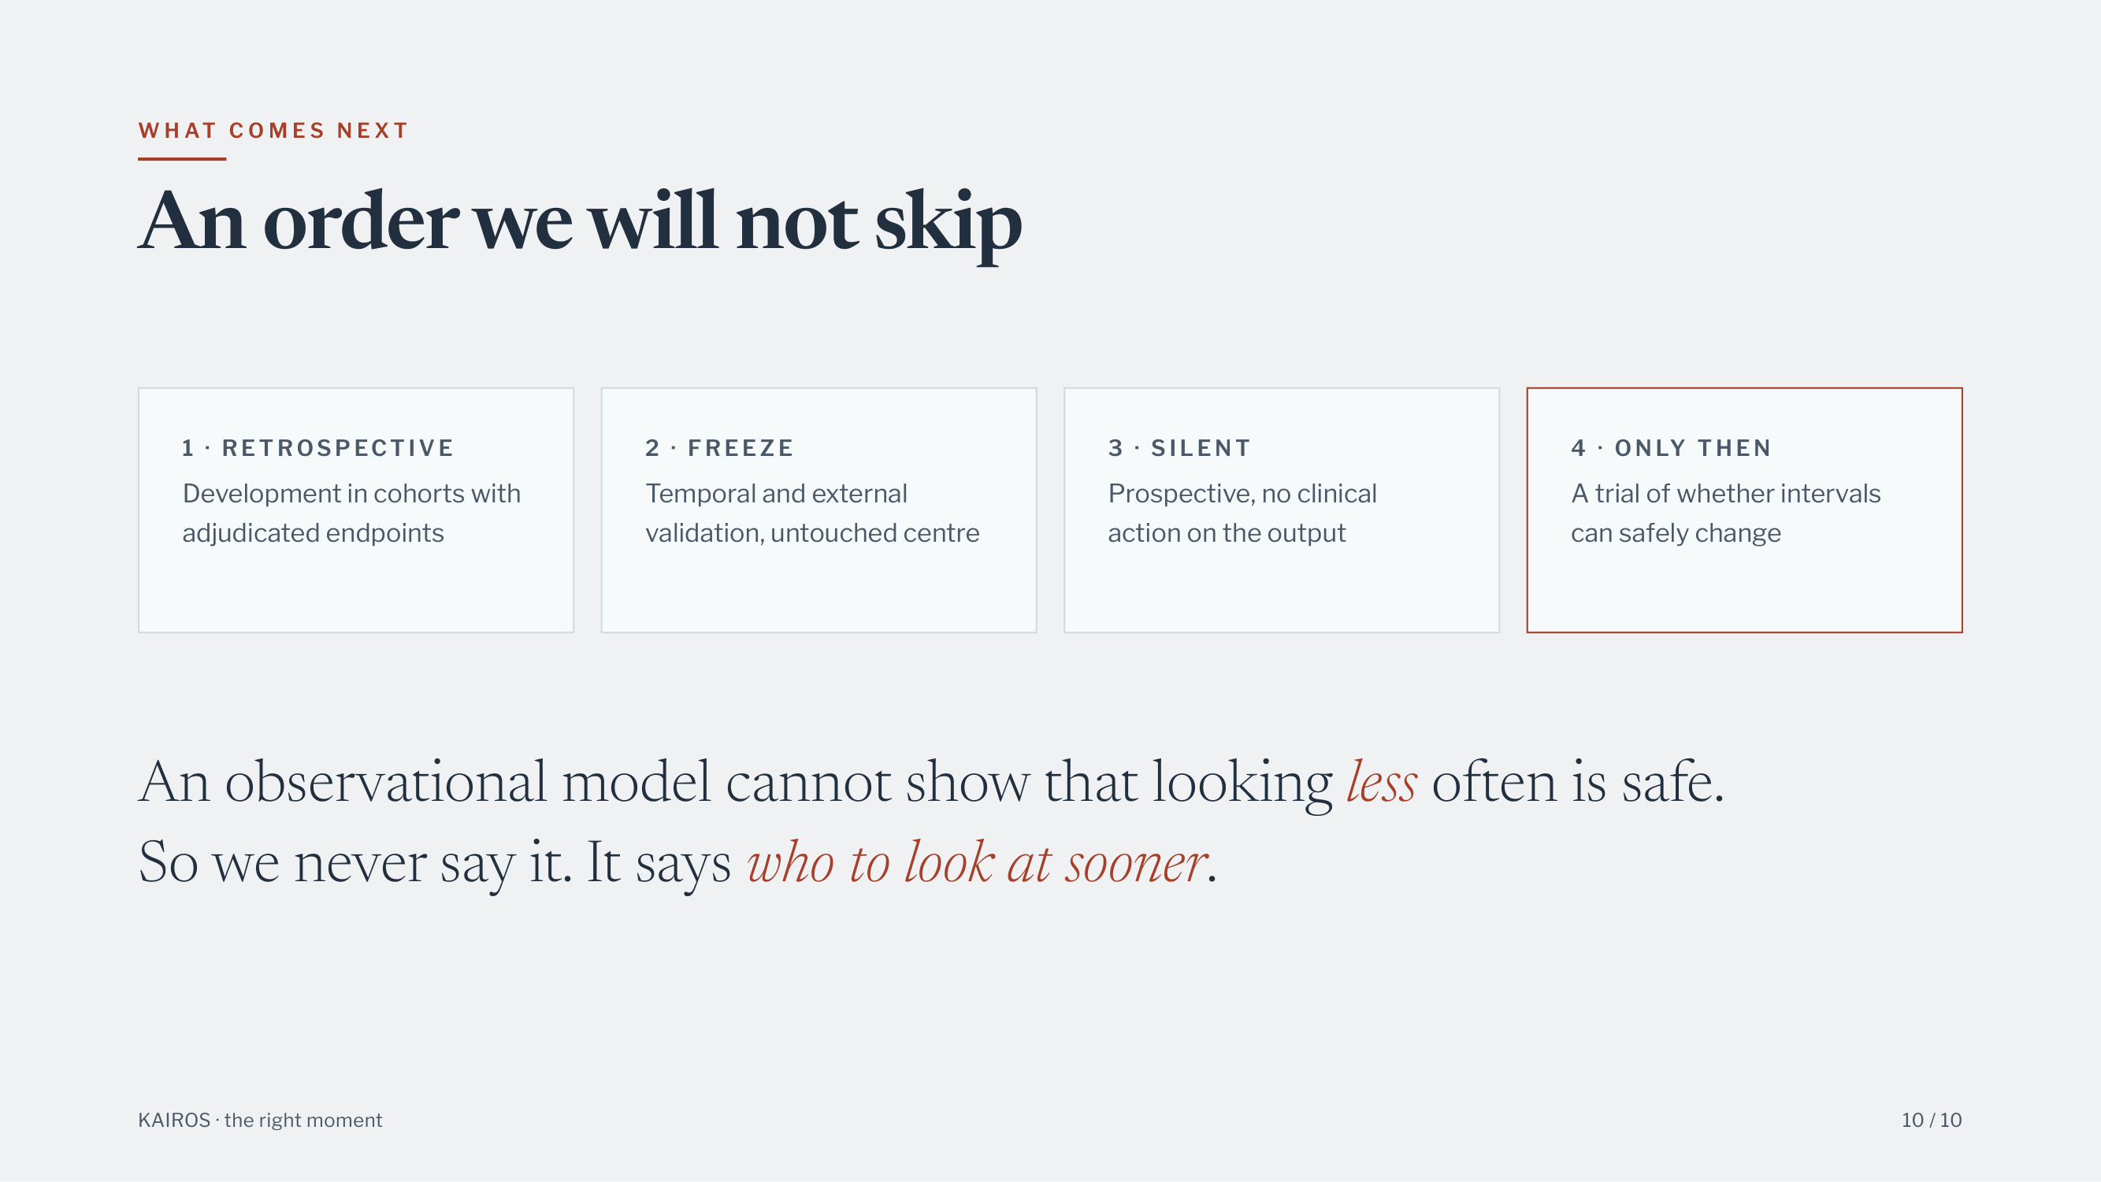
Notes:
W H AT C O M E S N E X T
An order we will not skip
1 · R E T ROS P ECT I V E
Development in cohorts with
adjudicated endpoints
2 · F R E E Z E
Temporal and external
validation, untouched centre
3 · S I L E N T
Prospective, no clinical
action on the output
4 · O N LY T H E N
A trial of whether intervals
can safely change
An observational model cannot show that looking less often is safe.
So we never say it. It says who to look at sooner.
KAIROS · the right moment
10 / 10

