Slide 1
Few-Shot Image Classification with Self-Supervised Backbones & kNN
Can frozen SSL representations enable competitive classification without any fine-tuning?
Kostis Matzorakis · George Manthos · Spiros Batziopoulos

Slide 2
Why Few-Shot + Self-Supervised?
Labelling is expensive: Medical imaging, satellite data, and rare species often have <10 labelled samples per class.
Self-supervised learning (SSL) trains powerful visual features from unlabelled data alone.
Key question: Can SSL features already separate classes well enough that a simple kNN classifier works with no gradient updates?
0
learnable parameters in our classifier
0
gradient updates on target data

Slide 3
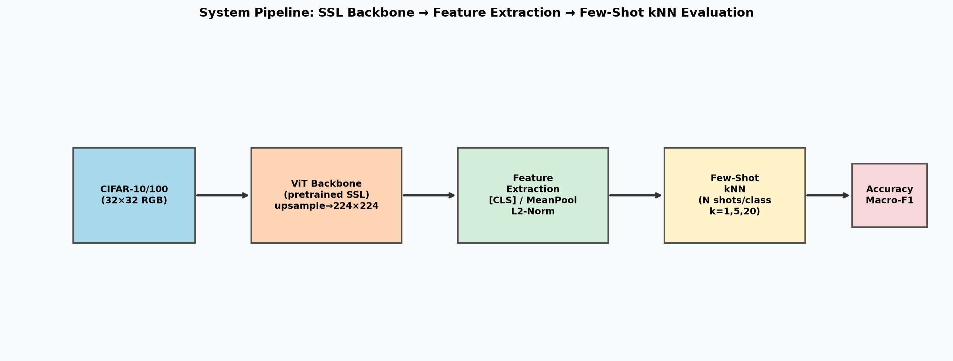
System Pipeline
CIFAR-10/100 32×32 RGB
→
Frozen ViT-S SSL Backbone
→
Features [CLS] / MeanPool L2-Norm
→
kNN Vote k=1,5,20 N shots
→
Accuracy Macro-F1
All backbone weights are frozen. Classification accuracy reflects purely the geometry of the pretrained feature space.

Slide 4
Backbone Models (All ViT-Small)
Model | SSL Objective | Pretrain Data | Patch Size
DINO ViT-S/16 | Self-distillation | ImageNet-1K | 16
DINOv2 ViT-S/14 | Self-dist. + MIM | LVD-142M | 14
DINOv2 ViT-S/14 (reg) | Self-dist. + MIM + Registers | LVD-142M | 14
DINOv3 ViT-S/16 | Self-dist. (distilled) | LVD-1689M | 16
MoCo v3 ViT-S/16 | Momentum contrastive | ImageNet-1K | 16
iBOT ViT-S/16 | Self-dist. + MIM | ImageNet-1K | 16
AttMask ViT-S/16 | Attention-guided MIM | ImageNet-1K | 16
Why these seven? Same ViT-Small capacity (~22M params) → differences in accuracy are due entirely to the pretraining objective, not model size.

Slide 5
Methodology — kNN Classifier
Feature Extraction
DINO-style Weighted kNN
Bicubic upsample 32×32 → 224×224 on GPU
ImageNet normalisation
Two pooling strategies:
CLS token — global summary
Mean pool — avg of spatial patches
L2 normalisation → cosine sim = dot product
ŷ = argmax_c Σ_{i ∈ N_k} exp(sim(x, x_i) / τ) · 𝟙[y_i = c]
Temperature τ = 0.07 (sharpens similarity)
Fully vectorised via `scatter_add`
No Python loops over test samples

Slide 6
Experimental Grid — 1,764 Conditions
Datasets
Backbones
Shots N
Hyperparams
CIFAR-10 (10 classes) CIFAR-100 (100 classes)
7 SSL models (DINO, DINOv2, DINOv2-reg, DINOv3, MoCo v3, iBOT, AttMask)
1, 2, 5, 10, 20, 50, 100 per class
k ∈ {1, 5, 20} Pool: CLS / MeanPool 3 seeds per config
7 models × 2 datasets × 2 pooling × 7 N × 3 k × 3 seeds = 1,764 evaluated conditions

Slide 7
Results
How do the backbones compare?

Slide 8
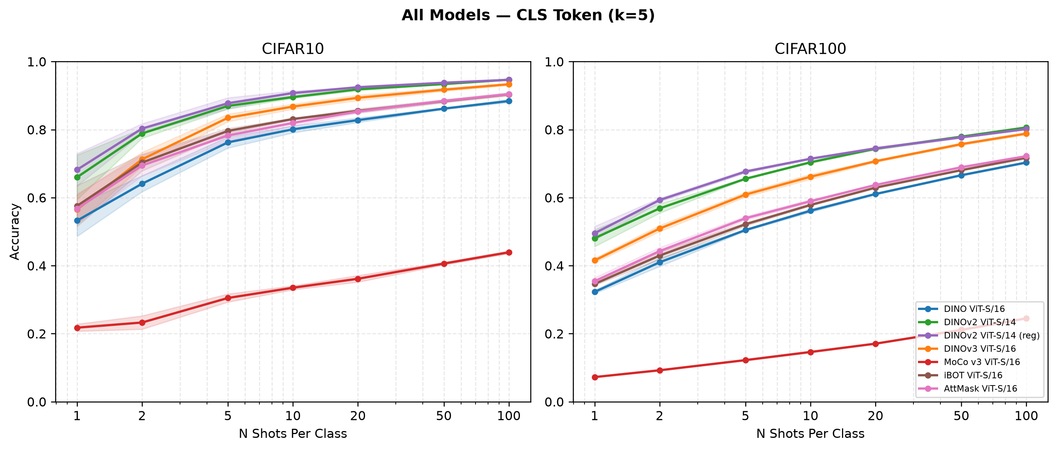
Accuracy vs. Shots — All Models (CLS, k=5)
DINOv2 variants dominate at every shot count on both datasets.
MoCo v3 lags by 50+ percentage points, contrastive pretraining doesn't form semantic clusters suitable for kNN classification.
Log-linear scaling: steepest gains are between 1→10 shots, with diminishing returns after.
Variance collapses: standard deviation shaded bands become extremely narrow beyond 20 shots.

Slide 9
CIFAR-10 Results: CLS Token (k=5)
Model | 1-shot | 5-shot | 10-shot | 100-shot
DINO ViT-S/16 | 53.2 ± 5.7 | 76.2 ± 2.0 | 80.1 ± 1.3 | 88.4 ± 0.5
DINOv2 ViT-S/14 | 66.0 ± 8.0 | 87.0 ± 1.1 | 89.6 ± 0.4 | 94.7 ± 0.2
DINOv2 (reg) | 68.2 ± 5.8 | 87.8 ± 2.0 | 90.7 ± 0.8 | 94.6 ± 0.0
DINOv3 ViT-S/16 | 56.5 ± 4.4 | 83.5 ± 1.1 | 86.8 ± 0.7 | 93.3 ± 0.3
MoCo v3 ViT-S/16 | 21.8 ± 1.3 | 30.5 ± 1.5 | 33.5 ± 0.7 | 43.9 ± 0.5
iBOT ViT-S/16 | 57.6 ± 6.0 | 79.6 ± 0.8 | 83.1 ± 0.2 | 90.4 ± 0.4
AttMask ViT-S/16 | 56.7 ± 4.3 | 78.3 ± 1.6 | 82.0 ± 1.0 | 90.4 ± 0.4
DINOv2-reg is superior at low shot counts (1, 5, 10 shots).
94.7% accuracy is achieved with only 100 shots per class.
MoCo v3 performance is extremely poor, failing to represent CIFAR-10 classes cleanly.
DINOv2 achieves 95.1% at 100-shot (k=20) matching a supervised ResNet-50 trained on 50× more labels.

Slide 10
CIFAR-100 Results — CLS Token (k=5)
Model | 1-shot | 5-shot | 10-shot | 100-shot
DINO ViT-S/16 | 32.3 ± 0.6 | 50.5 ± 0.3 | 56.1 ± 0.6 | 70.3 ± 0.3
DINOv2 ViT-S/14 | 48.1 ± 3.0 | 65.5 ± 0.2 | 70.4 ± 0.3 | 80.6 ± 0.3
DINOv2 (reg) | 49.5 ± 2.5 | 67.7 ± 0.5 | 71.4 ± 0.3 | 80.2 ± 0.3
DINOv3 ViT-S/16 | 41.5 ± 0.6 | 60.9 ± 0.7 | 66.1 ± 0.7 | 78.8 ± 0.3
MoCo v3 ViT-S/16 | 7.2 ± 0.0 | 12.2 ± 0.2 | 14.6 ± 0.2 | 24.5 ± 0.2
iBOT ViT-S/16 | 34.6 ± 0.4 | 52.2 ± 0.5 | 57.8 ± 0.3 | 71.7 ± 0.3
AttMask ViT-S/16 | 35.4 ± 1.0 | 53.9 ± 0.6 | 58.9 ± 0.5 | 72.2 ± 0.1
CIFAR-100 is 10× harder (100 classes, finer-grained distinctions).
DINOv2 achieves +82pp gain over random (1%) at 100 shots.
Model ranking is perfectly preserved across both datasets.

Slide 11
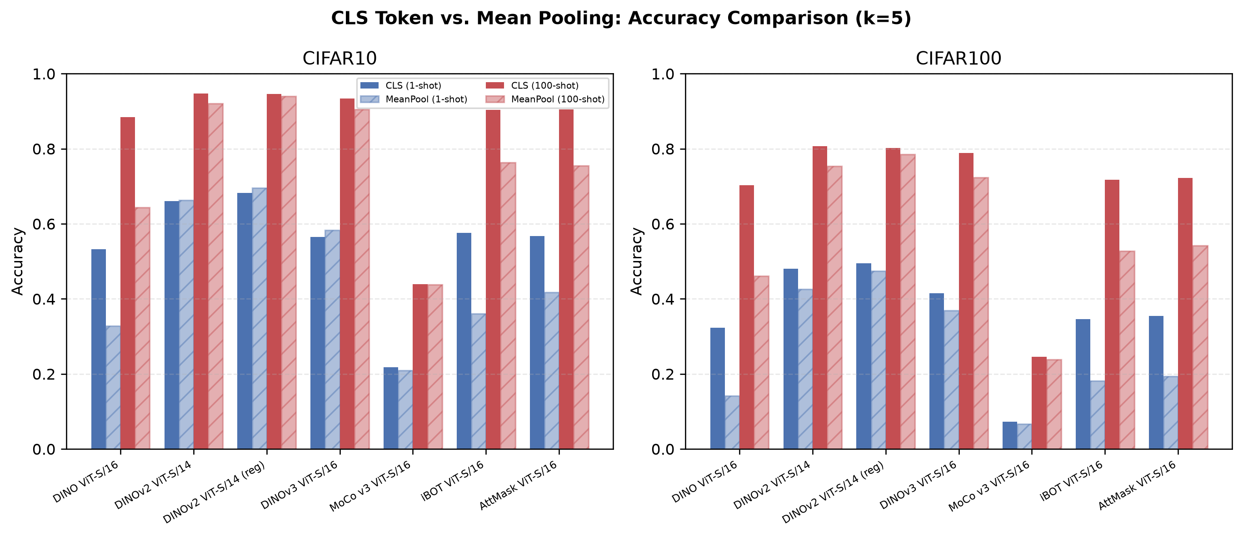
CLS Token vs. Mean Pooling
DINOv1: CLS wins big
88.4% (CLS) vs 64.4% (Mean): 24pp gap. CLS is explicitly optimised during pretraining.
DINOv2: Gap closes
94.7% (CLS) vs 92.1% (Mean): 2.6pp gap. MIM trains individual patch tokens to carry semantic content.
MoCo v3: Both poor
~44% either way. Feature representation quality, not pooling method, is the bottleneck.

Slide 12
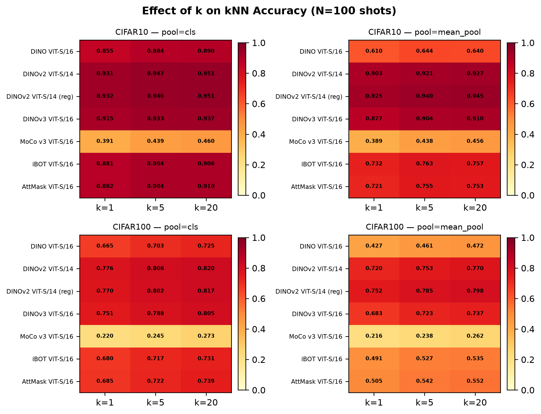
Effect of k (Number of Neighbours)
k has a moderate effect: k=1→k=20 improves classification accuracy by 1–5pp.
DINOv2 is highly robust to k: performance stays ≥93% for all tested k values on CIFAR-10.
MoCo v3 benefits more from larger k: its less structured feature space has noisy clusters, so majority voting helps reduce noise.

Slide 13
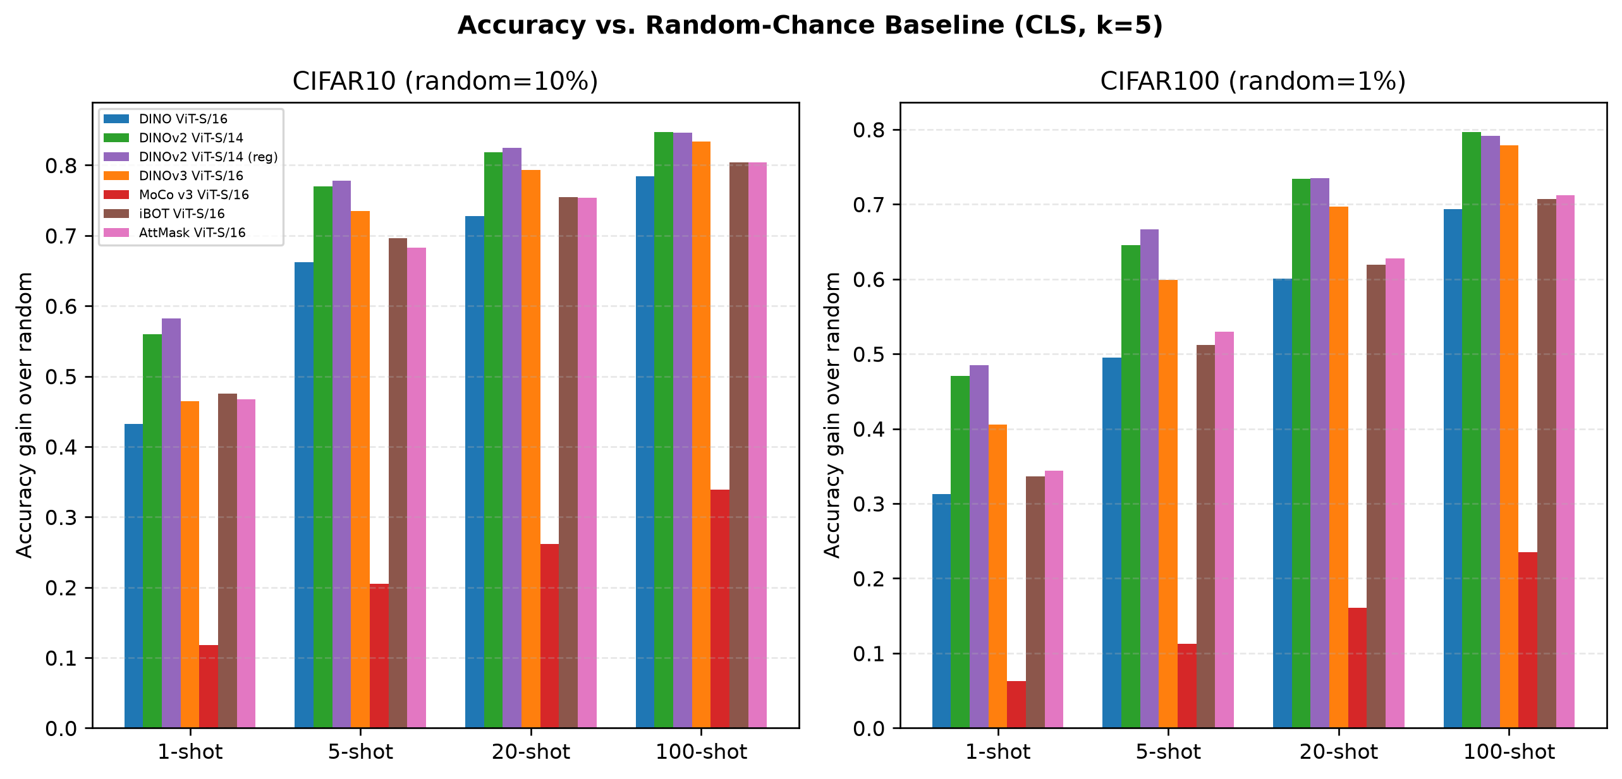
Gain Over Random Baseline
+85pp
DINOv2 gain on CIFAR-10 at 100-shot (vs 10% random)
+82pp
DINOv2 gain on CIFAR-100 at 100-shot (vs 1% random)

Slide 14
Key Findings, Mechanisms & Literature
A consolidated view of self-supervised representation geometry and empirical benchmarks
CORE FINDINGS
Key Observations:
DINOv2 achieves best performance across all shot regimes
DINOv3 improves scaling but not kNN geometry
Registers improve low-shot stability (1–10 shots)
MoCo v3 underperforms on ViT embeddings
iBOT / AttMask are strong but below DINOv2
Main Insight:
Performance depends more on embedding space geometry than model size
WHY (MECHANISMS)
Why these results happen:
DINOv2
Large-scale pretraining (LVD-142M)
Strong teacher–student distillation
Highly structured embedding space
Registers
Extra “memory tokens” absorb artifacts
Better low-shot robustness
DINOv3
Extreme scaling (data + params)
Optimized for generalization, not clustering
MoCo v3
Contrastive learning + negatives
Weaker ViT embedding geometry
iBOT / AttMask
Patch-level supervision
Strong local, weaker global alignment
LITERATURE
Caron et al., 2021 — DINO
https://arxiv.org/abs/2104.14294
Oquab et al., 2023 — DINOv2
https://arxiv.org/abs/2304.07193
Touvron et al., 2023 — Registers
https://arxiv.org/abs/2309.16588
Chen et al., 2021 — MoCo v3
https://arxiv.org/abs/2104.02057
Zhou et al., 2021 — iBOT
https://arxiv.org/abs/2111.07832
Kakogeorgiou et al., 2022 — AttMask
https://arxiv.org/abs/2203.12719

Slide 15
Key Findings
# | Finding | Evidence
1 | Pretraining objective > architecture | Same ViT-S → 43.9% to 94.7% accuracy
2 | Self-distillation >> contrastive | DINO beats MoCo by 50+ pp on kNN
3 | DINOv2 matches supervised baselines | 95.1% with 50× fewer labels than ResNet-50
4 | Register tokens help at low N | +2pp at 1-shot, converge at high N
5 | Log-linear scaling with N | Steepest gains 1→10 shots, diminishing after
6 | CLS > MeanPool for DINOv1 | 24pp gap; DINOv2 closes it to 2.6pp

Slide 16
Limitations & Future Work
Limitations
Future Work
Only ViT-Small variants evaluated and probably larger models (ViT-B/L) would likely improve downstream accuracy further.
Backbones differ in pretraining data (ImageNet-1K vs curated LVD-142M/1689M) is not a fully controlled comparison.
CIFAR-10/100 images are low-resolution (32×32) which creating a domain gap with the pretraining datasets.
Fine-tuning and linear probing strategies were not explored.
Evaluate ViT-Base, ViT-Large, and CLIP-based models.
Test on mini-ImageNet, CUB-200, and EuroSAT datasets.
Explore concatenating CLS and MeanPool features.
Compare kNN performance directly against linear probing and full fine-tuning.
Explore adapter layers for minimal parameter fine-tuning.

Slide 17
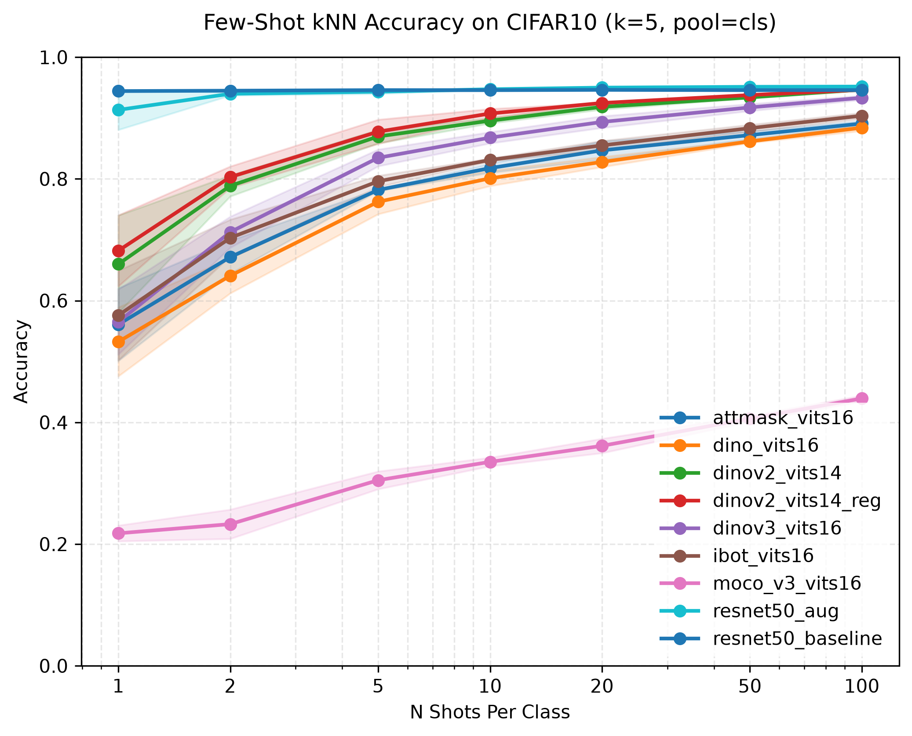
Supervised ResNet-50 Baseline (CLS, k=5)
The supervised ceiling matched on CIFAR-10 and beaten on CIFAR-100 by DINOv2, with zero labels in pretraining.
Model | 1-shot | 5-shot | 10-shot | 100-shot
ResNet-50 · CIFAR-10 | 94.4 ± 0.1 | 94.6 ± 0.1 | 94.6 ± 0.0 | 94.6 ± 0.1
ResNet-50 · CIFAR-10 (aug) | 91.3 ± 2.7 | 94.3 ± 0.3 | 94.7 ± 0.1 | 95.2 ± 0.2
ResNet-50 · CIFAR-100 | 72.2 ± 0.3 | 75.5 ± 0.1 | 75.7 ± 0.1 | 76.6 ± 0.1
ResNet-50 · CIFAR-100 (aug) | 59.8 ± 1.2 | 70.8 ± 0.4 | 72.9 ± 0.2 | 76.8 ± 0.1
Supervised ResNet (flat top lines) ≈ best self-supervised DINOv2 which uses no labels in pretraining.

Slide 18
Conclusion
Frozen SSL ViT-S + kNN achieves 95.1% on CIFAR-10 and 82.0% on CIFAR-100 with only 100 labels/class.
The pretraining objective and not the model size determines downstream kNN quality.
Self-distillation (DINO family) produces semantically clustered features ideal for non-parametric retrieval.
Modern SSL makes labelling-efficient classification practical today.
🔗 Repository: https://github.com/kostismatz/ssl-knn-fewshot | Thank you! Questions?

