Slide 1
DevRev:
Developer Revenue Analysis
Karl Ostmo
Nov 1, 2010

Slide 2
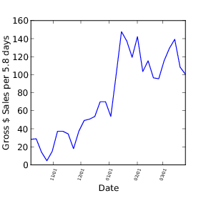
Revenue Tracking -- First Attempt (2/2)
Wrote Python script to split requested date range into 30-day chunks
Parse CSV files, aggregate in histogram
Problem: Records don't distinguish between apps
      Uses MatPlotLib for plotting
      Adjustable bin count
      Released online: http://www.anddev.org/general-f3/howto-graph-plot-android-market-sales-from-google-checkout-t9442.html
Combined sales, Oct – Mar

Slide 3
Revenue Tracking -- A Better Solution
Use Google Checkout's "Notifications" API to obtain more complete data
  XML web service (well-documented)
Combine with Android Market API
  Unpublished API, but reverse engineered (independent open source project)
  Gets a list of a publisher's current apps (with icons)
Productize as a new Android app!
Notes:
I discovered an API for Google Checkout
Google Checkout has no "summary" capability of its own, but provides an API to enable 3rd-party solutions
Android Market somewhat "grafted" on to this framework

Slide 4
System Overview
Notes:
The idea is to merge information from these two separate entities, Google Checkout and the Android Market...

Slide 5
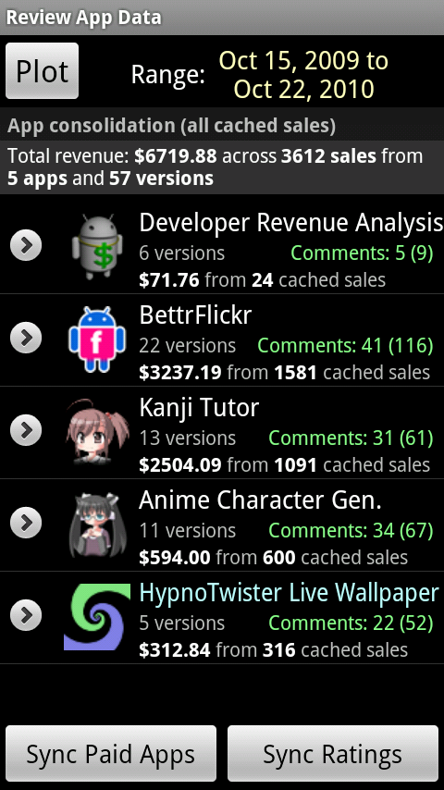
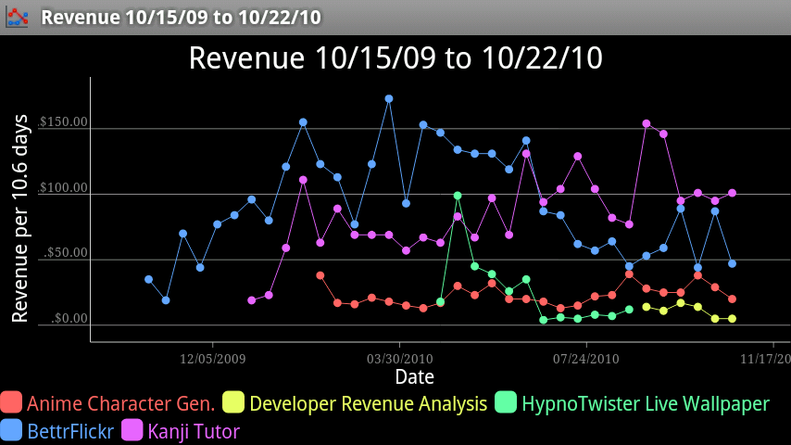
Preview of Final Product
Revenue summaries by App
Time plots

Slide 6
Challenges
Obtain data
Design schema
Platform bug
Improve speed

Slide 7
Challenges
Obtain data
Design schema
Platform bug
Improve speed
Notes:
The first step was to figure out how to use the available API functions to get the data I needed.

Slide 8
Google Checkout "Notifications" API What data is available?
  A "Full" record (a.k.a. <new-order-notification>)
    Created for every new order placed
    Large (~4KB)
      Order number
      Product ID
      Many extras: Billing address, product description, etc.
  A "Charged" record (a.k.a. <charge-amount-notification>)
    Created for every purchase unreturned after 24 hours
    Minimal data (< 0.5KB per record)
      Order number
      Charge amount
      Timestamp
Notes:
There were many different types of records described in the API documentation, but I these were two types of interest to me.

Slide 9
Google Checkout "Notifications" API Constraints
A "full" record has every field that a "charged" record does, but has no way to discriminate between returns and completed orders.
  Makes both types of query necessary
Because of returns, there will be fewer "charged" records than "full" records
Can query for records by date range or order number
Notes:
Here are some constraints that affected my design.

Slide 10
Google Checkout "Notifications" API Strategy
First query "charged" records by date
  Obtains order numbers for all "kept" purchases
  API gives 50 per page, with "next page" token
Next query "full" records by order number
  May specify 16 order numbers at a time
Implement a SAX parser, insert records into DB
Notes:
With those constraints in mind, I first...

Slide 11
Challenges
Obtain data
Design schema
Platform bug
Improve speed
Notes:
The schema design took place at the same time as developing the API queries.

Slide 12
Naïve Database Schema
CHECKOUT_PURCHASES
ORDER_NUMBER
MERCHANT_ITEM_ID
REVENUE_CENTS
ORDER_TIMESTAMP
ANDROID_MARKET
APP_ID
APP_TITLE
ICON
Color key:
INTEGER
TEXT
BLOB
Notes:
Ideally I would only need these two tables, where the MERCHANT_ITEM_ID assigned by Google Checkout matches with the APP_ID used by Android Market.

Slide 13
Naïve Database Schema
CHECKOUT_PURCHASES
ORDER_NUMBER
MERCHANT_ITEM_ID
REVENUE_CENTS
ORDER_TIMESTAMP
ANDROID_MARKET
APP_ID
APP_TITLE
ICON
Color key:
INTEGER
TEXT
BLOB
  Problem: New app versions (updates from the developer) are treated as distinct products in Google Checkout (they get a new MERCHANT_ITEM_ID)
    The most recent app version has a MERCHANT_ITEM_ID that matches the APP_ID
    All other app versions have unique MERCHANT_ITEM_IDs
    Many-to-one mapping between MERCHANT_ITEM_ID and APP_ID

Slide 14
Improved Database Schema
CHECKOUT_PURCHASES
ORDER_NUMBER
MERCHANT_ITEM_ID
REVENUE_CENTS
ORDER_TIMESTAMP
CHECKOUT_PRODUCTS
MERCHANT_ITEM_ID
CANONICAL_ITEM_ID
ITEM_TITLE
ANDROID_MARKET
APP_ID
APP_TITLE
ICON
CHECKOUT_PURCHASES is JOINed with CHECKOUT_PRODUCTS in a VIEW
ITEM_TITLE is compared to APP_TITLE and used to automatically set CANONICAL_ITEM_ID to the appropriate APP_ID
Notes:
I've introduced an intermediate table facilitates the grouping of "version products" as "app products".
I form a database VIEW joining the first two tables, so they can be treated as one in later queries.
The second bullet explains how the app versions with their different ITEM_IDs are automatically consolidated under one APP_ID.
!! However, it is possible for developers to change the title of their apps between versions, in which case the automatic consolidation won't work. I've provided an interface to make manual associations in that case.

Slide 15
Populating Database (1/2)
"Charged" record
  Order number
  Charge amount
  Timestamp
"Full" record
  Order number
  Merchant item ID
  Item title
Notes:
Recall the content of the two types of records we will query for using the Google Checkout API.

Slide 16
Populating Database (2/2)
"Charged" record
  Order number
  Charge amount
  Timestamp
"Full" record
  Order number
  Merchant item ID
  Item title
CHECKOUT_PURCHASES
ORDER_NUMBER
MERCHANT_ITEM_ID
REVENUE_CENTS
ORDER_TIMESTAMP
CHECKOUT_PRODUCTS
MERCHANT_ITEM_ID
CANONICAL_ITEM_ID
ITEM_TITLE
Notes:
This is how the database fields are populated by the fetched records. The order number is the common link.
Once the complete set of "Charged" records is obtained, the Full record fills in the missing information.

Slide 17
Challenges
Obtain data
Design schema
Platform bug
Improve speed

Slide 18
Platform Bug
Complete data loss in SQLite
  Sporratic but reproducible by inserting thousands of records
    Was I using the database incorrectly?
  Tracked to a bug in the version of SQLite used by the Android platform
    Browsed source code (http://source.android.com/)
    SQLite mailing list archive
  Remedied in Android 2.2
    Postponed release and set minimum platform version requirement

Slide 19
Challenges
Obtain data
Design schema
Platform bug
Improve speed

Slide 20
Reducing Download Times (1/2)
Problem: Unsatisfactory download times
  Almost 20 minutes for me (around 3600 records)
  What about other (more successful) sellers?
    My target audience: 100K sales or fewer
    At least, runs as a background process (start and forget, notified when complete)
Solution: Multithreaded downloads
  Server-bound, not bandwidth-bound
  Required refactoring design from sequential to parallel

Slide 21
Reducing Download Times (2/2)
Download takes 18 minutes without multithreading
Adding a second thread nearly doubles speed
No significant improvement beyond 30 threads (2:15)
Notes:
I reduced the download time by almost 90%.
The graph shows the differnt trials I ran to obtain the "sweet spot" for thread count.

Slide 22
User Interaction Sequence (1/2)
Obtain login credentials
Download sales within a certain date range
  Cache sales in database (persistent storage)
  Mark a date range as cached
    Allow cache date ranges to be merged
Automatically/manually consolidate Google Checkout "products" as Android Apps
View/Export sales plots

Slide 23
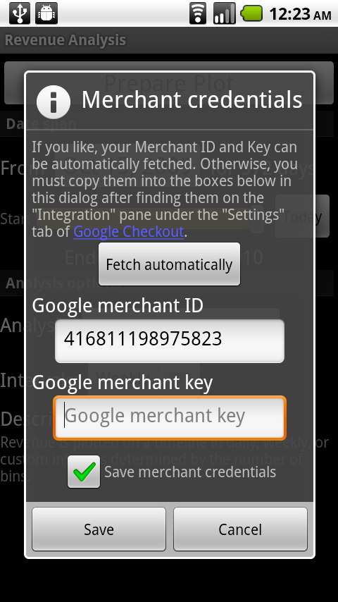
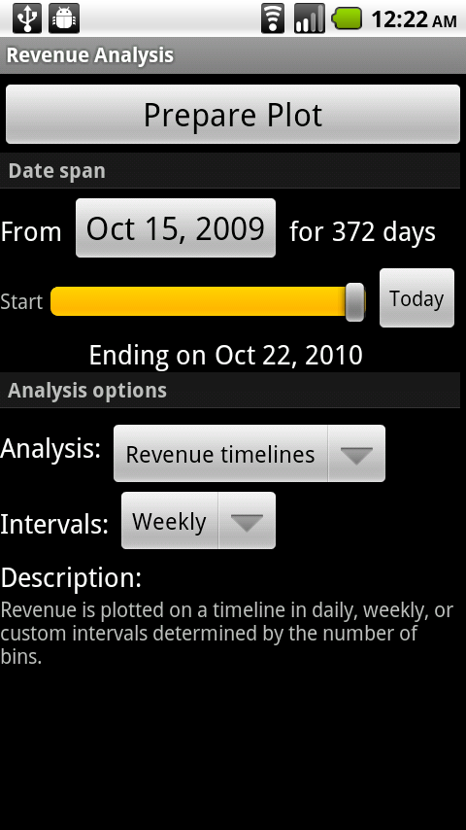
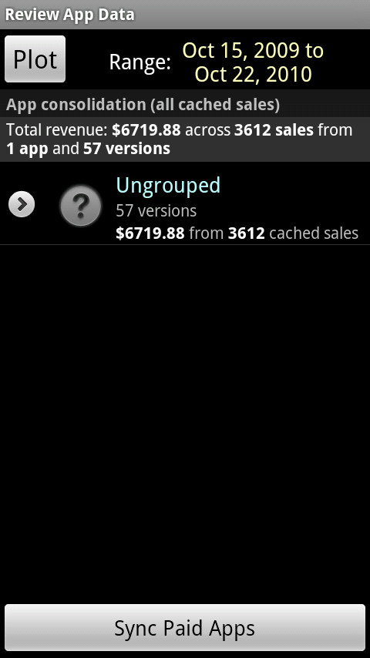
User Interaction Sequence (2/2)
(1)
Authenticate
(2)
Specify
date range
(and analysis parameters)
(3)
Consolidate
Notes:
Need a special Merchant Key to access the API, obtained by logging in to the Google Checkout website. Since web navigation is cumbersome on the device, I solicit the user login and screen scrape the website in the background for the key.
In Step 2 there's a slider and date field to specify the target range.
Step 3 is the consolidation phase, where Google Checkout "products" are associated with Android Market "apps". It can often be done automatically, but I had to allow for manual association if needed, since developers can retitle their apps across versions.
One goal was to get revenue summarized by app, and you can see that on the far right.

Slide 24
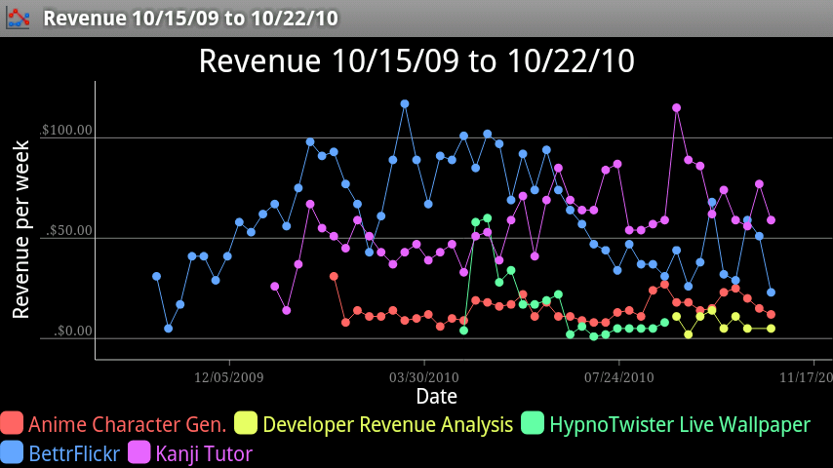
Finished product
App is self-hosting
Notes:
As the final stage I pass the acquired data along to my ChartDroid app for display.
And I think it's kind of neat to be able to say the app is self-hosting in a sense – you can see it starting in the corner.

Slide 25
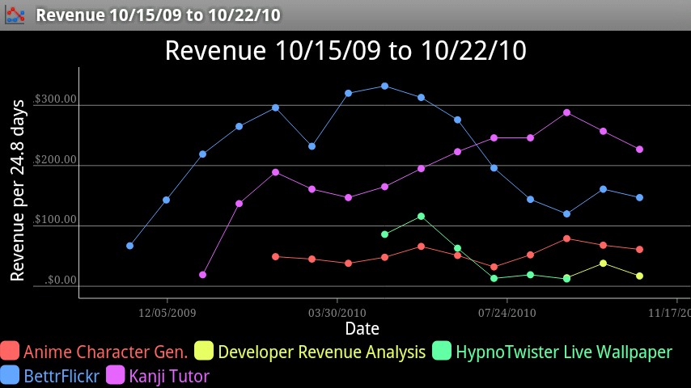
Smoothing with Larger Bin Widths
Notes:
This is not quite one month per bin.

Slide 26
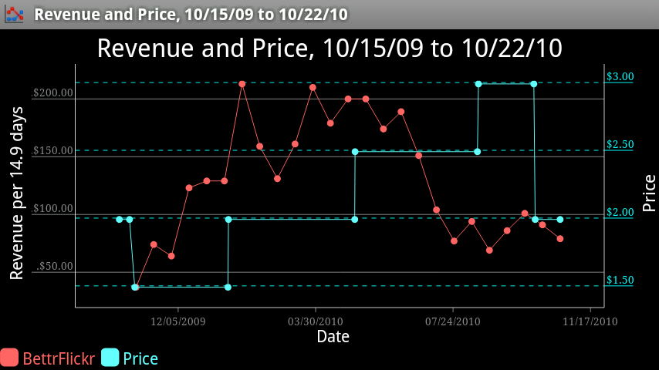
Cause of a Sales Trend? (1/2)
Notes:
Now that I've built this system, I wanted to see if I could answer some specific questions with it.
This is a simultaneous plot of Revenue and Price of my Flickr app. I had raised the price a few times, but was wondering if lowering it could increase sales.
Just from this graph, I'm not sure.

Slide 27
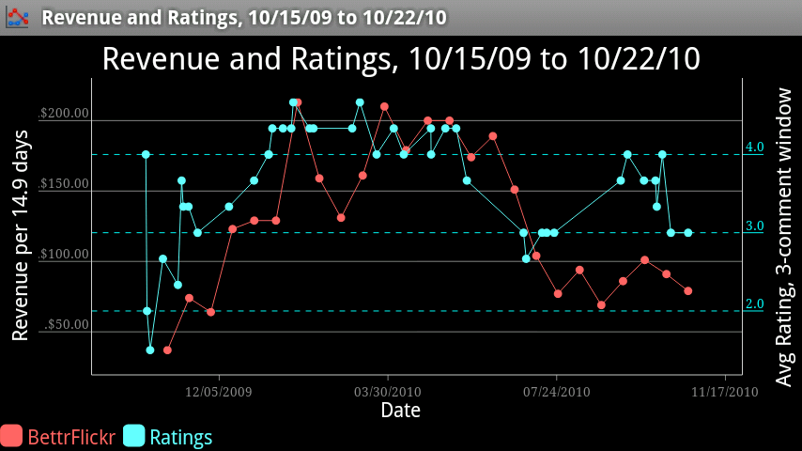
Cause of a Sales Trend? (2/2)
Notes:
What I found more interesting is the correlation between user ratings and revenue.
A precipitous drop where average rating drops from above 4 stars to below 3 stars
The rating in this plot are a windowed moving average of the latest ratings

Slide 28
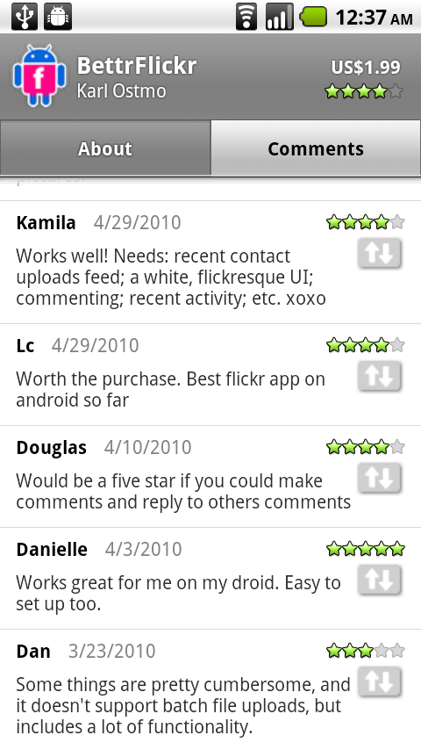
Conclusion
User comments have an important effect on sales
More data points needed to determine effect of price
  Preferably on an app with stable ratings
The two APIs were integrated successfully to produce revenue plots
Notes:
To summarize this whole endeavor, I was able to get Android sales statistics and plots that Google does not offer to developers, and share my effort with other developers in the form of another Android app.

