Slide 1
Practical Debugging for .NET Developers
Decompiling with ILSpy

Slide 2
What is ILSpy?
Open source Decompiler
Includes an open-source engine that you can use to decompile in your own code ICSharpCode.Decompiler
Used by dnSpy

Slide 3
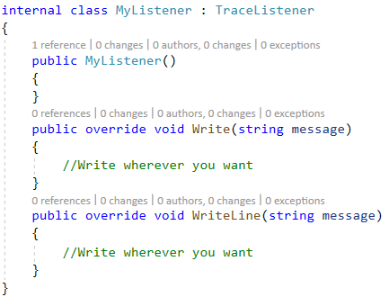
Shared logs with TraceListener

