Slide 1
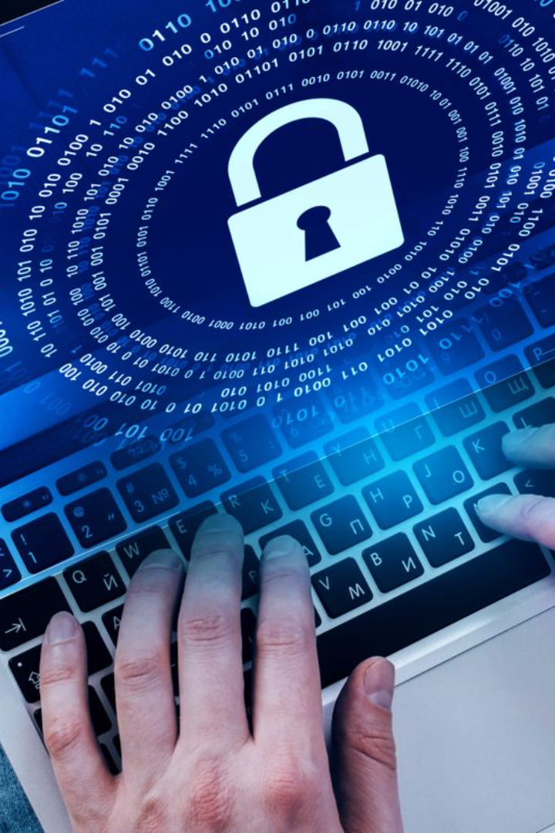

Überblick über die IT-Sicherheit in unserer Firma
Kostiantyn Cheshykhin
Flavia IT-Management GmbH

Slide 2

Maßnahmen zur Informationssicherheit
Implementierung der Multi-Faktor-Authentifizierung:
Stärken Sie den Zugangsschutz mit einem Multi-Faktor-Authentifizierungssystem.
Regelmäßige Aktualisierungen und Überwachung:
Gewährleisten Sie die Netzwerksicherheit durch regelmäßige Aktualisierungen von Antivirenprogrammen und Überwachung der Netzwerkaktivitäten.
Mitarbeiterschulungen und Seminare:
Organisieren Sie Schulungssitzungen und Seminare, um die Mitarbeiter über die Grundlagen der Cybersicherheit zu informieren

Slide 3

Data-Schutzmaßnahmen
Entwicklung und Umsetzung strenger Datenschutzrichtlinien: Etablieren und durchsetzen Sie robuste Richtlinien zum Schutz personenbezogener Daten.
Data Encryption during Transmission and Storage: Utilize up-to-date encryption algorithms to secure data during transfer and storage.
Regular Security Audits: Conduct periodic security audits to ensure compliance with DSGVO standards.

Slide 4

Risk Assessment Methods
Utilization of Threat Analysis and Risk Assessment: Apply a comprehensive approach to identify and evaluate potential risks to information security.
Continuous Update of Security Measures Catalog: Regularly review and update the catalog of security measures to ensure compliance with evolving requirements of DSGVO and BSI-Grundschutz.

Slide 5
Compliance with IT Security and Data Protection Standards
Adherence to GDPR, DSGVO, ISO 27001, and Relevant Regulations: Ensure compliance with legal and regulatory requirements for IT security and data protection.
Regular Updating of Security Policies: Keep security policies up-to-date with changes in legislation to maintain preparedness against evolving threats.
Addressing Human Factors in Cybersecurity: Conduct regular training sessions for employees to identify social engineering and phishing attempts. Regularly test for social engineering vulnerabilities.

Slide 6
Risk Mitigation Measures for the Human Factor
Implementation of User Behavior Monitoring and Analytics: Deploy monitoring and analytics systems to detect anomalies in user behavior.
Conducting Phishing Attack Simulations: Conduct simulations of phishing attacks to train staff in recognizing such threats.
Methods to Protect Against Password Theft:
Regularly updating password complexity policies and storage requirements.
Implementing two-factor and biometric authentication technologies.

Slide 7
Main Insights from the "Brain Hacking" Presentation
Understanding how psychology can be used for security hacking: Explore the psychological techniques hackers use to exploit vulnerabilities.
Integration of Attack Psychology Knowledge in Security Training: Incorporate knowledge of psychological attacks into employee security training.
Key Lessons from the Self-Study Cybersecurity Course:
Awareness of current threats and methods to prevent them.
Integration of acquired knowledge into security auditing processes and employee training.

Slide 8

Additional Measures for Cybersecurity
Implementation of an Automated Incident Detection and Response System: Deploy a system that can automatically detect and respond to security incidents.
Regular Penetration Testing: Conduct regular penetration tests to identify vulnerabilities in systems.

