Slide 1
Многопоточная синхронизация
(для самых маленьких)
Inspired by R.Lipovsky

Slide 2
pthread
#include <pthread.h>
int pthread_create(pthread_t *thread, const pthread_attr_t *attr, void *(*start_routine) (void *), void *arg);
int pthread_join(pthread_t thread, void **retval);
Создать поток / дождаться завершения потока
$ gcc --fsanitize=thread main.c – запуск с тред-санитайзером

Slide 3
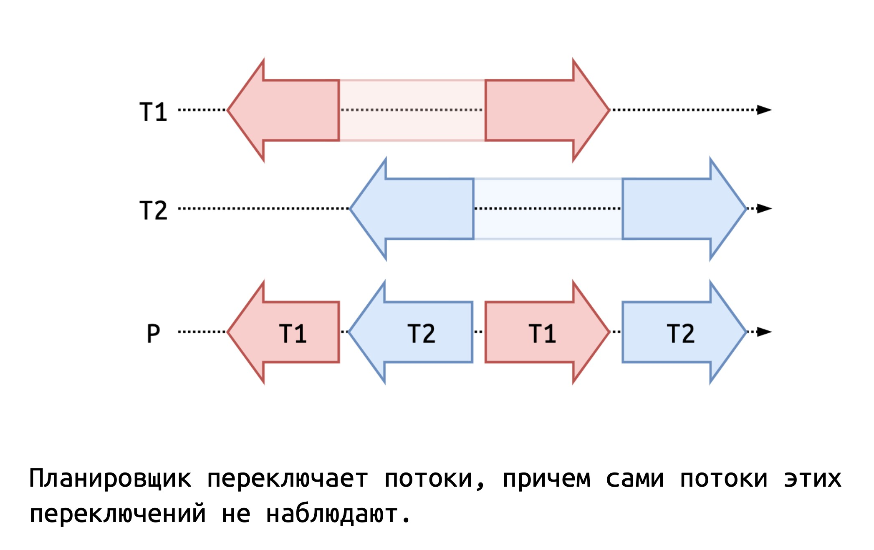
Конкурирующие операции

Slide 4
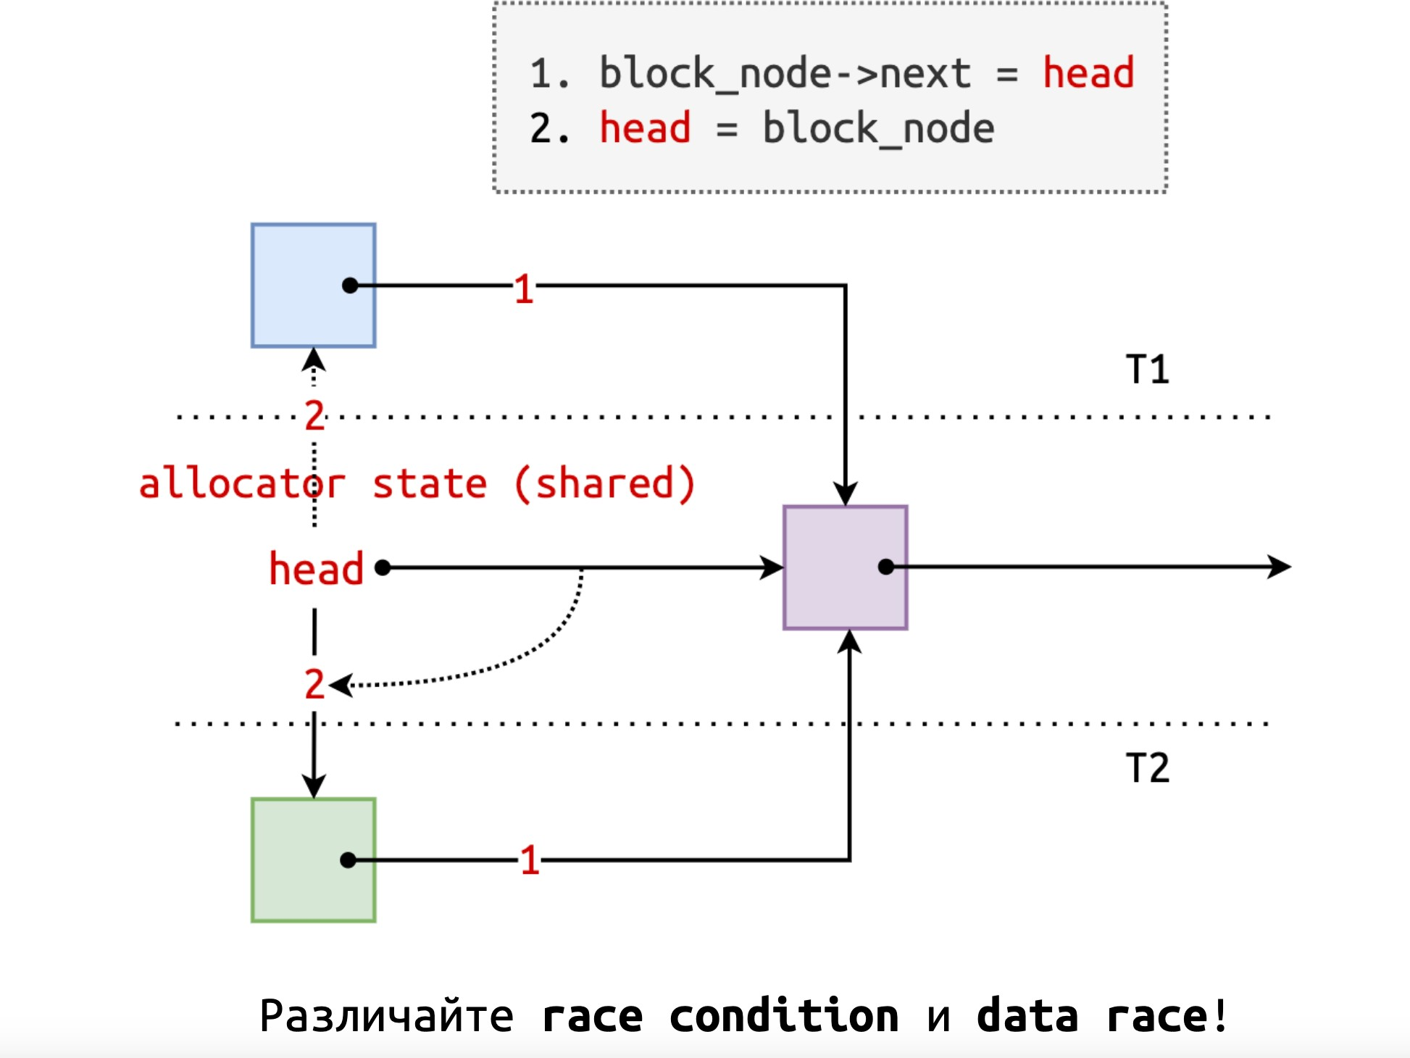
Race condition

Slide 5
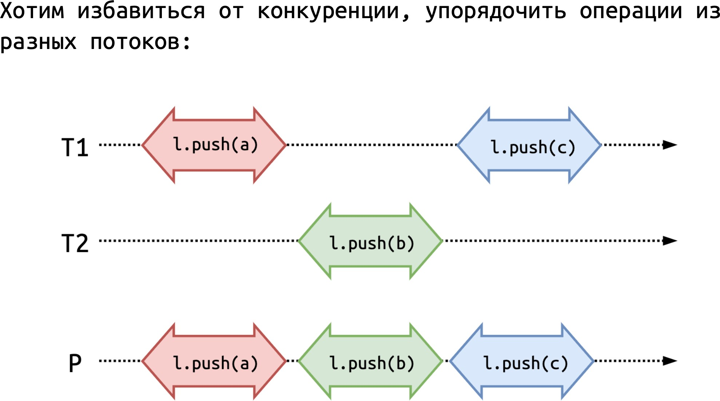
Mutual exclusion

Slide 6
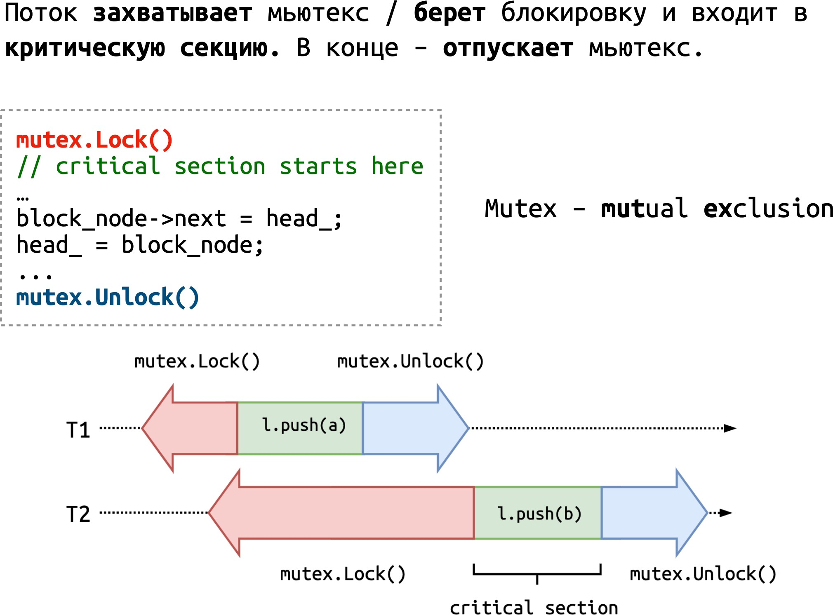
Mutex

Slide 7
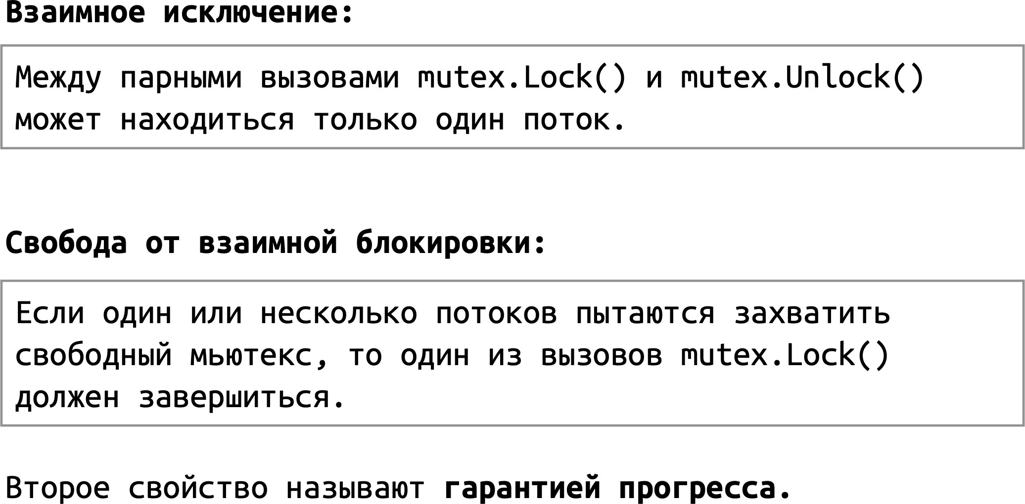
Свойства (гарантии)

Slide 8
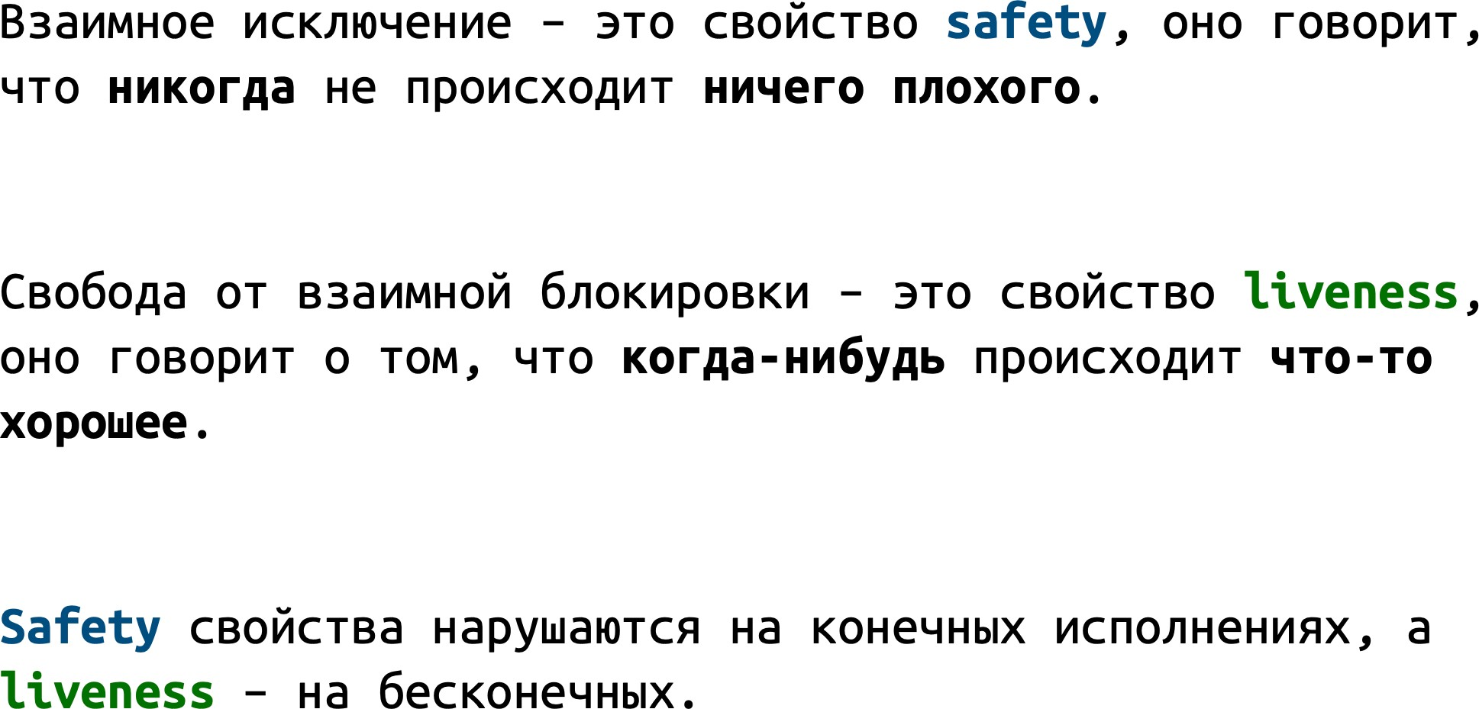
Safety и Liveness

Slide 9
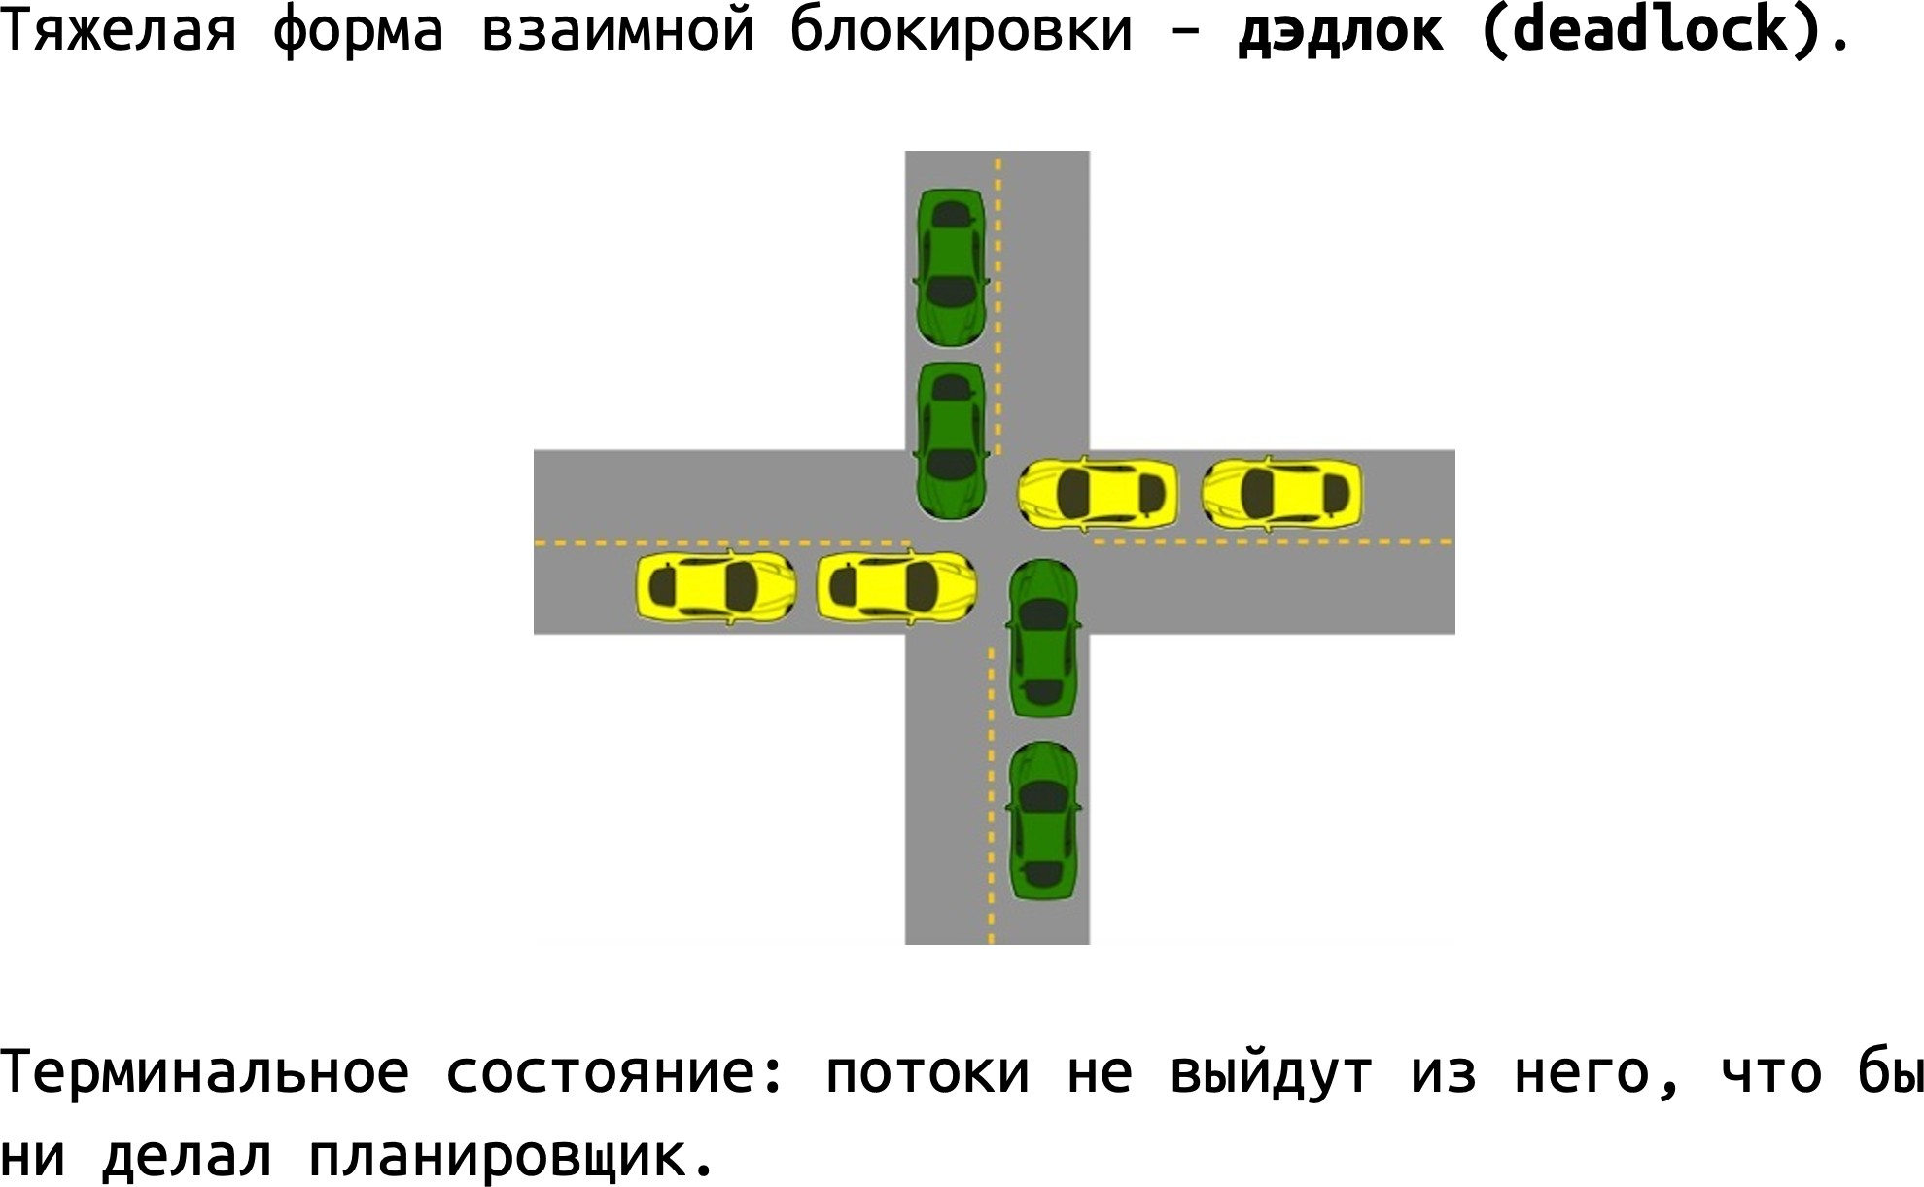
Deadlock

Slide 10
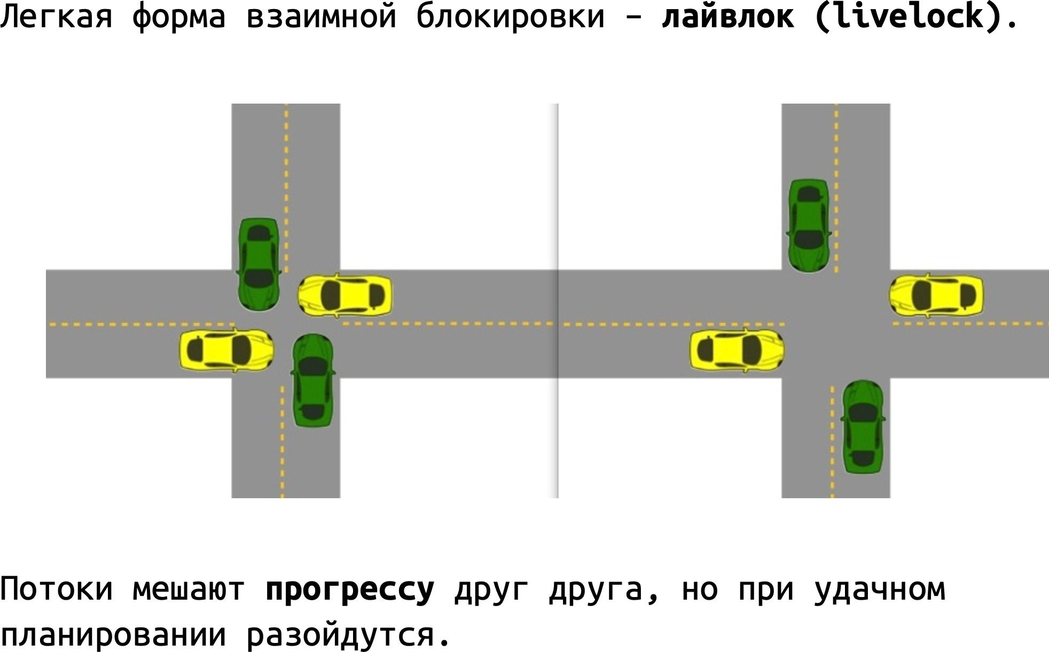
Livelock

Slide 11
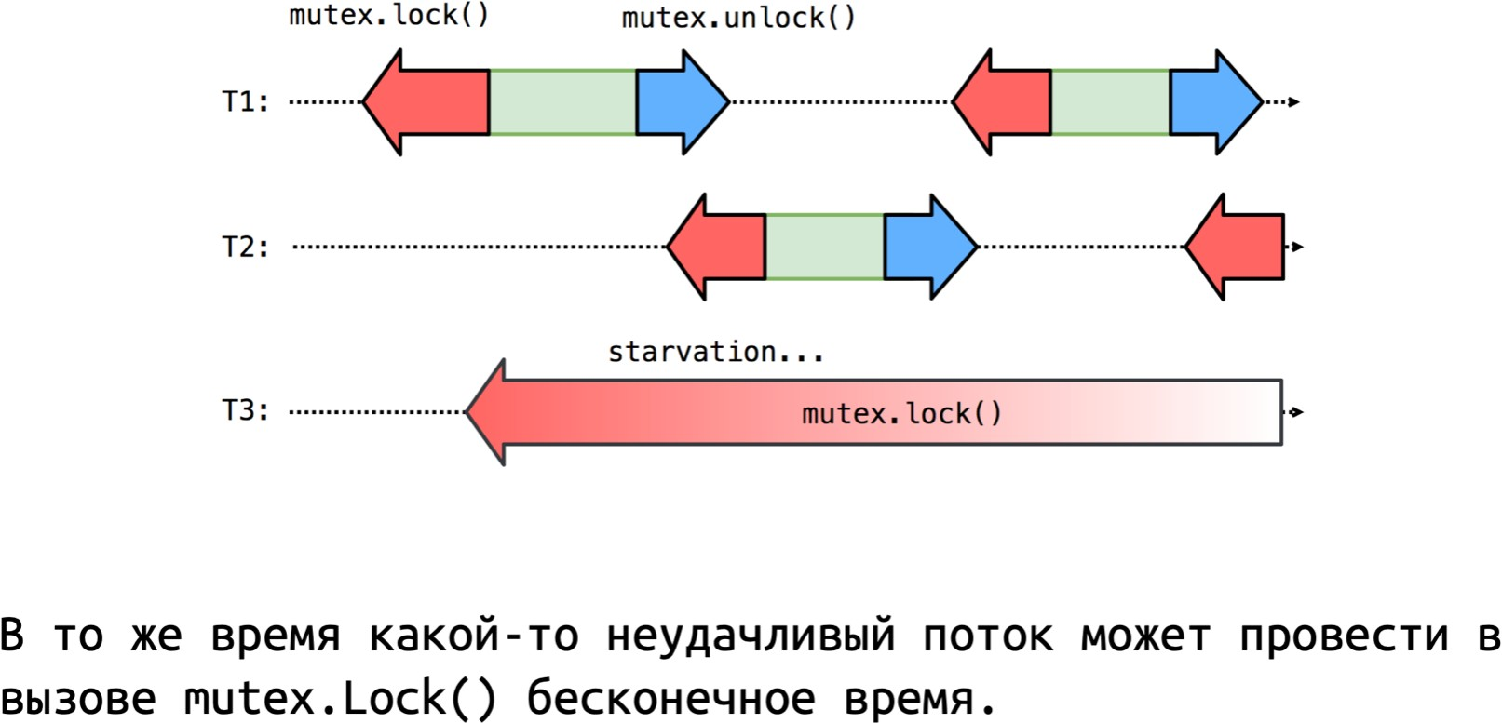
Глобальный прогресс

Slide 12
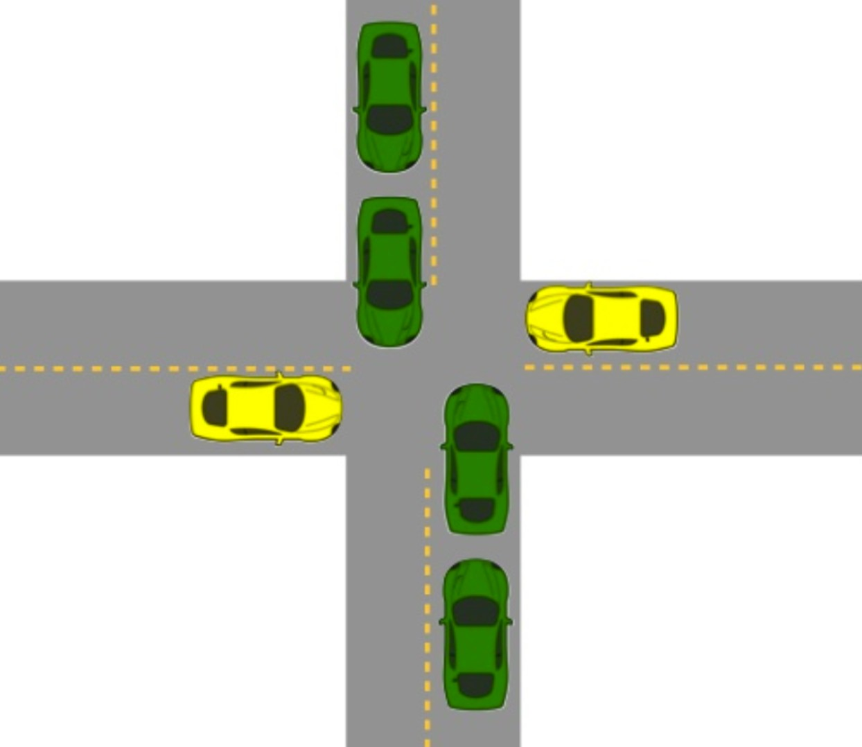
Starvation

Slide 13
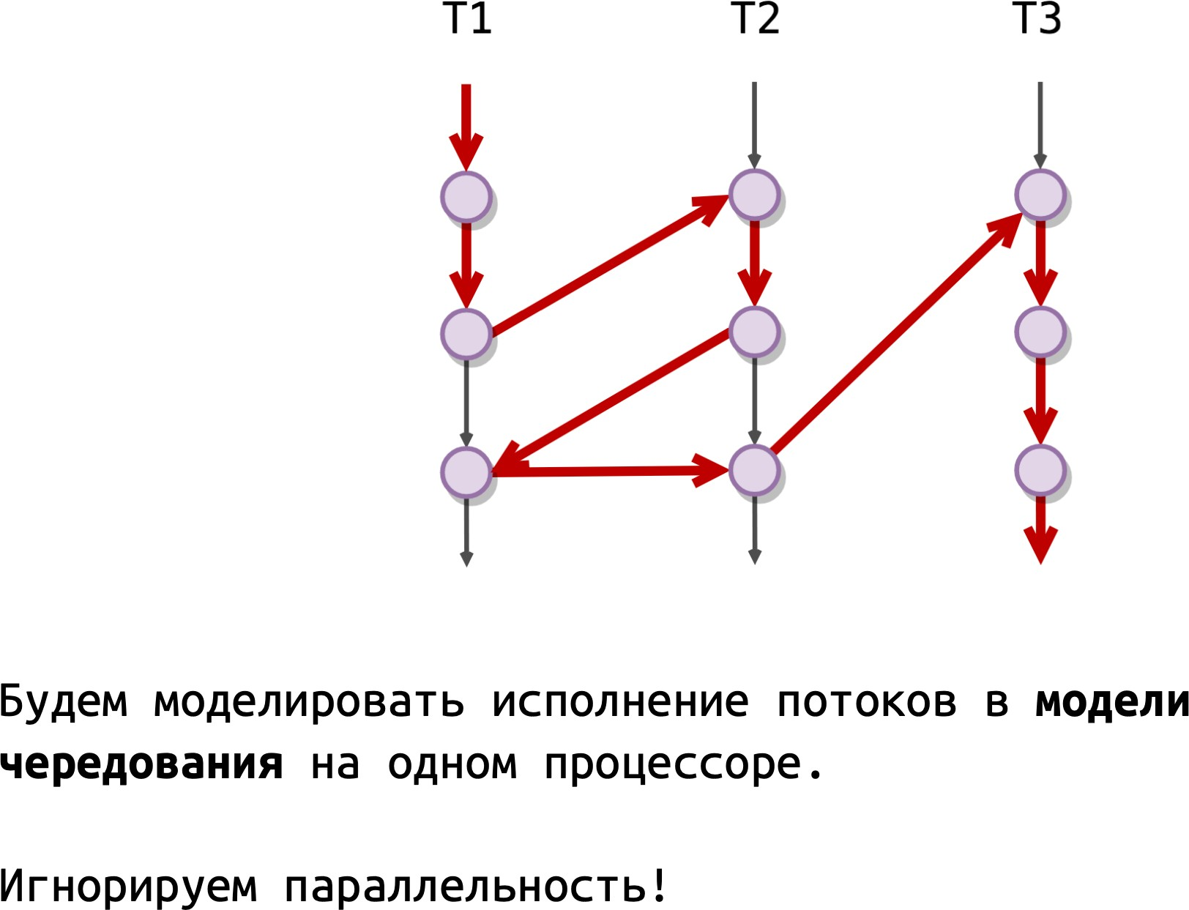
Interleaving

Slide 14
pthread_mutex
#include <pthread.h>
int pthread_mutex_init(pthread_mutex_t *mutex,
const pthread_mutexattr_t *mutexattr);
int pthread_mutex_lock(pthread_mutex_t *mutex);
int pthread_mutex_trylock(pthread_mutex_t *mutex);
int pthread_mutex_unlock(pthread_mutex_t *mutex);
int pthread_mutex_destroy(pthread_mutex_t *mutex);
Mutex

Slide 15
pthread_condvar
#include <pthread.h>
pthread_cond_t cond = PTHREAD_COND_INITIALIZER;
int pthread_cond_init(pthread_cond_t *cond,
pthread_condattr_t *cond_attr);
int pthread_cond_signal(pthread_cond_t *cond);
int pthread_cond_broadcast(pthread_cond_t *cond);
int pthread_cond_wait(pthread_cond_t *cond, pthread_mutex_t *mutex);
int pthread_cond_timedwait(pthread_cond_t *cond, pthread_mutex_t *mutex,
const struct timespec *abstime);
int pthread_cond_destroy(pthread_cond_t *cond);
Condvar
signal – restart no more than one thread waiting on a cv
broadcast – restart all thread waiting on a cv
Wait – atomically unlocks mutex and waits for a signal. Before starting, re-acquires mutex

Slide 16
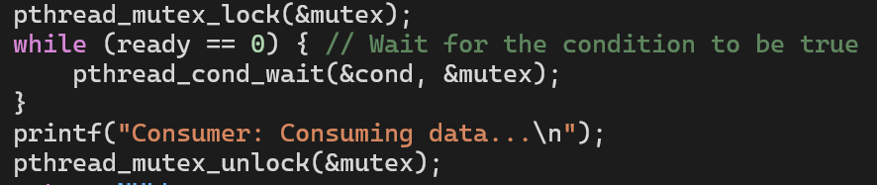
Condvar usage notes
Перед засыпанием на кондваре мьютекс всегда должен быть захвачен
Wait всегда должен вызываться в цикле из-за spurious wake-ups

Slide 17
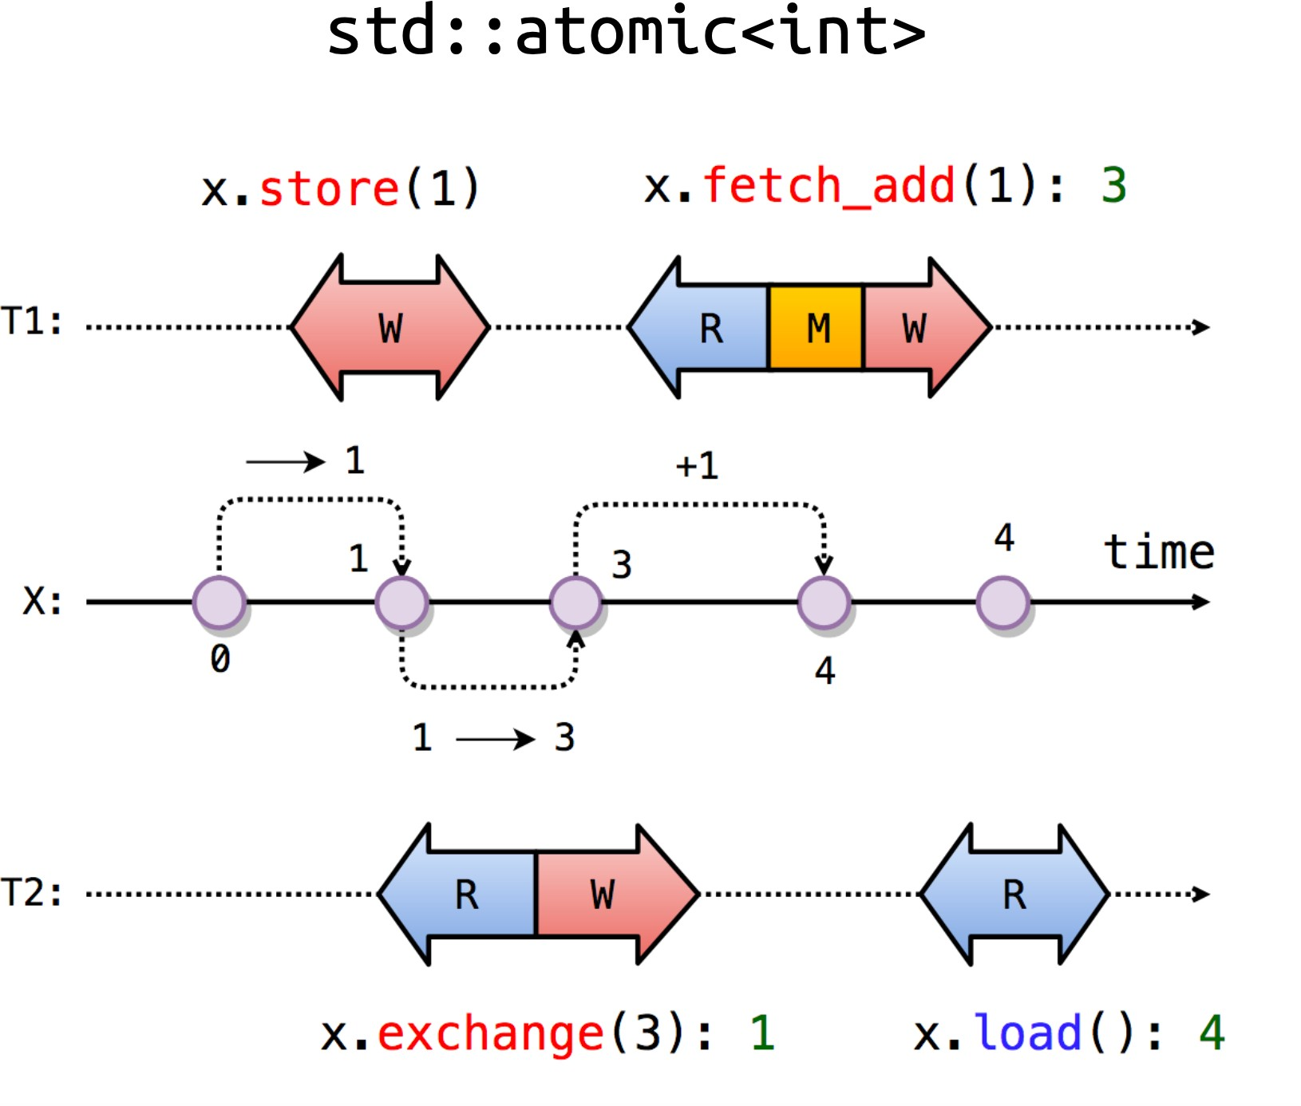
Атомики

Slide 18
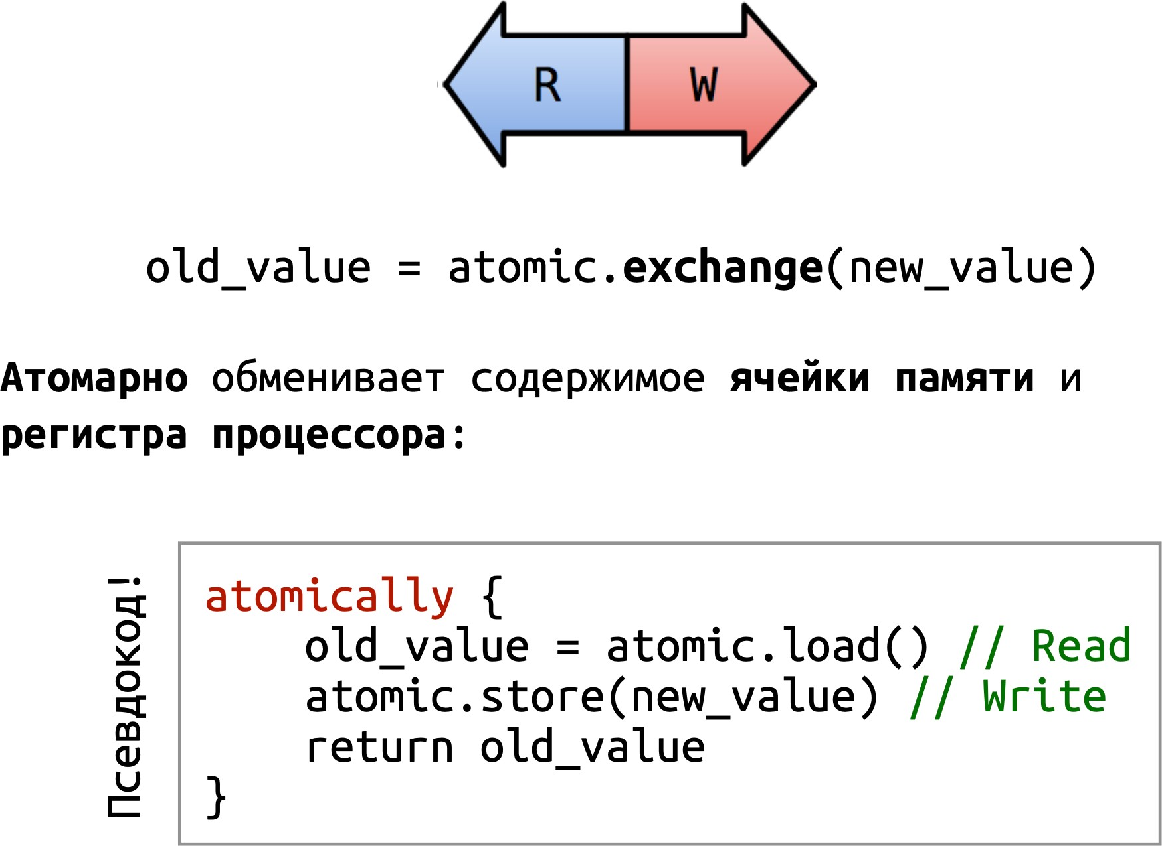
Exchange

Slide 19
Compare-and-Swap (CAS)
compare_exchange
bool compare_exchange_strong( T& expected, T desired)
Atomically compares the value representation of *this with that of expected. If those are bitwise-equal, replaces the former with desired (performs read-modify-write operation). Otherwise, loads the actual value stored in *this into expected (performs load operation).

Slide 20
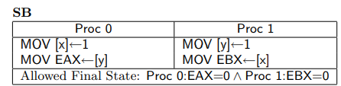
Memory models

Slide 21
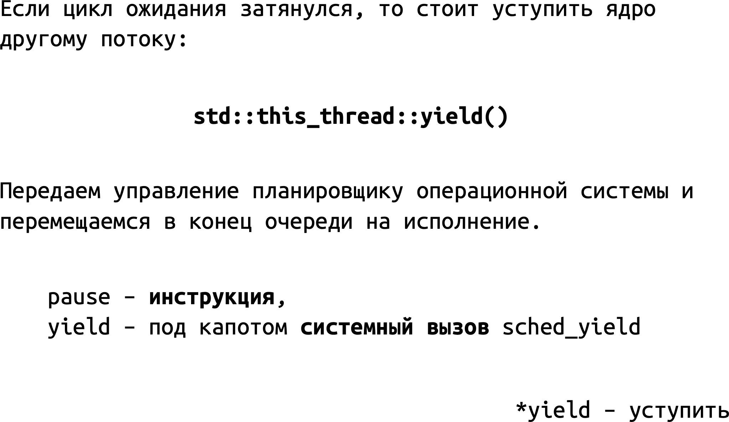
Yield

