Slide 1
Семинар по C++ №7
Sanitizers and GDB

Slide 2
Вспоминаем проблемы
Out of range
Double free
Memory leak
Use after free
Use after return
...

Slide 3
Sanitizers
There are many of them:
-fsanitize=address
-fsanitize=pointer-compare
-fsanitize=undefined
...
The full list

Slide 4
Adress Sanitizer
How to use?
g++ -fsanitize=address main.cpp
./a.out
ASAN_OPTIONS=detect_stack_use_after_return=1 ./a.out – for «use after return» checks
Why to use?
index out of range
double free
use after free
memory leak
...

Slide 5
Undefined
How to use?
g++ -fsanitize=undefined main.cpp
./a.out
Why to use?
To detect undefined behaviour

Slide 6
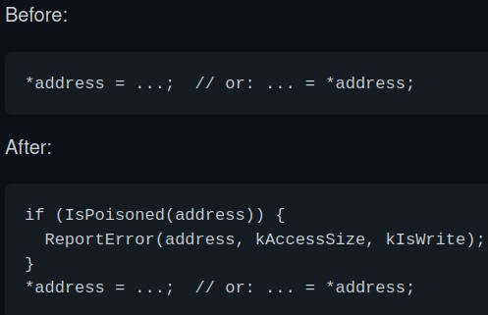
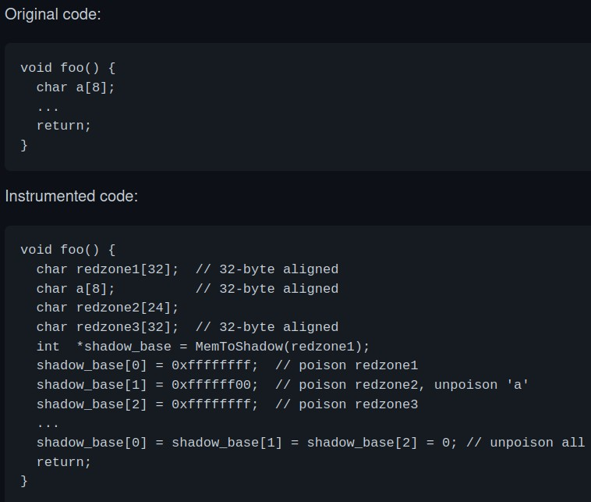
How does it work?
malloc/free wrappers
memory access wrappers
stack
For more information, read GitHub

Slide 7
GDB
g++ -g main.cpp – compile with debug information
gdb a.out – start debugging this executable
gdb --args a.out arg1 arg2 – pass command line arguments
break (b) func_name/line/...– set a breakpoint
run (r) – run a program to the end (or the nearest breakpoint)
continue (c) – continue execution to the end (or the nearest breakpoint)

Slide 8
Navigation
step (s) – go to the next line (step inside a function)
next (n) – go to the next line (do not step inside a function)
stepi / nexti – the same, but to the next assembly instruction
finish – continue until the end of current function

Slide 9
Breakpoints
break (b) func_name/line/...– set a breakpoint
info break – get the list of breakpoints
delete *break_num* – delete a breakpoint
clear – delete all breakpoints
enable / disable *break_num* – obvious

Slide 10
Stack
backtrace (bt) – show backtrace
backtrace full – show backtrace with local variables
list *func_name*/*line range*/... – displays some code

Slide 11
utils
set var *var_name*=*value* – set a value to a variable
p /format *var_name* – display a variable
Format
a – pointer
d – decimal
x – hexadecimal
f – floating point value
...
gdb --pid *pid* – attach to a working process

Slide 12
gdb with core dump
/var/lib/systemd/coredump – path to core dump
coredumpctl – cool utility for core dumps
unlz4 – unpack core dump
gdb a.out core – start core dump from gdb

Slide 13
TUI (Text User Interface) Mode
tui enable/disable
Layouts:
layout next/prev/src/asm/split/regs
Focus:
focus next/prev/src/asm/regs/cmd

Slide 14
Sources
GDB cheat sheet
One more

