Slide 1
Семинар по C++ №8
Sanitizers and GDB

Slide 2
Вспоминаем проблемы
Out of range
Double free
Memory leak
Use after free
Use after return
...

Slide 3
Sanitizers
There are many of them:
-fsanitize=address
-fsanitize=pointer-compare
-fsanitize=undefined
...
The full list

Slide 4
Adress Sanitizer
How to use?
g++ -fsanitize=address main.cpp
./a.out
ASAN_OPTIONS=detect_stack_use_after_return=1 ./a.out – for «use after return» checks
Why to use?
index out of range
double free
use after free
memory leak
...

Slide 5
Undefined
How to use?
g++ -fsanitize=undefined main.cpp
./a.out
Why to use?
To detect undefined behaviour

Slide 6
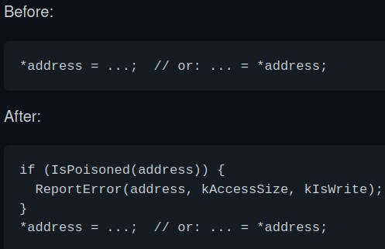
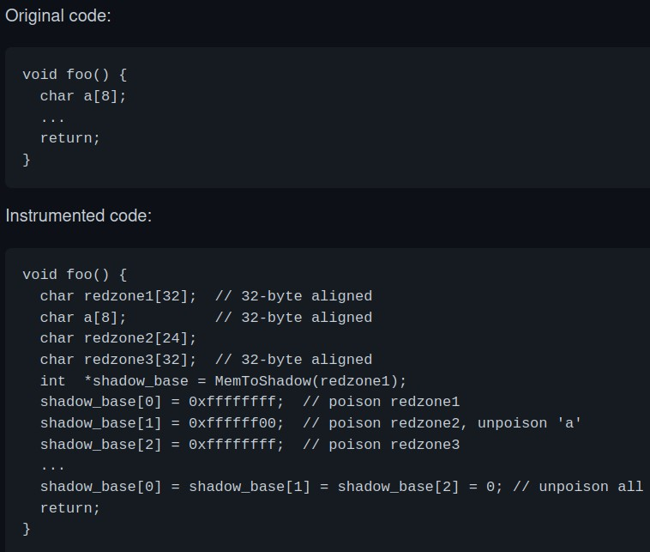
How does it work?
malloc/free wrappers
memory access wrappers
stack
For more information, read GitHub

Slide 7
GDB
g++ -g main.cpp – compile with debug information
gdb a.out – start debugging this executable
gdb --args a.out arg1 arg2 – pass command line arguments
break (b) func_name/line/...– set a breakpoint
run (r) – run a program to the end (or the nearest breakpoint)
continue (c) – continue execution to the end (or the nearest breakpoint)
quit – quit the debugger

Slide 8
Navigation
step (s) – go to the next line (step inside a function)
next (n) – go to the next line (do not step inside a function)
stepi / nexti – the same, but to the next assembly instruction
finish – continue until the end of current function
return – return from the function immediately

Slide 9
GDB (layout)
tui enable/disable (Ctrl + X A) / gdb –tui – запустить tui (Text User Interface)
layout next(n)/prev(p)/src/asm/split/regs - изменить layout
focus next(n)/prev(p)/src/asm/split/regs - изменить фокус
tui reg sse/float/… - добавить окно с определённым layout
Ctrl + X 2 – layout next
Ctrl + P / N – previous/next command
Ctrl + L – перерисовать экран GDB

Slide 10
Breakpoints
break (b) func_name/line/...– set a breakpoint
info break – get the list of breakpoints
delete *break_num* – delete a breakpoint
clear – delete all breakpoints
enable / disable *break_num* – obvious

Slide 11
Stack
backtrace (bt) –распечатать backtrace
backtrace full – распечатать backtrace и локальные переменные
list *func_name*/*line range*/... – распечатать код
info args – распечатать аргументы функции
info locals – распечатать локальные переменные

Slide 12
utils
set var *var_name*=*value* – set a value to a variable
gdb --pid *pid* – attach to a working process
detach – detach from a previously attached process
set disassembly-flavor intel (att) (>> ~/.gdbinit)

Slide 13
GDB (printing memory)
• set var *var_name*=*value* – установить значение переменной
• x/nfu addr - examine memory
• p /format *var_name* – display a variable
• Format:
• a – pointer
• d – decimal
• x – hexadecimal
• f – floating point value
• ...

Slide 14
GDB (reverse execution)
record – начать запись исполнения
reverse-step / rs – шаг в обратном направлении (с заходом в функцию)
reverse-next / rn – шаг в обратном направлении (без захода в функцию)
reverse-finish – шагать в обратном направлении до точки вызова функции
reverse-continue / rc – продолжить исполнение до следующего breakpoint

Slide 15
Core dump
sudo sysctl kernel.core_pattern= "./coredump" – установить сохранение корок в текущей директории
ulimit -c unlimited; ./a.out – убрать ограничения на размер корок и собрать coredump
gdb ./a.out ./coredump… – запустить coredump в отладчике

Slide 16
Sources
GDB cheat sheet
One more
Занятная статья на Хабре
TUI documentation
GDB Essentials Overview

