Slide 1
Семинар по C++ №6
Codestyle

Slide 2
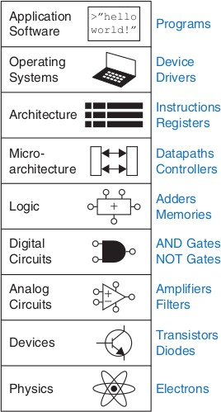
Abstraction
Abstraction – hiding details when they are not important
by «Digital Design and Computer Architecture» Harris & Harris

Slide 3
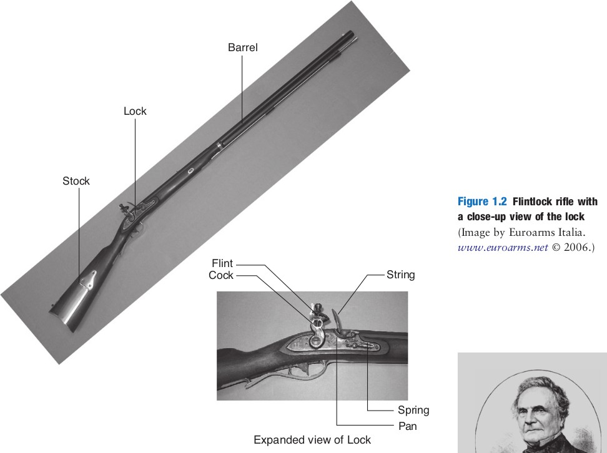
Discipline
Discipline is the act of intentionally restricting your design choices so that you can work more productively
at a higher level of
abstraction

Slide 4
The Three-Y’s
Hierarchy involves dividing a system into modules, then further sub-dividing each of these modules until the pieces are easy to understand.
Modularity states that the modules have well-defined functions and interfaces, so that they connect together easily without unanticipated side effects.
Regularity seeks uniformity among the modules. Common modules are reused many times, reducing the number of distinct modules that must be designed.

Slide 5
Code Style
Naming:
snake_style vs camelStyle
bool isPredicate(...) – Which?
void push_back(...) – To do what?
T size(...) - What?
T getLen() / void setLen(T obj)
One letter variable, translit variable – very bad
xx, yy,… // bad

Slide 6
More Code Style
Variable declaration – as close as possible to a place of using
using namespace - don’t use! (even using namespace std!)
Tabs -> 4 spaces
Too long lines (100 and more characters)
Do not copy-paste!
Manage whitespaces and blank lines
Use { } after if / for...
Don’t use casts. Especially, C-style casts

Slide 7
A bit more Code Style
Use x += c instead of x = x + c etc.
Use ++x instead of x++ if possible
Use ternary operator:
if (condition) x = a; else x=b;
condition ? x = a : x = b;
x = (condition ? a : b);
BAD GOOD

Slide 8
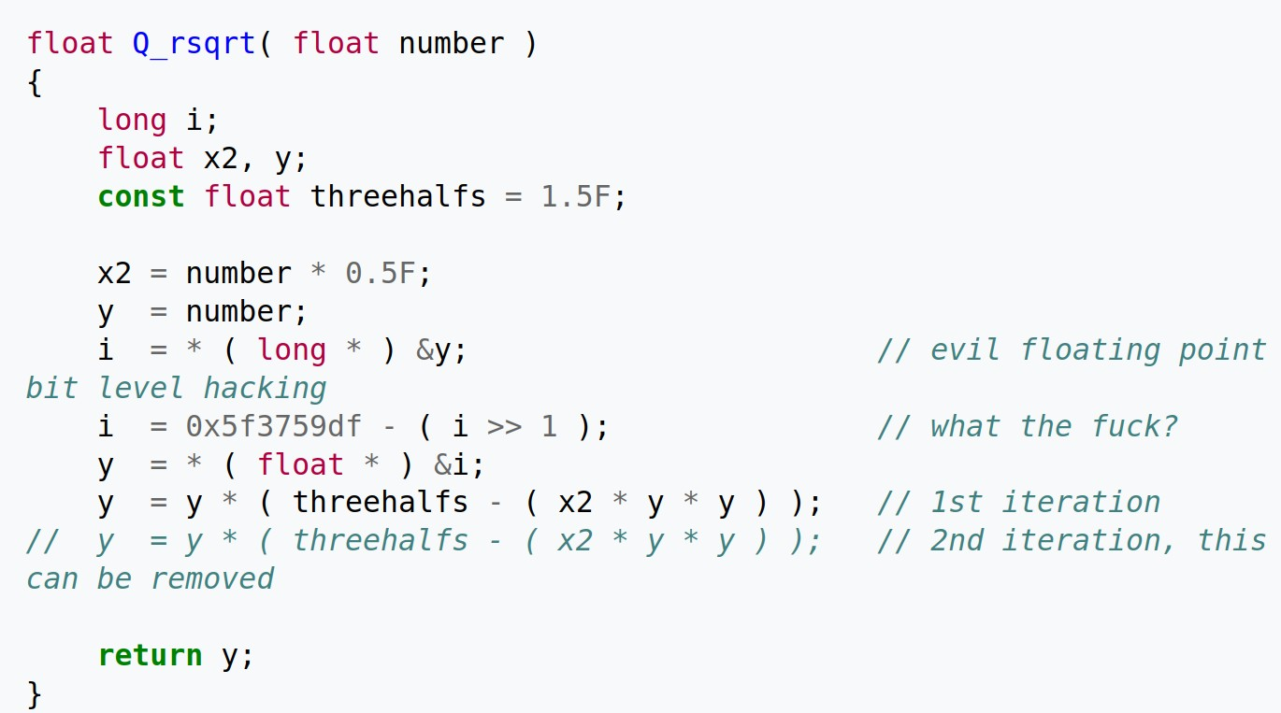
Don’t use magic constants
Inverse square root implementation, Quake Arena III

Slide 9
Tips, tricks && best practices
Don’t compare floats/doubles like var_1 == var2
abs(var_1 - var_2) < eps (~1e-5)
Use const and references in function arguments if possible
Make difference between struct and class

