Slide 1


BVRIT HYDERABAD
College of Engineering for Women
Department of CSE-AIML
BLOOD BANK AI
Team No: 1
22wh1a6603-Megana
22wh1a6605-Sadiya Tarannum 22wh1a6619-Indu
22wh1a6660-Niveda
Under the Guidance of:
Mr. Kishore Kumar
Assistant Professor

Slide 2
AGENDA
Abstract
Introduction
Problem Statement
Literature Survey
Existing system
Proposed system
Modules
Proposed Architecture
Tools and Technologies
Code Of Application
Result
Conclusion
Future Scope
References
Bibliography
2

Slide 3
ABSTRACT
The Blood Bank AI Management System is a robust and centralized platform aimed at addressing the inefficiencies in blood inventory management across hospitals. Leveraging artificial intelligence and real-time data management, this system empowers hospitals and government officials to collaboratively manage blood stocks, fulfill emergency and routine blood requests, and ensure optimal utilization of resources. The core objective is to automate blood matching, streamline hospital coordination, and provide a transparent, accountable system for managing life-saving blood transfusions. By integrating modern technologies such as AI, Firebase, and secure cloud hosting, the system ensures high availability, performance, and data integrity.

Slide 4
INTRODUCTION
Blood transfusions play a critical role in modern medical care. From surgeries and trauma care to chronic illnesses like anemia or thalassemia, the need for readily available, safe, and compatible blood is undeniable. However, the traditional systems for managing blood banks are often fragmented, with limited communication between hospitals, manual processes for inventory updates, and delays in fulfilling urgent needs. The Blood Bank AI Management System is developed as a smart web platform that connects multiple hospitals with a centralized government oversight system. By enabling real-time inventory management, intelligent blood matching, and automated notifications, it aims to save time, reduce wastage, and improve healthcare outcomes.

Slide 5
PROBLEM STATEMENT
In critical medical situations, delays in accessing compatible blood can lead to life-threatening consequences. Despite having blood units available across different hospitals, there is a lack of a centralized, intelligent system that connects demand with supply efficiently. Current systems are fragmented, with hospitals maintaining isolated inventories, manual communication methods, and no standardized platform for inter-hospital coordination. Furthermore, government health departments have minimal visibility into real-time blood availability, making proactive intervention difficult during crises. There is a pressing need for a smart, AI-powered system that bridges this gap, enabling real-time tracking, automatic matching of donors and recipients, and effective government oversight to reduce response time and save lives.

Slide 6
Literature Survey
Title | Author(s) | Description
AI-Based Blood Donor-Recipient Matching | Dr. S. Ramesh, A. Dasgupta (2022) | Discusses intelligent donor-recipient matching using AI, based on parameters like blood group, Rh factor, and urgency. Highlights the performance gain compared to traditional filtering systems.
Smart Blood Bank System Using IoT and AI | Priya R.Naveen K. (2021) | Describes a smart blood bank using real-time sensors and AI to detect shortages and alert donors. Focuses on the combination of hardware and software systems.
Analysis of Traditional Blood Bank Systems | K. Iyer, S. Nair | Reviews limitations of manual blood request systems. Highlights the need for automation and centralization.

Slide 7
EXISTING SYSTEM
Several apps and platforms provide access to blood donors and blood requests. Some commonly used services include:
Indian Red Cross App – Allows voluntary blood donor registration but lacks AI-based matching.
Friends2Support – Connects users to voluntary donors but lacks urgency prioritization and real-time verification.
Social Media Platforms – Users create emergency blood donation appeals on WhatsApp, Instagram, etc.
Limitations:
Lack of Real-time Availability: Most platforms rely on manually updated data and lack live donor status.
No AI or Intelligent Filtering: Existing systems don’t use AI to match based on urgency, blood compatibility, and location.
Fragmented Communication: Donors and recipients must contact each other individually; there’s no centralized notification system.
Poor User Verification: Some platforms lack rigorous verification, increasing risk of delays or misinformation.

Slide 8
PROPOSED SYSTEM
Objective: To enhance emergency blood donation by using AI and real-time tracking to connect donors and recipients efficiently.
Key Features:
AI-based donor-recipient matching.
Real-time updates on availability and blood group.
Government Based Portals
User-friendly NextJS interface.
Outcome: A reliable and responsive web platform that simplifies and speeds up the process of finding blood donors.
Advantages:
Real-time, AI-driven matching system.
Easily scalable and useful in emergency healthcare settings.

Slide 9
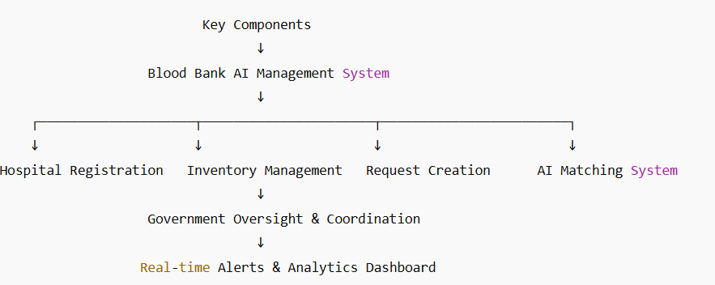
PROPOSED ARCHITECTURE

Slide 10
Tools and Technologies
Programming Languages: Typescript, Javascript
Frameworks: ReactJS, NextJs, TailwindCSS
Database: Supabase
Development Tool: VS Code, Git

Slide 11
Code of application
import { Toaster } from "@/components/ui/toaster";
import { Toaster as Sonner } from "@/components/ui/sonner";
import { TooltipProvider } from "@/components/ui/tooltip";
import { QueryClient, QueryClientProvider } from "@tanstack/react-query";
import { BrowserRouter, Routes, Route, Navigate } from "react-router-dom";
import { AuthProvider, useAuth } from "./context/AuthContext";
import HomePage from "./pages/HomePage";
import RegisterPage from "./pages/RegisterPage";
import DashboardPage from "./pages/DashboardPage";
import GovernmentLoginPage from "./pages/GovernmentLoginPage";
import GovernmentDashboardPage from "./pages/GovernmentDashboardPage";
import NotFound from "./pages/NotFound";
import Navbar from "./components/Navbar";
import Footer from "./components/Footer";

Slide 12
const HospitalProtectedRoute = ({ children }: { children: React.ReactNode }) => {
const { isAuthenticated, userType } = useAuth();
if (!isAuthenticated || userType !== 'hospital') {
return <Navigate to="/register" />;
}
return <>{children}</>;
};
const GovernmentProtectedRoute = ({ children }: { children: React.ReactNode }) => {
const { isAuthenticated, userType } = useAuth();
if (!isAuthenticated || userType !== 'government') {
return <Navigate to="/gov-login" />;
}
return <>{children}</>;
};

Slide 13
const AppRoutes = () => (
<AuthProvider>
<div className="flex flex-col min-h-screen">
<Navbar />
<main className="flex-grow">
<Routes>
<Route path="/" element={<HomePage />} />
<Route path="/register" element={<RegisterPage />} />
<Route path="/gov-login" element={<GovernmentLoginPage />} />
<Route path="/dashboard" element={
<HospitalProtectedRoute>
<DashboardPage />
</HospitalProtectedRoute>
} />
<Route path="/government-dashboard" element={
<GovernmentProtectedRoute>
<GovernmentDashboardPage />
</GovernmentProtectedRoute>
} />
<Route path="*" element={<NotFound />} />
</Routes>
</main>
<Footer />
</div>
</AuthProvider>
);

Slide 14
const App = () => (
<QueryClientProvider client={queryClient}>
<TooltipProvider>
<Toaster />
<Sonner />
<BrowserRouter>
<AppRoutes />
</BrowserRouter>
</TooltipProvider>
</QueryClientProvider>
);
export default App;

Slide 15
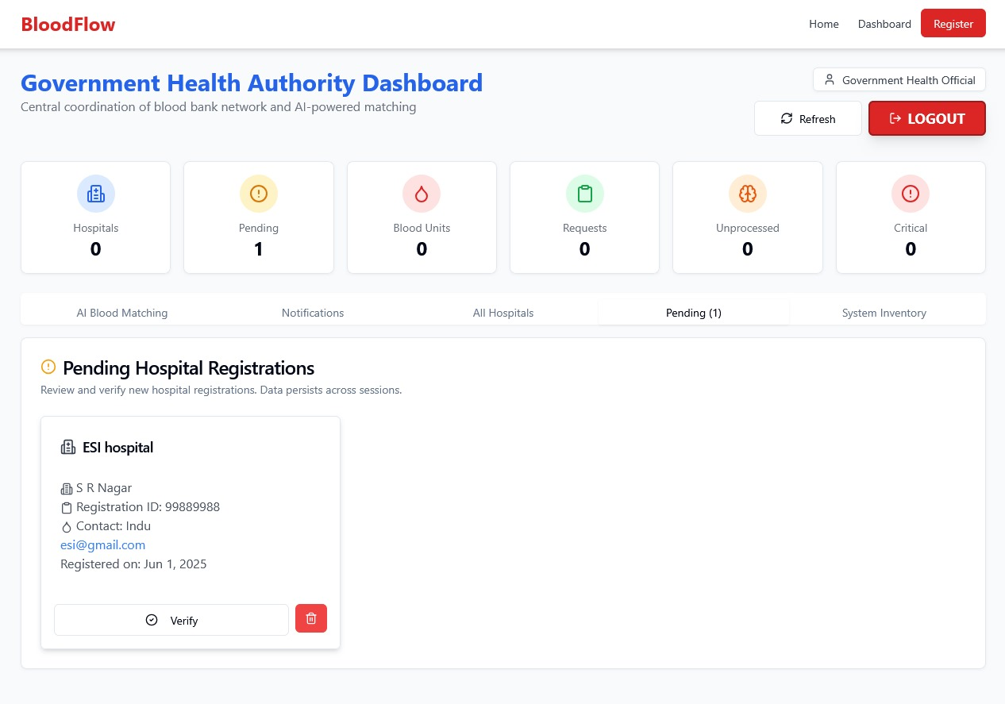
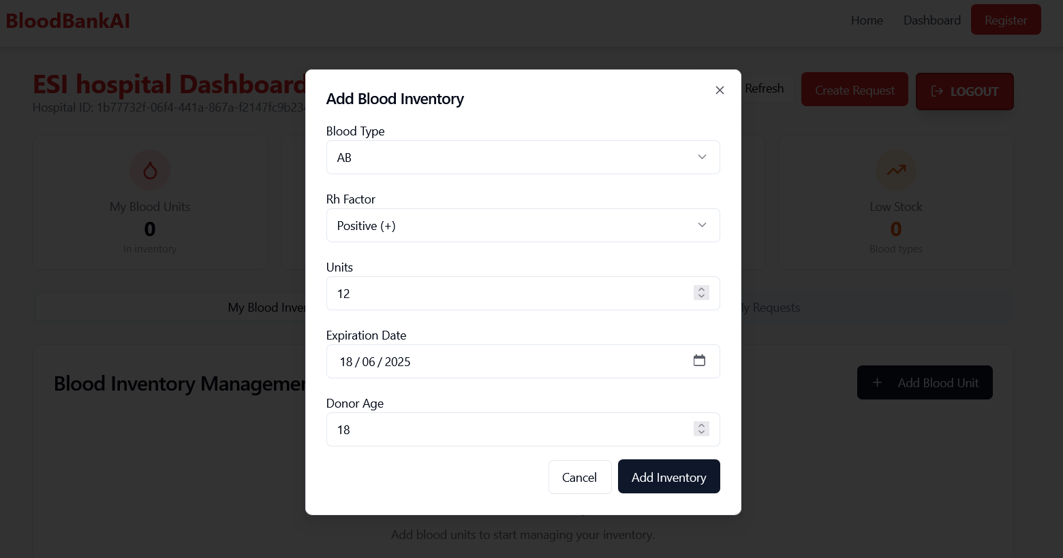
RESULT

Slide 16
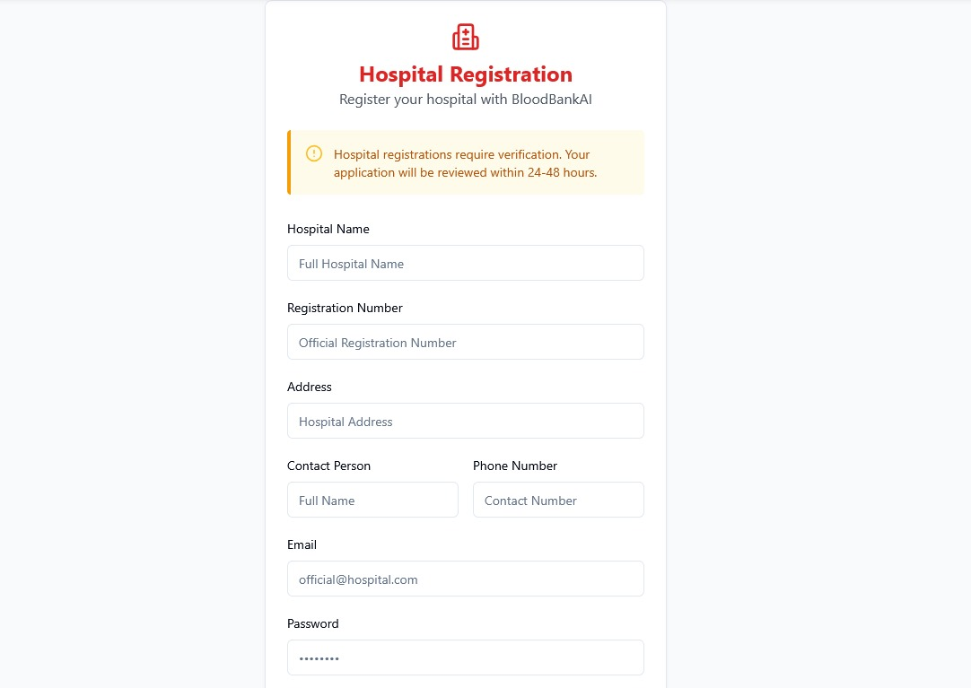
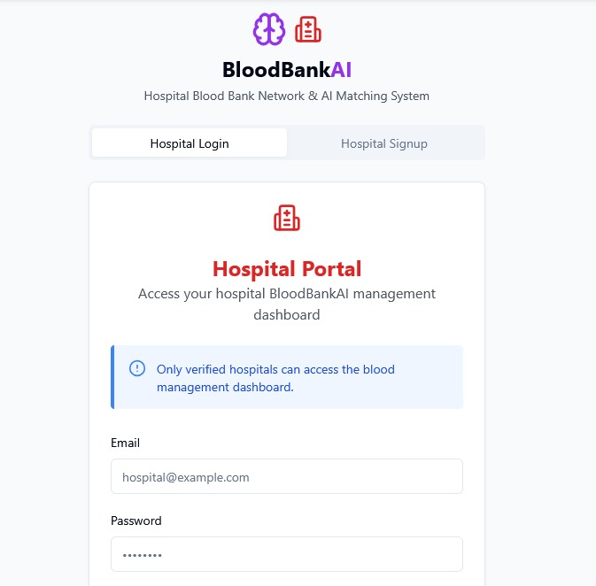

Slide 17
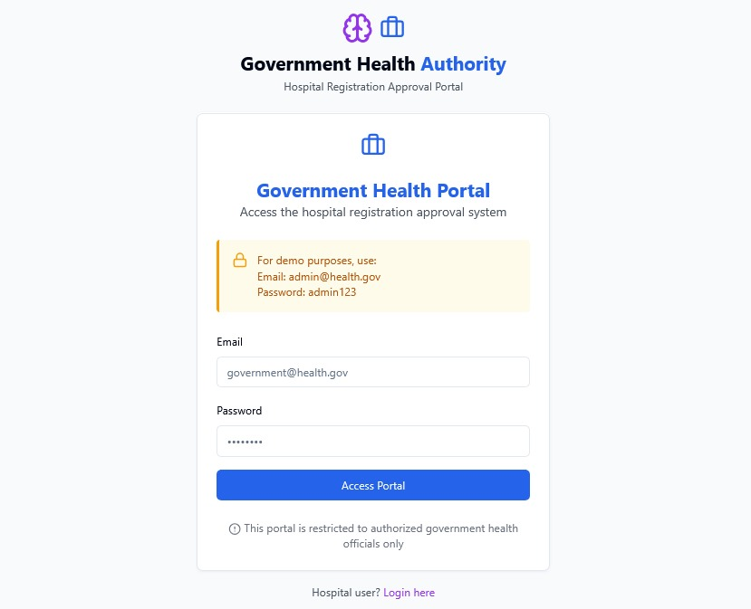

Slide 18
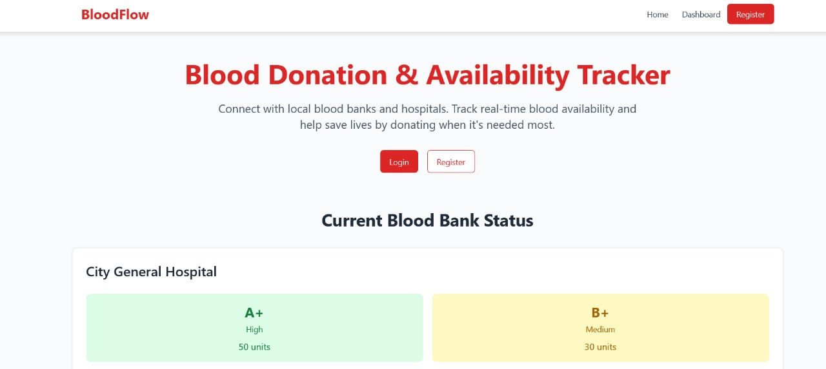

Slide 19
CONCLUSION
The Blood Bank AI Management System effectively addresses the critical challenges in blood inventory management and emergency response. By integrating AI-driven matching, real-time data tracking, and centralized oversight, the system ensures quick and accurate donor-recipient connections across hospitals. It minimizes delays, reduces blood wastage, and supports government coordination during medical emergencies. With its scalable design and smart automation, the platform transforms traditional blood bank operations into a faster, smarter, and more reliable solution that can save lives and improve healthcare efficiency.

Slide 20
FUTURE SCOPE
The Blood Bank AI Management System has significant potential for future enhancement. A dedicated donor module can be introduced to allow voluntary donors to register and receive real-time alerts based on location and compatibility, improving the speed and reach of donations. Developing a mobile application for Android and iOS would enhance accessibility, particularly for rural hospitals and emergency responders. Integrating blockchain technology can ensure transparency and traceability in the blood supply chain, building trust among stakeholders. To make the system more inclusive, multilingual support can be added for regional language users. Additionally, incorporating predictive analytics will help forecast blood demand based on seasonal trends, outbreaks, or emergencies. Smart notifications through SMS or WhatsApp can further improve communication and responsiveness, making the system even more effective and life-saving.

Slide 21
REFERENCES
Ramesh, S., & Dasgupta, A. (2022). AI-Based Blood Donor-Recipient Matching. (Explores AI-driven matching techniques for blood donation systems based on compatibility, urgency, and availability.) Available at: https://example.com/ai-blood-matching.
2. Priya, R., & Naveen, K. (2021). Smart Blood Bank System Using IoT and AI. (Describes integration of IoT sensors and AI for real-time monitoring and smart blood unit tracking.) Available at: https://example.com/smart-blood-iot

Slide 22
Bibliography
1. Web Resources:
World Health Organization (WHO). "Blood Safety and Availability." WHO Health Topics. Available at: https://www.who.int/health-topics/blood-safety Government of India. "e-RaktKosh – A Centralized Blood Bank Management System." Available at: https://eraktkosh.in
2. Technical References:
React Documentation. "Building User Interfaces with ReactJS." Available at: https://reactjs.org Firebase Documentation. "Realtime Database and Authentication." Available at: https://firebase.google.com/docs MongoDB Documentation. "Efficient Data Storage and Querying." Available at: https://www.mongodb.com/docs Vercel Documentation. "Deploying Frontend Applications with Vercel." Available at: https://vercel.com/docs

Slide 23
THANK YOU

