Slide 1

MongoDB Case study Review
19CSE357 | BIGDATA ANALYTICS DIVESH KOSURI [CB.EN.U4CSE19422]

Slide 2
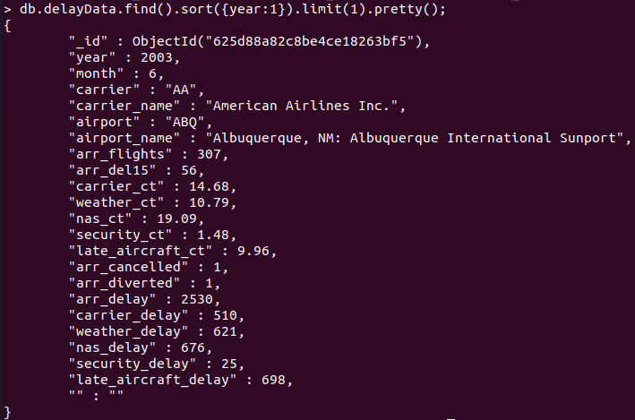
FINDING THE MINIMUM AND MAXIMUM YEAR RECORDED IN THE DATABASE
QUERY 1: db.delayData.find().sort({year:1}).limit(1).pretty();

Slide 3
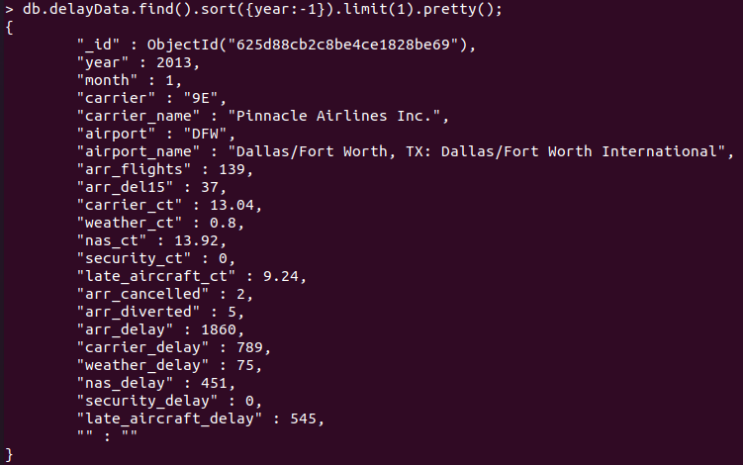
QUERY 2:
db.delayData.find().sort({year:-1}).limit(1).pretty();

Slide 4
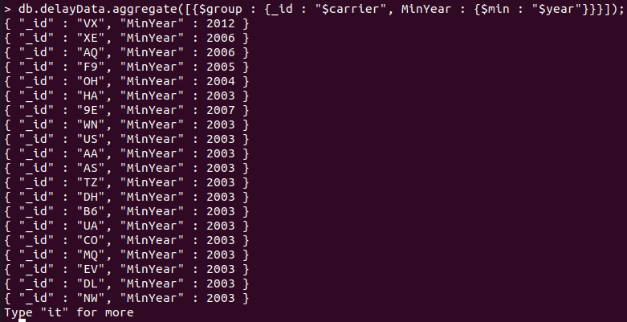
FINDING THE YEARS OF SERVICE [AGGREGATE FUNTIONS]
QUERY 3:
db.delayData.aggregate([{$group : {_id : “$carrier”, MinYear : {$min : “$year”}}}]);

Slide 5
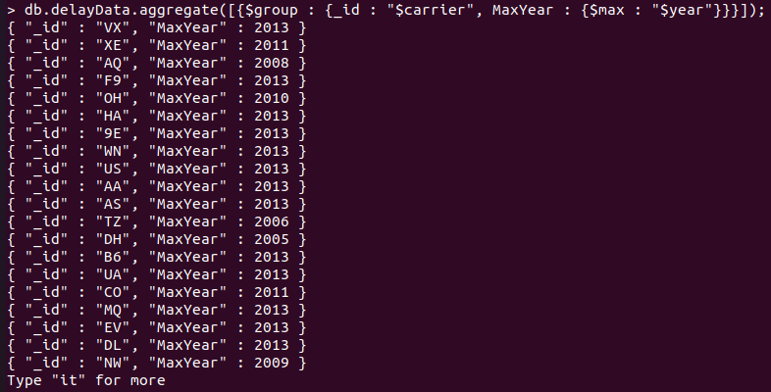
QUERY 4:
db.delayData.aggregate([{$group : {_id : "$carrier", MaxYear : {$max : "$year"}}}]);

Slide 6
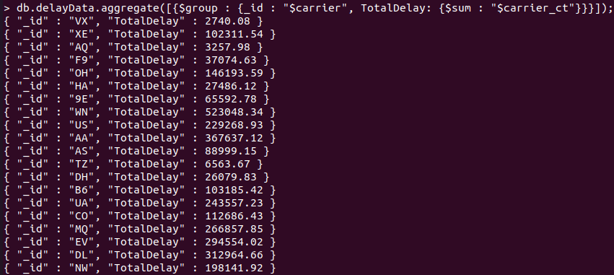
TO FIND THE TOTAL DELAY OCCURRED DUE TO CARRIER LOAD-UNLOAD
Query 5:
db.delayData.aggregate([{$group : {_id : "$carrier", TotalDelay: {$sum : "$carrier_ct"}}}]);

Slide 7
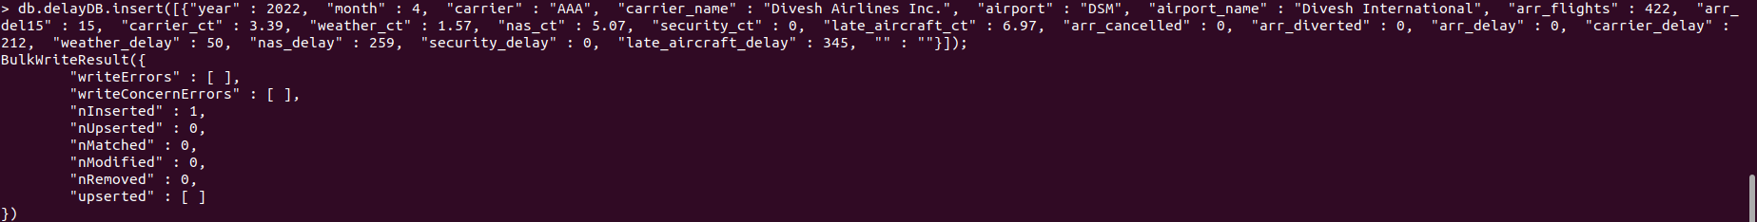
INSERTING NEW RECORD
QUERY 6: db.delayDB.insert([{"year" : 2022, "month" : 4, "carrier" : "AAA", "carrier_name" : "Divesh Airlines Inc.", "airport" : "DSM", "airport_name" : "Divesh International", "arr_flights" : 422, "arr_del15" : 15, "carrier_ct" : 3.39, "weather_ct" : 1.57, "nas_ct" : 5.07, "security_ct" : 0, "late_aircraft_ct" : 6.97, "arr_cancelled" : 0, "arr_diverted" : 0, "arr_delay" : 0, "carrier_delay" : 212, "weather_delay" : 50, "nas_delay" : 259, "security_delay" : 0, "late_aircraft_delay" : 345, "" : ""}]);

Slide 8
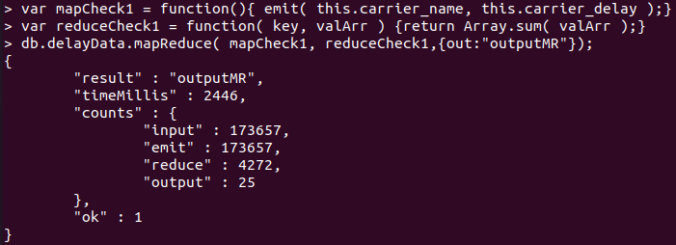
MAP-REDUCE QUERY 1
QUERY 7: Defining Mapper and Reducer
• var mapCheck1 = function(){ emit( this.carrier_name, this.carrier_delay );}
•var reduceCheck1 = function( key, valArr ) {return Array.sum( valArr );}
•db.delayData.mapReduce( mapCheck1, reduceCheck1,{out:"outputMR"});

Slide 9
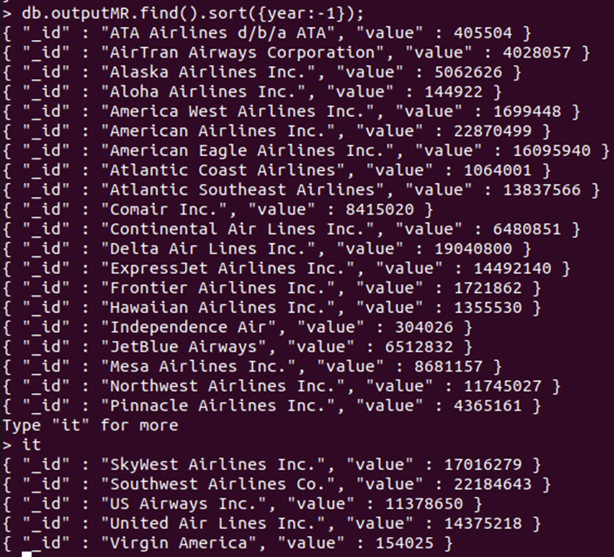
Loading Data
QUERY 8:
Loading the output with sorted order according to the requirement

Slide 10
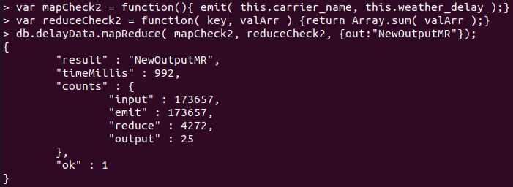
MAP-REDUCE QUERY 2
QUERY 9: Defining Mapper and Reducer
var mapCheck2 = function(){ emit( this.carrier_name, this.weather_delay );}
var reduceCheck2 = function( key, valArr ) {return Array.sum( valArr );}
db.delayData.mapReduce( mapCheck2, reduceCheck2, {out:"NewOutputMR"});

Slide 11
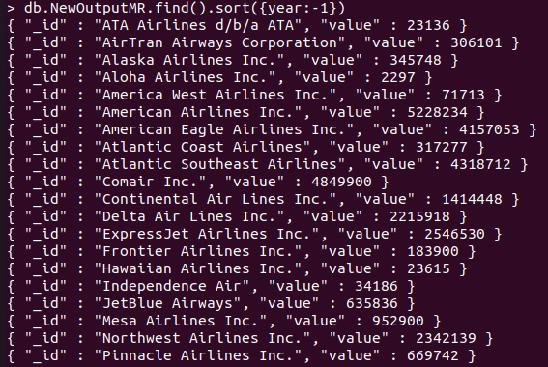
Loading Data
QUERY 10:
Loading the output with sorted order according to the requirement.

