Slide 1

MongoDB
CB.EN.U4CSE19459
SHANTHAN REDDY

Slide 2
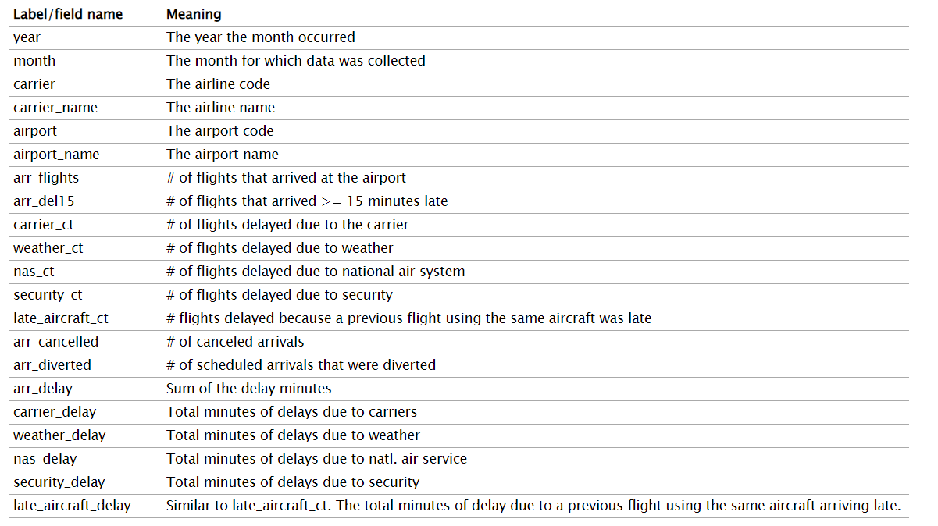
Dataset

Slide 3
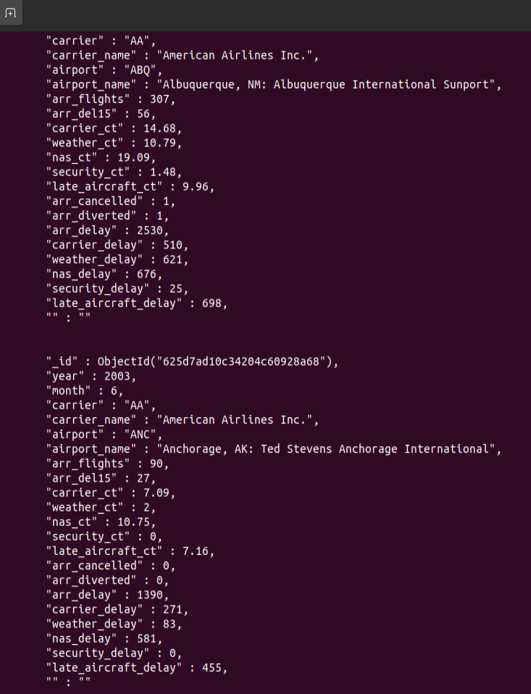
QUERY 1:
db.delayData.find({carrier_name:"American Airlines Inc."}).pretty();

Slide 4
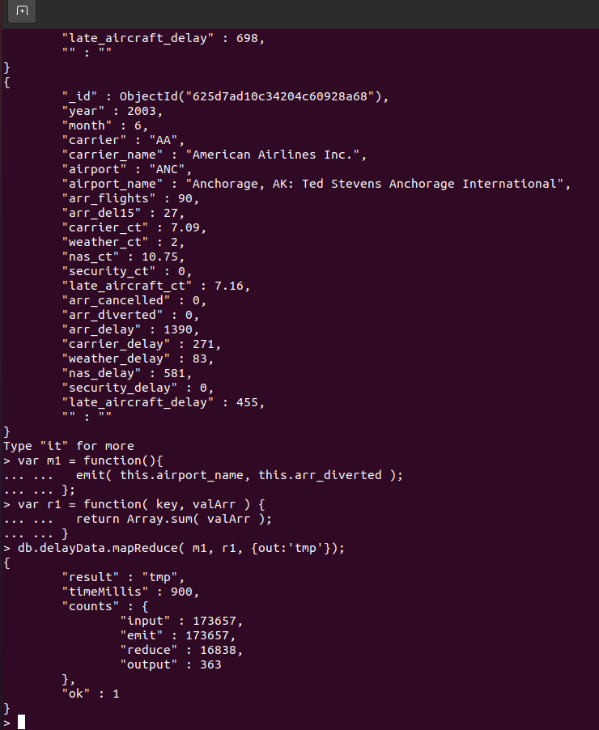
QUERY 2:
var m1 = function(){
... emit( this.airport_name, this.arr_diverted );
... };
var r1 = function( key, valArr ) {
... return Array.sum( valArr );
... }
db.delayData.mapReduce( m1, r1, {out:'tmp'});

Slide 5
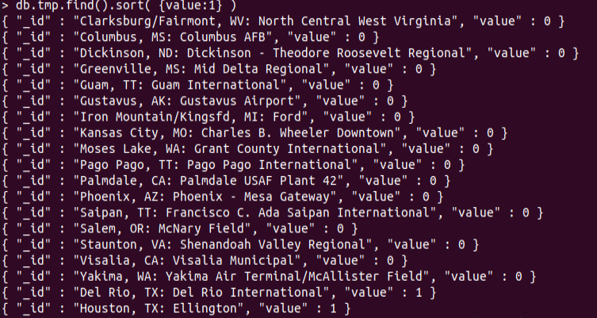
QUERY 3:
db.tmp.find().sort( {value:1} )

Slide 6
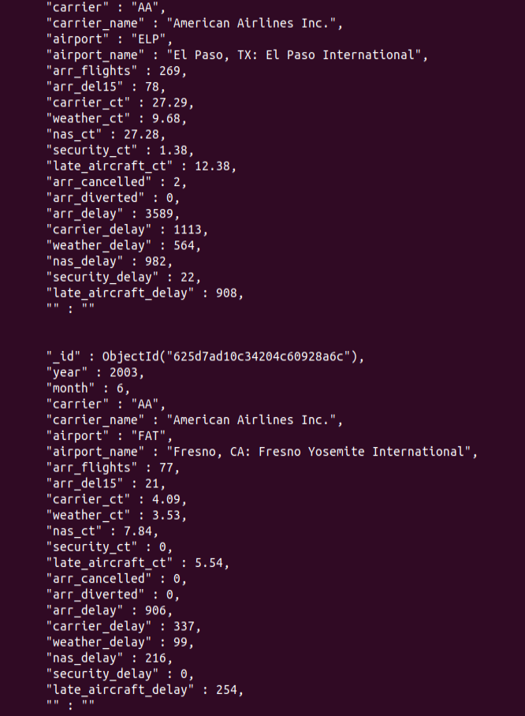
QUERY 4:
db.delayData.find({arr_cancelled:{$lte:5}}).pretty();

Slide 7
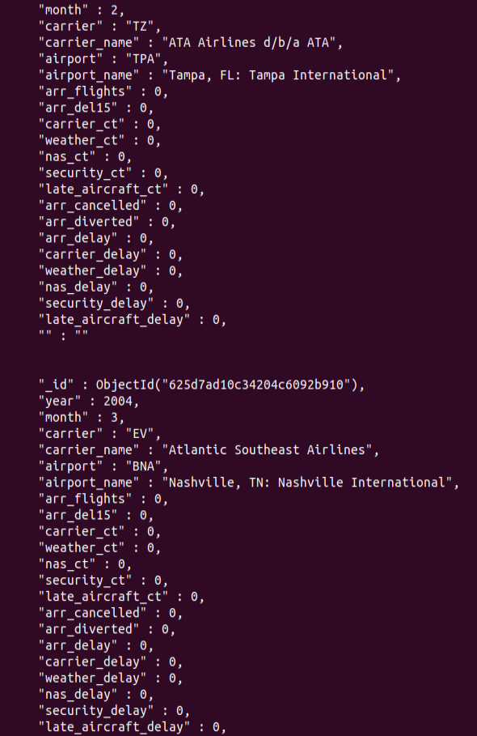
QUERY 5:
db.delayData.find().sort({arr_flights:1}).pretty().limit(10);

