Slide 1
MongoDB Review
P KOUSHIK [CB.EN.U4CSE19449]

Slide 2
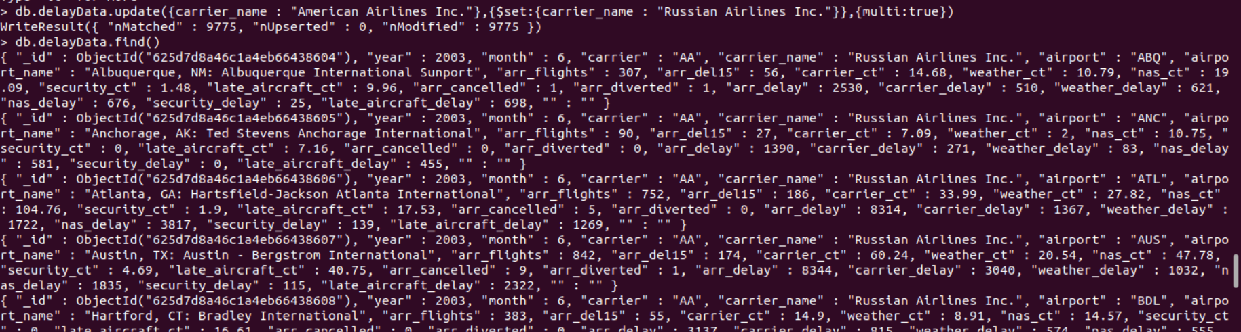
1. Updating the carrier name from the database.
db.delayData.update({carrier_name : "American Airlines Inc."},{$set:{carrier_name : "Russian Airlines Inc."}},{multi:true})

Slide 3
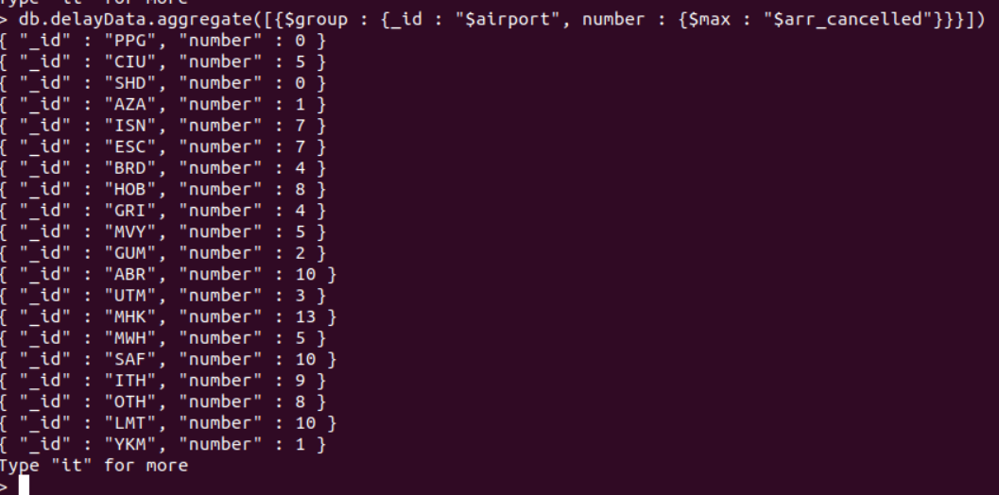
2. Finding the maximum number of flights cancelled for that airport
db.delayData.aggregate([{$group : {_id : "$airport", number : {$max : "$arr_cancelled"}}}])

Slide 4
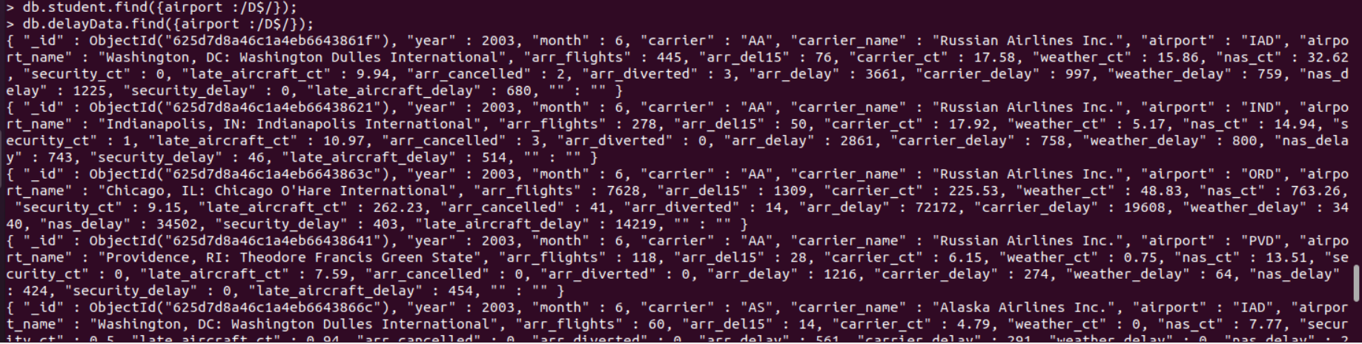
3. Finding the flights data which ends with a Strings
db.delayData.find({airport :/D$/});

Slide 5
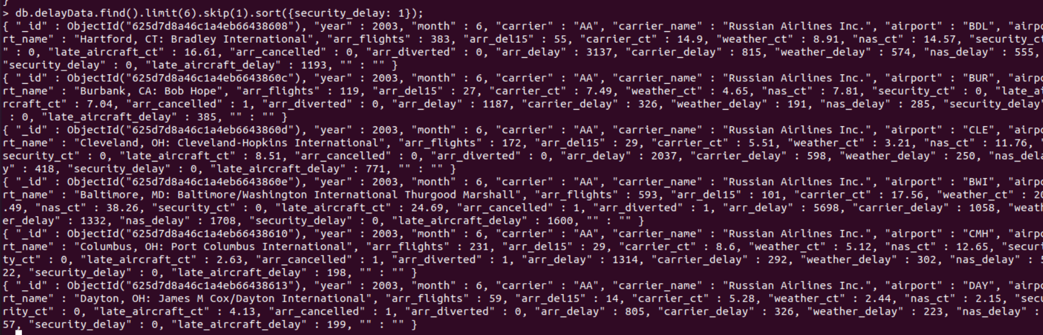
4. Skip:
db.delayData.find().limit(6).skip(1).sort({security_delay: 1});

Slide 6

5. To find how many flights are there in carrier by using Count:
db.delayData.count({carrier:"AA"});

