Slide 1


Geethanjali college of engineering and technology
APILOGGUARD For Security Events :
LIGHT WEIGHT API MONITORING SYSTEM
Batch No:C7
Guide: A Rahul
Team Members:
A. Bhavya Sri (21R11A05A5)
K. Bharath Kumar (21R11A05C8)

Slide 2
Overview:
Introduction
What is APILogGuard?
Key Features
System Architecture
Attack Simulation and Testing
Frontend Dashboard
Conclusion
Future Scope

Slide 3
Introduction:
APIs (Application Programming Interfaces) allow systems to communicate. They are the backbone of modern web and mobile apps.
APIs expose critical data and functionality. They are frequent targets of attacks like brute-force, DDoS, and credential stuffing.
Existing tools are:
Heavy and complex to set up.
Costly for small or custom projects.

Slide 4
Our Solution- APILogGuard
A custom-built, lightweight API security system:
Logs every API request and analyzes it.
Detects anomalies (Brute Force, DDoS, burst).
Displays real-time monitoring via a dashboard.
Supports exporting logs and anomaly reports (PDF/JSON).

Slide 5
Key Features
Feature | Description
Request Logging | Capture and analyze every API call
Anomaly Detection | Categorize threats (Critical/Suspicious/Benign)
Real-time Monitoring | Live dashboard updates
Log Downloads | Admin can export logs in JSON/PDF
Modular Architecture | Separated routes for Gateway, Anomaly, Logs, etc.
Attack Simulator | Stress test the system under attack scenarios

Slide 6
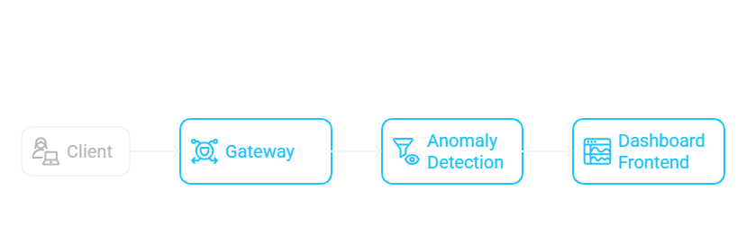
System Architecture
Client: Sends API requests.
Gateway: Captures and logs traffic, initial filtering (e.g., API key validation).
Anomaly Detection: Analyzes traffic for suspicious patterns (DDoS, brute-force).
Dashboard Frontend: Displays alerts, statistics, and live monitoring.

Slide 7
Components
Backend
Inspects all API requests.
Logs metadata: IP, method, endpoint, headers, latency.
Detects anomalies based on request patterns.
Our system scans on port 5000 for any api calls.
Monitoring Dashboard (Frontend)
Shows request data.
Allows anomaly report downloads.
Attack Simulator
CLI tool to simulate attacks like DDoS, Brute Force, Threat Injection.

Slide 8
Detailed Backend Breakdown
File/Route | Purpose
gateway.js | Logs API requests, monitors stats
anomaly.js | Stores detected anomalies
dashboard.js | Aggregates request + anomaly stats
logs.js | Exports logs as JSON or PDF
monitoring.js | Simulated system metrics
response.js | Simulates system rules/actions
siem.js | Static SIEM events and integrations
threat.js | Threat intelligence simulation

Slide 9
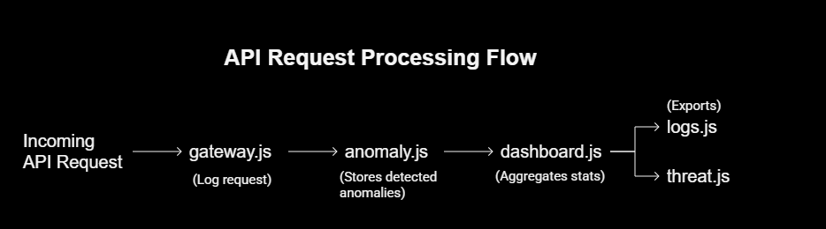

Slide 10
Attack Simulation and testing
attackSimulator.js — CLI Testing Tool:
Burst GET requests → Simulate high traffic
Simulate brute-force login attempts
Launch DDoS flood
Inject anomaly alerts and threat indicators
Measure system response and performance under load

Slide 11
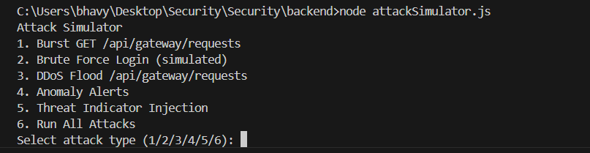
Attack Simulation and testing

Slide 12
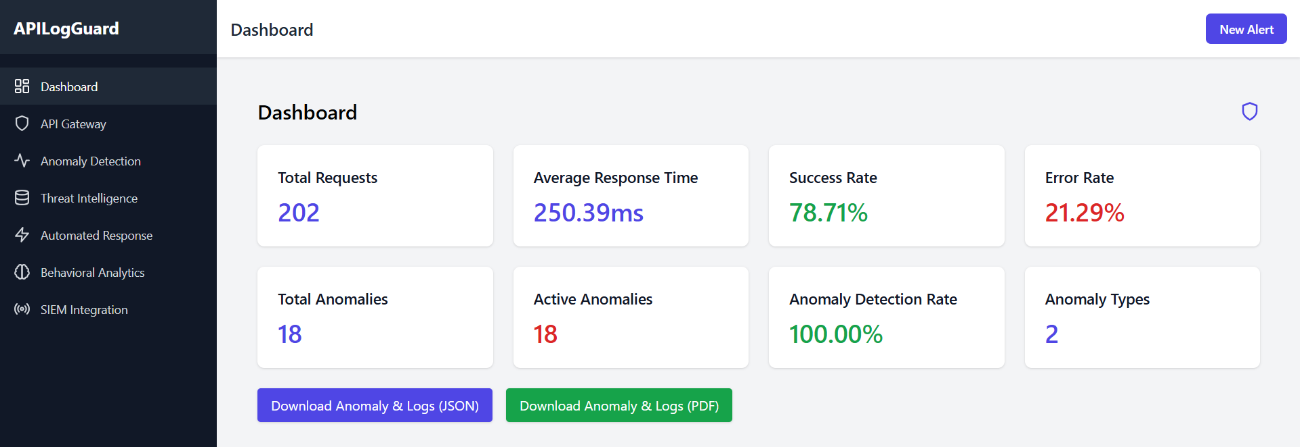
Frontend Dashboard
Dashboard (Real-time updates every 5s)
Admins can export reports

Slide 13
Conclusion
APIs are critical to modern applications but are increasingly targeted by cyber threats.
APILogGuard provides an efficient and real-time solution to monitor, detect, and respond to anomalies in API traffic.
The system enhances API security by combining gateway, anomaly detection, and a live dashboard for actionable insights.
Through this architecture, it ensures better protection, quicker threat response, and improved API resilience.

Slide 14
Future Scope
Add real-time WebSocket based alerts
Deploy on Cloud with auto-scaling
Add Machine Learning based anomaly detection

Slide 15
Thank you!!!

