Slide 1
Connecta
An online social networking system

Slide 2
Introduction
Connecta is an online social networking system(SNS), designed to connect people from different backgrounds.
It provides a platform for individuals to build and maintain connections
The system aims to have thousands of users in its space who can share information with their circle
Connecta is a social networking site that offers an alternative perspective on how we often use these kinds of sites
Millions of people have social profiles on many of the popular platforms including Facebook, Instagram, Snapchat, MySpace, and others
Thousands of SNSs support various interests and behaviors thanks to different technical affordances.

Slide 3
Key Features
User Registration:
Allows the user to register and create their account in the platform.
Feed:
Social media feed includes the stream of content/posts from different users, showing mostly relevant information to a particular user.
Profile Management:
Allows the user to manage their profile, which includes managing connections, posts, and updating their information.
Post Management:
Allows the user to create, delete and edit their posts accordingly.

Slide 4
Key Features(Contd.)
Accessibility of the Posts:
- Posts are divided into two categories: public and private, based on who can view the post; public and private.
- The public posts are visible to everyone, while the private posts are only visible to connections.
Making Connections or Connection Management:
Allows a user to expand their network by sending and accepting connections from different users.
Searching User accounts by different tags or Search Management:
Allows the user to search for a particular account based on their username, first name, last name, or company affiliation.

Slide 5
Use Cases
Class of Use Cases | Use Cases | Description of Use Cases
Use Cases related to user registration and authentication | Create | Create and verifies user info
 | Register | Register user info into system
 | Login | Login user into system
 | Reset password | Authenticate and change password
Use Cases related to post management | View feed | Shows post to user
 | Like post | Like posts from different user
 | Create post | Create post of their own
 | Delete post | Delete post of their own
Use Cases related to search functionality | Perform search | Search other accounts
 | View recent searches | Shows recent search for the user
 | Delete recent search | Clear recent search history
Use Cases related to connection management | View user profile | Shows profile of other users
 | Send connection request | Send request to user to connect
 | View connection requests | View request to user by others to connect
 | Accept connection request | Accept request sent to user
 | Remove connection | Delete a connection with another user
Use Cases related to profile management | Edit profile | Manage and update profile info
 | Delete profile | Remove a profile

Slide 6
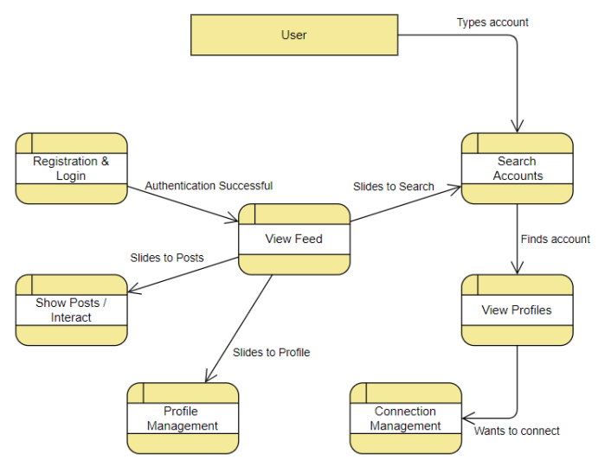
DFD 1

Slide 7
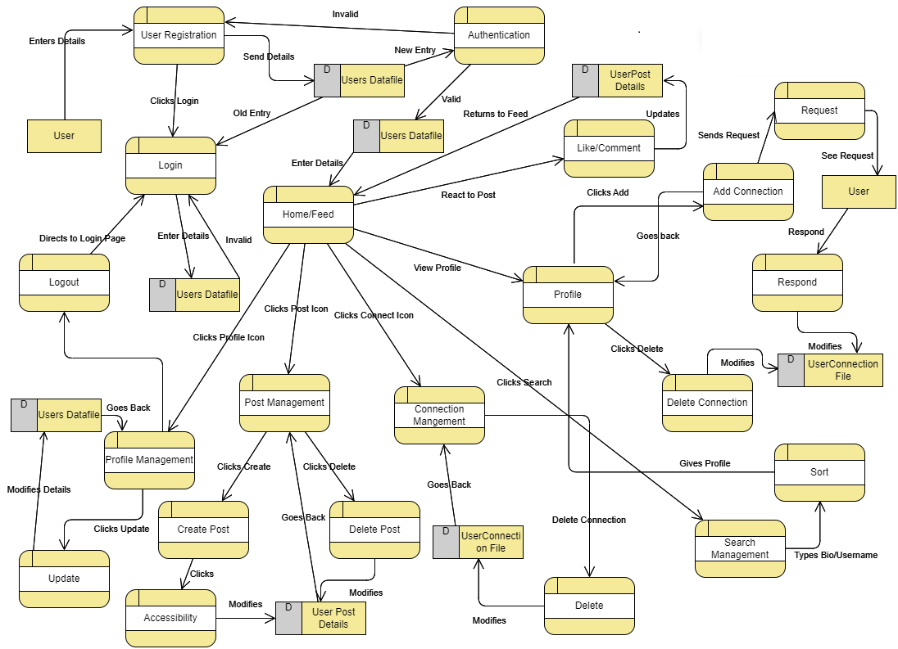
DFD 2

Slide 8
Reasons for selecting DFD 2:
Level-2 DFD gives detailed insights into processes in social networking.
Explicitly shows data flows and transformations in each sub-process.
Crucial for understanding how user data is processed, stored, and shared.
Enables identification of areas for optimization, process refinement, and enhancing data security.
Better choice for a thorough understanding of the online social networking system.

Slide 9
Performance Requirements
Connecta must be interactive, and the delay involved must be minimal. So, in every action response of the software, there is no immediate delay.
We aim to focus on two of the following requirements for our software:
The system should run seamlessly in modern and updated web browser environments.
When searching for other users, latency should be minimal.

Slide 10
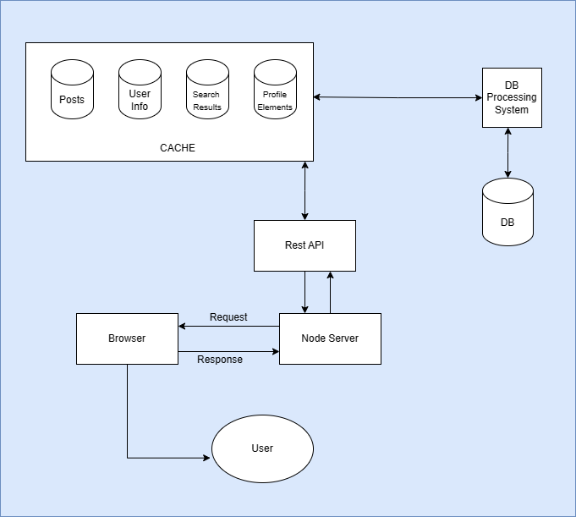
Software Architecture
Architecture 1: Shared Data Style Architecture with Cached Repository

Slide 11
Software Architecture
Architecture 1: Shared Data Style Architecture with Cached Repository
(contd.)
Components are organized for easy data sharing and Browser serves as the main user interface
User Interaction
When a user takes an action (e.g., views a webpage or submits a form), the browser sends an HTTP request to the server.
The API processes the request, retrieves necessary data, and uses frontend technologies (HTML, CSS, JavaScript) to create the client-side view.
The rendered view is included in an HTTP response sent back to the browser.
The interaction cycle concludes when the browser displays the received content to the user.

Slide 12
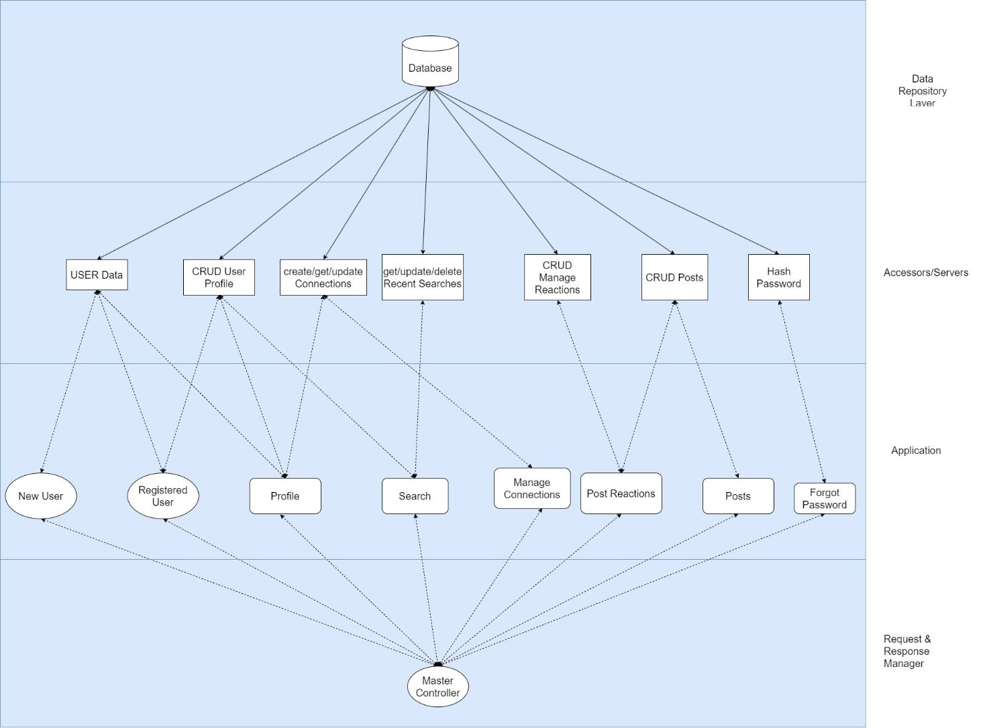
Software Architecture
Architecture 2: Shared Data Style Architecture for Connector and Component View (4-Layered model with blackboard variation)

Slide 13
Software Architecture
Architecture 2: Shared Data Style Architecture for Connector and Component View (4-Layered model with blackboard variation)
The topmost layer features an active data repository (blackboard) that facilitates real-time data sharing and updates. Real-time data availability enhances responsiveness and reduces latency.
The middle layer consists of data accessors that can update or retrieve data from the blackboard. Multiple components can simultaneously read from and write to the blackboard, promoting concurrency and reducing bottlenecks.

Slide 14
Software Architecture
Architecture 2: Shared Data Style Architecture for Connector and Component View (4-Layered model with blackboard variation)
The third layer contains application components that interact with the server or data accessors. Swift data retrieval and updates are crucial for a social media platform like Connecta, where real-time interactions are frequent.
The final layer houses a master controller that acts as a request and response manager. Centralized management streamlines communication between users and application services.

Slide 15
Scenarios of interest
S1 : User Registration and Profile Creation: A new user registers to the Connecta and creates a profile and posts text, images to the profile. (Normal Load, all servers are up and database is up)
S2 : Any data accessors or database is down
S3 : Highly loaded system.

Slide 16
 | Architecture 1 | Architecture 2
Security(S1) | No | Yes
Response Time (S1) | Higher | Lower
Response Time (S2) | High | N/A
Response Time (S3) | Higher | Lower
Data Currency (S1) | Yes | Yes
Debugging | Difficult | Easier
Creating New Features | Relatively Difficult | Easier

Slide 17
Non Functional Attributes
Security
Privacy
Robust user authentication
Data protection
Single sign on
Manage who can see one's content
Hash password before storing them

Slide 18
Non Functional Attributes (contd.)
Performance
Reliability
Different data accessors help in decreasing response time, as the architecture portrays.
The servers/accessors will use redundant component to handle failures
Can implement rollback mechanism to ensure data consistency

Slide 19
Non Functional Attributes (contd.)
Modifiability
The shared-data model lets us change individual components by keeping data producers and consumers apart
Changes to one component won’t directly impact others.

Slide 20
Future Extensions
To enhance user experience and further improve platform functionality, the following features are under consideration:
Implement a robust chat management system to fulfill the direct message requirements
Integrating a machine learning based model to provide user connection suggestions.

Slide 21
Conclusion
By doing Function Point analysis, we got 131 Adjusted Function Points for the system.
For JavaScript, based on industry data, the average (LOC/AFP ratio) is 64 LOC/AFP
So, the estimated size of code in JavaScript would be approximately 8,384 lines

Slide 22
Group 04
ANISH MANANDHAR - CS23BTKMU11001
ANKUSH NIROULA - CS23BTKMU11002
VIGNAN KOTA - CS21BTECH11029
DAVID MALOTH - CS21BTECH11035

Slide 23
Thank you

