Slide 1
99999
CASE STUDY 1
Data Profiling & Quality Assessment
Agency Performance Insurance Dataset
https://github.com/kotaamulyareddy/Data-Profiling-and-Quality-Assessment
213,328 rows across 49 columns | 36 columns contain a hidden 99999 sentinel value
Prepared by Kota Amulya Reddy
Notes:
Title slide. Replace/add presenter name if needed.

Slide 2
Understanding the Dataset Before Any Analysis
OBJECTIVE & APPROACH
1
2
3
4
Load & Validate Schema
Build a Data Dictionary
Detect Hidden Missingness
Clean & Check Integrity
Check shape, dtypes and column names, then split numeric and categorical fields. No column is assumed.
Record dtype, missing count and %, and unique values for every column in one table.
Find the 99999 placeholder code that standard null checks cannot see, then convert it to NaN.
Check duplicates, standardize categorical text, and review distributions, outliers, negatives and zeros.

Slide 3
Dataset Structure at a Glance
SCHEMA DISCOVERY
213,328
49
44
Total Rows
Total Columns
Numeric Fields
5
36
2,929,965
Categorical Fields
Columns with 99999
Missing Values After Cleanup
The data covers 1,623 agencies across 11 profile years and 6 states (IN, KY, MI, OH, PA, WV). The schema spans premium and loss amounts, retention and growth ratios, producer counts, and quote and bind activity from vendor systems.

Slide 4
The 99999 Sentinel Problem
KEY FINDING
Missing or not-applicable values are stored as the number 99999. The standard null check reports 0 missing values, while the true count after conversion is 2,929,965.
Where it appears
Why it matters
Period fields: ACTIVITY_NOTES_END_YEAR (209,258 rows), PL_END_YEAR (209,174), COMMISIONS_END_YEAR (205,604)
Ratios: RETENTION_RATIO (129,978), GROWTH_RATE_3YR (91,067), LOSS_RATIO (51,232)
Vendor counts: 6 CL_* columns (98,689 each) and 10 PL_* columns (57,444 each)
Identifiers and agency fields: PRIMARY_AGENCY_ID (37,874), MAX_AGE and MIN_AGE (5,639)
Averages and totals computed before cleanup are badly wrong, since 99999 dwarfs real values
Null checks show 0 missing values until 99999 is replaced, so the true gaps stay hidden
Year fields such as PL_START_YEAR would produce nonsensical date ranges

Slide 5
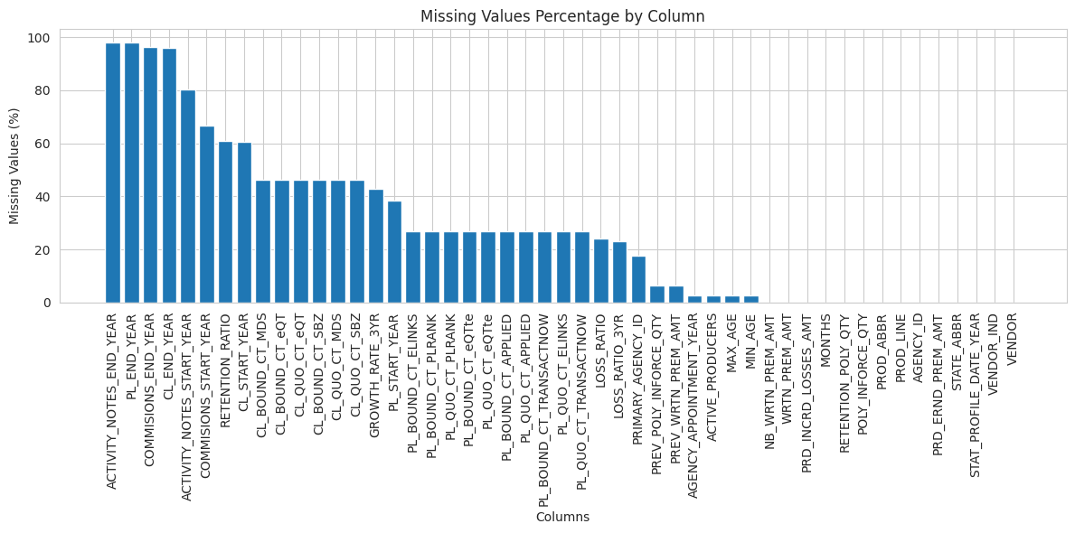
Where the Gaps Are Concentrated
MISSING VALUE ANALYSIS
Top risk fields
ACTIVITY_NOTES_END_YEAR
98.1%
PL_END_YEAR
98.1%
COMMISIONS_END_YEAR
96.4%
CL_END_YEAR
96.0%
RETENTION_RATIO
60.9%
16 columns exceed 30% missing
Period-end fields and vendor activity counts dominate the gaps. Identity, premium and product fields are fully populated.
Missing % computed after converting 99999 to NaN.

Slide 6
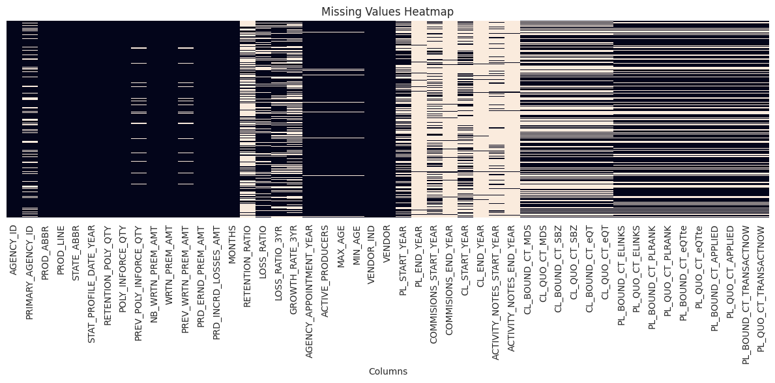
A Structural, Not Random, Pattern
MISSING VALUE ANALYSIS
How to read it
Light cells are missing values. The gaps cluster by column group: period fields and vendor activity counts are empty together, rather than scattered at random.

Slide 7
Duplicates, Negatives and Zero Values
DATA INTEGRITY CHECKS
Duplicate records
Negative WRTN_PREM_AMT
Zero-heavy columns
Full-row duplicate check after sentinel cleanup.
Rows with written premium below zero.
Top numeric column by count of exact zeros.
0 (0.0%)
4,796
157,684
No duplicates found across 213,328 rows, so no records need removal.
About 2.2% of rows, down to -$202,778. Likely refunds, cancellations or adjustments. Validate with the business.
PRD_INCRD_LOSSES_AMT (73.9% of rows). Next: PL_BOUND_CT_TRANSACTNOW 153,886 and PL_QUO_CT_TRANSACTNOW 151,070.

Slide 8
Standardizing Text to Prevent Split Groups
CATEGORICAL DATA CLEANING
Column | Before | After | Change after strip + upper
PROD_ABBR | 20 | 20 | None. Codes such as ANNIV and ANNIV 12 remain separate.
PROD_LINE | 2 | 2 | None
STATE_ABBR | 6 | 6 | None
VENDOR_IND | 2 | 2 | None
VENDOR | 10 | 10 | 'Unknown' became 'UNKNOWN'
Unique values shown are from the first 20 values printed per column. Cleaning with .str.strip() and .str.upper() changed only the VENDOR casing, so the categorical fields were already largely consistent.
Worth validating: MOTORHOM12 vs MOTORHOME and ANNIV vs ANNIV 12 may be distinct product codes or near-duplicates.

Slide 9
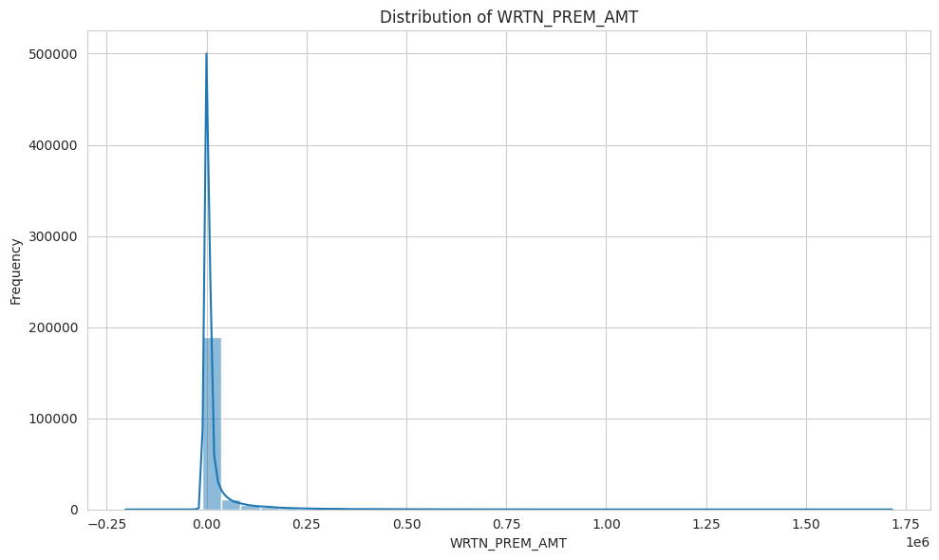
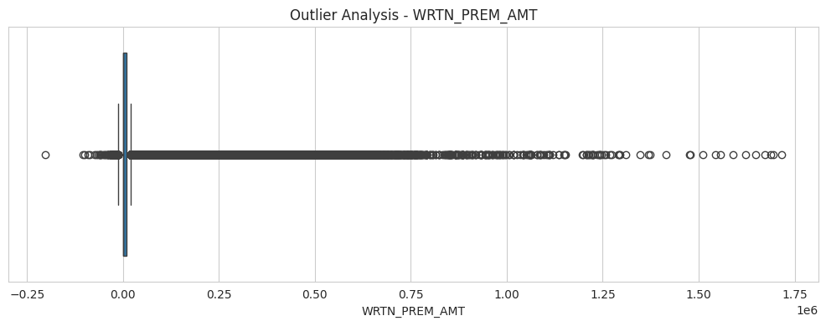
Written Premium Is Heavily Right-Skewed
NUMERIC DISTRIBUTION
The box is squeezed near zero while outliers stretch to about $1.7M.
$19.6K
$1.1K
Mean is about 17x the median. Use medians, log scales or trimmed views. A simple mean is dominated by very large policies.
Mean written premium
Median written premium

Slide 10
Highest-Risk Columns by Missingness
DATA DICTIONARY
Column | Raw dtype | Missing (99999) count | % Missing
ACTIVITY_NOTES_END_YEAR | int64 | 209,258 | 98.09%
PL_END_YEAR | int64 | 209,174 | 98.05%
COMMISIONS_END_YEAR | int64 | 205,604 | 96.38%
CL_END_YEAR | int64 | 204,760 | 95.98%
ACTIVITY_NOTES_START_YEAR | int64 | 171,536 | 80.41%
COMMISIONS_START_YEAR | int64 | 141,937 | 66.53%
RETENTION_RATIO | float64 | 129,978 | 60.93%
CL_START_YEAR | int64 | 129,311 | 60.62%
GROWTH_RATE_3YR | float64 | 91,067 | 42.69%
PRIMARY_AGENCY_ID | int64 | 37,874 | 17.75%
Raw counts show 0 nulls for every column. All figures here are true missingness after replacing 99999 with NaN. 16 of 49 columns exceed 30% missing.

Slide 11
Key Data Quality Risks
RISK SUMMARY
Hidden missing values
Structural missing data
1
2
36 of 49 columns use 99999. Null checks show 0 missing, but the true count is 2,929,965.
16 columns exceed 30% missing. Period-end and vendor fields are empty together, by source.
Duplicate records
Skewed and extreme values
3
4
None found: 0 of 213,328 rows. Full-row duplicates should still be rechecked on each refresh.
Mean premium $19.6K vs median $1.1K. Outliers reach about $1.7M and distort averages.
Negative premiums
Zero-heavy variables
5
6
4,796 rows (about 2.2%) are negative. May be refunds or adjustments. Confirm with the business.
PRD_INCRD_LOSSES_AMT is zero in 157,684 rows. Zero is often valid, not missing.

Slide 12
The Dataset Is Usable, With Guardrails
CONCLUSIONS & NEXT STEPS
Schema was validated, not assumed: 49 columns profiled across 213,328 rows.
Recommended next steps
1
Set an impute-vs-drop policy for columns above the 30% missing threshold
The 99999 sentinel was the most consequential finding: 36 columns, and 2,929,965 hidden missing values.
2
Validate negative premiums and zero-heavy fields with business stakeholders
No duplicates were found, and categorical text was standardized (only VENDOR casing changed).
16 columns exceed 30% missing, led by period-end and vendor fields.
3
Review the product codes ANNIV vs ANNIV 12 and MOTORHOM12 vs MOTORHOME before grouping by product

