Slide 1


DEPARTMENT OF ELECTRONICS AND COMMUNICATION ENGINEERING
HANDS-FREE PRESENTATION
Presented By:
Y.Rajya Lakshmi (21KE1A0463)
K.Ramya (21KE1A0430)
M.Sowmya (21KE1A0432)
V.L.K.MahaLakshmi (21KE1A0459)
T.Sravanthi (21KE1A0456)

Slide 2

CONTENTS
Introduction
Problem Statement
Existing System
Proposed Method
Features
Customer Segment
Conclusion

Slide 3
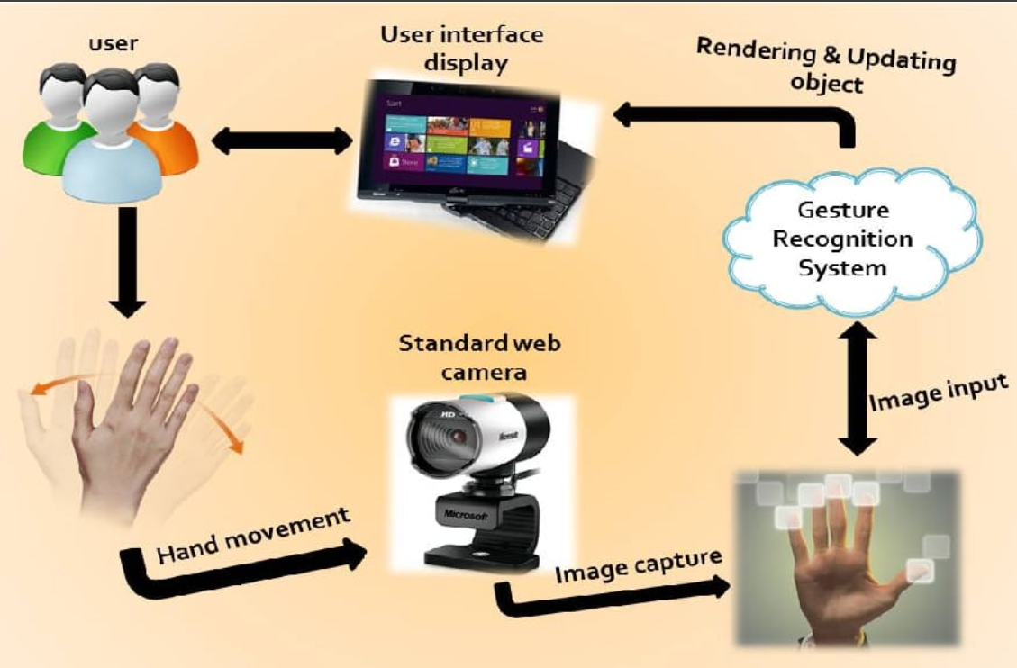
INTRODUCTION
Controlling PowerPoint presentations using hand gestures is a fascinating way to interact with your audience. This technology allows presenters to control their slides using hand gestures, making it easier to deliver a professional presentation.
One such example is the Python interface that can be used with Microsoft PowerPoint, which gives the presenter a lot of flexibility in controlling the slides of PowerPoint with hand gestures 1.
There are different ways of implementing gesture-based control of PowerPoint slides, such as using the open CV module, the Media Pipe Library, or the Kinect Sensor. Some examples of GitHub Projects that demonstrates techniques are this one, this one, this one.

Slide 4

PROBLEM STATEMENT
PowerPoint Presentations are widely used for delivering information and ideas to various audiences . However, the traditional methods of controlling the slides, such as using a keyboard, a mouse or a remote, can be inconvenient, distracting or limiting for the presenter.
Moreover the presenter may want to interact with the slides in more dynamic and expressive ways, such as pointing, writing or drawing on the screen.
Therefore, there is a need for a system that can recognise and interpret hand gestures as commands to control the PowerPoint slides in real-time, using a camera and computer vision techniques.
Such a system can enhance the presentation experience by offering a more natural and initiative way of communication, as well as improving accessibility for people who have difficulty using traditional input devices.

Slide 5
EXISTING SYSTEM
There are several existing solutions for controlling PowerPoint slides using hand gestures. Some of them are based on computer vision techniques that use a webcam or a built-in camera to capture and recognize hand gestures. Others use motion-sensing devices like data gloves, infrared sensors, or cameras to track hand movements and map them to presentation commands.
Hand Gesture Based Presentation Control.
PPT Control Using Hand Gesture.
Gesture Recognition Solution for Presentation Control.
Virtual Control System for Presentations by Real-Time Hand Gesture Recognition.

Slide 6
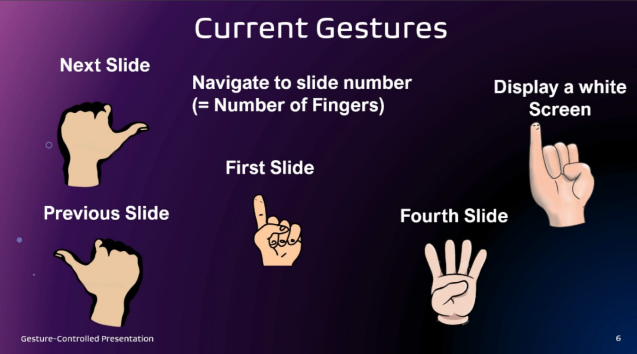
PROPOSED METHOD
There are many proposed methods for controlling PowerPoint slides using hand gestures. Some of them use computer vision techniques to capture and recognize hand gestures from a camera. Others use machine learning techniques and the OpenCV module to interpret gestures as commands. Here are some examples of these methods.
Gesture-Based control of presentation slides using
OpenCV.
Hand Gesture based presentation control.
Remotely controlled PowerPoint presentation
navigation using hand gestures.
Virtual control system for presentations by
Real-time hand gesture recognition.

Slide 7
FEATURES
Some of the features for controlling PowerPoint slides using hand gestures are:
Next slide: Move to the next slide by using a specific finger or hand gesture, such as raising your little finger1, pointing to the right2, or making a fist3.
Previous slide: Move to the previous slide by using a different finger or hand gesture, such as raising your thumb1, pointing to the left2, or opening your palm3.
Start/stop slideshow: Start or stop the slideshow mode by using another finger or hand gesture, such as raising your index finger1, making a circle2, or waving your hand3.
Pointing: Draw attention to a specific part of the slide by using a pointing gesture, such as using two fingers1 or one finger4.
Underlining: Emphasize a word or phrase on the slide by using an underlining gesture, such as using your index finger1 or one finger4.
Erasing: Remove the last annotation or mark on the slide by using an erasing gesture, such as using three fingers1 or shaking your hand4.

Slide 8

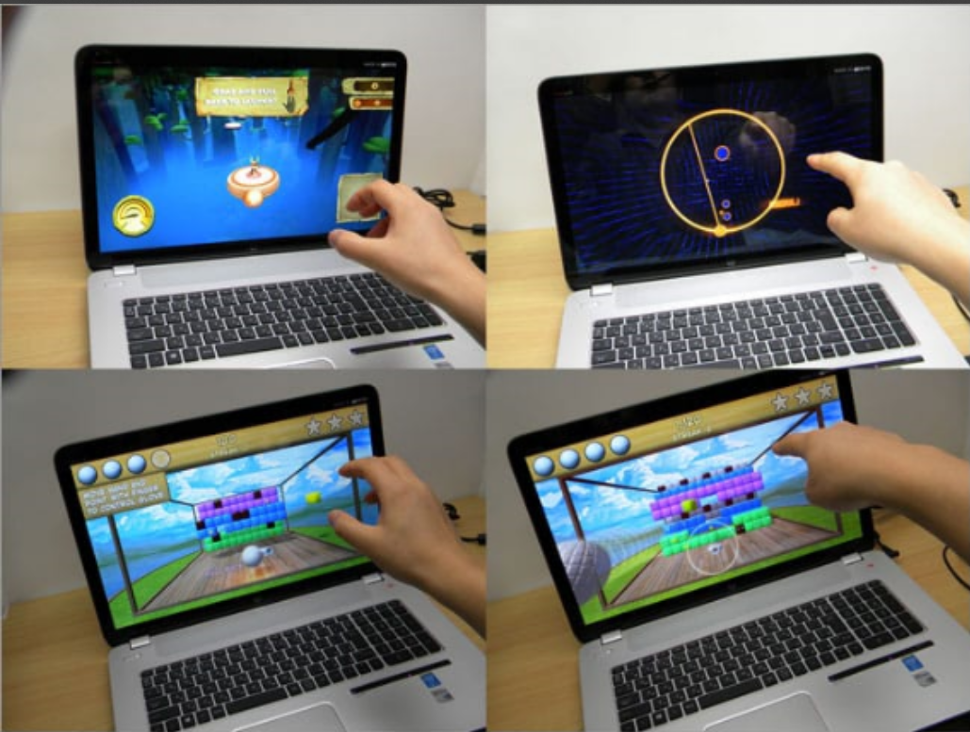

CUSTOMER SEGMENT
Customer segments are groups of potential customers who share similar characteristics, needs, and preferences.
One way to identify customer segments for controlling ppt slides using gestures is to use the market segmentation approach, which divides the market into smaller segments based on various criteria, such as demographics, psychographics, behavior, geography.
Teachers and students.
Business professionals and executives.
Gamers and entertainers.

Slide 9

CONCLUSION
Controlling ppt slides using gestures is a novel and innovative way of interacting
With presentations. It can enhance the user experience, improve the presentation quality, and increase the audience engagement.
By using computer vision and ML techniques, gesture recognition systems can accurately and reliably interpret hand movements as commands.
Gesture control can also offer convenience, accessibility, and flexibility for users who want to control their slides without the need for keyboards or specialized devices.
Controlling ppt slides using gestures is a promising and exciting field of research and development that can revolutionize the way we communicate and present information.

