Slide 1
Music recommendation
DTN group
Zalo Hackathon
17 Dec, 2017

Slide 2
Content
1. Overview
2. Recommendation system
3. DTN music recommendation
4. Q&A

Slide 3
Recommend system
Recommend interesting item to user
Common algorithms:
Recommender System
Collaborative filtering (CF)
Content-based (CB)
Hybrid

Slide 4
Collaborative filtering
Use user rating data to compute similarity between users (user based) or items (item based).
Recommend item by aggregating most similar user rating history (user base) or base on user rating history (item base).

Slide 5
Collaborative filtering
Advantage: item information is not necessary
Cold start problem:
New user
New item
Solution: hybrid with content based method

Slide 6
Content based
Modelling user preferences, compare with item properties to make recommendation
No dependency on other item or user
Problem:
Modelling: Machine learning, demographics,…
Data extraction: various base on item properties

Slide 7
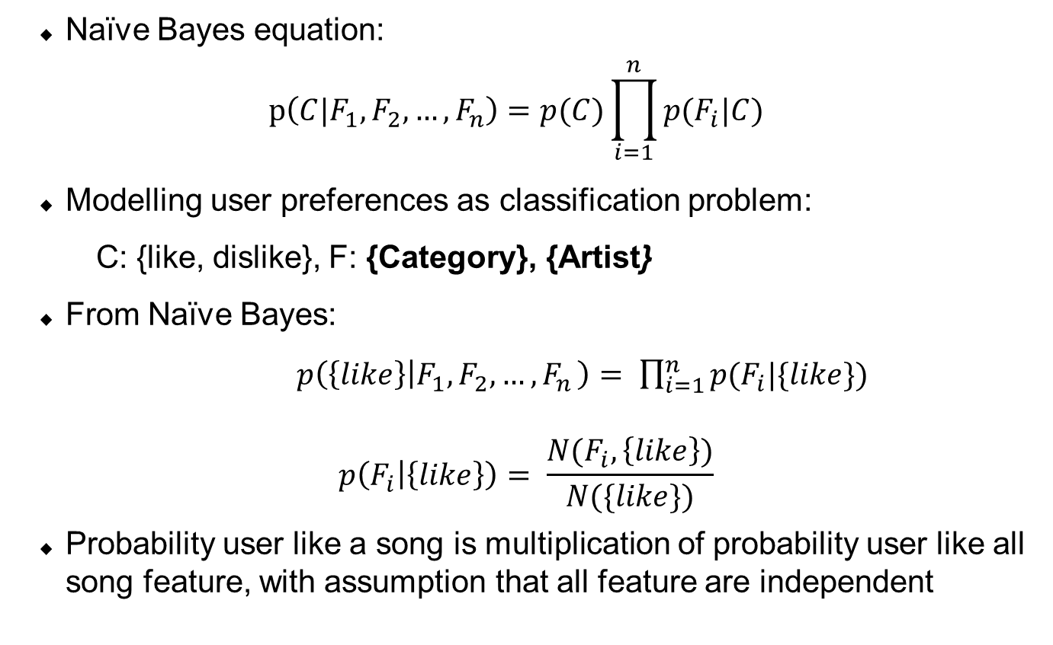
Recommend with Naïve Bayes
Naïve Bayes equation:
$$p\left(C|F_{1}, F_{2},…, F_{n}\right)=p(C)\prod_{i=1}^{n}{p(F_{i}|C)}$$
Modelling user preferences as classification problem:
C: {like, dislike}, F: {Category}, {Artist}
From Naïve Bayes:
$p\left(\left\{like\right\} | F_{1},F_{2},…{,F}_{n}\right)= \prod_{i=1}^{n}{p(F_{i}|\{like\})}$
$$p\left(F_{i} | \left\{like\right\}\right)= \frac{N(F_{i},\left\{like\right\})}{N(\{like\})}$$
Probability user like a song is multiplication of probability user like all song feature, with assumption that all feature are independent

Slide 8
DTN collaborative filtering
Rating score:
Listen less than 30s: rating is 0
Listen larger than 30s: rating is 1
Listen many times: rating is 2
Implementation:
Spark + Mllib
1/6 training data size
Storage: mysql

