Slide 1
ADVANCED IBM COURSERA DATA SCIENCE CAPSTONE PROJECT
ABHAY KOTAL

Slide 2
OUTLINES
Data-set use case
Data Exploration
Data Cleaning
Model Training
Model Evaluation and Hyperparameter Tuning

Slide 3
Data set
Data Set
Dataset published by ics this is heart disease datset uploaded by ronit on kaggle from archive.ici.uci.
The datset contains 14 features like age,sex,restecg,thal... etc and target variable that defines if a patient has heart disease or not
dg
Age | Sex | Chol | fbs | Target
32 | Male | 200 | 1 | 0
35 | Male | 204 | 0 | 1
38 | Female | 236 | 1 | 1

Slide 4
USE CASE
Tell a person has Heart Disease or not by getting past data from patients and applying it to new patients.

Slide 5
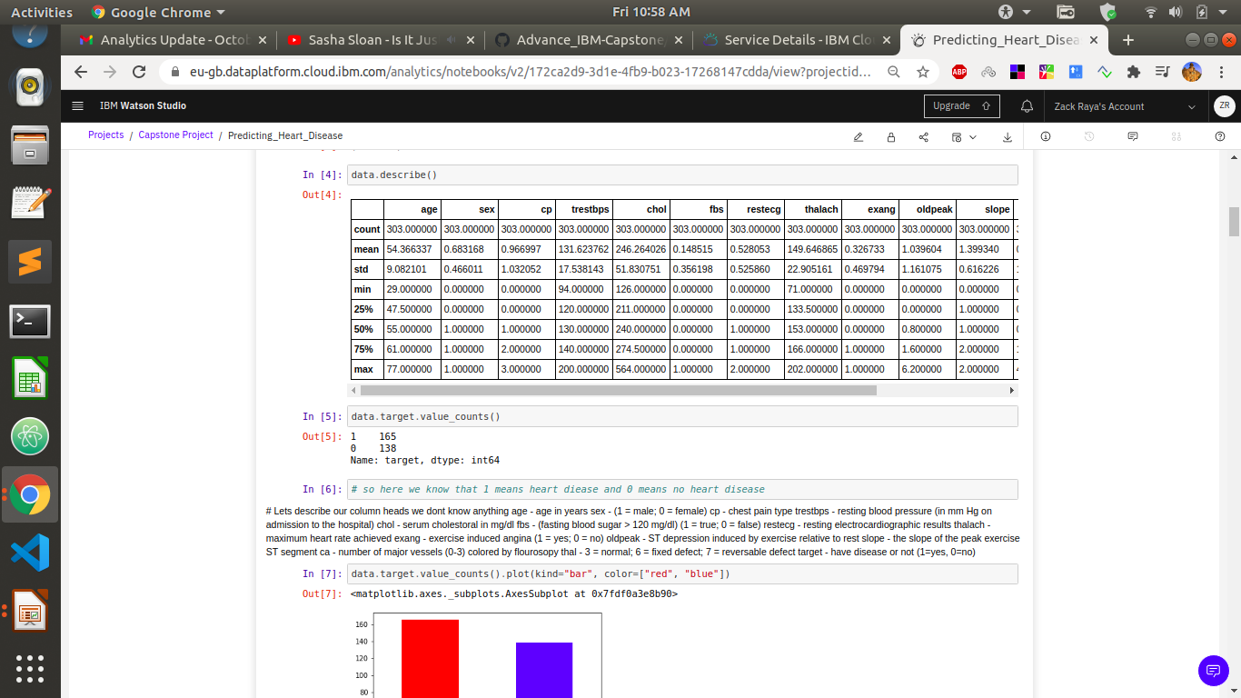
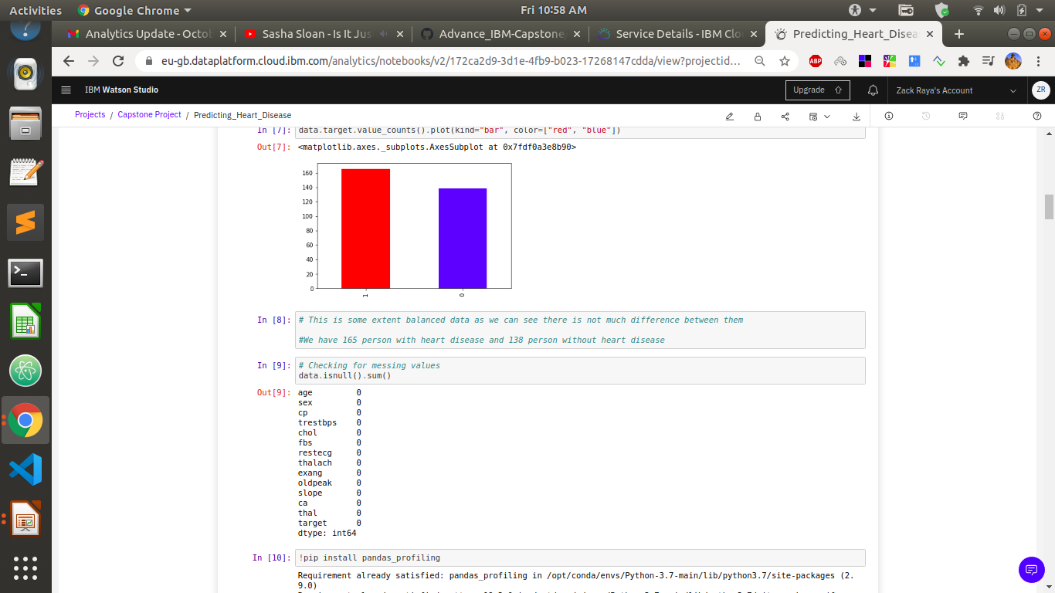
Data Exploration

Slide 6
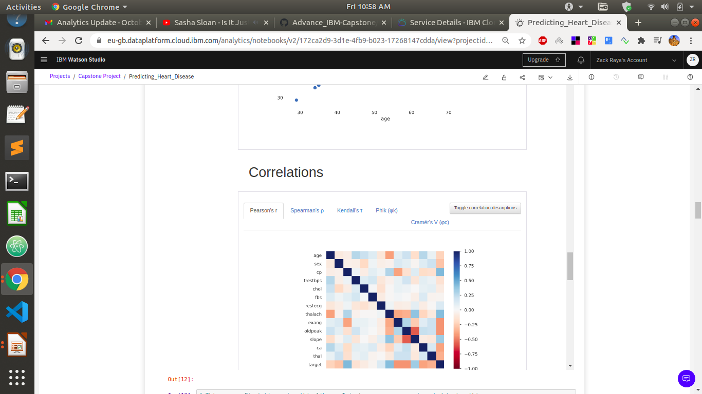
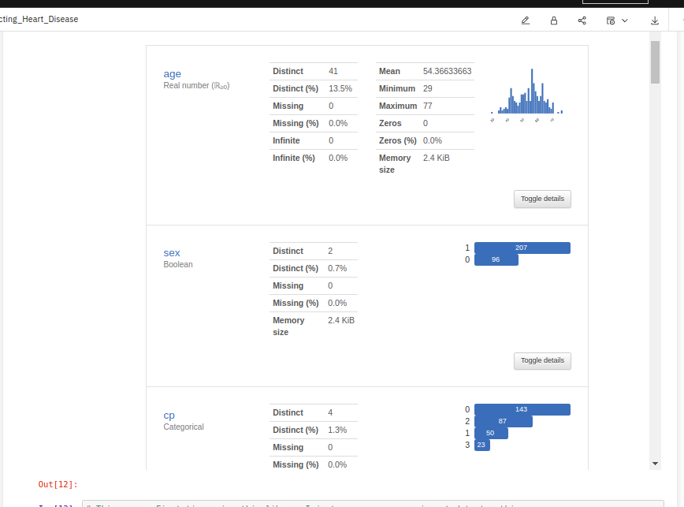
Data Exploration

Slide 7
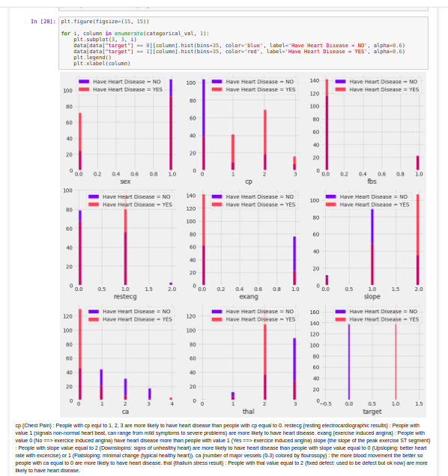
Data Exploration
cp {Chest Pain} : People with cp equl to 1, 2, 3 are more likely to have heart disease than people with cp equal to 0. restecg {resting electrocardiographic results} : People with value 1 (signals non-normal heart beat, can range from mild symptoms to severe problems) are more likely to have heart disease. exang {exercise induced angina} : People with value 0 (No ==> exercice induced angina) have heart disease more than people with value 1 (Yes ==> exercice induced angina) slope {the slope of the peak exercise ST segment} : People with slope value equal to 2 (Downslopins: signs of unhealthy heart) are more likely to have heart disease than people with slope value equal to 0 (Upsloping: better heart rate with excercise) or 1 (Flatsloping: minimal change (typical healthy heart)). ca {number of major vessels (0-3) colored by flourosopy} : the more blood movement the better so people with ca equal to 0 are more likely to have heart disease. thal {thalium stress result} : People with thal value equal to 2 (fixed defect: used to be defect but ok now) are more likely to have heart disease.

Slide 8
Data Cleaning
The data was perfectly cleaned already no missing values and no duplicate values.

Slide 9
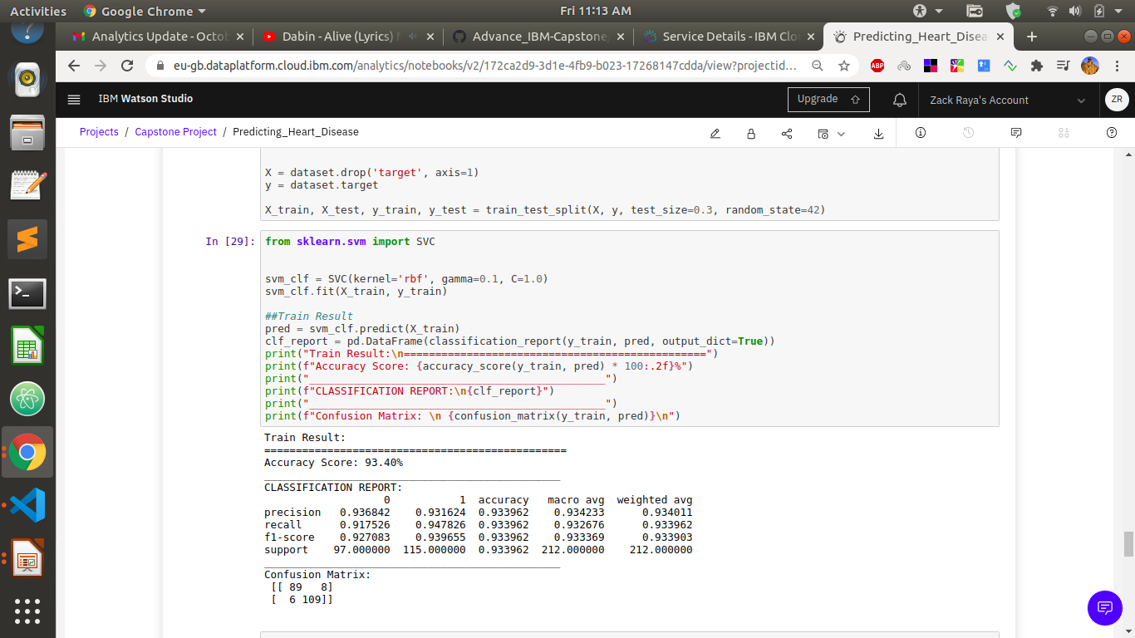
Model Training Using Svm

Slide 10
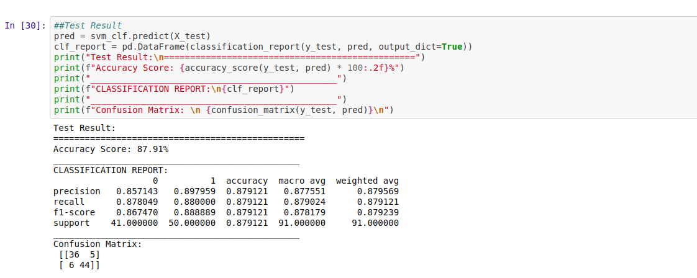
Model Evaluation

Slide 11
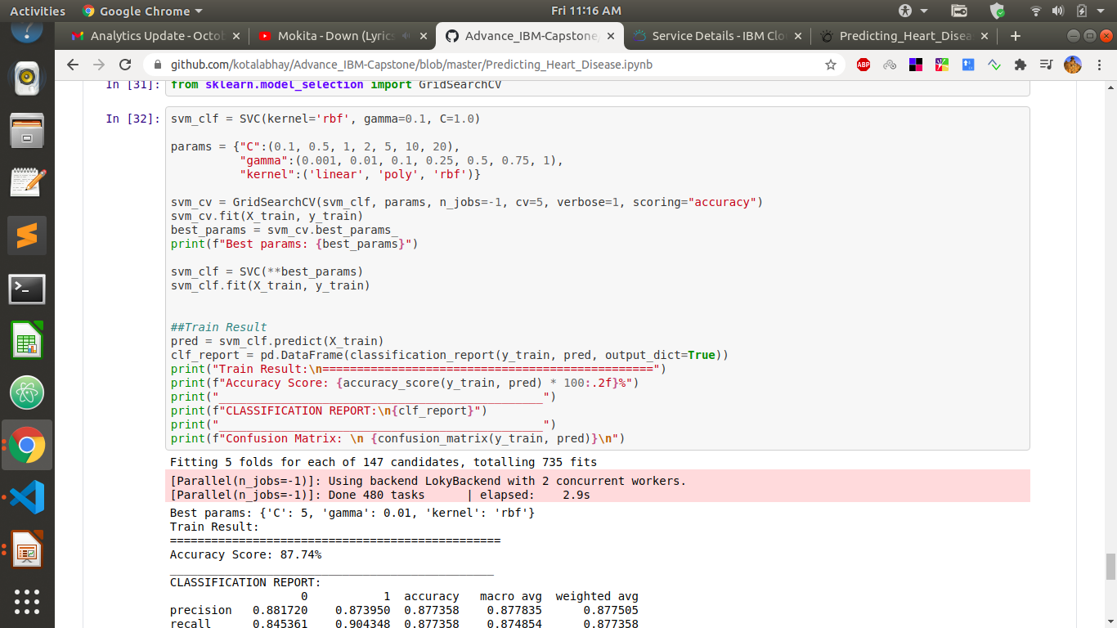
Hyper Parameter Tuning

Slide 12
Conclusion
Thus we have successfully build model that can predict if a patient has heart disease or not.

