Slide 1
Coursera Capstone
IBM Applied Data Science Capstone
Opening a New Shopping Mall in Mumbai,India
By: Abhay Kotal
November 2019

Slide 2
Business Problem
• Location of the shopping mall is one of the most important decisions that will
determine whether the mall will be a success or a failure
• Objective: To analyze and select the best locations in the city of Mumbai, India to open a new shopping mall
• This project is timely as the city is currently suffering from oversupply of shopping malls
• Business question
➢In the city of Mumbai, India, if a property developer is looking to
open a new shopping mall, where would you recommend that they open it?

Slide 3
Data
• Data required
➢List of neighbourhoods in Kuala Lumpur
➢Latitude and longitude coordinates of the neighbourhoods
➢Venue data, particularly data related to shopping malls
• Sources of data
➢Wikipedia page for neighbourhoods (https://en.wikipedia.org/wiki/Category:Suburbs_of_Mumbai)
➢Geocoder package for latitude and longitude coordinates
➢Foursquare API for venue data

Slide 4
Methodology
• Web scraping Wikipedia page for neighbourhoods list
• Get latitude and longitude coordinates using Geocoder
• Use Foursquare API to get venue data
• Group data by neighbourhood and taking the mean of the frequency of occurrence of each venue category
• Filter venue category by Shopping Mall
• Perform clustering on the data by using k-means clustering
• Visualize the clusters in a map using Folium

Slide 5
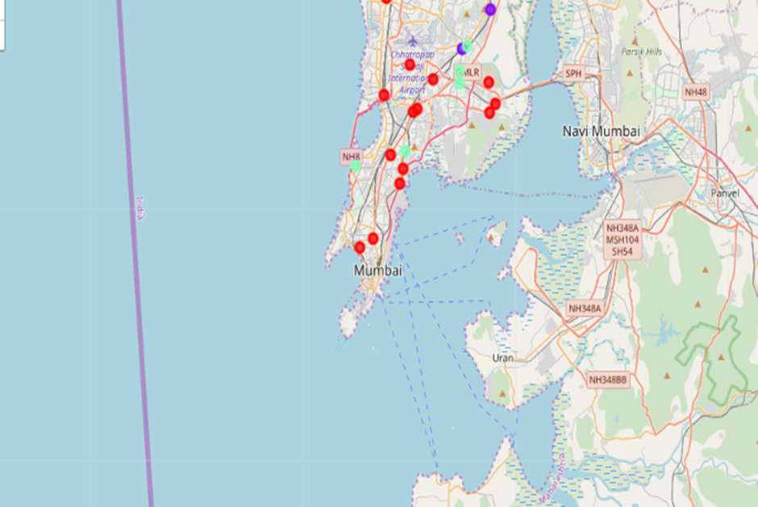
Results
• Categorized the neighbourhoods into 3 clusters :
➢Cluster 0: Neighbourhoods with high number of shopping malls
➢Cluster 1: Neighbourhoods with low number of shopping malls ➢Cluster 2: Neighbourhoods with moderate concentration of shopping malls

Slide 6
Discussion
• Most of the shopping malls are concentrated in the western area of the city
• Highest number in cluster 0 and moderate number in cluster 2
• Cluster 1 has very low number of shopping mall in the neighbourhoods
• Oversupply of shopping malls mostly happened in the westernarea of the city, with the suburb area still have very few shopping malls

Slide 7
Recommendations
• Open new shopping malls in neighbourhoods in cluster 1 with little to no competition
• Can also open in neighbourhoods in cluster 2 with moderate competition if have unique selling propositions to stand out from the competition
• Avoid neighbourhoods in cluster 0, already high concentration of shopping malls and intense competition

Slide 8
Conclusion
• Answer to business question: The neighbourhoods in cluster 1 are the most preferred locations to open a new shopping mall
• Findings of this project will help the relevant stakeholders to capitalize on the opportunities on high potential locations while avoiding overcrowded areas in their decisions to open a new shopping mall

Slide 9
Thank you!

