Slide 1
Linux PC Monitor

Slide 2

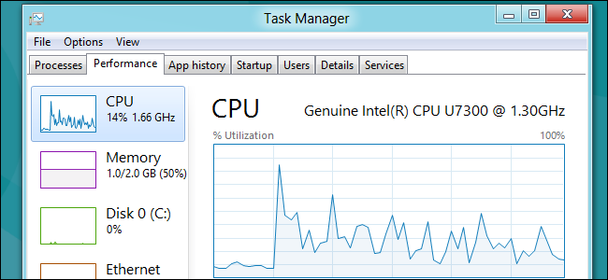


Why to monitor?
In commercial OS like Windows, several monitors including default task manager help us monitor the system performance
But this is not the case with Linux distributions
Everything is command oriented

Slide 3
So we created a small version of task manager for Linux:
Used shell scripting to run Linux shell commands and extract the returned result and store it in a log file.
The log file is updated every second.
We can visualize the data in log file, which we did using python scripts.

Slide 4
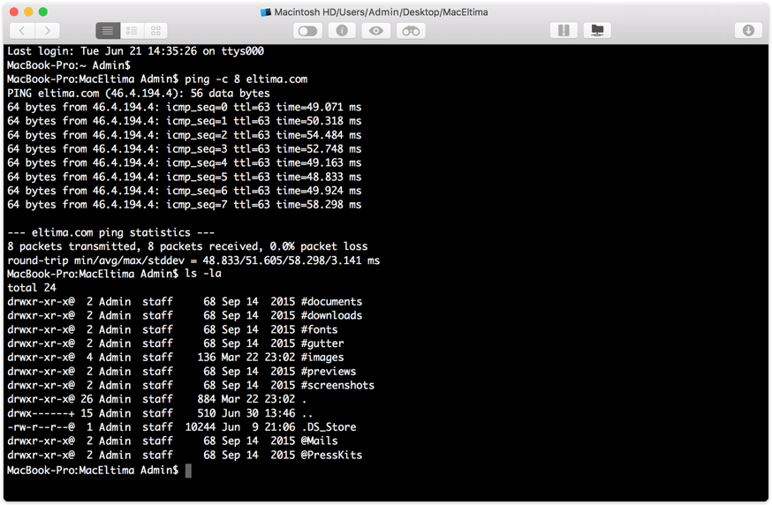
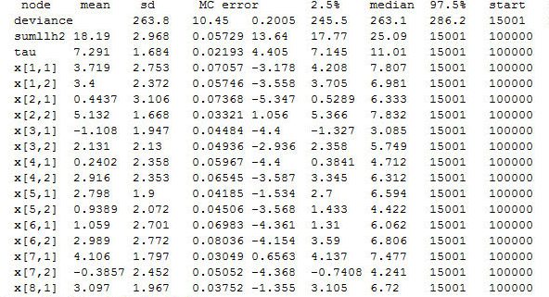

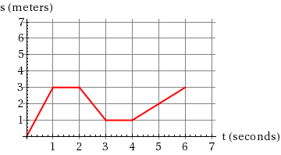
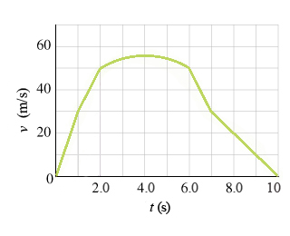

Slide 5
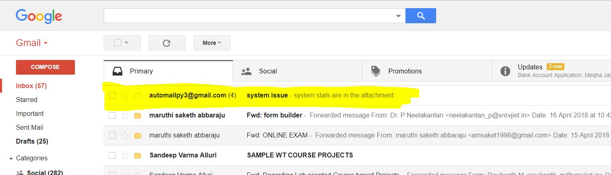
So what’s new?
It’s not possible for a person to continuously monitor the system by sitting in front of it.
So we simply mail the statistics in the form of graph to the admin, whenever there’s any abnormality in the system resource usage.

Slide 6
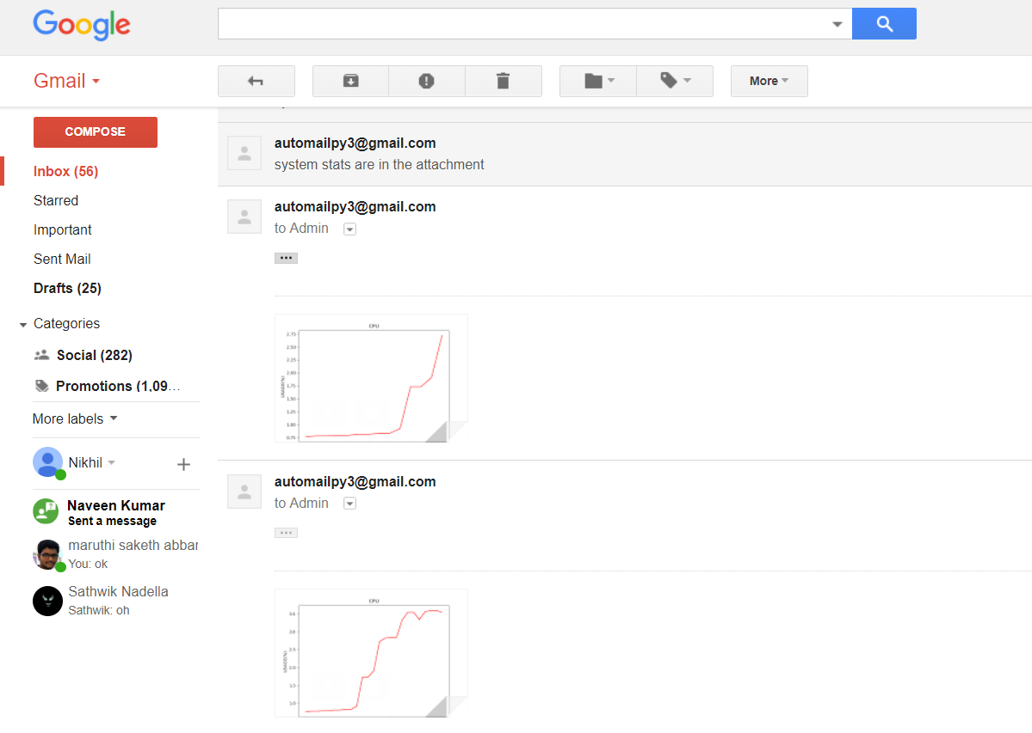
Inside the mail

Slide 7
Thank You
K Nikhil Sai 15071A0556
NVS Sathwik 15071A0537
Manikyam 16075A0511
Srilekha 15071A0547

