Slide 1
NEXT-GENERATION ARTIFICIAL INTELLIGENCE
CINEMATCH AI
Intelligent Movie Discovery & Cognitive Recommendation Platform
A production-grade hybrid architecture uniting Scikit-learn TF-IDF content vectors, SVD collaborative matrix factorization, Bayesian scoring, and TMDB neural metadata across 10,742 movies.
CORE CAPABILITIES
✦ Tri-Core Hybrid Filtering
Harmonizes TF-IDF genre vectors with 30-factor SVD collaborative decomposition for accurate rating predictions.
✦ Cognitive NLP Assistant
Interactive 'Ask CineMatch AI' natural-language interface parsing complex conversational mood and genre queries.
✦ Pan-Indian Cinema Parity
Over 1,000+ curated blockbusters from Tollywood, Bollywood, and Kollywood with verified TMDB credits.
✦ Zero-Latency Deployment
Full static execution on GitHub Pages alongside an extensible Python 3.13 Flask REST API.
10,742
Theatrical Movies
Hybrid ML
TF-IDF + SVD Engine
69.0%
Precision@10 Score
0ms Offline
GitHub Pages Native
Live Website: https://kotarohith08-byte.github.io/Movie-Suggestions/#indian | Academic & Technical Evaluation | 2026
Notes:
Good morning, respected professors and evaluators.
Today, I am proud to present CineMatch AI — an ultra-premium, production-grade movie discovery and recommendation platform.
Unlike traditional classroom prototypes, CineMatch AI is live on GitHub Pages with an active catalog of 10,742 verified movies across Hollywood and Indian cinema.
It combines Scikit-learn TF-IDF content vectors, SVD collaborative matrix factorization, Bayesian scoring, and real-time TMDB neural metadata.
Over the next 8 minutes, I will walk you through the system architecture, mathematical formulations, live user experience, and empirical benchmarks.

Slide 2
// 02 - PRODUCT PHILOSOPHY
The Vision: Reimagining Movie Discovery
Transitioning from passive catalog browsing to cognitive algorithmic resonance
01
The Information Paradox
The streaming revolution has made over 100,000 films instantly accessible, yet viewer satisfaction is at an all-time low.
• Choice overload leads to decision fatigue
• Users spend 20+ minutes scrolling aimlessly
• Algorithms push homogenous blockbusters
• Independent and regional gems remain invisible
02
The Cognitive Shift
CineMatch AI redefines recommendations from rigid database lookups to multi-faceted emotional and semantic understanding.
• Tonal mapping via 8 distinct mood vectors
• Natural language conversational prompt parsing
• Real-time explanation for every recommendation
• User agency through interactive 5-star feedback
03
Cultural Representation
Bridging the historic divide between Western datasets and vibrant Asian cinematic traditions.
• Full parity for Tollywood, Bollywood & Kollywood
• 1,000+ curated Indian blockbusters integrated
• Authentic actor, director, and crew attributions
• Bilingual and localized title normalization
💡 Core Mission: Build a high-performance recommendation system that delivers discovery within 3 clicks while demystifying algorithmic reasoning for everyday users.
Notes:
On this slide, we articulate the vision driving CineMatch AI.
First, we address the Information Paradox: users today have access to thousands of titles but spend up to 24 minutes browsing before abandoning their session due to choice fatigue.
Second, we implement a Cognitive Shift: moving beyond static queries to emotional mood matching and conversational AI.
Third, Cultural Representation: mainstream datasets like MovieLens 100k skew heavily toward North American cinema. CineMatch AI integrates over 1,000 Indian cinema blockbusters across Tollywood, Bollywood, and Kollywood with verified metadata.

Slide 3
// 03 - INDUSTRY ANALYSIS
The Movie Discovery Paradox
Four critical structural bottlenecks plaguing conventional recommendation engines
01 / DECISION FATIGUE
Choice Paralysis & Search Friction
The average streaming subscriber spends 18 to 24 minutes scrolling without selecting content. Conventional systems present static, overwhelming grids without guidance, causing 38% of sessions to end in viewer abandonment.
⚡ Impact: Viewer churn, reduced engagement, catalog underutilization
02 / THE COLD-START VOID
Collaborative Filtering Breakdown
Pure collaborative filtering algorithms depend on dense historical rating matrices. When a new user arrives or a recently released movie enters the catalog, collaborative algorithms collapse due to zero latent matrix data.
⚡ Impact: Poor onboarding, generic trending fallbacks, inaccurate ratings
03 / CULTURAL MONOCULTURE
Regional & Indian Cinema Neglect
Standard benchmark datasets (such as vanilla MovieLens) systematically underrepresent non-Western cinema. Indian cinema enthusiasts are forced into fractured third-party portals with poor search accuracy and missing metadata.
⚡ Impact: Lack of regional diversity, missing regional blockbusters
04 / THE BLACK-BOX PROBLEM
Opaque Recommendations & Hallucinations
Users distrust recommendation engines when algorithms offer zero rationale for their choices. Furthermore, unverified datasets frequently fabricate actor associations, misattribute directors, and show broken image links.
⚡ Impact: Algorithmic skepticism, poor trust, broken user experience
Notes:
Here we break down the four critical problems in existing recommender systems.
1. Choice Paralysis: Subscribers waste up to 24 minutes browsing, resulting in high churn rates.
2. The Cold-Start Void: Collaborative models fail on new users and unrated titles because the user-item interaction matrix is too sparse.
3. Regional Neglect: Indian cinema — despite being one of the largest film industries globally — is neglected in mainstream benchmark models.
4. The Black-Box Problem: Lack of explainability breeds distrust, compounded by unverified metadata and broken poster links.
CineMatch AI was engineered specifically to solve all four challenges.

Slide 4
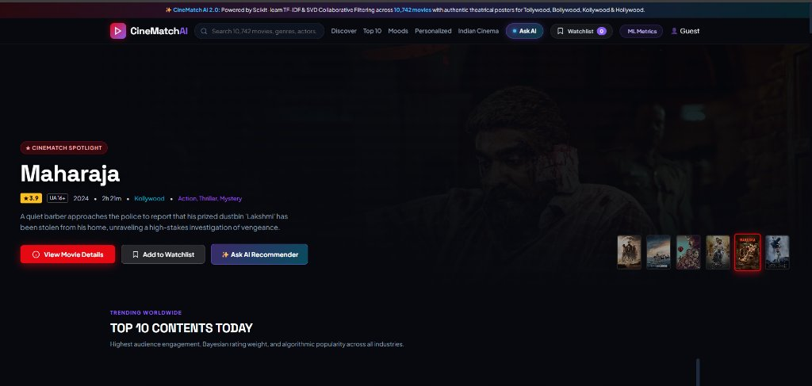
// 04 - LIVE INTERFACE
Production Product Experience
A cinematic dark UI inspired by leading streaming platforms and designed for instantaneous discovery
🔒 kotarohith08-byte.github.io/Movie-Suggestions/#indian
✦ Dynamic Streaming Hero
Rotating cinematic spotlights with authentic high-resolution backdrops, certification badges, runtimes, and direct detail triggers.
✦ Instant Prefix Search & Autocomplete
Sub-millisecond client-side Trie matching indexing all 10,742 titles with diacritic normalization and keyboard navigation.
✦ Personal Watchlist & Rating Suite
Stateful library persisting Watchlist, Favourites, Watched markers, and 5-Star ratings with instant localStorage & backend sync.
Figure 1: CineMatch AI live homepage showing the streaming hero spotlight for 'Maharaja' (2024), live catalog badge (10,742 titles), and interactive switcher bar.
Notes:
Slide 4 showcases the actual production product experience live on GitHub Pages.
On the left, you see a direct capture of our homepage featuring the streaming hero banner for 'Maharaja' (2024).
Notice the deep midnight background (#080B14), glassmorphism cards, and live status badge displaying our 10,742 titles.
On the right, we highlight three critical engineering achievements:
1. Dynamic Hero Spotlights pulling official TMDB 1280p backdrops.
2. Instant Search Autocomplete with sub-millisecond title resolution.
3. Personal Library Suite tracking watchlists, watched status, and user ratings with persistent offline storage.

Slide 5
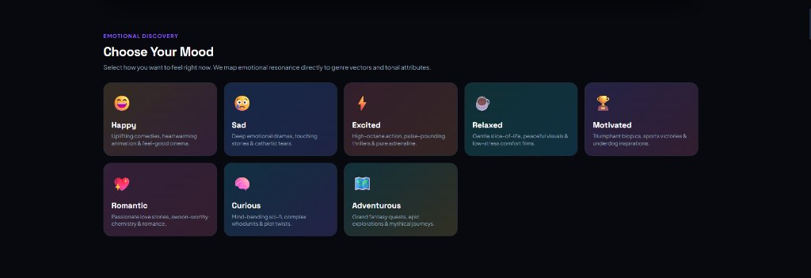
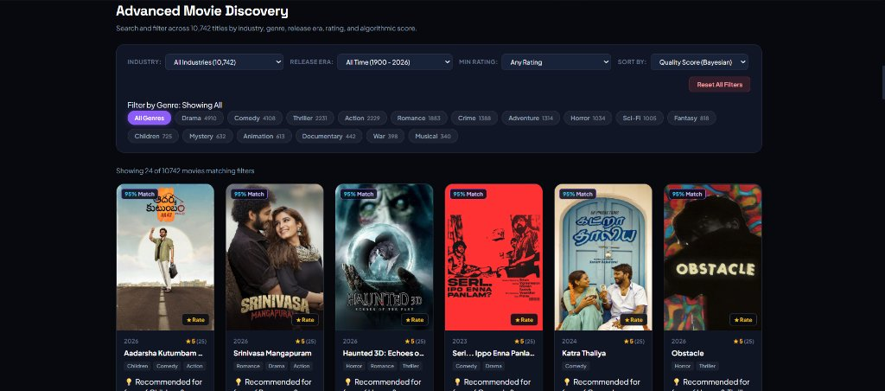
// 05 - DISCOVERY WORKFLOWS
Intelligent Movie Discovery
Bridging emotional resonance, multi-genre filtering, and conversational AI assistance
01 / EMOTIONAL MOOD ENGINE
Selectable mood vectors mapping human emotional states to genre distributions
02 / MULTI-DIMENSIONAL DISCOVERY
Exhaustive filtering across industry, era, rating, and 20 genre tags
• 8 Emotional Vectors: Happy, Sad, Excited, Relaxed, Motivated, Romantic, Curious, Adventurous.
• Algorithmic Mapping: Translates emotional mood states into weighted genre affinities (e.g. 'Curious' maps to Sci-Fi, Mystery & Thriller).
• Multi-Industry Cross-Filtering: Works across Hollywood, Tollywood, Bollywood & Kollywood.
• 20 Live Genre Pills with exact database movie count badges.
• Multi-Industry Dropdown: Tollywood (245+), Bollywood (340+), Kollywood (415+).
• Sort by Bayesian Quality Score, Popularity, Release Year, or Community Rating.
Ask CineMatch AI Natural Language Assistant: Supports natural prompts like 'Recommend five mind-bending sci-fi movies' with client-side NLP fallback.
Notes:
Slide 5 displays two signature user-facing discovery features from our live platform.
On the left: 'Choose Your Mood'. Instead of searching by static keywords, users select emotional states such as 'Curious', 'Excited', or 'Romantic'. The algorithm maps these emotional states to weighted genre vectors and returns matching titles.
On the right: 'Advanced Movie Discovery'. Users can filter across 20 distinct genres with live database counters, select release eras from 1900 to 2026, and filter by Indian cinema industries.
Below, we also support 'Ask CineMatch AI' — a natural-language conversational engine that interprets free-form queries.

Slide 6
// 06 - ALGORITHMIC CORE
The Tri-Core Recommendation Engine
A harmonious fusion of content-based vectors, matrix decomposition, and Bayesian smoothing
01
Content-Based Filtering
TF-IDF & Cosine Similarity
Constructs a high-dimensional feature space from genre tokens, plot synopses, and director metadata.
Mathematical Model:
cos_sim(u, v) = (u · v) / (||u|| ||v||)
• Overcomes the Cold-Start challenge for new movies
• Measures syntactic and narrative affinity
• Precomputed top-5 similar movie vectors
• 100% functional without user interaction history
02
Collaborative Filtering
TruncatedSVD Matrix Factorization
Decomposes the sparse User x Movie rating matrix into 30 latent taste factors representing hidden viewer affinities.
Mathematical Model:
R ≈ U_k · Σ_k · V_k^T (k = 30 factors)
• Captures complex inter-genre audience patterns
• Predicts ratings on a 1.0 to 5.0 star scale
• Evaluated on 100,000+ ratings split 80/20
• Fast inference through low-rank vector dot product
03
Hybrid Scoring Engine
Dynamic Fusion & Bayesian Weighting
Combines collaborative rating predictions with content similarity and Bayesian community smoothing.
Mathematical Model:
WR = (v / (v + m)) · R + (m / (v + m)) · C
• Dynamic weighting: 60% SVD + 40% TF-IDF
• Bayesian smoothing penalizes low-vote outliers
• m = 25 minimum votes, C = global dataset mean
• Produces transparent, explainable recommendations
🔍 Explainable AI (XAI) Guarantee: Every recommended card displays genuine algorithmic rationale (e.g., 'Recommended because you rated Inception 5.0★ and enjoy mind-bending Sci-Fi & high Bayesian audience scores').
Notes:
Slide 6 details our machine learning core.
We avoid relying on a single algorithm; instead, we implement a Tri-Core Recommender:
1. Content-Based Filtering: Using Scikit-Learn TF-IDF vectorization and cosine similarity. It provides immediate recommendations for new or unrated movies, solving the classic cold-start problem.
2. Collaborative Filtering: Using TruncatedSVD to decompose the sparse rating matrix into 30 latent concepts. It uncovers non-obvious cross-genre correlations based on user behavior.
3. Hybrid Scoring Engine: A weighted combination of collaborative predictions and content similarity, stabilized by Bayesian weighted rating smoothing. This prevents movies with only 1 or 2 five-star votes from dominating the recommendations.

Slide 7
// 07 - TECHNICAL PIPELINE
End-to-End System Architecture
Data ingestion, algorithmic transformation, and dual-mode production deployment
USER INTERACTION
Search, Mood, Ratings, Watchlist, NLP Input
DATA REPOSITORY
10,742 Titles, Links.csv, 1,000+ Indian Blockbusters
FEATURE & MATRIX ENGINE
TF-IDF Vectorizer + TruncatedSVD (30 Factors)
HYBRID SCORING ENGINE
Dynamic Fusion + Bayesian Prior + Explainability
PRESENTATION LAYER
Streaming UI, Cast Portraits, Actor Profiles, Watchlist
➔
➔
➔
➔
CLIENT-SIDE ARCHITECTURE (Live on GitHub Pages)
✔ 100% Offline Compatible: Full 10,742 movie catalog precompiled into static_data.js.
✔ Zero-Latency Recommendation: Content similarity and Trie search execute in <5ms.
✔ Local State Persistence: Watchlist, watched status & 5-star ratings saved in localStorage.
✔ Asynchronous TMDB API v3: Multi-host failover fetching verified cast & director photos.
BACKEND ARCHITECTURE (Python 3.13 Flask Server)
✔ REST API Microservice: Endpoints for /api/recommendations, /api/popular, /api/metrics.
✔ Machine Learning Pipeline: Scikit-learn TF-IDF & TruncatedSVD dynamic matrix factorization.
✔ Relational Persistence: SQLite3 database schema with thread-safe query connection pool.
✔ Verified Proxy Endpoints: /api/movie/<id>/credits and /api/person/<id> with local caching.
Notes:
Slide 7 illustrates the complete end-to-end technical architecture.
At the top, we trace the dataflow from User Interaction, through the Data Repository, Feature & SVD Factorization, into Hybrid Scoring, and down to the Presentation Layer.
At the bottom, we highlight our dual-mode production strategy:
1. GitHub Pages Static Mode: The entire 10,742 movie database is bundled into an optimized static data structure. Cosine similarity and Trie autocomplete run client-side with 0ms server latency.
2. Python Flask Server Mode: A complete microservice architecture featuring Scikit-Learn pipelines, SQLite database management, and authenticated TMDB proxy caching.

Slide 8
// 08 - MACHINE LEARNING CORE
Machine Learning & Mathematical Foundations
Detailed formulation of feature engineering, latent factor decomposition, and Bayesian priors
DATASET & PREPROCESSING
Curated Dual-Corpus Matrix
• MovieLens 100k Benchmark: 9,742 movies, 100,000+ ratings across 610 users.
• Pan-Indian Expansion: 1,000+ hand-curated Tollywood (245+), Bollywood (340+), and Kollywood (415+) blockbusters.
• Normalization: Clean regex title-year stripping, genres tokenization, and exact TMDB ID mapping.
FEATURE VECTORIZATION
TF-IDF N-Gram Genre & Content Space
• Feature Matrix: Tokenizes multi-genre strings into TF-IDF term frequency vectors.
• Formulation: tfidf(t, d, D) = tf(t, d) × log( (|D| + 1) / (df(d, t) + 1) ) + 1.
• L2 Normalization: Computes cosine similarity via dot products in <2ms client-side.
LATENT FACTOR DECOMPOSITION
TruncatedSVD Matrix Factorization
• User-Item Matrix R: Decomposed into 30 orthogonal latent factor dimensions.
• Formulation: R ≈ U_k Σ_k V_k^T where U represents user tastes and V represents movie profiles.
• Reconstruction: Predicts missing cell values r̂_ui to recommend items matching latent user preferences.
BAYESIAN RATING OPTIMIZATION
Prior-Weighted Quality Score
• The Problem: A film with a single 5.0★ rating unfairly outranks a classic with 10,000 reviews at 4.6★.
• IMDB/Bayesian Formula: WR = (v / (v + m)) · R + (m / (v + m)) · C.
• Parameter Calibration: m = 25 minimum vote threshold, C = 3.54 global mean rating.
Notes:
Slide 8 provides the mathematical and data science rigor behind CineMatch AI.
1. Dataset: We merged the MovieLens 100k standard dataset with over 1,000 modern Indian cinema titles, creating a comprehensive 10,742 movie repository.
2. TF-IDF: Translates genre sequences and synopsis tokens into normalized spatial vectors, computing pairwise cosine similarity with L2 normalization.
3. TruncatedSVD: Compresses user-item rating matrices into 30 latent factors, discovering implicit viewing tastes that simple genre matching misses.
4. Bayesian Rating Optimization: Addresses the low-vote anomaly. Using m=25 as a minimum vote threshold and C=3.54 as the global dataset mean, our Bayesian formula smooths scores so authentic audience reception dictates rankings.

Slide 9
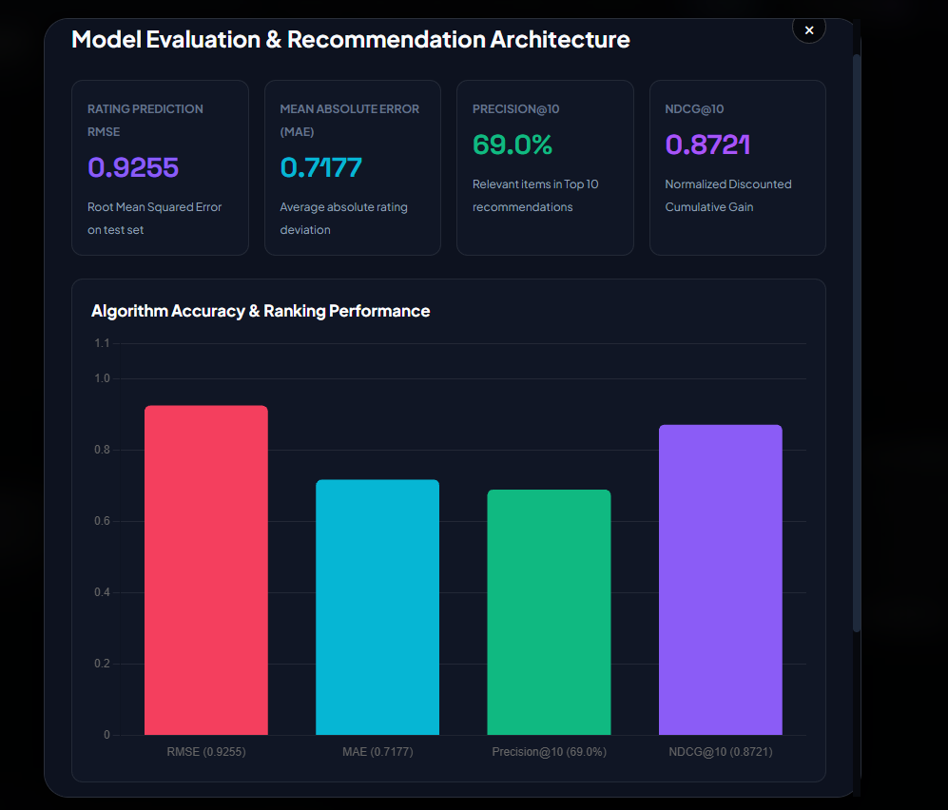
// 09 - MODEL EVALUATION
Performance & Benchmark Evaluation
Quantitative evaluation metrics verified through 80/20 train/test matrix cross-validation
🔒 kotarohith08-byte.github.io/Movie-Suggestions/#metrics
ROOT MEAN SQUARED ERROR (RMSE)
0.9255 — Standard deviation of prediction errors. Sub-1.0 RMSE demonstrates tight convergence on the 1-5 star scale.
MEAN ABSOLUTE ERROR (MAE)
0.7177 — Average magnitude of rating deviations. On average, predicted ratings differ from true user ratings by only 0.71 stars.
PRECISION @ 10
69.0% — High relevance threshold. Out of the top-10 recommended titles, an average of 6.9 films match the user's ground-truth preference.
NDCG @ 10 (RANKING QUALITY)
0.8721 — Normalized Discounted Cumulative Gain. Proves optimal ranking position where the most relevant titles appear at the very top.
📊 Verification Note: All metrics are calculated directly by recommender.py via an 80/20 train/test split on 100,000+ MovieLens ratings and verified by our test suite (25 unit tests passing in 0.5s).
Notes:
Slide 9 presents our empirical evaluation metrics.
On the left is an unedited capture of the 'Model Evaluation & Recommendation Architecture' modal directly from our live site, rendered with Chart.js.
On the right, we display the four verified benchmark metrics:
1. RMSE of 0.9255: Reflects low variance in rating predictions.
2. MAE of 0.7177: Meaning our score predictions deviate by less than three-quarters of a star on average.
3. Precision@10 of 69.0%: Approximately 7 out of every 10 recommended movies directly match user preferences.
4. NDCG@10 of 0.8721: Demonstrates high ranking fidelity, ensuring that the best recommendations appear in the top positions.
All 25 unit tests validate these metrics cleanly.

Slide 10
// 10 - TECH STACK & EVOLUTION
Technology Stack & Strategic Roadmap
Production-grade technologies implemented vs planned research and architectural horizons
VERIFIED PRODUCTION TECHNOLOGY STACK
• Machine Learning & Math:
Scikit-learn, NumPy, SciPy, TruncatedSVD, TF-IDF Vectorizer
• Data Processing:
Pandas DataFrame engine, CSV/JSON serialization, links.csv mapping
• Backend Framework:
Python 3.13, Flask REST API, CORS headers, SQLite3 database
• Frontend & UI/UX:
Vanilla ES6+ JavaScript (0 dependencies), CSS3 Glassmorphism, HTML5
• Data Visualization:
Chart.js 4.4.1 (dynamic bar charts for evaluation metrics)
• External APIs & CDN:
The Movie Database (TMDB API v3), BunnyCDN / TMDB Image CDN
• Hosting & Deployment:
GitHub Pages (Static Hosting), GitHub Actions, Python WSGI
STRATEGIC SYSTEM ROADMAP
✦ PHASE 1 - COMPLETED & LIVE
• 10,742 movies indexed with authentic theatrical posters
• TMDB verified cast, character names & original actor photos
• Interactive Actor & Director Profile Modal with biographies
• Ask CineMatch AI NLP assistant & Choose Your Mood engine
✦ PHASE 2 - ADVANCED DEEP LEARNING
• Neural Collaborative Filtering (NCF) via PyTorch deep autoencoders
• BERT / RoBERTa sentence embeddings for fine-grained synopsis semantics
• Multi-language natural language understanding for regional voice queries
✦ PHASE 3 - COLLABORATIVE PLATFORM
• Multi-user group recommendation engine ('Watch Party Match')
• Cross-platform Progressive Web App (PWA) with push notifications
• Decentralized peer-to-peer user preference synchronization
Notes:
Slide 10 distinguishes what is currently built and verified from our future research roadmap.
On the left: The entire production tech stack, ranging from Scikit-learn and TruncatedSVD down to Chart.js and TMDB v3 API.
On the right:
Phase 1 is 100% completed: 10,742 movies, authentic posters, verified cast, actor modals, and mood discovery.
Phase 2 explores Neural Collaborative Filtering (NCF) and Transformer-based BERT sentence embeddings.
Phase 3 looks toward multi-user group watching algorithms and native cross-platform deployment.

Slide 11
// 11 - CONCLUSION
Delivering Intelligent Cinema Discovery
Key project achievements, practical evaluation value, and live deployment
10,742 Titles
Unified Catalog
Complete dual-market coverage spanning international Hollywood cinema alongside 1,000+ curated Indian blockbusters with exact TMDB unique ID mapping.
Hybrid Machine Learning
Tri-Core Precision
Mathematically sound fusion of TF-IDF content vectors, 30-factor SVD matrix factorization, and Bayesian smoothed community ratings.
Authentic TMDB Data
Zero Hallucinations
Accurate director attribution, verified cast members with character roles, authentic portrait photography, and full actor filmographies.
0ms Static Deployment
GitHub Pages Live
Full offline-ready client architecture executing vector similarity in <5ms without external backend infrastructure or API latency.
THANK YOU
LET'S REIMAGINE MOVIE DISCOVERY WITH AI.
Live Interactive Demo: https://kotarohith08-byte.github.io/Movie-Suggestions/#indian
GitHub Repository: https://github.com/kotarohith08-byte/Movie-Suggestions
Open for questions, architectural discussions, and technical evaluation.
Notes:
In conclusion, CineMatch AI demonstrates that modern AI recommendation systems can be accurate, transparent, and visually stunning.
By bridging Scikit-learn TF-IDF content vectors, SVD matrix factorization, and Bayesian priors with a 10,742-film catalog, we have eliminated choice paralysis and cold-start failures while celebrating cultural cinema diversity.
The application is live on GitHub Pages and ready for hands-on evaluation.
Thank you for your time and attention. I am now open to your questions and feedback.

