Slide 1
The Basic Building Blocks of a Blockchain Application
May 2018

Slide 2
In memory of our father
By
Nikola Kotarov
Orlin Gotchev
Svetoslav Kotarov
Violeta Gotcheva

Slide 3
Outline
D. The Basic Building Blocks of A Blockchain Solution
D1. Immutable
D2. Trustless
D3. Secure
D4. Private
D5. Autonomous
E. Summary
A. The problem with Safety Certification Quiz Application
B. What is a blockchain?
C. Blockchain Terminology
C1. Assets and Identities
C2. Transactions
C3. Digital Signatures
C4. Cryptography Hashes

Slide 4


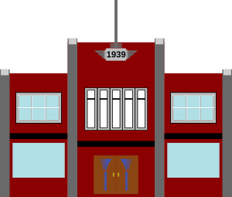
A. The problem …
4/36
Employer grants building access if employee is health and safety certified
Employee
Certification Authority
Issue certificate
Protect the integrity of the certificates
Validate the certificates when requested
Employer

Slide 5
5/36
A. The Problem: Health and Safety Training Record
Client API
mysql> select * from safety_results where trainee=‘violet’;
+----+-----------+-----------+-----------------------------+
| id | trainee | score | input_date |
+----+-----------+-----------+-----------------------------+
| 1 | violet | 24 | 2015-05-07 16:38:15|
+----+-----------+-----------+-----------------------------+
1 row in set (0.00 sec)
Server
Identity
Application
Data
Storage

Slide 6
6/36
Can we protect the record better?

Slide 7
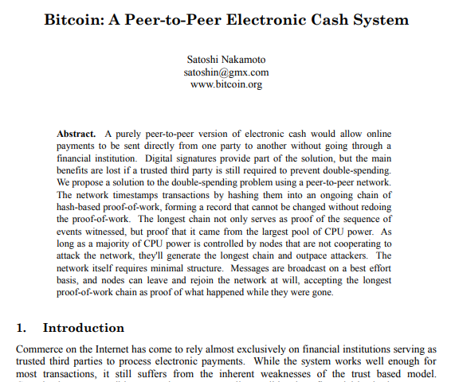
7/36
https://bitcoin.org/bitcoin.pdf
Naivecoin: a tutorial for
Building a cryptocurrency
https://lhartikk.github.io/

Slide 8
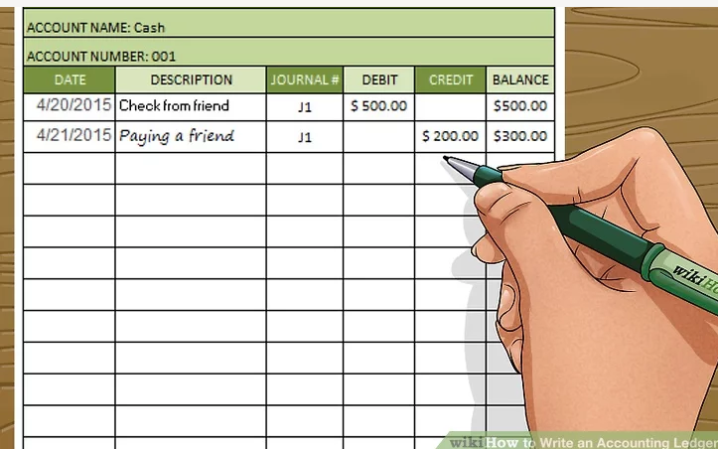
8/36
B. What is a blockchain?
A Distributed Ledger
From https://www.wikihow.com/Write-an-Accounting-Ledger

Slide 9
9/35
9/36
Centralized Decentralized Distributed

Slide 10



10/36
10/35
B.Public and Private networks
Public
Permissionless
Private
Permissioned
Bitcoin
Ethereum

Slide 11
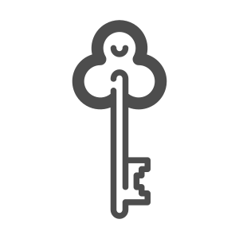
11/36
C.Blockchain terminology – Assets and Identities
An asset is the certificate.
Certificate
Public/Private keys are used to identify employer and employee
Private
Public

Slide 12
12/35
12/36
C.Blockchain terminology – Transactions and Signatures
Certificate
Digitally
Signed
The issuance of the certificate is a transaction.
The transactions are digitally signed
Private
Digitally
Signed
Public

Slide 13
13/36
C.Blockchain terminology – Cryptography Hashes
Integrity is protected by secure hashes
Message with arbitrary length
violet | 24 | 2015-05-07
SHA
256
Hash value with fixed length
a623246fe526351ca78bf28d67d432d5f01789fda188910bd23fb9482e21f5cc

Slide 14
14/36
can we create an immutable ledger? the blockchain (ledger) is immutable

Slide 15
15/36
D1.Immutable: Create a Reference Record for each (digital) Asset
Certificate Record
Certificate Reference
Trainee’s public key
Trainee’s public key
score
SHA256
hash
Input_date
Private
SHA256
Issuer signature
Issuer private key

Slide 16
16/36
D1.Immutable: Chain of Blocks
16/35
And all validated transactions are permanently stored in the data blocks which cannot be altered or deleted by anyone.
BLOCK 1
BLOCK 2
BLOCK 3
Certificate References
Certificate References
Certificate References
PreviousHash
PreviousHash
PreviousHash
TimeStamp
TimeStamp
TimeStamp
Hash
Hash
Hash

Slide 17
17/36
17/35
how do we trust the source(s) with the integrity of the records?
the blockchain (ledger) is
trustless.

Slide 18
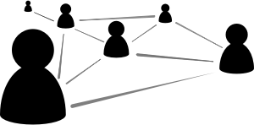
18/36
D2.Trustless: A distributed network of peer nodes each maintaining an identical copy of the blockchain
18/35
Blockchain
No intermediary
Traditional
Certification Authority

Slide 19
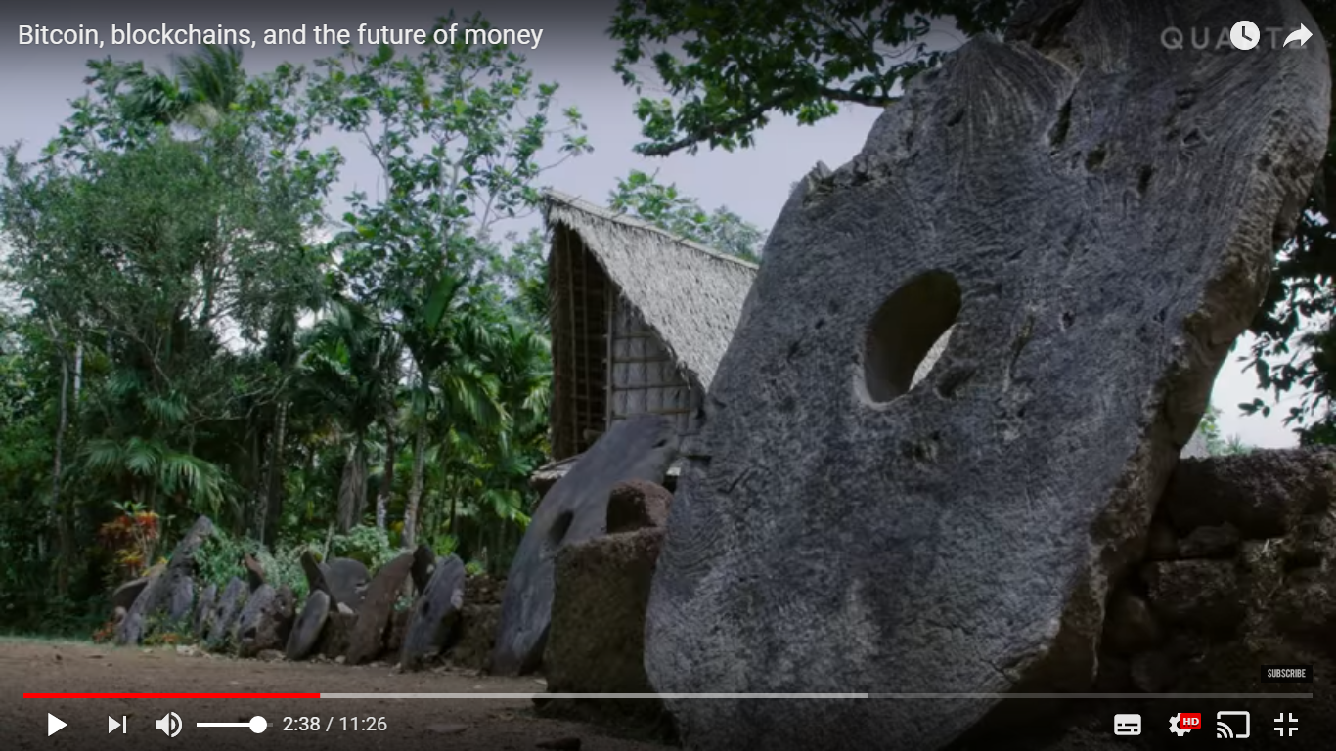
19/36
19/35
D2.Trustless : Rai stones used as money on the pacific island of Yap
https://youtu.be/A-L2M0l5dEY?t=30s

Slide 20
D2.Trustless: Blockchain peers do not trust each other
20/36
20/35
2. Add transaction to Block X
1. Submit transaction
3. Block X
Peer
Peer
3. Block X
Client
Application
SDK
3. Block X
3. Block X
Peer
Peer
More transactions?
New node?

Slide 21
21/36
how do peers sync the different copies of the blockchain?
The blockchain ledger is
secure

Slide 22
22/36
D3.Secure: Consensus about the truth
22/35
The technology relies on a consensus from all network members for the validation of a transaction.
A decentralized system makes it difficult for hackers to breach the transaction by targeting one unit, a common pain point in a centralized system where the data is stored at a single core.

Slide 23


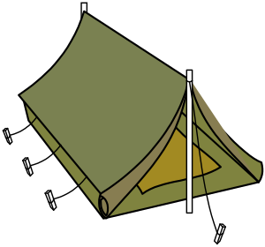

23/36
D3. Secure: Byzantine Fault Tolerance Consensus Algorithm
Byzantine General’s Problem
YES
https://www.youtube.com/watch?v=_MwqAaVweJ8
YES
YES
51% attack
YES
https://youtu.be/DHa5w1jWGuw
NO

Slide 24
24/36
D3.Security: Consensus by Proof of work (POW)
Bitcoin POW
scanning for a value that when hashed, such as with SHA-256, the hash begins with a number of zero bits.
Useful Proof-of-Work
Primecoin requires clients to find unknown prime numbers of certain types, which can have useful side-applications
https://bitcoinmagazine.com/articles/primecoin-the-cryptocurrency-whose-mining-is-actually-useful-1373298534/
Mining
Representation in majority decision making
One CPU = One VOTE
The majority decision is represented by the longest chain

Slide 25
25/36
D3.Security: Consensus in Hyperledger Fabric (private, permissioned blockchain)
Consensus = Transaction Endorsement + Ordering + Validation
Endorsing
Committing
E1
E1
Ordering
Client
Application
SDK
P1
O1
O1
E2
O1
O1
E3
P2
From https://docs.google.com/presentation/d/1p-5obfijoC1gBn9_FcUfOI7QytX8Oacekz9THd4-e00/edit#slide=id.p25

Slide 26
26/35
26/36
D4.the blockchain (ledger) can guarantee privacy
The Certificate
is public
The Certificate contains
personal data
How can the owner choose what to share with whom?

Slide 27

27/36
D4.Private: Zero knowledge proofs
Certificate Record
Certificate Reference
Trainee’s public key
Trainee’s public key
score
SHA256
hash
Input_date
SHA256
Issuer signature
Issuer private key

Slide 28
28/36
The blockchain ledger is autonomous

Slide 29
29/36
D5.Employer grants building access if employee has a health and safety certification
Certified?
Passed?
Training
and Quiz
Record
Certification
Employee
NO
YES
YES
NO
Grant Building
Access
Autonomous: Smart Contracts
Computer code on the blockchain • Business relationship • Automatic execution

Slide 30
30/36
Don’t we already run computer code with business logic and automation?

Slide 31
31/36
D5.Autonomous – Smart Contracts
31/35
Traditional
Blockchain
Client API
Client API
Server
Server
Identity
Smart
Contracts
Application
Data
Storage
Blockchain Network

Slide 32




32/36
32/35

Slide 33
33/36
H&SCertification
(Employer UI)
H&SCertification
(Employee UI)
Certificate in owner wallet
Identity Management
E. Summary: The Solution …
If certified then grant access
Else take certification

Slide 34
34/36
“Public, decentralized networks require high levels of security and spam-prevention that are best achieved by economic means: participants in the consensus must incur some economic cost, and all transactions processed by the network must pay a fee. “
From: https://cosmos.network/faq
E: Summary: cryptocurency?

Slide 35
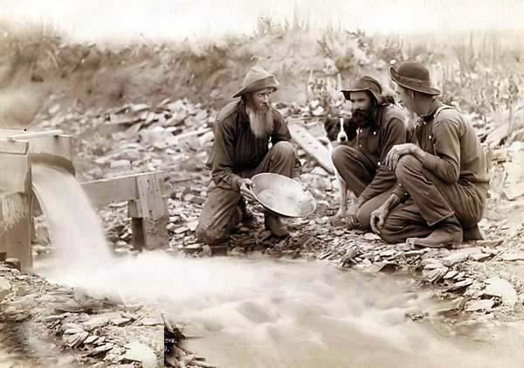
E. Summary: Takeaway
35/36
How many prospectors got rich during the California gold rush?

Slide 36
E. Summary: Takeaway
36/36
Identity Management
Academic Certification
Talent Recognition
Supply chain traceability
Voting
Land Registration
Health Care
Voting
Corporate registration
Energy trading
From https://www2.deloitte.com/insights/us/en/industry/public-sector/understanding-basics-of-blockchain-in-government.html
Immutable
thrustless
Secure
Private
Autonomous

