Slide 1
AWT CONTROLS

Slide 2
Introduction
Java AWT is an API that contains large number of classes and methods to create and manage graphical user interface ( GUI ) applications.
AWT means Abstract Window Toolkit.
Java AWT components are platform-dependent i.e. components are displayed according to the view of operating system.
But the disadvantage of such an approach is that GUI designed on one platform may look different when displayed on another platform that means AWT component are platform dependent.

Slide 3
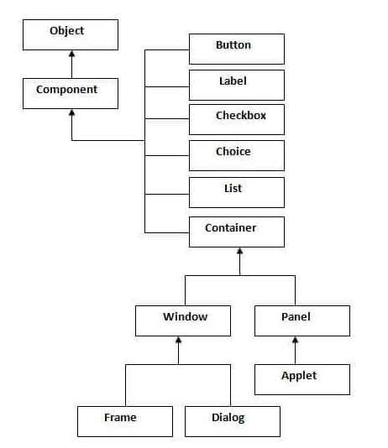
Java AWT Hierarchy
The hierarchy of Java AWT classes are given below, all the classes are available in java.awt package.

Slide 4
Component Class
Component class is at the top of AWT hierarchy.
It is an abstract class that encapsulates all the attributes of visual component.
A component object is responsible for remembering the current foreground and background colors and the currently selected text font.

Slide 5
Container
Container is a component in AWT that contains another component like button, text field, tables etc.
Container is a subclass of component class.
Container class keeps track of components that are added to another component.

Slide 6
Panel:
Panel class is a concrete subclass of Container. Panel does not contain title bar, menu bar or border. It is container that is used for holding components.
Window class
Window class creates a top level window. Window does not have borders and menu bar.

Slide 7
Frame
The Frame is the container that contain title bar and border and can have menu bars.
It can have other components like button, text field, scrollbar etc.
Frame is most widely used container while developing an AWT application.

Slide 8
Creating a Frame
Frame class has two different constructors:
Frame() : Creates a Frame
Frame(String title) : Creates a Frame With some title name
There are two ways to create a Frame. They are,
By Instantiating Frame class
By extending Frame class

Slide 9
Creating Frame Window by Instantiating Frame class
To create a Frame use the following syntax:
Frame fm=new Frame();
Frame f=new Frame(“Title Name”);

Slide 10
Frame Methods
To Specify size/coordinates to the frame
Syntax:
frameobject.setSize(coordinates);
ex: f.setSize(100,200);
To Appear/visible the generated frame
syntax:
frameobject.setVisible(true/false);
where true- it will be appeared
false- it will not appeared

Slide 11
setTitle():
It is used to assign some title name to a frame.
Syntax:
frameobj.setTitle(String name);
setBackground()
It is used to change the background color of a frame window
Syntax:
frameobj.setBackground(color_code)
Example:
f1.setBackGround(Color.red);

Slide 12
setForeground()
It is used to change the Foreground color (text).
Syntax:
frameobj.setForeground(color_code)
Example:
f1.setForeGround(Color.pink);
setLayout():
It is used to assign a layout manager to a frame window
frameobj.setLayout(LayoutType)
The default layout for frame is BorderLayout

Slide 13
To change to another layout use the following syntax.
f1.setLayout(new FlowLayout());
add():
it is used to add components to frame window.
Syntax:
frameobj.add(component)

Slide 14
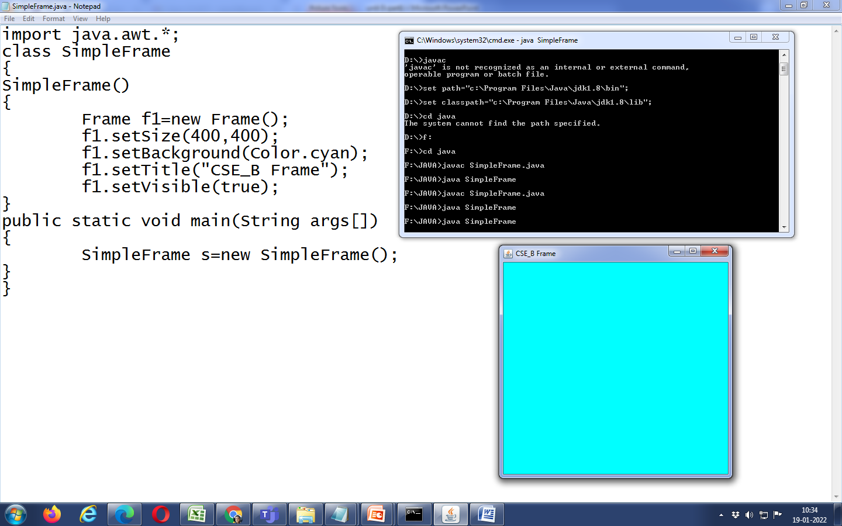
Sample program-1

Slide 15
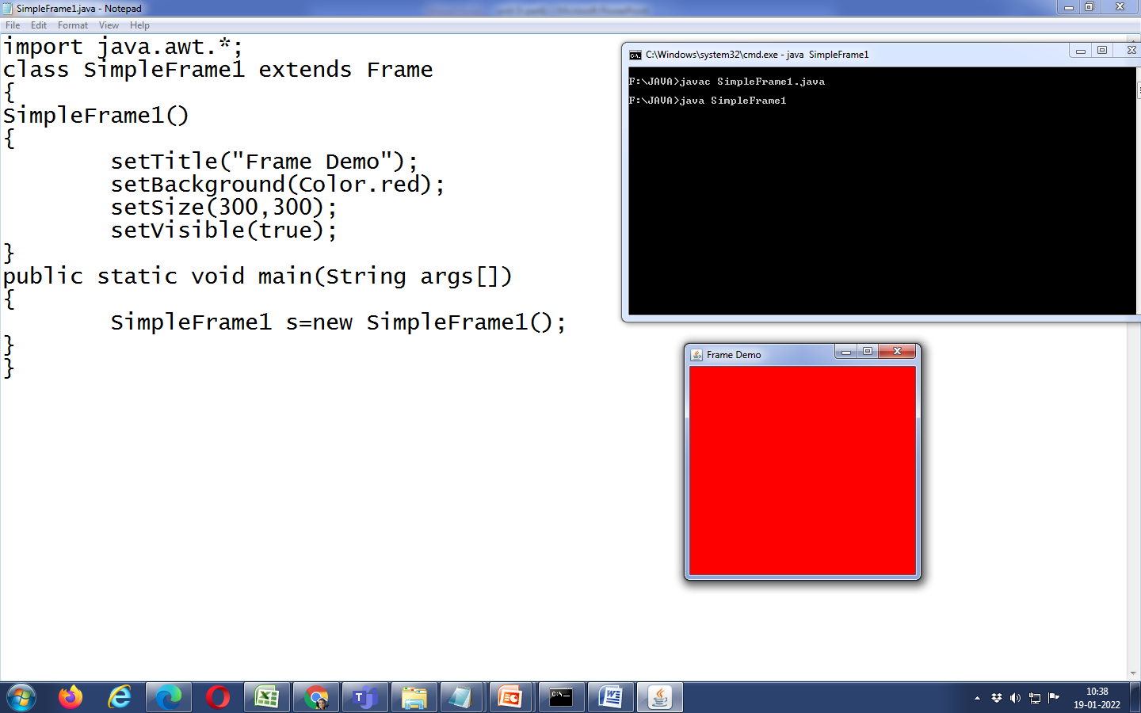
Sample Program-2

Slide 16
AWT COMPONENTS
In a window, we can add any number of components.
Some of the components are
Label
Button
TextField
CheckBox
Choice
List
ScrollBar
Menu

Slide 17
Label
The object of the Label class is a component for placing text in a container.
It is used to display a single line of read only text.
The text can be changed by a programmer but a user cannot edit it directly.
It is called a passive control as it does not create any event when it is accessed.

Slide 18
Creation of Label
To add any text/ label on the container need to create object using Label class.
To create any label use the below constructors.
Label() --- It creates an empty label
Label(String text) – It creates label with some text by default left alligned
Label(String name,int allign) - it creates label with text positioned with alignment

Slide 19
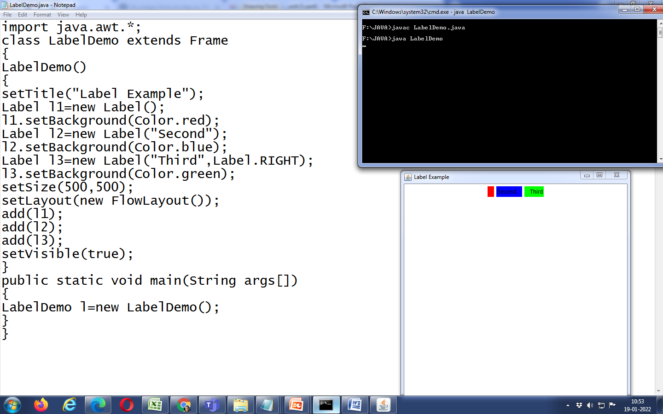
Sample Program

Slide 20
Methods
setText(): It is used to set some text for label object
Syntax: void setText(String text)
getText() : it retutrns text of a particular label object
Syntax: String getText()
setAllignment() : It is used to assign alignment position for a text on a label.
Syntax: void setAllignment(int pos)
The possible values for pos are Label.LEFT, Label.CENTER and Label.RIGHT

Slide 21
getAllignment(): It returns the allignment posittion
int getAllignment()

Slide 22
Button
It is a regular push button that can contain text.
It can be created by instantiating the Button class.
The text on the button is called button label.
It is a active component, when ever user presses a button an “ActionEvent” is generated.
A Button can be created using
Button button=new Button(); -- it creates empty button with out name Button button=newButton(String butname); -- it creates button with some name

Slide 23
Methods:
getLabel(): It returns the label name of a button.
Syntax: String getLabel()
2. setLabel() : It is used to assign a name to button.
Syntax: void setLabel(String label)

Slide 24
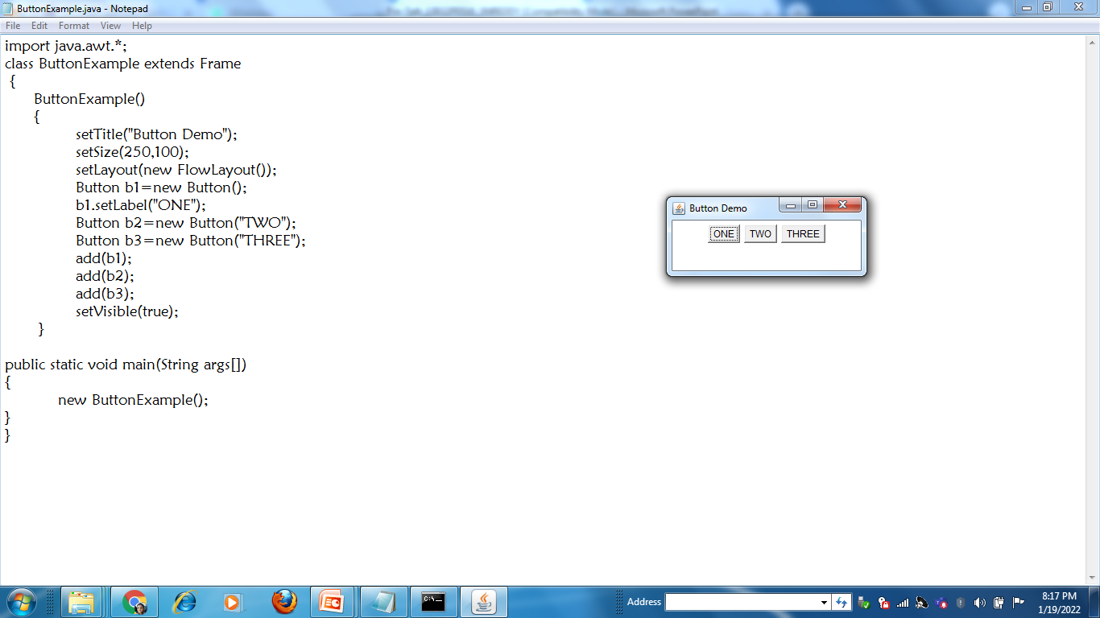
Example

Slide 25
TextField
The object of a TextField class is a text component that allows a user to enter a single line text and edit it.
Constructors:
TextField()
TextField(String name)
TextField(int columns)
TextField(String txt,int columns)

Slide 26
Creation of Text Field
TextField tf1=new TextField();
Methods:
1. setText(): It used to add some text to particulr text field object.
Syntax: void setText(String text)
getText(): it returns or extracts text from a particular text field.
Syntax: String getText()
3. void setEchoChar(char c) :It sets the echo character for text field.
4. char getEchoChar()It fetches the character that is used for echoing.

Slide 27
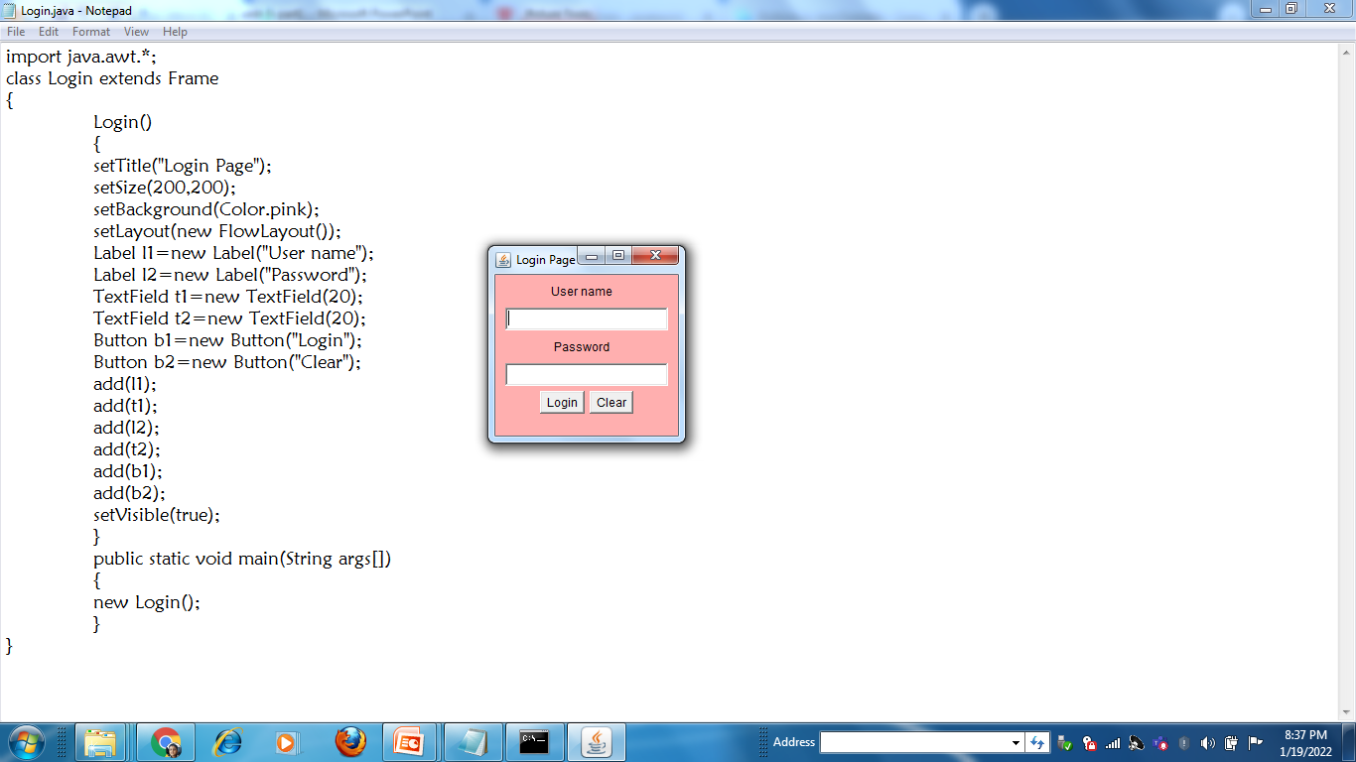

Slide 28
TextArea
The object of a TextArea class is a multiline region that displays text. It allows the editing of multiple line text.
Constructors:
TextArea(): It constructs a new and empty text area with no text in it.
TextArea(int row,int col) : It constructs a new text area with specified number of rows and columns and empty string as text.
TextArea (String text) :It constructs a new text area and displays the specified text in it.

Slide 29
TextArea (String text, int row, int column) :
It constructs a new text area with the specified text in the text area and specified number of rows and columns.
Methods:
void append(String str) It appends the specified text to the current text of text area.
int getColumns()It returns the number of columns of text area.
int getRows()It returns the number of rows of text area.
void insert(String str, int pos)It inserts the specified text at the specified position in this text area.

Slide 30
6. void setColumns(int columns)It sets the number of columns for this text area.
7. void setRows(int rows) It sets the number of rows for this text area.

Slide 31
Checkbox
The check box, as it is a component used to plot an option which can be connected (on ​​= true) or off (off = false).
It is usually used to display a set of options which can be selected independently by the user, or allow multiple selections.
These controls also have a label associated with them which describes the option of the checkbox.
This control supports many constructors.
Checkbox chbox=new Checkbox();
Checkbox chbox=new Checkbox(String str);
Checkbox chbox=new Checkbox(String str, boolean true);

Slide 32
Methods:
1. String getLabel() It fetched the label of checkbox.
2. boolean getState() It returns true if the checkbox is on, else returns off.
3. void setLabel(String label) It sets the checkbox's label to the string argument.
4. void setState(boolean state) It sets the state of checkbox to the specified state.

Slide 33
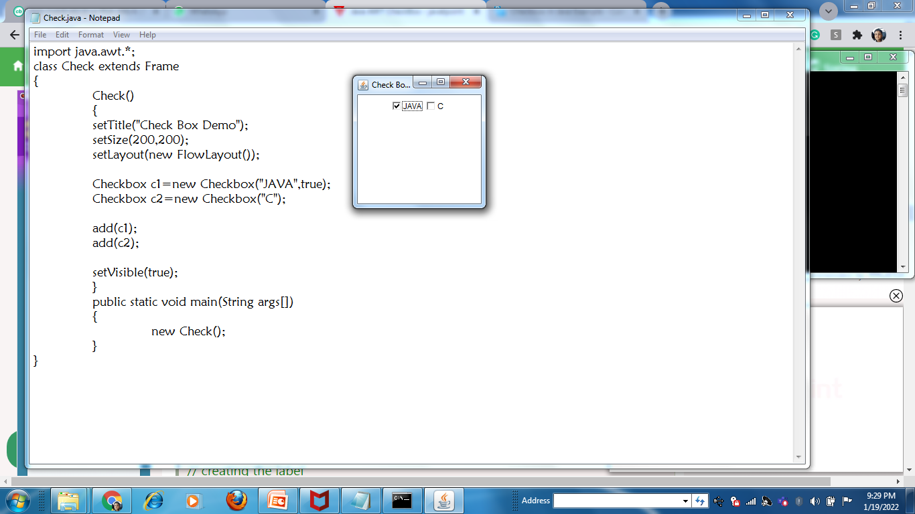

Slide 34
Radiobutton
At a time only one check box button is allowed to be in "on" state and remaining check box button in "off" state.
To create radio button, we need to use a built in class CheckboxGroup.
There is no special control for creating radio buttons in AWT.
To create radio buttons, first we need to create a
Checkbox group
CheckboxGroup cbg=new CheckboxGroup():

Slide 35
Constructors:
Only one constructor
Checkbox(String label, CheckboxGroup group, boolean state)
It constructs a checkbox with the given label, in the given checkbox group and set to the specified state.

Slide 36
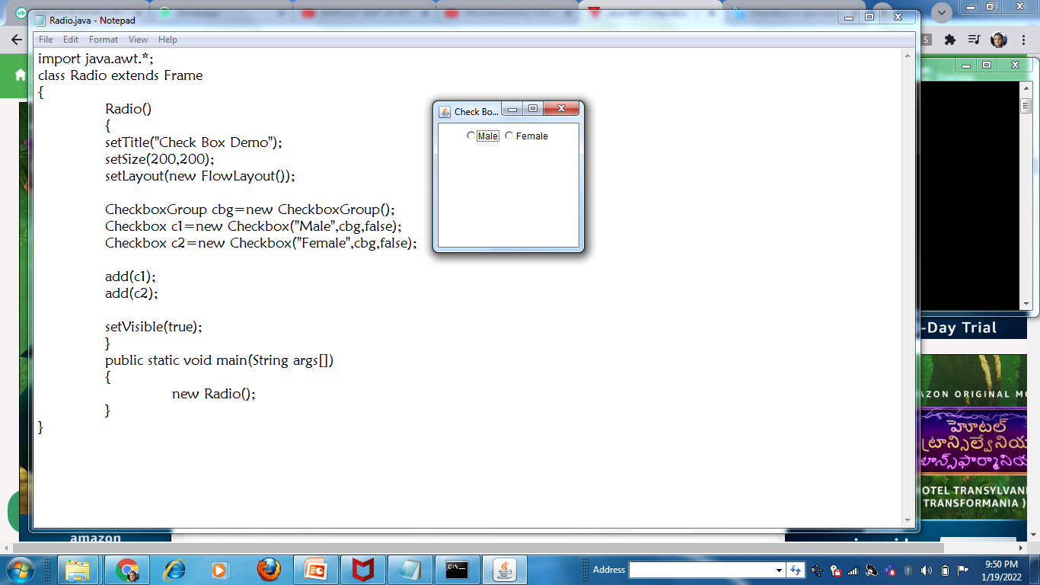

Slide 37
Choice
The object of Choice class is used to show drop down list of choices.
Choice selected by user is shown on the top of a menu.
A user is allowed to select one option from the choice.
To create a Choice list use the following syntax:
Choice c= new Choice();

Slide 38
Methods
void add(String item)It adds an item to the choice menu.
String getItem(int index) It gets the item at the given index position in the choice menu.
int getItemCount()It returns the number of items of the choice menu.
int getSelectedIndex()Returns the index of the currently selected item.
String getSelectedItem()Gets a representation of the current choice as a string.

Slide 39
void insert(String item, int index)Inserts the item into this choice at the specified position.
void remove(int position)It removes an item from the choice menu at the given index position.
void remove(String item)It removes the first occurrence of the item from choice menu.
void removeAll()It removes all the items from the choice menu.

Slide 40
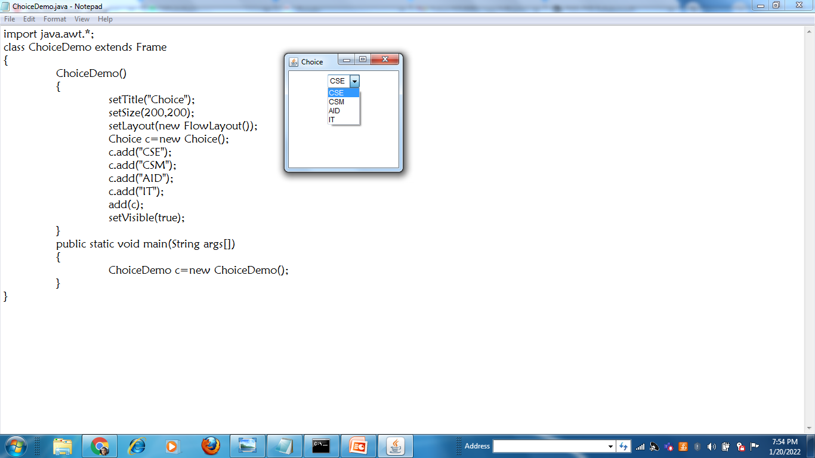

Slide 41
List
The object of List class represents a list of text items. With the help of the List class, user can choose either one item or multiple items.
To create a List use the following constructors
List()--- It constructs new List
List(int num) --- It constructs scrolling list; at a time specified number of items are visible
List(int num, bollean multiplemode) -- if boolean value is true.. It is allowed to select multiple options

Slide 42
Methods
void add(String item)It adds the specified item into the end of scrolling list.
void add(String item, int index)It adds the specified item into list at the given index position.
String getItem(int index)It fetches the item related to given index position.
int getItemCount()It gets the count/number of items in the list.
String[] getItems()It fetched the items from the list.

Slide 43
int getSelectedIndex()It fetches the index of selected item of list.
int[] getSelectedIndexes()It gets the selected indices of the list.
String getSelectedItem()It gets the selected item on the list.
String[] getSelectedItems()It gets the selected items on the list.

Slide 44
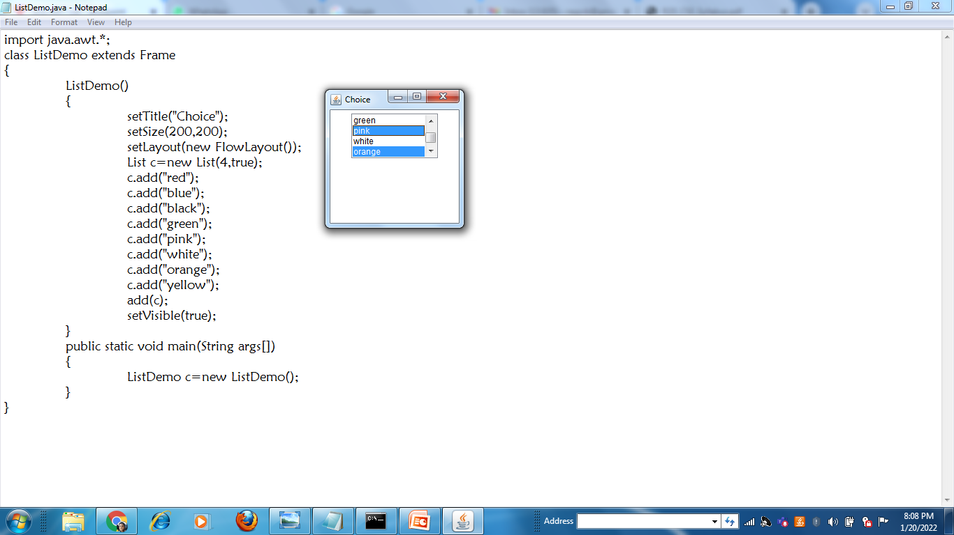

Slide 45
Canvas
The Canvas class controls and represents a blank rectangular area where the application can draw any paintings.
To create a Canvas use the following syntax:
Canvas ob=new Canvas();
Methods:
1. paint(Grpahics g): It is used to place a text or draw any shapes on the canvas window.

Slide 46
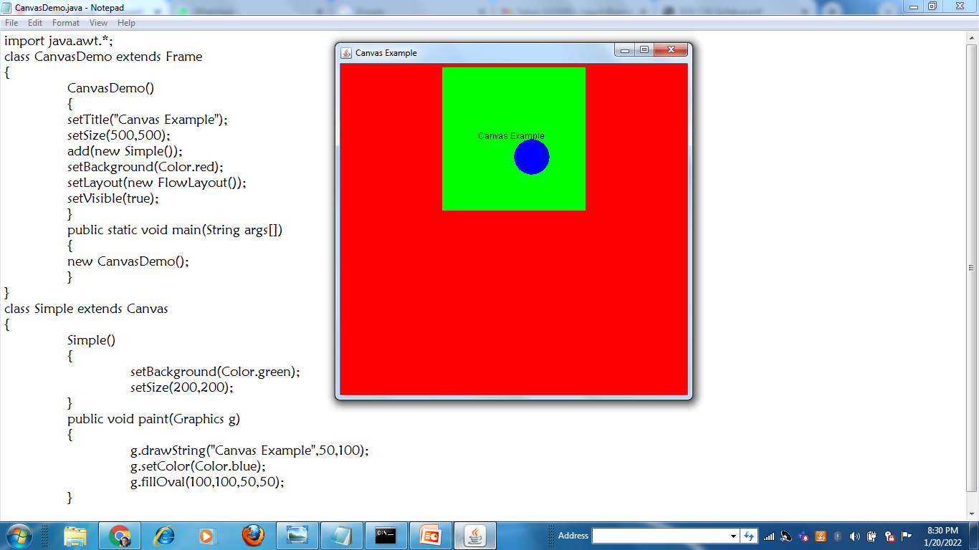

Slide 47
MenItem & Menu
The object of MenuItem class adds a simple labeled menu item on menu.
The object of Menu class is a pull down menu component which is displayed on the menu bar. It inherits the MenuItem class.
First we need to create MenuBar
MenuBar ob=new MenuBar();
Create Menu
Menu m1=new Menu(“Menu_name”);

Slide 48
Create MenuItem
MenuItem i1=new MenuItem(“Name”);
Add menu items on the Menu
m1.add(i1);
m1.add(i2);
Add Menus to MenuBar
At last add MenuBar to Container.
setMenuBar(mb);

Slide 49
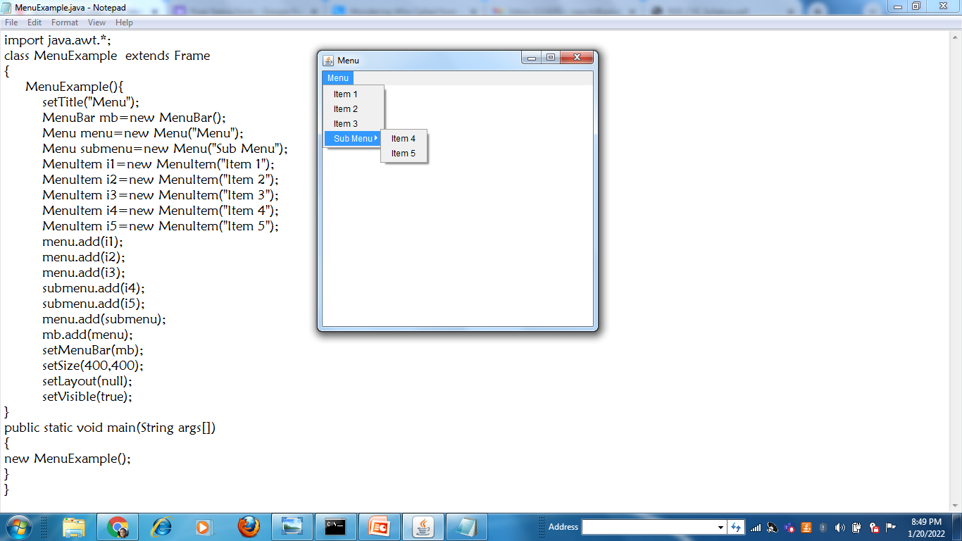

Slide 50
Scroll Bar
The object of Scrollbar class is used to add horizontal and vertical scrollbar. Scrollbar is a GUI component allows us to see invisible number of rows and columns.
It can be added to top-level container like Frame or a component like Panel.
The Scrollbar class extends the Component class.

Slide 51
Scrollbar Class Fields
static int HORIZONTAL - It is a constant to indicate a horizontal scroll bar.
static int VERTICAL - It is a constant to indicate a vertical scroll bar.
Constructors:
Scrollbar() Constructs a new vertical scroll bar.
Scrollbar(int orientation) Constructs a new scroll bar with the specified orientation.
orientation: specifiey whether the scrollbar will be horizontal or vertical.

Slide 52
Layout Managers
The Layout Managers are used to arrange components in a particular manner.
The Java LayoutManagers facilitates us to control the positioning and size of the components in GUI forms.
LayoutManager is an interface that is implemented by all the classes of layout managers.

Slide 53
Types of Layouts
FlowLayout
BorderLayout
GridLayout
CardLayout

Slide 54
Border Layout
The BorderLayout is used to arrange the components in five regions: north, south, east, west, and center.
Each region (area) may contain one component only.
It is the default layout of a frame or window.
The BorderLayout provides five constants for each region:
BorderLayout.NORTH
BorderLayout.SOUTH
BorderLayout.EAST
BorderLayout.WEST
BorderLayout.CENTER

Slide 55
Constructors
BorderLayout(): It creates a border layout, with no gaps between the components.
BorderLayout(int hgap,int vgap): creates a border layout with the given horizontal and vertical gaps between the components.
To add any component on the particular region use the following syntax:
Frameobj.add(component, Region)

Slide 56
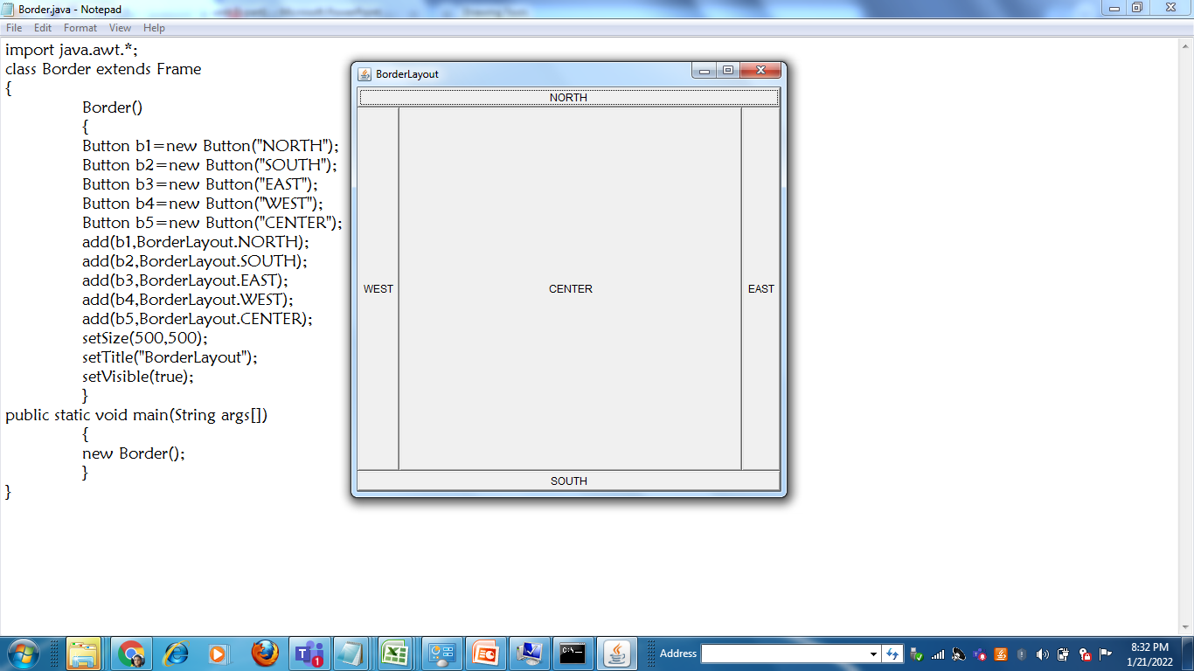
Example Program

Slide 57
Flow Layout
The Java FlowLayout class is used to arrange the components in a line, one after another (in a flow). It is the default layout of the applet or panel.
It follows left to right and top to bottom.
To apply flow layout for a frame window use setLayout() method.

Slide 58
Constructors of FlowLayout class
FlowLayout(): creates a flow layout with centered alignment and a default 5units horizontal and vertical gap.
FlowLayout(int align): creates a flow layout with the given alignment and a default 5units horizontal and vertical gap.
FlowLayout(int align, int hgap, int vgap): creates a flow layout with the given alignment and the given horizontal and vertical gap.
The possible alignment values are:
FlowLayout.LEFT,
FlowLayout.RIGHT, and
FlowLayout.CENTER

Slide 59
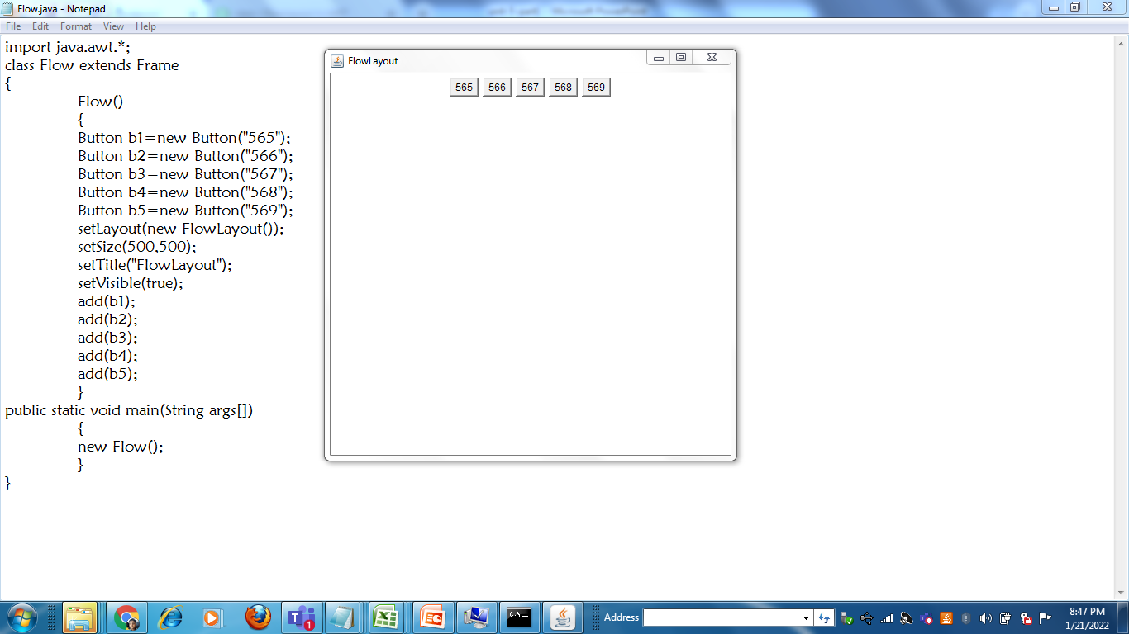

Slide 60
Grid Layout
The Java GridLayout class is used to arrange the components in a rectangular grid (matrix form). One component is displayed in each rectangle.

Slide 61
Constructors of GridLayout class
GridLayout(): creates a grid layout with one row, all components are placed on same row.
GridLayout(int rows, int columns): creates a grid layout with the given rows and columns but no gaps between the components.
GridLayout(int rows, int columns, int hgap, int vgap): creates a grid layout with the given rows and columns along with given horizontal and vertical gaps.

Slide 62
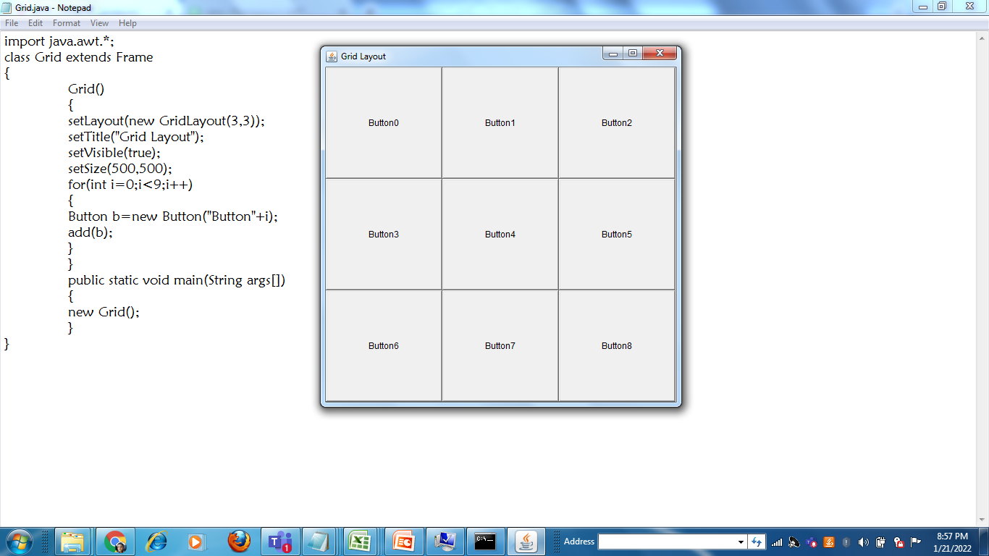

Slide 63
Card Layout
The Java CardLayout class manages the components in such a manner that only one component is visible at a time.
It treats each component as a card that is why it is known as CardLayout.
Constructors of CardLayout Class
CardLayout(): creates a card layout with zero horizontal and vertical gap.
CardLayout(int hgap, int vgap): creates a card layout with the given horizontal and vertical gap between borders.

Slide 64
Methods
public void next(Container parent): is used to flip to the next card of the given container.
public void previous(Container parent): is used to flip to the previous card of the given container.
public void first(Container parent): is used to flip to the first card of the given container.
public void last(Container parent): is used to flip to the last card of the given container.
public void show(Container parent, String name): is used to flip to the specified card with the given name.

Slide 65
