Slide 1
Project By
Name :KOTA SAGAR
Roll no :20761A0595
CSE –B
Project Guide
k. Devi Priya

Slide 2
Project info
I have designed a simple registration from about the job registration form ,
->Mainly I concentrated on the frontend and also covered the all the concepts in html and css and javascript
->in this job registration form I have classified web page into 2 types
1.primary details
2.secoundary details
->In this primary side I have mentioned all the basic details such as address ,contact info and bio data …
->on the other side the main details are required for the job like previous job details and education qualifications and company requirements etc…
->this info it will give brief idea about my project

Slide 3
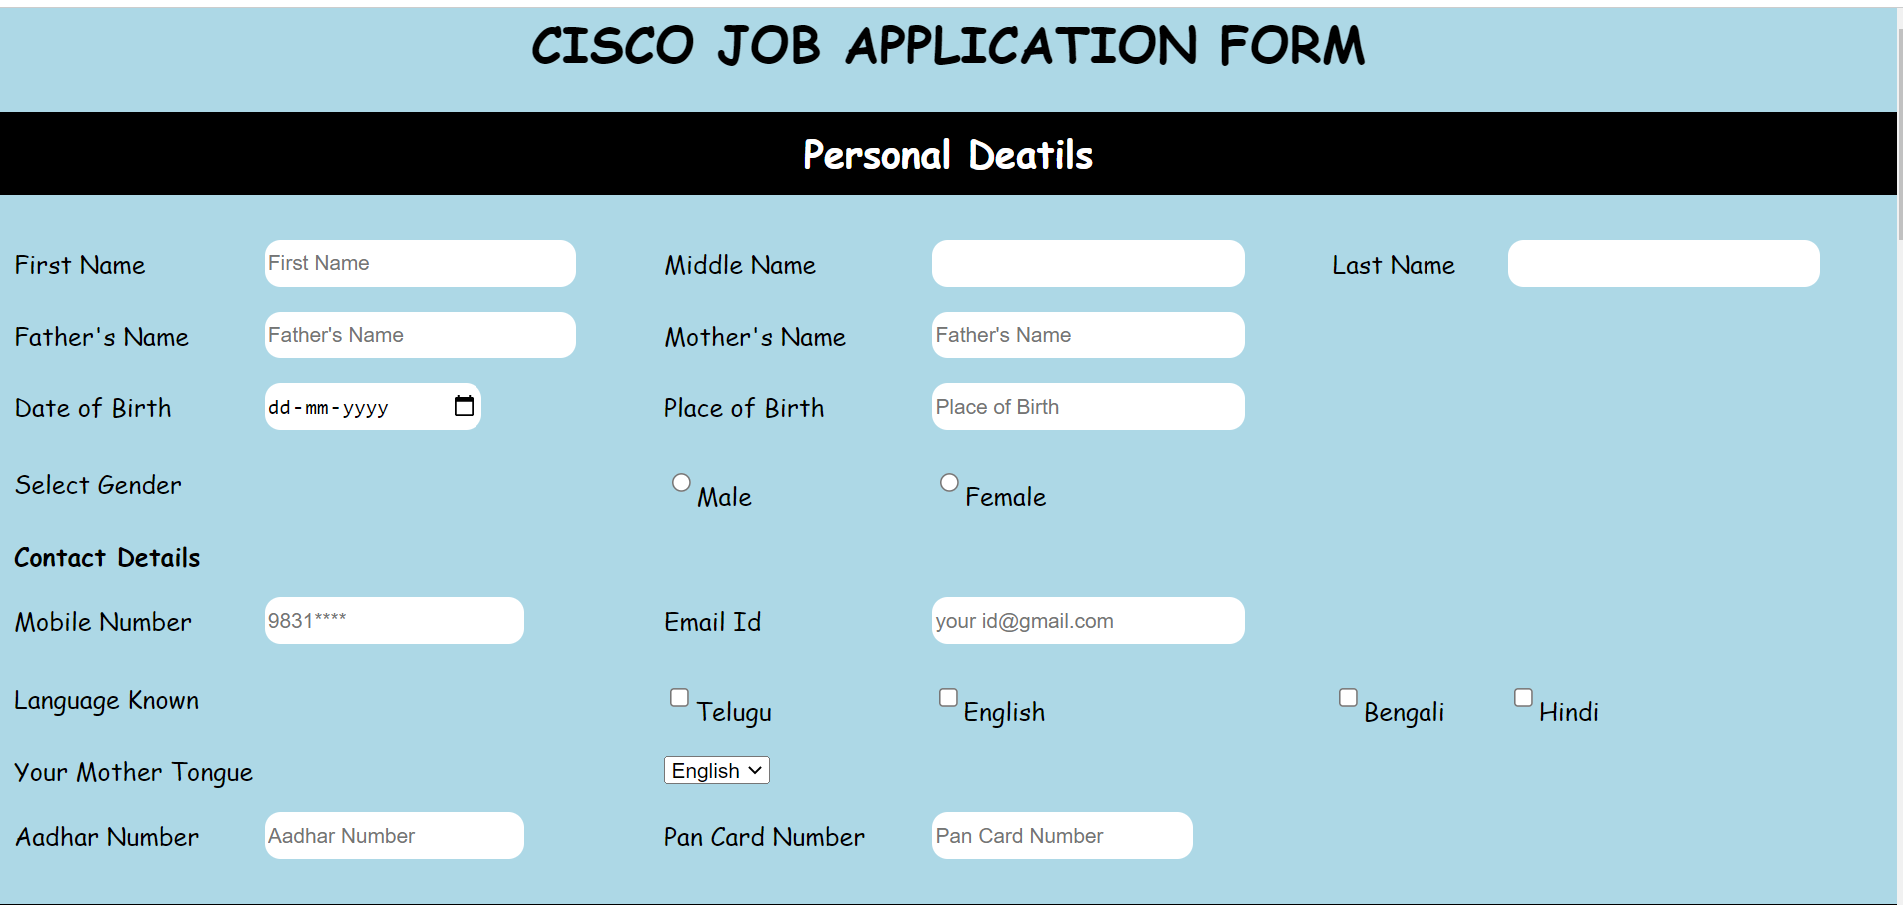
results

Slide 4
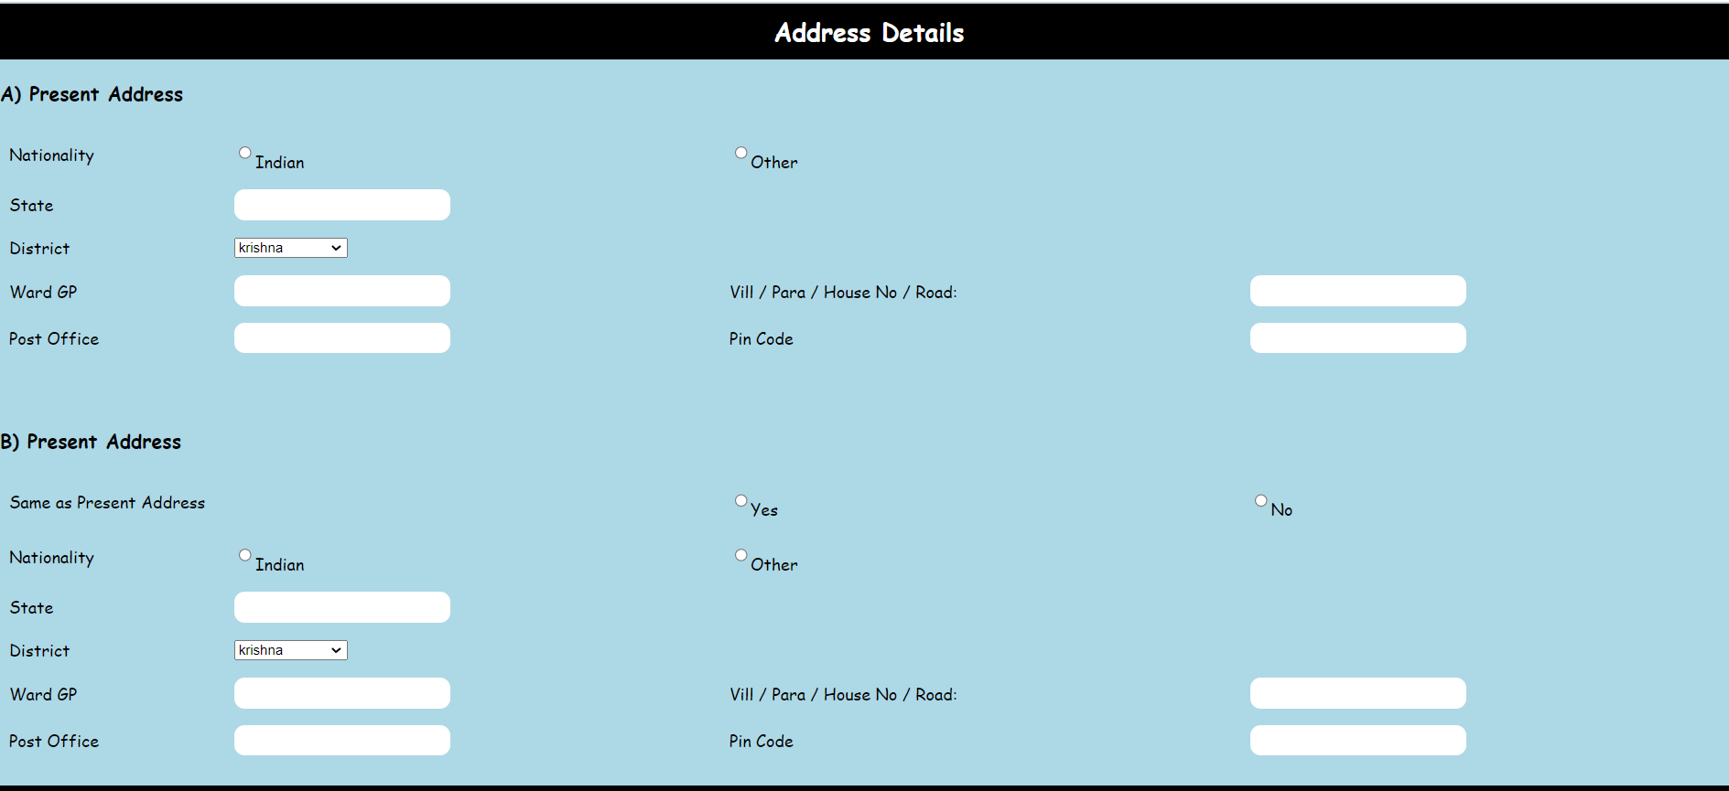

Slide 5
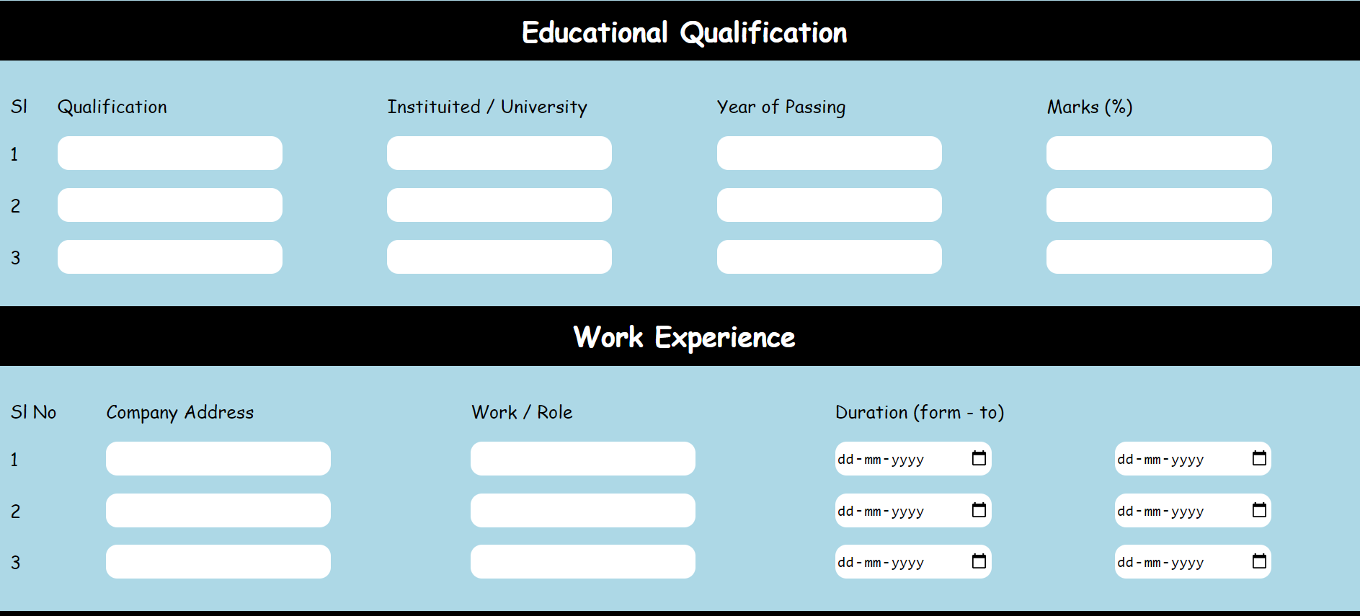

Slide 6
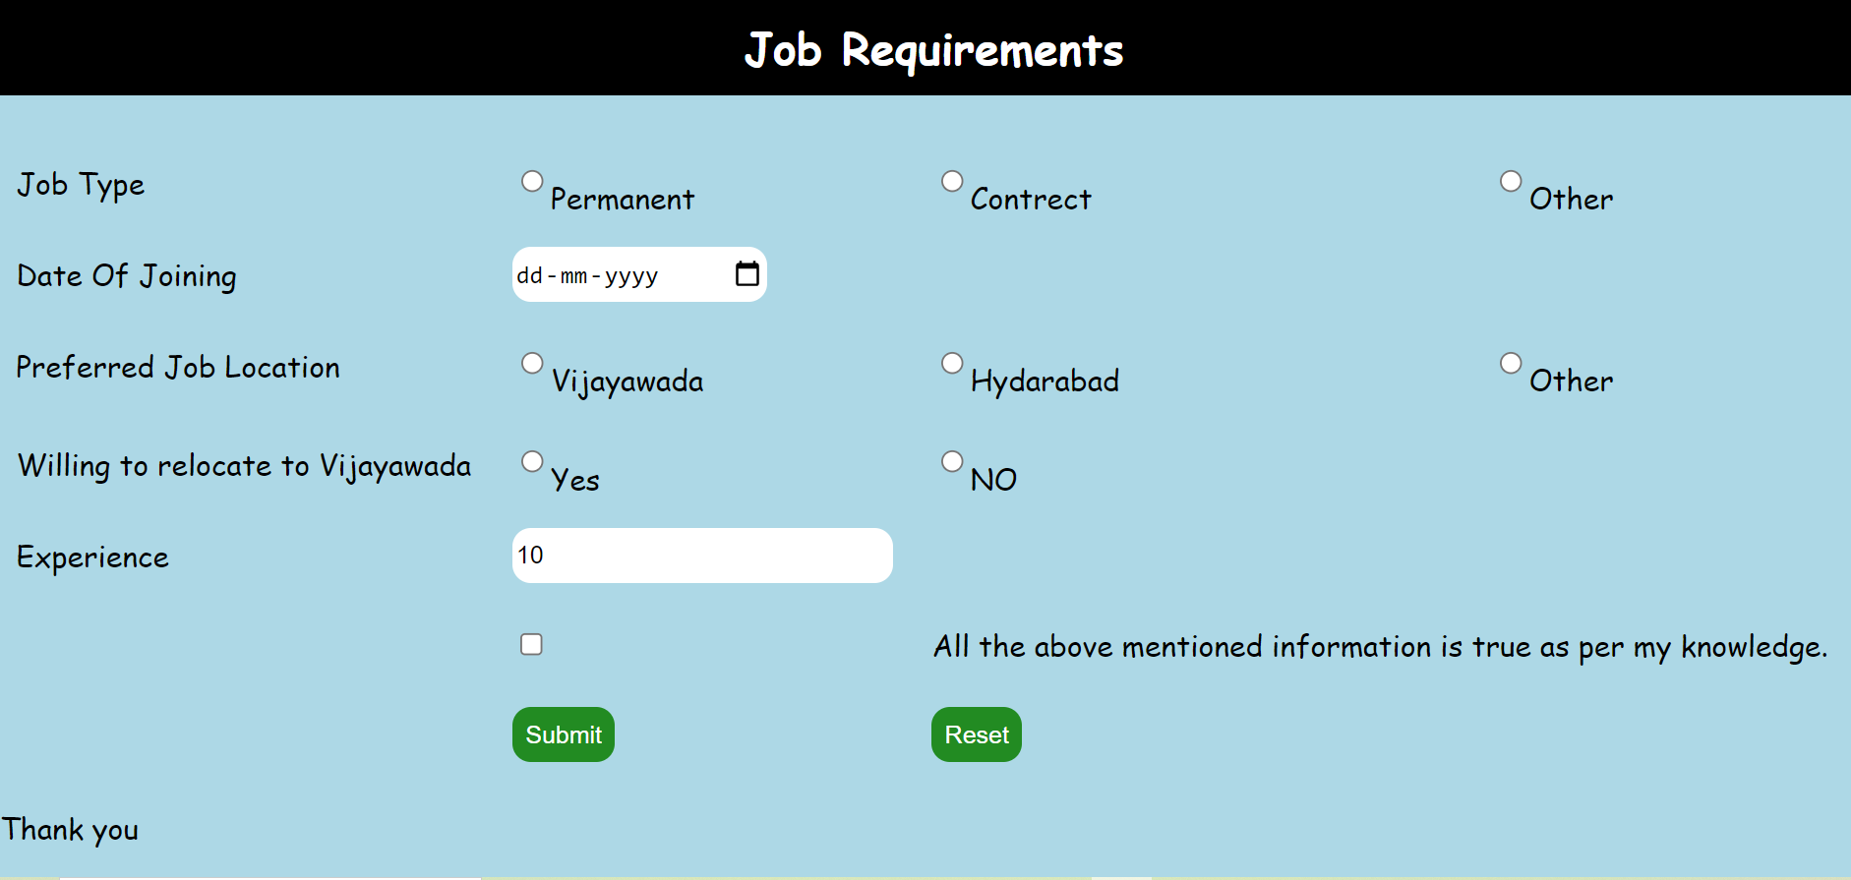

Slide 7
Conclusion
Mainly I worked my project on div tag defines a division or section in a HTML document.
I have included concepts like table with border zero ,list ,css properties ,javascript and some other concepts
This project will give entire idea to prepare a registration form
Links & references :-
>www.html.com
>www.codecademy.com
>www.w3schools.com
>www.tutorialspoint.com

Slide 8
The end

