Slide 1
Sales Forecasting of Retail Clothing Product Categories
KOTA SANJEEVA

Slide 2
contents
Domain Background
Problem Statement
Datasets , Inputs and Preprocessing
Time series model
Regression model
Conclusion

Slide 3
Domain Background
Retail is one of the most important business domains for data science and data mining applications because of its prolific data and numerous optimization problems such as optimal prices, discounts, recommendations, and stock levels that can be solved using data analysis methods.

Slide 4
Problem Statement
The initial sales data given is monthly sales data by product category. You have to make month level forecasts for the year 2016 (Jan 2016 to Dec 2016) using time series models for each product category with the past historical data provided for the period from 2009 to 2015.
Using Time Series and Regression models.

Slide 5
Datasets and Inputs
Sales : “Train.csv”
1. This table contains the Temporal data like Year, Month, and Product category and Sales (In Thousand Dollars), provided for the period 2009 to 2015
2. Weather data: “WeatherData.xlsx”
This is obtained for the period from 2009 to 2016 from different sources and has the information about the weather conditions like temperature, wind speed, humidity, visibility, precipitation etc.
3. Event/Holidays data: “Events_HolidaysData.xlsx”
It’s obvious that we shop more during the holidays or during festivals etc. Hence, the event data for the period from 2009 to 2016 has the information like Year, Month-Date, Event, Day category(federal holiday or event)
4.Macro Economic Data: “MacroEconomicData.xlsx”
This data is provided for the period from 2009 to 2016 with the details like CPI, GDP, Cotton production, mill usage, unemployment rate etc.
This has the details of attributes for the datasets cited above (1 to 4)

Slide 6
preprocessing
Checking missing values and missing values are presenting in “Sales.In.ThousandDollars.” attribute.
Imputation of missing values using “na.locf()” function.
Year and Month converting into Date format.
Combined four datasets.
Again checking missing values and imputing missing values.
Binding WomenClothing attribute with remaining three data set.

Slide 7
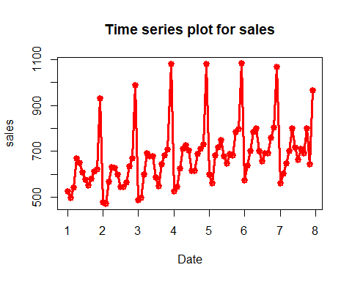
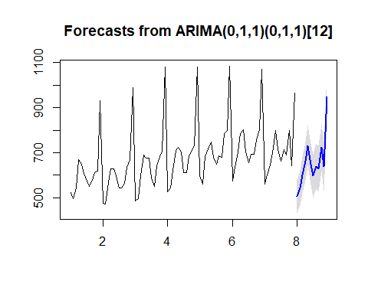
Time series model
Time series plot for sales on MenClothing.
Forcasting on MenClothings.

Slide 8
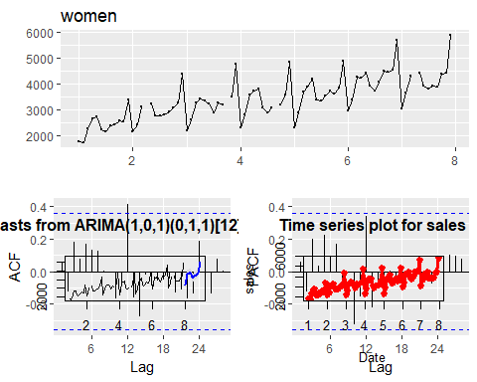
Time series model
Time series plots for sales and forecasting on WomenClothing.

Slide 9
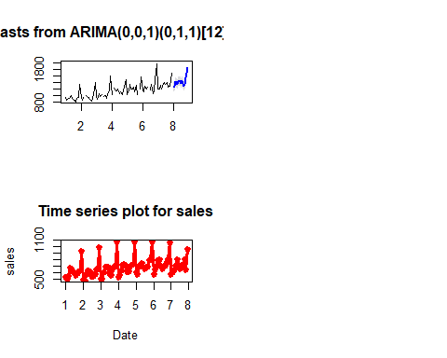
Time series model
Time series plots for sales and forecasting on OtherClothing.

Slide 10
Regression model
In the field of business regression is widely used, Businessman interested in predicting future sales, price, profit etc.
Apply Linear Regression model.
Based on MAPE, my model predicted best model.
MAPE value is 10.88.
R-seq value is 96.07.
Of the results obtained from time series model and regression model, for the ProductCategory “WomenClothing” and also give a report the impact of causal variables on the results.

Slide 11
Conclusion
In fashion retail system, the sales of the apparel product are strongly influenced by the calendar factor.
For fashion retail sales forecasting, regarding the data source, there are three kinds of data, namely, the time series data, cross-section data, and panel data. The time series data, which is collected over discrete intervals of time, is widely used in fashion forecasting and the methods applied to time-series data are also well developed.
These two kinds of data are not yet fully used for fashion sales forecasting. Recently, a forecasting method using the regression is developed and it will be an interesting future research direction to explore the use of these different types of data for fashion sales forecasting.

