Slide 1
NYC 311 Interpreter Access KPI Report
Weekly Summary

Slide 2
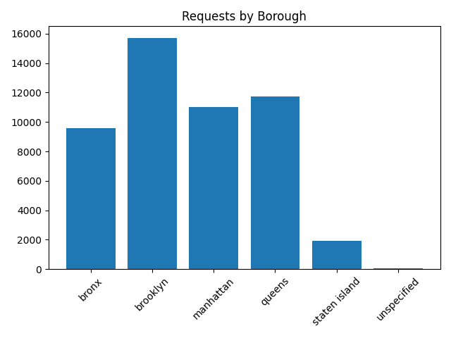
Borough Breakdown

Slide 3
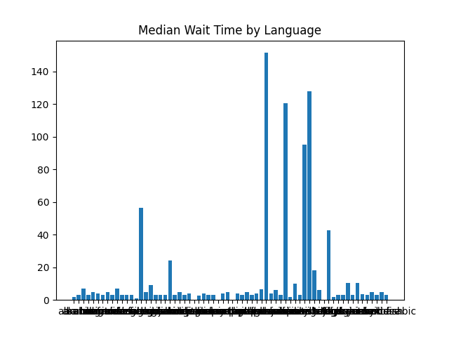
Median Wait Time

Slide 4
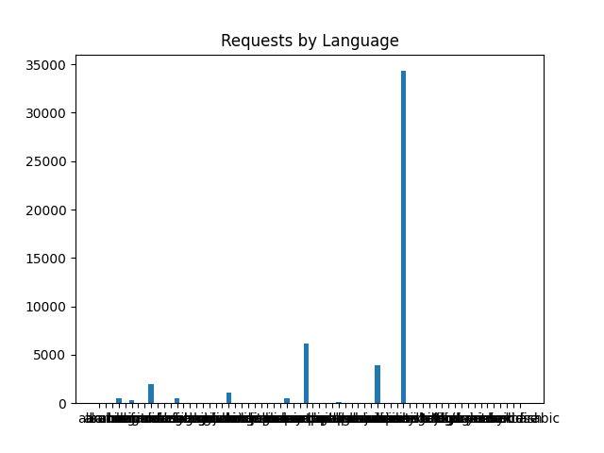
Requests By Language

Slide 5
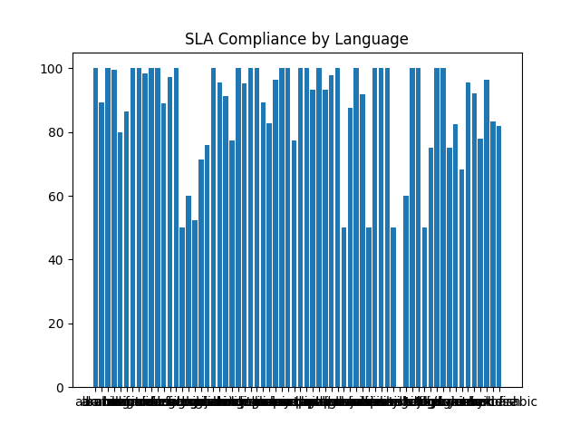
Sla Compliance

