Slide 1
Performing Logistic Regression

Slide 2
About K2 Analytics
At K2 Analytics, we believe that skill development is very important for the growth of an individual, which in turn leads to the growth of Society & Industry and ultimately the Nation as a whole. For this it is important that access to knowledge and skill development trainings should be made available easily and economically to every individual.
Our Vision: “To be the preferred partner for training and skill development”
Our Mission: “To provide training and skill development training to individuals, make them skilled & industry ready and create a pool of skilled resources readily available for the industry”
We have chosen Business Intelligence and Analytics as our focus area. With this endeavour we make this “Python Essentials – Part 1” accessible to all those who wish to learn Python. We hope it is of help to you. For any feedback / suggestion or you are looking for job in analytics then feel free to write back to us at ar.jakhotia@k2analytics.co.in
Welcome to Python!!!

Slide 3
Content
Understanding Natural Log and Exp
Logistic Regression Equation
Creating Dataset to perform Logistic Regression
Getting Summary Statistics
Performing Basic Transformations
Missing Value Imputation
Computing Information Value
Visualization
Running Logistic Regression
Model Performance Measure

Slide 4
Understanding Natural Log and Exp Logistic Regression Equation

Slide 5
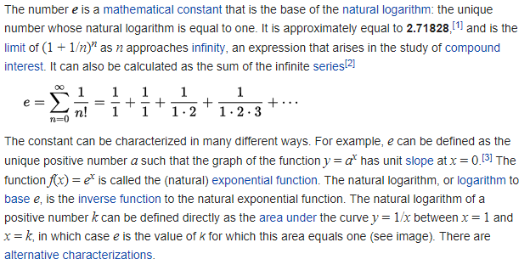
e (mathematical constant)
https://en.wikipedia.org/wiki/E_(mathematical_constant)

Slide 6
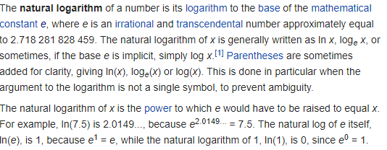
Natural Logarithm
https://en.wikipedia.org/wiki/Natural_logarithm

Slide 7
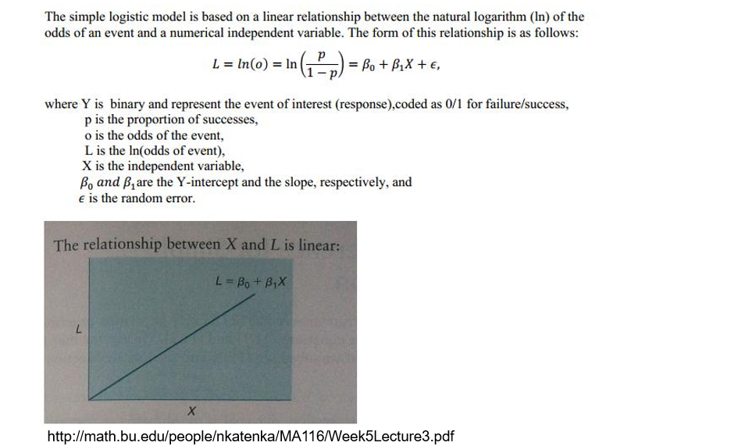
Logistic Regression Equation

Slide 8
Creating the Dataset for Performing Logistic Regression

Slide 9

Importing Required Packages
Import Packages

Slide 10
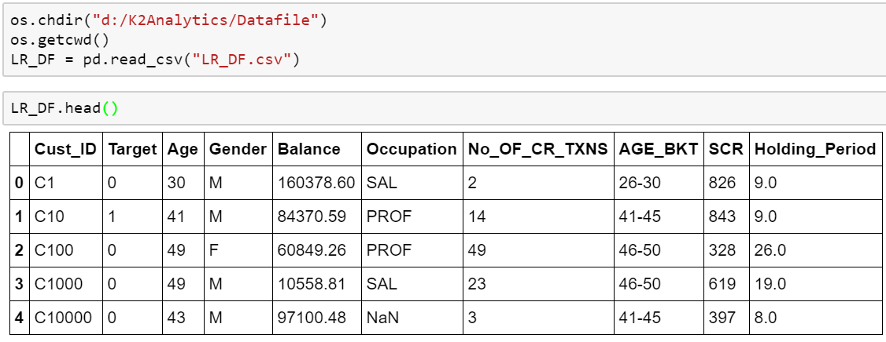
Setting working directory and importing data

Slide 11
Exploratory Data Analysis

Slide 12
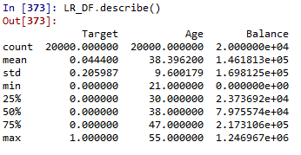
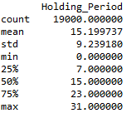
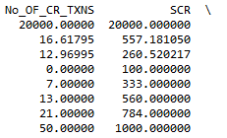
Getting summary statistics
Read & interpret the summary statistics properly like:
Min-Max range for continuous variables
Mean , Median , Standard deviation , Quantile deviation values for continuous variables
Count for continuous variables

Slide 13
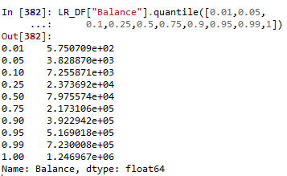
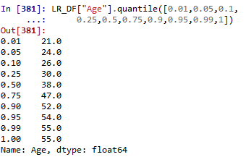
Getting percentile distribution

Slide 14
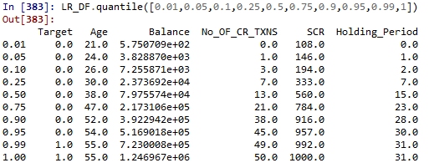
Getting percentile distribution for all numeric variables

Slide 15
Performing Basic Transformation Capping & Flooring Missing Value Imputation

Slide 16
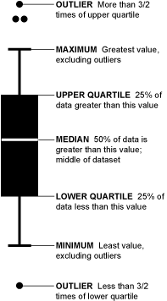
Outlier treatment | Capping & Flooring
Typically we floor and cap variables at
p1 and p99 percentile
or (Q1 – 1.5 IQR) and (Q3 + 1.5 IQR)
or based on Business Judgment
Box Plots helps quickly identify presence of outliers

Slide 17
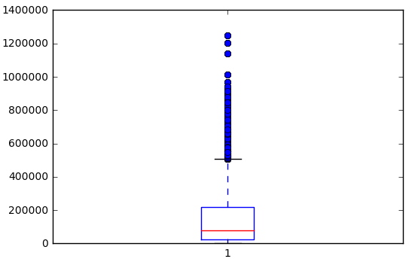
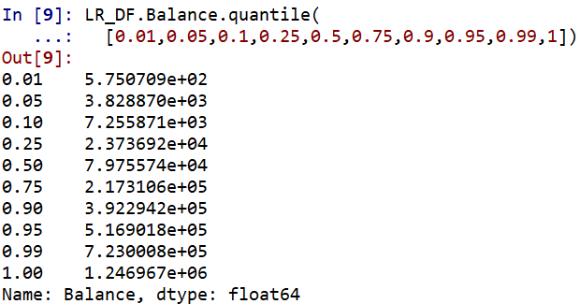

Outlier treatment for Balance Variable

Slide 18
Missing Value Imputation
Imputation is the process of replacing missing data with substituted values
In Python, missing values are indicated by NAN
Simple missing value imputation techniques
Mean, Mode imputation
Using information from related observations
Imputation based on logical reasons
Creating missing category

Slide 19
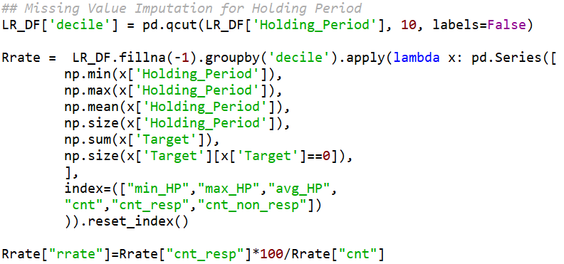
Missing value imputation…

Slide 20
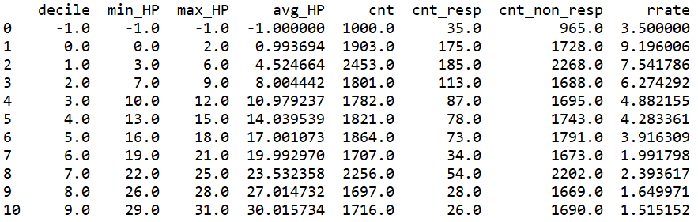
Response Rate table

Slide 21
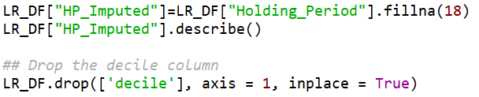
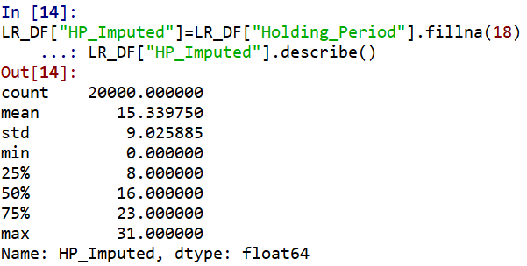
Imputing Holding Period value

Slide 22

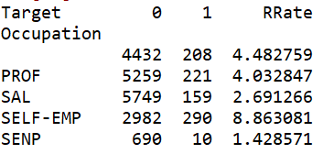
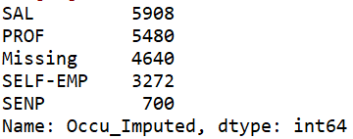
Missing value treatment for categorical variable…
Approx 25% of observations have missing values

Slide 23
Significant Variable
Visualization and Pattern Detection

Slide 24
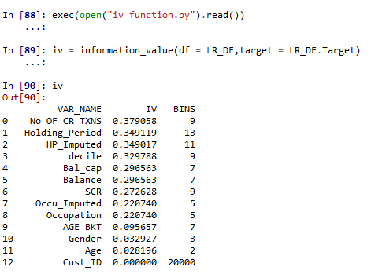
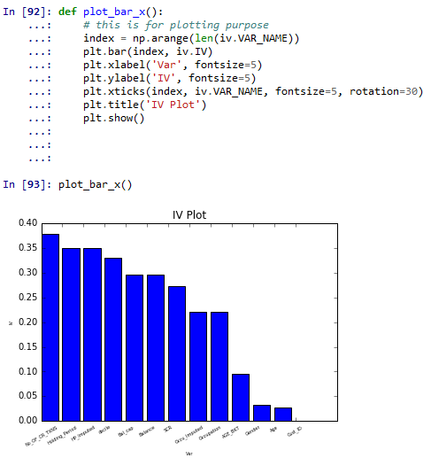
Information Value
http://blog.k2analytics.co.in/2014/06/information-value-concept-in-scorecard-development/

Slide 25
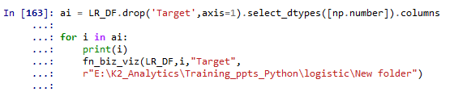
Visualization Code

Slide 26
Holding Period

Slide 27
Age

Slide 28
Model Development

Slide 29
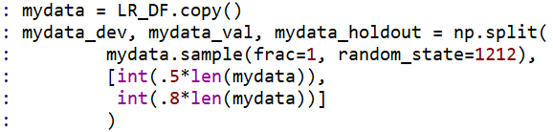
Dev – Val – Hold Out Sampling
## Sampling Code
Modeling Base
Development
Sample
50%
## Checking the samples
Validation
Sample
30%
Hold Out
Sample
20%

Slide 30
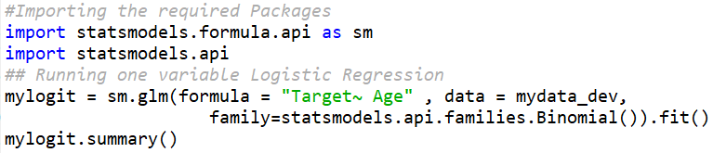
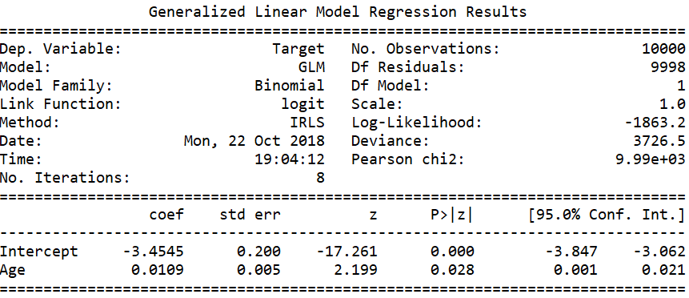
Running One Variable Regression with Age
Age variable is not significant at
alpha = 0.0001

Slide 31
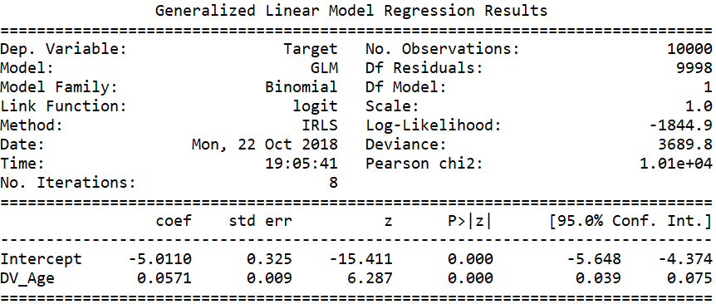
Running One Variable Regression with DV_Age
Transformed Age variable is significant at
alpha = 0.0001

Slide 32
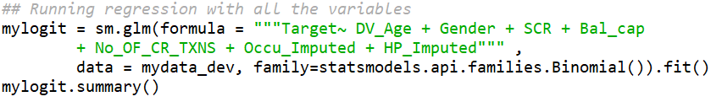
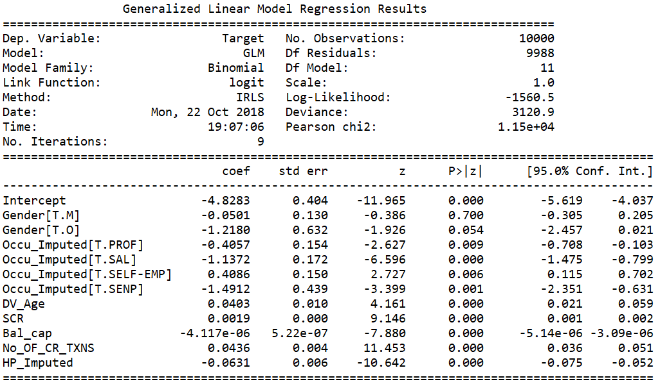
Running Regression with all variables
Gender is insignificant as such we must drop this variable

Slide 33
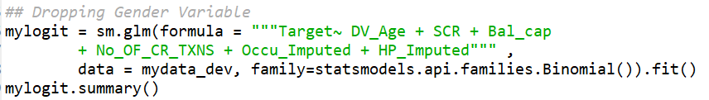
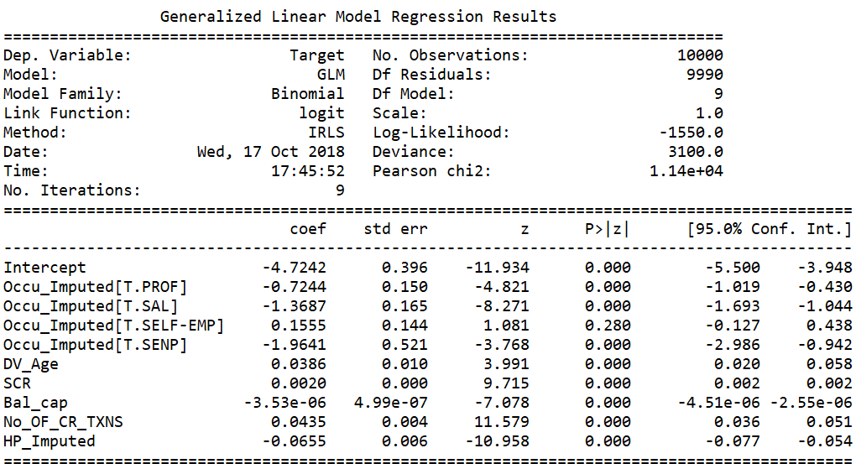
… dropping Gender variable from regression
Check the sign of variable beta and ensure they are inline with the trend
Ensure there is no sign change of estimate

Slide 34
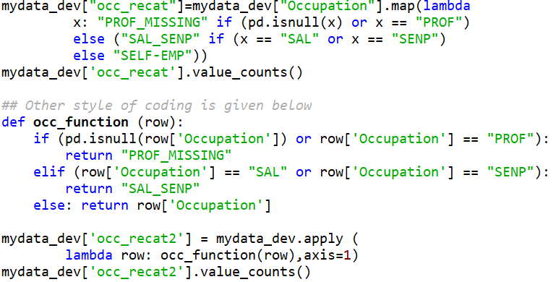
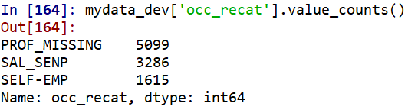
Occupation variable transformation

Slide 35

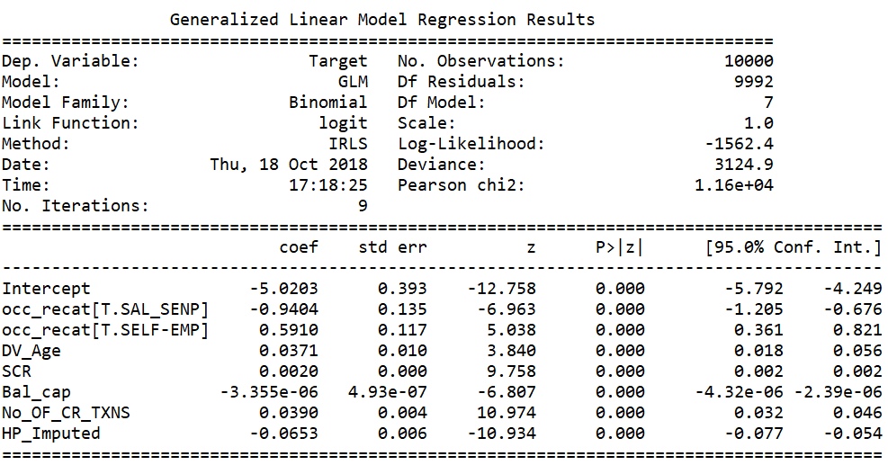
…with recategorized occupation variable
Occupation variable betas are now stable

Slide 36
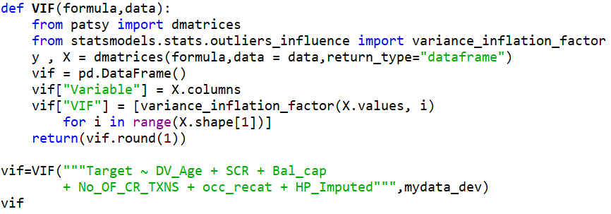
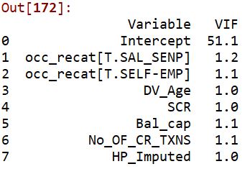
Check for Variance Inflation Factor (VIF)

Slide 37
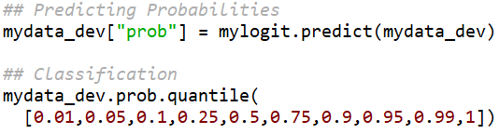
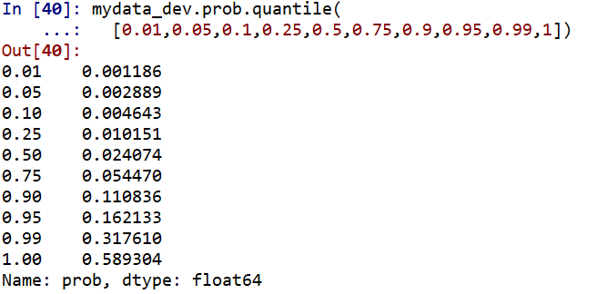
Predicting Probability & Class
Note 99 percentage of observation have probability less than 0.5. If we use 0.5 as cut-off then only 1% cases will be classified as responders
Using 0.956 as cut-off will ensure atleast 4.4% customers are classified as Responder based on the model.

Slide 38
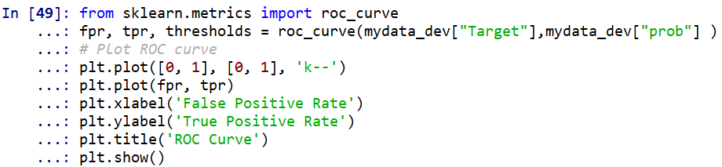
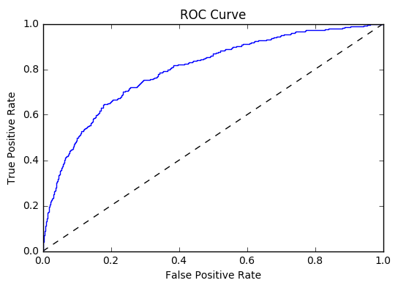

AUC-ROC Curve

Slide 39
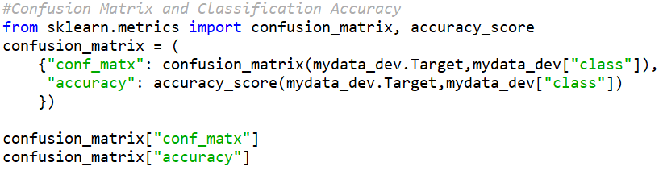
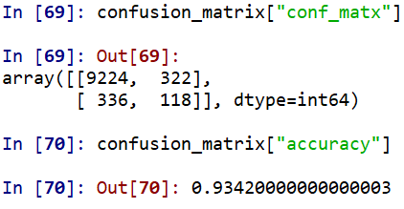
Confusion Matrix (Contingency Table)

Slide 40
Model Validation

Slide 41
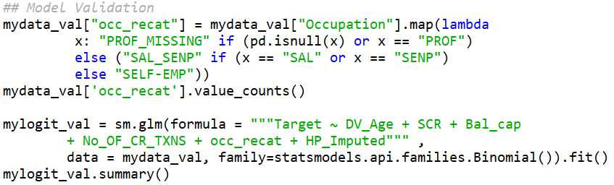
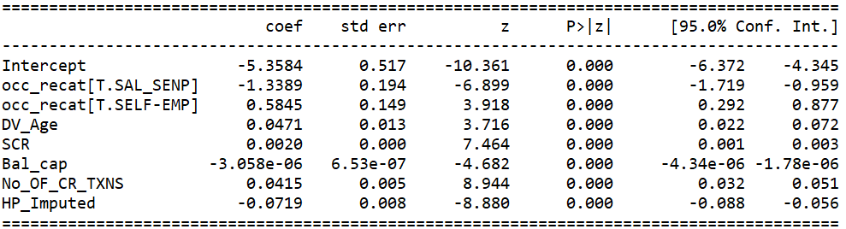
Model Validation

Slide 42
Model Validation | Dev / Val Ratio
Variable | Dev. Estimate | Val. Estimate | Beta Ratio
Intercept | -5.0485 | -5.3584
occ_recat[T.SAL_SENP] | -0.8911 | -1.3389 | 1.50
occ_recat[T.SELF-EMP] | 0.6542 | 0.5845 | 0.89
DV_Age | 0.0394 | 0.0471 | 1.19
SCR | 0.0019 | 0.002 | 1.05
Bal_cap | -3.95E-06 | -3.06E-06 | 0.77
No_OF_CR_TXNS | 0.0402 | 0.0415 | 1.03
HP_Imputed | -0.0626 | -0.0719 | 1.14

Slide 43
Lab Assignment

Slide 44
Lab Assignment
Build the Visualization Chart for the following
Balance vs Target
SCR vs Target
Check the Model Performance Measures on Validation Sample
AUC
Check the Model Performance Measures on Hold Out Sample

