Slide 1
GIAW Training
GPHA Internal Audit Workspace
End-user and administrator training · Version 1.0, October 2026
Notes:
Welcome participants. Introduce yourself and the support contacts. Explain that the session is hands-on: each participant has a training account on a training copy of GIAW, never the live system. Ask everyone to sign in now so problems are found early.

Slide 2
What you will be able to do today
Find your way
Sign in, use the sidebar, Workspace Apps, search, help and notifications
Do your part of the audit cycle
Plan, fieldwork, evidence, issues, report and follow-up for your role
Work safely
Drafts never lost, sign-offs, electronic signatures, segregation of duties
Stay on top of work
Task Tracker priorities, to-dos and requests every day
Notes:
Read the outcomes aloud. Ask participants which part of their work they most want GIAW to help with, and note it on the flip chart.

Slide 3
Training tracks
Track | Audience | Duration
A · Foundations | Everyone | 1 h 30
B · Auditor | Senior Auditors, Auditors, Audit Clerks | 1 day
C · Manager | Unit Heads, Audit Managers, PIAs, GM Audit | 1 day
D · Auditee | Heads of department, action owners | 2 h
E · Administrator | Super Administrators, Administrators, IT | 1 day
F · GRC | Risk, compliance and policy owners | 2 h
Notes:
Explain which track each participant is on. Everyone does Foundations first. Managers also benefit from the auditor sessions as a refresher.

Slide 4
GIAW at a glance
1
38
5
0
system for the whole audit cycle
screens grouped into 6 solution areas
job roles with 51 fine-grained permissions
work lost: every form autosaves
Built on FastAPI and MySQL, hosted on GPHA's own server, with HTTPS, two-step verification and an append-only audit trail.
Notes:
One system replaces the retired Audit Manager application and scattered spreadsheets. The numbers are from the current build.

Slide 5
The audit cycle in GIAW
Universe → Plan → Audit → Planning → Fieldwork ⇄ Requests → Issues → Report → Remediation → Close
Notes:
Walk through the diagram left to right. Every box is a screen they will use today. Point out that requests and evidence run alongside fieldwork, and that issues lead to remediation actions.

Slide 6
Getting started
Signing in, the screen, help and notifications
Notes:
Session A2, about 30 minutes, then Exercise 1.

Slide 7
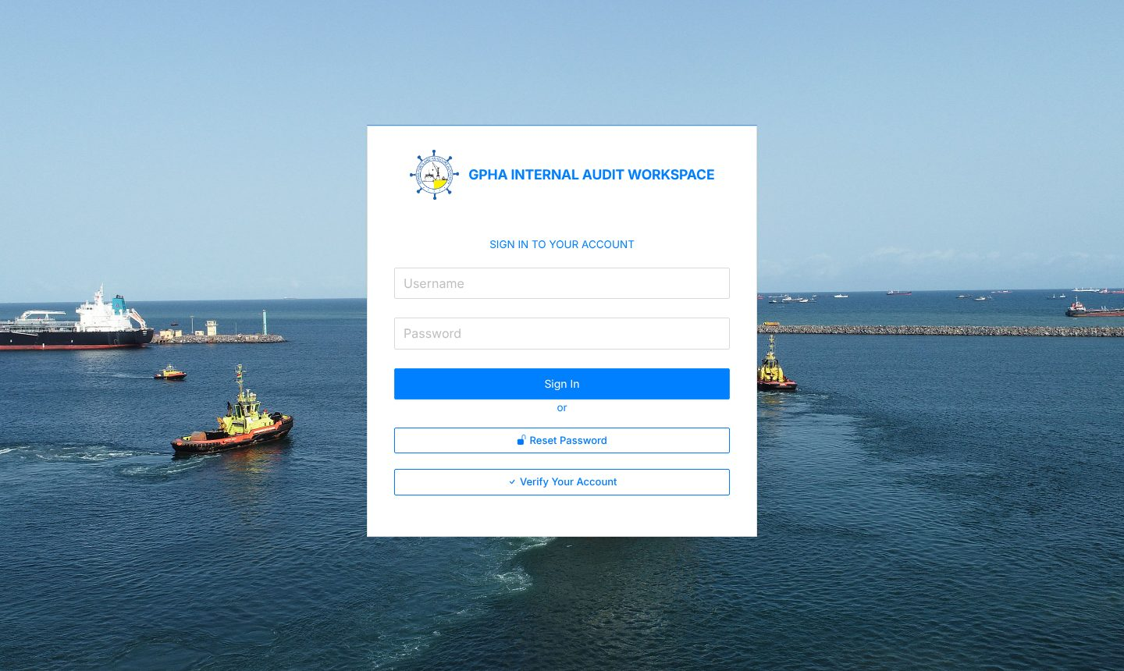
Signing in securely
1
Open the GIAW address
From IT, in Edge or Chrome
2
Username and password
Then Sign in
3
Two-step code
6 digits from your authenticator app, if required
4
Five wrong tries
Account locked for 15 minutes
Notes:
Demonstrate signing in. If two-step verification is enabled for their role, show the QR code set-up with an authenticator app. Stress: never share passwords; GIAW never asks for them by e-mail.

Slide 8
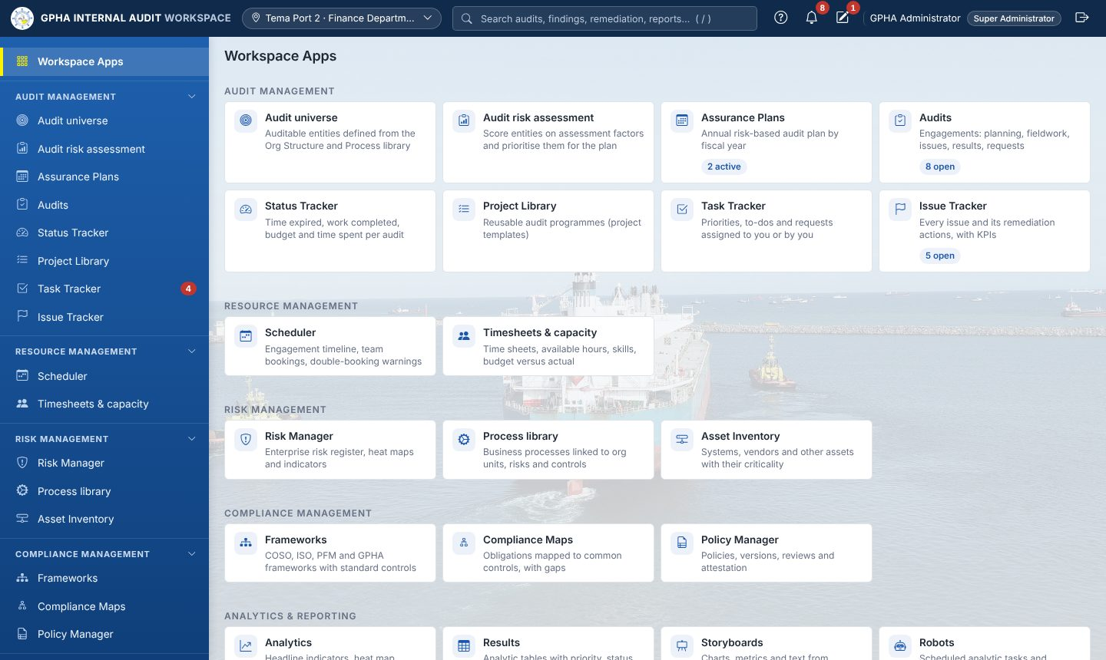
The screen layout
Workspace Apps: every app as a tile
Sidebar groups fold and unfold
Search everything you may see: press /
? help for the current page
Bell: notifications · Pencil: My Drafts
Phones: open the menu with ☰
Notes:
Point to each area on the live system: top bar (workplace, search with the / key, help, bell, drafts, profile, sign out), the sidebar groups, and the Workspace Apps tiles with live counts.

Slide 9
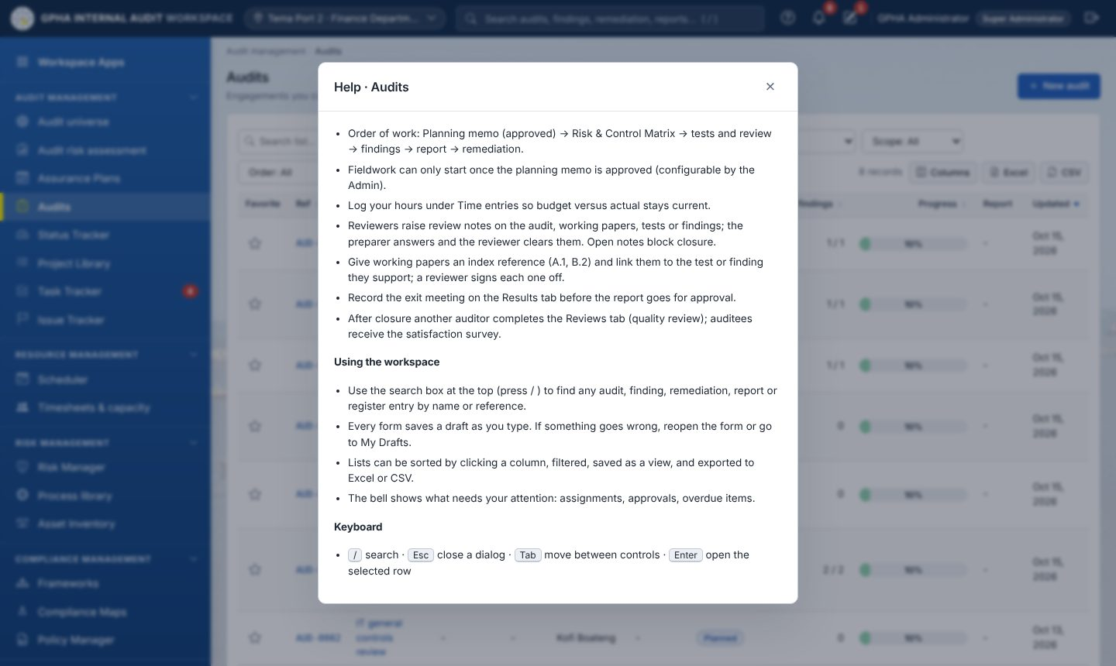
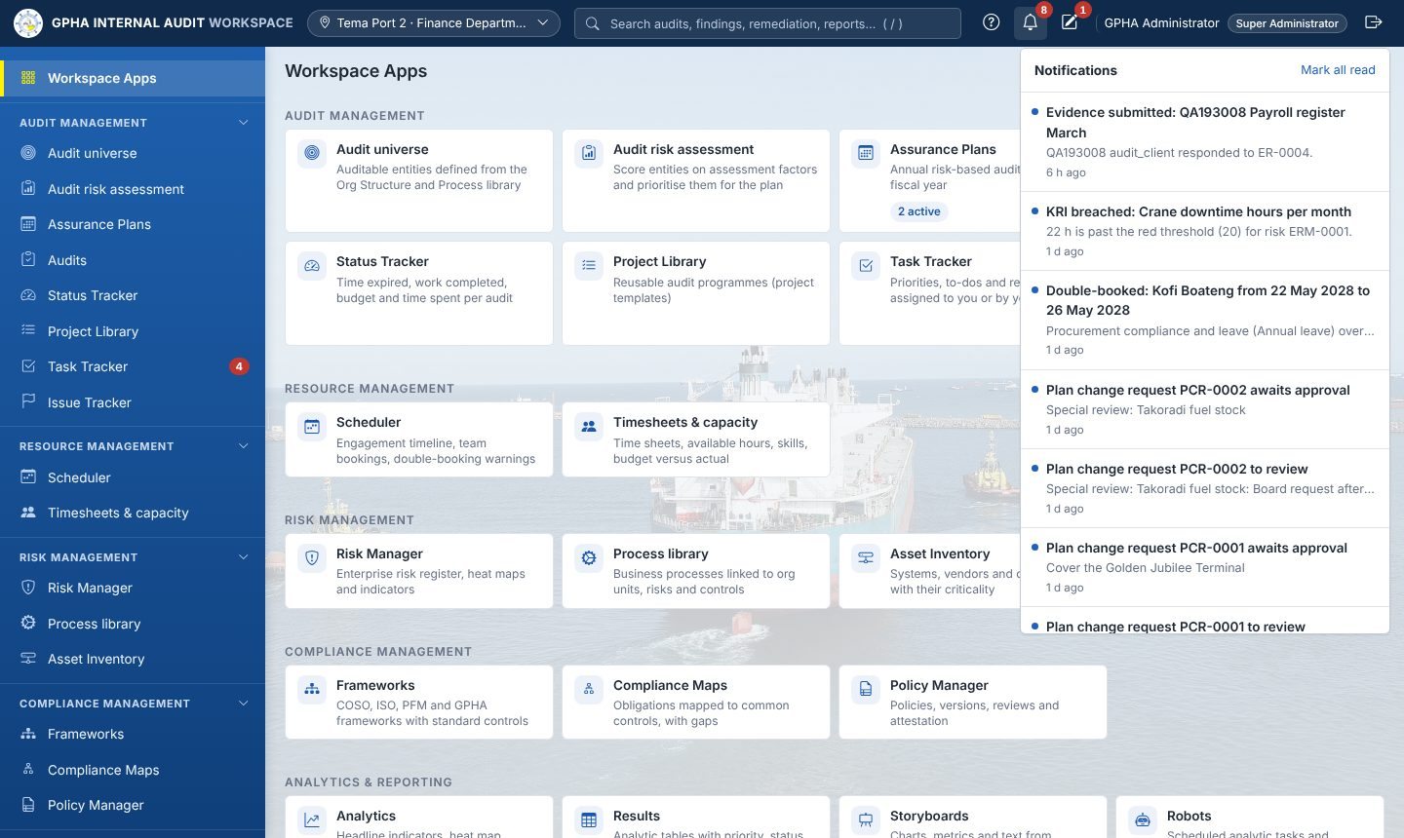
Help, notifications and drafts
? opens help for the page you are on · the bell lists assignments, reviews and reminders · the pencil opens My Drafts
Notes:
Open the help panel and the bell on the live system. Show that selecting a notification opens the record. Mention e-mail copies if GPHA has enabled the mail relay.

Slide 10
Working with GIAW
Lists, forms, drafts and electronic signatures
Notes:
Session A3, about 40 minutes, then Exercise 2.

Slide 11
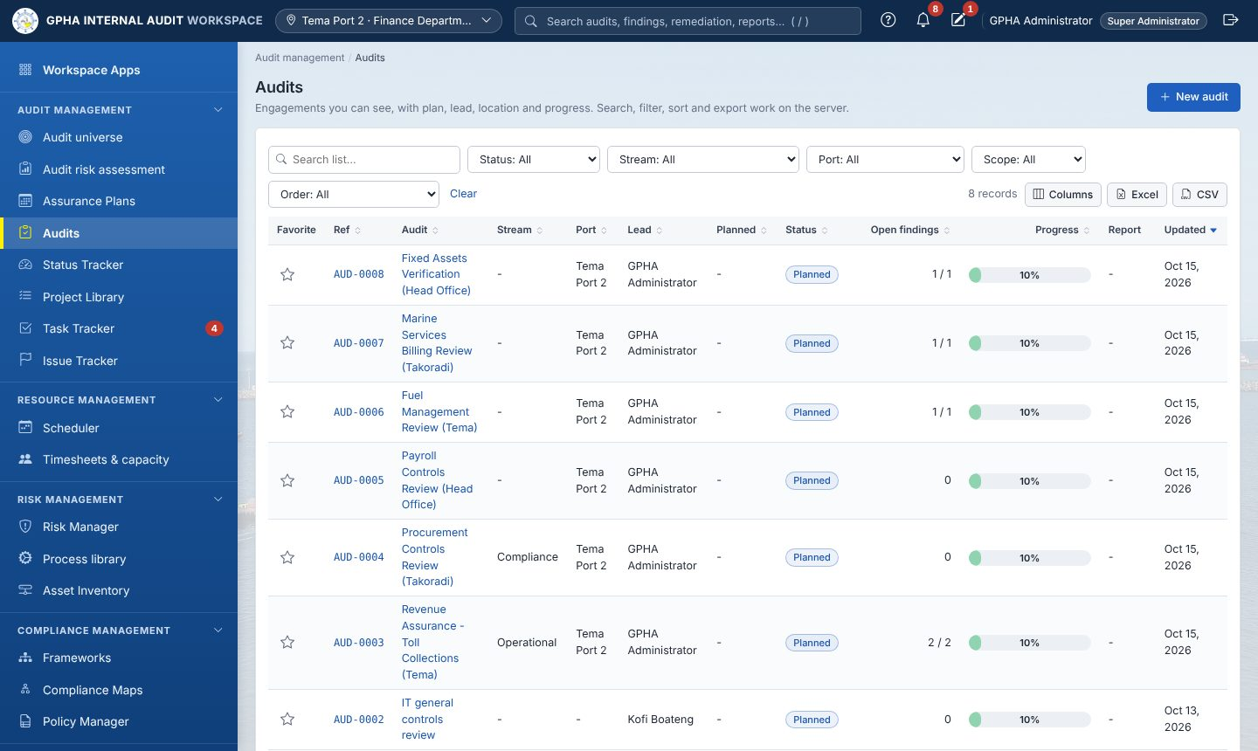
Every list works the same way
1
Search and filter
Type in Search list; use the drop-downs
2
Sort
Select a column heading
3
Columns and export
Excel or CSV of what you see
4
Saved views
Keep your favourite filters
Notes:
Demonstrate on Audits: search, a filter, sort a column, hide a column, export to Excel, save a view.

Slide 12
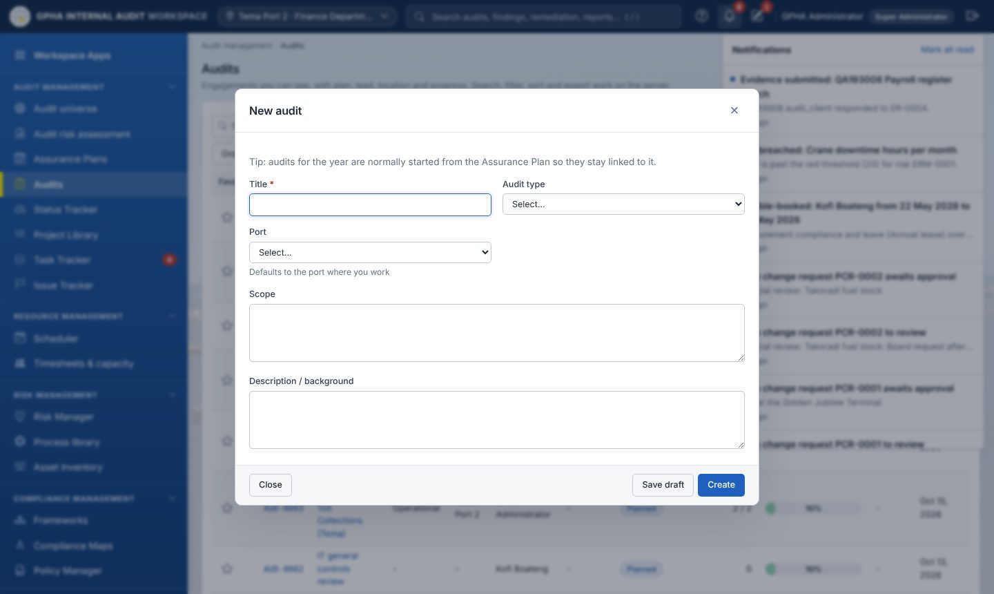
Forms never lose your work
Autosave
Saved on your PC instantly and on the server a second later
Restore
Reopen the form and select Restore, or use My Drafts
Required fields *
Errors shown under the field
Notes:
Start a new audit, type a title, close the tab, reopen: the draft is restored. Show My Drafts. Mention that validation messages appear under the field in plain words.

Slide 13
Sign-offs, e-signatures and segregation of duties
Electronic signature
Approvals record who, what and when; a password may be required
You cannot approve your own work
A different authorised person must review, approve or close
Everything is traceable
History on each record; Activity logs for administrators
Preparer
Detail Reviewer
General Reviewer
Supplemental
Specialty
Up to five sign-off levels on fieldwork pages (configurable); the preparer signs first
Notes:
Key control message: the system will not let anyone approve their own work. Approvals are electronic signatures, recorded with name and time. Every change is in History and Activity logs.

Slide 14
Audit management
From the Assurance Plan to a closed audit
Notes:
Track B and C core content.

Slide 15
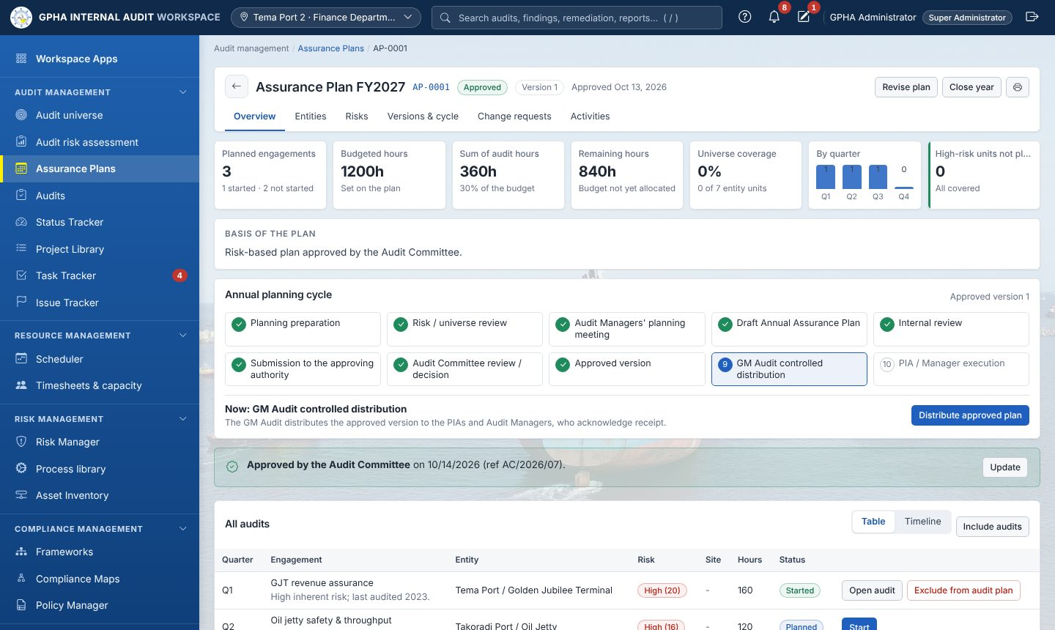
The Assurance Plan cycle
1
Prepare
Checklist, universe review, managers' meeting
2
Draft and review
Engagements, hours, coverage; GM Audit review
3
Committee decision
Approved version is frozen
4
Distribute and start
Recipients acknowledge; Start creates the audit
Notes:
Show the plan page. Explain that an approved plan is frozen; any change is a plan change request with an impact analysis, and significant changes go to the Audit Committee.

Slide 16
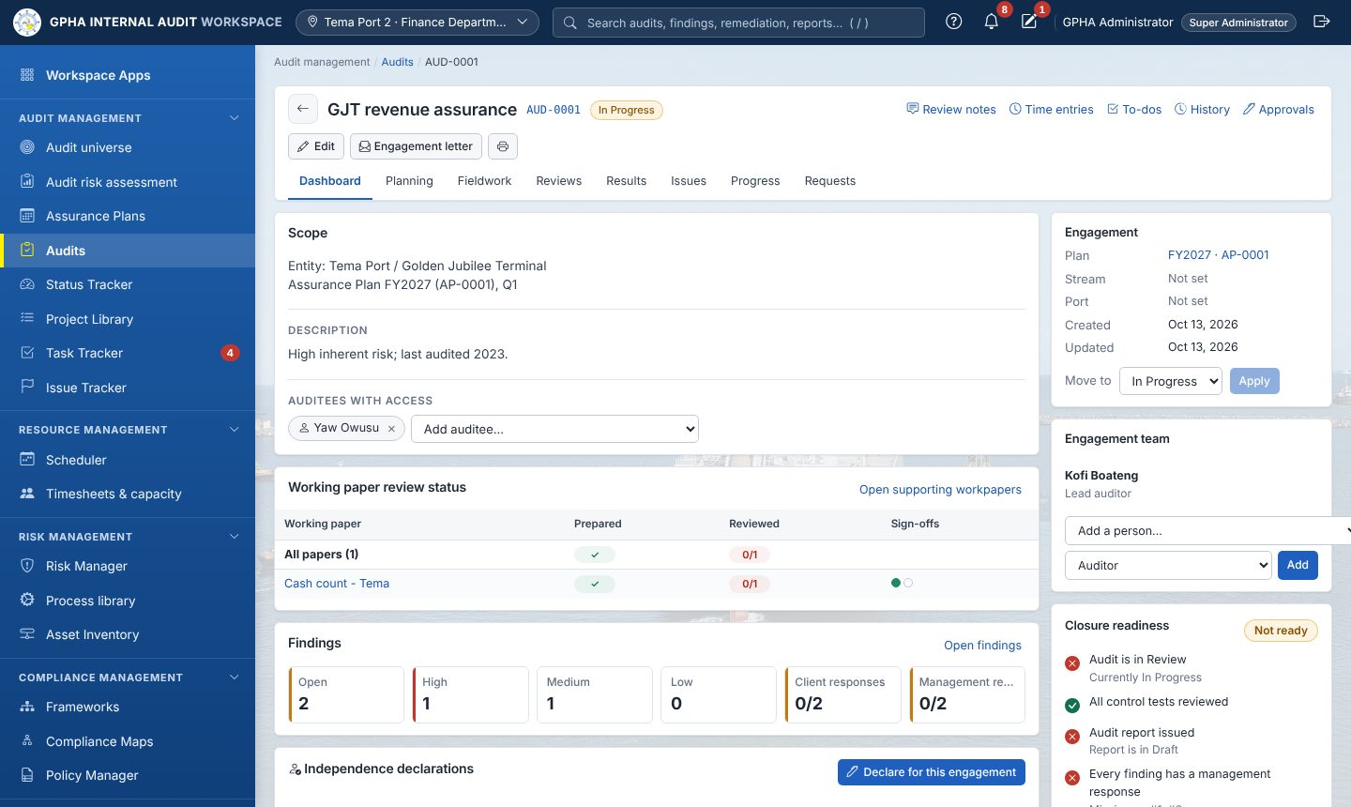
The audit page
Tabs: Dashboard · Planning · Fieldwork · Reviews · Results · Issues · Progress · Requests
Add auditees under Auditees with access
Build the engagement team
Move to changes the status
Closure readiness shows what is missing
Notes:
Tour the Dashboard: header actions, utility links, tabs, auditees with access, engagement team, Move to, and the Closure readiness checklist.

Slide 17
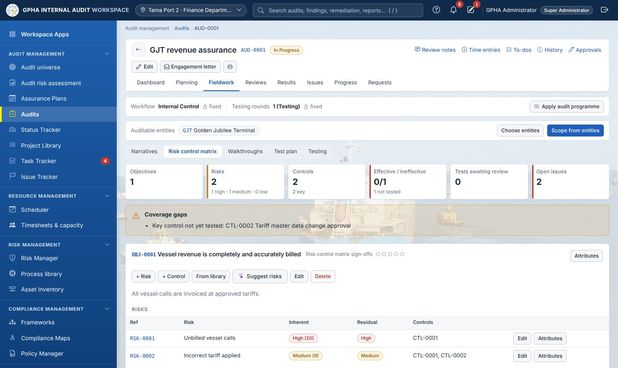
Fieldwork: the risk control matrix
1
Objective
What the process must achieve
2
Risks and controls
Ratings, key controls, From library
3
Test
Sample, exceptions, conclusion
4
Sign off
Then reviewers sign in order
Notes:
Demonstrate adding an objective, a risk and a control, then From library. Point at the coverage gap banner. Then show the Testing sub-tab and raising an issue from an ineffective test.

Slide 18
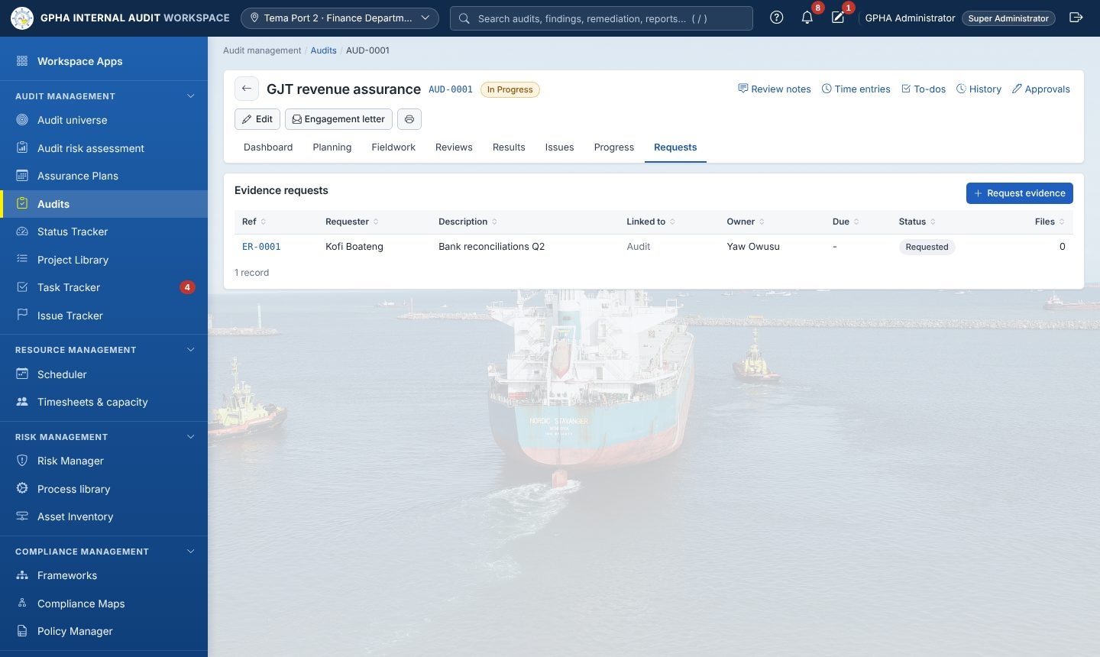
Requesting evidence from auditees
Requested
Submitted
Accepted
Returned sends it back with a comment
Reminders: daily or weekly
Link to a test, procedure or issue
Auditees cannot accept their own evidence
Notes:
Show Request evidence. The assignee must first be added to Auditees with access. Explain returns, reminders, and that files are encrypted with a fingerprint.

Slide 19
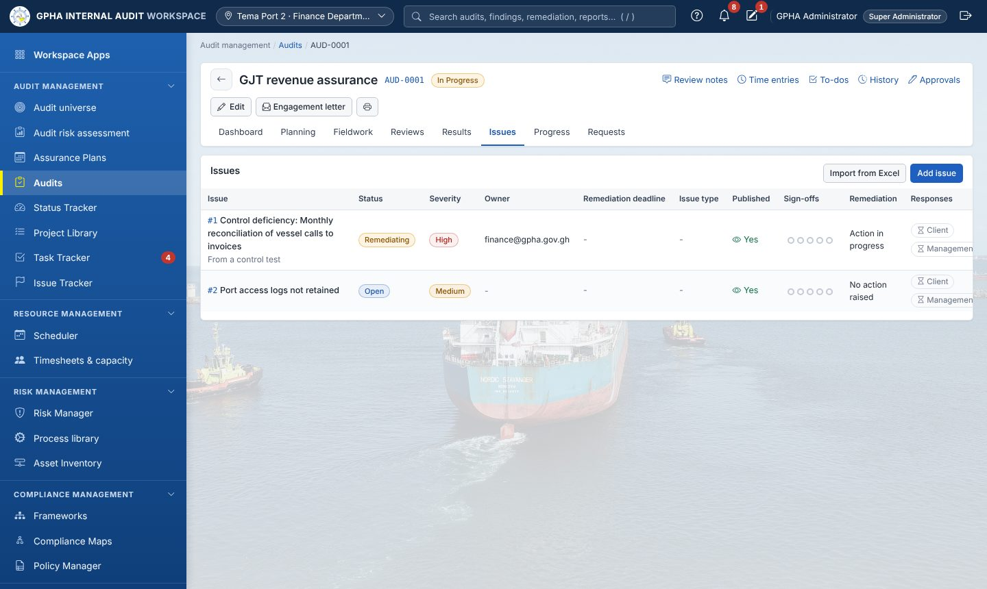
Issues: record, publish, respond
1
Add issue
Severity, type, owner, recommendation
2
Publish
Auditee cannot see it before
3
Management response
Officer and target date
4
Raise action
Remediation with due date
Notes:
Very important: new issues are hidden from the auditee until published. Demonstrate Publish, then switch to the auditee account to show the response.

Slide 20
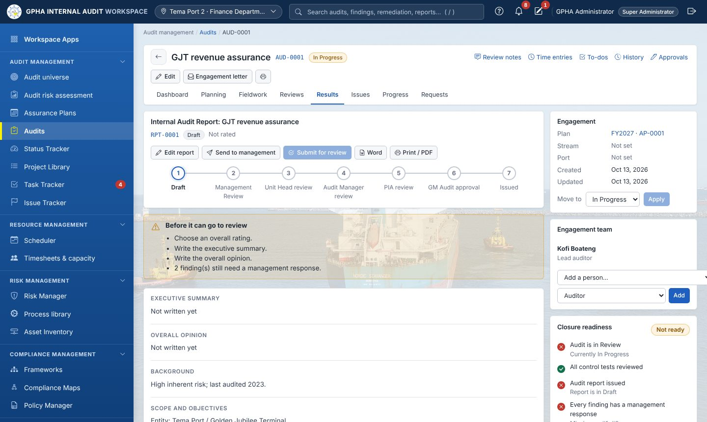
The report review chain
Draft
Management Review
Manager Review
CAE Approval
Issued
Notes:
Each step is an approval by a different person. The response deadline for management is counted in working days, skipping weekends and configured holidays. Issues are frozen once the report is issued.

Slide 21
Closing an audit
1
Status Review
All fieldwork done
2
Tests and notes
Reviewed and cleared
3
Report issued
Responses and actions agreed
4
E-signature
By a different authorised manager
Notes:
Show the Closure readiness checklist. Closing needs an electronic signature by an authorised manager who did not prepare the audit.

Slide 22
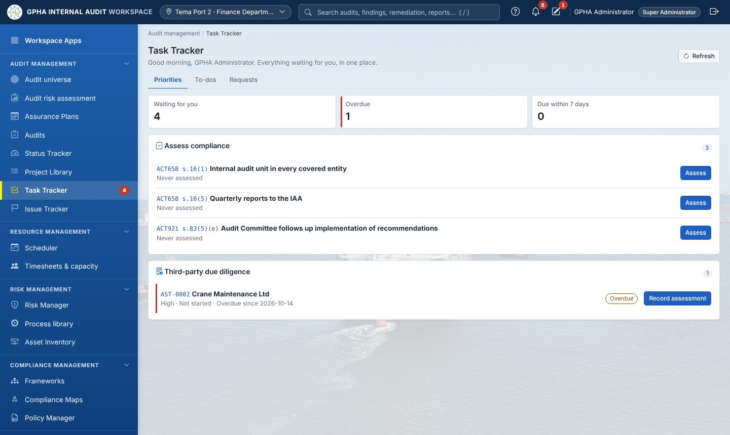
Task Tracker: your daily start
Priorities
Everything waiting for you, with action buttons
To-dos
Assigned to me, by me, closed
Requests
All evidence requests you can see
Notes:
Ask everyone to open Task Tracker. Priorities gathers everything waiting for you across all apps. The red number in the sidebar is the count.

Slide 23
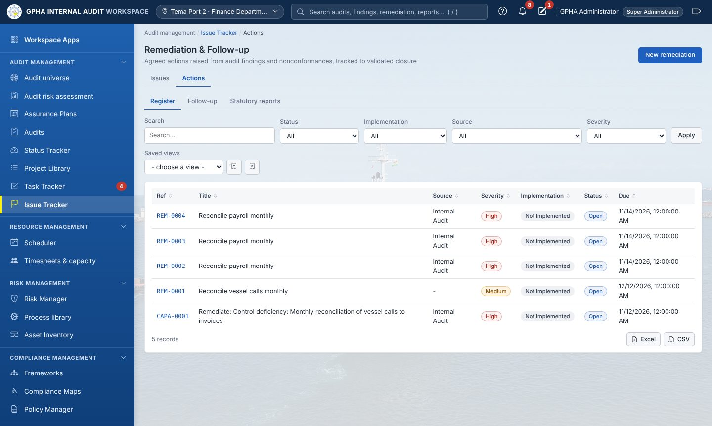
Remediation and follow-up
Owner updates
Validation
Closure
Default due days: High 30, Medium 60, Low 90
Escalation: Audit Managers at 14 days, CAE at 30
Statutory quarterly report and annual statement in Word and Excel
Notes:
The owner updates progress and evidence; a different auditor validates; an authorised person closes. Overdue actions escalate automatically.

Slide 24
Oversight, risk and compliance
Analytics, the Audit Committee, Risk Manager and third parties
Notes:
Track C (C6) and Track F.

Slide 25
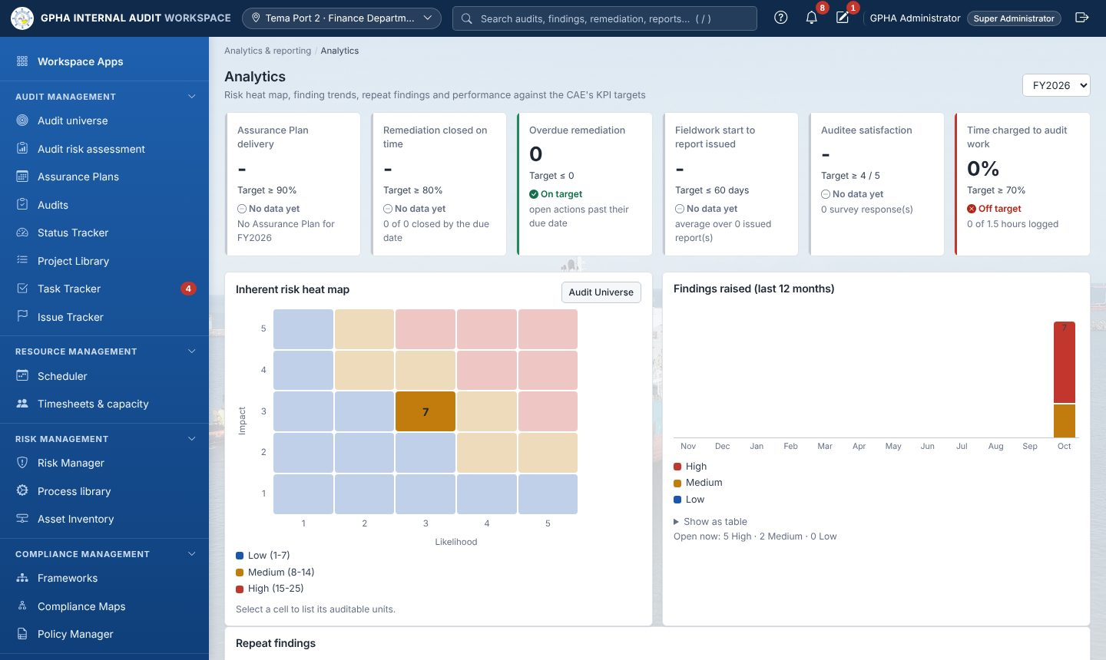
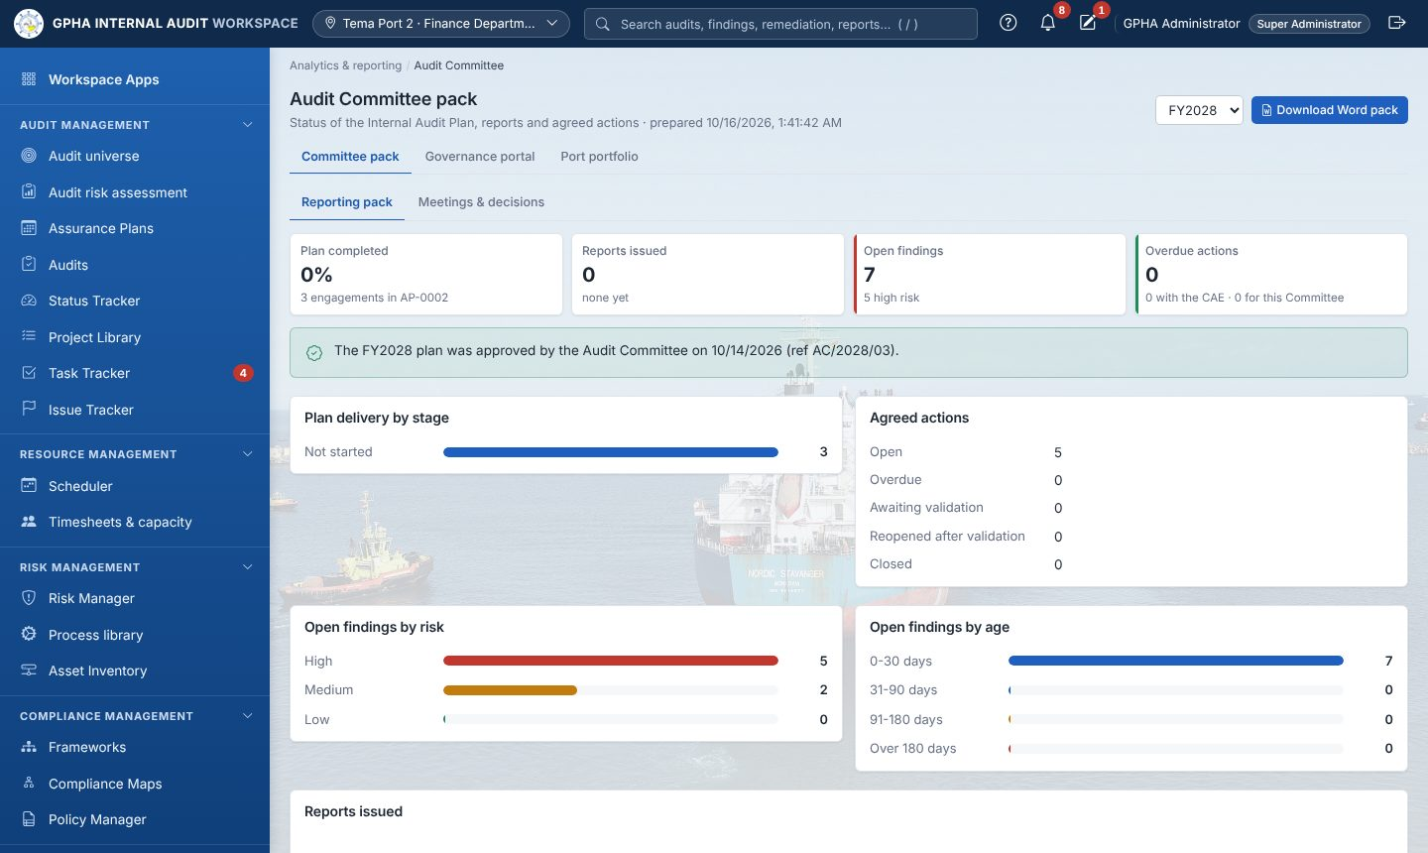
Analytics and the Audit Committee pack
KPIs against configured targets · heat map · repeat findings · committee pack in Word · meetings and decisions
Notes:
Show the KPIs against targets and the heat map, then the Committee pack and its Word download.

Slide 26
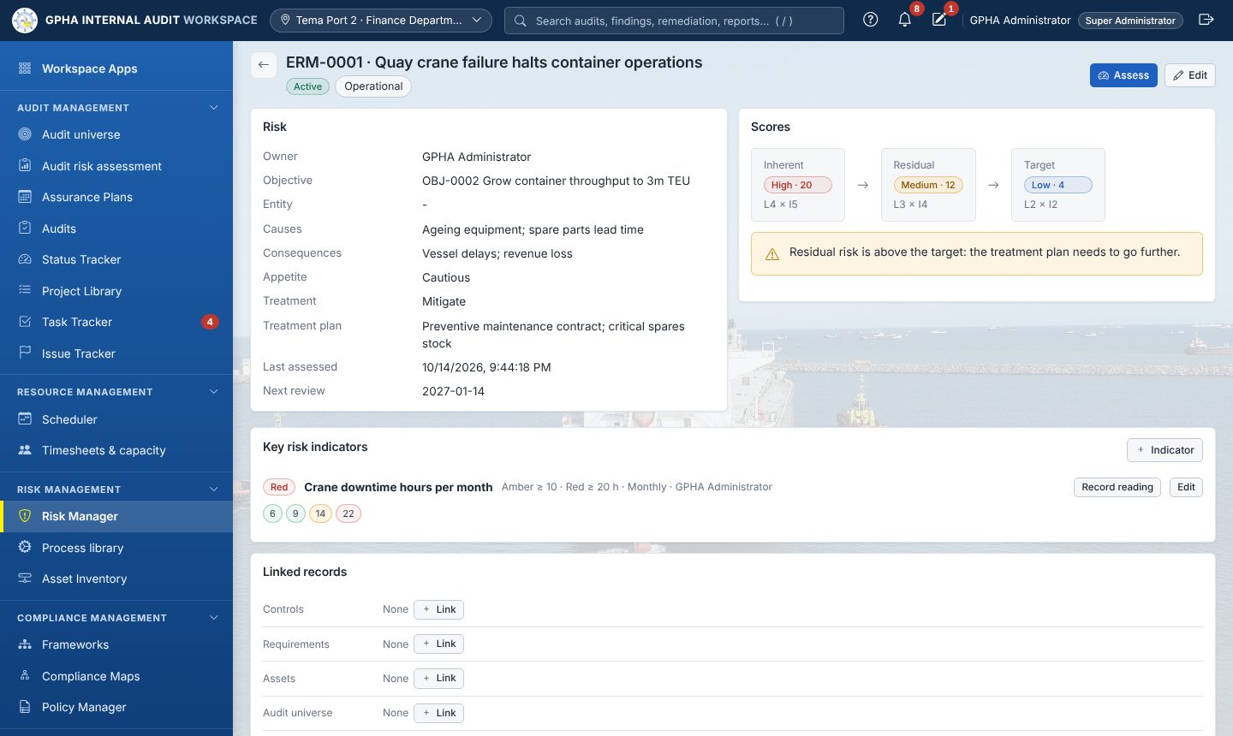
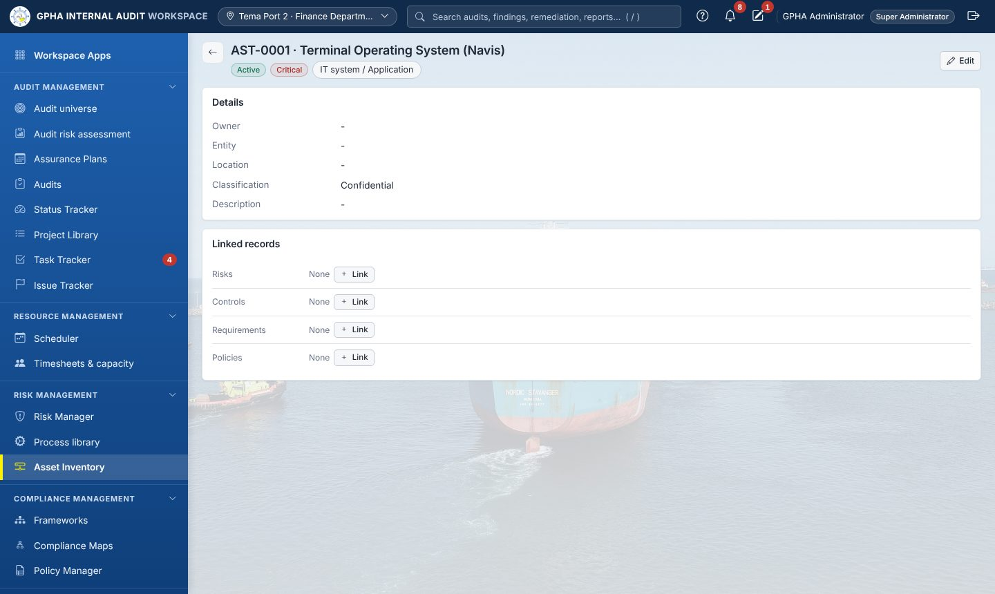
Risk Manager and third parties
Risk owners and third-party owners see their reviews in Task Tracker › Priorities
Notes:
Open a risk: inherent, residual and target scores, KRIs and linked records. Then a third party in Asset Inventory with its due-diligence assessments.

Slide 27
For auditees
Answering requests, issues and actions
Notes:
Track D. Use the auditee training account for the demonstration.

Slide 28
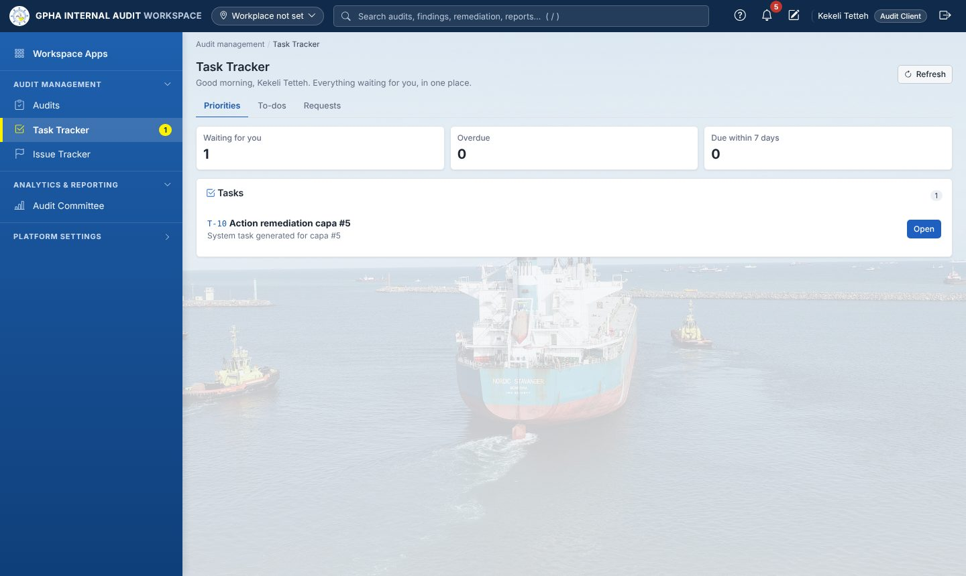
Auditees in four steps
1
Open Priorities
Task Tracker › Priorities
2
Submit evidence
Upload files, short response, Submit
3
Respond to issues
Officer and target date
4
Update actions
Progress and evidence; IA closes
Notes:
Auditees only see the audits they were added to and published issues. Their whole job happens from Task Tracker Priorities.

Slide 29
Administration
Users, roles, configuration and backups
Notes:
Track E. IT staff attend E1 for installation and the service.

Slide 30
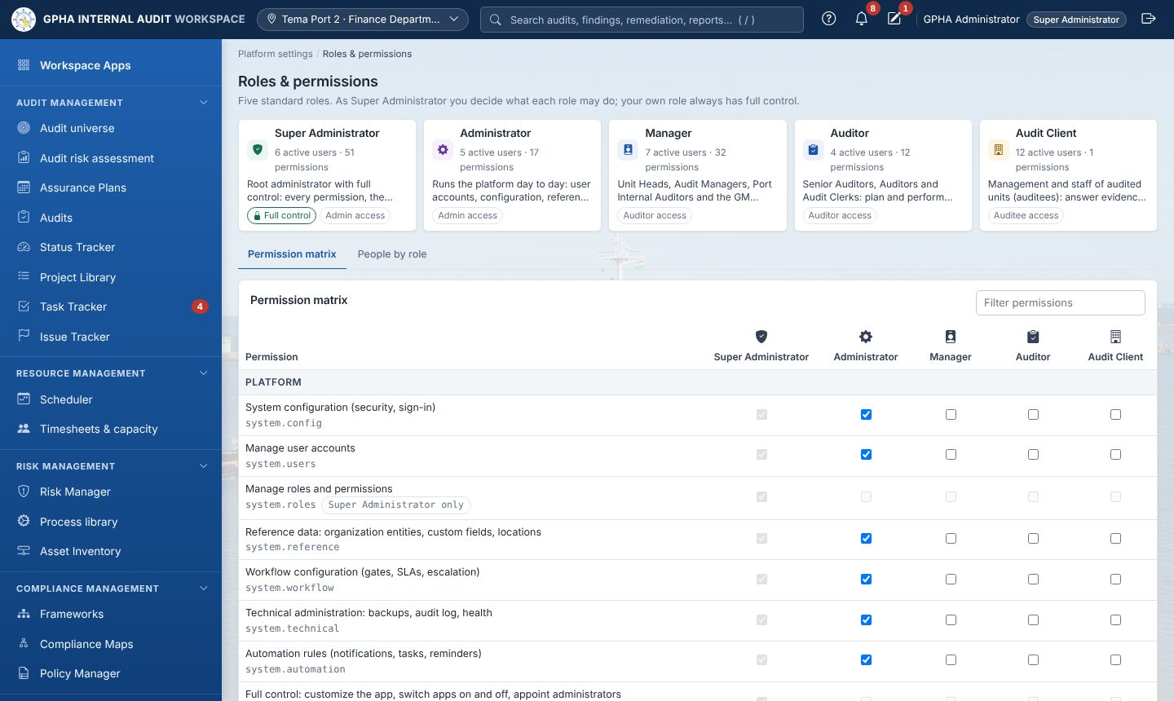
Users and job roles
Job role | Scope
Super Administrator | Everything, incl. permissions
Administrator | Platform, no audit approval
Manager | Plan, review, approve, close
Auditor | Perform engagements
Audit Client | Respond as auditee
Notes:
Show adding a user with a job role and workplace. The Roles & permissions matrix has 51 permissions; only Super Administrators change it. Segregation of duties is enforced regardless.

Slide 31
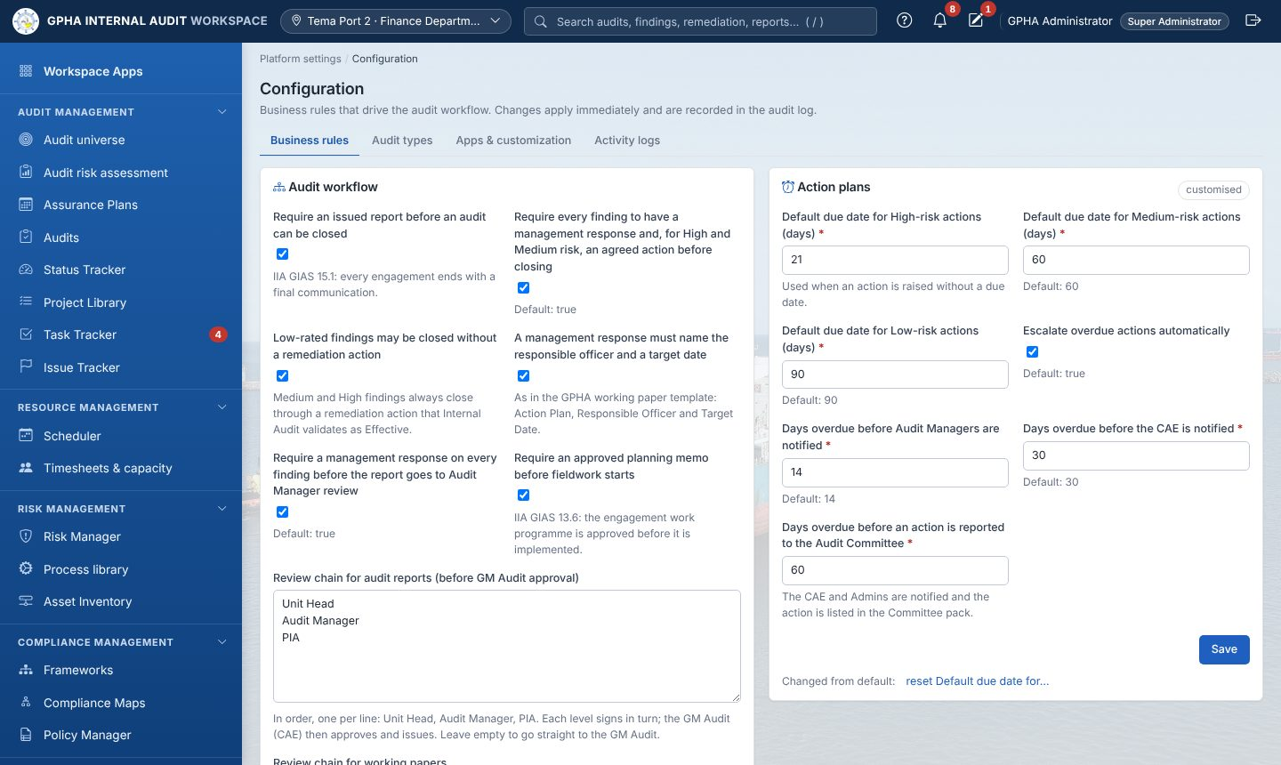
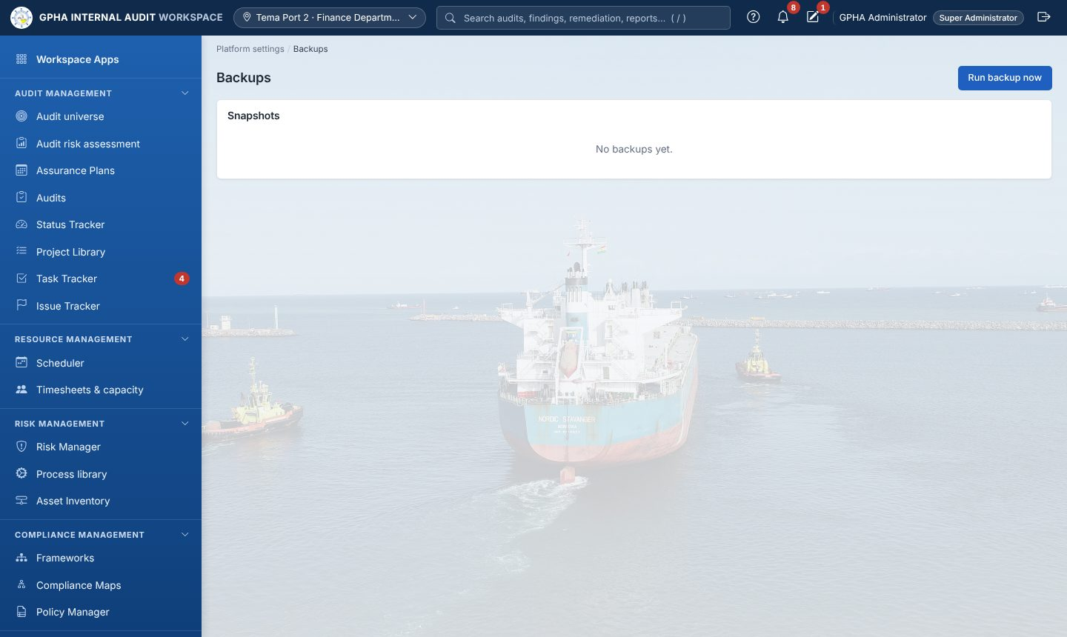
Configuration and backups
Never put .env, the encryption key, backups or database dumps in e-mail, chat or source control.
Notes:
Configuration changes take effect immediately and are logged. Backups are encrypted; the encryption key must be stored separately and safely. Test a restore every quarter with verify_backup.

Slide 32
Wrap-up
Practice, check your knowledge, get help
Notes:
Hand out the quick reference cards and evaluation forms.

Slide 33
Hands-on exercises
Track | Exercises
Foundations | 1 Sign in and find your way · 2 Lists, drafts and export
Auditor | 3 Set up an audit · 4 Fieldwork · 5 Request evidence · 6 Issues · 7 Remediation
Manager | 8 Plan cycle · 9 Review work · 10 Report chain · 11 Close the audit
Auditee | 12 Priorities · 13 Submit evidence · 14 Responses and actions
Administrator | 15 Users · 16 Org Structure · 17 Configuration · 18 Backups
GRC | 19 Risk and KRI · 20 Third party due diligence
Notes:
Participants complete the exercises for their track from the Training Guide. Tick each one when the participant shows the expected result.

Slide 34
Check your knowledge
1
Where do you see everything waiting for you?
2
Can you review a test you performed yourself?
3
The auditee cannot see your new issue. Why?
4
How is an approved Assurance Plan changed?
Notes:
Ask the questions to the room before revealing the answers. Answers: 1 Task Tracker Priorities; 2 No, a different authorised person; 3 Publish it; 4 Through a plan change request.

Slide 35
Thank you
Help: the ? button on every page · your super user · the GIAW support contact
Manuals: User Manual, Training Guide, Administration Guide
Notes:
Collect the evaluation forms. Remind participants of the support route and that the training copy stays available for practice. Record attendance and knowledge-check scores in the completion record.

